Slide 1

Process Mining Virtual Internship
by
J Naga Vyshnavi
Roll No. 224G1A3360
Department of Computer Science and Engineering (Data Science)
Srinivasa Ramanujan Institute of Technology
(Affiliated to JNTUA & Approved by AICTE) (Accredited by NAAC with ‘A’ Grade & Accredited by NBA (EEE, ECE & CSE)
Rotarypuram Village, B K Samudram Mandal, Ananthapuramu – 515701.
2024- 2025

Slide 2

Contents
Process Mining Virtual Internship
Course Objective
Introduction
Technology
Applications
Modules
Real Time applications
Learning outcomes
GitHub Link
Queries
224G1A3360
DEPT. OF COMPUTER SCIENCE AND ENGINEERING (AI & ML)

Slide 3
Course Objective
Process Mining Virtual Internship
The main objective of Celonis Process Mining is to help organizations optimize and improve their business processes by providing detailed insights into how these processes actually operate.
Using data extracted from enterprise systems (like ERP, CRM, and other databases), Celonis visualizes and analyzes the real process flows, identifying inefficiencies, bottlenecks, and opportunities for improvement.
Celonis helps organizations make data-driven decisions to drive operational excellence and improve overall business outcomes.
224G1A3360
DEPT. OF COMPUTER SCIENCE AND ENGINEERING (AI & ML)

Slide 4
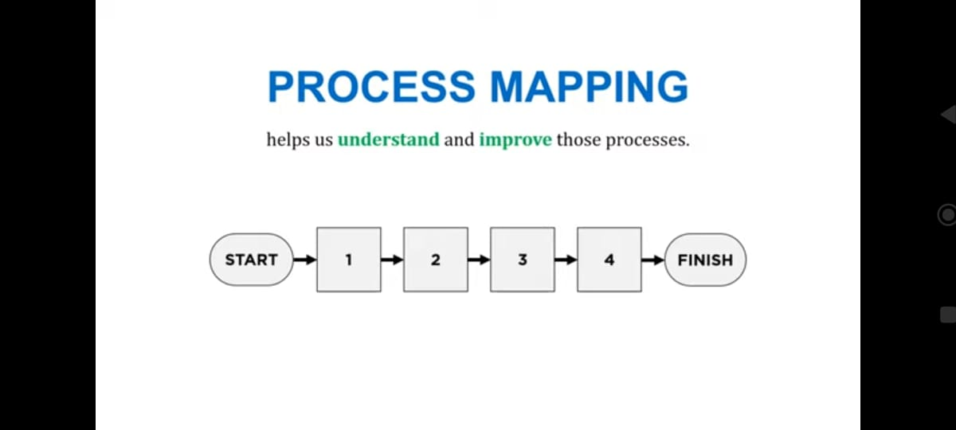
Introduction
Process Mining Virtual Internship
Process:
A process is a structured set of activities or tasks that are carried out to achieve a specific goal or output. In a business context, processes are sequences of steps that transform inputs (like resources, data, or materials) into outputs (products, services, or results) for customers or other stakeholders.
224G1A3360
DEPT. OF COMPUTER SCIENCE AND ENGINEERING (AI & ML)

Slide 5
Contd...
Process Mining Virtual Internship
Process Mining:
Process mining is a data-driven technique that analyzes and visualizes business processes based on the actual data generated by information systems (such as ERP, CRM, or workflow systems). It provides a detailed and accurate view of how processes are carried out in practice, as opposed to how they were designed or imagined.
224G1A3360
DEPT. OF COMPUTER SCIENCE AND ENGINEERING (AI & ML)

Slide 6
Technology
Process Mining Virtual Internship
Data Integration and ETL (Extract, Transform, Load)
Celonis connects to various enterprise systems to extract data for process mining. The platform supports integration with systems like SAP, Oracle, Salesforce, and many others. This data is extracted in the form of event logs, which contain key information such as timestamps, activities, case IDs, and other relevant details.
ETL pipelines are used to ensure the data is properly extracted, cleaned, transformed, and loaded into the Celonis system for analysis.
Celonis Data Connectors make it possible to connect to diverse data sources like relational databases, cloud applications, and legacy systems, ensuring comprehensive data coverage.
224G1A3360
DEPT. OF COMPUTER SCIENCE AND ENGINEERING (AI & ML)

Slide 7
Contd...
Process Mining Virtual Internship
Process Mining Algorithms
At the heart of Celonis are its process mining algorithms that analyze event log data to automatically generate visual representations of processes. These algorithms provide deep insights into how processes are actually executed.
Process Discovery Algorithms: These algorithms recreate the process flows based on event data, showing how different process instances follow various paths.
Conformance Checking Algorithms: These algorithms compare actual process flows with predefined or expected process models to identify deviations or compliance issues.
Variant Analysis Algorithms: They help analyze different variations of a process to find inefficiencies or root causes of process deviations.
224G1A3360
DEPT. OF COMPUTER SCIENCE AND ENGINEERING (AI & ML)

Slide 8
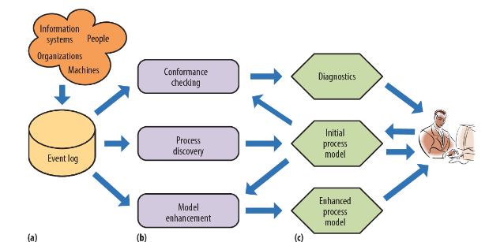
Contd...
Process Mining Virtual Internship
224G1A3360
DEPT. OF COMPUTER SCIENCE AND ENGINEERING (AI & ML)

Slide 9
Applications
Process Mining Virtual Internship
1. Business Process Optimization
2. Compliance and Auditing
3. Customer Experience Improvement
4. Robotic Process Automation (RPA)
5. Finance and Accounting
6. Manufacturing and Production
224G1A3360
DEPT. OF COMPUTER SCIENCE AND ENGINEERING (AI & ML)

Slide 10
Modules
Process Mining Virtual Internship
Process Mining Fundamentals
Introduction to Process mining
Get data into Celonis
Write PQL queries
224G1A3360
DEPT. OF COMPUTER SCIENCE AND ENGINEERING (AI & ML)

Slide 11
Process Mining Fundamentals
Process Mining Virtual Internship
Data-Driven Process Insights: Celonis starts by extracting and analyzing event logs from business systems.
Process Discovery and Visualization: It creates real-time visual maps of processes, revealing inefficiencies, variations, and performance gaps.
Actionable Analytics: With conformance checking, performance monitoring, root cause analysis, and prescriptive recommendations, Celonis provides tools to not just identify but resolve process issues.
Automation and Predictive Capabilities: Through integration with RPA and predictive analytics, it automates tasks and forecasts process outcomes.
Real-Time Monitoring: Celonis provides live, continuous monitoring of business processes for instant feedback and proactive decision-making.
224G1A3360
DEPT. OF COMPUTER SCIENCE AND ENGINEERING (AI & ML)

Slide 12



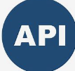
Get data into Celonis
Process Mining Virtual Internship
Pre-Built Connectors: Use native connectors (e.g., SAP, Salesforce) to import data directly from major systems
Your title here
CSV/Excel Upload: Manually upload event logs in CSV or Excel format.
APIs: Use Celonis APIs to programmatically push data into the platform.
224G1A3360
DEPT. OF COMPUTER SCIENCE AND ENGINEERING (AI & ML)

Slide 13
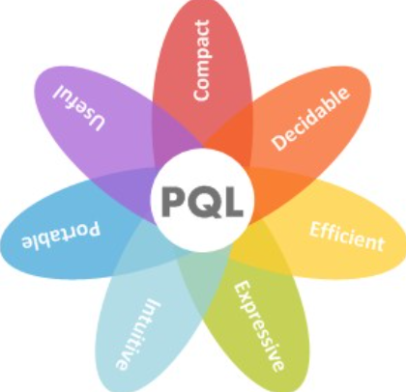
Write PQL queries
Process Mining Virtual Internship
PQL is a powerful tool in Celonis Process Mining that allows users to extract valuable insights from event logs by querying cases, activities, attributes, and variants.
It provides advanced filtering and calculation capabilities, enabling process analysts to uncover inefficiencies, identify bottlenecks, measure performance, and ensure compliance with process models.
With PQL, businesses can gain a deeper understanding of how processes are executed and where improvements can be made.
224G1A3360
DEPT. OF COMPUTER SCIENCE AND ENGINEERING (AI & ML)

Slide 14
Write PQL queries
Process Mining Virtual Internship
To gain valuable process insights, it is essential for Process Mining users to formalize their process questions as executable queries. For this purpose, we present the Celonis Process Query Language (Celonis PQL), which is:
•a domain-specific language
•tailored towards a particular process data model and
•designed for business users.
It translates process-related business questions into queries and executes them on a custom-built query engine, the Celonis PQL Engine.
224G1A3360
DEPT. OF COMPUTER SCIENCE AND ENGINEERING (AI & ML)

Slide 15
Real Time Applications
Process Mining Virtual Internship
IT & software: IT professionals benefit from sorting out disorganized engineering processes by gaining clarity and managing the complexity of ERP migrations and implementation. They can also monitor systems in real-time to ensure everything is running smoothly.
Education: Educational process mining (EPM) allows administrators to analyze and visualize students’ learning behavior by applying specialized algorithms. The student activity logs provide insights into tracking and monitoring their academic performance.
Healthcare: The healthcare industry has a surplus of data, from health records to appointment booking procedures. Professionals can reconstruct this data digitally with process mining software for seamless integration.
Retail : Used to analyze and interpret customer data. All this data can reveal actionable information about customer behavior through trends and associations. The data collected can then be used to optimize pricing, gain new customers, and increase loyalty.
224G1A3360
DEPT. OF COMPUTER SCIENCE AND ENGINEERING (AI & ML)

Slide 16
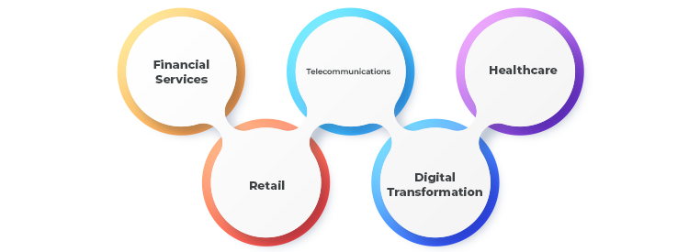
Contd..
Process Mining Virtual Internship
Telecommunication : Process mining helps telecommunication companies identify anomalies and predict fraudulent activities by monitoring user behavior and operational workflow.
224G1A3360
DEPT. OF COMPUTER SCIENCE AND ENGINEERING (AI & ML)

Slide 17
Learning Outcomes
Process Mining Virtual Internship
•Understand what Process Mining is and the basics of how it works.
•To extract insights from event logs, identify bottlenecks, inefficiencies, and opportunities for optimization.
•To extract and create visual representation of processes to aid decision making and process improvement efforts.
•Attain skills in using process mining tools and interpreting the results to enhance organizational efficiency and effectiveness.
•Summarize what an Event Log is and why we need it for Process Mining.
•Identify business use cases for Process Mining.
•Understanding how to discover, analyze and improve business process using data driven techniques.
224G1A3360
DEPT. OF COMPUTER SCIENCE AND ENGINEERING (AI & ML)

Slide 18
Git Hub Dashboard
Process Mining Virtual Internship
224G1A3360
DEPT. OF COMPUTER SCIENCE AND ENGINEERING (AI & ML)

Slide 19
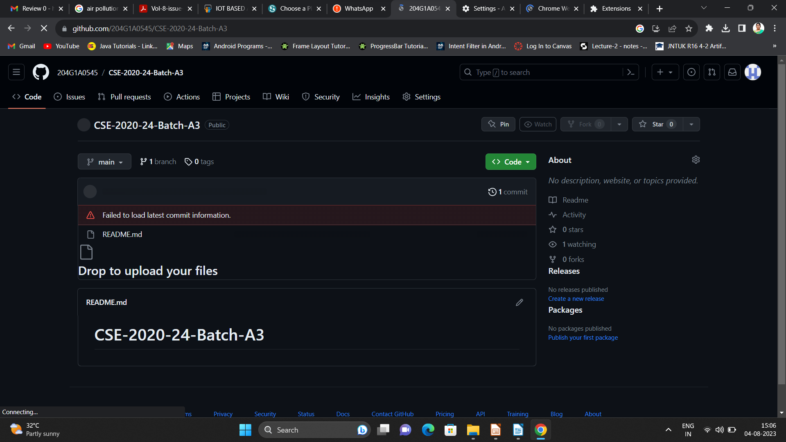

Git Hub Dashboard
Repository Name Like: Summer Internship - I
Under that include document, presentation and Certificate(Pdf).

Slide 20
Process Mining Virtual Internship
Any Queries?
224G1A3360
DEPT. OF COMPUTER SCIENCE AND ENGINEERING (AI & ML)

Slide 21
Process Mining Virtual Internship
Thank You!!!
224G1A3360
DEPT. OF COMPUTER SCIENCE AND ENGINEERING (AI & ML)

