Slide 1
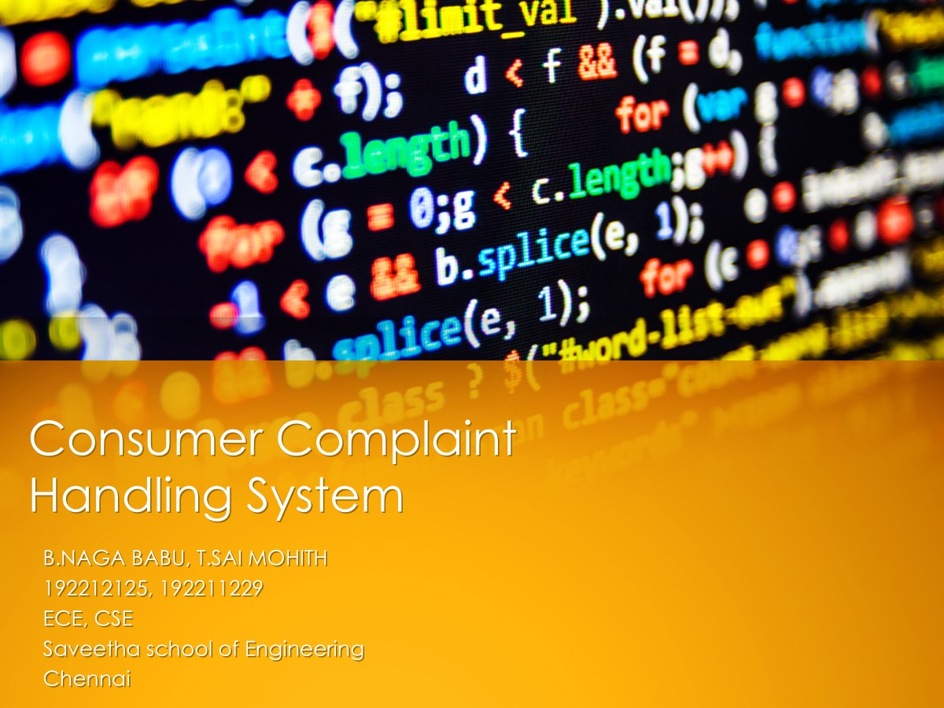

Slide 2
Problem Statement
Project: Consumer Complaint Handling System
Problem Statement: In modern customer-centric industries, efficient handling of consumer complaints is crucial for maintaining satisfaction, trust, and brand loyalty. As businesses grow, they often face challenges in managing and resolving customer issues promptly and effectively. A robust complaint handling system is essential to streamline the process, reduce response times, and ensure that customer grievances are addressed and resolved efficiently.
Tasks :
Accept consumer complaints through a web or mobile interface.
Automatically categorize complaints based on predefined criteria (e.g., product issues, service delays).
Assign complaints to the correct department or personnel for resolution.
Provide real-time tracking and status updates for customers.
Enable feedback collection after the complaint resolution.
Ensure data security and compliance with privacy regulations.
Outcome : The outcome of this project is to develop an automated Consumer Complaint Handling System that accepts customer complaints, categorizes them based on the type of issue, assigns them to the appropriate department or personnel, and tracks the resolution progress. The system should also allow for feedback on the resolution process to ensure continuous improvement. By automating the complaint handling process, businesses can enhance customer experience, reduce manual workload, and improve the quality of support services. The system should be designed to handle a large volume of complaints, prioritize critical issues, and maintain an efficient resolution workflow.

Slide 3

AIM
1.Objective:
•To develop an automated system for handling consumer complaints in an organized and efficient manner.
•The system should streamline the process of registering complaints, categorizing them, assigning responsibilities, tracking progress, and obtaining feedback.
2.Benefits:
•Improved customer experience: Timely and transparent complaint resolution.
•Operational efficiency: Reduced manual workload, faster response times.
•Continuous improvement: By analyzing feedback, businesses can enhance their services.

Slide 4
ABSTRACT
The Consumer Complaint Handling System is a C-based application that automates complaint registration and management. It enables customers to file complaints, which are categorized and assigned to relevant personnel for resolution. Each complaint is tracked with a unique ID, ensuring transparency throughout the process. The system updates complaint statuses and allows for feedback collection post-resolution. Using file handling, complaints are stored in text files, allowing easy retrieval and updates. This lightweight application aims to reduce manual intervention, enhancing business operations. It provides a foundation for businesses to manage customer complaints efficiently and improves the quality of service. The system minimizes errors and delays by automating complaint categorization and status updates. The system is designed with simplicity and efficiency in mind, making it easy to use and implement. It demonstrates the practical application of C programming to solve real-world problems.

Slide 5
INTRODUCTION
Efficient complaint handling is crucial for maintaining customer satisfaction. This system automates the process, enabling businesses to register, categorize, and resolve complaints quickly. It ensures complaints are tracked with unique IDs and updated statuses, with feedback collected after resolution. Built in C programming, it minimizes manual work and can be expanded with future technologies like databases or mobile interfaces.

Slide 6
CODE IMPLIMENTATION
Modules:
Complaint Registration: Accept customer details and complaint information.
Complaint Categorization: Categorize complaints based on predefined criteria.
Assignment: Assign the complaint to the appropriate department or personnel.
Status Tracking: Update and display the status of complaints.
Feedback Collection: Record customer feedback on resolution.
Data Storage:
Use text files (e.g., complaints.txt) to store complaints.
For encryption and privacy backend support is needed.
Use structured formats for storing data (e.g., CSV or fixed-width records).
Flow:
Main menu for user interaction.
Sub-menus for various functionalities.
Code Outline:
Struct Definition
Functions
Register Complaint
View Complaints
Update Complaint Status
3. Main Menu

Slide 7
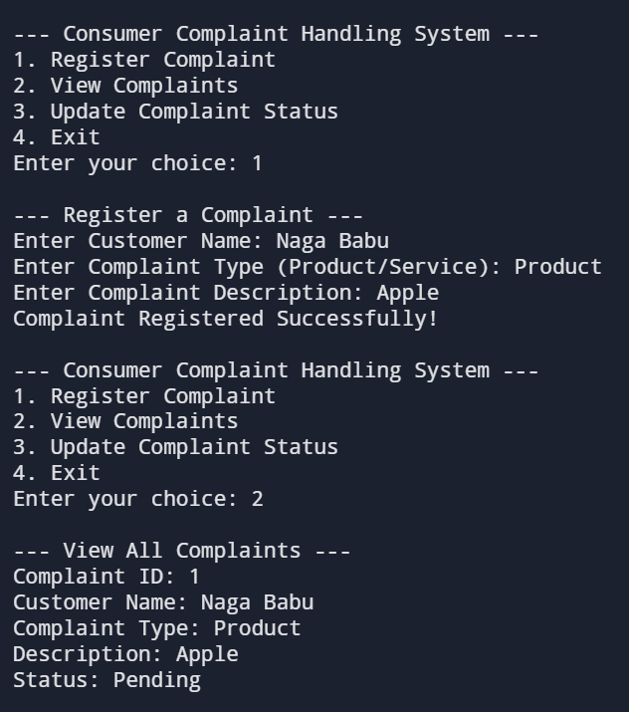
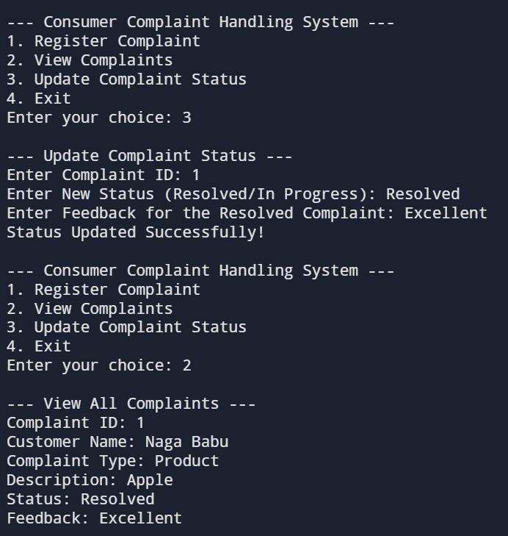
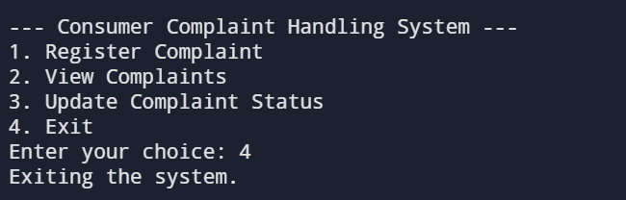
RESULTS

Slide 8
Engineering Standards
1.BASIC PROGRAMMING STANDARDS
ISO/IEC 9899 - C Language Standards
i.ISO/IEC 9899:1990 (C90)
Original standard, also known as ANSI C.
Standardized the C language with improvements over K&R C.
ii.ISO/IEC 9899:1999 (C99)
Introduced new data types (long long int, _Bool).
Added inline functions.
Supported variable-length arrays.
Added new standard library functions.
Improved type checking.
iii.ISO/IEC 9899:2018 (C17)
Bug-fix release with no major new features.
Improved clarity and fixed defects in C11.
iv.ISO/IEC 9899:202x (C2x)
Upcoming standard (under development as of 2024).
Expected to introduce further improvements and updates.
2.Software Engineering Standards
i.ISO/IEC 12207 (SDLC)
Provides a structured framework for the software development lifecycle.
ii.IEEE 829 (Testing Documentation)
Standardizes documentation for thorough and traceable software testing.
iii.ISO/IEC 25010 (Software Quality)
Defines quality attributes like functionality, performance, and maintainability.
Usability & QA Guidelines: Ensures efficient performance, ease of maintenance, and user-centric design.

Slide 9
Future Scope
Future improvements include integrating a database for better data management, developing web and mobile interfaces, and using machine learning for automatic complaint categorization. Real-time tracking, multi-language support, and integration with CRM tools like Salesforce are also potential enhancements. These features would make the system more accessible, intelligent, and scalable for future business needs.
Retail Consumer Support System
Service Provider Complaint Management
Product Quality Feedback System
E-Commerce Complaint System
Hotel or Hospitality Industry Complaint Management
Health Care Patient Feedback System
Banking and Financial Services Complaint System
Database Integration
Machine Learning for Automatic Categorization
Enhanced User Experience (UX)
Advanced Analytics and Reporting

Slide 10
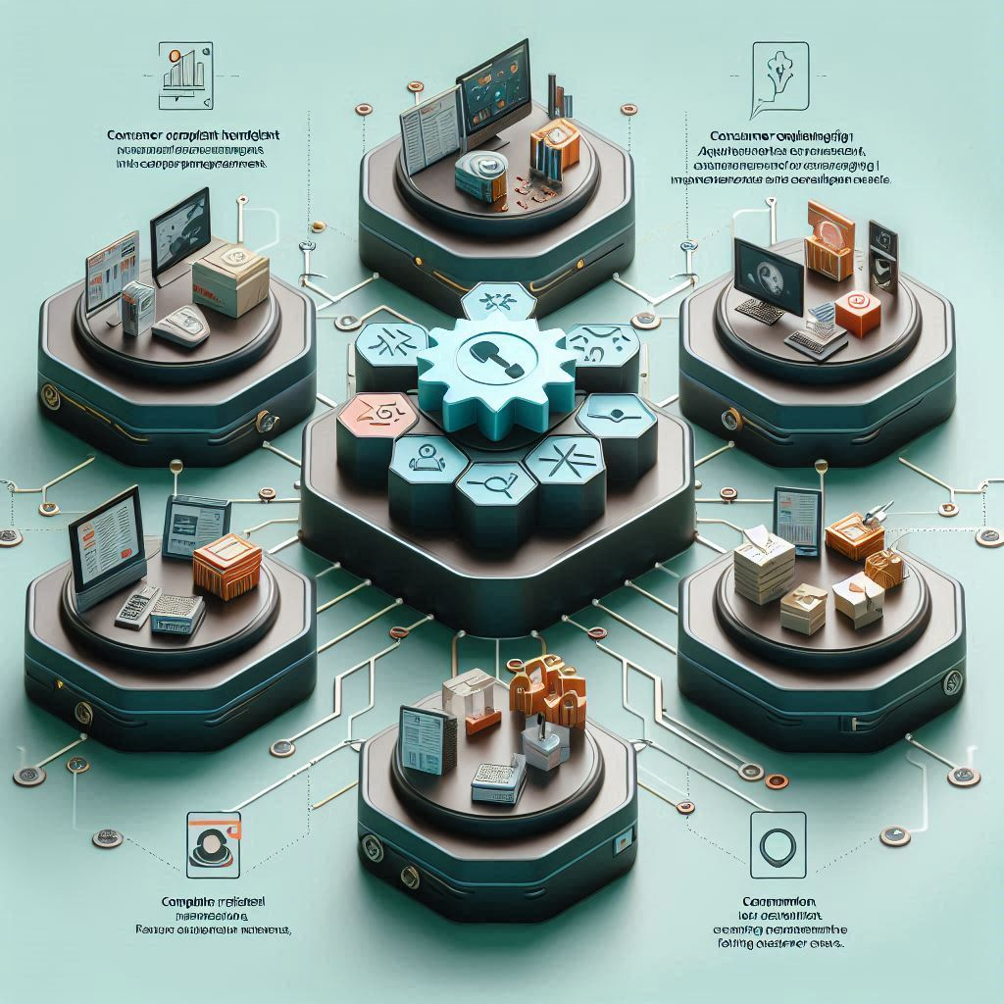
Conclusion
The Consumer Complaint Handling System automates complaint management, improving efficiency and customer satisfaction. Built with C programming, it provides essential features such as complaint registration, tracking, and feedback collection. While simple, it has the potential for future enhancements, ensuring scalability and adaptability to evolving business needs. The system highlights the importance of automation in customer service.

Slide 11
