Slide 1
ERP & SAP Overview

Slide 2
Lesson Objectives
Need for ERP
What is ERP?
Example Scenario
Business Challenges
Examples of ERP
Benefits of ERP
Disadvantages of ERP
ERP Software Package(SAP)
Modules of SAP
Example of integration of different modules
Businesses on SAP
Common Client Roles
Notes:
Add instructor notes here.

Slide 3
Lesson Objectives
Additional Client Roles
Sample SAP System Landscape
Transport Request
Transport Migration
SAP R/3
Understanding different SAP Layers
SAP Releases
Enhancement & Support Packages
Different types of SAP Projects
Testing Phases in SAP Projects
Customization
Transaction Code
Ways of accessing an application
Notes:
Add instructor notes here.

Slide 4
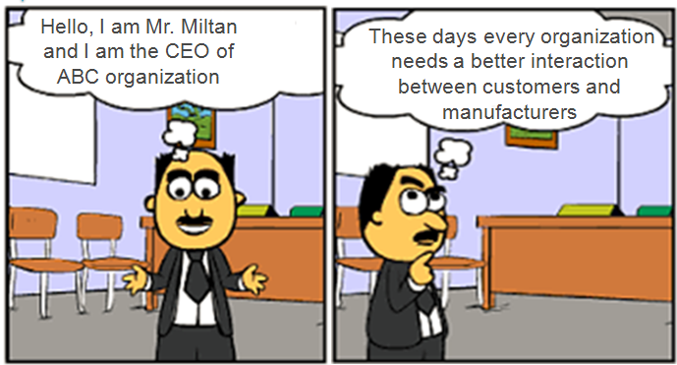
Need for ERP
Notes:
Add instructor notes here.

Slide 5
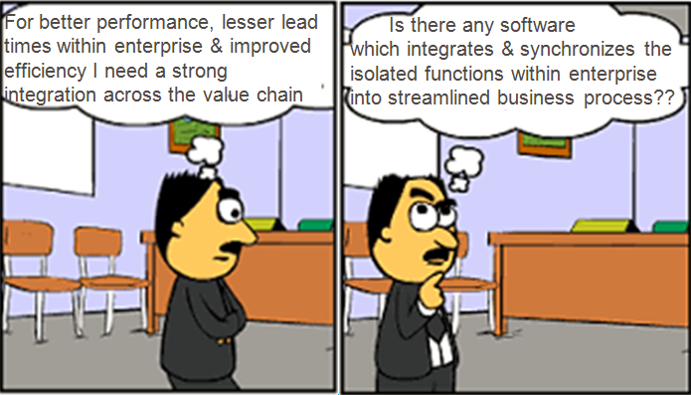
Need for ERP(continued…)

Slide 6
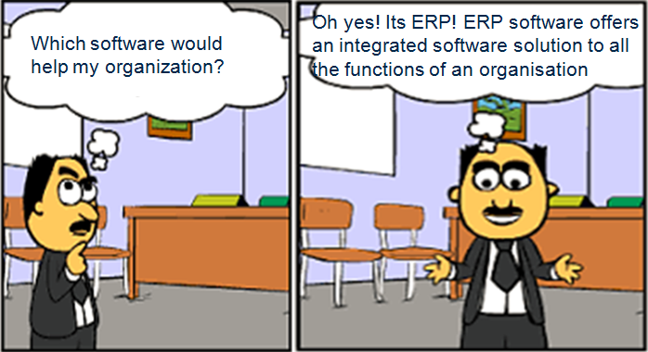
Need for ERP(continued…)

Slide 7

What is ERP?
Stands for Enterprise Resource
Provides an integrated information storehouse where
information needs to be stored only once & can be
further processed & reported to anyone in the value
chain
A high-end sophisticated software that provides accurate, timely
information for taking appropriate business decisions.
Traditional application systems treat each transaction separately.
They are built around the strong boundaries of specific functions
that a specific application is meant to cater. ERP stops
treating these transactions separately as stand-alone activities &
considers them to be the part of the inter-linked processes that
make up the business.
Notes:
Add the notes here.
Add instructor notes here.

Slide 8
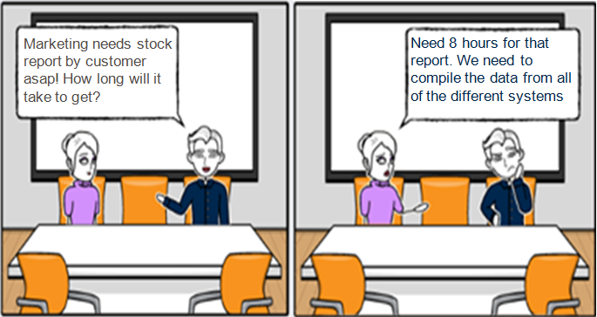
Example Scenario
Notes:
Add the notes here.
Add instructor notes here.

Slide 9
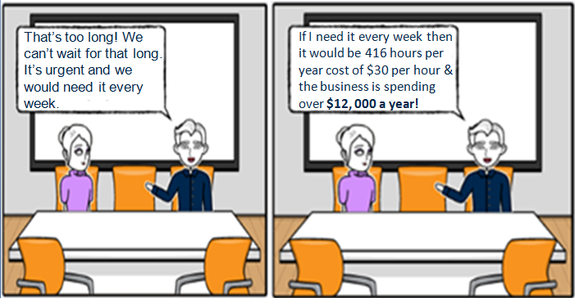
Example Scenario(continued…)

Slide 10
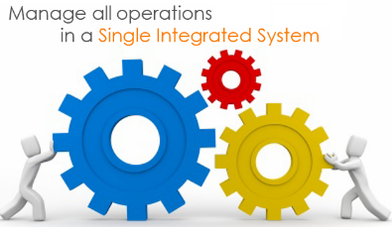
What is ERP?(Continued…)
These long reporting hours and huge costs could be avoided with
ERP
In summary, in its most basic form an ERP system will bring core
business functionality into one concise, integrated system that will
save time, money and stress for you and your business
Notes:
Add the notes here.
Add instructor notes here.

Slide 11
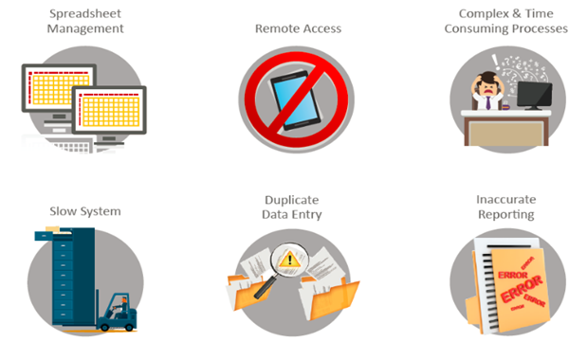
Business Challenges

Slide 12
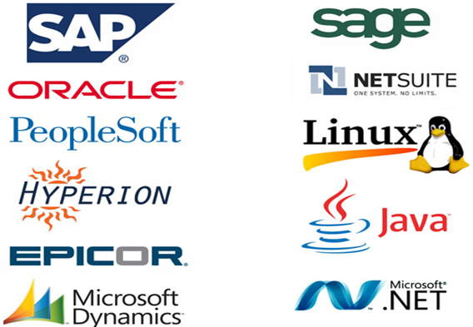
Examples of ERP

Slide 13
Benefits of ERP
Saves time and expenses
Allows faster decision-making by the management, utilizing the data
and reporting tools designed in the systems
Single data source and sharing of data among all the units of an
organization
Helps in tracking every transaction that takes place in an
organization, from starting till end
Supplies real-time information whenever required
Provides synchronized information transfer in between different
functional areas such as sales, marketing, finance, manufacturing,
human resource, logistics, etc
Improved cost control

Slide 14
Benefits of ERP(continued…)
Gives Accounts Payable personnel increased control of invoicing
and payment processing and hence boosting their productivity &
eliminating their reliance on computer personnel for these operations
Greater accuracy of information with detailed content, better
presentation, satisfactory for the auditors
Faster response and follow-up on customers
More efficient cash collection. Better monitoring and quicker
resolution of queries
Enables quick response to change in business operations and
market conditions. Helps to achieve competitive advantage by
improving its business process

Slide 15
Benefits of ERP(continued…)
Improves supply-demand linkage with remote locations and
branches in different countries
Provides a unified customer database usable by all applications
Improves International operations by supporting a variety of tax
structures, invoicing schemes, multiple currencies, multiple period
accounting and languages

Slide 16
Disadvantages of ERP
Sometimes business processes critical to an organization are to be
re-engineered to align them with an ERP solution
Cost of complex integration can be very high
Switching from one ERP solution to another increases the
implementation cost even further
End-users are to be trained for their daily operations
Customization is not preferred

Slide 17

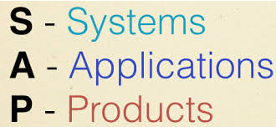
ERP Software Package(SAP)
SAP AG(a German Company) has developed an ERP package
called SAP
The company has over 335,000 customers in over 180 countries
SAP looked at the entire business as a single entity when
developing this software
Has a number of Application Modules in the package
Each of the modules has a number of components, each taking care
of specific functionalities of any normal business

Slide 18
Modules of SAP

Slide 19
FI-Finance
Type | Topics
Basic data | Accounts Debtors Creditors
Functions | General ledger accounting Accounts payable Accounts receivable Bank accounting Travel management Asset accounting Lease accounting
FI contains the functionalities for the administration, processing and reporting of all accounting data

Slide 20
CO-Controlling
Type | Topics
Basic data | Cost center Profit center
Functions | Cost element accounting Cost center accounting Internal order Activity based costing Product cost controlling Profitability analysis
CO is the module for the coordination, monitoring and optimization of the processes regarding costs

Slide 21
PS-Project Systems
Type | Topics
Basic data | Structures Resources
Functions | Project planning Costs Tasks Production Purchasing Forecasting
PS supports projects in planning and execution of financial and logistics activities

Slide 22
SD-Sales & Distribution
Type | Topics
Basic data | Customer Prices Conditions
Functions | Sales Shipping Customer service management Foreign trade Billing Availability check
SD supports the sales and distribution processes

Slide 23
MM-Material Management
Type | Topics
Basic data | Material Master Vendor
Functions | Consumption based planning Purchasing Suppliers Workbench External Service Management
MM covers the purchasing of material and services as well as the inventory management

Slide 24
WM-Warehouse Management
Type | Topics
Basic data | Warehouse
Functions | Warehouse movements Goods receipt Goods issue Stock transfer and replenishment Hazardous materials Cycle counting
WM supports the logistics processes within the warehouse

Slide 25
PM-Plant Maintenance
Type | Topics
Basic data | Equipments Technical objects
Functions | Preventive maintenance Maintenance order management Work clearance maintenance Warranty claim processing Plant maintenance projects
PM takes care about the maintenance of plants, machines and technical objects

Slide 26
QM-Quality Management
Type | Topics
Basic data | Inspection plan Test equipment Inspection characteristics Inspection methods
Functions | Quality planning Quality inspection Quality control Test equipment management
QM supports the quality management according ISO 9000

Slide 27
HR-Human Resources
Type | Topics
Basic data | Human resources Contracts
Functions | Personnel management Personal time management Payroll Training and event management
HR supports all the processes about the employees

Slide 28
Other Industry Solutions
Aerospace/Defense
Automotive
Banking
Chemicals
Consumer Products
Engineering/Construction
Financial Svc Provider
Healthcare
High Tech
Higher Education/Research
Insurance
Media
Mill Products
Mining
Oil & Gas
Pharmaceuticals
Public Sector
Retail
Service Providers
Telecommunications
Utilities
…so on …

Slide 29
Overview IS
Type | Topics
IS Automotive | KANBAN JIT Outbound/Inbound Vehicle management
IS Oil and Gas | Transport planning Trader’s and scheduler’s workbench
IS Utilities | Energy data management Contract management
IS Retail | Retail Promotions
The IS modules are extensions of R/3 and provide additional functionalities for specific industries

Slide 30
Overview APO
Type | Topics
Basic data | Locations Products Resources Transportation lanes
Functions | Demand planning Supply network & Service Parts planning Production planning and detailed scheduling Global availability check Transportation management
APO contains a fully integrated pallet of functions for the planning and execution of supply chain processes

Slide 31
CRM-Customer Relationship Management
Type | Topics
Basic data | Business partners Products Product catalogues
Functions | Account planning Activity and Opportunity management Credit management Contracts and agreements Sales transactions Service contracts and service plans Service processes
CRM supports all customer-focused business areas, from marketing to sales and service, as well as customer interaction channels, such as the interaction center, the Internet, and mobile clients

Slide 32
SRM-Supplier Relationship Management
Type | Topics
Basic data | Catalogs
Functions | Catalog content management Self-service procurement Service procurement Plan-driven procurement with supplier integration Spend analyses
SRM provides methods to coordinate and optimize the business processes with the key suppliers

Slide 33
BW-Business Warehouse/BI-Business Intelligence
Type | Topics
Basic data | Info cubes
Functions | Reports Analysis
Data warehousing in BI represents the integration, transformation, consolidation, cleanup, and storage of data.

Slide 34
ABAP
Programming language developed by SAP
Strong integration of OPEN SQL for managing large data sets
SAP Script is used for forms
ABAP is the SAP internal programming language

Slide 35
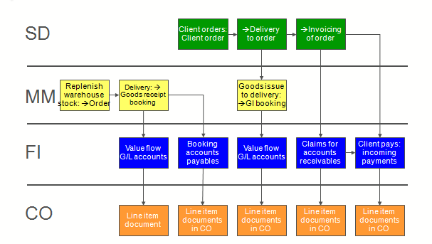
Example of integration of different modules

Slide 36
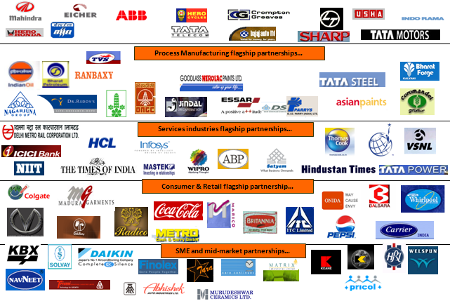
Businesses on SAP

Slide 37
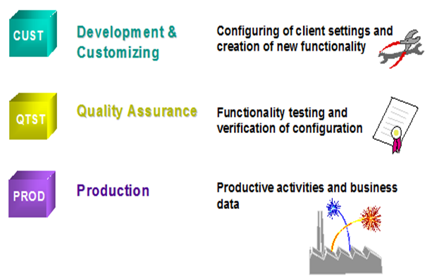
Common Client Roles

Slide 38
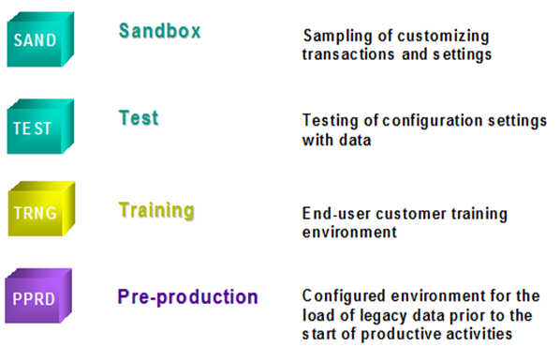
Additional Client Roles

Slide 39
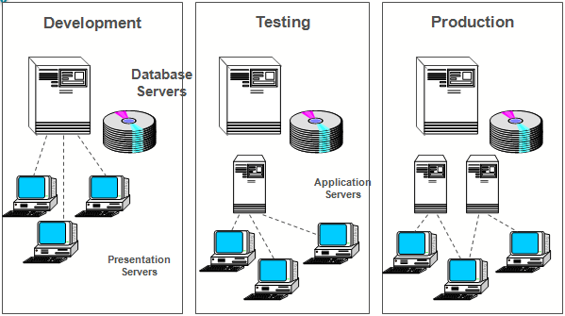
Sample SAP System Landscape

Slide 40

Transport Request
A kind of 'Container / Collection' of changes that are made in the
development system
The changes are done in the development system and then
transported to the Quality system via the Transport Request and
similarly from Quality to subsequent systems
Naming convention: <SID>K<Number> [Not modifiable by system
administrators]
SID – System ID
K – Is fixed keyword/alphabet
Number – can be anything from
a range starting with 900001

Slide 41
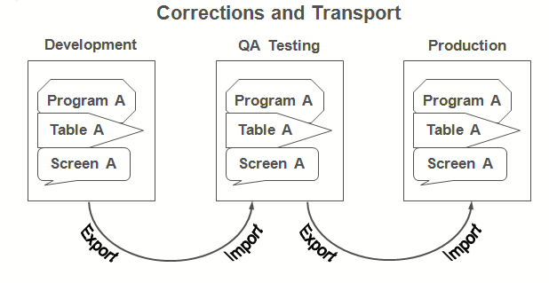
Transport Migration

Slide 42
SAP R/3
R signifies Real-time system
3 represents 3-tier architecture
SAP R/3 is a 3 tier architecture consisting of 3 layers
Presentation
Application
Database
In simple words, it’s a client server architecture
SAP R/3 is the former name and it was renamed SAP ERP
It was later renamed Enterprise Central Component or ECC
Successor software to SAP R/3 is known as SAP ERP Central
Component (ECC)

Slide 43
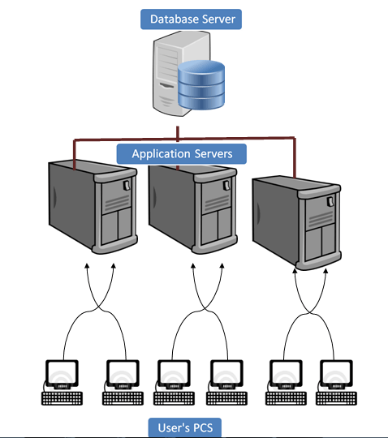
Understanding different SAP Layers

Slide 44

Presentation Layer
Contains the software components that make up the SAPgui
(graphical user interface).
Interface between the R/3 System and its users. The R/3
System uses the SAPgui to provide an intuitive graphical user
interface for entering and displaying data

Slide 45
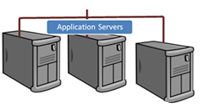
Application Server
Application server is built to process business-logic.
Workload is distributed among multiple application servers. With
multiple application servers, the user can get the output more quickly
Application server exists at a remote a location as compared to the
location of the user PC

Slide 46
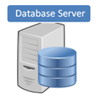
Database Layer
Consists of a central database system containing all of the data in
the R/3 System
Database and Application may exist on the same or different
physical location
SAP has manufactured its own database named HANA which is
compatible with all major databases such as Oracle

Slide 47
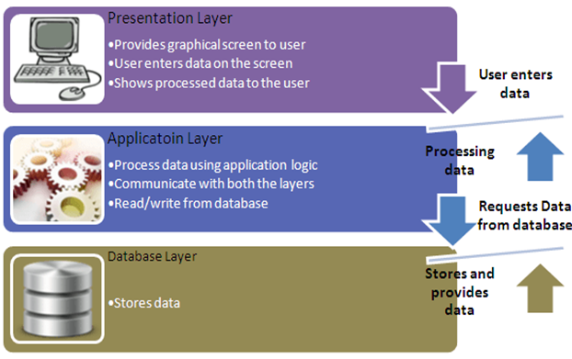
Diagrammatic representation

Slide 48


Accessing SAP
Users can access SAP system in two ways:-
Through SAP GUI
Through Web browser
It's called front-end. Only the front-end is installed in the user's PC
not the application/database servers
Front-end takes the user's requests to database server and
application servers

Slide 49
Releases
SAP R/1 System RF: 1973
SAP R/2 Mainframe System: 1979
SAP R/3 Enterprise Edition 1.0 A: July 1992
SAP R/3 Enterprise Edition 4.0B (SAP R/3 4.0B): 06 April 1998
SAP R/3 Enterprise Edition 3.1l (SAP R/3 3.1I): 11 May 1998
SAP R/3 Enterprise Edition 4.3
SAP R/3 Enterprise Edition 4.5B (SAP R/3 4.5B): 29 March 1999
SAP R/3 Enterprise Edition 4.6B (SAP R/3 4.6B): 06 December 1999
SAP R/3 Enterprise Edition 4.6C (SAP R/3 4.6C): 03 April 2000
SAP R/3 Enterprise Edition 4.6F
SAP R/3 ENTERPRISE 47X110: 15 July 2002

Slide 50
Releases(Continued…)
SAP R/3 ENTERPRISE 47X200: 22 September 2003
SAP ERP Central Component (ECC) 5.0: 21 June 2004
SAP ERP Central Component (ECC) 6.0: 24 October 2005
SAP enhancement package 1 for SAP ERP 6.0 (EHP1 FOR SAP ERP 6.0): 21 December 2006
SAP enhancement package 2 for SAP ERP 6.0 (EHP2 FOR SAP ERP 6.0): 27 July 2007
SAP enhancement package 3 for SAP ERP 6.0 (EHP3 FOR SAP ERP 6.0): 07 December 2007
SAP enhancement package 4 for SAP ERP 6.0 (EHP4 FOR SAP ERP 6.0): 21 November 2008
SAP enhancement package 4 for SAP ERP 6.0 on SAP enhancement package for SAP NetWeaver 7.0 (EHP4 FOR SAP ERP 6.0 / NW7.01): 21 November 2008
SAP enhancement package 5 for SAP ERP 6.0 (EHP5 FOR SAP ERP 6.0): 12 July 2010

Slide 51
Releases(Continued…)
SAP enhancement package 6 for SAP ERP 6.0 (EHP6 FOR SAP ERP 6.0): 24
August 2011
SAP enhancement package 7 for SAP ERP 6.0 (EHP7 FOR SAP ERP 6.0): 13
August 2013
SAP Fiori 1.0 for SAP ERP (UI FOR EHP7 FOR SAP ERP 6.0): 29 November 2013
SAP enhancement package 8 for SAP ERP 6.0 (EHP8 FOR SAP ERP 6.0): 20
January 2016

Slide 52
Enhancement & Support Packages
Enhancement packs, meanwhile, are updates within versions, but
they can be relatively major updates and introduce new features
Support packages are bundles of fixes to existing functionality and don't usually (but can!) introduce new functionality

Slide 53
Different types of SAP Projects

Slide 54

Implementation Project
Client wants to implement SAP Module(Ex: HCM/MM/SD/FI/CO etc)
for the first time
Consultant from various modules do configuration based on their
requirements
Role of consultants are:
Prepare interfaces/RFC’s to interact with Sap/3rd party
Data migration from Legacy system to SAP system
Configuration
Integration of several modules
Testing
Document preparation
End user training, etc

Slide 55

Support Project
After implementation of SAP modules customer/business need
assistance of consultants in their day to day business operations
End users raise their issues, errors, etc through a
ticket handling tool
Ticket Handling Tool is a must which helps to track the status of
tickets
Examples of Ticket Handling Tool are:
HP ALM
BMC Remedy
SM7, etc

Slide 56

Roll Out Project
Company has upgraded/implemented one or more modules of SAP
for one country & wants to do the same or similar upgrade or
implementation for different countries

Slide 57

Upgrade Project
Customers are moving from the older versions of ECC to new
versions
Example : Company migrating from older versions like 4.5,4.6b, 4.6c
to ECC 5.0 / ECC 6.0 . SAP HR EHP3 to SAP HR EHP 5

Slide 58

Testing Phases in SAP Projects
Unit Testing: Standalone tests of the various SAP modules
System Integration Testing: Proper Business Process is followed
in this wherein Consultants from different modules do the testing
together. For example 1st Step would be of SAP SD, 2nd would be of
SAP MM and 3rd of SAP PP and so on
User Acceptance Testing: Actual Business Users do this testing in
SAP as per their Business Process.

Slide 59

Customization
Although SAP provides some default functionalities there are some
processes which are client specific and don’t meet with the SAP
functionalities
This is called as Fit Gap Analysis i.e. the Distance Between Actual
and Existing/Supporting
Customizations are done with the help of ABAPers

Slide 60
Customization(Continued…)
Changes in SAP are done to meet business requirements. These
changes are outlined in a document called as Functional
Specification Document which mentions the Business Requirement,
the configurations done, customized configurations. This document
is the responsibility of the Functional Consultants. The ABAPers are
responsible for capturing their changes in a document called
Technical Specification Document
SAP recommends all the customizing changes should have their
names starting with Y or Z
A to X is reserved by SAP

Slide 61
Customization(Continued…)
For example standard sales order document type is OR. If Client
wants to create a new sales order document type then it’s name
would Yxx or Zxx
xx →alphabetic, numeric or alphanumeric
as per the Client’s naming convention
Customization can be costly and can complicate future upgrades to
the software because the code changes/modifications may not
easily migrate to the new version

Slide 62
Transaction Code
Consists of letters, numbers, or both, and is entered in the command
field at the top of the SAP screen
Each function in SAP ERP has an SAP transaction code associated with it
Use a transaction code to go to any task in an SAP application
faster. By entering a transaction code instead of using the menu, you
go to a task and start the function in a single step
Examples:
SPRO→ Display Implementation Guide
SE16N→Table access

Slide 63
Ways of accessing an application
T-code in Command Field
Command Field
T-code

Slide 64
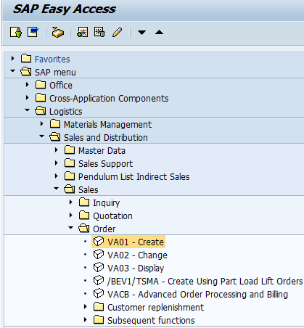
Ways of accessing an application(Continued…)
SAP Menu Path

