Slide 1
Availability Check & Transfer of Requirements

Slide 2
Lesson Objectives
Availability check & TOR
Purpose
Use
Challenges
Availability Check – Overview
Types of Availability Check
Scope of the Availability Check
Availability Check in Sales Order
Control of Availability Check
Transfer of Requirement – Overview
Types of Transfer of Requirements
Control of Transfer of Requirements
Prerequisites for Availability Check
Availability Check – Configuration
Availability Check – Order Processing
Availability Check – Delivery Processing

Slide 3
Lesson Objectives
TOR – Configuration
Let Me
Additional Info

Slide 4
Purpose
When a customer places an order for a material and requests that the material be delivered to him on a specific date. This delivery date can only be confirmed after ensuring the material availability after considering all the inward as well as out ward stock movements
The availability check shall happen and take into account the respective activities that must be carried before a delivery can take place
Similarly the procurement department is also to be informed on the quantities which sales require to be able to deliver against the orders received. This information can trigger production orders for manufacture
If sufficient quantities are not available to cover the requirements, purchase orders, can be created in purchasing on the basis of transfer of requirements planning

Slide 5

The Availability Check and Requirement Transfer help to determine delivery date for a customer
Use
These also help in determining whether the goods are ready or to be produced or to be procured externally

Slide 6
Challenges
•We need to ensure that when availability check fails, i.e., when the requested delivery date cannot be met from the nearest distribution center, then to check in other centers if goods delivery is possible from
one of these centers.
•Another important factor to be taken into account is that some customers might be preferred customers and if availability check fails, provision should be in place to release goods already reserved for some customer order.

Slide 7
Availability Check – Overview
Types of Availability Check
Scope of the Availability Check
Availability Check in Sales Order
Control of Availability Check

Slide 8
Types of Availability Check
There are three types of Availability check
Check on the basis of Available To Promise (ATP) Quantities
☞ The ATP quantity is calculated from the warehouse stock, the planned inward movements of stock (production orders, purchase orders, planned orders) and the planned outward movements of stock (Sales Orders, deliveries, reservations). This type of check performed dynamically in the transaction. Planned independent requirement are not taken into account here
Check against product allocation
☞ Product allocation facilitates period-based distribution of products for certain customers or regions. This type of check is useful in a cases, for example, the production is very low, customer requirement is high
Check against planning
☞ The check against planning is performed against independent requirements which are usually created for an ‘anonymous’ market rather than being customer specific.

Slide 9

Scope of the Availability Check
The following elements can be included in the availability check:
Stock: Safety stock, Stock in transfer, Stock in quality inspection, blocked stock
Inward movement of goods: Purchase orders, Purchase requisitions, Planned orders, and Production orders
Outward movement of goods: Reservations, Dependent reservations and requirements, sales and delivery requirements

Slide 10
Availability Check – Sales Order
When you create an order, the system determines the required material availability date on the basis of the customer’s requested delivery date. On this date you must begin picking, packing and loading the goods. Therefore this is the date of significance for requirements planning on which the availability check should be checked
The following data is required for determining this date:
Route from the shipping point to the ship to party Shipping point from which the goods are issued Loading group from the material master record Weight group determined from the order using the order quantity

Slide 11
Control of Availability Check
The control features specific to Sales and Distribution are: Checking group: It controls whether the system is to create individual or collective requirements in sales and shipping processing.
The checking group can also be used to deactivate the availability check. It is proposed in the material master record on the basis of the material type and the plant, and copied into the sales documents
Checking Rule: The use of Checking rule to control the scope of the availability check for each transaction in sales and distribution. You also specify the check should including or excluding replenishment lead time
Schedule line category: Schedule line category controls whether an availability check and transfer of requirements should be carried out in the sales documents
Delivery item category: The delivery item category can be used to control whether an availability check takes place in deliveries.

Slide 12
Control of Availability Check
Replenishment lead time (RLT) is the time that is needed to order or produce the requested material. Depending on the material type, replenishment lead time can be calculated according to various time periods. RLT is only included in the check performed on the basis of the ATP quantity
•Availability is only checked up to the end of RLT. If the material availability date (ready for packing and transporting) is calculated on the basis of the current date to lie after the RLT for the item, the item itself can be confirmed despite insufficient stock being available.
In this case, the system assumes that any quantity requested by the customer can be procured by the material availability date and considers the goods to be available.

Slide 13
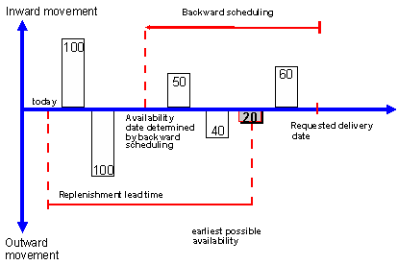
Control of Availability Check
Availability Check with RLT :
The customer wants 20 units delivered in full by the requested delivery date. Using backward scheduling, the system determines a material availability date. But no goods are available as the inward movement of 100 pieces is used up by an outward stock movement. Therefore no stock is available for the material availability date determined by the system. But since RLT is taken into account, the material availability date is proposed at the end of RLT

Slide 14
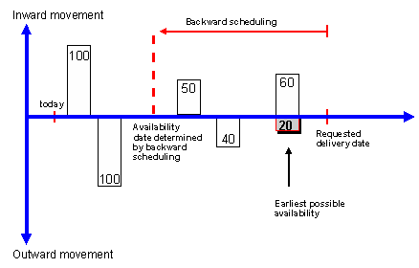
Control of Availability Check
Availability Check without RLT:
If RLT is not to be taken into account in the availability check, the system conducts an unrestricted availability check. Please see the figure below for illustration. The customer wants 20 units delivered in full by the requested delivery date.

Slide 15
Availability Check – Against Product Allocation
Product allocation Procedure is maintained in material master basic View.
Product allocations are stored in the planning hierarchy at different levels.
During order processing, an availability check can be carried out against product allocations. The result of this check informs you whether an order requirement can be confirmed according to the products allocated to the customer. This means that the order confirmation is no longer only important for order entries but also for the divided product allocations.

Slide 16
Transfer of Requirement – Overview
Types of Transfer of Requirements
Control of Transfer of Requirements

Slide 17

Types of Transfer of Requirements
Individual Requirements: A TOR occurs for each sales document that is created. The advantage is that the source document can be identified by looking in the availability overview for each requirement.
Collective Requirements: Collective requirements combine several document quantities based on criteria such as Plant, Batch, Storage location, Date, Transaction and Requirements Class. Collective requirements can either be created daily or weekly. The source documents initiating the collective requirements cannot be identified directly but can be determined from the list of orders for the material.

Slide 18

Control of TOR
The control features specific to Sales and Distribution need to be maintained in Customizing:
Requirements Class: The requirements class contains all control features for planning. In addition, it is specified at a global level whether an availability check is to take place for the material in the sales and distribution documents on the basis of the ATP quantity (ATP = available to promise) and whether requirements are to be passed on
Requirements type: The requirements are identified by the requirements type. The requirements type refers to the requirements class and its control features
Schedule line category: Schedule line category controls whether an availability check and transfer of requirements should be carried out in the sales documents
Checking group: It controls whether the system is to create individual or collective requirements in sales and shipping processing.

Slide 19
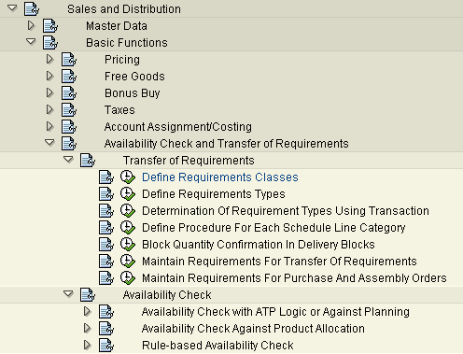
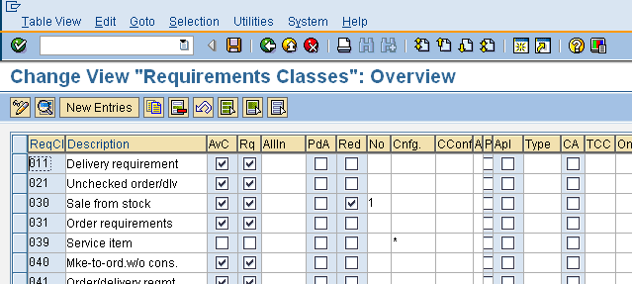
Prerequisites for Availability Check
1. The availability check must be switched on at the requirements class level
The Availability check box (AvC) must be ticked
Menu Path: IMG→ Sales & Distribution→ Basic Functions→ Availability Check & TOR→ TOR → Define Requirement Classes

Slide 20
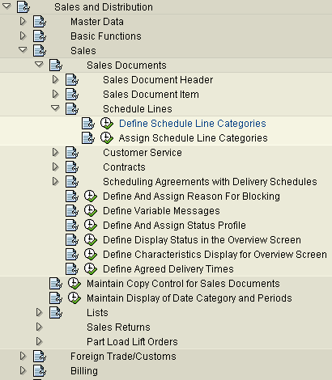
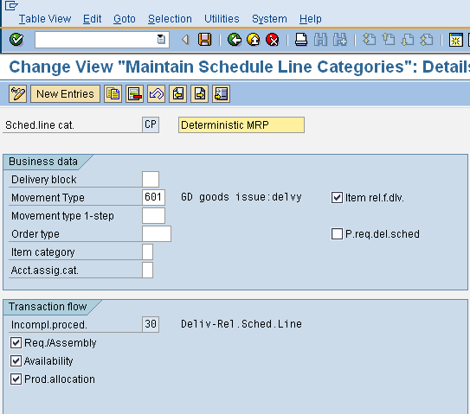
Prerequisites for Availability Check
2. In order to have availability check in the sales document, the indicator must be set at the schedule line category level.
Availability Check Box must be ticked
Menu Path: Display IMG→ Sales & Distribution→ Sales→ Sales Documents→  Schedule Lines→ Define Schedule Line Categories

Slide 21
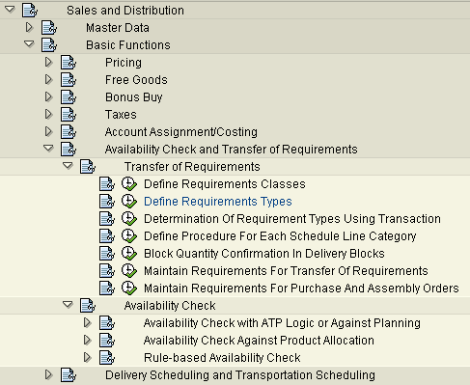
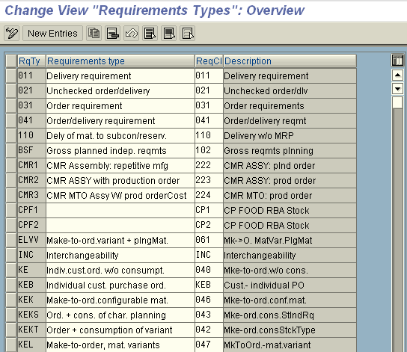
Prerequisites for Availability Check
3. A requirements type must exist by which the requirements class can be found
Assign Requirement Class to Requirement Type
Menu Path: Display IMG→ Sales & Distribution→  TOR→ TOR → Define Requirement Types
Basic Functions→ Availability Check &

Slide 22
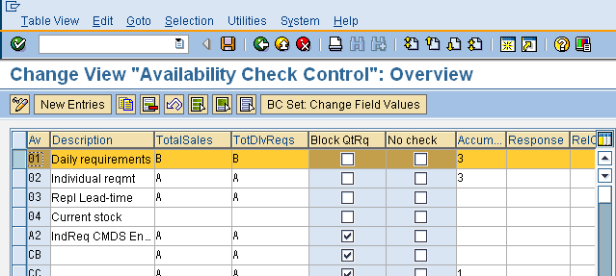
Availability Check - Configuration
1. Define Checking Groups:
Use standard SAP checking group “01” for daily requirements and 02 for individual requirements. In order to create new group, copy an existing group, change the name (ensure that the name starts with “Z”) and description to your preference
“Block QtRq” is set if we want several users to be able to process the material simultaneously in different transactions without blocking each other
Total Sales and Total Delivery requirement are selection option whereby you can configure the checking rule to sum up the requirements to post to MRP either individually or by day or week
The “No Check” indicator is used when you want a material not be relevant for Availability Check
IMG→ Sales & Distribution→ Basic Functions→ Availability Check & TOR→ Availability Check→  Availability Check with ATP Logic or Against Planning→ Define Checking Groups

Slide 23
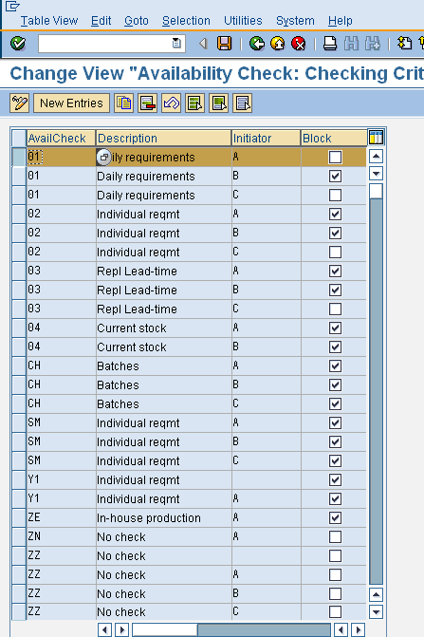
Availability Check - Configuration
2. Defining Material Block for other users
Tick the “Block” checkbox to block a particular material from being checked for availability if it is being checked at the same time by another user. This ensures two users cannot confirm the same quantity for the same material at the same time.
IMG→ Sales & Distribution→ Basic Functions→ Availability Check & TOR→ Availability Check→  Availability Check with ATP Logic or Against Planning→ Define Material Block For Other Users

Slide 24
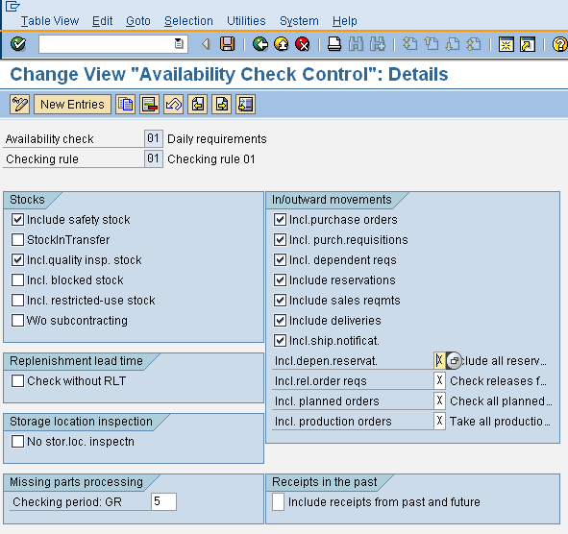
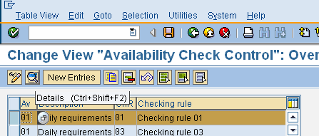
Availability Check - Configuration
3. Control of Availability Check
We indicate what stock in hand, which inward and outward stock movements should be taken into consideration while carrying out availability check.
The Control group specifies in combination with the checking rule the scope of
availability check
IMG→ Sales & Distribution→ Basic Functions→ Availability Check & TOR→ Availability Check→ Availability Check with ATP Logic or Against Planning→ Carry Out Control For Availability Check

Slide 25
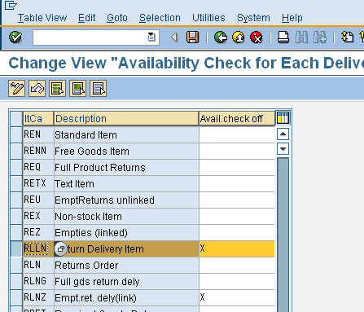
Availability Check - Configuration
4. Determining the Procedure for Each Delivery Item Category
Here we have the option for switching off availability check. This option is used for return items.
IMG→ Sales & Distribution→ Basic Functions→ Availability Check & TOR→ Availability Check→  Availability Check with ATP Logic or Against Planning→ Determine Procedure For Each Delivery Item Category

Slide 26
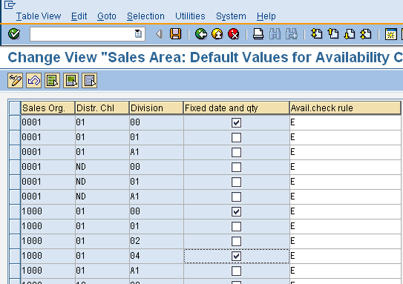
Availability Check - Configuration
5. Defining the Default Settings
Here we define default setting for each sales area.
IMG→ Sales & Distribution→ Basic Functions→ Availability Check & TOR→ Availability Check→  Availability Check with ATP Logic or Against Planning→ Define Default Settings

Slide 27
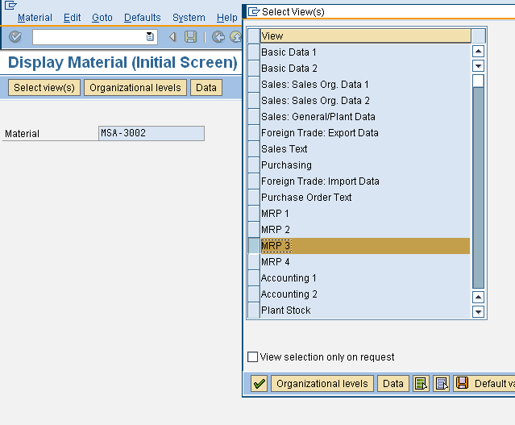
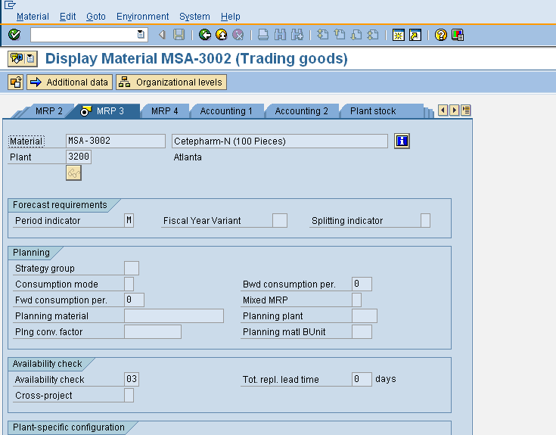
Prerequisites for Availability Check
5. A checking group must be defined in the “Availability Check” field in the “MRP 3” screen of the material master.
Availability check
SAP Menu→ Sales & Distribution→ Master Data→ Products→ Material→ Trading Goods→ MM01 – Create

Slide 28
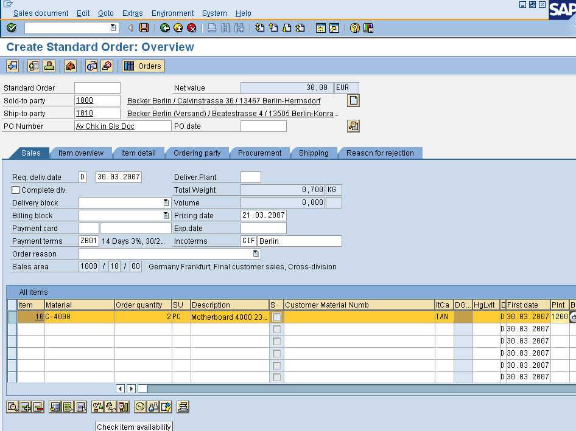
Prerequisites for Availability Check
4. A plant must be determined in the sales order for the line item. It can either be proposed from the customer material info or customer master or material master or can be proposed manually in the document
Plant must be defined in sales order
SAP Menu -> Logistics -> Sales & Distribution -> Sales ->Order -> VA01 -Create

Slide 29

Availability Check – Order Processing
In the sales menu you select Environment -> Availability Ovw to display availability status for a material with reference to the plant and checking rule
To display item availability
During order creation, availability check can be carried out by clicking on the button as shown in the screenshot. We can also display item availability as shown in the screen shot

Slide 30
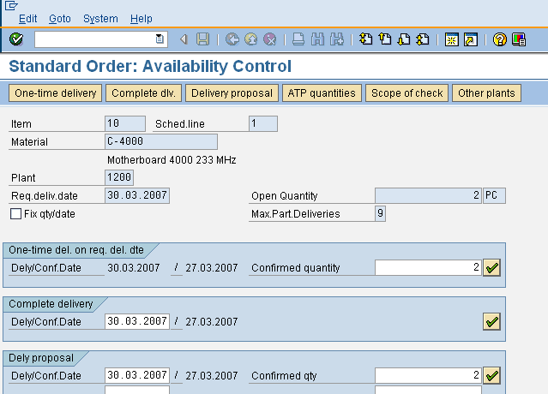
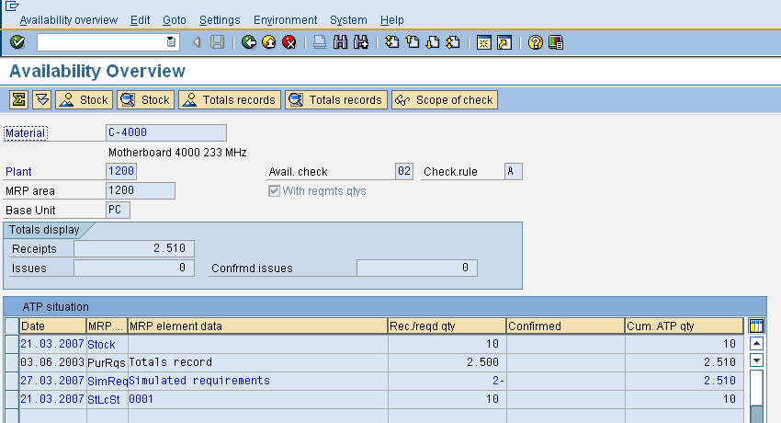
Availability Check – Order Processing
On the Availability Control screen, we can choose between the following delivery proposals:
One-time delivery on the requested delivery date
Complete delivery
Delivery proposal: In this section, the system checks whether and for which dates partial deliveries can be made.
On the Availability Overview screen, we can view:
Availability Checking Group and Checking Rule.
Scope of Check
Quantity available and simulated requirements and the number of storage location
To check availability situation in other plants

Slide 31
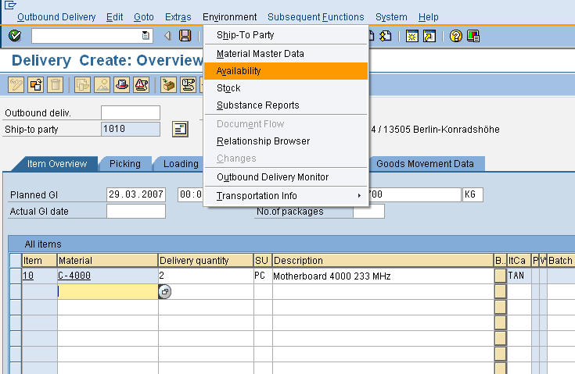
Availability Check – Delivery Processing
In the delivery document, we can go to the availability overview screen by using the path: Environment – Availability. The availability overview screen is shown as the second screenshot in the previous slide.

Slide 32
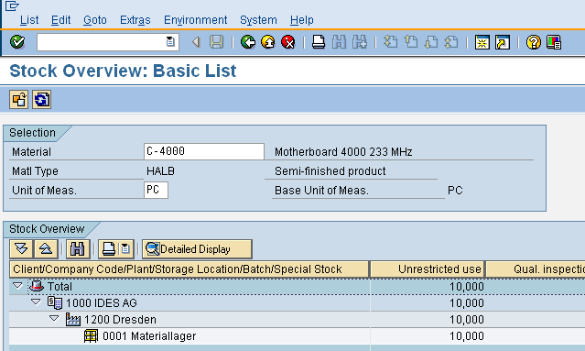
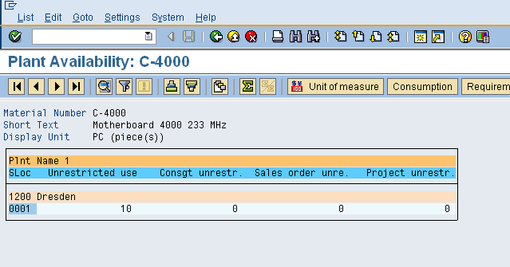
Availability of a Material
Availability of a material can be displayed as below:
1. Stock for a material by storage
location and plant
SAP Menu -> Logistics -> Materials Management ->Environment -> Stock
-> MMBE – Stock Overview
Plant
Storage
Location
Company Code
2. To check Stock Availability for a material by plant
SAP Menu -> Logistics -> Materials
Management ->Environment -> Stock
-> MB53 – Stock of Material by Plant

Slide 33
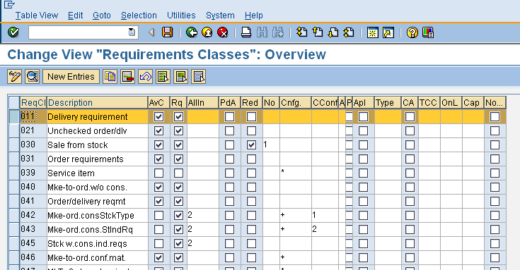
TOR - Configuration
1. Defining the Requirements Classes
Requirements class is the key factor in the TOR. It is based on the requirement types of the sales document. These requirement classes are also used in PP, so be sure to involve PP and MM in any changes you envisage in the SD module.
The availability check box (AvC) must be ticked in order to carry out availability check.
The TOR check box (Rq) must be ticked in order to transfer requirements
IMG→ Sales & Distribution→  Define Requirement Classes
Basic Functions→ Availability Check & TOR→ TOR →

Slide 34
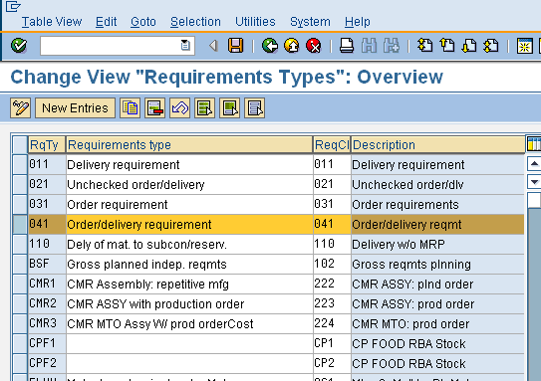
TOR - Configuration
2. Defining the Requirements Type
•The relationship between requirement type and requirements class is many to one.
IMG→ Sales & Distribution→ Basic Functions→ Availability Check & TOR→ TOR
→ Define Requirement Types

Slide 35
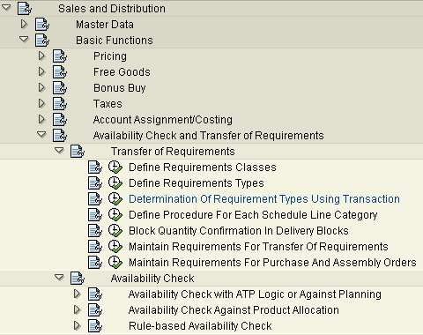
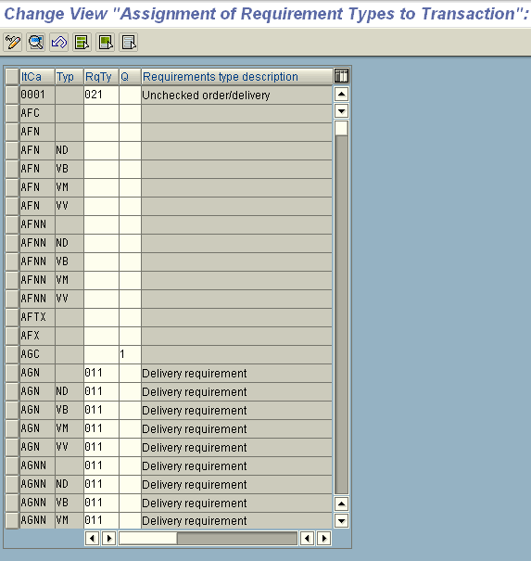
TOR - Configuration
3. Assign Requirements Type
Assign requirement type to the relevant item category in the sales order and the MRP type found on the material Master Record
IMG→ Sales & Distribution→ Basic Functions→ Availability Check & TOR→ TOR
→ Determination of requirement types using transaction

Slide 36
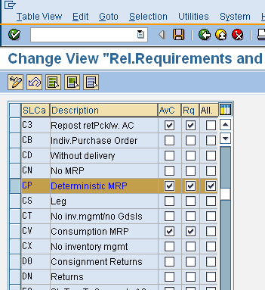
TOR - Configuration
4. Defining Procedure For Each Schedule Line Category
We deactivate a setting at the schedule line level only if it is already set at the requirements class level.
IMG→ Sales & Distribution→
Basic Functions→ Availability Check & TOR→ TOR →
Define Procedure For Each Schedule Line Category

Slide 37
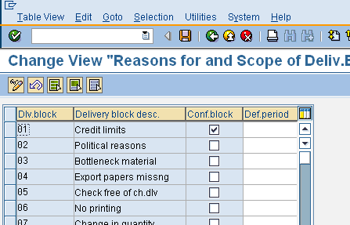
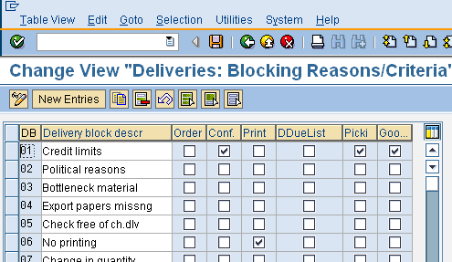
TOR - Configuration
5. Block quantity confirmation in delivery blocks
This enables us to unreserve or not reserve any quantity that has been confirmed for an order for which a delivery is blocked.
We have the provision of setting this for different reasons and at different transactions
IMG→ Sales & Distribution→ Basic Functions→ Availability Check & TOR→ TOR →
Block quantity confirmation in delivery blocks

Slide 38
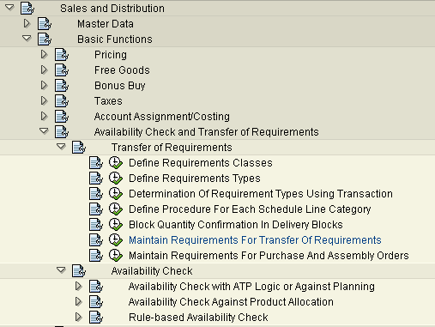
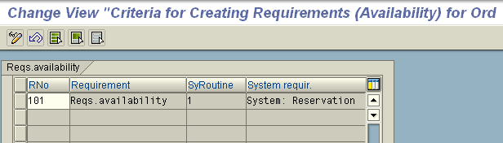
TOR - Configuration
6. Maintain Requirements for Transfer of Requirements
In the same way as the requirements used in access sequence, that is, a number of preconditions must exists of the transaction to be carried out, requirements can be used to determine that the TOR to MRP is not carried out unless a number of condition are met.
IMG→ Sales & Distribution→
Basic Functions→ Availability Check & TOR→ TOR →
Maintain Requirements for Transfer of Requirements

Slide 39
Let Me
Use the Transaction Codes below to view the configuration settings for Availability Check and Transfer of Requirements:
OVZG | Define Requirements Classes
VOV6 | Define Schedule Line Categories
OVZH | Define Requirements Types
OVZ2 | Define Checking Groups
OVZ9 | Carry out control of Availability Check
OVZ7 | Block quantity confirmation in delivery blocks
MMBE | Stock Overview by Plant and Storage Location
MB53 | Plant Stock Availability
MD04 | Stock/Requirements List
VA02 | Change Sales Order: Initial Screen
VL02n | Change Outbound Delivery

Slide 40
Let Me
Create a new checking group by copying “01” and/or “02”.
Create a new material by copying C-4000. Assign the checking group to the new material.
Create sales orders with the data provided in the exercise data slide.
Alter the controls provided in the checking group and other controls as described in the earlier slides to see how availability check is affected.
Read the information on RLT provided in the “TellMe” section and through configuration see its effect on material availability date.

Slide 41
Additional Info
To check the availability over follow menu path Logistics ->Materials Management -> Environment -> Stock -> Availability Overview (CO09)
•An advantage of this availability overview will show sales order quantity, sales order number, an line item number, and requirement class for each schedule line for which demand is created.
•In case of maintaining requirements (preconditions ) for TOR - the Standard SAP requirement ‘102’ prevents reservations from being carried out in the event of credit block

