Slide 1
OTC Basic Functions

Slide 2
Lesson Objectives
Purpose
Use
Challenges
SD Basic Functions-Concept
Partner Determination
Account Determination
Delivery & Transportation Scheduling
Output Control
Text Control
Incompletion Log
Dynamic Item proposal
Material Determination
Listing & Exclusion
Free Goods
Bonus Buy
Cross Selling
Notes:
Add instructor notes here.

Slide 3
Lesson Objectives
SD Basic Functions-Configuration
Partner Determination
Account Determination
Delivery & Transportation Scheduling
Output Control
Text Control
Incompletion Log
Dynamic Item proposal
Material Determination
Listing & Exclusion
Free Goods
Bonus Buy
Cross Selling
Important Transaction Codes
Additional Info
Notes:
Add instructor notes here.

Slide 4
Purpose
Products are sold or sent to business partners or services are performed for them. Information about the products and services as well as about the customers is the basis for sales processing
The Sales Department shall have details of their Customers, availability of products, promotional offers, free samples if any allowed, additional items or alternatives to the products ordered, where to account the various revenues generated etc. All such information is used appropriately and perform order entry and delivery in the system
The simple process of order creation and delivery is helped &
complemented by many complex individual utilities

Slide 5



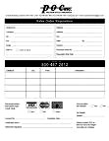



Use
VALIDATES
BUSINESS ROCESSES
BASIC FUNC
Basic functions consist of a host of functionalities such as Partner determination, Account assignment, Incompletion procedure etc. which optimizes the processing of Sales & Distribution transactions and provides information, checks, validations, verifications and control to the business at several levels

Slide 6
Challenges
To deal with multiple partners involved in a single sales transaction
To confirm a delivery date to the customer at the time of ordering
To determine and recognize various revenues generated in financial accounting
To be aware & implement various promotional schemes for a business drive
To convey special instructions of various kinds to various business partners involved

Slide 7
SD Basic Functions-Concept
Part I
Partner Determination
Account Determination
Delivery & Transportation Scheduling
Output Control
Text Control
Incompletion Log

Slide 8
SD Basic Functions-Concept
Part I
Partner Determination
Account Determination
Delivery & Transportation Scheduling
Output Control
Text Control
Incompletion Log

Slide 9


Business Partners
Customer
Vendor
Forwardin g Agent
Business Partner
Employee
Others
Contact Person
Business partners do play different roles (functions) called Partner Functions in business transactions

Slide 10




Partner Functions
Ship-to Party
Sold-to Party
Bill-to Party
Customer
Payer
A business partner like Customer can play many roles (functions) in a transaction The partner functions like of Sold-to Party, Ship-to Party, Bill-to Party and Payer are essential for sales document processing

Slide 11
Partner Functions
Sold-to Party: Sold- to party is the business partner to whom the goods are sold. It needs only sales relevant data in customer master
Ship-to Party: Ship-to Party is the business partner to whom the goods are shipped. It needs only shipping relevant data such as unloading point
Bill-to Party: Bill-to Party is the business partner to whom the bills is sent, needs only the basic data such as address and output procedures
Payer: Payer is the individual or the company who settles the invoice

Slide 12





Customer Master - Account Group
Account Group is a classification of customer master record,
Sold-to Party Ship-to Party
Customer
Bill-to Party
Payer
Account Group controls,
Which fields in the master record are required or optional
Number range for the customer account number (external or internal)
Whether it is one-time account
Default value for pricing procedure indicator
IMG → Logistics General →Business Partner →Customers →Control

Slide 13
Partner Determination
The idea behind partner determination is that the several SD activities from the customer point of view such as receiving of sales order or delivery document, payment of the invoices etc. can be done by separate entities or by a single entity which on holistic basis are customers to the business
The business then needs to decide as to what data pertaining to each business partners need to be maintained and also controlling the activities related to these partners in the entire sales and distribution process
Determination of Partner Functions in SAP can be broadly classified into three areas,
Master Data
Document Data and
Sales Activities

Slide 14
Partner Determination
The Master data comprises of Customer Master data
The Document data consists of Sales document (header & item), Delivery, Billing (header & item), Shipment.
Sales activities comprise the computer aided selling
Partner function can be set up for :
Customer Master
Sales document header
Sales document item
Delivery
Shipment
Billing header
Billing item
Sales activities (CAS)

Slide 15
SD Basic Functions-Concept
Part I
Partner Determination
Account Determination
Delivery & Transportation Scheduling
Output Control
Text Control
Incompletion Log

Slide 16
Revenue Account Determination
Whenever a sale is posted to accounting, SAP must determine the account where the revenues and discounts should be posted. For e.g. revenue from domestic sales shall go to an account and export sales shall go to a different account. Depending upon various conditions the relevant accounts shall be determined
Through Revenue Account Determination the billing values are transferred from the SD to FI. Revenue account determination is carried out using the condition technique
The following steps are involved in the Revenue Account assignment :
Check master data relevant for account assignment
Define dependencies for revenue account determination
Define access sequence and account determination types
Define and assign account determination procedures
Define and assign account keys

Slide 17
Check master data relevant for
Account Assignment
Through check master data relevant for account assignment, one can create Account Assignment Grouping criteria
This grouping then provides the system with an extra variable to determine the required G/L account
After creation of the account assignment groups, they must be assigned to the Material Master and Customer Master records

Slide 18
Account Determination Procedure - Steps
Account determination table
In the account determination table, you define the criteria on which account determination should depend
Access sequence
Here, you define in which sequence fields are read from the billing document (header and item). An access sequence refers to the permitted field combinations stored in the condition table.
Account determination type
The account determination type is a module of the conditions technique. You have to create at least one account determination type and allocate it to an account determination procedure.

Slide 19
Account Determination Procedure - Steps
Account determination procedure
The account determination procedure contains the necessary account determination types with which the SAP System can automatically find the revenue accounts
Account key
With the three-digit account key, you finally allocate the revenue account

Slide 20
SD Basic Functions-Concept
Part I
Partner Determination
Account Determination
Delivery & Transportation Scheduling
Output Control
Text Control
Incompletion Log

Slide 21








Delivery & Transportation Scheduling
Shipping activities and transportation can be scheduled automatically in sales documents
Scheduling helps to confirm a delivery date to a customer. Pick/Pack time, Loading time, Transportation Lead time & Transit time are used to determine the delivery date
Sales Order
Transportation Planning Date
Material Availability Date
Order Date
Loading Date
Goods Issue date
Delivery Date

Slide 22


Delivery Scheduling
Delivery Scheduling includes Pick/Pack time and the Loading time
These times depend on the shipping point that delivers the order item. A shipping point is defined with pick/pack time and loading time. These times can be in terms of days or hours
A sales document type can be made relevant for delivery scheduling or not. When you specify delivery scheduling, the system automatically determines
The pick/pack time and
The loading time
for each schedule line, according to shipping point from which an item is shipped. The system uses the pick/pack time and the loading time to help determine the material availability date & the loading date respectively

Slide 23


Transportation Scheduling
Transportation scheduling includes the determination of the transportation lead time and transit time
Both time periods are proposed from the route determined for the order item
Sales document type can be made relevant for transportation scheduling or Not. When you specify transportation scheduling, the system proposes the following times for each schedule line:
Transportation lead time
Transit time
These times are defined by route. The system uses the transportation lead time and the transit time to help determine the transportation planning date and the goods issue date respectively

Slide 24
SD Basic Functions-Concept
Part I
Partner Determination
Account Determination
Delivery & Transportation Scheduling
Output Control
Text Control
Incompletion Log

Slide 25











Output Control
Output is the information that is sent to the customer using various media, such as mail, EDI, or fax
Examples include: the printout of a quotation or an order confirmation, order confirmations using EDI, or invoices by fax
Output can be sent for various sales and distribution documents - order, delivery, billing document
Output types include, for example: quotation, order confirmation, invoice
In the output master data, you define the transmission medium, the time, and the partner function for an output type
Output Determination is
carried out using SAP
condition technique
Printer
Fax
Output mediums

Slide 26























Output Determination
Output Masterdata
Sales order
Output type :
Partner function Transmission Medium Language
Output type : Order confirmation Trans medium : Print output Partner func : AG 3000
Language : EN
Output
Determination
Procedure
PRINT
Customer Printer
Order confirmation
Customer : 3000
We will deliver Item Material
1 Mat 100
Qnt
100

Slide 27
SD Basic Functions-Concept
Part I
Partner Determination
Account Determination
Delivery & Transportation Scheduling
Output Control
Text Control
Incompletion Log

Slide 28

Texts
Document (sales / delivery / Billing)
Master Data
Header
Item
Master
Material Master Basic texts Sales text
PO Text
Customer Master Central Texts S&D texts
Contact person texts
Customer Material
info’
Info Record texts
•Header Text
•Header notice
•Shipping requirements
•Material Sales text
•Packing note
•Shipping requirements
•Contractual requirements
Texts are proposed from the master records in the sales and distribution documents, if you have made the appropriate setting.
You can integrate standard texts into the sales and distribution documents.
Texts can be copied from a reference sales and distribution document into another sales and distribution document (e.g. from an inquiry into a sales order or from an order into a delivery).
The copying of texts can be made language dependent, if required.
You can change copied texts
In a Sales Document Texts can be maintained as Header or Item Text
Text Determination is carried out by SAP Condition Technique

Slide 29




Text Sources
Customer Master
Central Texts
Financial Accounting Texts
Sales & Distribution Texts
Contact Person Texts
Material Master
Basic Texts
Sales Texts
Purchase Texts
Customer Material
Info
Customer – material Texts
Sales order
----------
----------
----------
Header Texts
Item Texts

Slide 30

Text Determination
The following steps are involved in text determination
Select a text object and define the rules for text determination for this object. Text objects are, for example, the sales texts in the customer master record or the sales document header.
Define the permitted text types for every text object. If the text types contained in the standard SAP R/3 System are not sufficient, create new ones.
Define the access sequences. This way, you define how the SAP System should determine the texts for a text type.
``
Group the text types together in text determination
procedures.
Allocate the text determination procedures so that a
procedure applies to the following criteria in each case: account group – customer; sales & distribution document; item category

Slide 31
SD Basic Functions-Concept
Part I
Partner Determination
Account Determination
Delivery & Transportation Scheduling
Output Control
Text Control
Incompletion Log

Slide 32
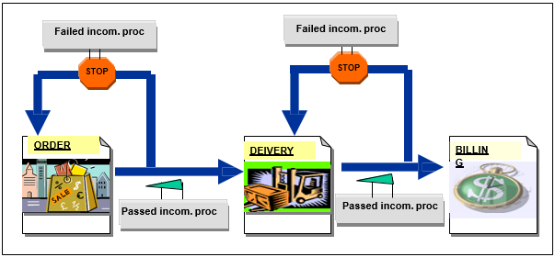
Incompletion Procedure
The data maintained in Sales document is passed through to delivery and finally to billing. So it is imperative that SAP has a specific control system to see that the requisite data is maintained at different SD levels.
For this reason, SAP has an incompletion procedure to highlight missing data in sales and delivery documents as well as sales activities and partner functions

Slide 33











Incompletion Procedure - How it works…?
Order
Sold to party Order no.
0001
200
Order : Incompletion log
X
Item 10
Material M1 Plant
Item 10
Missing Data Plant
Schedule line
Item 20
Material M2 Plant P1
Incompletion log is called up
When saved
When called up from menu
Schedule line

Slide 34
Status Groups
It is a grouping of different kinds of status. A group can consist of any combination of general, delivery, billing, & pricing status
Using status groups, you can determine which status messages appear when you process different documents. The status group also provides the link, during sales order processing, between the incompletion log (where the system prompts you to enter data in required fields) and the header and item status screens in the sales document
The fields that appear in the incompletion log are defined for each sales document by an incompletion procedure, where you assign a status group to each field
Then, during sales order processing, if you omit to fill a required field, the system prompts you for the relevant information in the incompletion log records the status messages in the sales document, according the assigned status group

Slide 35




Defining Incompletion Procedure
Incompletion Procedure is carried out by SAP condition Technique. It is defined for various incompletion groups
Incompletion groups
Sales header
✓Sales item
Sales schedule line
Delivery header
Delivery item
Partner
Sales activity
Here we group together the fields that are to be checked for completeness
For every field in the procedure, we
also have to define whether warning message is to be issued during processing if no data is entered in this field

Slide 36
SD Basic Functions-Concept
Part II
Dynamic Product proposal
Material Determination
Listing & Exclusion
Free Goods
Bonus Buy
Cross Selling

Slide 37




Dynamic Product Proposal
A product proposal is a list of products for a specific customer that is automatically proposed during sales document processing. The business can decide for themselves which materials should be displayed as product proposals in the sales document. We can also determine the sequence in which the materials appear in the product proposal.
Product Proposal
Business
Product A
Product B
Product C
Customer
Product D
Product E
SALES DOCUMENT PROCESS

Slide 38













Dynamic Product Proposal
During sales document processing, the system displays a product proposal in the item overview according to the customer and the business transaction
It displays the material number, material description, and historical order quantities in the sales unit last used. To use a material again, you just have to copy it
The system does not run the standard checks (pricing, availability, incompletion, material determination, free goods determination and so on) until you have entered the order quantities
Product pro. parameters
+
Sales order
Customer
x
Order no Customer no
101
2000
Product proposal
Material no E600
E700
Material description Qnt Cds 25
Dvds 45
Business transaction E.g..- Sales order
Copyright © Capgemini 2015. All Rights Reserved

Slide 39
SD Basic Functions-Concept
Part I I
Dynamic Product proposal
Material Determination
Listing & Exclusion
Free Goods
Bonus Buy
Cross Selling

Slide 40
Material Determination
With material determination, the material entered is replaced automatically by the material found during document creation
This material determination is dependent on the sales document and can, for example, be used in a promotion when a product is only to be sold with special packaging
During order processing, the system can then automatically exchange the material with the normal packaging for the material with the special packaging for a given period of time

Slide 41

Material Determination

Slide 42











Material Determination
It is carried out using condition technique
It can be achieved just against any key word & not necessarily against an existing material no. It can also be considered against available quantities of the materials to be replaced
Determination procedure
Sales order
x
Order no : 100 Customer : 200
Item Material
1 M001
Substitution strategy
Description Qnt
Sales doc.
type
Toothpaste
25
1
M002
combo pack
25
Copyright © Capgemini 2015. All Rights Reserved

Slide 43
SD Basic Functions-Concept
Part II
Dynamic Product proposal
Material Determination
Listing & Exclusion
Free Goods
Bonus Buy
Cross Selling

Slide 44
Listing & Exclusion
With material listing or exclusion we can control which materials can be sold to each customer
If a material listing is created for a customer, the customer can only buy the materials contained in the list. The system does not allow any materials to be entered if they are not contained in the material listing
Material exclusion lists which materials a customer cannot buy

Slide 45
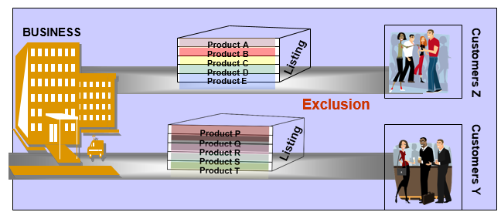
Listing & Exclusion

Slide 46
SD Basic Functions-Concept
Part II
Dynamic Product proposal
Material Determination
Listing & Exclusion
Free Goods
Bonus Buy
Cross Selling

Slide 47










Free Goods
Free goods refer to the process where the business offers a scheme where the customers can get free goods if they buy certain products of certain quantities
Buy 1 get 1 free
BUSINESS
Buy 1 get 1
free
Customers

Slide 48




Free Goods
Inclusive | The customer only pays for some of the goods requested. The rest of the goods are free of charge. Two out of eight eggs are free goods. Therefore, if you order 8 eggs, 8 will be delivered and you will not be charged for 2 of them. So in this case, you have ordered an inclusive bonus quantity. | 2 from 8
Exclusive | The customer pays for the goods ordered and is given extra goods free of charge. The exclusive bonus quantity is also called exclusive free goods and means that in addition to the purchase order, a certain quantity of materials are guaranteed as free goods. In other words, a larger quantity is delivered than is ordered, whereby no charge is made for the additional quantity delivered. | 3 + 1
Exclusive different material | The materials delivered as free goods do not necessarily have to be the same as the materials orders. When a customer orders 3 large trays of eggs, the customer would be offered a chicken for free! | 3 + 1
The free goods can also be in the form of discount to the extent of the goods value The free goods quantity can be defined as a quantity proportional to the sold quantity. For the delivery you can control whether the free goods are processed independently or whether they are only copied to the delivery for partial delivery or full delivery.

Slide 49
SD Basic Functions-Concept
Part II
Dynamic Product proposal
Material Determination
Listing & Exclusion
Free Goods
Bonus Buy
Cross Selling

Slide 50






Bonus Buy
Business
Customers
Bonus buys are deals, which grant special prices, discounts or free articles, if certain prerequisites and general conditions are fulfilled
In the Bonus Buy, Coupons can be assigned as prerequisite
Coupons in SAP R/3 Retail are treated like articles

Slide 51

Bonus Buy
Bonus buy deals are :-
Based on certain prerequisites
Based on certain scales
Resulting in certain conditions being granted
General requirements
If you buy 5 promotion articles ...
... spending over a total amount of 50 USD...
We‘ll give you a certain article with 10 % discount ...
... 5 % discount for 3 articles ... 10 % discount for 5 articles...

Slide 52
SD Basic Functions-Concept
Part II
Dynamic Product proposal
Material Determination
Listing & Exclusion
Free Goods
Bonus Buy
Cross Selling

Slide 53

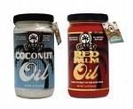

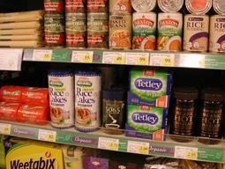
Cross Selling
Cross selling allows us to establish, for example, whether a given product is always sold in combination with another product or several other products
Knowledge about such relationships
between products opens up new opportunities in the way we arrange your product offering
We can then place the products concerned adjacent to each other in our catalog, on the supermarket shelf, or indeed in the Web shop, or conduct advertising campaigns aimed specifically at promoting these products

Slide 54
SD Basic Functions-Configuration
Part I
Partner Determination
Account Determination
Delivery & Transportation Scheduling
Output Control
Text Control
Incompletion Log

Slide 55
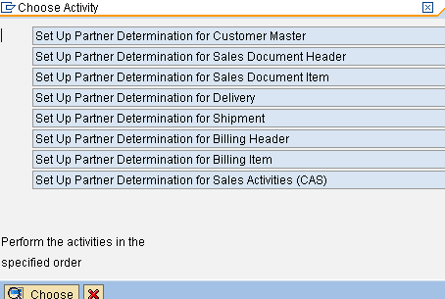
Partner Determination - Configuration
Partner Determination is maintained for various Partner Objects
IMG -> SD -> Basic Functions -> Set up partner determination

Slide 56
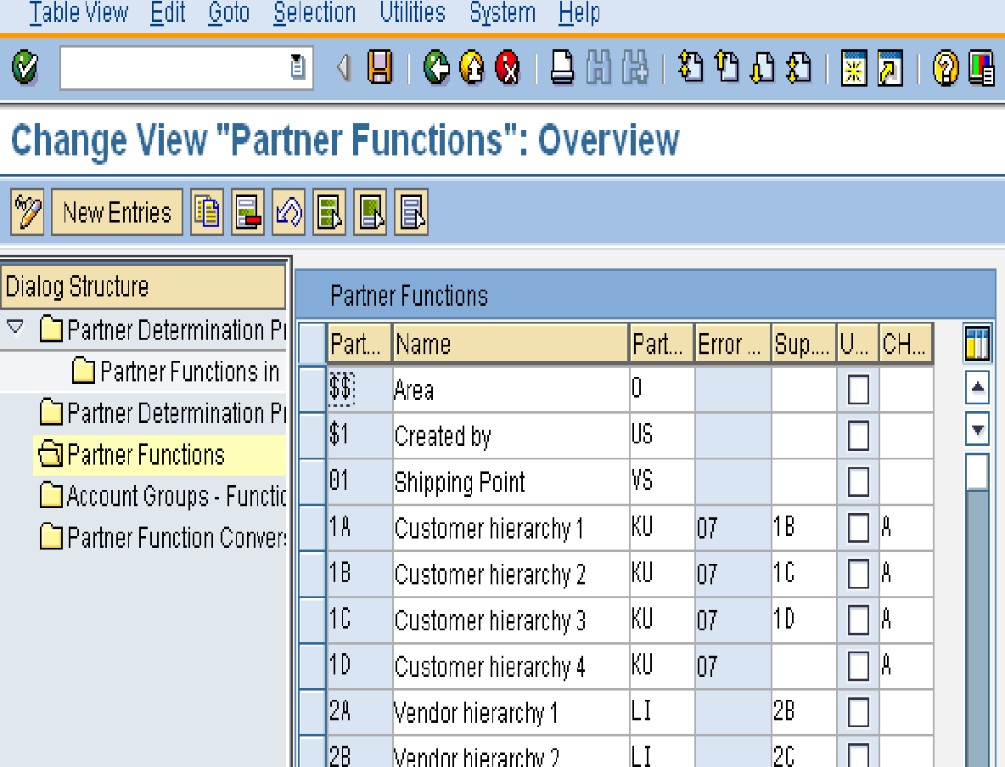
Partner Determination
Partner functions are defined first
The partner type specifies if the partner is a customer, contact person, vendor etc
The error group is the incompletion procedure used by the system to register partner fields that are not filled in the relevant partner object
IMG > SD > Basic Functions > Set up partner determination > Set Partner Determination for Customer Master > Partner functions

Slide 57
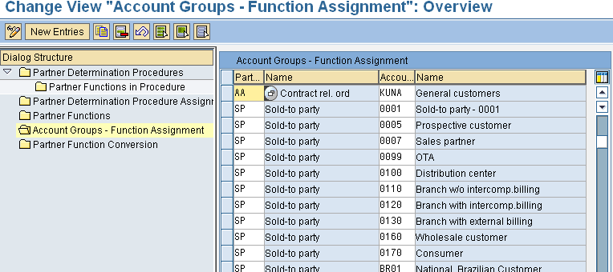
Partner Determination
Partner Functions are assigned to Account Groups to ensure only relevant Partner Functions are allowed for a specific Account Group

Slide 58
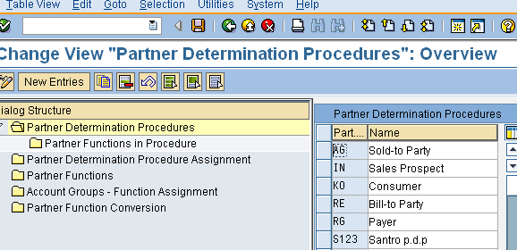
Partner Determination
Partner Determination Procedure is maintained for each Partner Object E.g. Customer Master
IMG > SD > Basic Functions > Set up partner determination > Set Up Partner Determination for Customer Master > Partner determination procedure

Slide 59
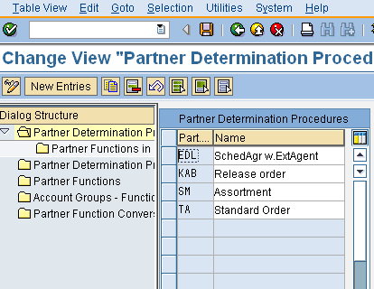
Partner Determination
Partner Determination Procedure is maintained for each Partner Object E.g. Sales Document Header
IMG > SD > Basic Functions > Set up partner determination > Set Up Partner Determination for Set Up Partner Determination for Sales Document Header > Partner determination procedures

Slide 60
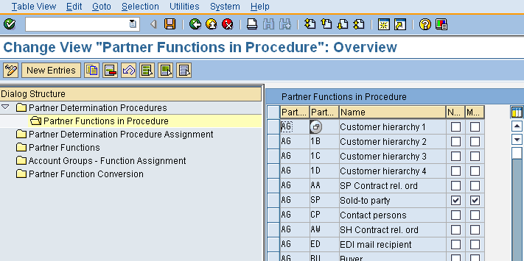
Partner Determination
Partner Determination Procedure is assigned with relevant Partner Functions. Eg: Customer Master
Indicates that the system must allow only one entry of this partner function in the partner object
The mandatory field indicates the partner function is mandatory for setting up the partner function for that particular
record
IMG > SD > Basic Functions > Set up partner determination > Set Partner Determination for Customer Master > Partner functions in Procedure

Slide 61
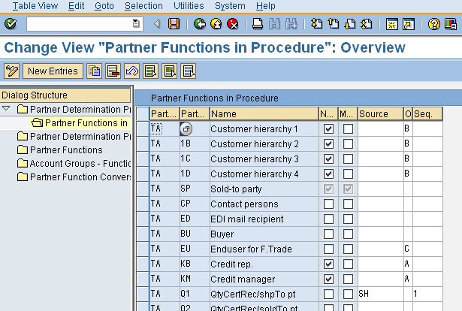
Partner Determination
Partner Determination Procedure is assigned with relevant Partner Functions. E.g. Sales Document Header
To make the partner functions Not modifiable the sales document
To make the partner functions Mandatory in the sales document
The fields for source and sequence are used where the system needs to obtain a partner record from any associated partner in the sales document other than that of the sold to party
IMG > SD > Basic Functions > Set up partner determination > Set Up Partner Determination for Set Up Partner Determination for Sales Document Header > Partner determination procedures > Partner functions in procedure

Slide 62
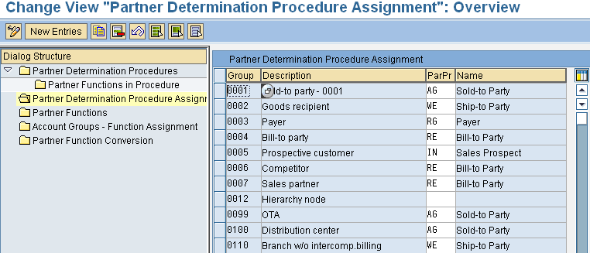
Partner Determination
Partner Determination Procedure is assigned to the Partner Object Eg: Customer Account Group
Account Group
Partner Determination Procedure
IMG > SD > Basic Functions > Set up partner determination > Set Up Partner Determination for Customer Master > Partner determination procedures > Partner Determination Procedure Assignment

Slide 63
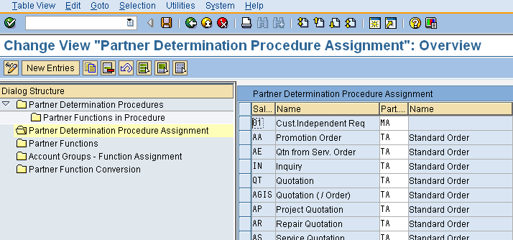
Partner Determination
Partner Determination Procedure is assigned to the Partner Object E.g.: Document Type (Sales Document Header)
Sales Document Type
Partner Determination Procedure
IMG > SD > Basic Functions > Set up partner determination > Set Up Partner Determination for Sales Document Header > Partner determination procedures > Partner Determination Procedure Assignment

Slide 64
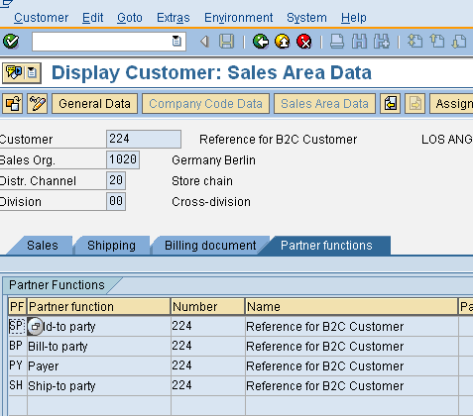

Partner Functions – Customer Master
PARTNER FUNCTIONS IN CUSTOMER MASTER

Slide 65
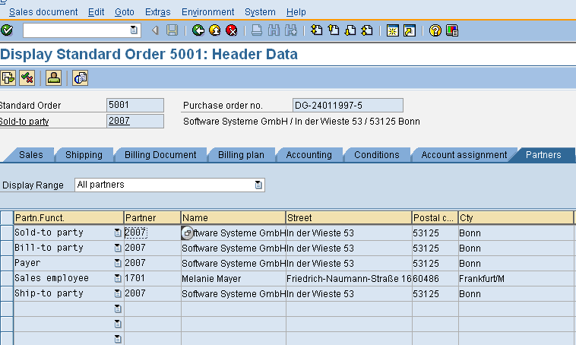

Partner functions - Sales order
PARTNER FUNCTIONS

Slide 66
SD Basic Functions-Configuration
Part I
Partner Determination
Account Determination
Delivery & Transportation Scheduling
Output Control
Text Control
Incompletion Log

Slide 67
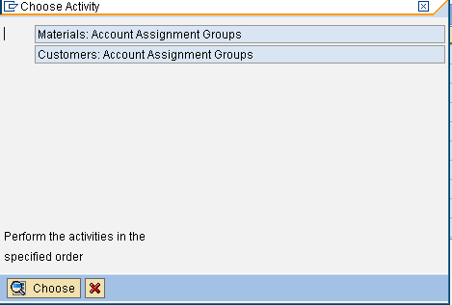
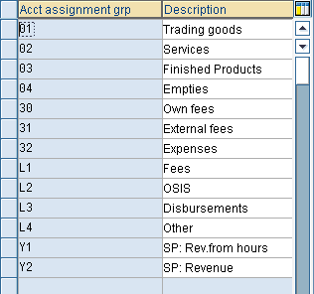
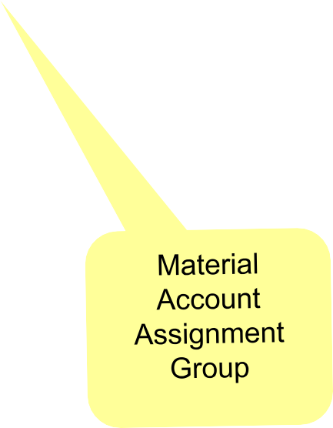

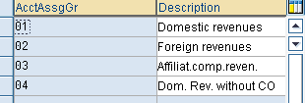
Master data relevant for Account
Assignment
Path : IMG > SD > Basic Functions > Account assignment > Check master data relevant for account assignment

Slide 68
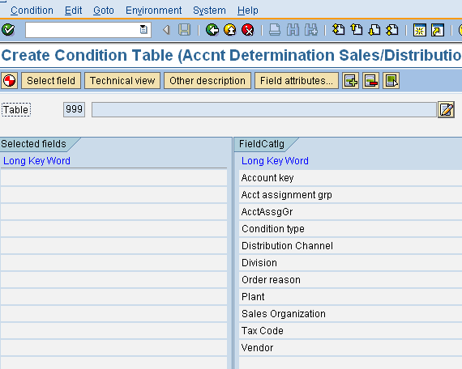
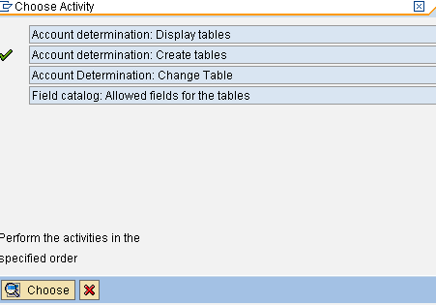
Define Condition Table
Click to generate
Selected Fields
Fields to select from
Path : IMG > SD > Basic Functions > Account assignment > Define dependencies for revenue account determination

Slide 69
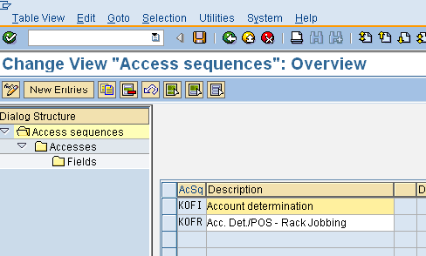
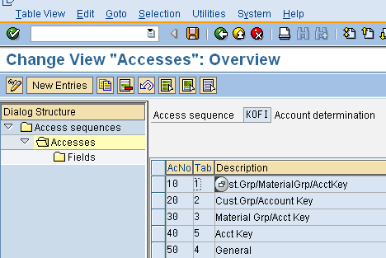
Define Access Sequence
The SAP standard access sequence is KOFI
To create a new, make a copy of KOFI
Here we assign the condition table we created earlier
The access no signifies the sequence in which the control would move top to bottom
IMG > SD > Basic Functions > Account assignment > Define access sequence and account determination types > Maintain access seq. for account determination

Slide 70
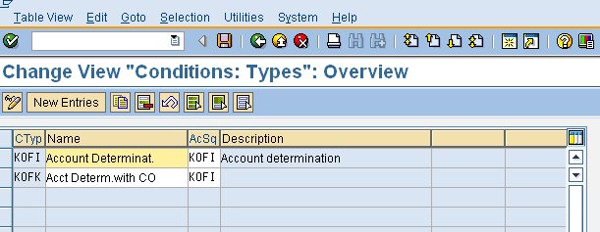
Define Account Determination Type
Here we assign Access Sequence to Condition Type
A new Condition Type is created by copying the existing one
IMG > SD > Basic Functions > Account assignment > Define access sequence and account determination types > Define account determination types

Slide 71
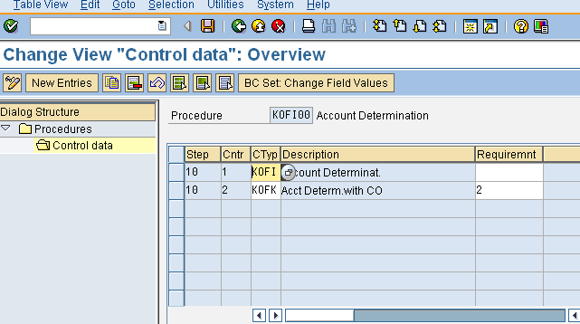
Define Account Determination Procedure
Account Determination Procedure is defined and assigned with Account Determination Types
SAP provides two standard cond. Typs – KOFI & KOFK for account determination in standard procedure KOFI00
To create your own, make a copy of KOFI00
IMG > SD > Basic Functions > Account assignment > Define access sequence and account determination types > Define and assign account determination procedures
> Define account determination procedure

Slide 72
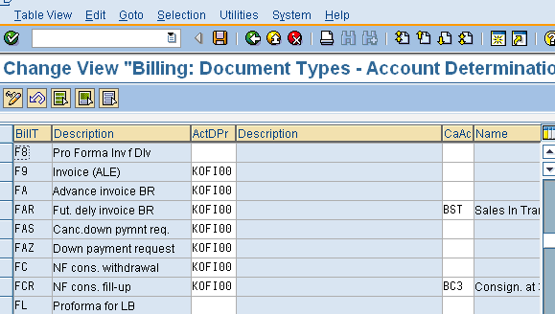
Assign Account Determination Procedure to Billing Type
The column described as CaAc represents the cash allocation key, which causes the system to post directly to a GL account for cash entry rather than into receivable account. The system will use EVV account key post to cash sale
Path : IMG > SD > Basic Functions > Account assignment > Define access sequence and account determination types > Define and assign account determination procedures > Assign account determination procedure

Slide 73
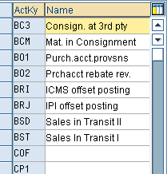
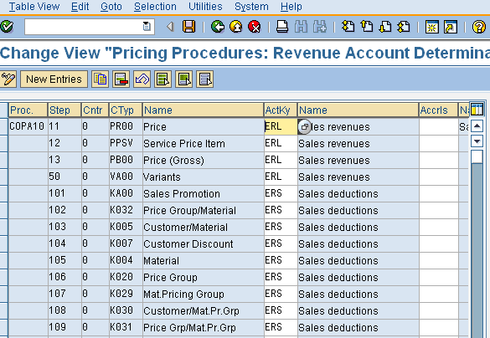
Define and assign Account Keys
The account key is a 3 character alpha numeric key with a short description
The account keys specify the nature of G/L accounts whether it is sales revenue or discount
The assignment of the account key is the process of assigning the account key to the condition type as done in the pricing procedure maintenance
IMG > SD > Basic Functions > Account assignment > Define access sequence and account determination types > Define and assign account determination procedures > Define and assign account keys

Slide 74
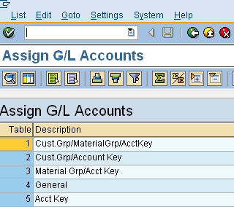
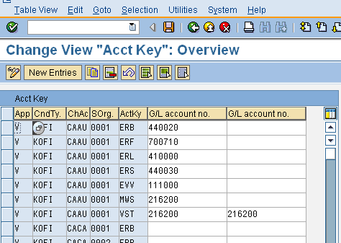
Assign G/L accounts
Here the assignment of the GL accounts to the condition tables as specified in the access sequence are done
Standard G/L account is determined based on :
Condition Type
Chart of Accounts
Sales Organization
Account assignment group of material
Account assignment group of customer
IMG > SD > Basic Functions > Account assignment > Define access sequence and account determination types > Define and assign account determination procedures > Assign GL account

Slide 75
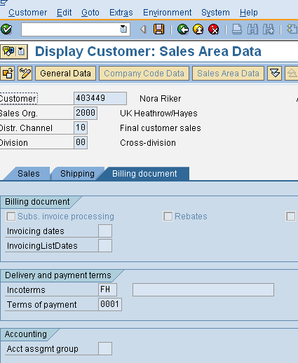
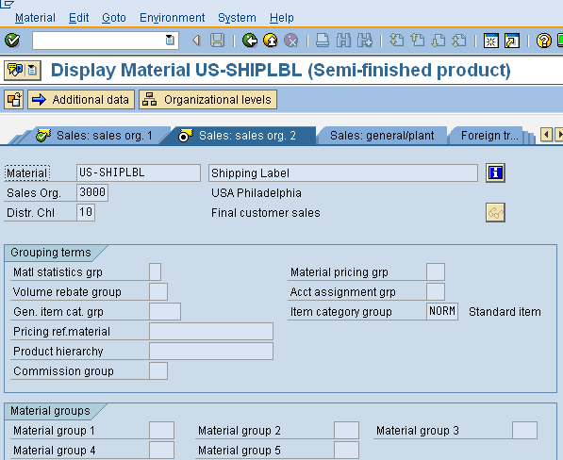
Master data to be maintained for Account
Determination
Customer Master
Material Master
Acct Assgmt group
In customer
master
Acct assgmt group
In material master

Slide 76
SD Basic Functions-Configuration
Part I
Partner Determination
Account Determination
Delivery & Transportation Scheduling
Output Control
Text Control
Incompletion Log

Slide 77
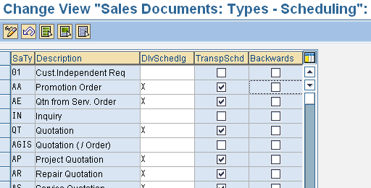
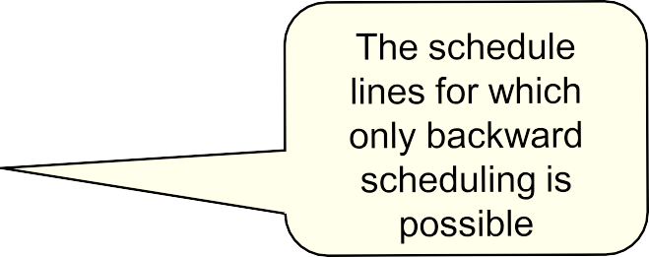
Define Scheduling by Sales Document Type
In this configuration activity you define for sales document type whether delivery scheduling and/or transportation scheduling should be carried out.
IMG > Logistics execution > Shipping > Basic shipping functions > Scheduling >
Delivery & transportation scheduling > Define scheduling by sales document type

Slide 78
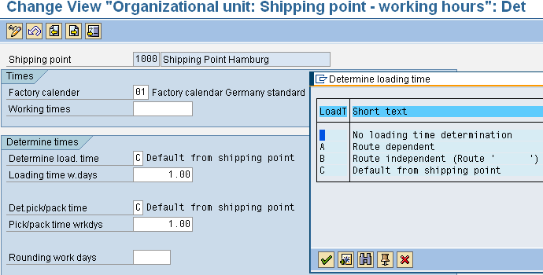
Define Scheduling by Shipping Point
Delivery scheduling takes pick/pack times and loading times into account. These times are dependent on the shipping point which is responsible for delivering the order item.
In this menu option you define the type of delivery scheduling for each shipping point
Influences the duration in hours / minutes if maintained
Time in
days
IMG > Logistics execution > Shipping > Basic shipping functions > Scheduling >
Delivery & transportation scheduling > Define scheduling by shipping point

Slide 79
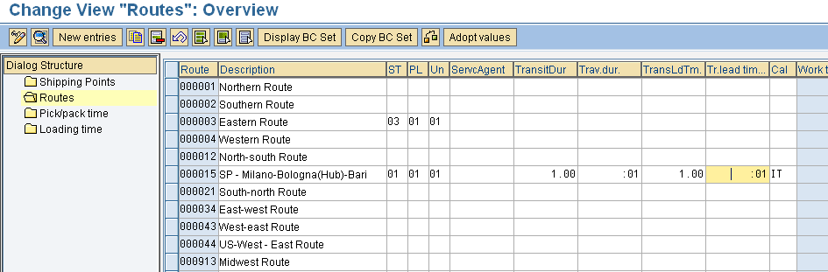
Maintain Duration
Transit time in Days or hours/minutes
Depending on the shipping point, the system uses the lead times either in calendar days or in hours/minutes (if the working hours have been maintained in the referring shipping point)
Transportation Lead Time in Days or hours / minutes
IMG > Logistics execution > Shipping > Basic shipping functions > Scheduling > Delivery & transportation scheduling > Maintain duration

Slide 80
SD Basic Functions-Configuration
Part I
Partner Determination
Account Determination
Delivery & Transportation Scheduling
Output Control
Text Control
Incompletion Log

Slide 81












Output Determination
Output determination is configured through SAP Condition Technique for the following :-
ORDER
Maintain Output control for sales order
DEIVERY
Maintain Output control for delivery doc.
BILLING
Maintain Output control for billing doc.
Apart from that output can be maintained for Sales Activities !

Slide 82
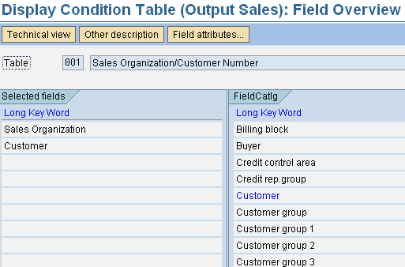
Maintain Condition Tables
Here we define the combination of fields for which we want to create output condition records in a condition table (Eg: for sales documents)
Field catalogue to select field
Key fields for output determination
IMG > SD > Basic Functions > Output control > Output determination > Maintain output determination for sales documents

Slide 83
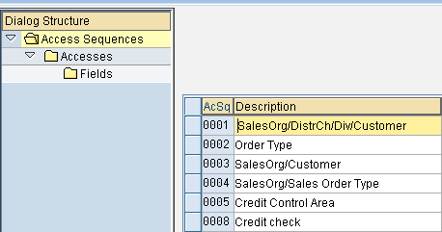
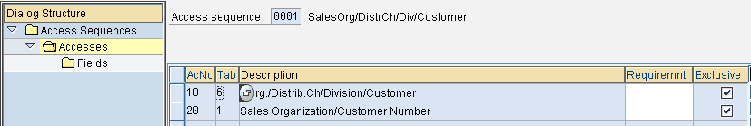
Maintain Access Sequence
The exclusive indicator signifies once the condition record is found, the control will not move to any other access
The condition tables
Condition tables with key fields for output determination

Slide 84
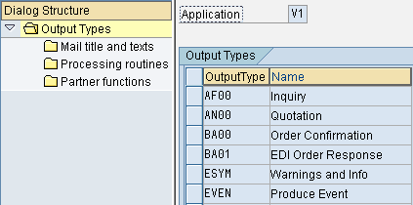
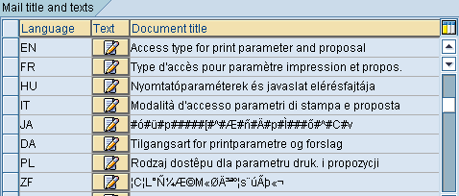
Maintain Output Types
Output Type specifies the kind of output to be produced
A description (maximum of 50 lines long) of a document, folder, distribution list or link
When faxing or printing, you can use parameters in the title, which are then evaluated when the document is sent. As a result, the sent documents can be identified more easily, for e.g., if you have specified the document number as a parameter
If you send faxes via SAP connect, the title appears in your outbox. If you print the message, the title appears in the spool list
Output
types

Slide 85
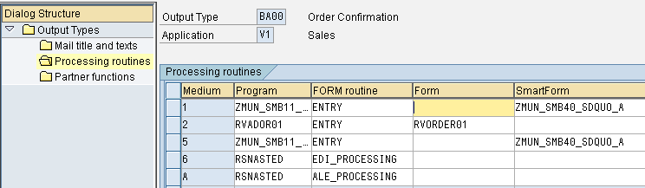
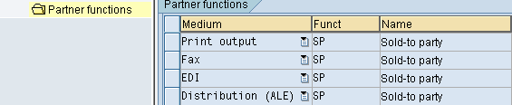
Maintain Output Types
The program that the
Routine to be called up in the processing program
A Form in the sap script is used for page layout
system calls up to process the output
Partner functions defined for output types

Slide 86
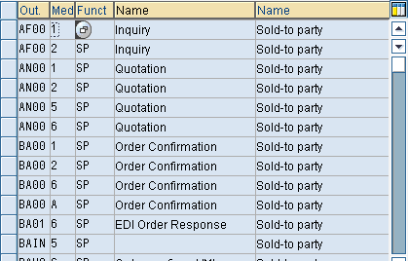
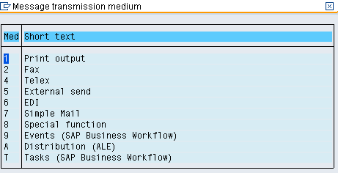
Assign Output Types to Partner functions
Here we assign each partner function to output type and medium. The medium signifies as to how the output is to be produced. For example, 1 is print output whereas 2 is fax

Slide 87
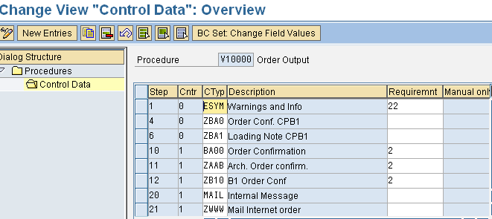
Maintain Output Determination Procedures
Here we maintain output determination procedures. We incorporate the previously created output types within the procedure by clicking “control data” tab
Output types assigned to the procedure
Requirements are routines which signify that the output determination takes into account the output type, if the reqmt. is fulfilled. E.g. :- 2 is order confirmation

Slide 88
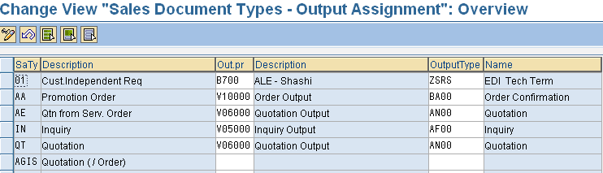
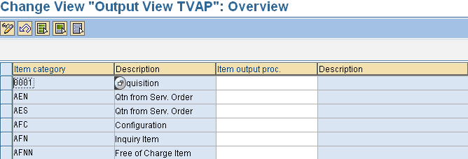
Assign Output Determination Procedure to
Sales Document Header & Items
Output Determination procedure
Output Determination procedure

Slide 89
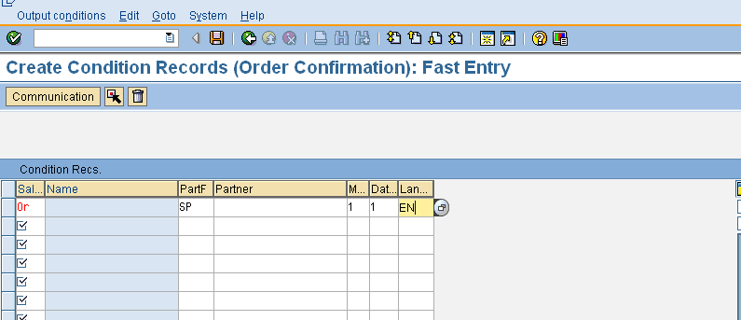





Output Condition Record - Create
Transaction Code: VV11

Slide 90
SD Basic Functions-Configuration
Part I
Partner Determination
Account Determination
Delivery & Transportation Scheduling
Output Control
Text Control
Incompletion Log

Slide 91


Text ID (Text Type)
The text ID defines the various types of texts related to a text object
Click here to maintain Text ID
Text Object Text Id
IMG > SD > Basic Functions > Text Control > Define Text Types

Slide 92

Text Procedure
Click here to maintain
/ change Text Procedure
Text Procedure
Text Procedure identifies a group of text types that you can use in, for example, a sales document header. The text procedure also determines the sequence in which the text types appear in the document

Slide 93

Access Sequence
Access sequence identifies an access sequence that the system uses to determine which text (s) should be copied into a sales, shipping, or billing document
Determines
Which text types are llowed
The sequence in which the text types are checked by the system
When you create a new access sequence, the system automatically assigns a new number

Slide 94

Text Procedure Assignment
Here we can assign the text procedures to sales document types or item categories or account groups
IMG > SD > Basic Functions > Text Control > Define and assign Text determination Procedure

Slide 95
SD Basic Functions-Configuration
Part I
Partner Determination
Account Determination
Delivery & Transportation Scheduling
Output Control
Text Control
Incompletion Log

Slide 96
Incompletion Procedure – Configuration
The following steps are involved in configuring incompletion procedure
Define incompletion procedures
Assign incompletion procedures
Define status groups

Slide 97


Define Incompletion Procedure
Select an incompletion group & click procedures to define a procedure
Define an incompletion procedure, for example 11 - procedure for sales order
IMG > SD > Basic Functions > Log of Incomplete Items > Define incompletion procedures

Slide 98

Define Incompletion Procedure
In the next step in incompletion procedure definition, we assign the fields to the procedure which should be checked for incompleteness as also if any warning message is to be issued if there are no data in the fields.
if checked gives a warning message if the field has no input
The fields assigned to procedure to check incompletion
The screen in which the correction can be done
The status groups, to be discussed later in this section

Slide 99


Assign Incompletion Procedures
Incompletion procedures are assigned to various incompleteness objects
IMG > SD > Basic Functions > Log of Incomplete Items >Assign incompleteness procedures

Slide 100

Define Status Groups
In the status groups we define which functions may be carried out by an incomplete SD documents or items
For example, setting “General” status in the status group and assigning the same to a field will cause the sales document to be incomplete, but will allow the document to be further processed
IMG > SD > Basic Functions > Log of Incomplete Items > Define Status Groups

Slide 101
SD Basic Functions-Configuration
Part II
Dynamic Product Proposal
Material Determination
Listing & Exclusion
Free Goods
Bonus Buy
Cross Selling

Slide 102










Dynamic Product Proposal
The following steps are involved in configuring dynamic product proposal
Sales doc. type
PP
Procedure
4 Assign Document Procedure to Sales Doc. Type
“OR”
PP
3 Define PP Procedure & Determine Access Sequence
Procedure
ORDER
2 Define Document Procedure for Product Proposal
Customer master
1 Define Customer Procedure for Product Proposal

Slide 103










Customer Procedure for Product Proposal
Define the Customer Procedures for Product Proposal
PP Cust Proc field in Customer master.
IMG > SD > Basic Functions > Dynamic product proposal > Define customer procedure for product proposal

Slide 104










Document Procedure for Product Proposal
Define the Document Procedures for Product Proposal
Assign the Document Procedures
to Doc. Types
IMG > SD > Basic Functions > Dynamic product proposal > Define document procedure for product proposal

Slide 105

Table of Origin (Source Indicator) for PP
Source Indicator that specifies which data source (for e.g., order history, item proposal, listing) system uses to determine the product proposal. The indicator is displayed in the sales document
If the same material for the product proposal is determined from several data sources (for e.g., from both the listing & the order history), the system always displays the data source that it accessed first
IMG > SD > Basic Functions > Dynamic product proposal > Maintain Table of Origin for Product Proposal

Slide 106


Dynamic PP Procedure
Number of periods that should be displayed in sales document
Name of function module that is to be called up within the access sequences for the product proposal procedure
Source Indicator
IMG > SD > Basic Functions > Dynamic product proposal > Define PP procedure and determine access sequence

Slide 107

Dynamic PP Procedure Determination
During a sales document processing the PP Procedure is determined for the combination of Sales Area and the Cus PP Procedure
Sales Organization
Distribution Channel
Division
Cus PP Procedure
PP
Procedure
IMG > SD > Basic Functions > Dynamic product proposal > Maintain Procedure
Determination

Slide 108
Dynamic PP Procedure Determination
During a sales document processing the PP Procedure is determined for the combination of Sales Area and the Cus PP Procedure
Sales Organization
Distribution Channel
Division
Cus PP Procedure
PP
Procedure
IMG > SD > Basic Functions > Dynamic product proposal > Maintain Procedure
Determination

Slide 109
SD Basic Functions-Configuration
Part II
Dynamic Product proposal
Material Determination
Listing & Exclusion
Free Goods
Bonus Buy
Cross Selling

Slide 110
Material Determination
The following steps are involved in configuring material determination
 | Defining Condition Tables, Access Sequence, Condition Type and Maintaining Determination Procedure Assigning Determination Procedure to sales document types.
 | 3 Define Substitution Reasons and Strategies.

Slide 111


Material Determination
Maintain pre requisites for determination procedure
Maintain Determination Procedure
IMG > SD > Basic Functions > Material determination > Maintain pre requisites for material determination

Slide 112



Material Determination
Assign Determination procedures to sales document types.
Determination procedure
Sales doc type
IMG > SD > Basic Functions > Material determination > Assign procedures to sales document type

Slide 113

Substitution Reasons
This is a reason for material substitution and specifies the reason why the system automatically carried out material substitution
Controls whether product selection should occur automatically in the background or whether the alternative materials should be offered for
selection in a dialog box
Controls whether the outcome of product selection should replace the original entry or whether it should be recorded as a sub item of the original entry
Indicates whether the system prints the name or number of the original material (before substitution) on corresponding output (for example, on order confirmations).
Indicates whether the system displays a warning message before substituting a material.
IMG > SD > Basic Functions > Material determination > Define substitution reasons

Slide 114

Condition Record - Create
Material entered in the order
Material for Substitution
T Code : VB11

Slide 115
SD Basic Functions-Configuration
Part II
Dynamic Product proposal
Material Determination
Listing & Exclusion
Free Goods
Bonus Buy
Cross Selling

Slide 116
Listing & Exclusion
The Listing & Exclusion is carried out by condition technique
1 Defining tables, Access Sequence, Condition Type and Maintain
Procedure
2 Assign Determination Procedure to Sales Document Types.

Slide 117
Listing & Exclusion
The Listing & Exclusion is carried out by condition technique
1 Defining tables, Access Sequence, Condition Type and Maintain
Procedure
2 Assign Determination Procedure to Sales Document Types.

Slide 118



Listing & Exclusion
IMG > SD > Basic Functions > Listing & Exclusion
Maintain Procedure
Procedures assigned to sales document types

Slide 119

Condition Record - Create
Listed / Excluded materials
T Code : VB01

Slide 120
SD Basic Functions-Configuration
Part II
Dynamic Product proposal
Material Determination
Listing & Exclusion
Free Goods
Bonus Buy
Cross Selling

Slide 121









Free Goods
The following steps are involved in free goods determination
1 Condition Technique – Defining Tables, Access Sequence,
Condition technique
Condition Type and maintaining Free Goods determination procedure
2 Determine item categories for free goods
Item categories
3 Control free goods pricing
Free goods pricing
4 Maintain copy control
Copy control

Slide 122


Free Goods Determination Procedure
Access sequence for free goods
Access sequence assigned to Condition type.
IMG > SD > Basic Functions > Free goods > Condition technique for free goods

Slide 123


Free Goods Determination Procedure
Pricing procedure for free goods
Free goods Pricing
Procedure Determination is dependent on
Sales org
D chnl.
▪Division
Doc. Pri. Pro.
▪Cust. Pri. Pro.
Pricing procedure determination for
free goods

Slide 124


Determine Item Categories for Free Goods
The Item Category for Free Goods (standard TANN) is determined as below. The determination combination has Usage as FREE and a Higher Level Item Category as TAN
IMG > SD > Basic Functions > Free goods > Determine item categories for free goods items

Slide 125




Control Free Goods Pricing
Pricing for Inclusive Free Goods without item generation
IMG > SD > Basic Functions > Free goods > Control free goods pricing

Slide 126

Maintain Copy Control
We maintain the copy controls at item category level. The control with the 'Structure/ NewFreeGoods' field is most relevant for free goods. Here we can control whether the free goods should also be transferred when you copy from one order to another, or whether we should re-determine them.
IMG > SD > Basic Functions > Free goods > Maintain copying control

Slide 127



Free Goods – Condition Data
Screen display
VBN1 – Create Free goods VBN2 – Change Free goods VBN3 – Display Free goods

Slide 128
SD Basic Functions-Configuration
Part II
Dynamic Product proposal
Material Determination
Listing & Exclusion
Free Goods
Bonus Buy
Cross Selling

Slide 129
Bonus Buy
The following steps are involved in configuring bonus buy
1 Defining Condition Tables, Access Sequence, Condition Type
Maintaining Pricing Schema.
Activation of Bonus Buy Determination.

Slide 130



Bonus Buy - Configuration
Condition table in access sequence
IMG > SD > Basic Functions > Bonus Buy

Slide 131


Bonus Buy Procedure
Bonus Buy
IMG > SD > Basic Functions > Bonus Buy
Activation of Bonus Buy Determination

Slide 132
SD Basic Functions-Configuration
Part II
Dynamic Product proposal
Material Determination
Listing & Exclusion
Free Goods
Bonus Buy
Cross Selling

Slide 133


Define Cross-selling Determination Procedure
IMG > SD > Basic Functions > Cross selling > Define determination procedure for cross selling

Slide 134



Maintain Customer / Document Procedure
Define customer procedures for cross selling
Define document procedures for cross selling
Assign document procedures to document types
IMG > SD > Basic Functions > Cross selling > Maintain customer/document procedures for cross selling

Slide 135




Define / Assign Cross Selling Profile
Define Cross Selling Profile
Assign profiles
IMG > SD > Basic Functions > Cross selling > Define and assign cross selling profiles

Slide 136

Customer Master data for Cross Selling
The field, 'PP cust Proc' in Customer Master Data needs to be updated in if the Cross-Selling is to be active
T Code : VD02

Slide 137

Condition Master Data
VB41 – Create Cross Selling VB42 – Change Cross Selling VB43 – Display Cross Selling
You can set up the system so that if a customer orders a specific article, a list of other suggested articles appears as well.

Slide 138
Important Transaction Codes
Transaction Codes | Application
VA01 / 02 / 03 | Create / Change / Display Sales Order
VV11 / 12 / 13 | Create / Change / Display Output for Sales Docs
SO10 | Maintain Standard Text
VB11 / VB12 / VB13 | Create / Change / Display – Material Determination
VB01 / VB02 / VB03 | Create / Change / Display – Listing / Exclusion
VBN1 / VBN2 / VBN3 | Create / Change / Display – Free
VA51 / VA52 / VA53 | Create / Change / Display – Item Proposal
VB41 / VB42 / VB43 | Create / Change / Display – Cross Selling

Slide 139
Additional Info
Item Proposal:
If a customer frequently buys the same product pallet, you can specify the item proposal number in the customer master record. Item proposals are stored independently of customers. The materials of an item proposal can be proposed by the SAP System as an entry tool during order processing
You can then:
Copy the materials as they are
Change the specifications and only copy some materials or partial quantity
You can only include the products in a product proposal for which you created a material master record
Item Proposal Types are technically stored as Sales Documents and are controlled by Item Proposal Type ( standard PV / MS )

Slide 140
Additional Info
The item proposal number thus generated can be added to a Customer Master Record and automatically called while creating an order
VA51- Create
VA52-Change
VA53-Display
VA55-List of Item Proposals

