Slide 1
SD Inter Company Sales

Slide 2
Lesson Objectives
Inter Company Sales
  Purpose
  Use
  Challenges
Intercompany Sales
  Pre-Requisites
  Posting of the Inter Company Invoice
Inter Company Sales: Flow
Configurations
  Master Data – Customer Configurations
  Master Data – Material Configurations
  Condition Type
  Master Data – Condition Records
Notes:
Add instructor notes here.

Slide 3
Lesson Objectives
Transaction Steps
  Transaction Steps – Order
  Transaction Steps – Delivery
  Transaction Steps – Billing
  Posting of the Inter Company Invoice
Transaction Codes
Steps
Tips and Tricks
Notes:
Add instructor notes here.

Slide 4
Inter Company Sales…?
Inter company sales is the process in which a certain legal entity sells products from within a delivering plant that does belong to another legal entity
A company arranges for direct delivery of goods to its customers from the stocks maintained by the other company, but belonging to the same corporate organization. Thus leading to Inter Company Sales
This prevents the company from over stocking the goods beforehand in the their own warehouse and can choose from whom to deliver the customer

Slide 5





Inter Company Sales
Order
XXXX
Cust Inv
$$$
Delivery
XXXX
Inter Co. Inv
Notes:
This In-house course was developed to meet the needs of SAP R/3 Consultants working at Capgemini. This course is designed to present a high level view of XXXX and to provide the Consultants with basic information about how to use this Functionality.
More in-depth courses have been developed to train Consultants in specific areas discussed during this course.
Your comments at the conclusion of this training session are appreciated and will help us better tailor future courses to meet your training needs.

Slide 6
Purpose
Occasionally we come across companies that operate several companies and carry on trading of goods and services among themselves. A Customer -Vendor relationship is established between them
The organization may be required to handle several production and sales companies. They have to ensure that the flow of documents between two companies adheres to the same overall organization
Prices need to be set up either as the cost price + extra charges or by trade agreements. Any change in values or information need to be synchronized immediately in the other company
A process shall enable to ensure the integrity of orders and documents in during sales

Slide 7
Use
Inter Company Sales process prevents the company from over stocking the goods beforehand in the their own warehouse and can choose from whom to deliver the customer
Enables all company codes to share information on inventories, tracking inter-company shipments, and viewing automatic FI postings and settlements
  Automatic Inter Company account reconciliation and settlement
  In-transit inventory visibility and reporting
  Workload reduction in processing invoices
  Eliminate invoicing errors
  Eliminates reconciliations

Slide 8
Challenges
What should be the transfer price for the inventory moving across the company codes
How should the postings-both units and valuation, be made to FI for the goods moved
Automatic synchronization and updates of trading documents

Slide 9
Inter Company Sales
Inter company sales processing allows a company to sell goods from a plant which is assigned to another company code
Inter company sales processing is initiated with the sales organization creating an order on the delivering plant belonging to a different company code
The system checks the company codes of the sales organization and of the delivering plant and automatically carries out inter company billing processing thru Inter Company Billing document

Slide 10
Inter Company Sales
The plant in the delivering company code delivers the goods to the customer for whom the sales organization placed the order
  Two billing documents are created in this case:
  A customer billing document which is sent from the sales organization to the customer who receives the goods
An Inter Company Billing document which is sent from the delivering plant to the sales organization

Slide 11




Inter Company Sales
Order
XXXX
1
Customer
1000
Ordering Sales Organization
2
A sales organization which is assigned to the ordering company code creates a sales order ordering goods from the plant assigned to another company code.
2
3000
Delivering Plant

Slide 12

Inter Company Sales
3000
3
3
Customer
Delivering Plant
The plant in the delivering company code delivers the goods to the customer for whom the sales organization placed the order.

Slide 13

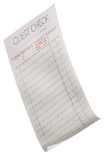
Inter Company Sales
3000
5
5
Ordering Sales Organization
1000
The delivering company then bills the ordering company for the goods delivered to the customer by means of Inter Company Billing document.
Delivering Plant
4
4
The ordering sales organization bills the customer for the goods delivered
Customer

Slide 14
Pre-requisites – Org’ Units
The ordering sales organization and delivering plant must belong to different company codes
Required combination of Sales Organization and Delivering Plants have to be maintained
Sales Area-Sales Organization, Distribution Channel and Division, must be assigned to all the plants in which Inter company sales processing is being carried out

Slide 15





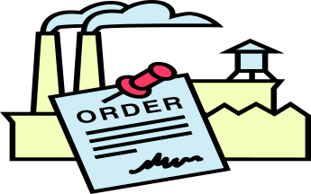

Pre-requisites – Org’ Units
ABC GROUP
Plant: Y
Plant:B
Plant:A
Plant:C
Plant: X
3000
1000
Company Code:1000
Company Code:3000

Slide 16
Pre-requisites – Others
Inter company Billing Document type must be assigned for required sales document types
An internal customer number must be created, to represent the ordering Sales Organization, in the Sales organization representing the delivering plant
Material must exist in all the plants participating in Inter Company Sales process
Condition types representing the Inter company sales processing is to be maintained in the pricing procedure
Condition records have to be maintained for the required combination of sales organization and plants

Slide 17
Posting of the Inter Company Invoice
The delivering company and the ordering company belong to the same corporation. Therefore, the inter company billing document for the delivering company is posted as invoice receipt for the ordering company
The ordering company can post an invoice receipt either:
  manually after posting goods issue and can print out an invoice document with the help of output type RD00, which is then sent to the end customer or
  automatically with the inter company billing document: via IDOC/EDI. The system uses the output type RD04 contained in the output determination procedure V40000, which is assigned to internal billing type
The delivering company must be created as a vendor to enable posting to the financial document of the ordering company

Slide 18
Inter Company Sales: Flow
CC 1000
CC 3000
1000
Sales Order
3000 Delivering Plant
Outbound Delivery
Post Goods Issue
Customer Invoice
Inter Company Invoice
Accounts Receivable
Accounts Payable
Accounts Receivable
IDOC

Slide 19
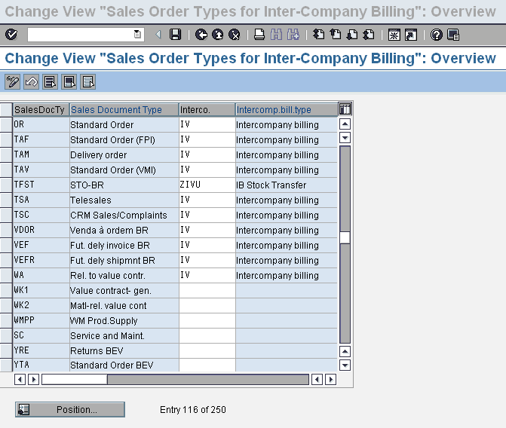
Configurations
Define Order Types For Inter company Billing:
  Inter company billing document type ‘IV’ is assigned to all those order document types for which inter company sales processing can be carried out.
Menu Path: IMG→ Sales & Distribution→Billing→Inter Company Billing→Define Order Types For Inter company Billing

Slide 20
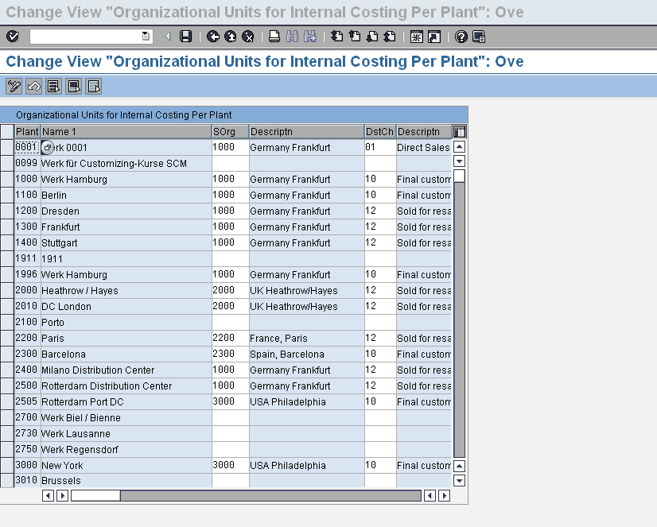
Configurations
Assign Organizational Units by Delivering Plant:
  Sales organization, Distribution Channel and Division are allocated to the plants for which intercompany sales processing is possible. The delivering plant uses these specifications to process intercompany billing.
Delivering Plant
Menu Path: IMG→Sales & Distribution→Billing→Inter Company Billing→Assign Organizational Units by Plant

Slide 21
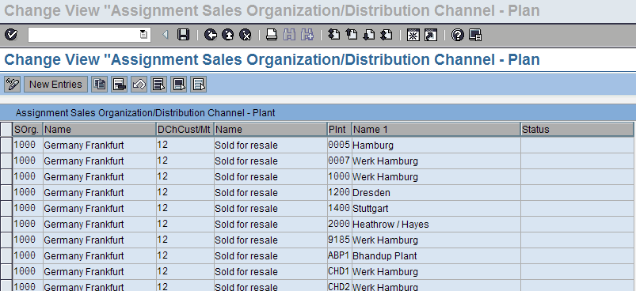
Configurations
Assign Plant to Sales Organization and Distribution Channel:
  Sales Organization and Distribution Channel have to be assigned to the Delivering Plant to enable sales processing.
Menu Path: IMG-> Enterprise Structure->Assignment->Sales and Distribution-> Assign Plant to Sales Organization and Distribution Channel.

Slide 22
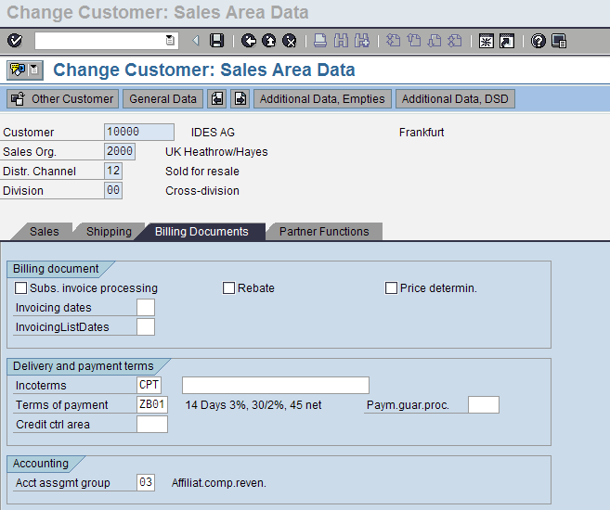
Master Data – Customer
Create Internal Customer Number By Sales Organization:
  A Customer Master record is to be created in the Sales Organization representing the Delivering Plant.
  The Internal Customer created represents that Sales Organization belonging to the ordering Company Code
Menu Path: Easy Access -> Logistics -> Sales & Distribution -> Master Data -> Customer -> Create. T-Code: XD01

Slide 23
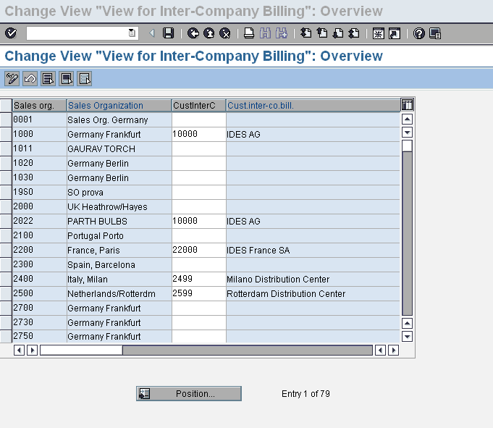
Configurations
Define Internal Customer Number By Sales Organization:
  The Internal Customer number has to be assigned to the Ordering Sales Organization
Menu Path: IMG-> Sales & Distribution ->Billing->Inter Company Billing-> Define Internal Customer Number By Sales Organization

Slide 24
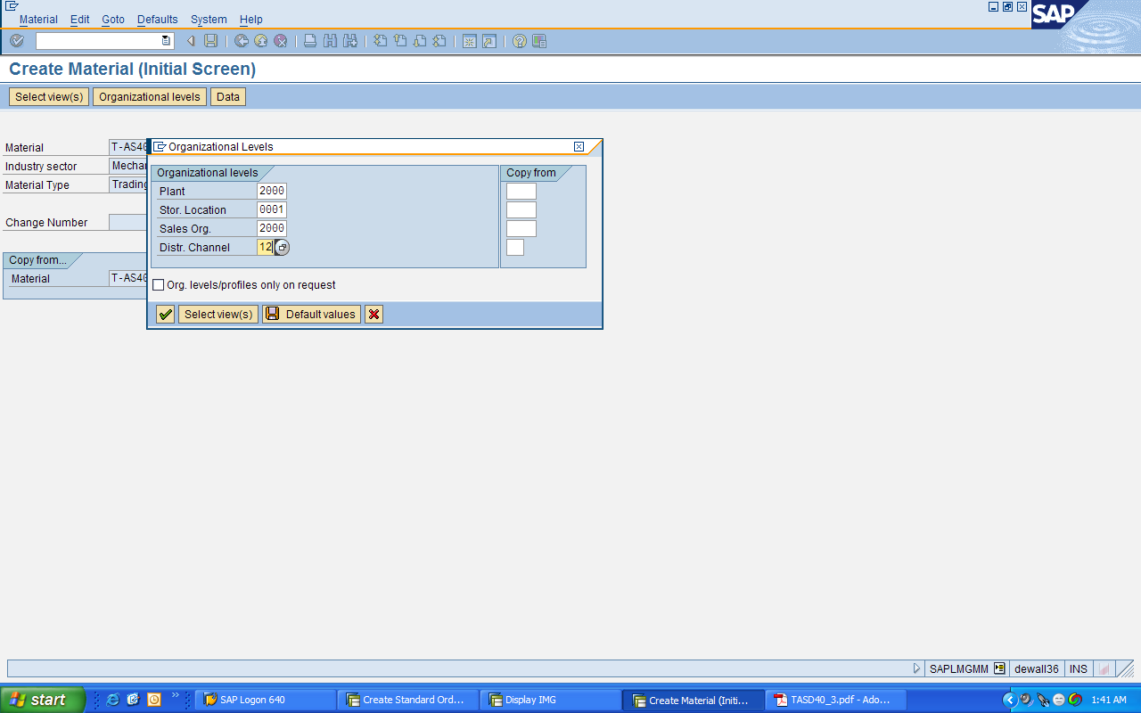
Master Data – Material
Extend the material in the Delivering Plant:
  Enter the Delivering Plant in the material records, which will be relevant for sales processes carried out by the Ordering Sales Organization.
Menu Path: Easy Access -> Logistics -> Sales & Distribution -> Master Data -> Products -> Material -> Other Material -> Change. T-Code: MM02

Slide 25
Configurations – Condition Type
Creating Inter Company Condition Types:
  The delivering plant uses one of the following condition types to bill the sales organization
  PI01 Inter company: fixed amount per material unit
  PI02 Inter company: percentage of the net invoice amount
  These condition types specify that the price charged by the delivering plant to the sales organization is shown as a statistical value in the sales order and an effective charge in the internal invoice
Menu Path: IMG → Sales and Distribution → Basic functions → Pricing → Pricing Control → Define Condition type
T-code: V/06

Slide 26
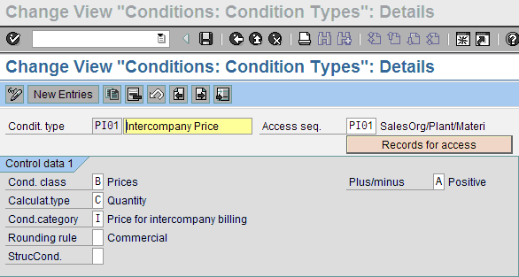
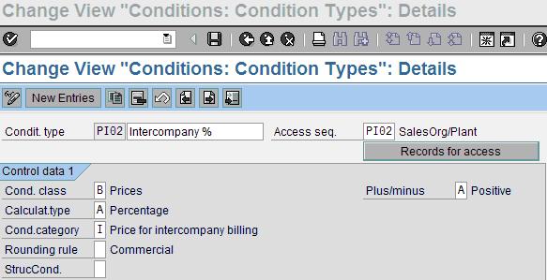
Configurations – Condition Type

Slide 27
Master Data – Condition Records
Creating Inter Company Condition Records:
  PI01 Inter company: fixed amount per material unit
  PI02 Inter company: percentage of the net invoice amount
Menu Path: Easy Access →Logistics → Sales and Distribution → Master Data → Conditions → Select using Condition Type → Create
T-Code: VK11

Slide 28
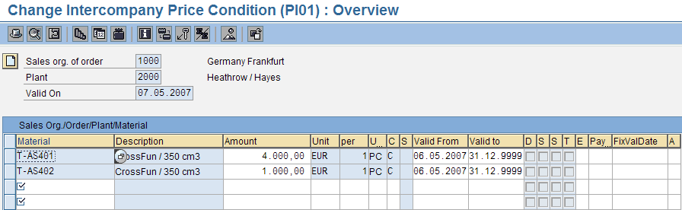
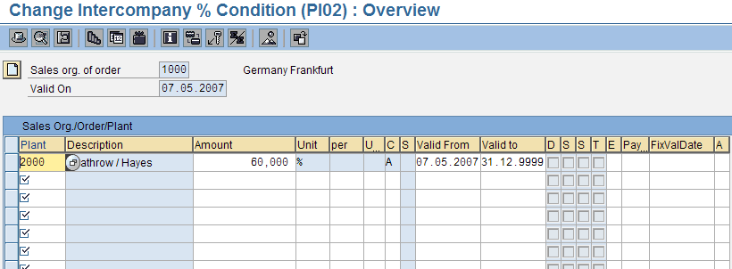
Master Data – Condition Records

Slide 29
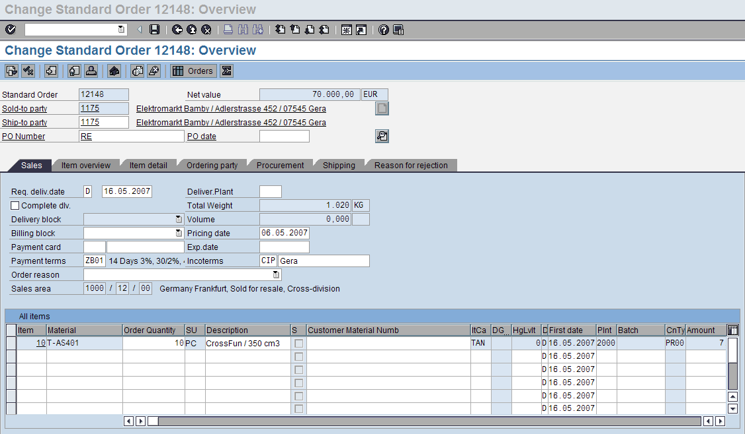
Transaction Steps - Order
Create Order: The ordering Sales Organization prepares the sales order
The system checks for the company codes and the permissible combinations of the ordering sales organization and delivering plant, to carry out the Inter company Billing process
Menu Path: Easy Access -> Logistics -> Sales & Distribution -> Sales -> Order -> Create. T-Code: VA01

Slide 30
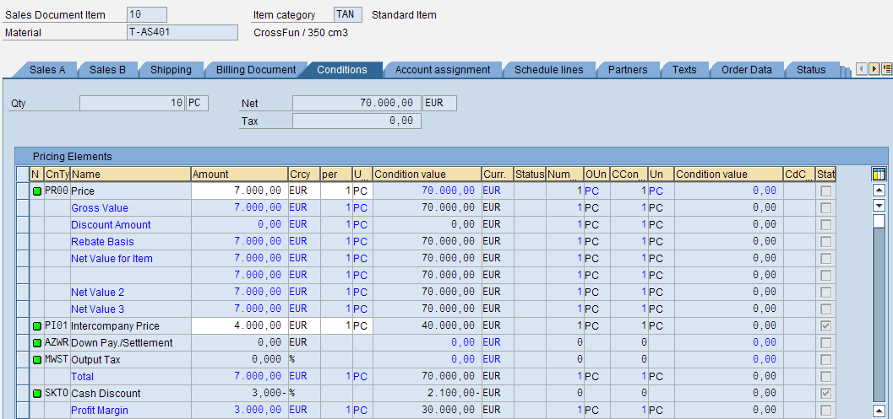
Transaction Steps - Order
The system automatically carries out pricing a per the pricing procedure assigned to the sales organization
The inter company charge (PI01/PI02) appears in the conditions screen of the sales order as a statistical value -the charge has no effect on the final value of the sales order for the customer
The inter company charge is not printed out on documents for the customer
Statistical Condition value
Menu Path: Easy Access -> Logistics -> Sales & Distribution -> Sales -> Order -> Create. Code: VA01

Slide 31
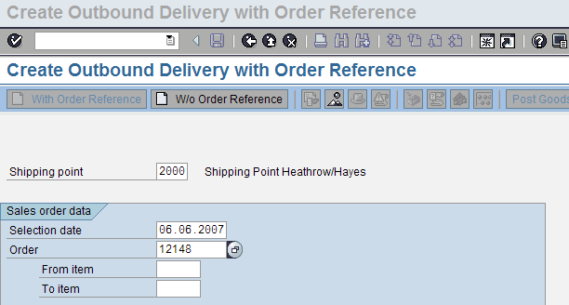
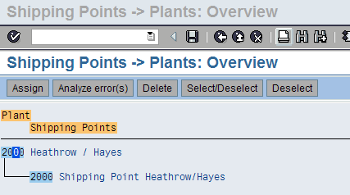
Transaction Steps - Delivery
The Delivery is created by the Ordering Company from the Shipping Point which is assigned to the Delivering Plant
Menu Path: Easy Access →Logistics →Sales & Distribution→ Shipping and Transportation→ Outbound Delivery→ Create→ Single Document→ With ref to Sales Order. T-Code: VL01N

Slide 32
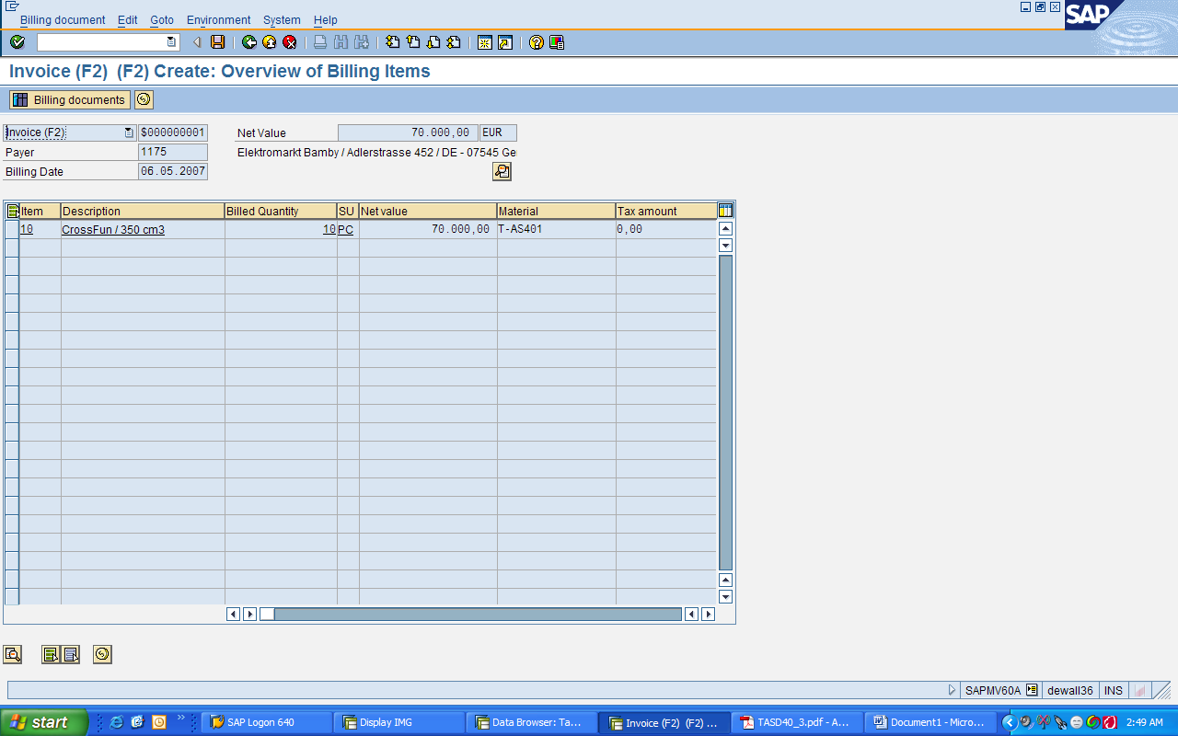
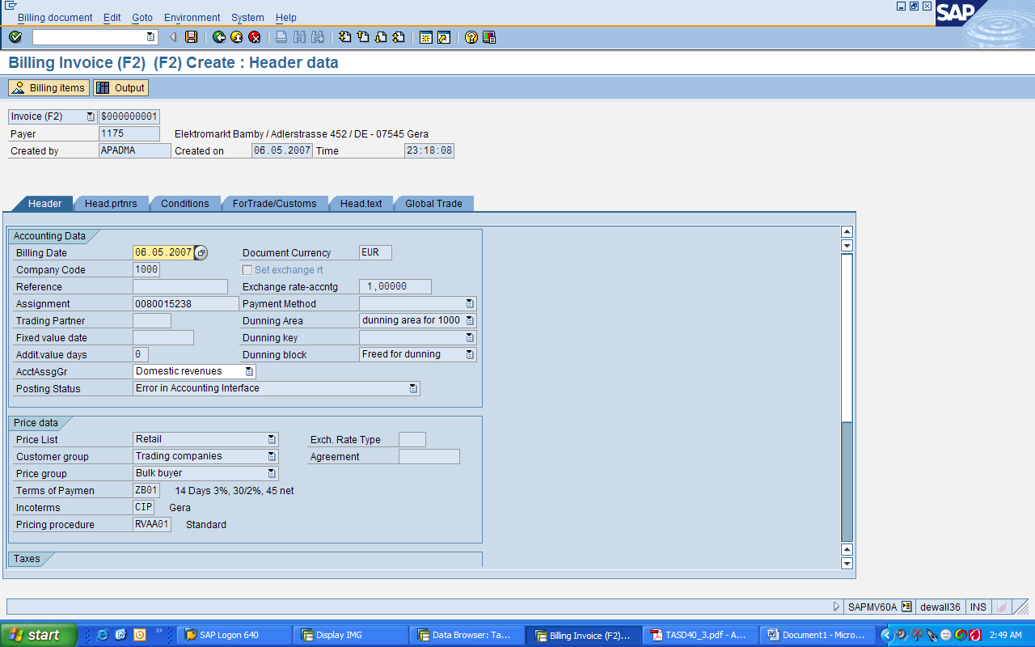
Transaction Steps - Billing
The Ordering Company creates the invoice for the end customer
The Payer and the Company Code are derived from the Order created by the Ordering Company Code
Menu Path: Easy Access -> Logistics -> Sales & Distribution -> Billing -> Billing document -> Create. T-Code: VF01

Slide 33
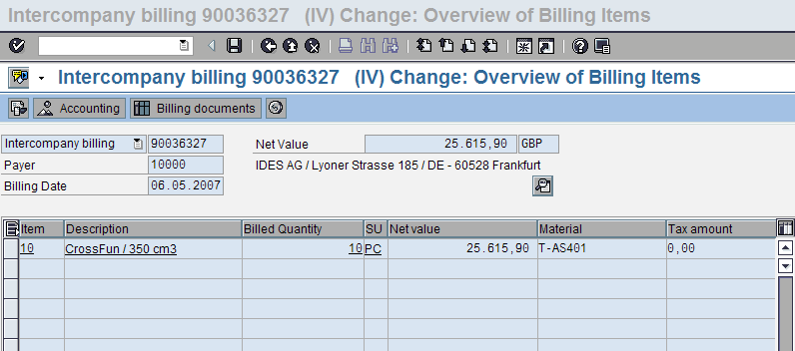
Transaction Steps - Billing
The Company associated with the Delivering Plant bills the Ordering Company thru the means of Inter Company Billing document.
The Payer and the Company Code are derived from the Order created by the Ordering Company Code.
Menu Path: Easy Access -> Logistics -> Sales & Distribution -> Billing -> Billing document -> Create. T-Code: VF01

Slide 34
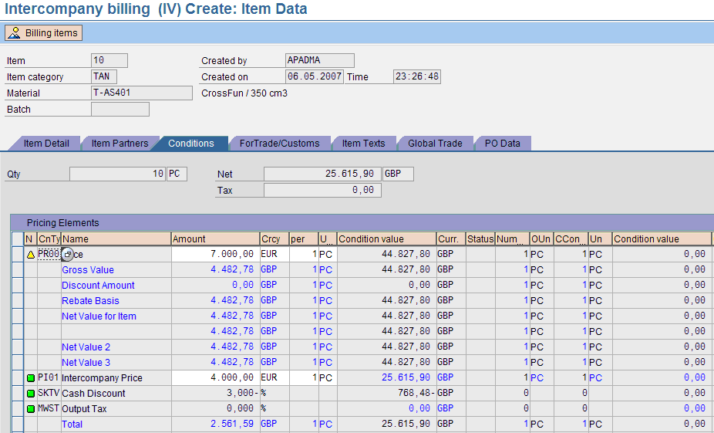
Transaction Steps - Billing

Slide 35
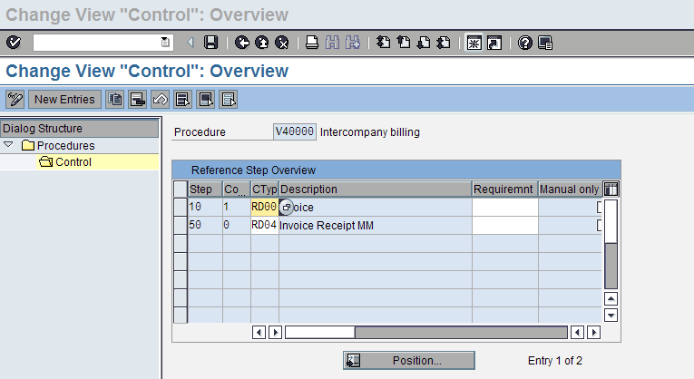
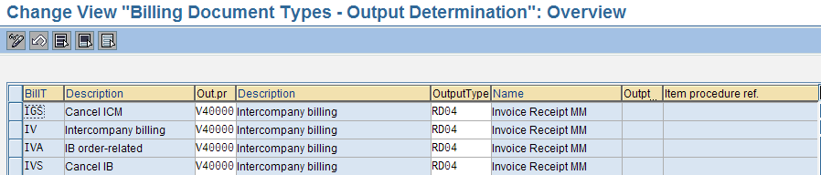
Posting of the Inter Company Invoice
Manual posting of the invoice is done after good issue & system prints invoice document with the help of output type RD00, which is then sent to the end customer. Automatic posting of the inter company billing document is done via IDOC/EDI. The system uses the output type RD04 contained in the output determination procedure V40000, which is assigned to internal billing type

Slide 36
Transaction Codes
IMG→Sales & Distribution→Billing→Inter Company Billing
OVV8 | Define Order Types For Inter company Billing
OVV9 | Assign Organizational Units by Delivering Plant
OVX6 | Assign Plant to Sales Organization and Distribution Channel
XD01 | Create Internal Customer Number By Sales Organization
OVVA | Define Internal Customer Number By Sales Organization
MM02 | Extend the material in the Delivering Plant
V/06 | Create Inter Company Condition Types-PI01
VK11 | Create Inter Company Condition Records
VA01 | Create Order
VL01N | Create Delivery
VF01 | Create Standard Invoice
VF01 | Create Inter Company Invoice

Slide 37
Steps
Step | Menu Path / T Code | Expected Result
1. | Menu Path : IMG-> Sales & Distribution ->Billing->Inter Company Billing-> Define Order Types For Inter company Billing | ‘Change View “Sales Order for Inte-Comapny Billing”: Overview ‘ screen appears
2. | Assign Inter-Company document type “IV” against the required order document type and Save | The system accepts the input and Data is saved
3. | Menu Path: IMG-> Sales & Distribution ->Billing->Inter Company Billing-> Assign Organizational Units by Plant. | ‘Change View “Organizational Units for Internal costings per Plant”: Overview ‘ screen appears
4. | Assign Sales Organization and Distribution Channel to the Delivering Plant and Save | The system accepts the inputs and Data is saved
5. | Enter Tcode: XD01 | ”Customer Create “ : Initial Screen” appears
6. | Enter the data relevant to represent the ordering sales organization. Eg:Address, currency, Delivering Plant, Payment Terms, etc and Save | System Displays the message “Customer XXXX saved”
7. | Menu Path: IMG-> Sales & Distribution ->Billing->Inter Company Billing-> Define Internal Customer Number By Sales Organization | ‘Change View “View for Inter-Company Billing”: Overview’ screen appears.

Slide 38
Steps(Continued…)
Step | Input | Expected Result
8. | Assign the Internal Customer created in the step: 6 to the ordering Sales Organization and Save | The data gets saved.
9. | Enter T code MM02 | “Change Material (Initial screen)” appears
10. | Enter the Delivering Plant in the material records and Save. | System displays message : Material XYZ saved”
11. | Call Transaction VK11 and enter the required condition type and maintain data. | ‘Create ZZCC Condition (Fast Entry )’ screen appears and the system accepts and saves the data entered.
12. | Call Transaction VA01 | ‘Create ZZZZ Sales Order : Initial screen’ appears
13. | Enter Order Type, Sales Organization, Distribution Channel & Division | ‘Create ZZZZ Order: Overview’ screen appears
14. | Enter Sold-to party, PO no, Material no. , Quantity and the Delivering Plant. | The system accepts the inputs and displays the Net Value of the order on the top.
15. | Navigate to Goto→Item→Conditions | ‘Create ZZZZ Order : Item Data’ screen appears Check condition types PI01/PI02. They do not affect the Net price of the item.
16. | Go back after save the order. | System displays the message “ ZZZZ Order ZZXX has been saved”
17. | Call TCode: VL01N | “Create Delivery: Initial Screen “appears.

Slide 39
Steps(Continued…)
Step | Input | Expected Result
18. | Enter the shipping point and Order no created in the step 17 | “Create Outbound Delivery with Order Reference” screen appears
19. | Complete Picking and PGI activities and save the Delivery. | System displays message “ Delivery No ZZYY Saved”
20. | Call Tcode: VF01 | “Create Billing: Initial Screen” appears.
21. | Enter the Delivery document created in the Step:19 and Save. | Note the invoice value is based on the sale price derived from the order document. System displays the message “Invoice ZZFF is saved”
22. | Again call Tcode: VF01 | “Create Billing: Initial Screen” appears.
23. | Enter the same Delivery document created in the Step:19 and select the billing type as “IV” | “Intercompany Billing : Overview screen appears”
24. | Check the Payer, Net Value of the Invoice | Internal customer no assigned to the ordering sales organization in the Step: 8 is displayed as the Payer. Net Value of the Inter Company invoice is different from the value of the invoice created in Step: 10.
25. | Navigate to Goto→Item→Conditions | The net value of the item is based on values of Inter Company conditions - PI01/PI02.
26. | Save the invoice | System displays the message “Invoice ZZII is saved”

Slide 40
Tips and Tricks
  For the system to determine another delivering plant for the material in the customer order item, when entering a sales document:
    Ensure that the same delivering/supplying plant is maintained in the Customer material info record, if any
    The internal customer master for the delivering sales organization must also contain the same plant
  The delivering company must be created as a vendor to enable posting to the financial document of the ordering company

