Slide 1
SD Master Data

Slide 2
Lesson Objectives
Master Data
Purpose
Use
Challenges
SD Master Data – Types
Customer Master
Material Master
Customer-Material Info Record (CMIR)
Condition Master
SD Master Data - Customer
Customer Master - Account Group
Customer Master Record
Customer Master – Transactions
Customer Master – Create
Notes:
Add instructor notes here.

Slide 3
Lesson Objectives
Customer Master – CIN Details
Customer Master – Extras & Environment
SD Master Data – Material
Material Master - Material Type
Material Master - Configuration
Material Master - Transactions
Material Master - Create
Material Master – Views
Customer Master – Mass Maintenance
Material Master – Mass Maintenance
Master Data – Customer Material Info
Notes:
Add instructor notes here.

Slide 4
Lesson Objectives
SD Master Data - Condition
Condition Master – Example
Condition Technique – Example
Condition Type – Controls
Pricing Procedure
Condition Record – Create
Condition Record – Functions
Condition Master – Output
Condition Master – Texts
Condition Master – Free Goods
Condition Master – Material Determination
Condition Master – Cross Selling
Notes:
Add instructor notes here.

Slide 5
Lesson Objectives
Condition Master – Listing & Exclusion
Transaction Codes
Review Questions
Tips and Tricks
Additional Info
Notes:
Add instructor notes here.

Slide 6
Master Data
The facts describing your core business entities: Customers, Suppliers, other business partners, products, chart of accounts, & employees
The high value information an organization uses repeatedly across many business processes
Master Data is critical because it provides the business context by providing concrete data models for business processes
Ensures consistent master information across transactional and analytical systems

Slide 7
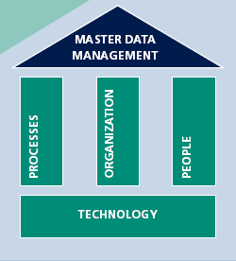
Purpose
Data is spread across many systems. We don’t know which data is right.
Compiling reports is very difficult
Lack of Master data may lead to:
Repetitive Data entry
Inconsistency
Erroneous data leading to rework, unhappy customers or loss of revenue
Large amount of training impact to train the users on data entry on various screens
Unproductive use of time

Slide 8








Use
Engineering
Quality
Production
Master Data
Sales
Accounting
Purchasing
Ware housing
Master data is centrally stored (shared across departments) and processed to eliminate data redundancy
Master Data helps in keeping validation & fast user entry for transactions
One time creation of data which is rarely changed. Only the incremental data required to be maintained

Slide 9

Challenges
Relevant Data
Different Part Numbers in different Systems
Duplicated parts in distributed but also local systems
Unnecessary efforts for order handling & warehousing
Materials
(What?)
Different Customer Numbers in different systems
Time consuming manual effort, still unsatisfying result as a basis for negotiating with & managing customers by giving comprehensive feedback
Customers
(To Whom?)
Different terms & conditions in different systems
High manual efforts to verify contract compliance
Lack of information leading to loss of sales
Terms & Conditions
(At what price?)

Slide 10







SD Master Data - Types
MASTER DATA
Pricing
Condition Master

Slide 11

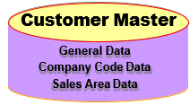
Customer Master
The customer master contains all customer-relevant data necessary for processing inquiry,
quotation, order, delivery, invoice and
customer payments
Depending on the Configuration settings,
Customer Masters can have System generated or manually assigned numbers
Mostly customers will belong to one Sales Area. They can also be extended to many other sales areas. During order entry SAP will prompt you to choose the relevant one

Slide 12


















Material Master
Basic
Data
Same Material can be used by different Departments, hence material has many Views
Material Master has Main Views (Basic Data, MRP, Purch. Org) and Additional Views (UOM, Text, etc.)
In Material Master some views are maintained at Client Level whereas the others are maintained at other Orgaizational levels, e.g. Plant Level, Sales Org/Dist Channel level, etc
The data in Material Master is either descriptive (name, size, etc) or can control certain functions (material group, procurement key, etc.)
Material Master has ~ 800 fields
Calssi fication
Material Planning
Forecast
Stock Plant/Sloc
Quality
Material Master
Accounting
Work Schedule
S&D
Purchasing
Storage
Ware house
Material Master
Additional Data
Text
UOM
Addition Document EAN Data
Consumption

Slide 13
Customer-Material Info Record (CMIR)
Customer Material Info Record is used to store the information about how a particular material is referred by a customer
Customer-Material Info Record has priority over Customer Master & Material Master data. For example during Delivering Plant determination the CMIR is accessed first (then, if plant information is not maintained there, system tries to determine it from Customer Master, etc.)

Slide 14


Customer-Material Info Record (CMIR)
Purchase Order
Sales Order
Item Description Qty
OE-952 Photocopier 1
Item Description Qty
157-E24 Xerox machine 1
Customer’s
Business
part number and description
(Yours) part number and description

Slide 15
Condition Master
Condition Master is stored in the form of Condition record (information on prices, texts, partners, substitute materials etc.) During sales order processing, the system uses the condition technique to determine these data
The configuration for Condition Technique works as follows:
Define condition types for each elements
Define the condition tables that enable you to store and retrieve condition records for each of the different condition types
Define the access sequences that enable the system to find valid condition records
Group condition types and establish their sequence in pricing procedures.
Once this set up is done you maintain Condition records that allow you to store and retrieve the data in the system

Slide 16
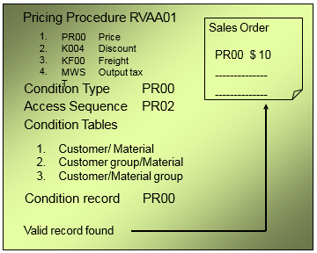
Condition Master

Slide 17
SD Master Data
Customer
Material
Conditions

Slide 18
Customer Master - Account Group
Account Group is a classification of customer master record
Account Group controls
Which fields in the master record are required or optional
Number range for the customer account number (external or internal)
Whether it is one-time account
Default value for pricing procedure indicator
IMG →Logistics General→Business Partner→Customers →Control

Slide 19
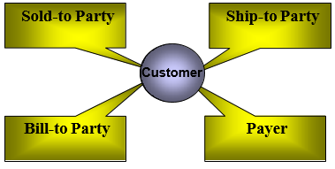
Customer Master - Account Group

Slide 20
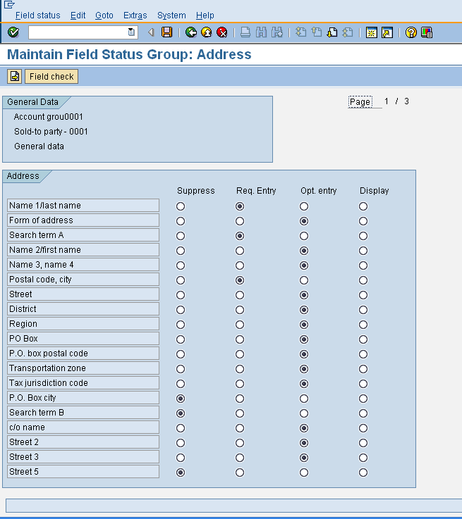
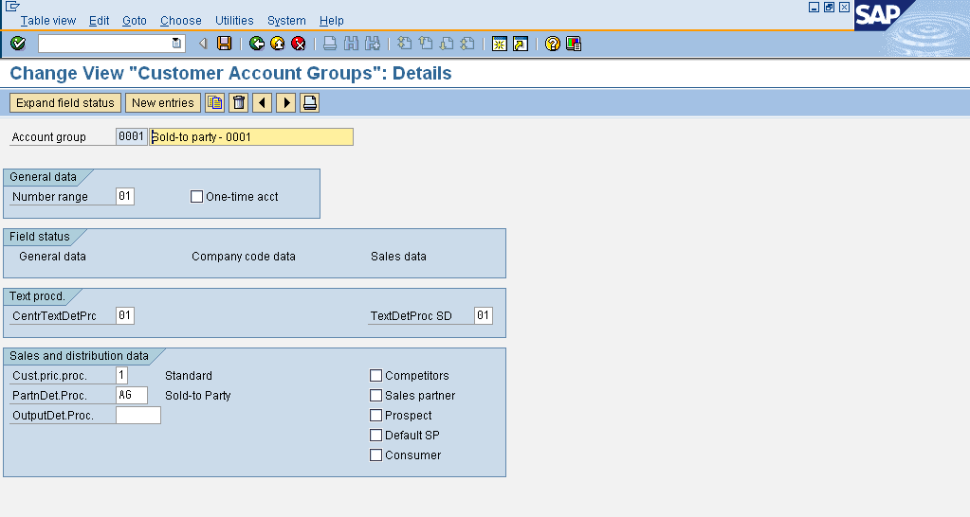
Customer Master - Account Group
Can be defaulted in the Master Record
To configure an account group: IMG →
Logistics General → Business Partners
→ customers → controls → Define account groups and field selection for customer

Slide 21




Customer Master Record
General Data
Client
Accounting
Company Code
Sales
Sales Area
Balance
Sheet
Sales Area & Company Code Data maintained centrally as well as independent of each other
Data on the client level can be used by all company codes

Slide 22




Customer Master Record
Options for Customer Data
XD01 - Create Customer (complete)
Customer
XD03 - Display Customer (complete)
VD03 – Display Customer ( S&D) FD03 – Display Customer ( FI)
VD01 – Create Customer ( S&D)
FD01 – Create Customer ( FI)
Create
Change
Display
Create
Create Centrally
Change
Change Centrally
Display
Display Centrally
XD02 - Change Customer (complete) VD02 – Change Customer ( S&D)
FD02 – Change Customer ( FI)

Slide 23












Customer Master - Transactions
Transaction Codes | Application
VS00 | SD Main Menu for Customer
XD01 | Create Customer (Centrally)
XD02 | Change Customer (Centrally)
XD03 | Display Customer (Centrally)
XD04 | Customer Changes (Centrally)
XD05 | Block Customer (Centrally)
XD06 | Mark for Deletion (Centrally)
XD07 | Change Customer Account Group
XD99 | Mass Maintenance: Indus. Matl Master
VXBC | List of Blocked Customers

Slide 24
Customer Master - Create
Customer Master creation needs the following pre-requisites:
Defined Account Groups
Defined internal or external number ranges
SD Organizational Data
Customer Master can also be created with reference to an existing record

Slide 25
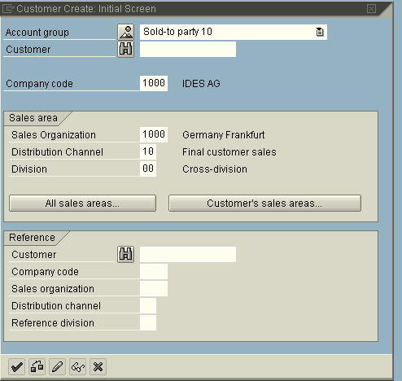
Customer Master - Create

Slide 26
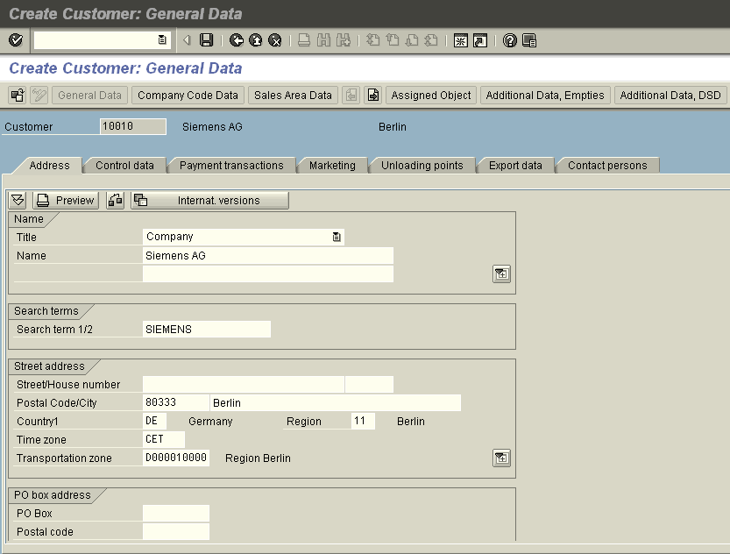
The General data is created at client level. It contains Address, Control Data, Payment Transactions, Marketing, Unloading Points, Export Data & Contact Person information
Customer Master- General Data

Slide 27
Customer Master – General Data
Important Fields | Screen | Application
Search Term | Address | Short description used for search helps. All entries are automatically converted into capital letters. There are two such fields for search terms which can be used independently of each other.
Transportation Zone | Address | The system automatically proposes a suitable route by using the transportation zone of the goods recipient in combination with other information about the delivery, such as the Countries of origin and destination, Shipping conditions & Transportation group.
Country Key | Address | The country key contains information which the system uses to check entries such as the length of the postal code or bank account number.
VAT Registration number | Control Data | The VAT registration number is used within the EU for tax-exempt deliveries for the "EC sales list". The check rules are defined for each EU country and cannot be changed.
Vendor | Control Data | In case of Stock transfer one plant to another plant. The plant will needs to created as customer & a vendor. The code is maintained in both the masters.
Industry | Marketing | Industry code can be used for reporting analysis. (for example) Industry wise sales of the customers).
Customer Classification | Marketing | The customer can classified as per the reporting requirements for that industry & can be used for reporting.

Slide 28



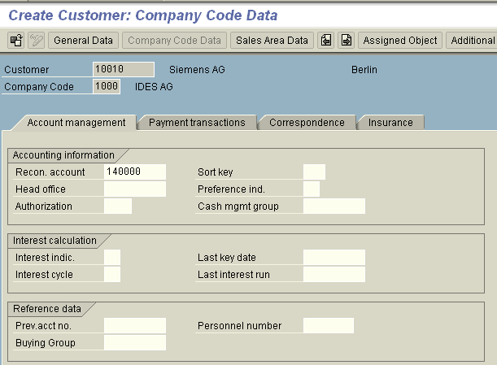
Customer Master – Company Code Data
Maintained at Company code level.
Contains Account Management, Payment Transaction, Correspondence & Insurance related Information
Is maintained in Company Code view

Slide 29

Customer Master – Company Code Data
Important Fields | Screen | Application
Reconciliation Account | Account Management | This is a mandatory field. The reconciliation account in G/L accounting is the account which is updated parallel to the sub ledger account for normal postings.
Payment Methods | Payment Transactions | List of payment methods which may be used in automatic payment transactions with this customer/vendor if you do not specify a payment method in the item to be paid.
Terms of payment | Payment Transactions | Key for defining payment terms composed of cash discount percentages and payment periods.
Dunning Procedure | Correspondence | When the customer needs to be send reminders for payment. Then dunning procedure can be maintained.
Policy Number | Insurance | In case of export credit insurance, the policy number & amount insured etc details are maintained in Insurance screen

Slide 30

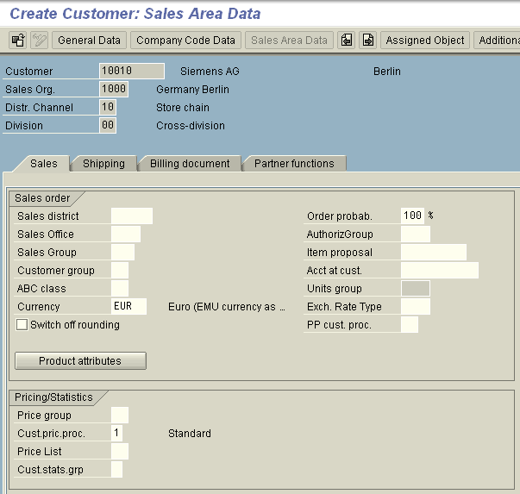
Customer Master – Sales Area Data
Sales Area Data contains data related to:
Sales
Shipping
Billing Document
Partner Functions

Slide 31
Customer Master – Sales Area Data
Important Fields | Screen | Application
Sales office | Sales | Sales Office defines Geographical aspects of the organization in business development and sales. Used for Reporting.
Sales group | Sales | The staff of a sales office may be subdivided into sales groups. Used for Reporting.
Customer pricing procedure | Sales | Determines which pricing procedure the system should apply when you create a sales document for the customer.
Customer Statistics Group | Sales | Specifies a statistics group for this customer and helps determine which data the system updates in the logistics information system.
Shipping Conditions | Shipping | General shipping strategy for the delivery of goods. The Shipping condition along with other entities determine the shipping point & Route proposed by the system.
Account Assignment Group | Billing | Group of customers with the same accounting requirements. The grouping can be domestic customers, foreign customer, an affiliate customer etc.
Tax classification | Billing | The indicator with which the system determines output tax for the customer when processing sales and distribution-specific documents.

Slide 32

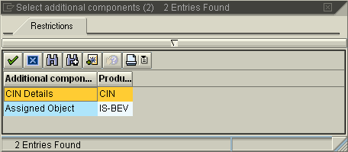
Customer Master – CIN Details
Additional Component - CIN details enables you to capture the tax related information for the customer
This information can be maintained either in customer master additional component - CIN details or in J1ID – CIN master data transaction

Slide 33

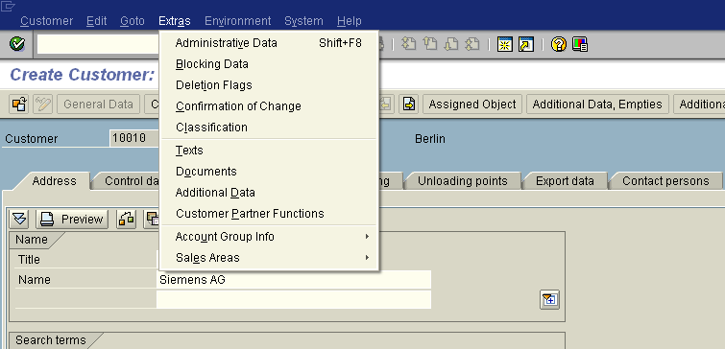
Customer Master - Extras & Environment
Extras Menu : Customer Account Group details, Blocking Data, Deletion Flags, Text data can be maintained
Field Changes Account Groups Credit Management
Customer Material Information List Documents
Customer Hierarchy Sales Summary Internet Services Assigned Object
>
>
>
Ctrl+Shift+F12
Environment Menu : Field Changes, Administrative data and other related information can be displayed.

Slide 34
Customer Master – Extras
Options for Maintaining Customer Master Data | Purpose
Blocking Data | This contains blocking of customer at company code level and Sales Areas level. The posting Block can be for All Company code or Selected Company Code. The Sales & Distribution Blocks can be for All Sales Areas or Selected Sales Area for Order, Delivery , Billing & Sales Support Blocks.
Deletion flag | The customer can be flagged for deletion for All Sales Areas or Selected Company Code or Selected Sales Area. The deletion blocks can be for General Data or Selected company code including general data. Data records such as Customers & Materials can be flagged for deletion but they do not get deleted from the system and can be used to process a transaction. To avoid any confusion, the name / description of these records is changed to <DO NOT USE xxxx>.
Administrative Data | It shows for which account group that customer is created. What levels ( i.e. General Data, Company Code Data and Sales Area Data) , it has been created by whom & when.
Confirmation of Change | The confirmation of change status can be given central or at company code level with changes to sensitive field. The current status can be confirmed or rejected.
Text | The customer master text can be maintained for General data level applicable at client level and / or Company code and / or sales area data level.
Customer links to Documents | Any documents / records with version applicable for that customer can be linked in the customer master data.
Additional Customer Data | SAP provides 10 freely definable fields for attributes & 5 additional fields for condition determination & pricing.

Slide 35

Customer Master - Environment
Options for Maintaining Customer Master Data | Purpose
Account Changes | This functionality allows you to view changes to all fields or changes to the sensitive fields( for example Payment Terms). Sensitive fields need to be configured so in Customizing in FI menu. The changes include Deletions if any.
Customer Material Information | This menu option directly takes you to the view of the customer material info records VD53 transaction.
Credit Management | This search criteria takes you to the customer credit management FD33 transaction for the to view the credit limit details of the customer.
List Documents | This functionality allows you to view list of documents ( Inquiries, Quotations, Orders, Contracts, Deliveries & Billing documents) created for that customer.

Slide 36
SD Master Data
Customer
Material
Conditions

Slide 37
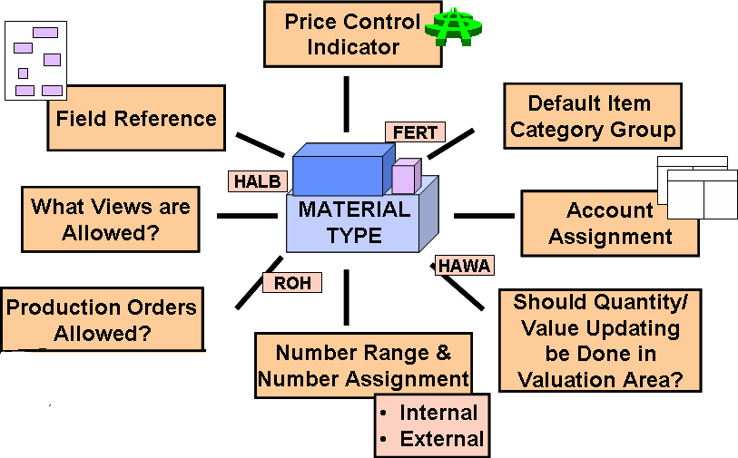
Material Master - Material Type

Slide 38
Material Master - Material Type
Configure material types:
IMG → Logistics General →Material Master →Basic Settings →Material Types →Define Attributes for Material types

Slide 39
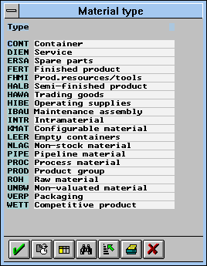
Material Master - Material Type
When creating a material master record, the user must assign the material to a material type
Materials with the same basic attributes are grouped together and assigned to a material type
Permits user to manage different materials in a uniform manner in accordance with your company’s requirements
The material type determines certain attributes of the material and has important control functions

Slide 40
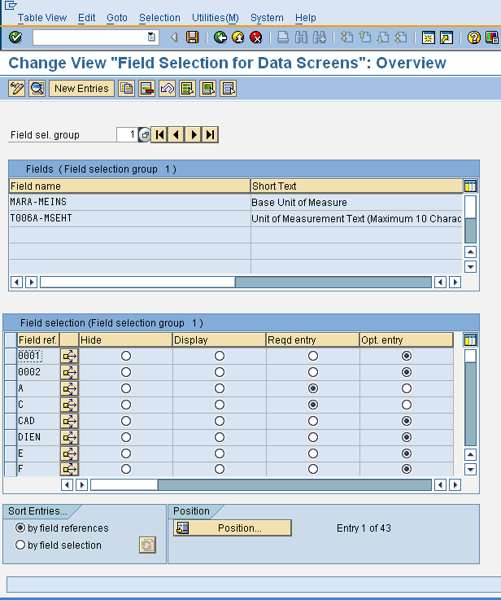
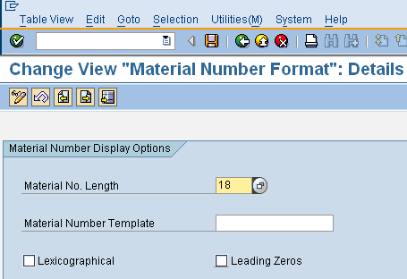
Material Master - Configuration
Menu path Logistics General → Material Master
→Settings for Key fields.
Here you can define Material Groups, Division, ABC Indicators, Material Statuses, Storage and Temperature Conditions etc
Menu path Logistics …→ Data relevant for
Sales & Distribution
Here you define Product Hierarchies, Sales Statuses, Material Groups & Commission Groups
Logistics General → Material Master → Basic settings
→ Define Output format of Material Numbers
To customize Material Master navigate to IMG
menu path Logistics General → Material Master
It is only possible to set or reset (cancel) this indicator (Lexogra[hical) if no numeric material numbers have been used yet in the system

Slide 41

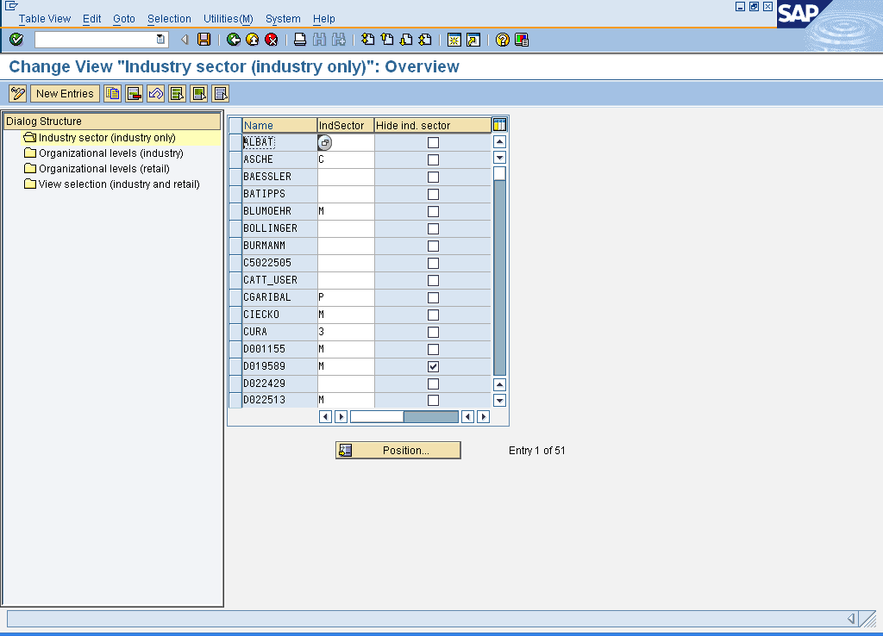
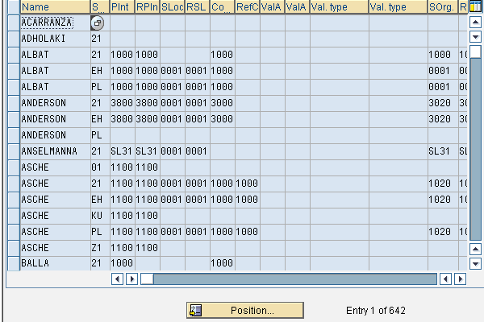
Material Master - Configuration
Here, you can define for a combination of user and screen sequence that certain views appear as pre-selected in the Select View(s) dialog box.
You can define that a particular industry sector is proposed whenever the user creates a material master record..
You can define for a combination of user and screen sequence, the organizational levels that are proposed whenever the user creates, changes, or displays a material master record

Slide 42
Material Master - Transactions
Transaction Codes | Application
MM01 | Create Material
MM02 | Change Material
MM03 | Display Material
MM04 | Display Material Change Documents
MM06 | Flag Material for Deletion
MM17 | Mass Maintenance: Indus. Matl Master
MM50 | List Extendable Materials
MM60 | Materials List
MM70 | Sel. Materials Flagged for Deletion
MMSC | Enter Storage Locations Collectively
MMAM | Change Material Type
MR21 | Change Material Price

Slide 43
Material Master - Create
The Material Master creation needs the following pre-requisites:
Defined Industry Sector & Material Types
Defined internal or external number ranges
Defined Screen Sequence
Material Master can also be copied from the existing created material

Slide 44

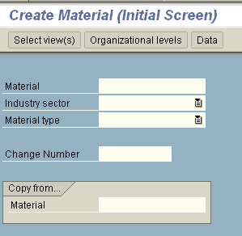
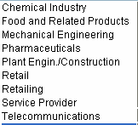
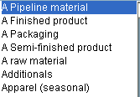
Material Master - Create

Slide 45
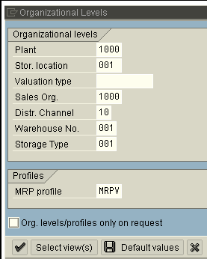
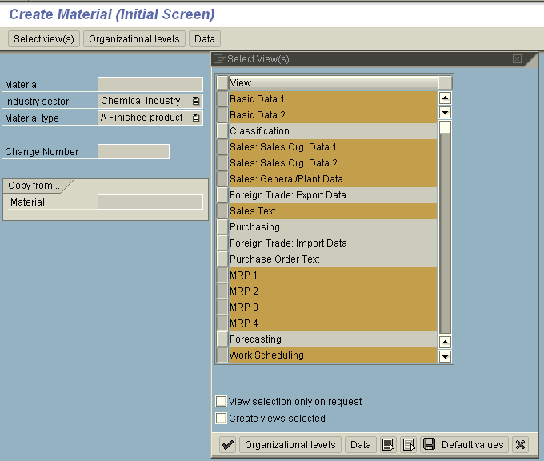


Material Master – Views
In Material Master some views are maintained at Client Level whereas the others are maintained at other Organizational level, e.g. Plant Level
Sales Org 1 & 2 views are maintained at Sales Org & Distribution Channel level
The list of views available for a material type is maintained in the configuration
Each user department has its own view of the material master containing department-specific data.

Slide 46
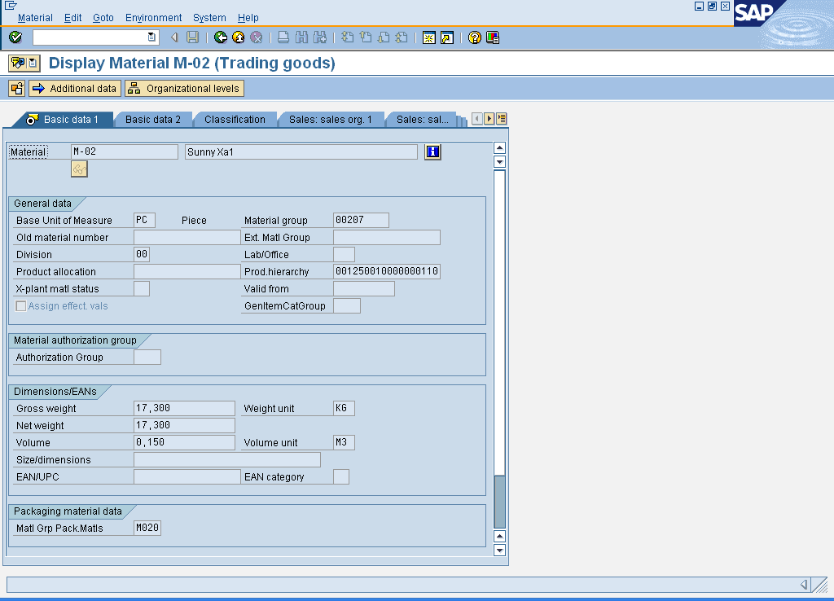
Material Master – Basic Data
Basic data is valid for the whole company. The Organizational Levels dialog box does not appear before you access this data screen

Slide 47
Material Master – Basic Data
Material Master – Basic Data
Important Fields | Screen | Application
Material description | Basic Data 1 | Text containing up to 40 characters that describes the material in more detail. This defaults from Basic Data 1.
Base Unit of Measure | Basic Data 1 | Unit of measure in which stocks of the material are managed. This defaults from Basic Data 1.
Division | Basic Data 1 | This filed also appears in the Sales Views and is generally populated from there.
Material Group | Basic Data 1 | Key that you use to group together several materials or services with the same attributes. This is a very important field for reporting & analysis
X-plant material status | Basic Data 1 | It restricts the usability of the material for all plants, that is, it defines whether a warning or error message is displayed if you include the material in a particular unction for Procurement, Production etc.
Size/Dimensions | Basic Data 1 | It’s a Text field that you can use as you like. The filed length is 32 characters.
Material is Configurable | Basic Data 2 | If this indicator is set, you can assign a variant class to the material, making it possible to use it as a configurable material. The indicator is defaulted for material type KMAT

Slide 48
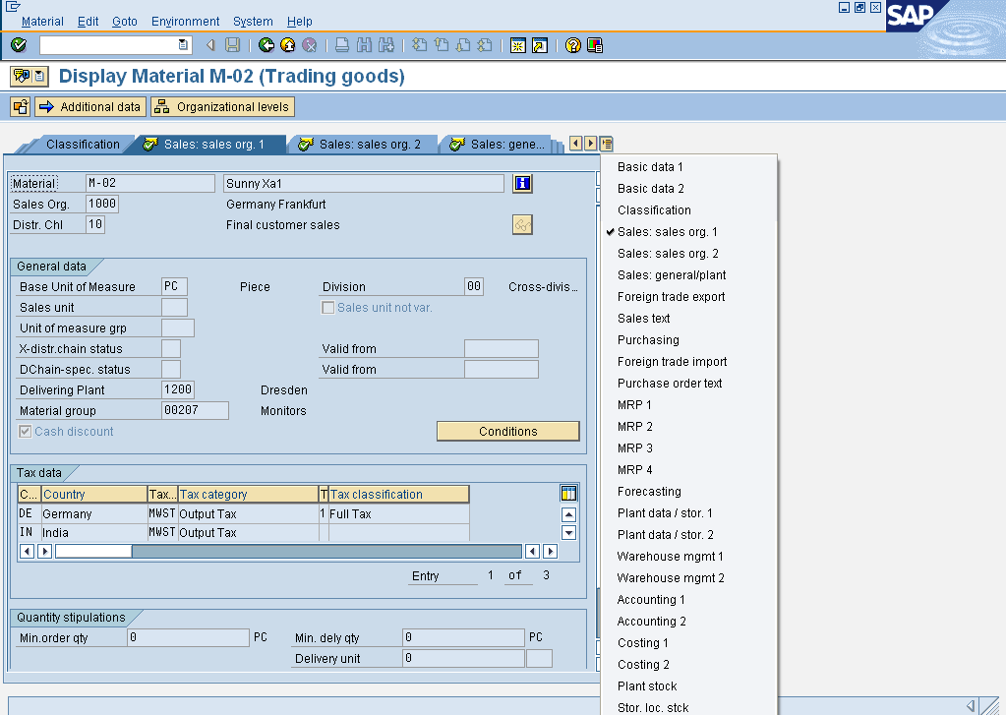
Material Master – Sales Views
Material Master has 4 Sales views: Sales Org 1,
Sales Org 2, Sales: Gen Plant
& Sales Text

Slide 49
Material Master – Sales Views
Important Fields | Screen | Application
Sales Unit of Measure | Sales: Sales Org. 1 | Enter a value in this field only if you want to use a unit of Measure differing from the base unit of measure.
Delivering Plant | Sales: Sales Org. 1 | This plant is automatically copied into the sales order item as the default value
Tax classification material | Sales: Sales Org. 1 | The indicator with which the system determines output tax for the material when processing sales and distribution-specific documents.
Material Statistics Group | Sales: Sales Org. 2 | Specifies a statistics group for this material and helps determine which data the system updates in the logistics information system.
Account assignment group | Sales: Sales Org. 2 | Group of materials with the same accounting requirements.
Item category group | Sales: Sales Org. 2 | Materials grouping that helps the system to determine Item Categories during sales document processing.
Checking Group for Availability Check | Sales: General/Plant | Specifies whether and how the system checks availability and generates requirements.
Transportation group | Sales: General/Plant | A grouping of materials that share the same route and transportation requirements.
Loading group | Sales: General/Plant | A grouping of materials that share the same loading requirements.

Slide 50
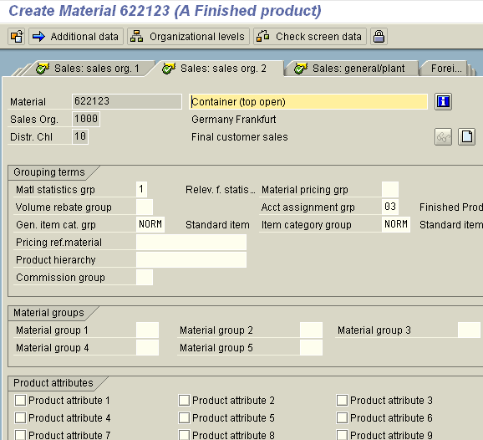
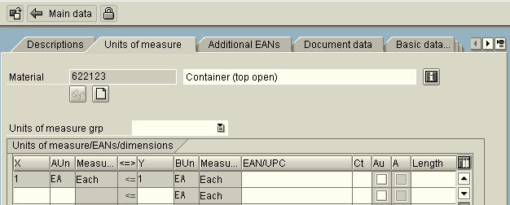
Material Master – Additional Data
Descriptions in different languages, Alternate Units of Measure, Basic Data Text etc. can be maintained in Additional data views

Slide 51
Material Master – Environment
Options in Material Master Data | Purpose
Defaults Data | This option in Material Master allows you can set Industry Sector Default, Hide Industry Sector in Industry Sector, Default views & Default the organizational data for the material.
Information on Material | This is the only place wherein we can see the material details in change or display mode of the transactions. These details are Industry sector, Material Type, Created by , Creation date, changed by, changed date, View wise status information such deletion flags or locks for a material.
Display Changes | List of all change documents for the material
Stock Overview | This search will directly takes you to MMBE transaction for stock display at plant & storage location level.

Slide 52

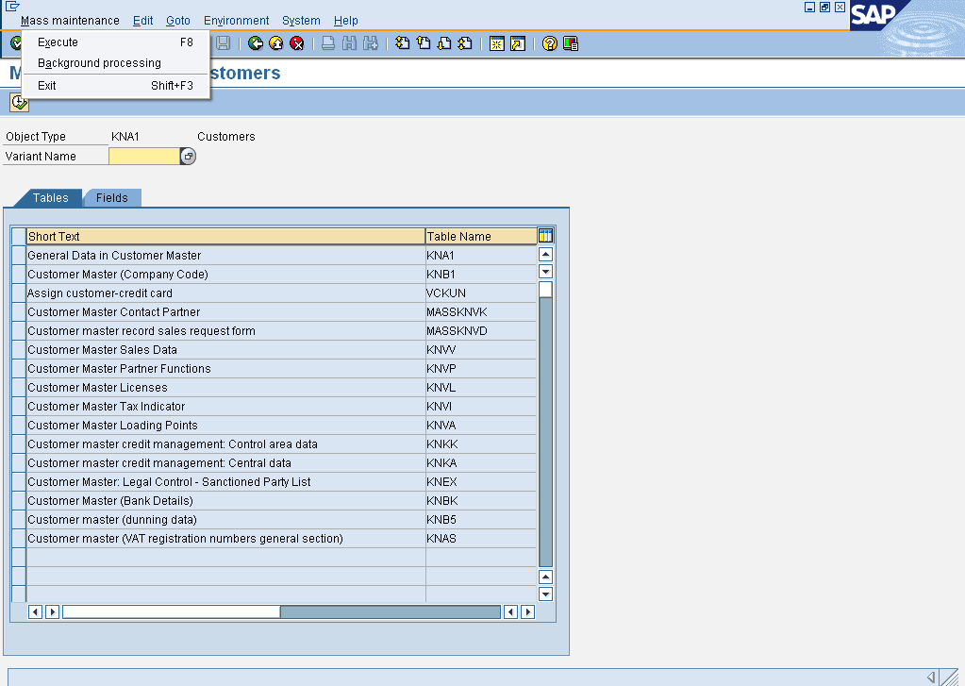
Customer Master – Mass Maintenance
For processing large amount of data, Mass maintenance transaction MASS is used
Mass maintenance is possible for a specific table(s) & field(s) within a table
Data also can be copied from a reference Customer master
If you wish to change a large number of objects simultaneously, you should choose background mode

Slide 53
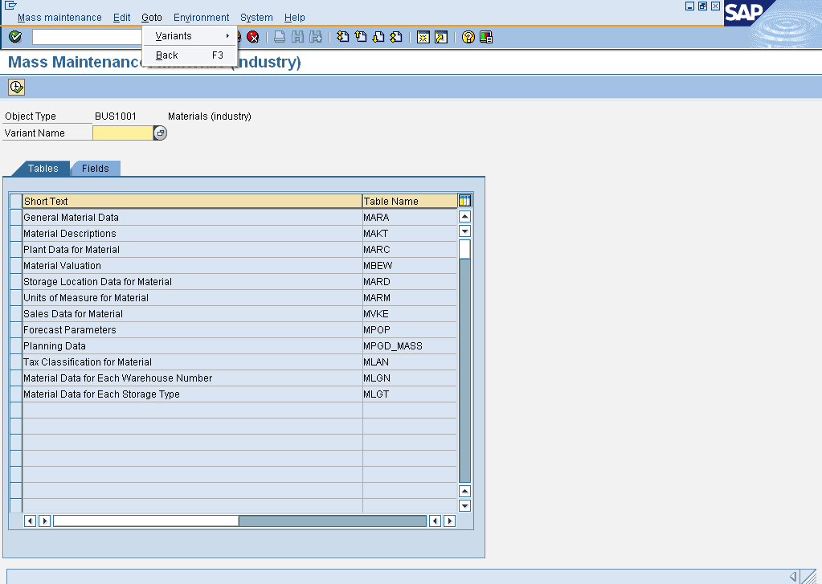
Material Master – Mass Maintenance
The user chooses the tables & fields to be changed from a list
The consistency checks are carried out collectively when the change is saved, not at the time a value is actually entered or changed
Changes can be made to several objects simultaneously
Mass-maintenance makes particular sense if you have to adapt existing datasets to a changed situation

Slide 54


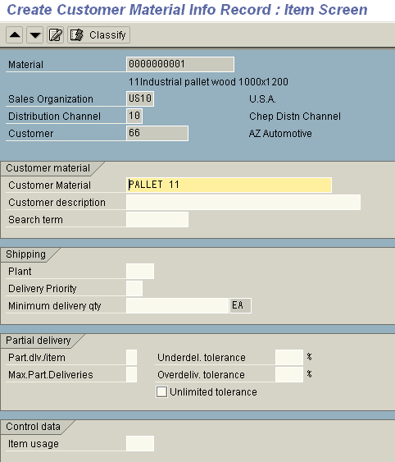
Master Data – Customer Material info
If the customer uses a different identifier than the one the business uses for the material, this can be included in a customer material information
Uniquely identifies the material from the customer's point of view
Customer material info can also include shipping specific data like plant, delivery tolerances, partial delivery details etc.
The user can simplify the data entry process by using a customer-material info record during sales processing
VD51 – Create VD52 – Change VD53 - Display

Slide 55
SD Master Data
Customer
Material
Conditions

Slide 56




Condition Master – Example
Pricing Elements
Prices
Discount /
Surcharges
Freight
Taxes
Material Price, Customer Price
Material Group Discount, Material Discount
Incoterms part1
Taxes
Condition Types
PR00 - Price
K029 – Material Group discount K004 – Material discount
KF00 - Freight
MWST – Output tax
All of the pricing elements that you use in your day-to-day pricing procedures - the prices, surcharges, discounts, freight charges, and taxes - are defined in the R/3 system as condition types
During sales order entry, the system can calculate prices automatically by finding a gross price, deducting all the relevant discounts and adding any surcharges such as freight and sales tax
Depending on the pricing policies of your company, you may be able to change prices manually during sales order processing. You may, for example, be able to enter or change certain discounts within a specified range

Slide 57

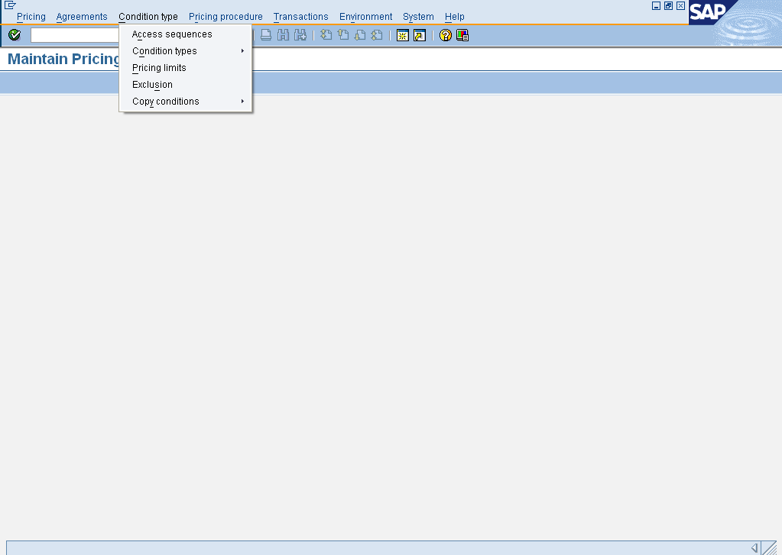
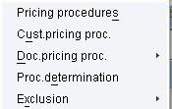

Condition Technique - Example
Pricing in SAP consists of 4 components :
Pricing Procedure (defines the conditions permitted and the sequence in which the system takes these conditions into account during sales processing)
Condition Type (Condition type is a characteristic of a condition)
Access Sequence (defines the order in which the system searches for condition records)
Condition Tables (contains key fields for which conditions records are created
Use Transaction Code VOK0 to access this screen

Slide 58
Condition Type - Controls
The condition class allows standard processing within the system
Condition classes available are: Prices, Discount or Surcharge, Taxes, Expense Reimbursement, etc.
You can control for each condition type whether the system allows a condition to be only a surcharge (plus, positive) or discount (minus, negative) or whether both are possible
Condition category further classification of condition types (e.g. Basis Price, Internal Price, Intercompany Price, etc.)
You also define how the condition is calculated (Calculation type) and whether the condition is calculated based on a scale (Scale basis)
You can define which changes can be applied for the condition type, and whether manual entries are allowed

Slide 59
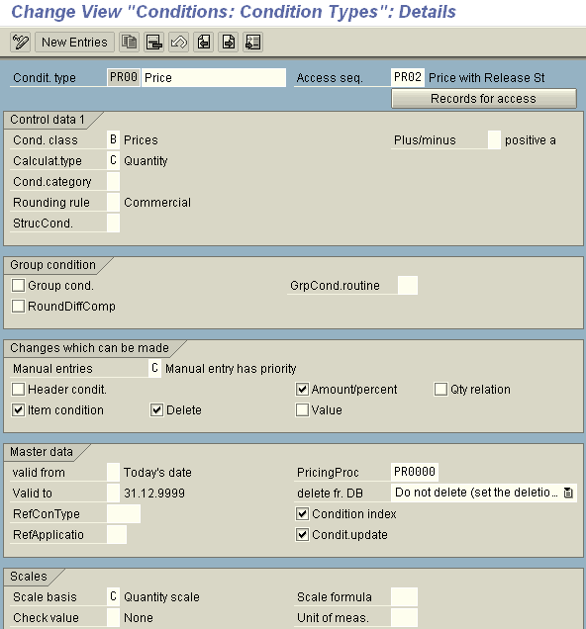
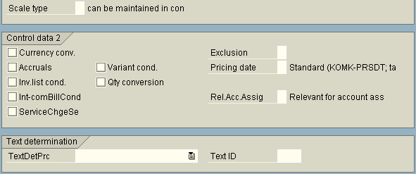
Condition Type - Controls

Slide 60
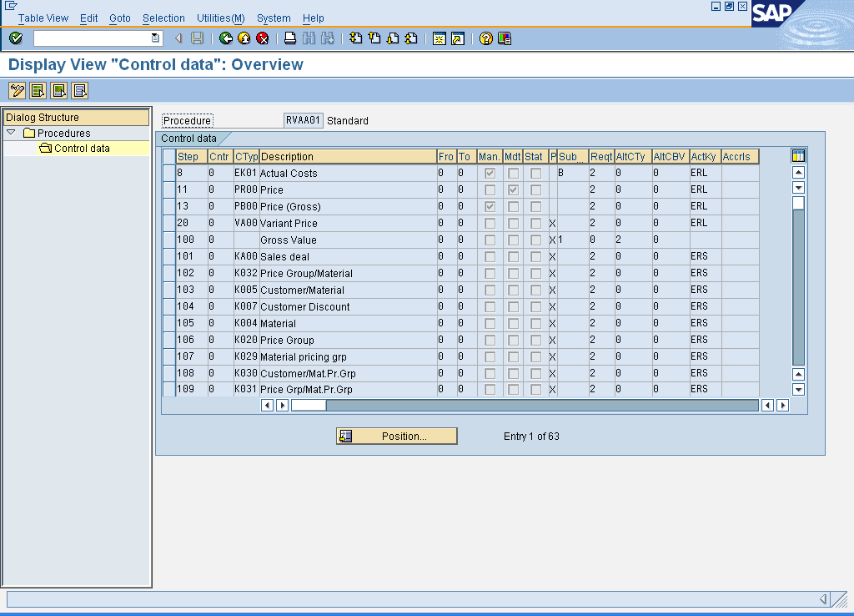
Pricing Procedure
You can a mark a condition type in the pricing procedure as being:
a mandatory condition
a manually entered
condition
for statistical purpose only
A statistical condition does not impact the net value of the line item or document but is used for information purposes only. An example of a statistical condition is VPRS cost.
Account key is integration between SD & FI , that defines different type of G/L account.
Menu path: Sales & Distribution → Basic Functions → Pricing → Pricing Control →
Define & Assign Pricing Procedures

Slide 61


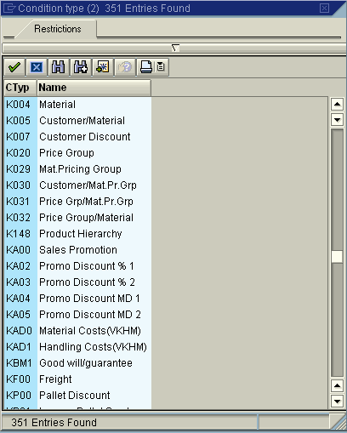
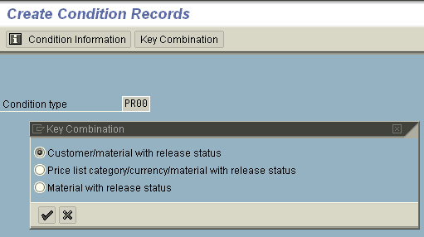
Condition Record - Create
A data record that stores a condition is called condition record
Condition records can be maintained at any level, e.g.: customer, material, material group, customer group
VK11 - Create Condition Record

Slide 62
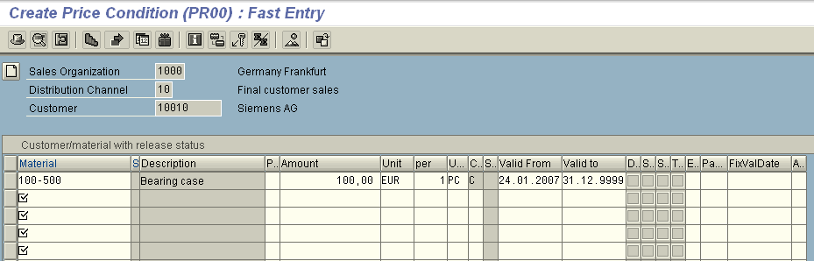
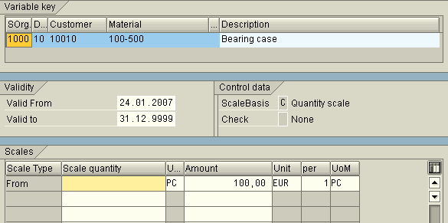
Condition Record - Create
Pricing condition records will have validity periods, upper & lower limits, and can also have scales

Slide 63
Condition Record - Functions
Options in Condition Records | Purpose
Condition Supplements | There may be a requirement to always activate certain conditions within a document at the same time. This requirement may be satisfied by storing the values for several condition types in one condition record which is referred to as a condition supplement.
Additional Data | In addition, there are three fields on the condition record which can be found under additional sales data: Maximum value, Maximum quantity (condition base value), Maximum number of orders (up to a maximum of three)
Scales | The values in a condition record (prices, surcharge, discount) can be maintained according to a scale. The number of scale levels is unlimited.
Validity Periods | A condition record can be limited for a certain period of time (validity period). For example: A price valid for an entire year or Discounts valid for a month during a sales promotion.
Condition Text | You can maintain long texts in the condition records for pricing and agreements (rebates, sales deals, and promotions).
Cumulative Values | In order to update the condition records during sales processing, the condition update field must be turned on for the condition type. Once the configuration is set and a condition record is created, the system will automatically update the values in the condition record when sales order and billing documents are saved.

Slide 64
Condition Master – Output
Output types are used to represent various forms of output in the SAP system. Examples of output types in Sales and Distribution processing are order confirmations, pick lists, freight lists, invoices, etc.
You can choose Extras → Output → Header or Item → Print Preview on the overview screen of the sales document to preview the Output
You can send output documents more than once. This can be useful if, for example, there are technical or other problems when you print an output document the first time

Slide 65
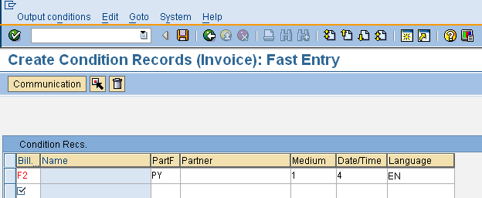
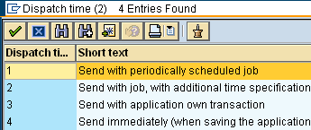
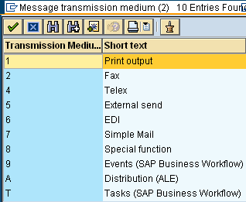
Condition Master - Output

Slide 66
Condition Master - Output
Output types are used to represent various forms of output in the SAP system
Examples of output types in Sales and Distribution processing are order confirmations, Delivery note, freight lists, and invoices
You can also choose Extras→Output→Header or Item→ Print Preview on the overview screen of the sales document
You can print output documents more than once

Slide 67




Condition Master – Texts
Customer Master
Central Texts
Financial Accounting Texts
Sales & Distribution Texts
Contact Person Texts
Material Master
Basic Texts
Sales Texts
Purchase Texts
Customer Material
Info
Customer – material Texts
Sales order
----------
----------
----------
Header Texts
Item Texts

Slide 68

Condition Master– Texts
Document (sales / delivery / Billing)
Master Data
Header
Item
Master
Material Master Basic texts Sales text
PO Text
Customer Master Central Texts S&D texts
Contact person texts
Customer Material
info’
Info Record texts
•Header Text
•Header notice
•Shipping requirements
•Material Sales text
•Packing note
•Shipping requirements
•Contractual requirements
Texts are proposed from the master records in the sales and distribution documents, if you have made the appropriate setting.
You can integrate standard texts into the sales and distribution documents.
Texts can be copied from a reference sales and distribution document into another sales and distribution document (e.g. from an inquiry into a sales order or from an order into a delivery).
The copying of texts can be made language dependent, if required.
You can change copied texts
In a Sales Document Texts can be maintained as Header or Item Text

Slide 69





Condition Master – Free Goods
Inclusive | The customer only pays for some of the goods requested. The rest of the goods are free of charge. Two out of eight eggs are free goods. Therefore, if you order 8 eggs, 8 will be delivered and you will not be charged for 2 of them. So in this case, you have ordered an inclusive bonus quantity. | 2 from 8
Exclusive | The customer pays for the goods ordered and is given extra goods free of charge. The exclusive bonus quantity is also called exclusive free goods and means that in addition to the purchase order, a certain quantity of materials are guaranteed as free goods. In other words, a larger quantity is delivered than is ordered, whereby no charge is made for the additional quantity delivered. | 3 + 1
Exclusive different material | The materials delivered as free goods do not necessarily have to be the same as the materials orders. When a customer orders 3 large trays of eggs, the customer would be offered a chicken for free! | 3 + 1
The free goods quantity can be defined as a quantity proportional to the sold quantity For the delivery you can control whether the free goods are processed independently or whether they are only copied to the delivery for partial delivery or full delivery.

Slide 70
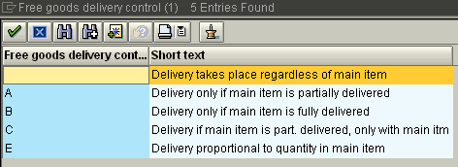
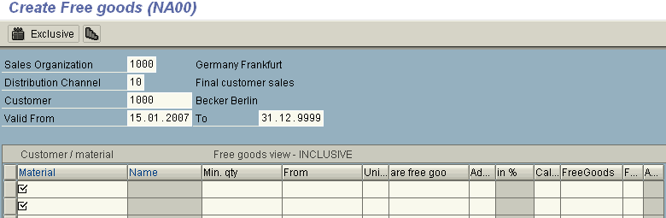
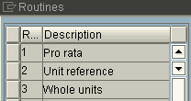
Condition Master – Free Goods
Screen display
VBN1 – Create Free goods VBN2 – Change Free goods VBN3 – Display Free goods

Slide 71



Condition Master – Material Determination
→
Material determination enables the automatic substitution of materials in sales documents during sales order processing
You may wish to use Material Determination for:
Replacing a standard product with the one with promotional packing
Substituting discontinued materials with newer materials
The system can re-determine product substitutions when copying them from sales order to deliveries (optional)

Slide 72
Condition Master – Material Determination
When you enter a material in a sales order, the system checks whether you have set up product selection for this material. If so, it creates a list of possible alternatives, checking each to determine current stock availability, and whether the customer would accept it based on the product attributes
For each valid substitute that if finds, the system creates a sub-item

Slide 73
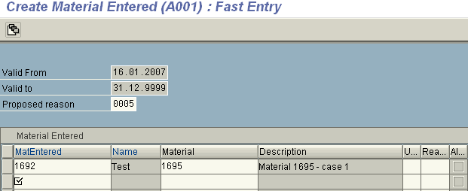
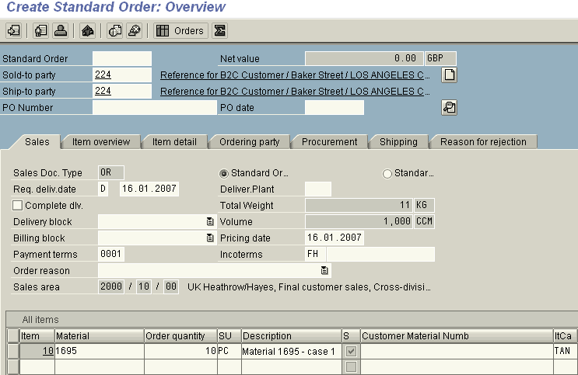
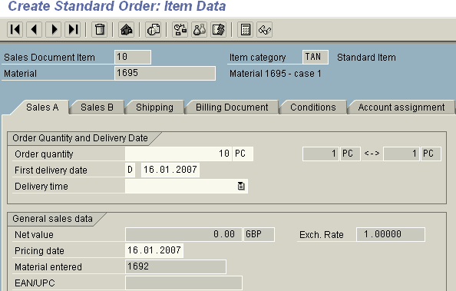
Condition Master – Material Determination
Condition record
Material Determination
Material Entered
Substitute
Material
Sales Order
VB11 – Create Material determination VB12 – Change Material determination VB13 – Display Material determination

Slide 74


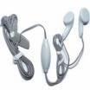

Condition Master – Cross Selling
+
+
+

Slide 75
Condition Master – Cross Selling
You can set up the system so that if a customer orders a specific article, a list of other suggested articles appears as well
Cross selling articles can be delivered independently of their corresponding main articles in the sales order, or the cross selling articles can only be shipped either together with or after the main articles have been shipped

Slide 76
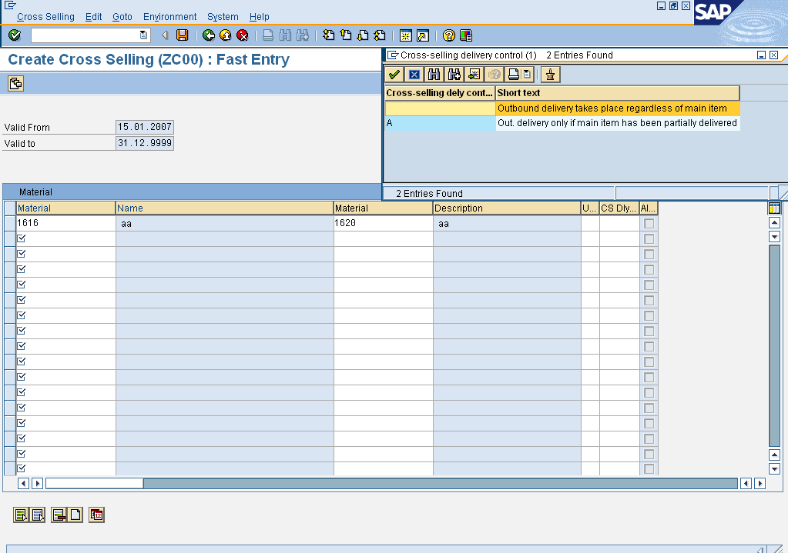
Condition Master – Cross Selling
VB41 – Create Cross Selling VB42 – Change Cross Selling VB43 – Display Cross Selling

Slide 77







Condition Master – Listing & Exclusion
Master data for Material Listing
Master data for Material Exclusion
Sold-to party: C1 Item: M1
M2 M3
Sold-to party: C1 Item: M1
M2 M3
M$
Customer : C1 Material: M1, M2
Customer : C2 Material: M3, M4
VB01 – Create Listing / Exclusion
VB02 – Change Listing / Exclusion
VB03 – Display Listing / Exclusion

Slide 78

Condition Master – Listing & Exclusion
VB01 – Create Listing / Exclusion
VB02 – Change Listing / Exclusion
VB03 – Display Listing / Exclusion
Note: The screen elements are similar for Listing & Exclusion

Slide 79
Transaction Codes
OVT0 | What account groups controls
OBD2 | Change view account groups – Edit Field Status - How to suppress or mandatory field in Account Groups.
OVZC | Define & assign number ranges for customers
OB20 | Define Transaction dependent screen layout for customer master
OMS3 | Define Industry Sector and Industry sector – specific filed selection
OMS2 | To view the different attributes for material types – Check views, valuation, quantity & value updating.
V/06 | Creation of condition types
V/07 | Creation of Access Sequence
V/08 | Define pricing procedure
OVKK | Assign pricing procedure
VOK0 | Master Transaction for Pricing

Slide 80

Review Questions
What is the combination of Sales Organisation / Distribution Channel and Division?
What are the 3 views/ levels in the customer master called?
What is the first step you should take before setting up new
customer master record?
What are the mandatory partner types that are automatically created when entering the sold-to customer?
What are the additional partner type that can be added to the
customer master record?
What are the views/ levels in the Material master called?
What is the first step you should take before setting up new Material Master record?
What are the 4 components of pricing?
What is condition type & condition record?

Slide 81
Tips and Tricks
For a Customer Master SAP provides 10 additional freely definable fields in General Data & 5 more in Sales Area Data. These can be used for analysis & pricing control. It is possible to rename these fields
On the Sales Org 2 view of Material Master, SAP provides 10 fields for Product Attributes. With the help of these (and some more settings in document type) it is possible to restrict delivery of certain materials to certain customers. It is possible to rename these fields

Slide 82
Tips and Tricks
KNA1 (Customer General Data) & KNB1 (Customer Company Code Data) and MARA (Material Master Basic Data) MARC (Material Master Plant Data) tables can be directly accessed using special transactions SE16_KNA1, SE16_KNB1 and SE16_MARA & SE16_MARC
Maintenance of certain types of data such as Terms of Payment, Routes, Inco-terms, Factory Calendar which is actually part of customizing, can be reached from SAP Easy access menu path of by using Transaction Codes OBB8, OVLH, OVSG & SCAL
You can maintain Texts independent of any Master Data object by using Transaction code SO10

Slide 83



Additional Info – Mass Creation
Legacy
SAP
Batch Data Communication Technique (BDC) is also used for transferring data into SAP system
The LSMW (Legacy System Data Migration Workbench) is an R/3 based tool that supports you when you transfer data from non-SAP systems to SAP R/3.

Slide 84

Additional Info - Archiving
The SAPF056 program archives customer master records and writes the
achievable master records to an archiving file.
The number of master records to be archived depends on the following selections:
Customer numbers
Company codes (if FI data is to be taken into consideration)
Sales organization (if SD data is to be taken into consideration)
System conditions (see criteria below).
Note that company code data and sales area data cannot be archived in one program run. When you make your selections, you can only choose either company code or sales area data.
Only that master data is taken into account that is marked for deletion

