Slide 1
SD Outline Agreements

Slide 2


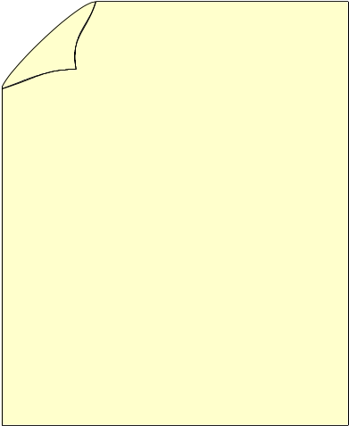
SD Outline Agreements
Contract
Scheduling
Agreement

Slide 3
SD Outline Agreements
Outline Agreements
  Purpose
  Uses
  Challenges
Scheduling Agreement
  Why Scheduling Agreement ?
  Scheduling Agreement Process
Contracts
  Quantity Contracts
  Releasing The Quantity Contract
  Quantity Contract Processing
Value Contracts
  Value Contract Types
  Assortment Module
  Releasing The Value Contracts
  Value Contract Process

Slide 4
SD Outline Agreements
Group Master Contracts
Service Contracts
  Releasing The Service Contracts
  Service Contract Process
Contract Data in Sales Document
Contract Cancellation
Contract-Configuration
  Create the Outline Agreement Document Types
  Create the Outline Agreement Item Categories
  Create Scheduling Agreement
  Create Quantity Contracts
  Create Value Contract
  Create Service Contract
  Let Me
  Help Me

Slide 5

Purpose
Agreements play an important role in nearly all business processes.
Customers and vendors agree on the goods to be provided under certain conditions and within a specific timeframe.
Agreements streamline business processes for both partners in a business relationship.

Slide 6

Uses
Agreements aim at streamlining business processes of both customer and vendor.
Agreements can be effectively used to improve the efficiency in the following business areas.
    Reduce costs
    Increase quality
    Increase speed of delivery

Slide 7

Challenges
How to meet specific pricing requirements in an agreements
How to incorporate various date relevant requirements (start date, end date, billing date etc..)
How confirm delivery date with assured quantities
How to deal with returns in agreements
How to ensure the data transfer between transactions

Slide 8

SD Outline Agreements
Outline agreements are legal documents which
represent an arrangement between a supplier
and a customer for the purchase of goods
Types of Outline Agreements
- Scheduling Agreements
- Contracts

Slide 9

Scheduling Agreement
A scheduling agreement is an outline agreement between Company and Customer that is valid for a certain period of time. Scheduling agreement contain specific delivery dates in addition to target quantity and price information
Since a scheduling agreement contains delivery dates and quantities, a delivery note is created directly from the agreement. Scheduling agreements are fulfilled by creating deliveries on the due date for the schedule lines. You must create your own schedule lines by entering the delivery dates requested by the customer. (via Schedule lines)
In the scheduling agreement, the other functions can be carried out as in the order.

Slide 10

Scheduling Agreement
You must create your own schedule lines by entering the delivery dates requested by the customer. To create delivery dates for an item, select the item and go to “Item>Schedule lines. If the system cannot confirm the quantity specified on a given date, a second schedule line with the confirmed quantity and date will be automatically created.
A new type of scheduling agreement, called a delivery order has been developed for component suppliers. It represents a pick-up sheet, which functions much like a JIT delivery schedule, except that the pickup sheet is not renewed. The customer transmits material release data informing the component supplier of needed materials and the date the forwarding agent will pick them up.

Slide 11

Why Scheduling Agreement ?
Scheduling agreements are very much useful in industries where materials are produced in accordance with expected demand.
Example:
Suppose in automobile industry a car manufacturer produces 1200 cars in a year.
He on an average produces 100 per month. Suppose he requires radial tires from XXXX company, he need not place an order for the entire quantity he requires over an year.
Instead the company enters into an scheduling agreement with XXXX company which ensures timely supply according to the need of production run.

Slide 12
Scheduling Agreement Process
Run Delivery due list
Deliver Orders due for delivery
Create Scheduling Agreement
Create Billing

Slide 13

Contracts
A contract is an agreement stating that your customer will order a certain quantity of product from you within a given time frame. A Contract is an outline agreement between Company and Customer that is valid for a certain period of time and contains an overall target quantity or value that a customer agrees to buy at a specific price over a certain period of time; however, it does not contain specific delivery dates (no schedule lines or delivery information.)
Contracts are 4 types.
        Quantity contracts
        Value contracts
        Master contracts
        Service contracts

Slide 14

Quantity Contracts
Quantity contracts are agreements between the customer and company to order specific quantities of a product within a set timeframe. The customer does not provide any information about delivery dates, only the start and end date of the contract. Quantity contracts are usually agreed to at discounts from totals if priced individually.
A quantity contract is fulfilled when the customer places orders against it in the contract period. These orders are known as release orders or ‘call-offs’. However, they are standard orders that automatically reference the customer’s quantity contract and reduce the remaining amount of product to be ordered under the contract.
If a customer can give delivery dates for the product, then it is preferable to use a scheduling agreement, instead of a quantity contract.

Slide 15
Releasing The Quantity Contract
Release orders are created referencing the Quantity contract.
Release orders created update the quantity contract.
Since the contract does not contain any schedule lines or delivery information, a customer must fulfill the contract by placing a purchasing order against quantity contract.
If you try to change a contract after the release order creation, the system warns you that subsequent documents exist.

Slide 16
Quantity Contract Processing
Create Quantity Contract
Create release Sales order with reference to the Quantity contract
Deliver Orders
Create Billing

Slide 17

Value Contracts
A value contract is a value based outline agreement with a customer in which it is agreed that a certain value of products will be purchased over a period of time.
Value contracts contain:
  Validity period
  The agreed upon total value
  Rules controlling the who can release against the contract through partner authorizations
  Restrictions regarding what materials can be ordered against the contract

Slide 18

Value Contract Types
There are Two types of value contracts:
    Standard value contract: It is used in majority of instances. It is based on total value of an assortment of materials for a particular Customer. We use document type WK1 for these type of contracts.
    Material Related Value Contract: it is based on a single material (usually configurable material). We use document type WK2 for these type of contracts.

Slide 19

Assortment Module
An Assortment Module is a order entry tool that displays a list of materials and services that can be released from a value contract. It has a validity date and a restriction that only the materials and services that belong in the same sales organization and distribution channel for which your release order is being made will be displayed.
While creating an Assortment module we have to provide the materials and their respective validity dates.

Slide 20
Releasing The Value Contracts
Release orders are created referencing the value contract.
The system checks the released materials against the rules of the value contract as well as whether the release is within the validity period of the value contract.
The value of the released material is checked against the remaining open value of the contract. It is possible to define whether a value contract quantity can be exceeded or not.
Value contracts can be billed directly or billed per release order.
When billing documents are billed directly, a billing plan can be used.

Slide 21
Value Contract Process
Create release Sales order with reference to Value contract
Create Value Contract
Deliver Orders
NOTE: Assortment module is created to club the materials for which the value contract should be updated. We can also create a value contract for a single material.
Create Billing

Slide 22

Group Master Contract Process
Contracts can be grouped and assigned to a Master Contract
All Contracts assigned to the Group Master Contract should be created in the same sales area.
Quantity Contract
Value Contract
Service Contract
Group Master Contract

Slide 23
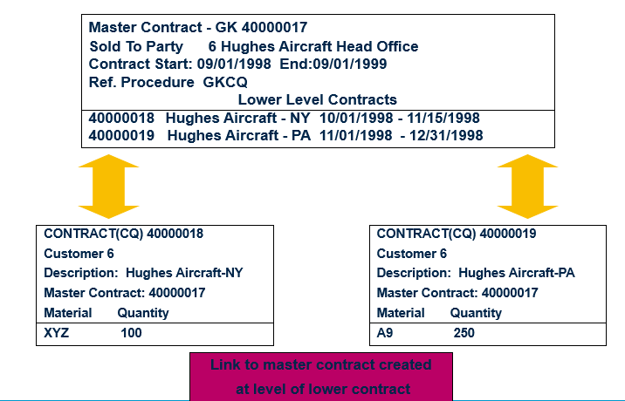

Group Master Contracts

Slide 24

Service Contracts
A service contract is an agreement that contains the conditions for offering a certain service to the customer. You can manage rental and maintenance contracts in the standard version of the SAP R/3 System. A service contract contains validity dates, cancellation conditions, price agreements, and information on possible follow-up actions.
Element of the service contract in which you define the services or products you are providing the customer with under the terms of the service contract.

Slide 25

Continued…
A service contract describes which services are to be performed, for which objects, and under which conditions.
A service contract consists of a header and one or more items. The header and each item can contain the following data:
Pricing conditions
Contract data
Text
Status
Partner data

Slide 26

Releasing The Service Contracts
Release orders are created referencing the service contract.
The system checks the released materials against the rules of the service contract as well as whether the release is within the validity period of the service contract.

Slide 27
Service Contract Process
Create release Sales order with reference to Service contract
Create Service Contract
Create Billing

Slide 28
Contract Data in Sales Document
The contract start and end dates can be entered manually or determined automatically. The system can propose these dates upon document creation according to a date determination rule which can be proposed for the contract type.
Sales document types are used to control whether or not additional contract data is allowed. Contract data can be maintained at header and item levels. Contract data at header level is valid for all items as long as different data is not entered at item level.
In addition to the contract start and end dates, contract data includes the Installation Date, the Contract Signed Date, and the Dismantling Date. These dates are manually maintained in a contract and can be used to determine the contract start and end dates.

Slide 29

Contract Cancellation
For canceling a contract we use the document type ’CQ’
The following information is required while canceling contracts
Reason why the contract is cancelled.
When will be the cancellation effective.
Once the contract is cancelled we cannot create release Orders with respect to contracts.
We cannot cancel a contract after its validity is over.

Slide 30
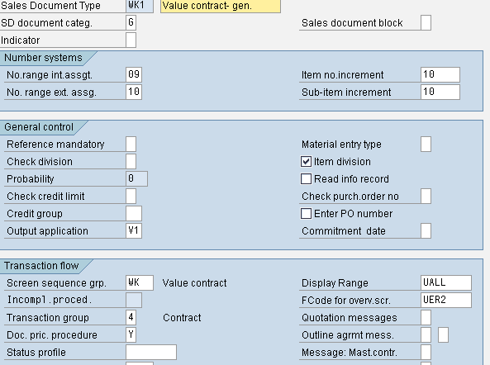
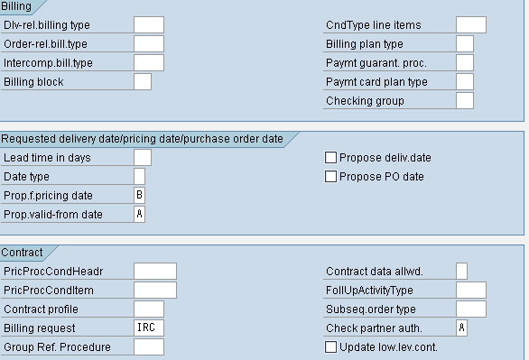
Value Contract-Configuration
SPRO→ Sales and Distribution→ Sales→ Sales Documents→ Sales Document Header→ Define Sales Document Types (VOV8)

Slide 31
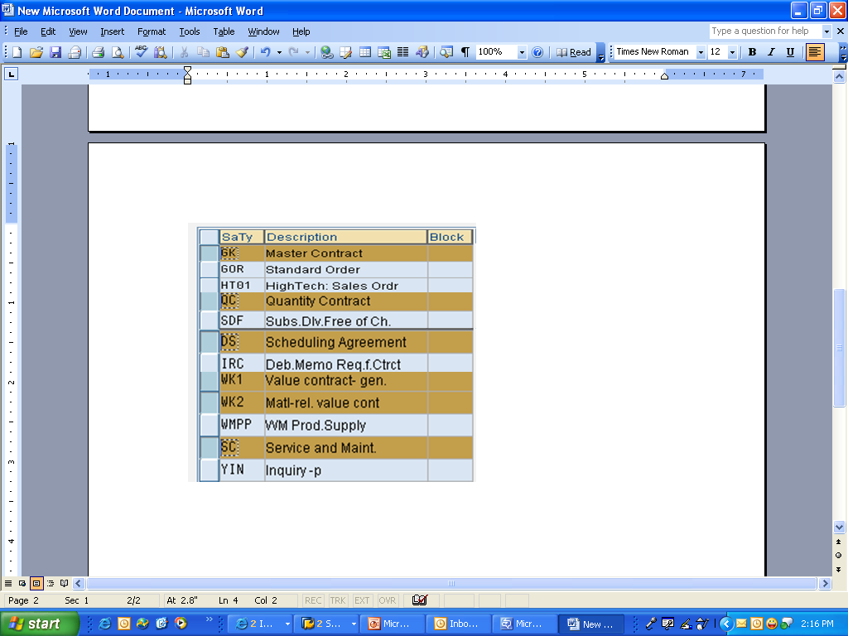
Create the Outline Agreement Document Types(VOV8)
SPRO→ Sales and Distribution→ Sales→ Sales Documents→ Sales Document Header→ Define Sales Document Types (VOV8)

Slide 32
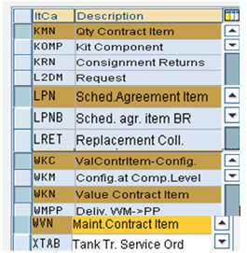
Create the Outline Agreement Item Categories(VOV7)
SPRO→ Sales and Distribution→ Sales→ Sales Documents→ Sales Document Item→ Define Item Categories(VOV7)

Slide 33
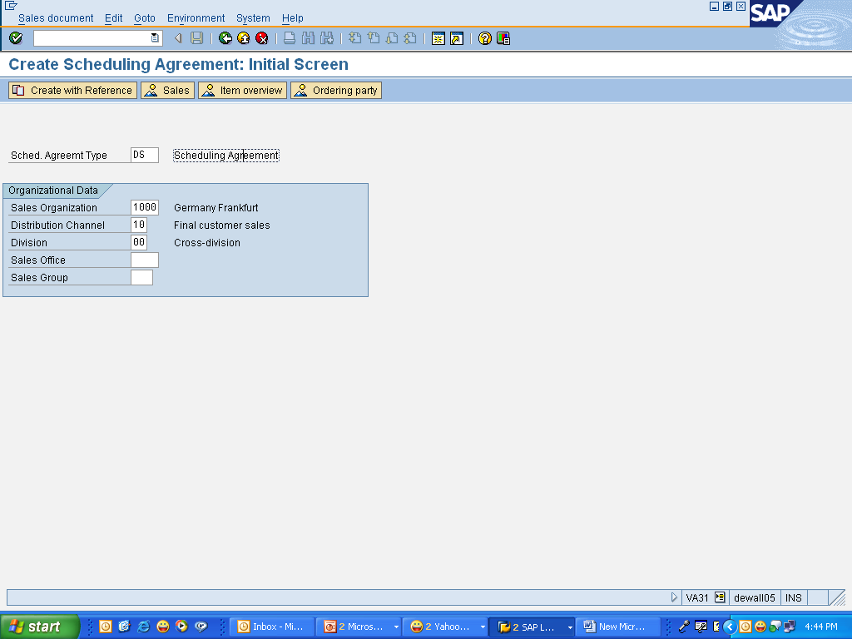
Create Scheduling Agreement
Logistics>Sales and Distribution>Sales> Scheduling Agreement> Create(VA31)

Slide 34
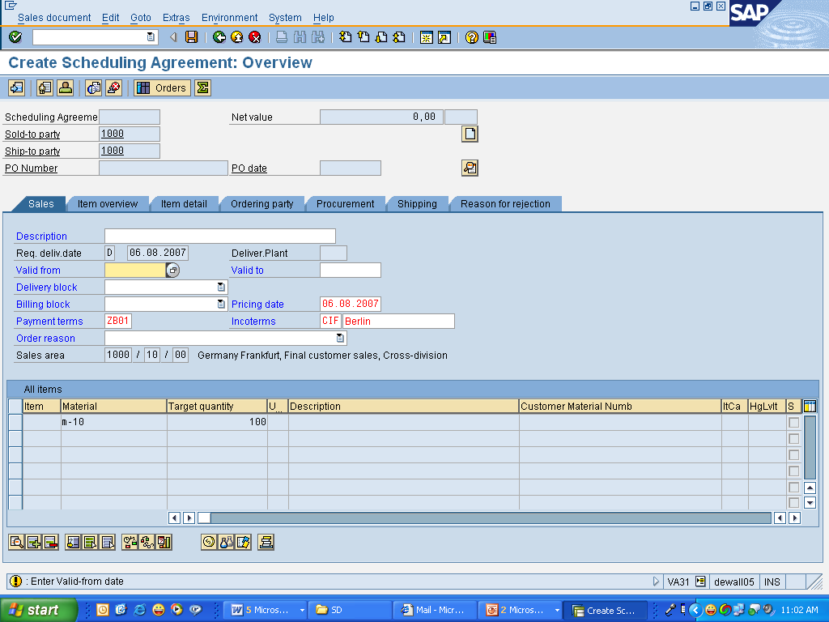
Enter the Validity Periods, Material and Target Quantity
Continued...
Validity Period
Target Quantity
Logistics>Sales and Distribution>Sales> Scheduling Agreement> Create(VA31)

Slide 35
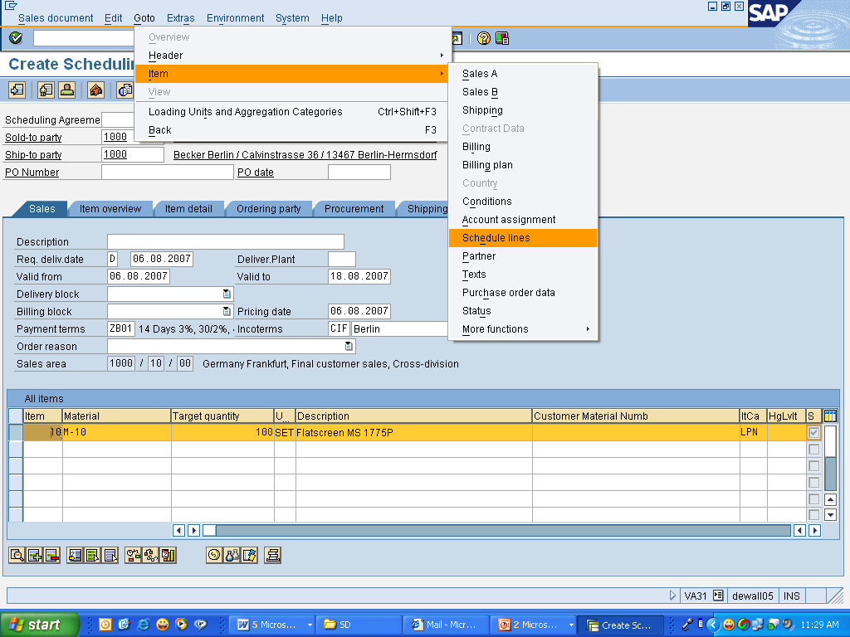
Continued...
Select the Line item and Go to->item->Schedule lines

Slide 36
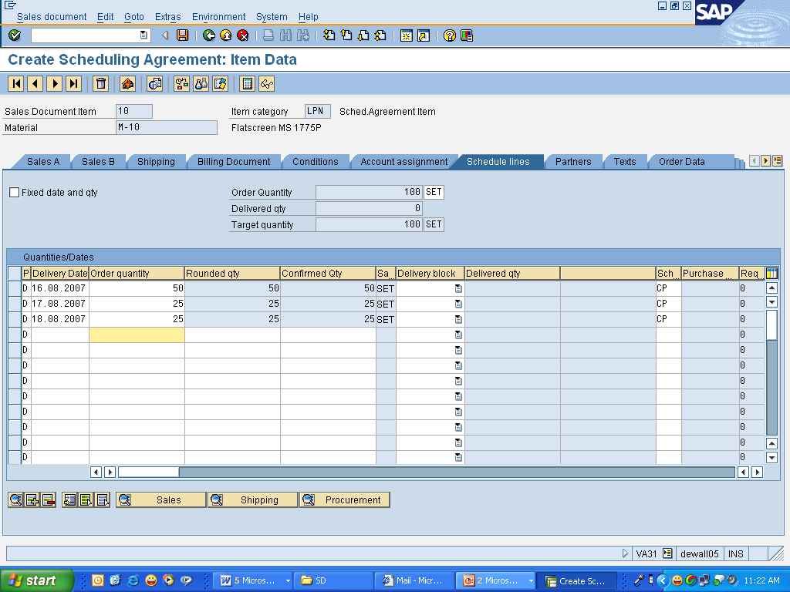
Continued...
Scheduling Agreements :
Contains fixed delivery dates and quantities.
Once the scheduling agreement is due for delivery, you can create
the delivery as normal or by using a delivery due list

Slide 37
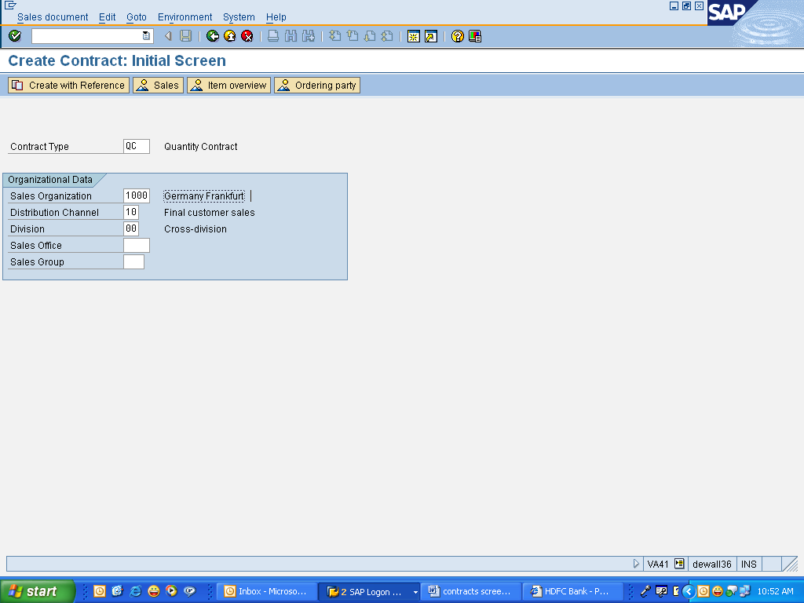
Create Quantity Contracts
Logistics>Sales and Distribution>Sales> Contracts->create(VA41)

Slide 38
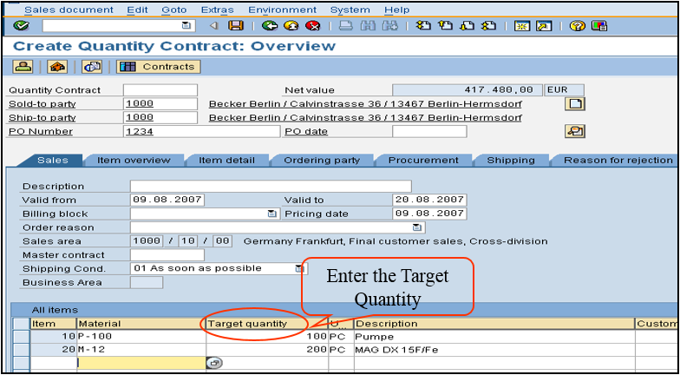
Continued...
Logistics>Sales and Distribution>Sales> Contracts->create(VA41)

Slide 39
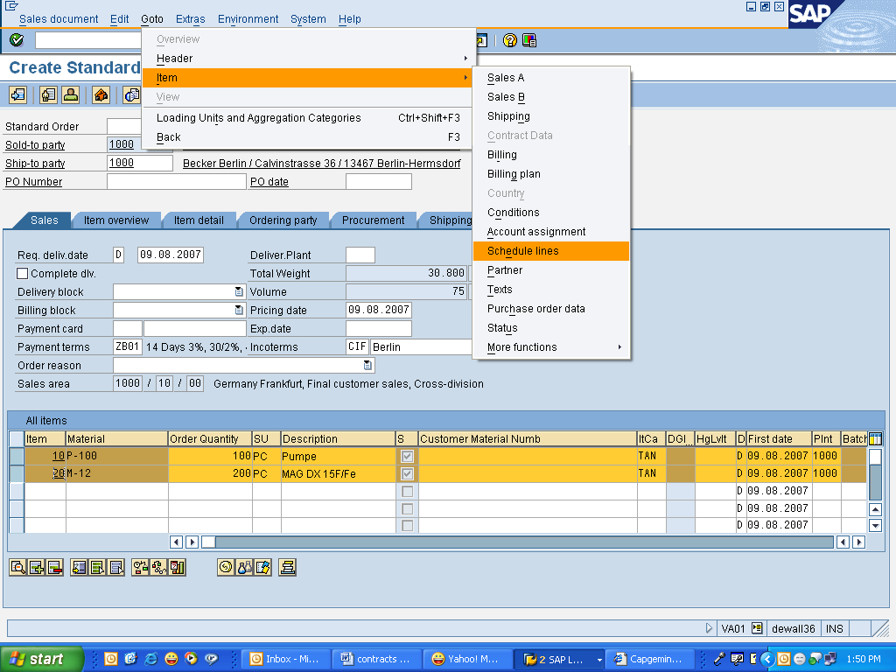
Continued...
Logistics →Sales and Distribution →Sales→ Order→ Create (VA41)

Slide 40
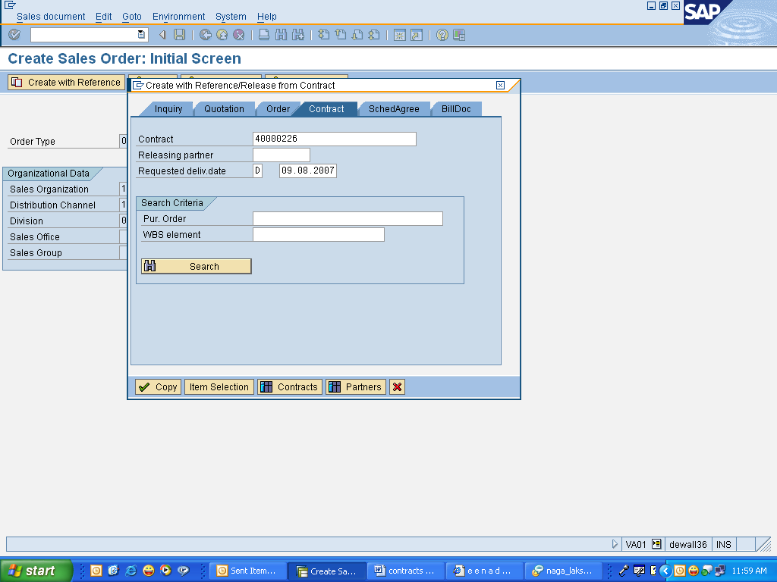
Release the Quantity Contract
Click the create
with reference
Logistics>Sales and Distribution>Sales>Order>Create (VA01)

Slide 41
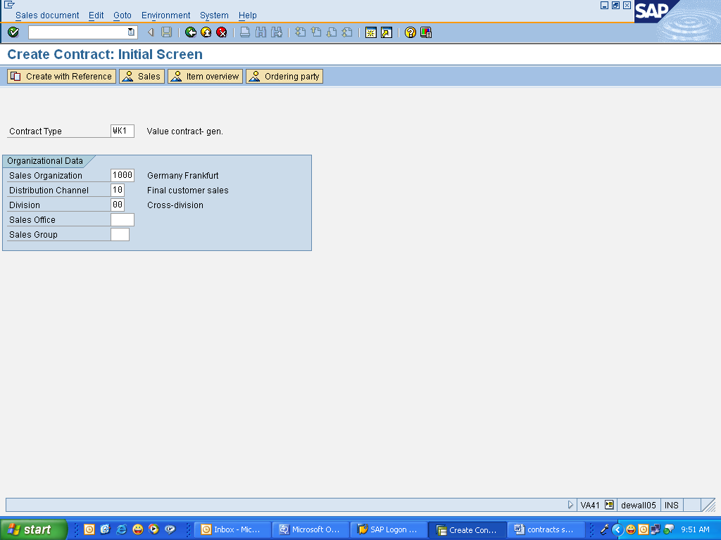
Create Value Contract
Logistics>Sales and Distribution>Sales> Contracts->create (VA41)

Slide 42
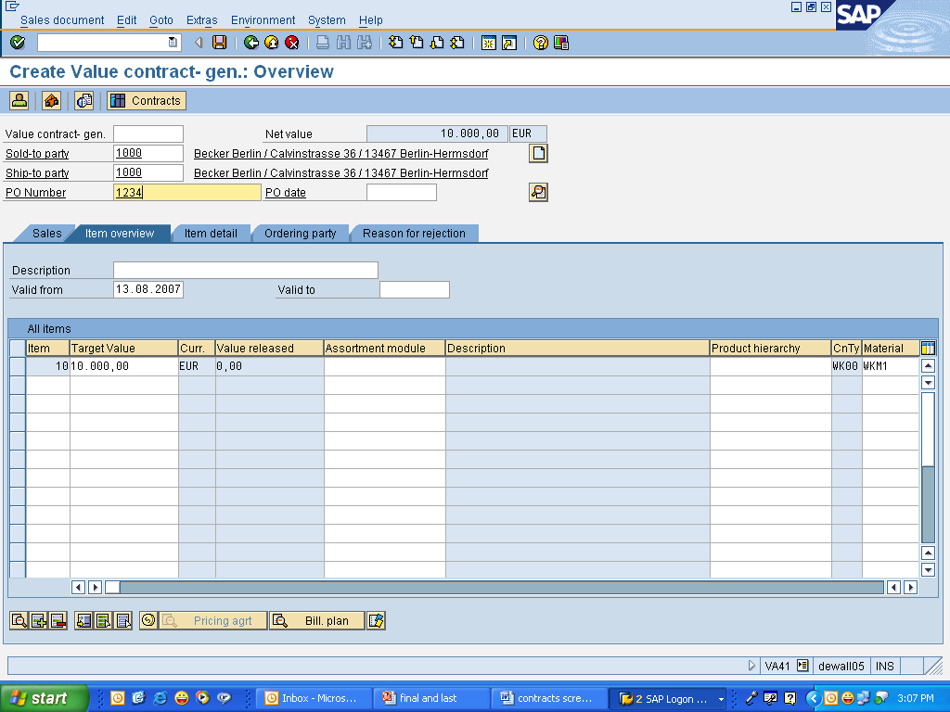
Continued...
Here we are giving the target contract value
Logistics>Sales and Distribution>Sales> Contracts->create (VA41)

Slide 43
Release the Value Contract
Click the create with reference
Logistics>Sales and Distribution>Sales>Order>Create (VA01)

Slide 44
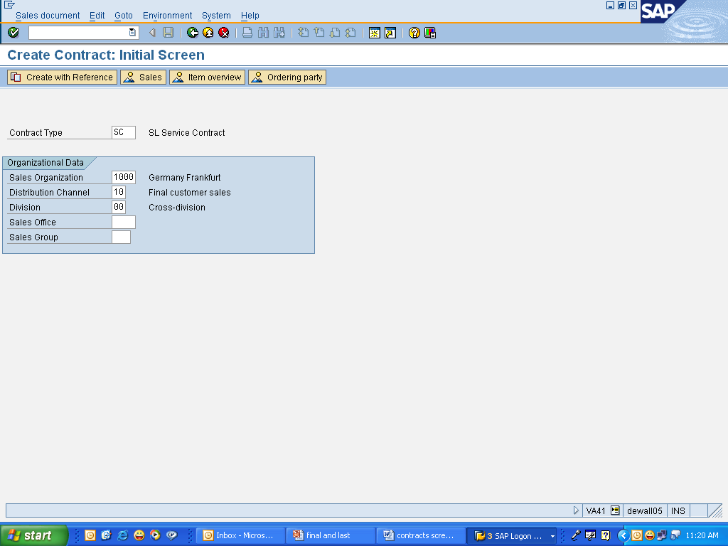
Create Service Contract
Logistics>Sales and Distribution>Sales> Contracts->create(VA41)

Slide 45
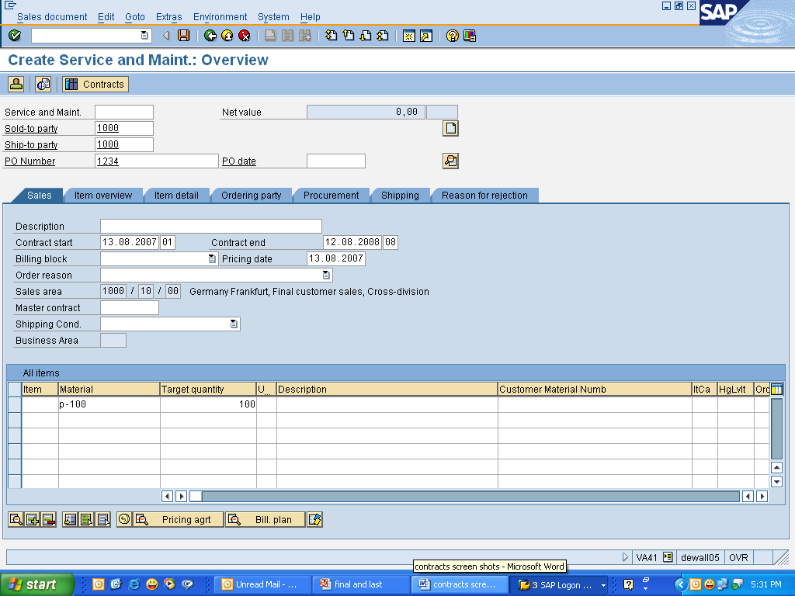
Continued...
Logistics>Sales and Distribution>Sales> Contracts->create(VA41)

Slide 46
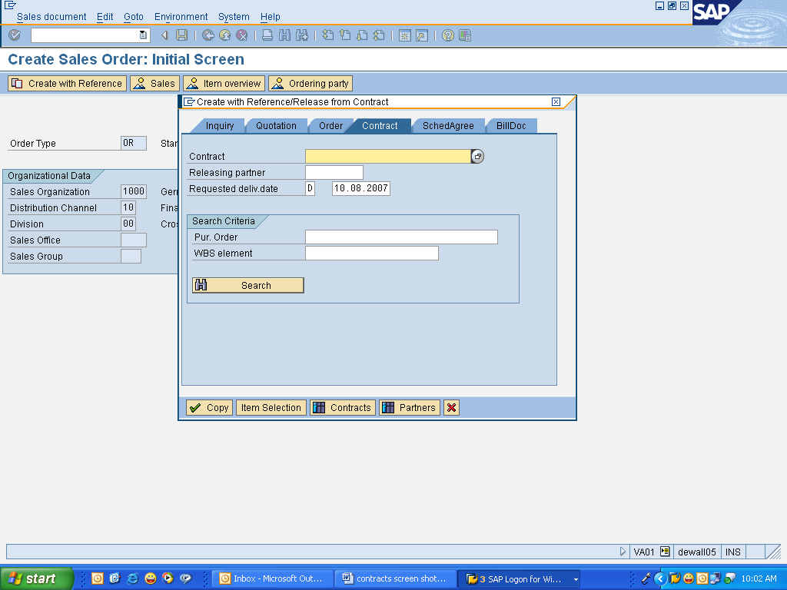
Release the Service Contract
Click the Create
With reference
Logistics>Sales and Distribution>Sales>Order>Create (VA01)

Slide 47
LetMe
Use the Transaction Codes below to view the configuration settings for Sales Document Type, Item categories, Schedule Lines, Create the Scheduling agreements and Contracts.
VA31 | Create Scheduling agreements
VA41 | Create Contracts
VA01 | Release the Contracts( with Reference contracts)
VOV8 | Define Sales Document Types
VOV7 | Define Item categories
VOV6 | Define Schedule lines
VOV5 | Schedule line Determination
VOV4 | Item Category Determination

Slide 48
Sales Document Types & Item Categories
Sales Document Types | Item Categories
DS→ Scheduling Agreements | LPN
QC→ Quantity Contracts | KMN
WK1→ Value Contract General | WKN
WK2→ Material Relevant Value Contract | WKC
SC→ Service Contracts | WVN

Slide 49
Help Me
To have more information,
http://help.sap.com/saphelp_47x200/helpdata/en/75/ee0e9755c811d189900000e8322d00/frameset.htm
http://help.sap.com/saphelp_erp2004/helpdata/EN/dd/55fd53545a11d1a7020000e829fd11/frameset.htm
http://help.sap.com/saphelp_erp2004/helpdata/EN/dd/56045d545a11d1a7020000e829fd11/frameset.htm

