Slide 1
OTC Sales Returns

Slide 2
Lesson Objectives
Sales Return
  Purpose
  Use
  Challenges
Process Flow
  Process Flow: Customer Complaint
  Process Flow : Sales return processing using Inspection lot
Process Description
Document Flow for Return
Integration with QM
Free-of-Charge Subsequent Delivery
Blocking Complaints
Rejecting Complaints
Notes:
Add instructor notes here.

Slide 3
Lesson Objectives
  Configuration
  Define Sales Document Types
  Define Item Categories
  Assign Item Categories
  Define Order Reasons
  Define Delivery Document Type
  Copy control: Sales document to delivery document
  Copy Control: Billing Document to Sales Document
  Document Flow
  Goods Movement Types
Additional Info
Tips and Tricks
Notes:
Add instructor notes here.

Slide 4

Purpose
To address products that customer has returned due to complaints
The complaints may be due to
  Quality defects
  Incorrect Deliveries
  Products damaged in transit, etc..
Once the analysis of returned goods complete manufacturer determines :
  Goods are sent either for rework or scrap
  Whether customer will be credited for goods
  and if yes, in what amount

Slide 5

Use
You use sales returns entry to enter items that the customer has returned, in order to analyze and settle them
The complaints could be related to quality defects or incorrect deliveries

Slide 6

Challenges
The returned goods has to be tracked and checked for the quality defects
Based on the condition of the goods, corresponding postings will be done
Credit notes will be given to the customer or create free of charge subsequent delivery

Slide 7
Process Flow
Create Return order
Creation of return
delivery
Posts
Goods receipt
Received material will be posted to appropriate stock such as blocked stock, scrap, unrestricted use stock
It involves: Inspection lot is automatically generated.
Defect capturing.
Quality notification is raised.
Quality Inspection
Is material
repairable?
Credit memo,
Scrap goods
No
Yes
Repair service
material
Complete repairs
processing
Complete order status Return serviceable material to customer

Slide 8




Process Flow : Customer Complaint
:
Customer complains
Notification is created
Notification is saved
about
a
product
1
2
Quality
notification
3
Quality
notification
Informing
person
Identification
4
responsible using
Description
SAP
Business
Defects
Workflow
Causes
Quality assurance
Tasks
department
Activities
(QM)
SD
data
Catalogs
R/3

Slide 9
Process Flow : Sales return processing using Inspection lot
Quality
notification
Return
order
1
2
Goods issue
Return
order
1
Status
2
Blocked
sales
order stock
●
Repair
Goods receipt
●
No repair
:
required
Customer return delivery
Inspection lot for returns
●
Scrap
Stock
UD
B
Unrestricted
-
B
B
C
use stock
A
Sales order stock
,
stock type
:
Inspection stock

Slide 10
Process Description
When customer informs regarding goods return, you record the details about his request by creating return order. Return order can be created with reference to order or invoice
If the goods are sent to warehouse then return delivery is created and the goods are posted to appropriate stock such as sales order stock, return stock or blocked stock
This process can also be initiated by quality notification
If inspection lot has been activated for serviceable material, inspection lot is created automatically. Here, the material will be assigned to inspection stock during repairs
If inspection lot is not activated, material is assigned to unrestricted stock and it is recommended that material is posted to blocked stock during repairs. The movement type used is 344/E

Slide 11
Process Description (Contd.)
Once goods are returned, technical check is performed by Quality Department. This involves :
  Actions to be taken
  Task to be performed
  Cost (labor hour involved)
Once you have checked the goods, You can implement the following:
  Approver approves the Returns order by removing the block
  Reject it by entering reason of rejection against the material
Now, a credit memo is generated with reference to return order or delivery as per the situation
If it is agreed on providing replacement, create a free of charge subsequent delivery based on the return

Slide 12
Document Flow for Return
Sales
Shipping
Billing
Order
Delivery
Invoice
Return Delivery
Return
Credit memo
Dotted line indicates that return doesn’t have to refer preceding document.

Slide 13
Integration with QM
Material movements
Stock categories:
- inspection stock
- blocked stock
- available stock
Stock postings:
- available qty
- return qty
Goods Receipt
Inspection lot
Usage decision
Defects
Quality
notification
Quality notifications

Slide 14
Free-of-Charge Subsequent Delivery
If a customer complaints and returns goods , create free of charge subsequent deliveries to send products to customer free of charge
Document flow :
  Order - Free of charge delivery - Delivery.
Set the delivery block in order
After you have checked the goods, You can process complaint by implementing one of following activity:
  approve it by removing delivery block
  reject it by entering reason of rejection against the material
Once approved, create delivery based on free of charge subsequent delivery

Slide 15
Blocking Complaints
When you enter a complaint, system automatically sets delivery and billing block
You can set delivery and billing block for sales document types.
If you haven't set any block in customizing but you want to block the complaint, you can enter block manually in relevant sales document

Slide 16
Rejecting Complaints
If you want to reject complaints, you can maintain reason of rejection for :
  entire sales document
  one or more items
If you maintain the reason, then it has following effects :
  For free of charge subsequent deliveries, a delivery cannot be created
  For returns, credit or debit memo can be created

Slide 17
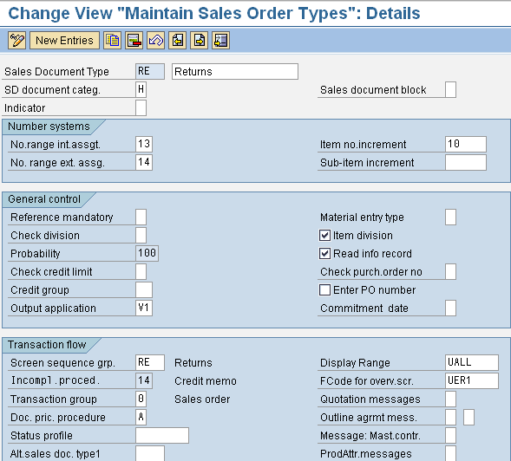
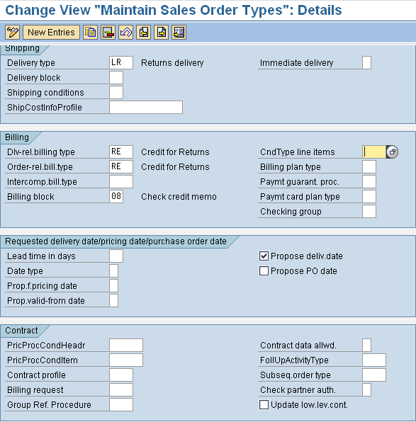
Configuration-Define Sales Document Types
Standard document type : RE
Delivery type that the system automatically proposes for this type of sales document during delivery processing
Assign Number Range
Maintain incompletion block
Transaction Code : VOV8
Menu Path : Sales and Distribution → Sales → Sales Documents → Sales Document Item → Define Sales Document Types.

Slide 18
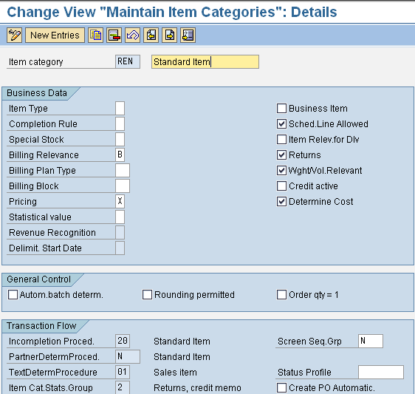
Define Item Categories
Standard document type : RE
Select field if item is return item.
Indicates what basis for billing should be.
For returns, status is according to order quantity.
Assign Number Range
Indicates whether the system automatically carries out pricing at the item level.
Maintain incompletion block
Indicates whether the system takes the value of an item into account when it determines the total value of a document.
Transaction Code : SPRO
Menu Path : Sales and Distribution → Sales → Sales Documents → Sales Document Item → Define Item Categories.

Slide 19
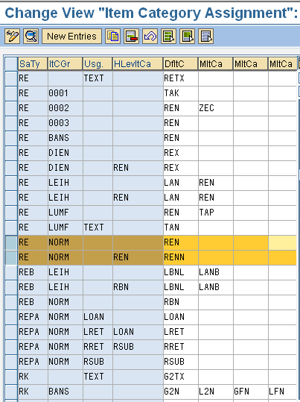
Assign Item Categories
The item usage indicator controls the system reaction when you process a
Sales document item in certain context (e.g. text , packing item etc)
Enter sales document type
The item category of the higher-level item determines the item category
of related sub-items.
System uses to determine item categories during processing of sales documents.
Specifies an item category that you can enter as an alternative to the
automatic proposal from the system.
Transaction Code : SPRO
Menu Path : Sales and Distribution → Sales → Sales Documents → Sales Document Item → Assign Item Categories.

Slide 20
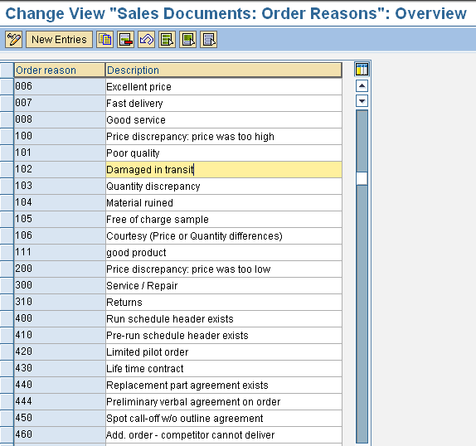
Define Order Reasons
Define reason of rejection. (it describes why an item in sales document was rejected. )
Transaction Code : SPRO
Menu Path : Sales and Distribution → Sales → Sales Documents → Sales
Document Header → Define Order reasons

Slide 21
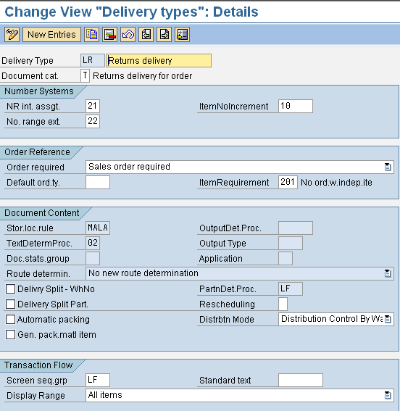
Define Delivery Document Type
It determines how the system stores and keeps track of document data.
Define delivery document type
Indicates whether a delivery that has no reference to an existing sales order is allowed.
Specifies a statistics group for this sales document type and helps determine which data the system updates in the LIS.
Transaction Code : OVLK
Menu Path : Sales and Distribution → Sales → Maintain copy control for sales documents

Slide 22
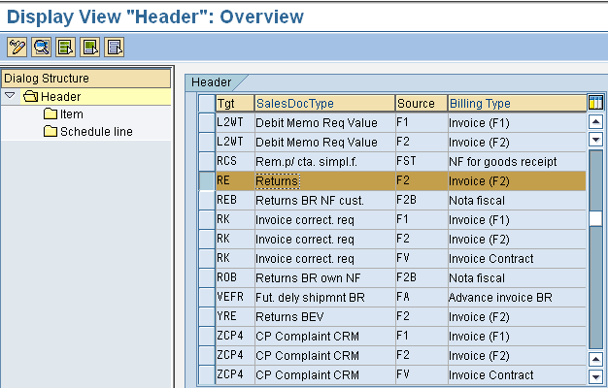
Copy control :
Sales document to delivery document
define control data for the document flow of deliveries. Also you can specify which document type is to be assigned to copied reference documents, and which item categories are to be copied.
Transaction Code : VTFA
Menu Path : Sales and Distribution → Sales → Maintain copy control for sales documents

Slide 23
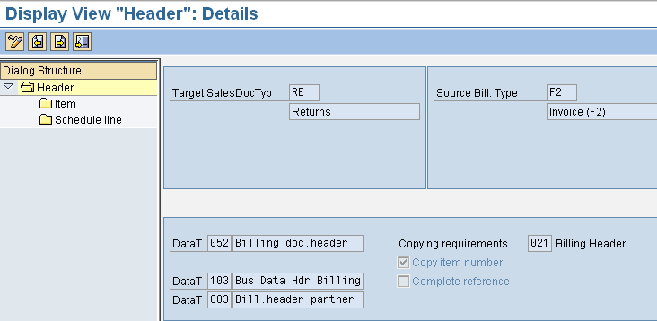
Copy Control: Billing Document to Sales Document
define control data for the document flow from billing document to sales documents.
Transaction Code : VTAF
Menu Path : Sales and Distribution → Sales → check

Slide 24
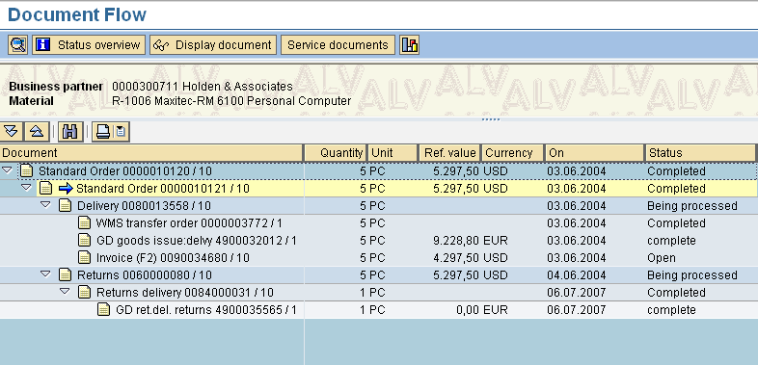
What will be document flow?
What is sales
document number ?
What is status of document ?
What is delivery
document number ?
Transaction Code : VA03
You can display sales order and click on ‘ DOCUMENT FLOW ’.

Slide 25
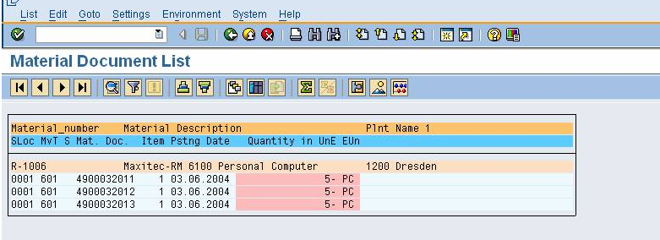
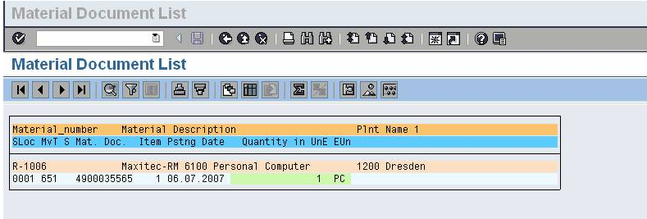
Goods Movement Types
Movement Type for Goods Issue
Movement Type for Goods Returns
Transaction Code : MB51

Slide 26

Additional Info
You can create invoice
  With reference order
  T-Code is VA01
You can create
  Spilt invoices (if Bill to party is different)
  Collective (if Bill to party is same or you can combine
  Items from more than one delivery)
You can create invoice list
  for invoices and debit memos
  for credit memos

Slide 27
Tips and Tricks
You can create invoices using background job.
You can run background job automatically as follows :
  Periodically
  At a specific time
You can edit log by viewing ‘Change Billing Document’.
Billing Document type is determined automatically ,
hence no need to select in ‘ create billing document ‘screen .
{

