Slide 1
OBJECTIVES
To design a GaN HEMT power amplifier operating in the S-band frequency range, optimized for both high linearity and efficiency.
To design and layout the PA, followed by EM co-simulation.
04/09/24
Capstone Project B.Tech 2021-25 Phase -2 ISA 1
1

Slide 2
OBJECTIVES
SPECIFICATIONS TARGETED
Output Power | 40 dBm
PAE | 70%
Gain | > 13 dB
S11 and S22 | < -15 dB

Slide 3
METHODOLOGY
Transistor choice: GaN HEMT CGH40010F model from CREE
Biasing conditions: For class AB operation at Vds=28 V and Vgs=-2.7 V.
Stability analysis: unconditional stability was achieved across the entire frequency range by incorporating a 5-ohm series resistor at the gate terminal of the device.
Load-pull analysis to obtain optimal load and source impedance.

Slide 4

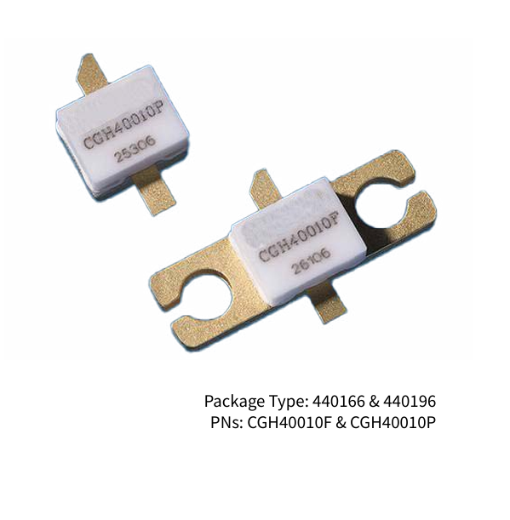
METHODOLOGY
Transistor choice: GaN HEMT CGH40010F model from CREE
It’s superior characteristics:
Wide bandgap,
High breakdown voltage,
Exceptional electron mobility,
And high saturation velocity

Slide 5
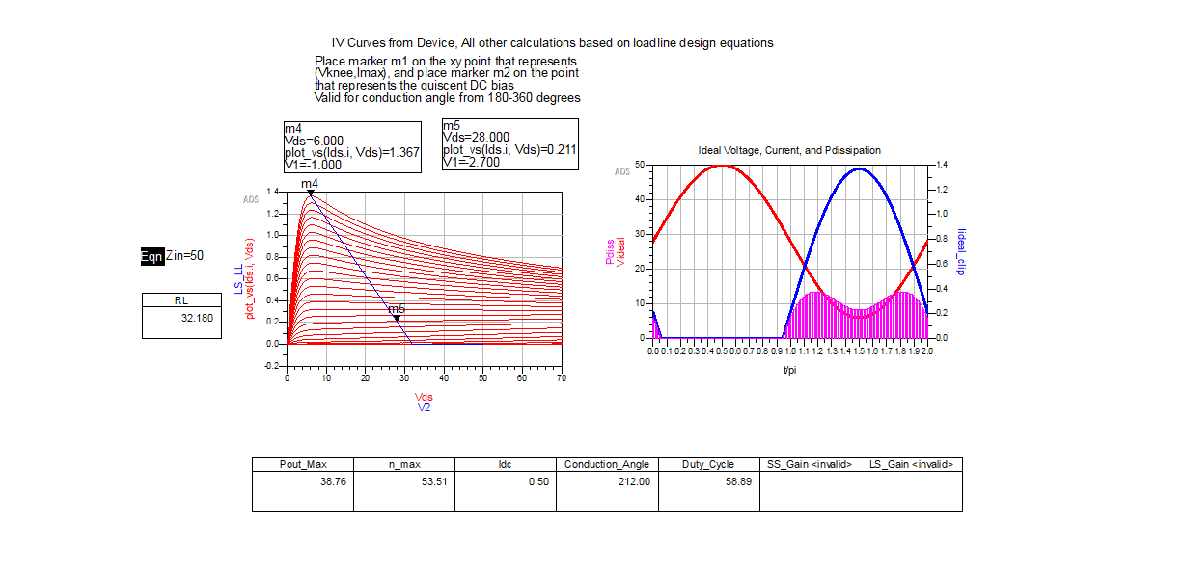
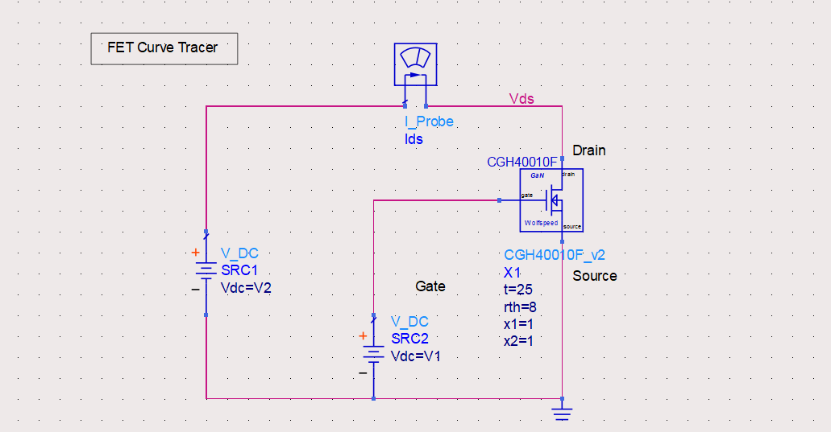
METHODOLOGY
DC Biasing of the transistor:
The transistor is biased for
Class AB operation
At V1=-2.7V, V2=28V.

Slide 6
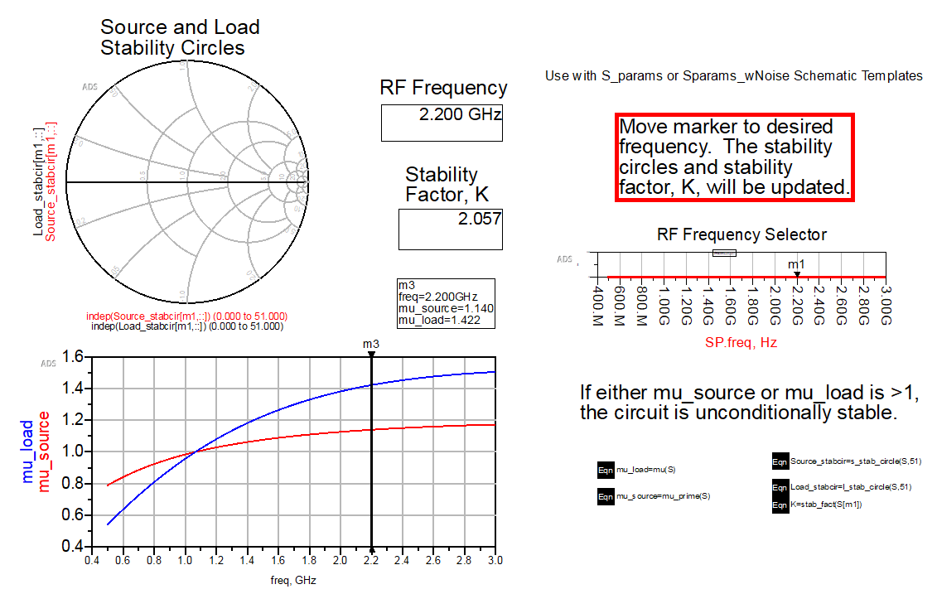
METHODOLOGY
STABILITY ANALYSIS:
A stability analysis was conducted on the device, examining Rollet's K factor.
The results indicated instability within the desired operating frequency range as K was found to be less than 1.
To address this, various stabilization methods were explored and the addition of a 5-ohm resistor was found to be optimal.
Thus, unconditional stability was achieved across the entire frequency range by incorporating a 5-ohm series resistor at the gate terminal of the device.
The stability factor (K) was confirmed to be greater than 1 throughout the operating band, ensuring reliable circuit performance.

Slide 7
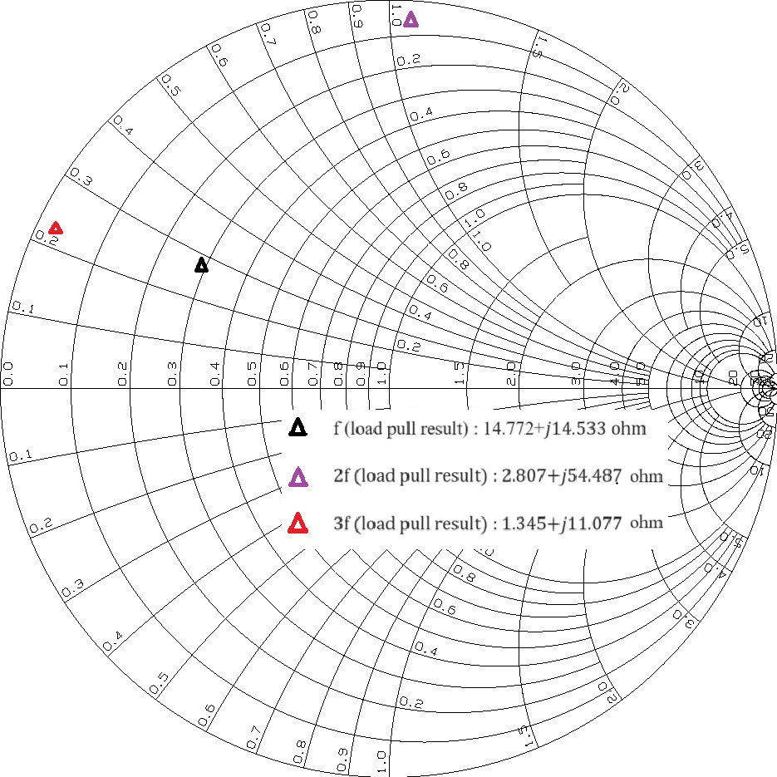
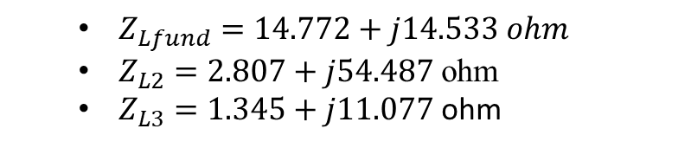
METHODOLOGY
LOAD-PULL ANALYSIS:
Load pull analysis is conducted to determine the optimal impedance which when matched to a 50-ohm load, maximize power transfer while minimizing losses.
The optimal load impedance thus obtained at fundamental, 2nd and 3rd harmonic frequencies were
r
In order to transform these impedance optimally, the impedance matching network (IMN) for the design of high efficiency PA is constructed.

Slide 8
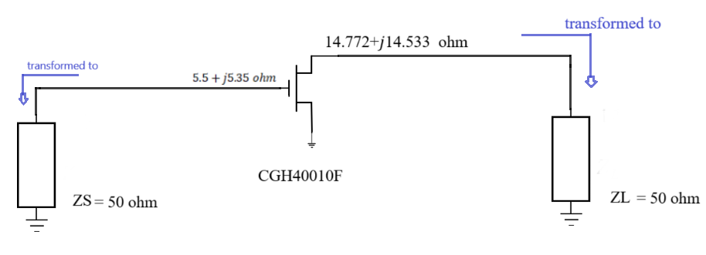
METHODOLOGY
WHY IMPEDANCE MATCHING?
The reason impedance matching is important in transmission lines is to ensure that a 5V signal sent down the line is seen as 5V signal at the end of the receiver.
If impedance between the load and source is mismatched, there will be some reflections when the signal is launched. As a result, some signal is lost and maximum power is not transferred to the receiver, which decreases efficiency.
When the source and load are matched, reflections are suppressed. As a result, the signal transmitted at the source is received at the load with minimal losses.

Slide 9
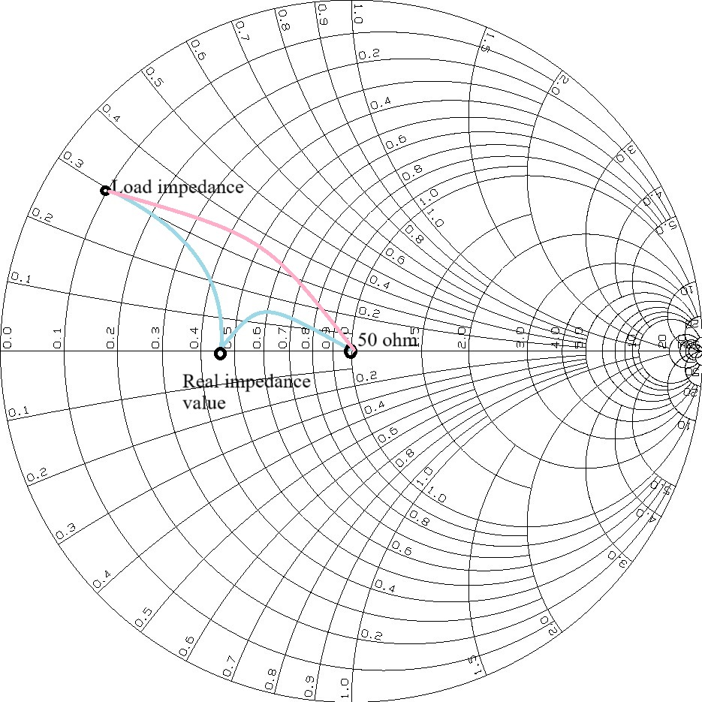
METHODOLOGY

Slide 10
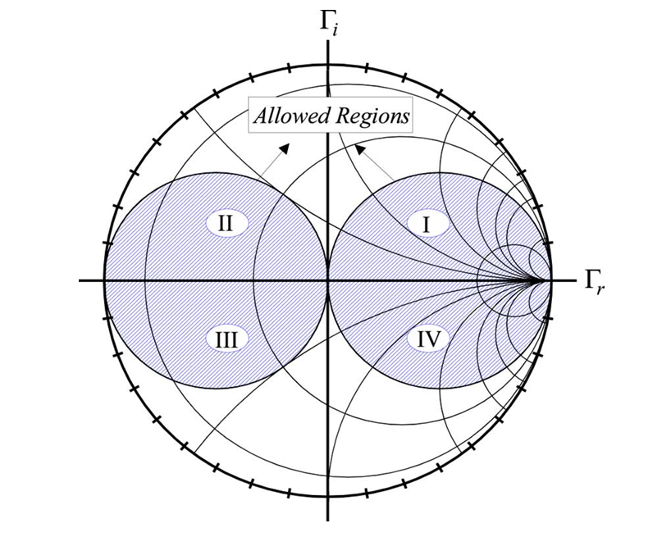
METHODOLOGY
The impedances in region 2 and 4 can be matched by a single transmission line. However, those in region 1 and 3 need to be transferred to regions 2 and 4, respectively. This involves employment of an additional transmission line.
An alternative approach is used to eliminate the use of an additional transmission line by modifying the equations.
An alternate equation is proposed (8) to find the electrical length of a single transmission line that matches load to the impedance that lie in quadrant 2.
Allowed regions displayed on smith chart

Slide 11
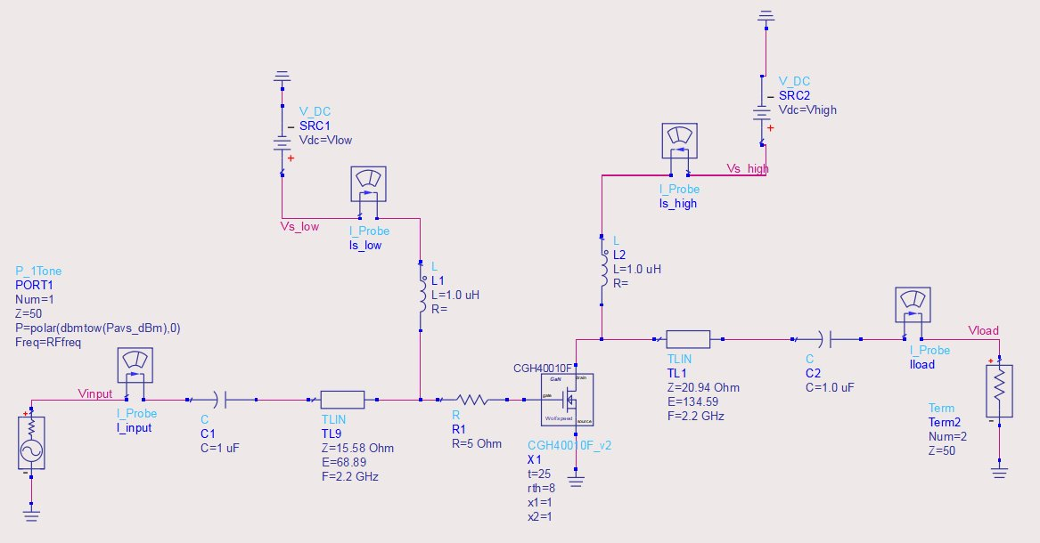
Schematic of PA with fundamental matching network
METHODOLOGY

Slide 12
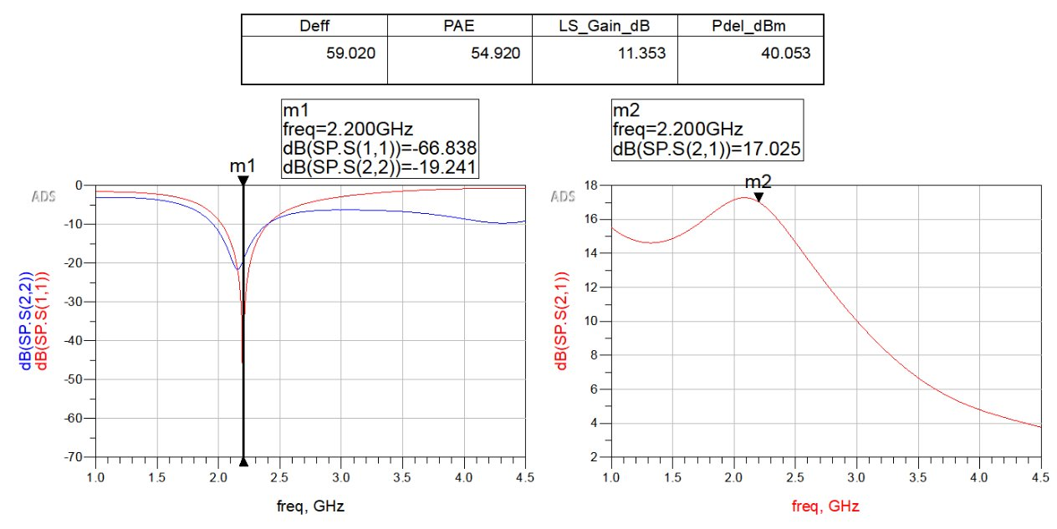
METHODOLOGY
Simulation Results of PA with Fundamental matching

Slide 13
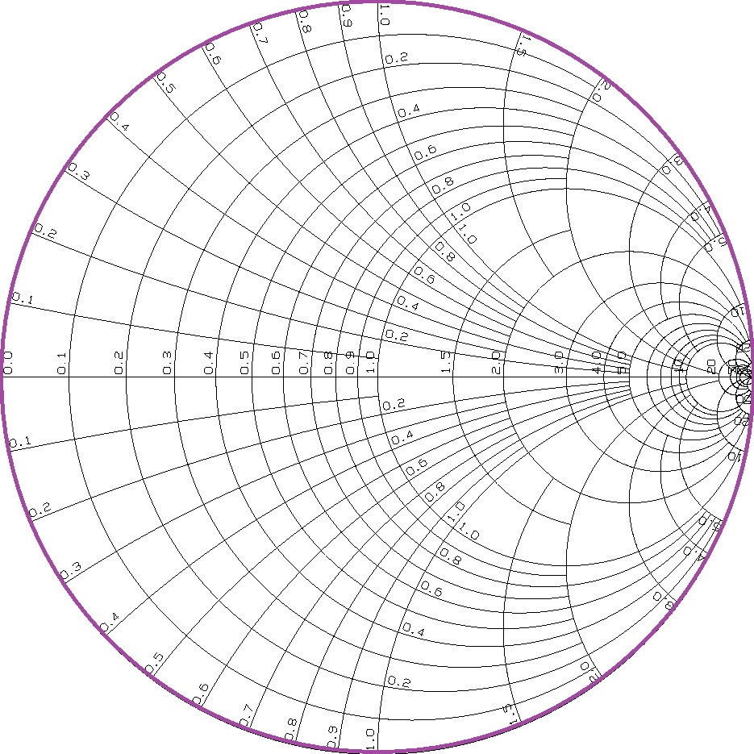
METHODOLOGY
λ/2 stub:
A λ/2 stub repeats the impedance seen at its far end. This means the input impedance of a λ/2 stub is exactly the same as the load impedance ZL​ at the end of the stub.
Mathematically, if ZL​ is the impedance at the load end, then: Zin​=ZL​
A λ/2 stub causes a 360-degree rotation (a full circle) around the Smith chart. This brings you back to the same point where you started.
λ/2 stub
λ/2 STUB
Short circuit
Z = 0
Open circuit
Z = ∞

Slide 14
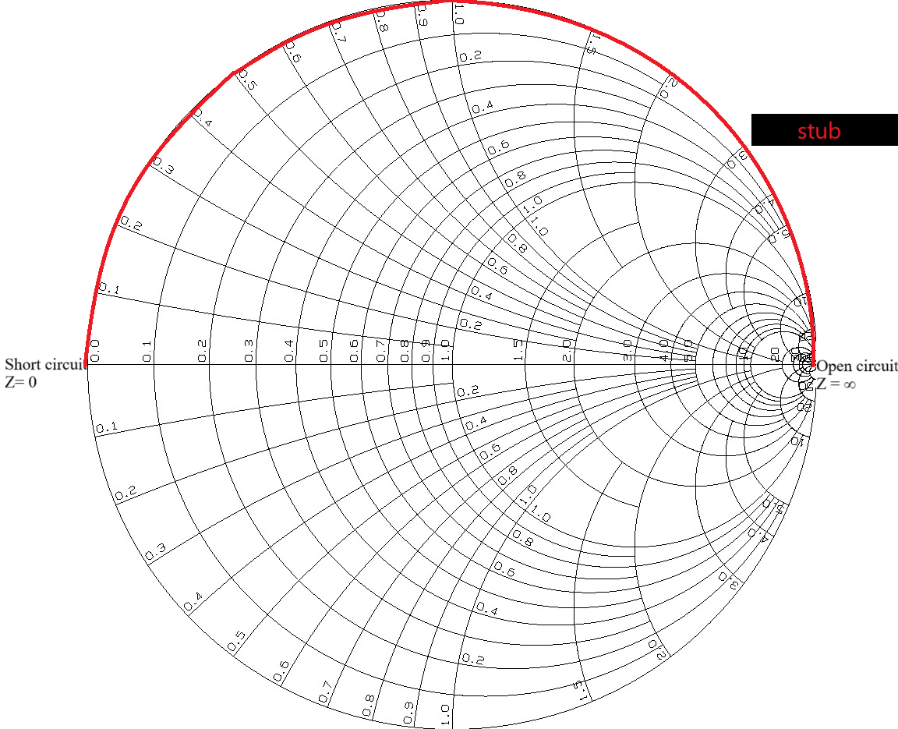

METHODOLOGY
λ/4 STUB:
A λ/4 stub acts as an impedance inverter. This means that it transforms an impedance ZL at one end of the stub to its reciprocal (with respect to the characteristic impedance Z0 of the transmission line) at the other end.
Mathematically, if the load impedance at the end of a λ/4\ stub is ZL, the input impedance looking into the stub will be:
λ/4 STUB
A λ/4 stub causes a 180-degree rotation (half a circle) around the Smith chart's constant resistance or constant conductance circle. This effectively inverts the impedance.

Slide 15
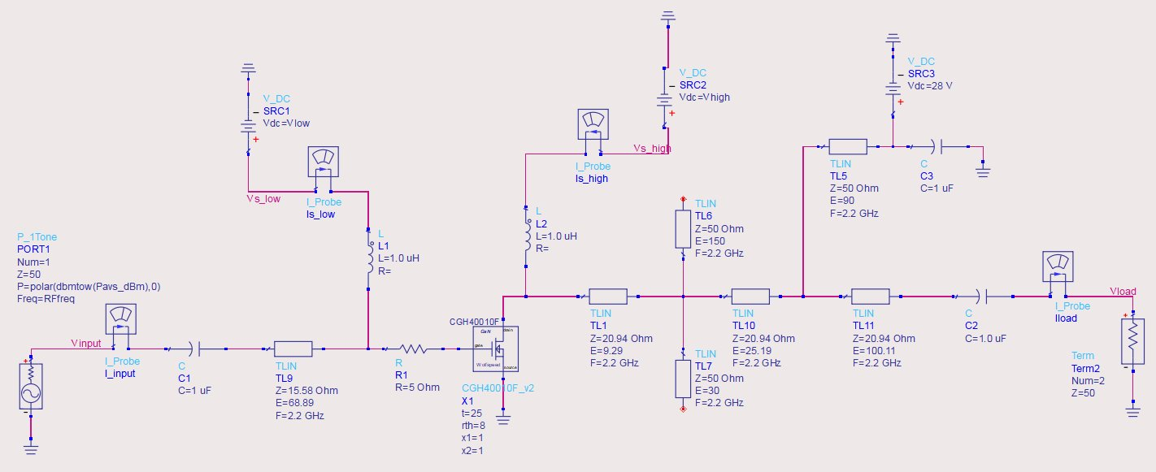
METHODOLOGY
Schematic of PA with harmonically tuned matching network

Slide 16
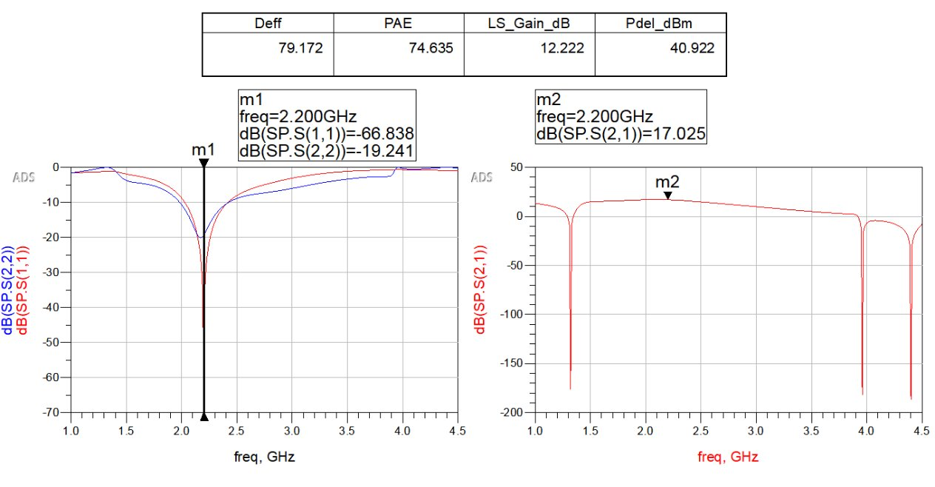
METHODOLOGY
Simulation Results of PA with Harmonically tuned matching

Slide 17
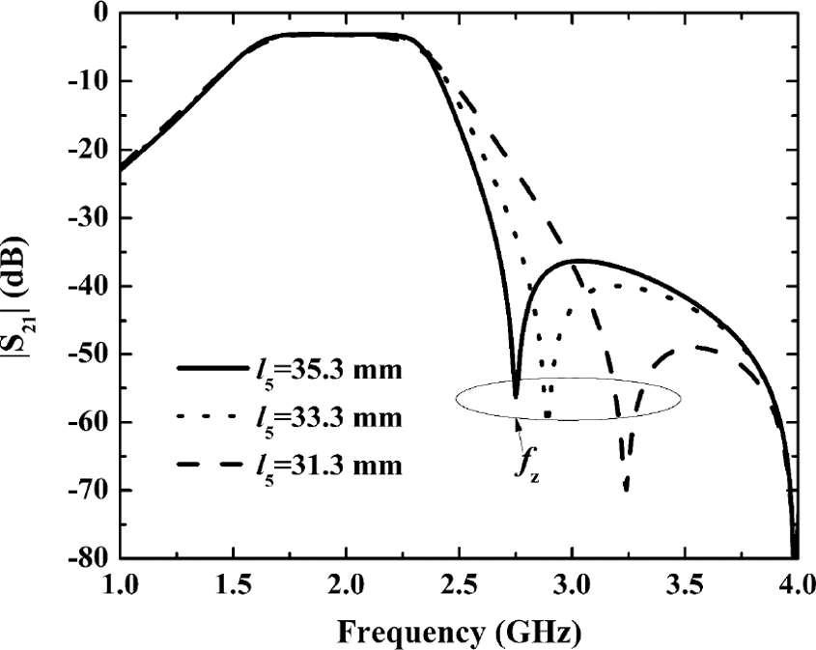
METHODOLOGY
A small signal gain exceeding 12 dB is observed outside the desired bandwidth. This needs to be addressed to ensure that the transmitting bandwidth is limited to 200 MHz.
HOW?
TRANSMISSION ZERO

Slide 18
TRANSMISSION ZERO
METHODOLOGY
A transmission zero is a frequency at which the transfer function of a circuit or filter network goes to zero, meaning that the circuit completely blocks or attenuates signal transmission at that specific frequency.
They are often intentionally designed into filters and amplifiers to suppress unwanted frequencies.
Transmission zeros help achieve sharp selectivity in filter designs. By creating transmission zeros near the edges of the passband, you can improve the filter's ability to reject unwanted signals while maintaining a flat response in the desired passband, thereby enhancing the desired response.

Slide 19
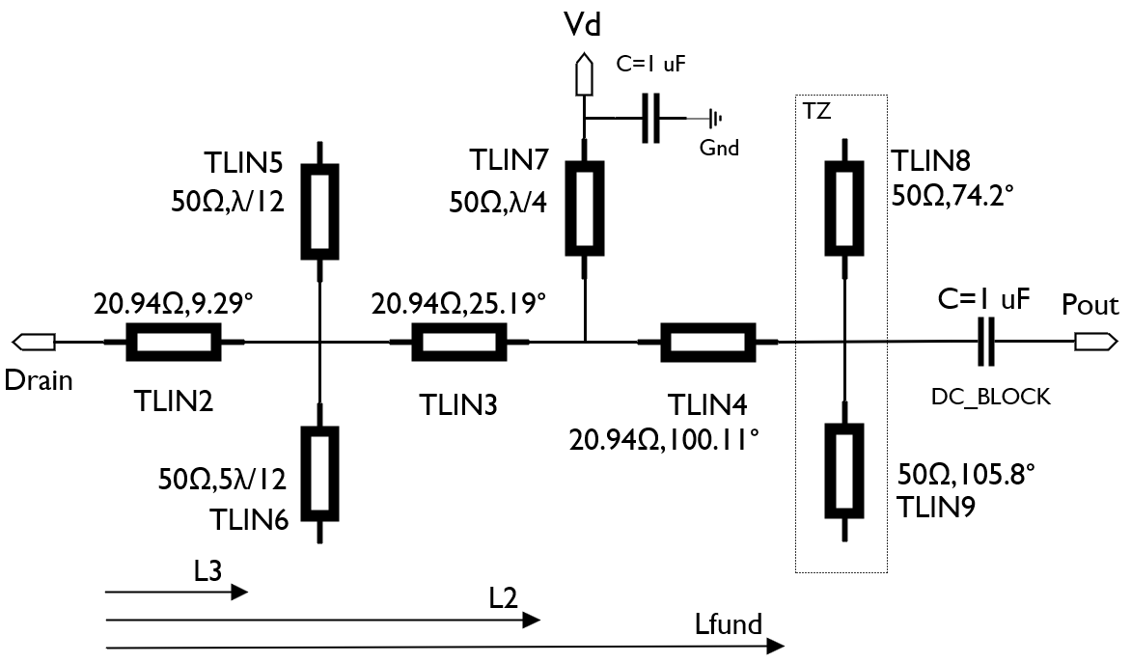
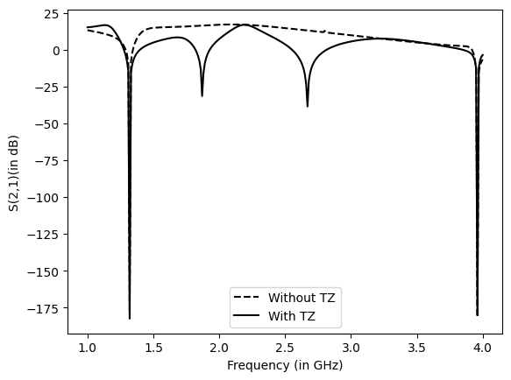
METHODOLOGY
To keep the transmitting bandwidth confined to 200 MHz, a transmission zero was generated with the help of shunt stubs that do not disrupt the matching and improve band selectivity, blocking unwanted signal outside the bandwidth.
A transmission zero is introduced by incorporating an open-circuited stub (TLIN8) after the output matching network. This stub is precisely tuned to an electrical length of 74.2 degrees, complemented by another open-circuited stub (TLIN9) with a 105.8-degree length, combining to form a λ/2 stub. This configuration safeguards the integrity of the matching network while achieving the desired transmission zero.

Slide 20

METHODOLOGY
Fundamental Matching

Slide 21
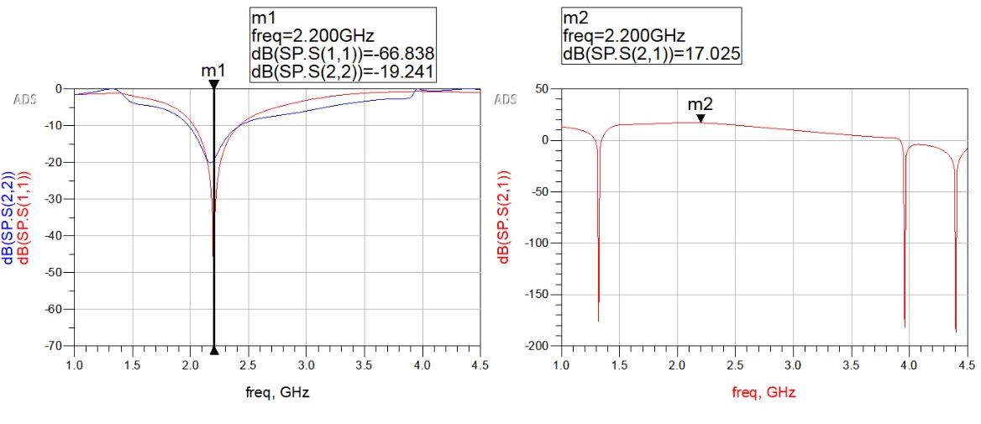
METHODOLOGY
Fundamental Matching
Harmonic tuning

Slide 22
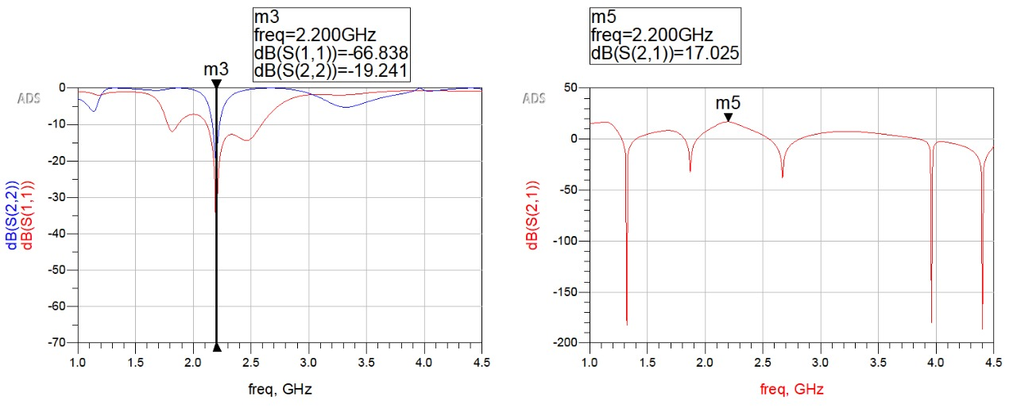
METHODOLOGY
Fundamental Matching
Harmonic tuning
Transmission zero

Slide 23
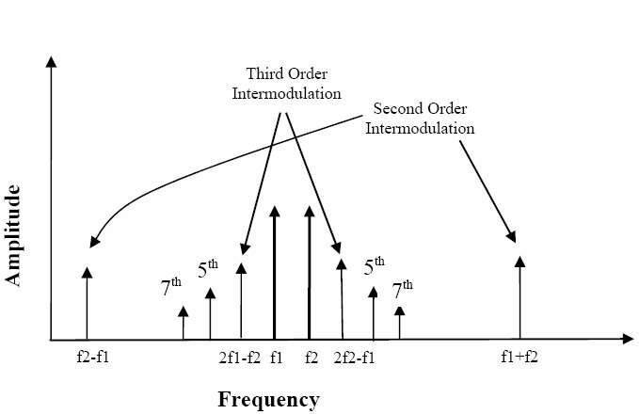
METHODOLOGY
What are Intermodulation distortions ?​
IMD can occur when a signal interacts with a nonlinear system. ​
This interaction causes frequency mixing and harmonic generations at multiples of frequencies, which creates additional peaks in the signal's power spectrum.​
IMD can cause minor to severe interference to other operations on the signal.​

Slide 24
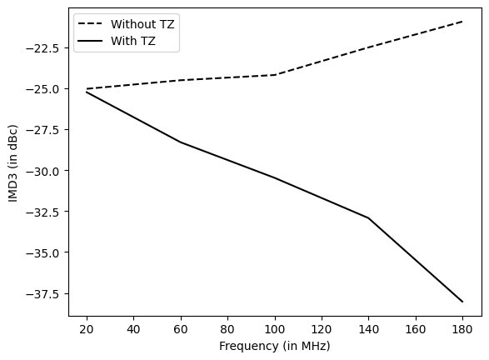
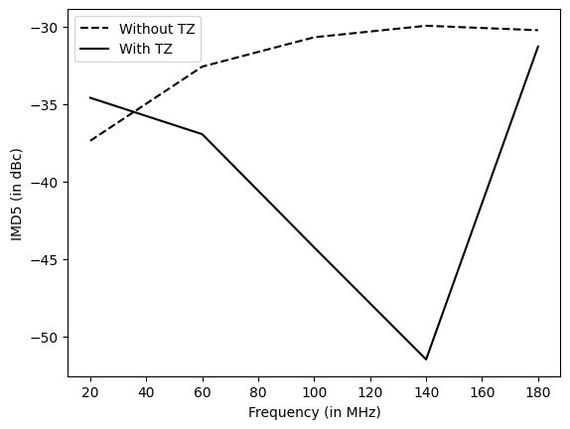
METHODOLOGY
On introducing transmission zero, the effect of 3rd and 5th order IMD were minimized. As the small signal gain reduces as we move away from centre frequency.​

Slide 25
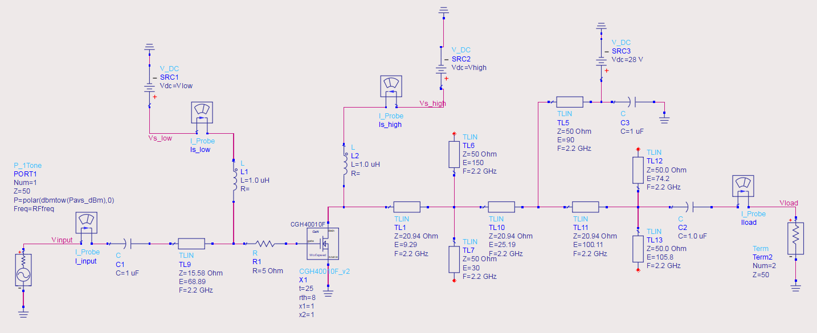
Final Schematic of HT PA
WORK PROGRESS

Slide 26
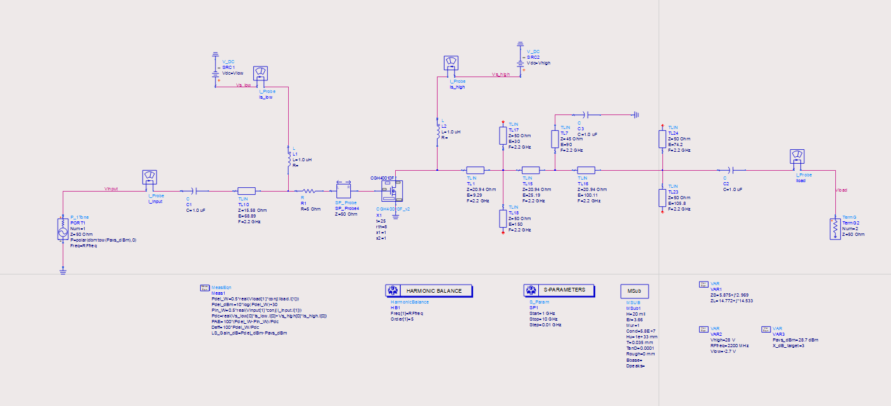
WORK PROGRESS

Slide 27
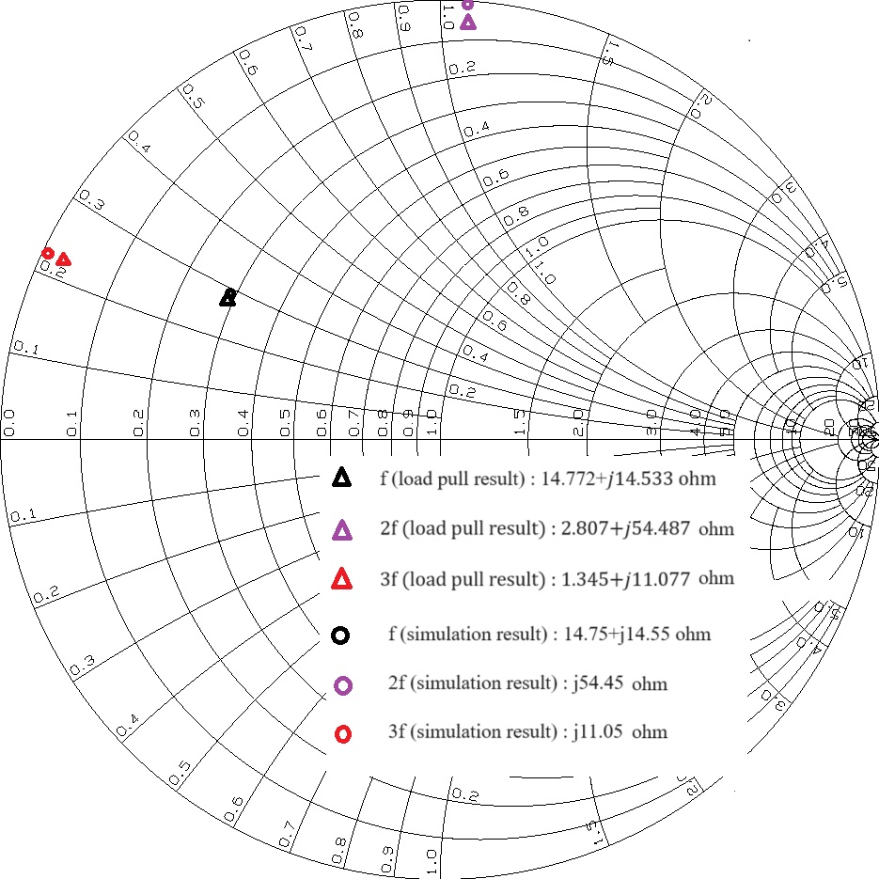
Smith chart for fundamental and harmonic impedances from load-pull simulation and designed results.
WORK PROGRESS

Slide 28
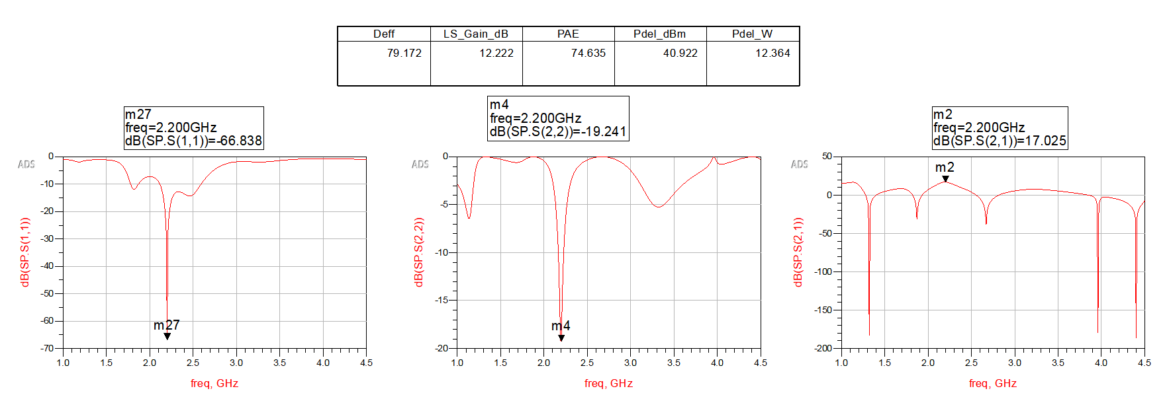
WORK PROGRESS
Simulation Results and Analysis
04/09/24
Capstone Project B.Tech 2021-25 Phase -2 ISA 1
28

Slide 29
WORK PROGRESS
 | INITIAL SPECIFICATIONS TARGETED | ACHIEVED
Output Power | 40 dBm / 10 W | 40.92 dBm / 12.3 W
PAE | 70% | 74.6%
Large signal gain | 12 dB | 12.2 dB
S11 | -15 dB | -66 dB
S22 | -15 dB | -19 dB
04/09/24
Capstone Project B.Tech 2021-25 Phase -2 ISA 1
29

Slide 30
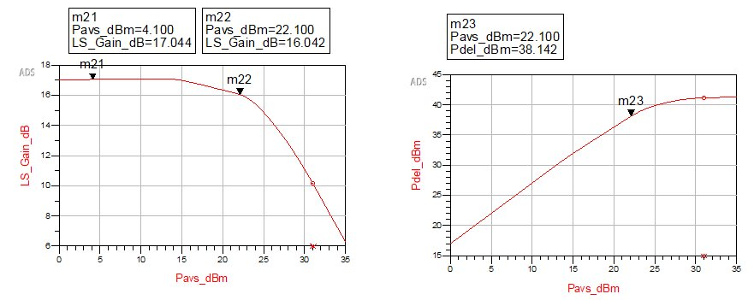
WORK PROGRESS
P1dB compression point was analysed to understand the linear behaviour of PA.​
It is found that increasing the input power level above 22.1 dBm introduces non-linearity, producing distortions.​

Slide 31
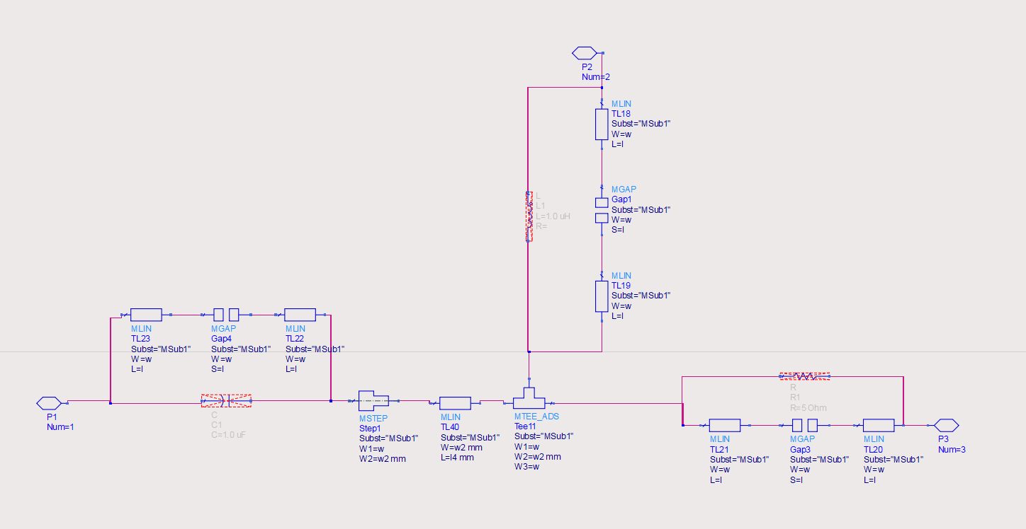
WORK PROGRESS
INPUT MATCHING NETWORK WITH INTERCONNECTS​

Slide 32
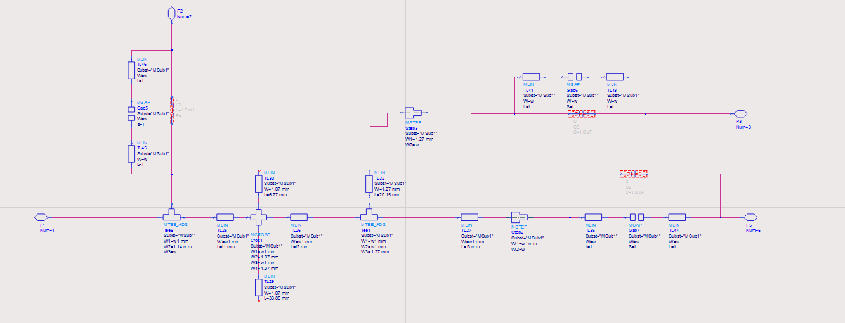
WORK PROGRESS
OUTPUT MATCHING NETWORK WITH INTERCONNECTS​

Slide 33
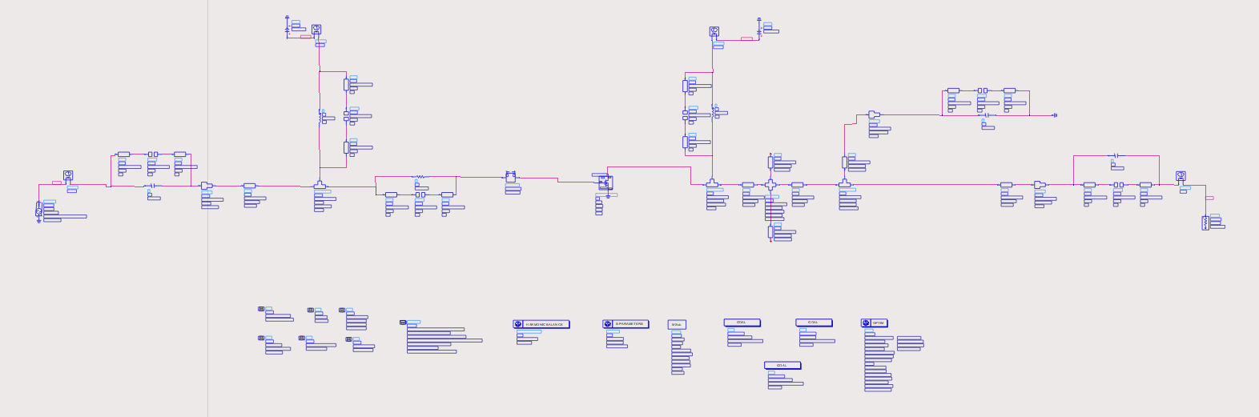
WORK PROGRESS
PA SCHEMATIC WITH INTERCONNECTS​

Slide 34
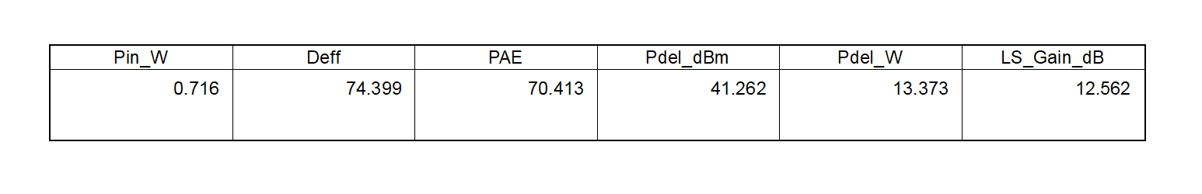
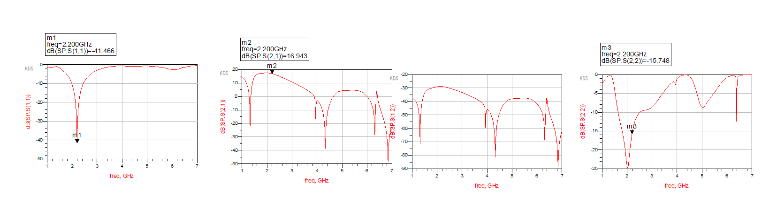
WORK PROGRESS
SIMULATION RESULTS AND ANALYSIS​

Slide 35
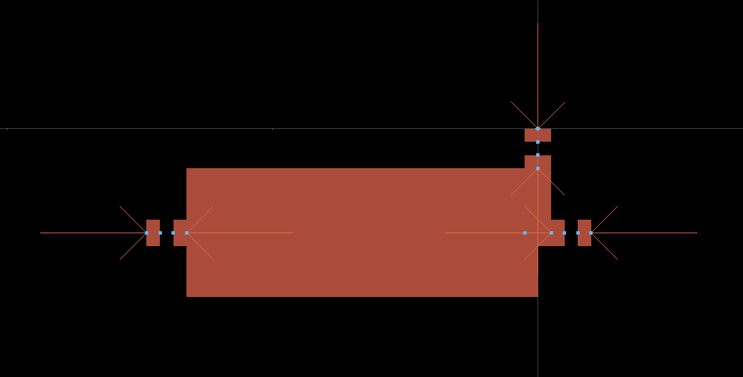
WORK PROGRESS
LAYOUT OF INPUT MATCHING NETWORK​

Slide 36
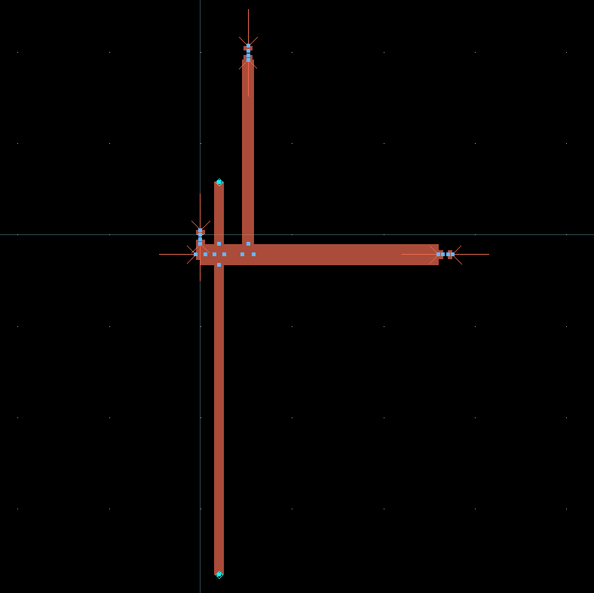
WORK PROGRESS
LAYOUT OF OUTPUT MATCHING NETWORK​

Slide 37
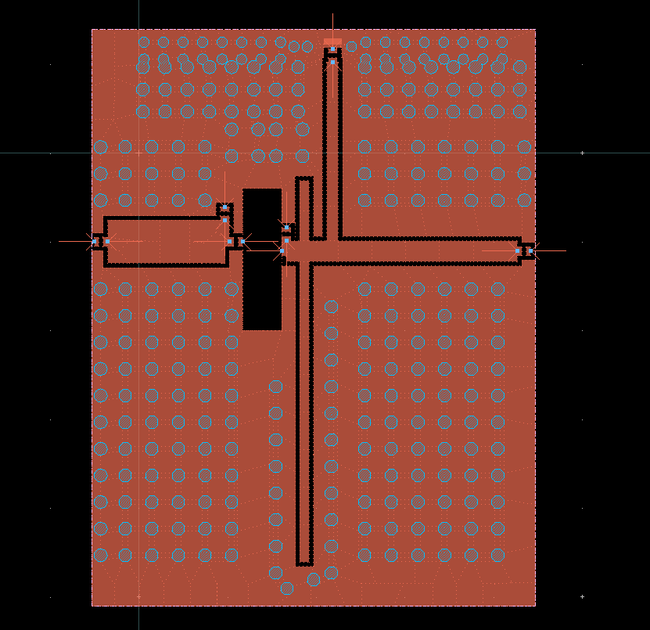
WORK PROGRESS
PA LAYOUT​

Slide 38
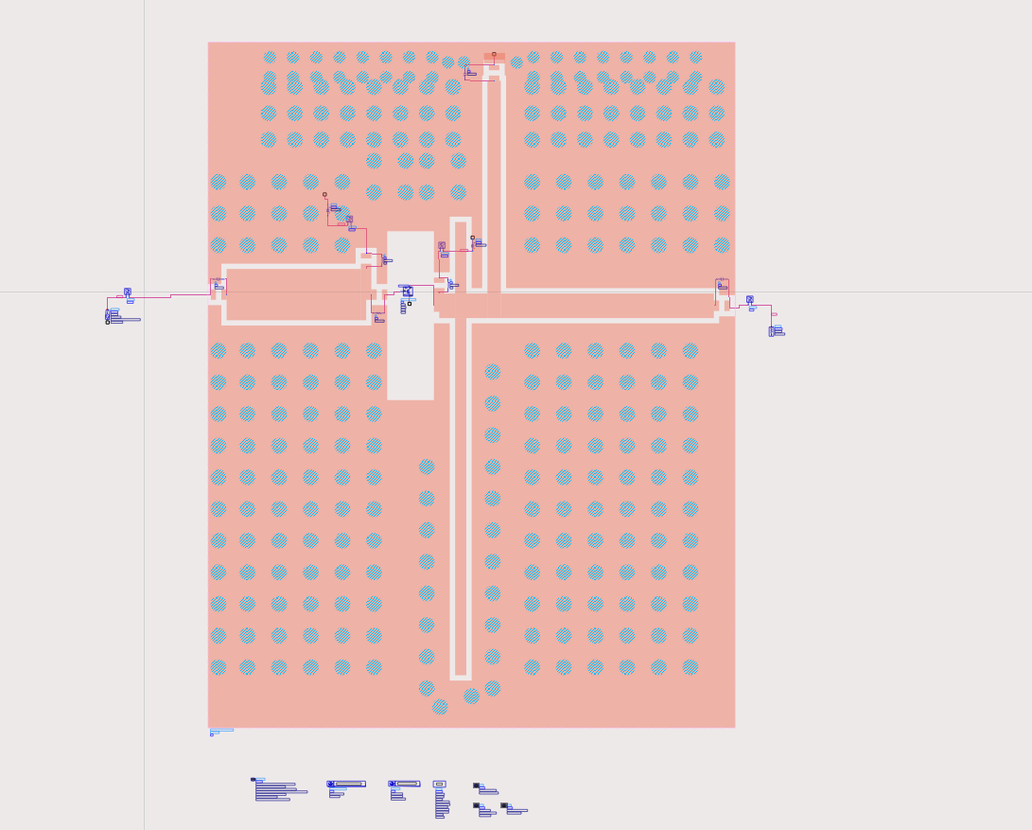
WORK PROGRESS
EM COSIMULATION TESTBENCH​

Slide 39
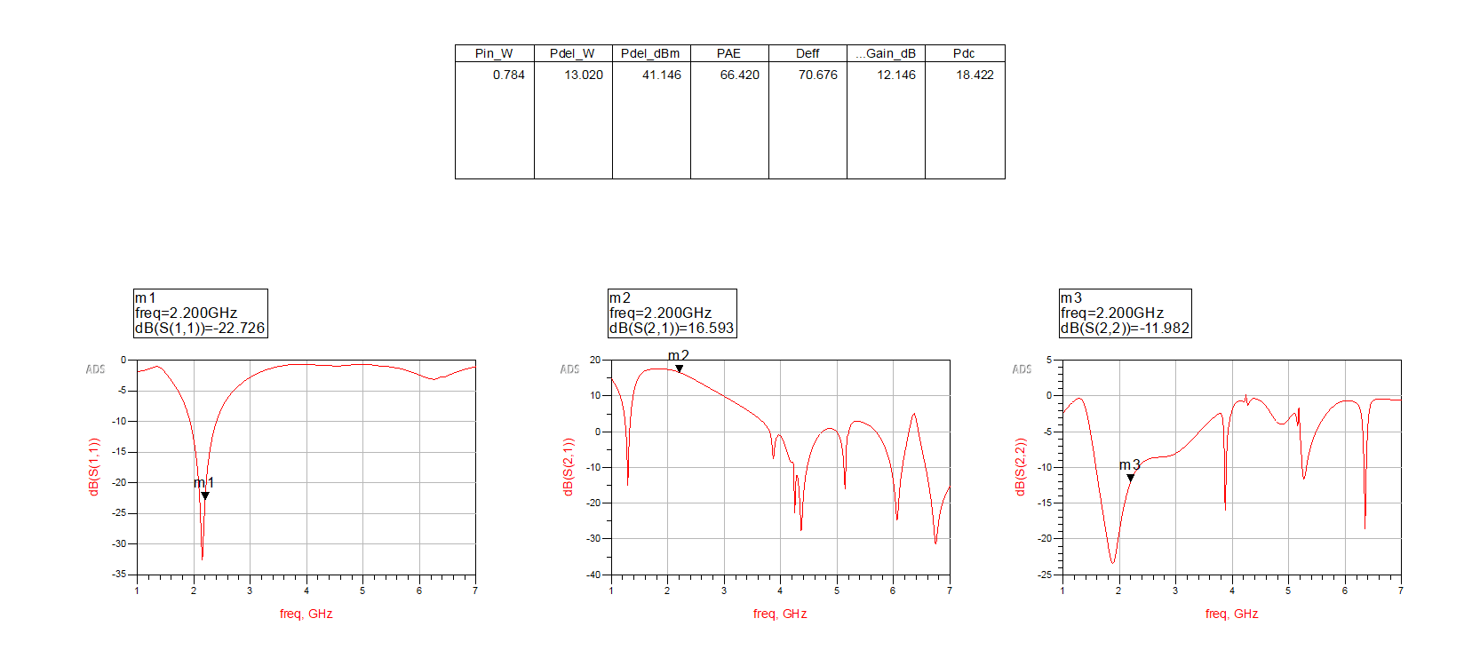
WORK PROGRESS
EM COSIMULATION SIMULATION AND RESULTS​

