Slide 1
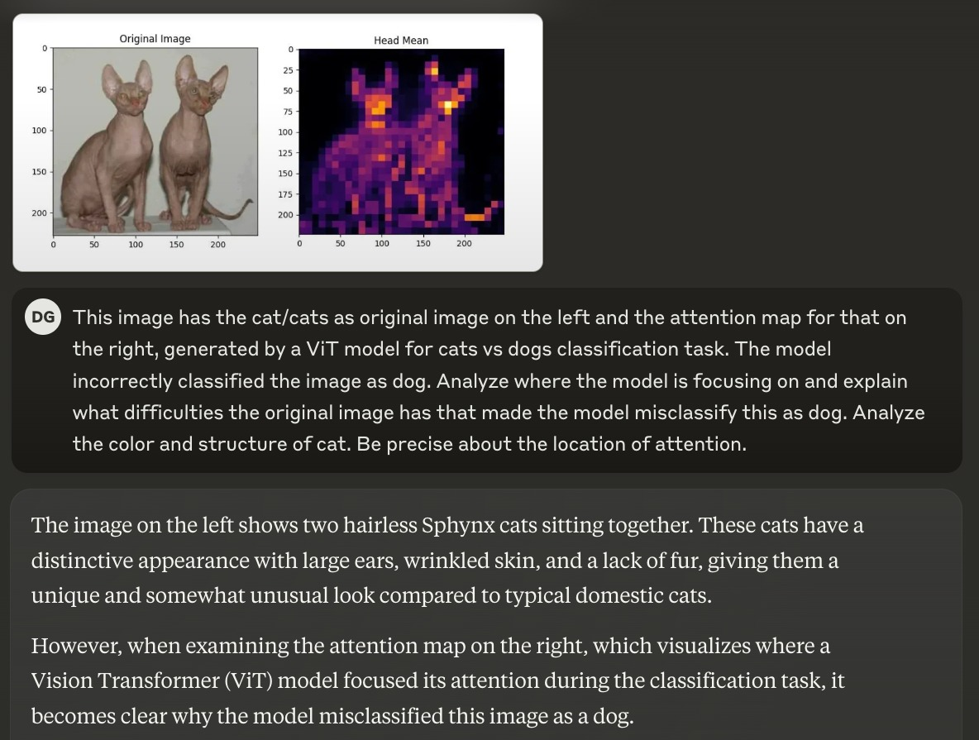
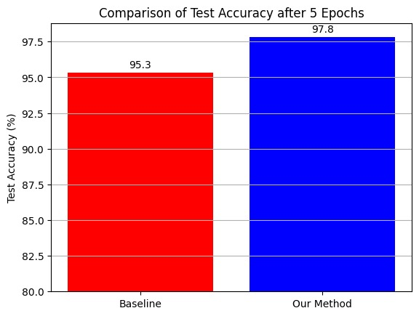
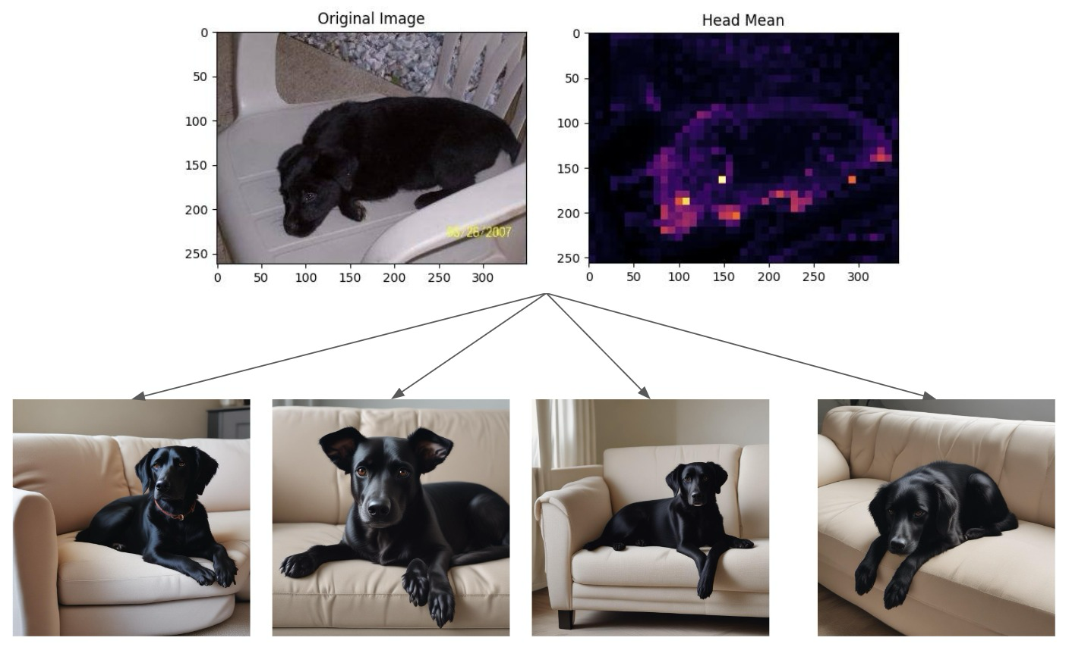
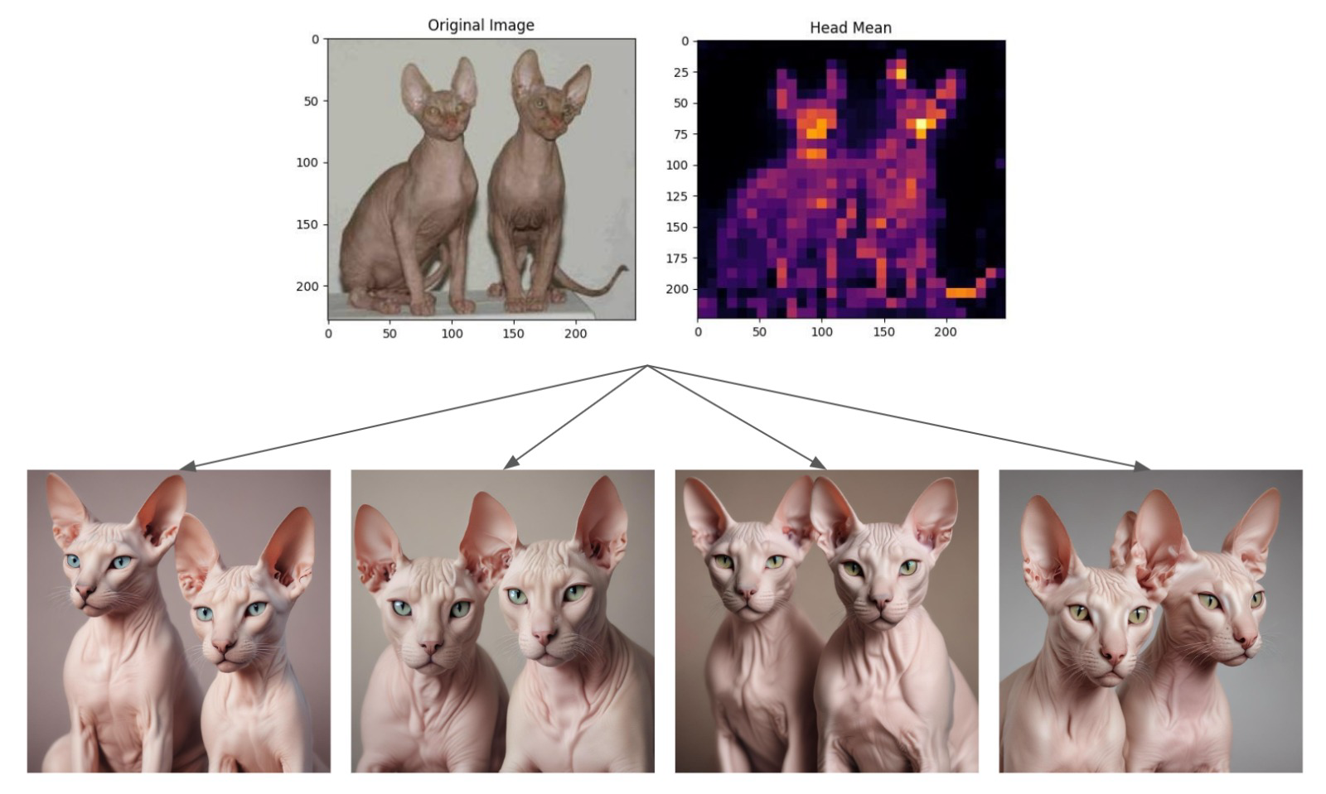
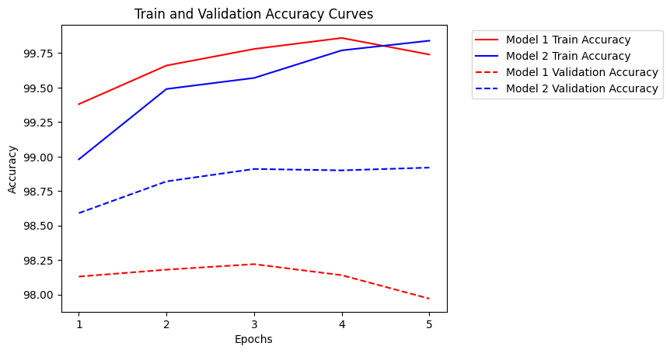
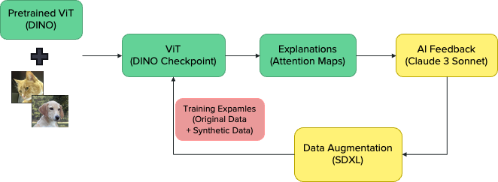
.
Does Explainability Help in Improving Vision Transformer?
Nagacharan Vemula, Darshan Govindaraj, Nivetha Murugaiyan Kumar, Siqin Yang, Saurabh Zinjad
Arizona State University, CSE 598: Operationalizing Deep Learning: Socio Perspective (2024 Spring)
Introduction
Method
Results (continued)
Vision transformers (ViTs) have achieved remarkable success in classification tasks. However, they can still struggle with certain examples. Leveraging explanation like attention maps along with AI feedback could help identify weaknesses and generate targeted training data to improve performance.
In this project, AI assistants are incorporated to automatically utilize ViT’s explainability information. Specifically, AI assistants first analyzes explanations and then synthesizes new data examples for data augmentation. While prior work has explored explainability for vision transformers and data augmentation separately, combining AI-driven feedback loops for targeted synthetic data creation is a novel approach in this study.
Trained the ViT DINO on the Cats-vs-Dogs dataset as baseline model.
Generated attention maps for misclassified test data samples.
Utilized Claude to analyze attention maps and to generate prompts for SDXL.
Utilized SDXL to generate 5 synthetic training images based on Claude's prompt for each misclassified data sample.
Further trained DINO with 5x150 new synthetic images + original data.
Evaluated the performance of baseline model & data-augmented model.
Generated Prompt:
"Hairless Sphynx cats in profile view, emphasizing distinct facial features, large ears, and wrinkled skin texture. Warm brown color matching the original cats' tone. Unique body shape and posture that highlights similarities and differences compared to dogs."
Figure 5. Prompt Generation by Claude
Results
Discussion
We observed a 2.5% increase in accuracy on the test data with our method compared to the baseline.
Based on the results, we can say that using AI feedback can help address the model's weaknesses and improve its performance in those areas.
We want to experiment with state-of-the-art models like Claude Opus and GPT-4 for the AI feedback functionality in the future.
Figure 3. Test Accuracy Comparison
References
Caron, M., Touvron, H., Misra, I., Jégou, H., Mairal, J., Bojanowski, P., & Joulin, A. (2021). Emerging Properties in Self-Supervised Vision Transformers. arXiv preprint arXiv:2104.14294.
Podell, D., English, Z., Lacey, K., Blattmann, A., Dockhorn, T., Müller, J., Penna, J., & Rombach, R. (2023). SDXL: Improving Latent Diffusion Models for High-Resolution Image Synthesis. arXiv preprint arXiv:2307.01952.
Figure 1. Pipeline Design
Figure 2. Images Generated by SDXL
Figure 4. Train and Validation Accuracy Comparison

