Slide 1
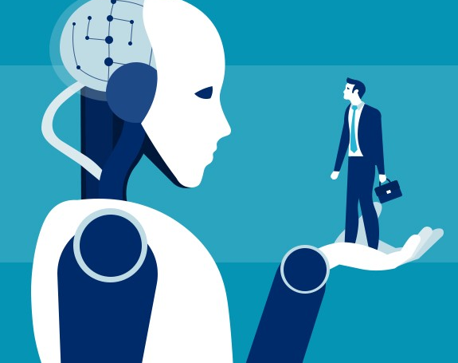

Team name: RPTECHBYTE
Application ID:SPS_CH_APL_20200002693
By Nagadath.G & Sindhura.P
AI Recruiter
Shortlist a Suitable candidate
for specific Job Role

Slide 2

Introduction
AI for recruiting is an emerging category of HR technology designed to reduce or even remove time consuming activities like manually screening resumes.
The basic challenge of recruitment remain including how to find, screen and shortlist candidates.
Shortlisting is the most time taking process in the recruitment.
The another main challenge will be Determining the Shortlist Criteria and it’s the most effecting factor of recruitment process.
The important thing here is to apply your criteria consistently , fairly and objectively across all candidates. This AI recruiting helps in Automating Candidate Short Listing.
To help you in identifying the right candidates from a large applicant pool, We have come up this AI recruitment technology Project.

Slide 3
Introduction
AI for recruiting is an emerging category of HR technology designed to reduce or even remove time consuming activities like manually screening resumes.
The basic challenge of recruitment remain including how to find, screen and shortlist candidates.
Shortlisting is the most time taking process in the recruitment.
The another main challenge will be Determining the Shortlist Criteria and it’s the most effecting factor of recruitment process.
The important thing here is to apply your criteria consistently , fairly and objectively across all candidates. This AI recruiting helps in Automating Candidate Short Listing.
To help you in identifying the right candidates from a large applicant pool, We have come up this AI recruitment technology Project.

Slide 4
Introduction
AI for recruiting is an emerging category of HR technology designed to reduce or even remove time consuming activities like manually screening resumes.
The basic challenge of recruitment remain including how to find, screen and shortlist candidates.
Shortlisting is the most time taking process in the recruitment.
The another main challenge will be Determining the Shortlist Criteria and it’s the most effecting factor of recruitment process.
The important thing here is to apply your criteria consistently , fairly and objectively across all candidates. This AI recruiting helps in Automating Candidate Short Listing.
To help you in identifying the right candidates from a large applicant pool, We have come up this AI recruitment technology Project.

Slide 5
Introduction
AI for recruiting is an emerging category of HR technology designed to reduce or even remove time consuming activities like manually screening resumes.
The basic challenge of recruitment remain including how to find, screen and shortlist candidates.
Shortlisting is the most time taking process in the recruitment.
The another main challenge will be Determining the Shortlist Criteria and it’s the most effecting factor of recruitment process.
The important thing here is to apply your criteria consistently , fairly and objectively across all candidates. This AI recruiting helps in Automating Candidate Short Listing.
To help you in identifying the right candidates from a large applicant pool, We have come up this AI recruitment technology Project.

Slide 6
Existing Problems
Problem 1
What if we fail in choosing the right criteria for selection?
The selection criteria may vary from position to position & company to company based on their need.
Selecting the essential and desirable criteria for the job role is the main challenge that decides the whole recruitment problem.
But , in most of the cases the company itself will be in a confused state of right criteria for the recruitment.
This Right Criteria Selection is a major problem.

Slide 7
Existing Problems
Problem 2
Introverts tend to fail in interviews
It is estimated that a maximum 40 percent of the interviewees are introverts.
This became a problem for the interviewers to know whether they are talented enough for that job or not.
This also became a curse for the introverts when it comes to job interviews.
Many times the hiring mistake of first impressions knocks introverts out of the ring in the first few minutes of the interview
Probably, Companies will not be realizing how much talent they're missing out on?

Slide 8
Proposed Solution
We have come with a three phase solution scheme
where each phase deals with the recruitment process in a Different way
Phase 1
General way of recruitment.
Here, the Company should set its requirements initially.
when a candidate submits his details, our model compares with the requirements and takes an action based on it.

Slide 9
Proposed Solution
Phase 2
Deals with AI-enabled way of recruitment.
This is to overcome Problem 1 discussed above
Our model trains based on the previously working employees data.
Applies this knowledge of existing employees to new applicants in order
to predict the Selection Possibility for the shortlisting candidates list.
Phase 3
It is based on Work & Prove method.
This is to overcome Problem 2 discussed above
Here, the job posting company should post a challenge of work.
Our ChatBot displays the problem to the candidate which must be solved that results in expected output.

Slide 10
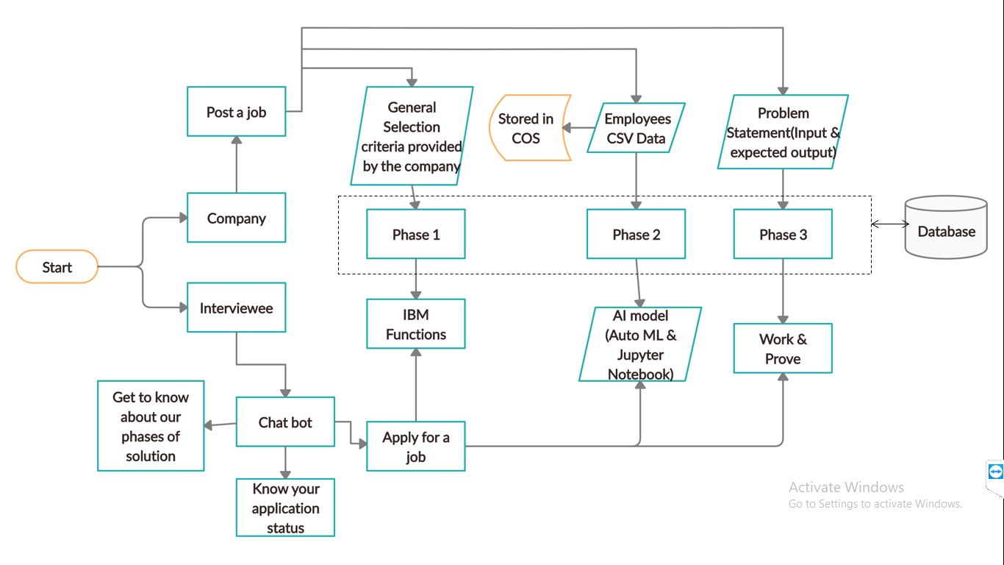
FlowChart

Slide 11

Advantages
1.The first main advantage is :
Helps to balance the dilemma triangle where you had to choose between ‘good’, ‘cheap’, and ‘fast’ – but could only pick two? By significantly reducing the amount of time you need to spend digging through resumes or screening applicants, AI helps you move through the interview process faster – without sacrificing quality of candidates.
2.AI can help in Determining Unbiased Criteria for a candidate
3. By automating conversations related to specific hiring or job questions, candidates can get the answers they’re looking for at any time of the day.
4. Right Criteria Selection- Even if the company doesn’t know about the required criteria , We use the AI model for predicting based on previous employees data.

Slide 12

Disadvantages
The two main disadvantages of AI recruitment are:
AI’s data-based conclusions may not show a recruiter what someone’s work ethic or character is like. Sometimes a Face To Face Interview is the best way for a company to recruit based on what they need in the present moment.
In this project we haven’t included a crosscheck method to know whether the candidate included details are valid are not.

Slide 13
Conclusion
Finding, connecting, and retaining people is a complicated process whereas Our AI Recruiter helps in doing the entire screening process and connects the recruiters and candidates with a better experience. We’ve used the IBM Watson Assistant, IBM cloud services and apps to the best of our chance to make the project more Accurate and Useful. Because of our three phase solution
We have even provided an opportunity for introvert candidates
We can determine right criteria for shortlisting using the previous Working employees traits trained AI model
ChatBot interaction for the candidates makes the project even more Accessible Because the Candidate Experience is such a core element of the recruiting process

Slide 14
Thank You

