Slide 1

Chronic Kidney Disease Prediction using Logistic Regression Machine Learning Algorithm
G.Nagadath

Slide 2
Overview
This project is about predicting whether a person
has chronic kidney disease or not. In this Project, we tried to provide a platform(website) for users to enter their symptoms and medical values as an input to predict the possibility of Chronic Kidney disease
After applying all algorithms of Classification ,
we came to conclusion that Logistic Regression is the good fit of all.
Thus, we have used it to predict the outcome

Slide 3
Technical Description:
Python community has developed many modules to help programmers implement machine learning.So,We have used python-3 for implementing our model using various ML algorithms. After implementing our model, IBM Watson studio is used to integrate and deploy the code & making it accessible in various user platforms. Then, NodeRed is used to created an Web UI.

Slide 4
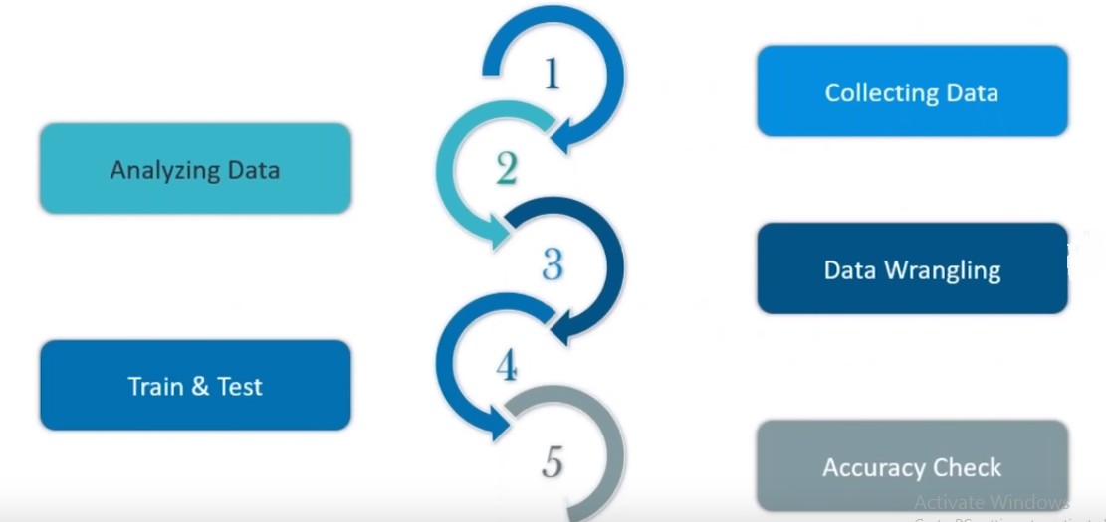
Followed steps for implementing the code in
Python-3:

Slide 5
1. Collecting Data
I used the dataset from the UCI Machine Learning Repository named Chronic Kidney Disease. Total 400 instances of the dataset is used for the training to prediction algorithms.
2. Analysing Data
At first, we have verified whether there are any abnormal values or null values and then we tried to replace them with the appropriate values.

Slide 6
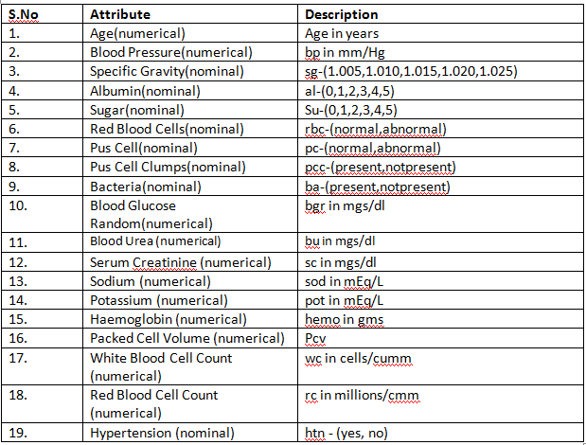
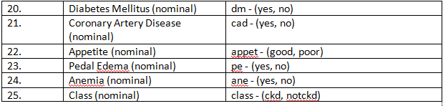

Slide 7

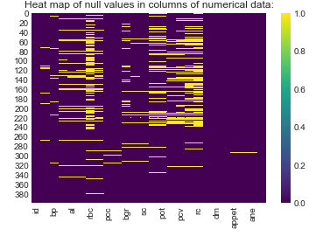
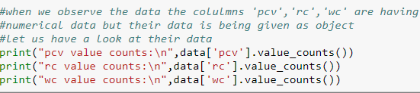
Verifying the data to check the presence of null values or any abnormal values:

Slide 8
3. Data Wrangling
Here we have retrieved the values from abnormal values and replaced all the null values to mean/mode of the column based on their type (categorical/continuous).
All the categorical values of a column are replaced with its respective mode of it .In columns of numerical data,we replaced the null values with mean values.
.
Filling Null Values with Mode values:
data['rbc'].fillna('normal',inplace=True)
data['pc'].fillna('normal',inplace=True)
data['pcc'].fillna('notpresent',inplace=True)
data['ba'].fillna('notpresent',inplace=True)
data['htn'].fillna('no',inplace=True)
data['dm'].fillna('no',inplace=True)
data['cad'].fillna('no',inplace=True)
data['appet'].fillna('good',inplace=True)
data['pe'].fillna('no',inplace=True)
data['ane'].fillna('no',inplace=True)

Slide 9
Filling Null Values(Mean):
data.fillna(data.mean(),inplace=True)
Encoding the categorical data:
enc= {"rbc":{"normal": 1, "abnormal": 0},
"pcc": {"present": 1, "notpresent": 0},
"htn": {"yes": 1, "no": 0},
"dm": {"yes": 1, "no": 0,"\tno":0,"\tyes":1," yes":1},
"cad": {"yes": 1, "no": 0,"\tno":0},
"appet": {"good": 1, "poor": 0},
"ane": {"yes": 1, "no": 0},
"classification":{"ckd":1,"notckd":0,"ckd\t":1}}
data.replace(enc, inplace=True)

Slide 10
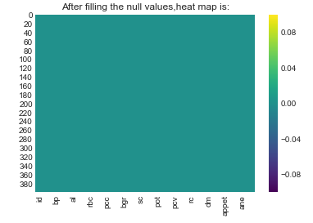
Converting Abnormal(String) values to Numerical Data:
#converting the string type into numeric data of the specific columns--pcv,rc,wc
for x in data['pcv']:
if type(x)!=float:
data['pcv']=data['pcv'].replace(x,int(x))
for x in data['wc']:
if type(x)!=float:
data['wc']=data['wc'].replace(x,int(x))
for x in data['rc']:
if type(x)!=float:
data['rc']=data['rc'].replace(x,float(x))
After Missing Value Treatment:
It indicates that all the null values are removed(0.0) from the data.
One more thing we have included in Data Wrangling is Visualization.

Slide 11
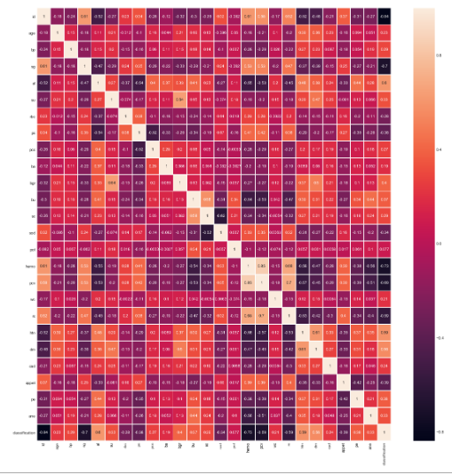
Visualization:
In visualization, we have shown the relation between the independent and dependent variables and based on the correlation (using the heat map) we have shown the dependency between them. Let us plot the attributes that influence more(like hemo,sg,su..)

Slide 12
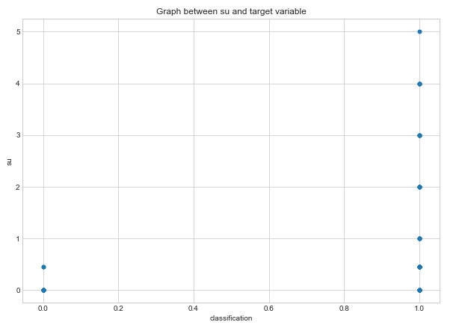
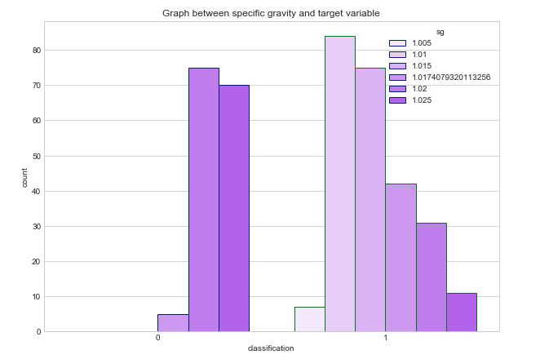
High value of sugar tends to be a ckd
Specific gravity of range 1.02 and 1.025 tend to be notckd

Slide 13
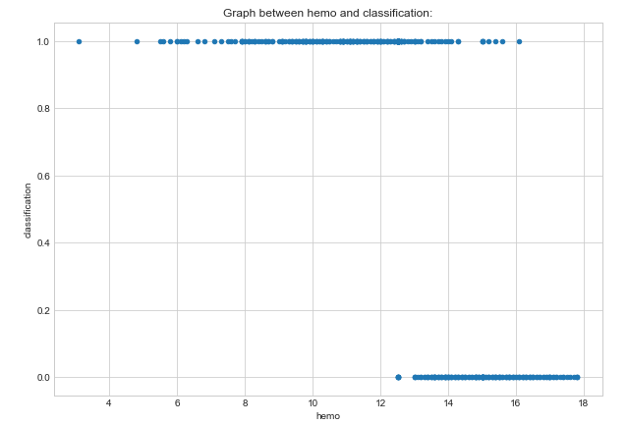
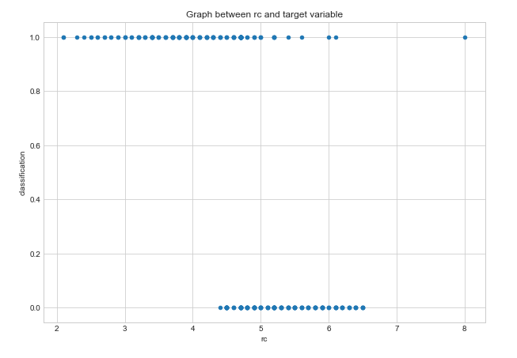
From the above graphs, we have observed that some of the independent variables effects the dependent variables in a sigmoidic fashion. So, we have decided to choose Logistic Regression model as an algorithm for this project.

Slide 14
We have used Train-Test-Split as an resampling technique
Data Preparation:
#x is input features and y is target variable
from sklearn.cross_validation import train_test_split
X_train,X_test,Y_train,Y_test=train_test_split(x,y,test_size=0.3,random_state=1)
5.a.Accuracy Check for Logistic Regression Model
from sklearn.linear_model import LogisticRegression
lr=LogisticRegression()
lr.fit(X_train,Y_train)
prediction=lr.predict(X_test)
from sklearn.metrics import accuracy_score
accuracy_score(Y_test,prediction)
Accuracy Score given by this model is 96.667

Slide 15
5.b.Accuracy Check (Using Confusion matrix)
from sklearn.metrics import confusion_matrix
confusion_matrix(Y_test,prediction)
Output:
array([[49, 1],
[ 3, 67]], dtype=int64)
Now,the accuracy is :
(49+67)/(49+1+3+67)=0.9667
Error is :
(1+3)/(49+1+3+67)=0.0333

Slide 16
Integrating with IBM Watson Studio:
from watson_machine_learning_client import WatsonMachineLearningAPIClient
wml_credentials={
"url":"https://eu-gb.ml.cloud.ibm.com",
"access_key":"Cuti3KcdJ1id2wcyxhWWpDdOvkPkQIxn57cLrdZZ6QtV",
"username": "67bd1788-b2af-4125-9a54-0749f351a933",
"password": "11266c89-5eb2-48ce-8608-7ec3a2db7e1a",
"instance_id": "6529a811-fd68-4a82-8d1b-03a175a24ff2"
}
client=WatsonMachineLearningAPIClient(wml_credentials)
model_props={client.repository.ModelMetaNames.AUTHOR_NAME:"Nagadath_G",
client.repository.ModelMetaNames.AUTHOR_EMAIL:"nagadath28@gmail.com",
client.repository.ModelMetaNames.NAME:"Kidney Disease Prediction"}
model_artifact=client.repository.store_model(lr,meta_props=model_props)
published_model_uid=client.repository.get_model_uid(model_artifact)
deployment=client.deployments.create(published_model_uid,name="Kidney Disease Prediction")
scoring_endpoint=client.deployments.get_scoring_url(deployment)

Slide 17
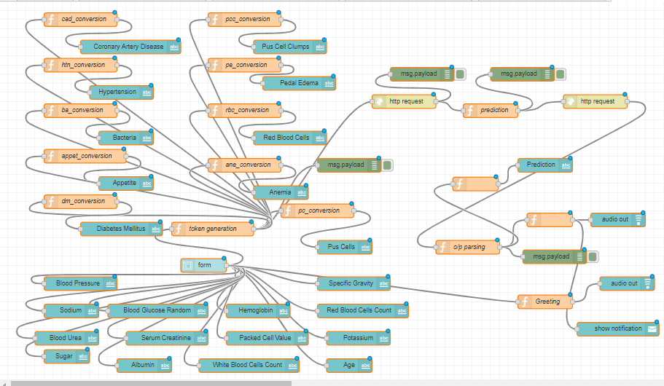
After the completion of integration, we’ll get a scoring end point which is used to gives permissions to other platforms to link with our model.
Then we used NodeRed to make a platform(UI) which allows user to interact with our model.

Slide 18
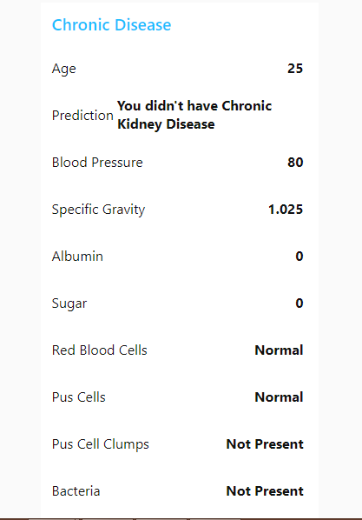
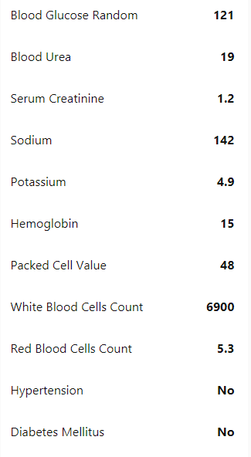
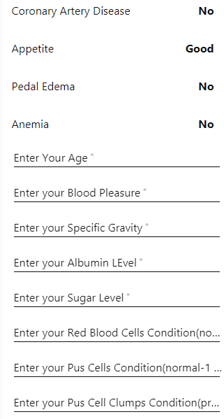
UI for our Model

