Slide 1

Prediction of quality of wine
Team:RPTECHBYTES
Nagadath.G

Slide 2
Why should we know the quality of wine??
Health effects of wine depend on the quality of wine:
Benefits of good quality wine:
It increases the bone density.
It reduces the risk of heart disease
It boosts the immune system.
ILL effects of bad quality wine:
Cardio vascular diseases
Headaches
Decreasing bone density
Mental stability decreases

Slide 3
Overview
The purpose of this project was selecting right attributes for classifying wine into one of the quality categories: bad,medium,good.In this Project, we tried to provide a platform(website) for users to enter the contents of wine as input to predict the quality of wine.
After applying all algorithms of Classification ,Among all of them Support Vector Classifier has got an accuracy of 93.91%
So, I have used Support Vector Classifier to predict the quality of wine in these 3 categories.

Slide 4
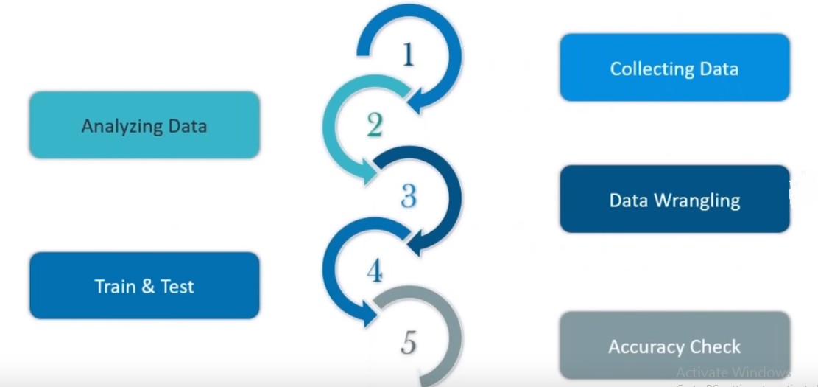
Followed steps for implementing the code in
Python-3:

Slide 5
1. Collecting Data
I collected the datasets of both red wine and white wine.
The 2 datasets of red and white wine are joined into one larger dataset, With another additional column ‘color’
There are 12 features involved in the data set.
Columns are renamed as shown in the table
There were 6497 observations in the dataset with 11 physiochemical variables, one color attribute and one output quality variable measuring quality score.

Slide 6
Table of attributes:
 | Attribute Name | Column
1 | Fixed Acidity | fa
2 | Volatile Acidity | va
3 | Citric Acid | ca
4 | Residual Sugar | rs
5 | Chlorides | cl
6 | Free Sulphurdioxide | fsd
7 | Total Sulphurdioxide | tsd
8 | Density | den
9 | pH | ph
10 | Sulphates | so
11 | Alcohol | al
12 | Quality(score between 0 to 10) | quality

Slide 7
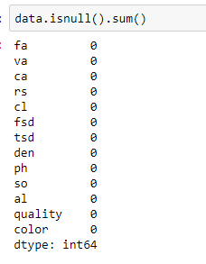
2. Analysing the Data
It seems that the dataset is very clean, with no missing data and clear structure.
All variables are numeric.
The range of independent variables
varies greatly, so when building the
model I will preprocess them to be
within the same range.

Slide 8
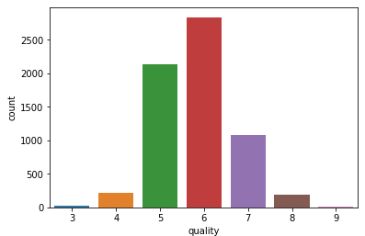
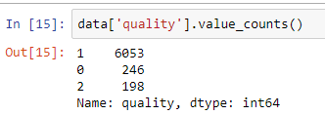
Labeling the quality:
Score under 5 : bad(0)
Score between 5 and 7 : medium(1)
Score above 7 : good(2)

Slide 9
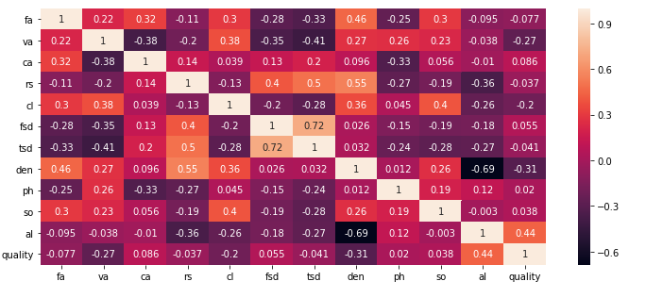
Visualization:
Based on the correlation (using the heat map) we have shown the dependency between different attributes.Lets study about attributes having more correlation..

Slide 10
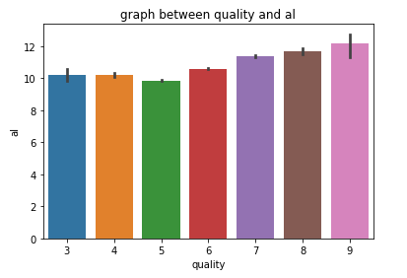
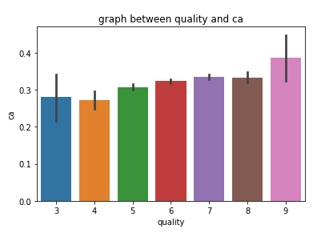
It seems there’s positive relationship between alcohol and quality. High quality wines are more likely to have high percentage of alcohol.
Composition of citric acid go higher as we go higher in the quality of the wine

Slide 11
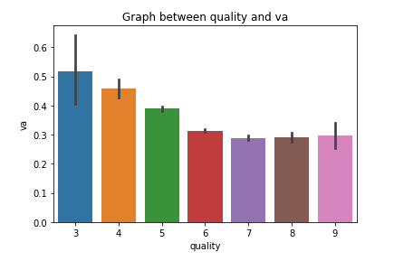
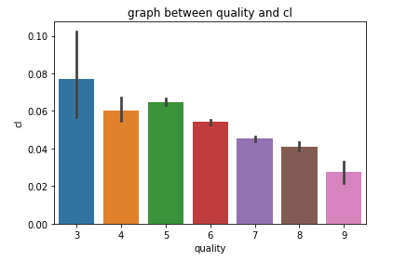
Quality of wine increases as the volatile acidity decreases.
Quality of wine goes up as the composition of chlorides increases.

Slide 12
We have used Train-Test-Split as an resampling technique
Data Preparation:
#x is input features and y is target variable
from sklearn.cross_validation import train_test_split
X_train,X_test,Y_train,Y_test=train_test_split(x,y,test_size=0.3,random_state=1
The range of independent variables varies greatly, so before building the model I am going to preprocess them to be within the same range using StandardScaler technique
from sklearn.preprocessing import StandardScaler
sc=StandardScaler()
X_train=sc..fit_transform(X_train)
Y_train=sc..fit_transform(X_train)

Slide 13
Data Modelling:
The highest accuracy is obtained in case of Support Vector Classifier with 93.91% accuracy .
We found the best parameters of SVC using GridSearchCV method
from sklearn.svm import SVC
svc2 = SVC(C=1.2,gamma =1.0,kernel= 'rbf')
svc2.fit(X_train, Y_train)
pred_svc2 = svc2.predict(X_test)
from sklearn.metrics import accuracy_score
print(accuracy_score(pred_svc2,Y_test)*100)
Web based application:
We incorporated a responsive web based frontend for better and easier
experience for users.They could easily enter the values of the parameters and can see
the predicted output.

Slide 14
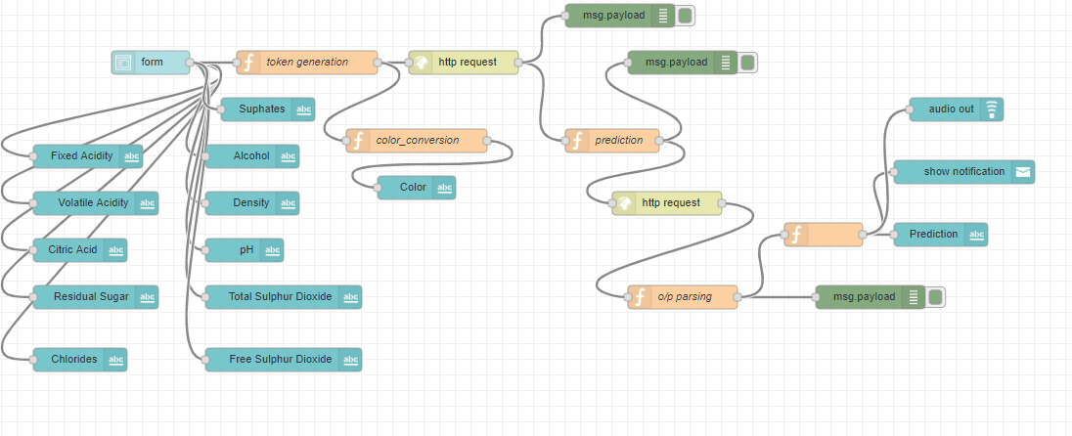
Node Red Flow:
Used NodeRed to make a platform(UI) which allows user to interact with our model.

Slide 15
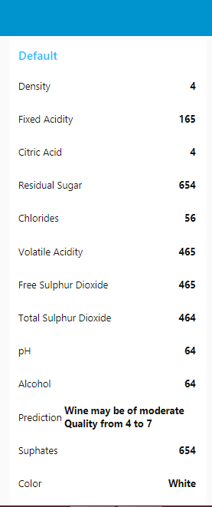
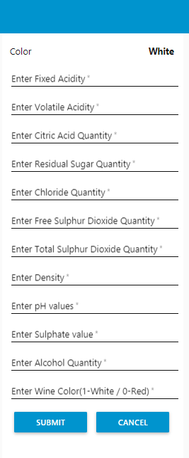
UI for our Model

