Slide 1

GIPT UI/UX Enhancements Proposal
Prepared for Aptin | Grid Interconnection Processing Tool (GIPT) | Southern California Edison

Slide 2
Objective of UI/UX Enhancements
Enhance user experience through consistent and modern UI.
01
Improve clarity, readability, and layout structure.
02
Incorporate feedback from Aptin and team.
03

Slide 3
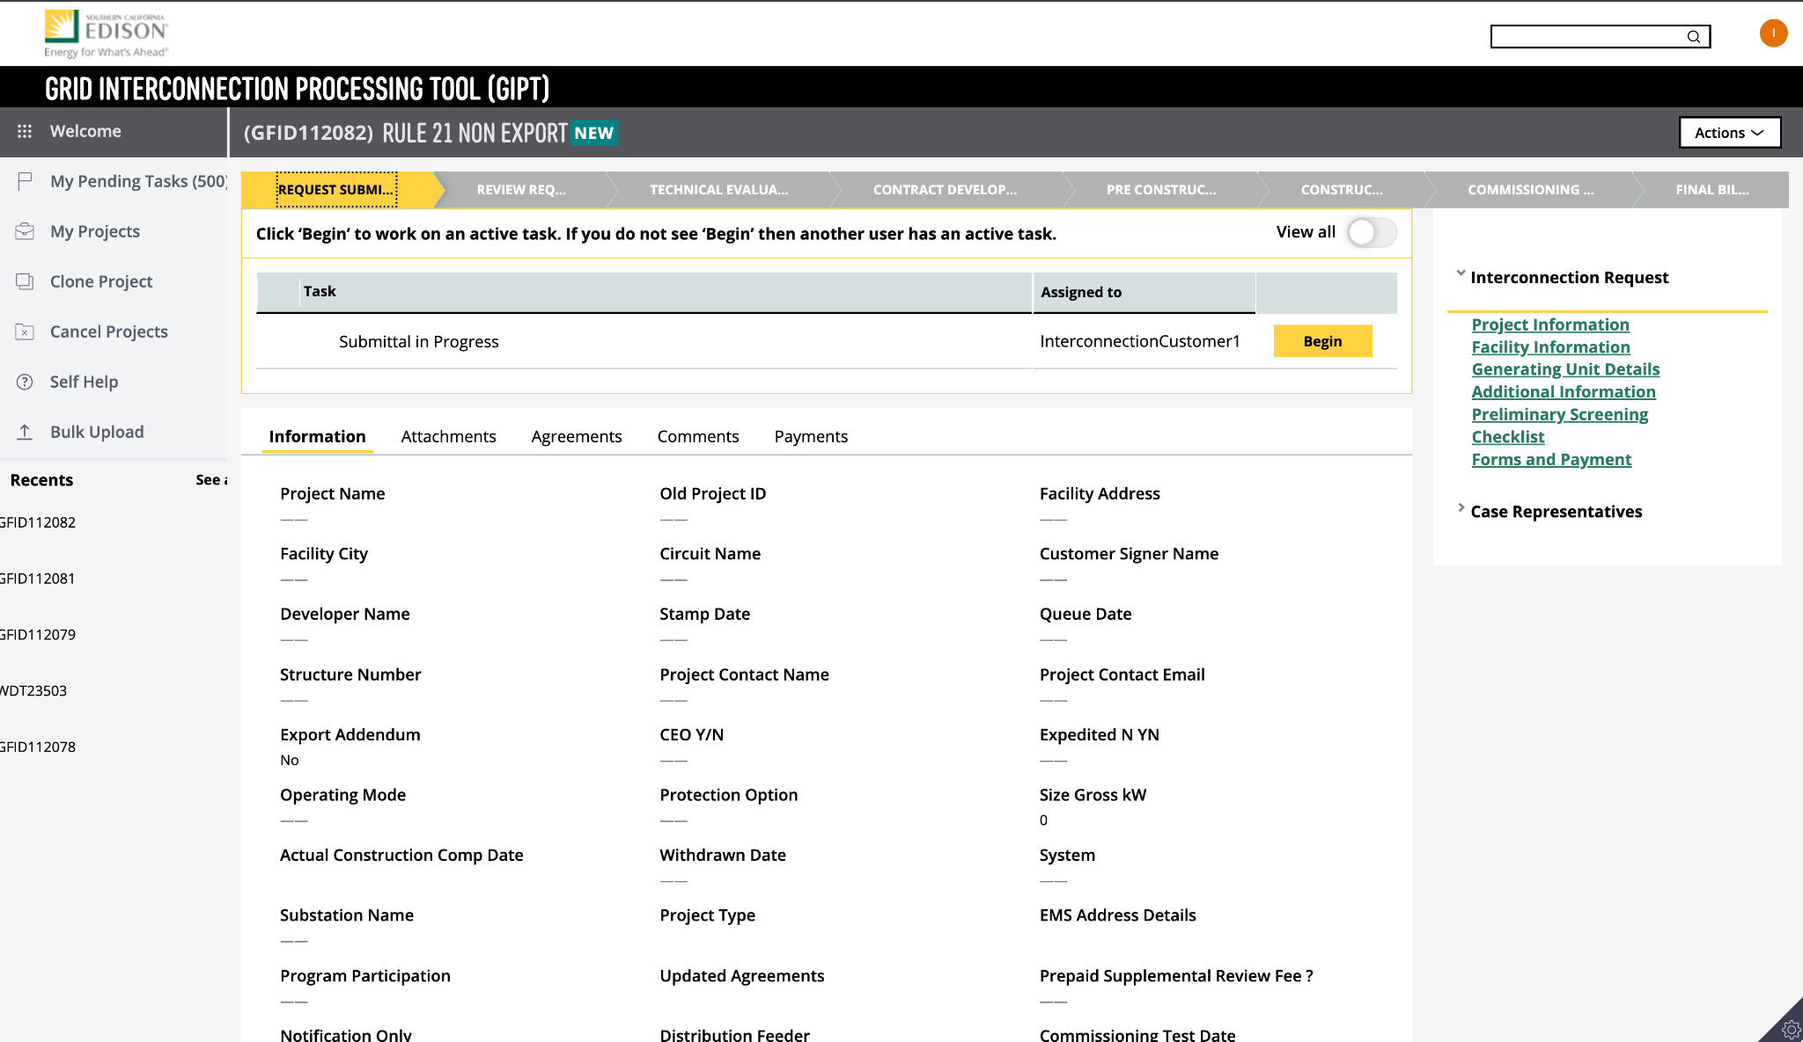
Before (Current UI)

Slide 4
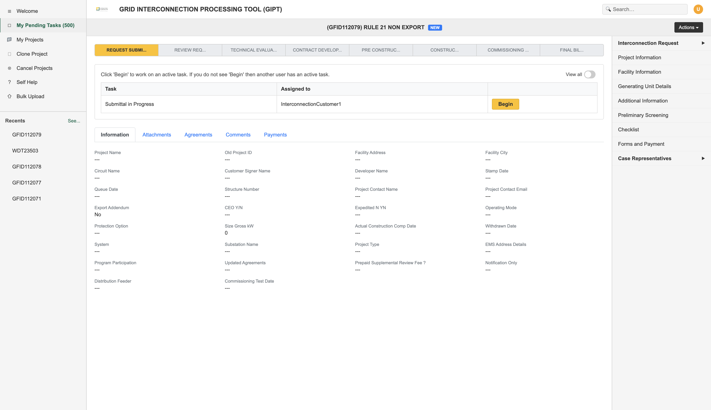
After (Proposed UI)

Slide 5
Set 2: Signatories Form Layout

Slide 6
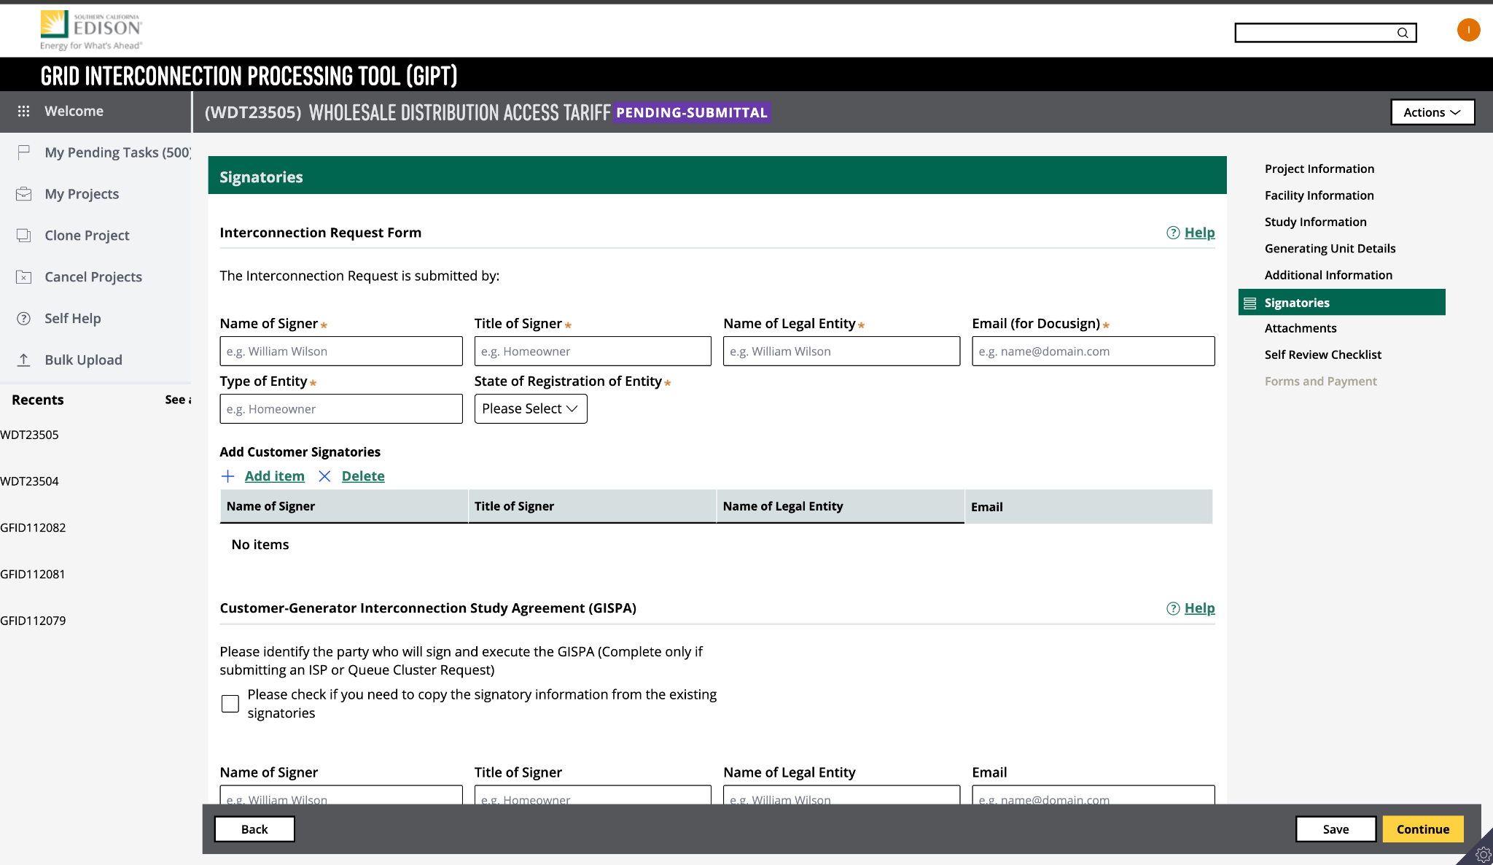
Before (Current UI)

Slide 7
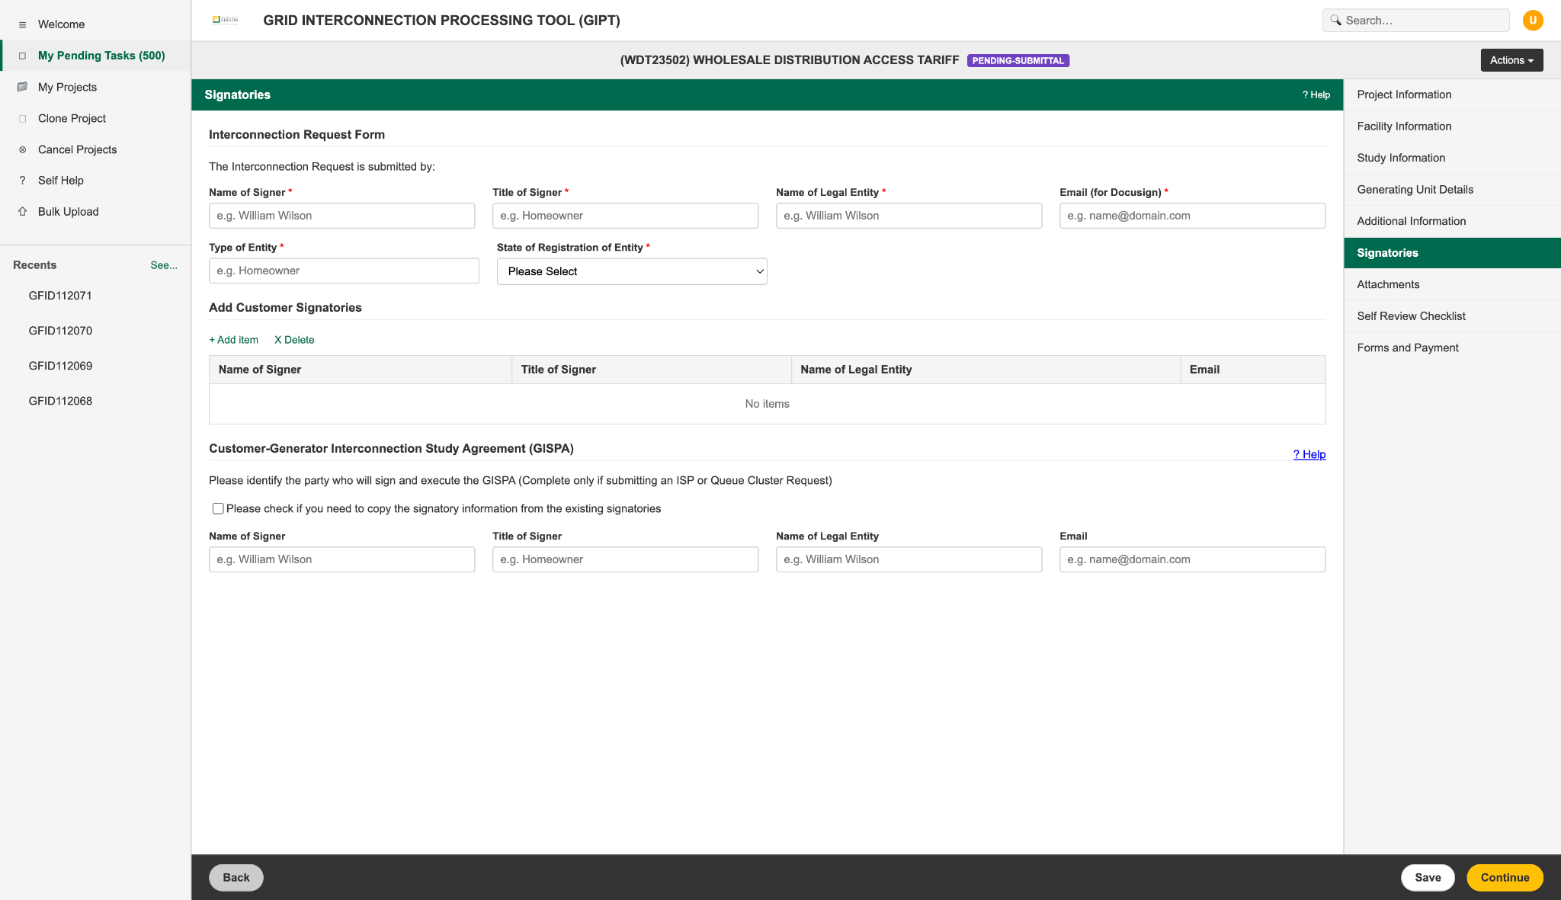
After (Proposed UI)

Slide 8
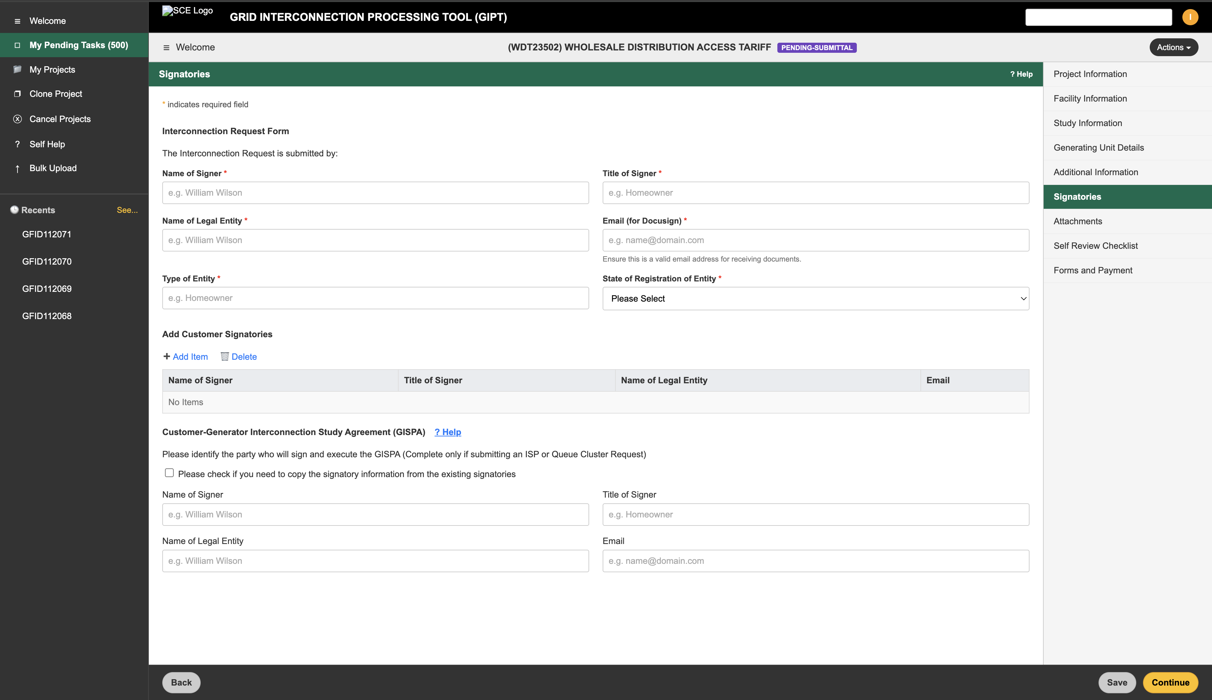

Slide 9
Set 3: Dashboard Redesign Proposal

Slide 10
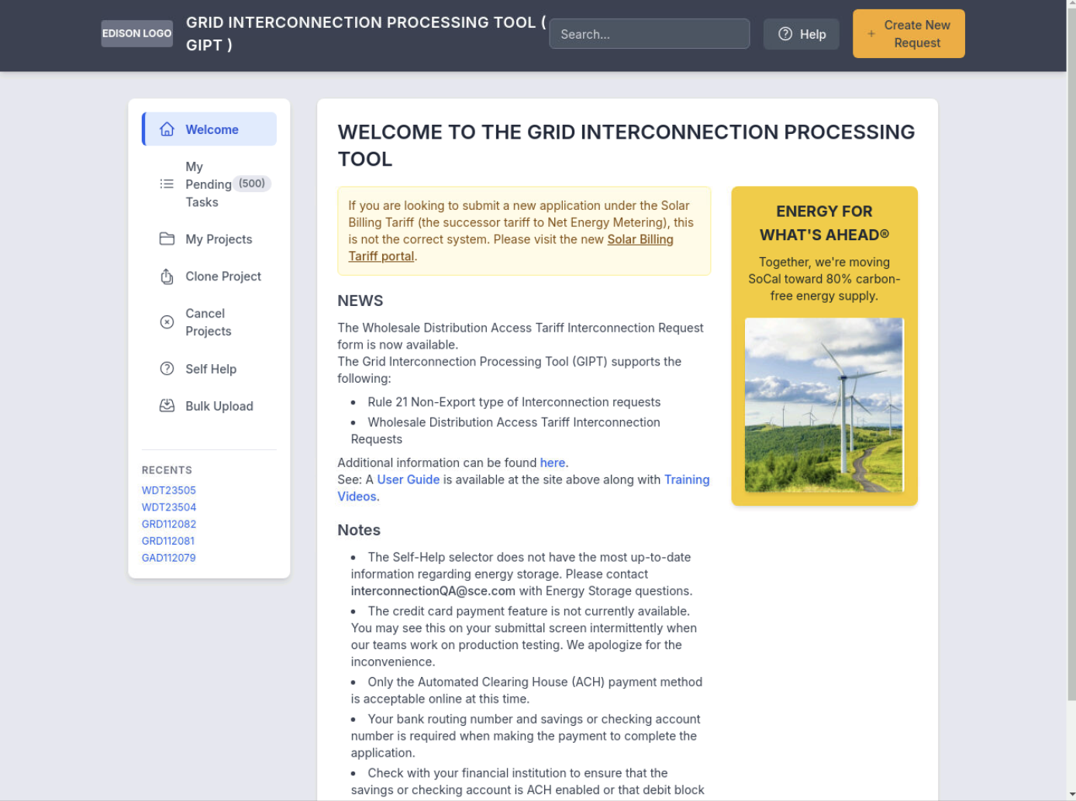

Slide 11
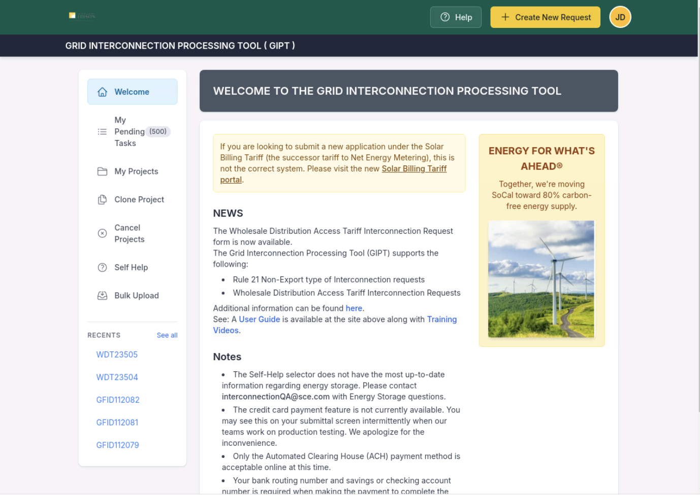
MY initial ui Review- just sharing Thoughts.

Slide 12
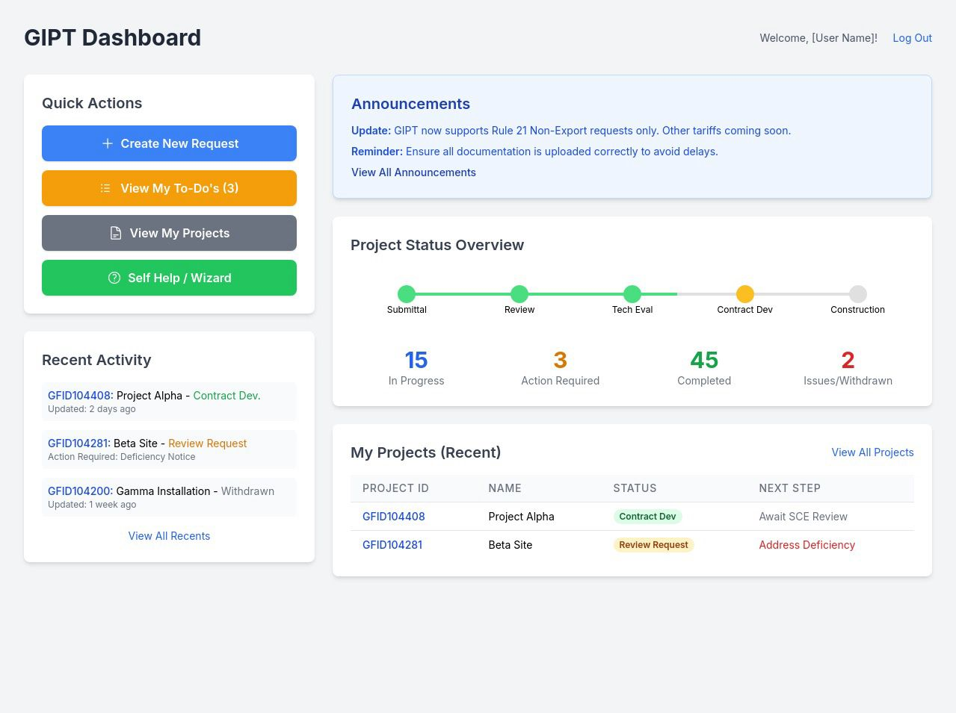
Dashboard Walkthrough – Not final

Slide 13
Set 4: Cylindrical Button Style

Slide 14
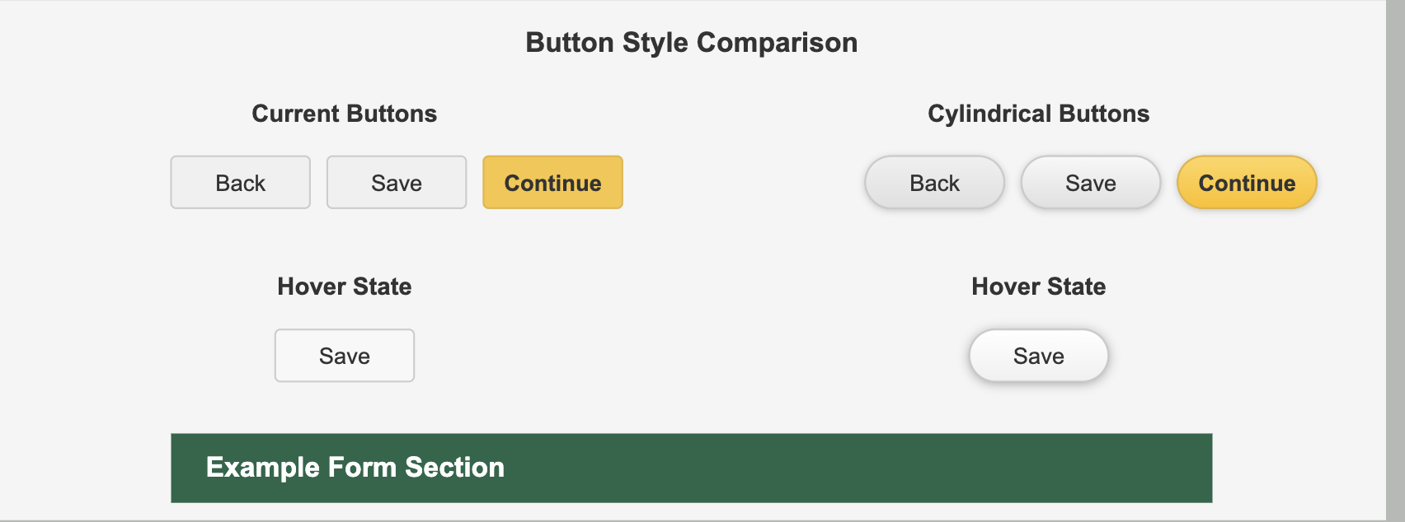
Proposed UI

Slide 15
Next Steps
Collect feedback from Aptin and stakeholders.
Finalize visual standards for rollout.
Begin phased deployment of approved enhancements.

