Slide 1

WEBSITE TRAFFIC ANALYSIS
PRESENTED BY,
S.JUSVANTHIHA
V.DHARSHINI
V.KAMALA
K.NAGALAKSHMI

Slide 2
OBJECTIVES
DATA COLLECTION
DATA IMPORTING
DATA ANALYZING
DATA PREPROCESSING
DATA VISUALIZATION

Slide 3
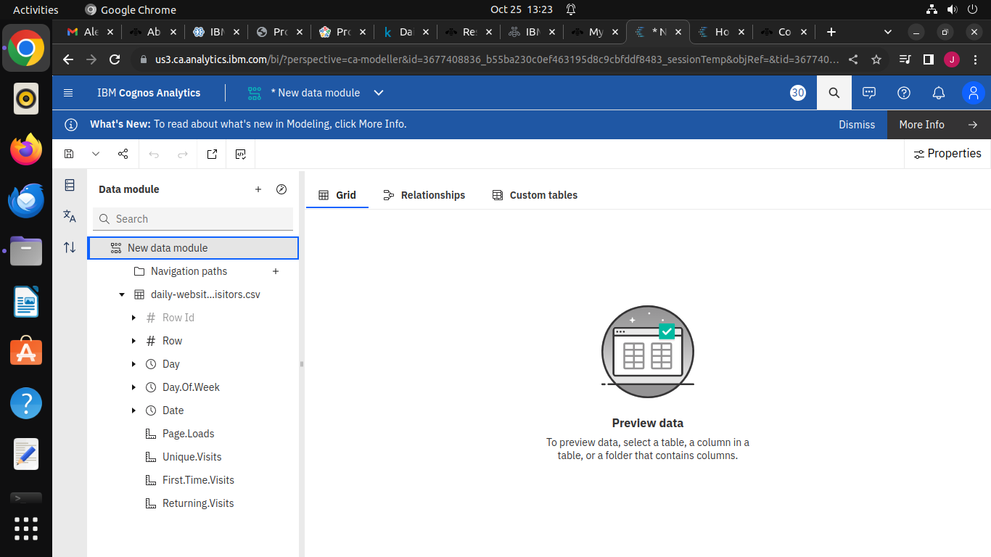
STEP-1:Downloading and uploading the dataset
The Following dataset is downloaded and it is saved in file manage and it is uploaded

Slide 4
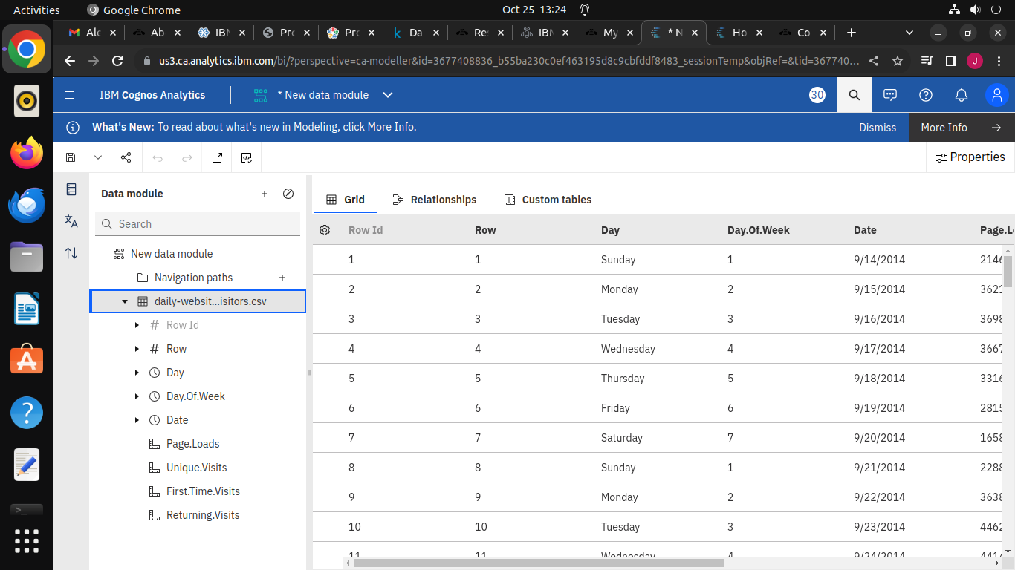
Step-2:Data collection and analysis
In this stage,data is collected and analysis using IBM cognos analytics software

Slide 5
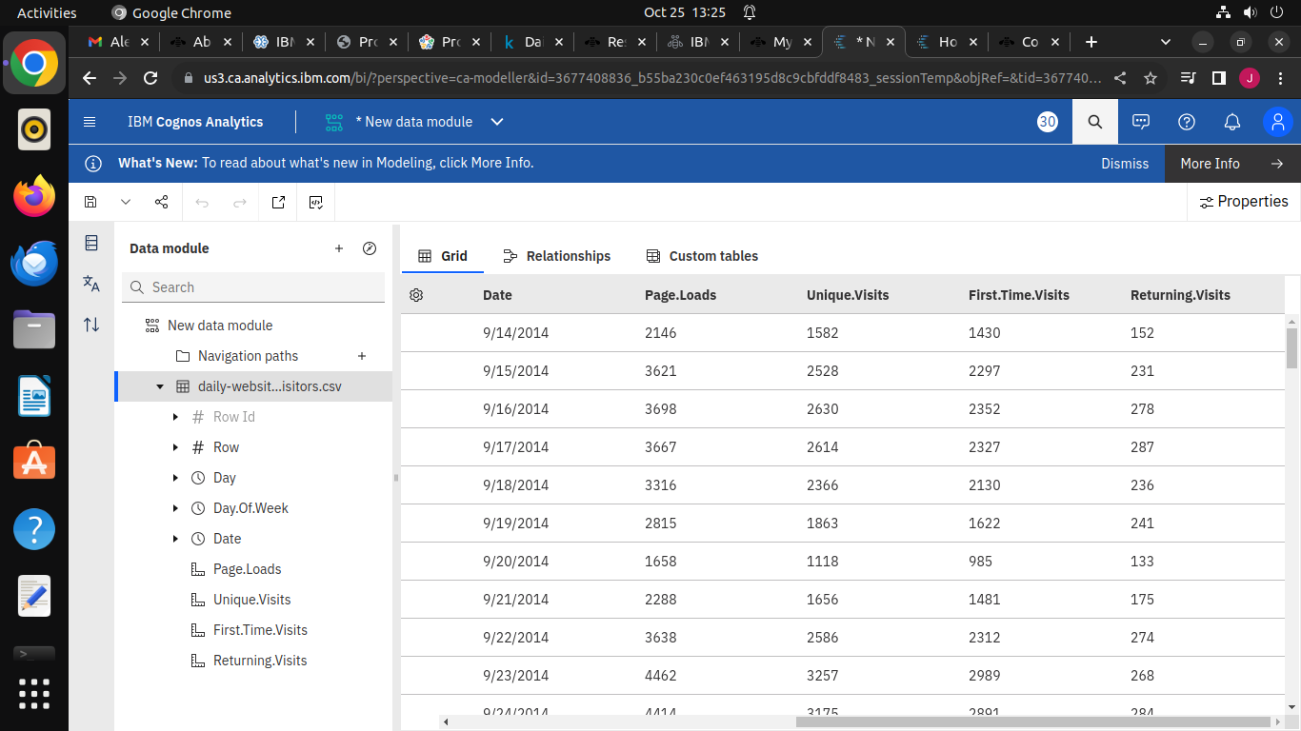

Slide 6
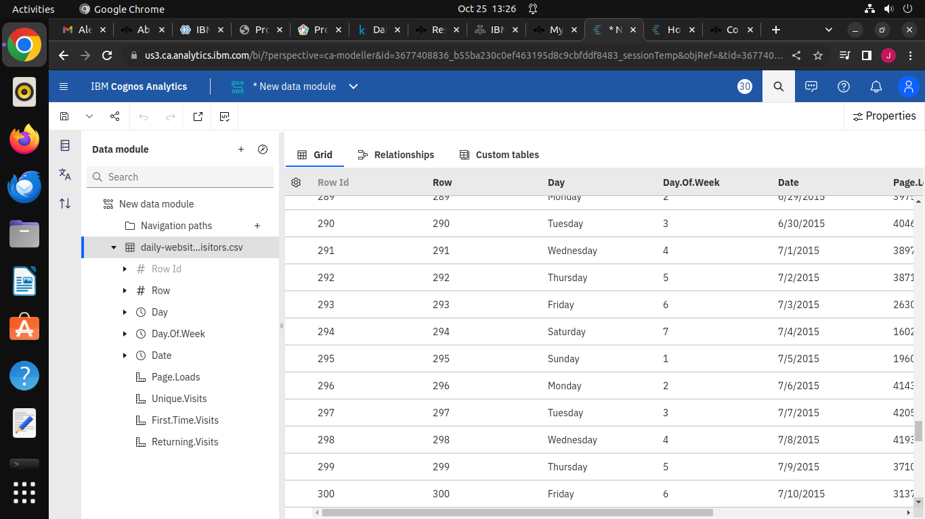

Slide 7
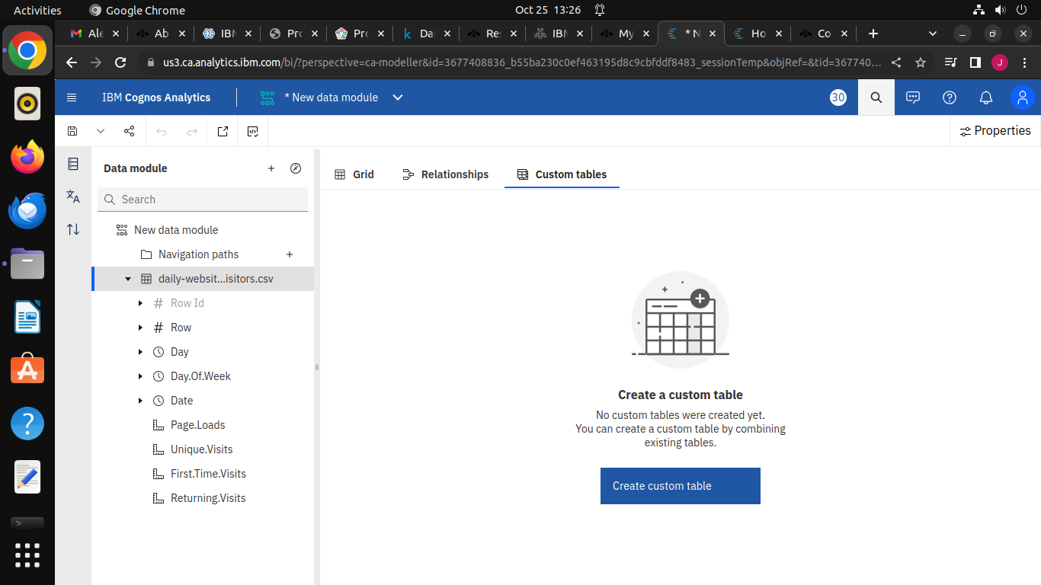
Step-3:Data preprocessing and cleaning

Slide 8
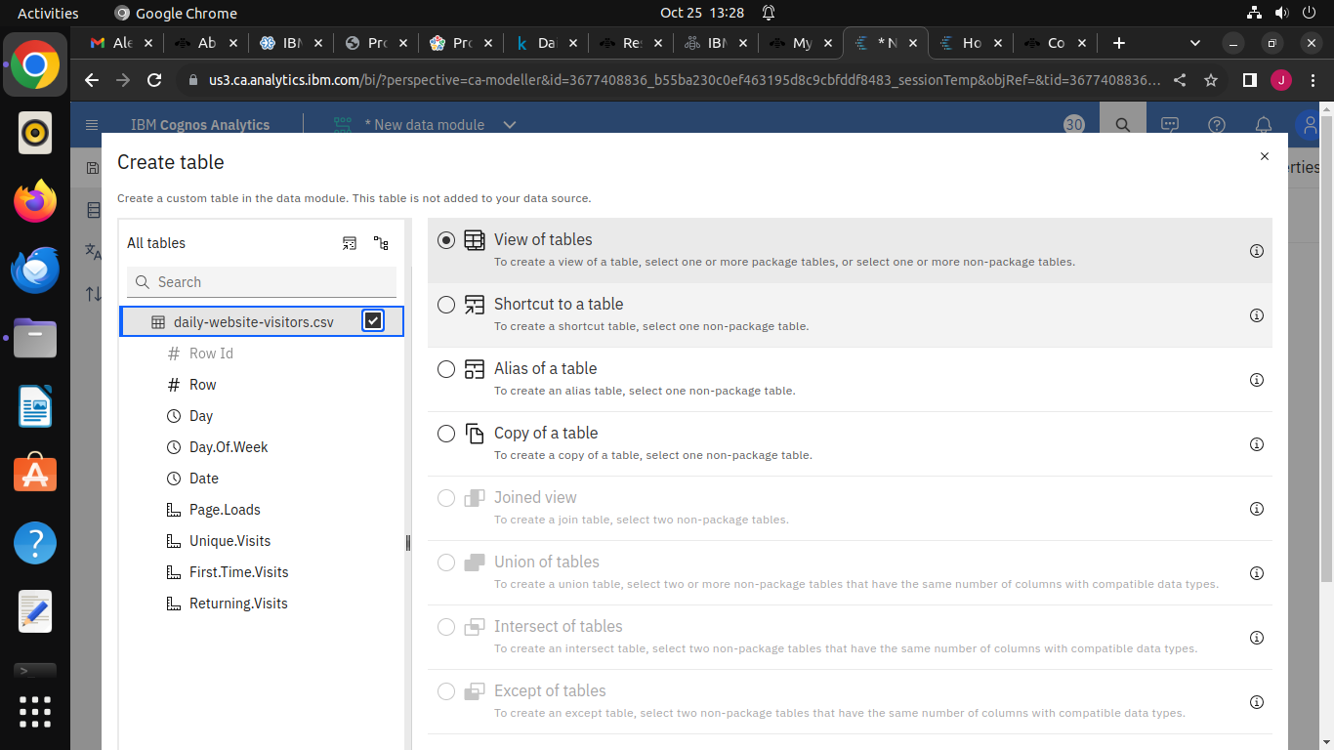

Slide 9
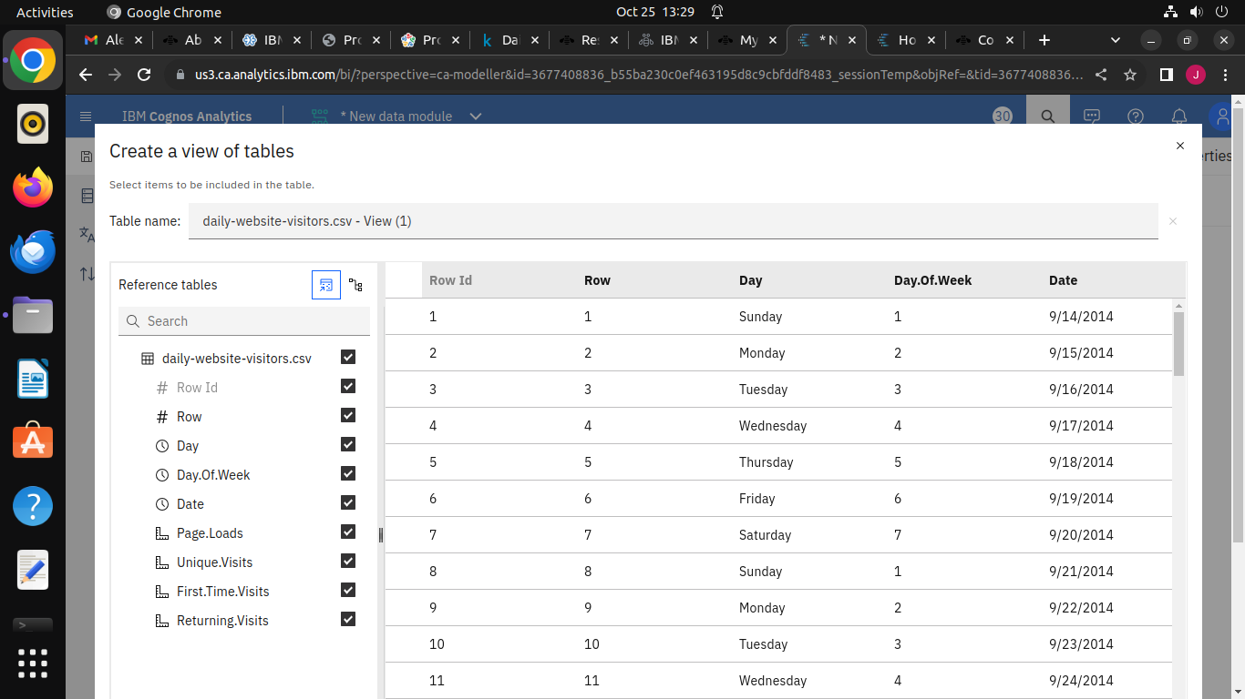

Slide 10


Slide 11
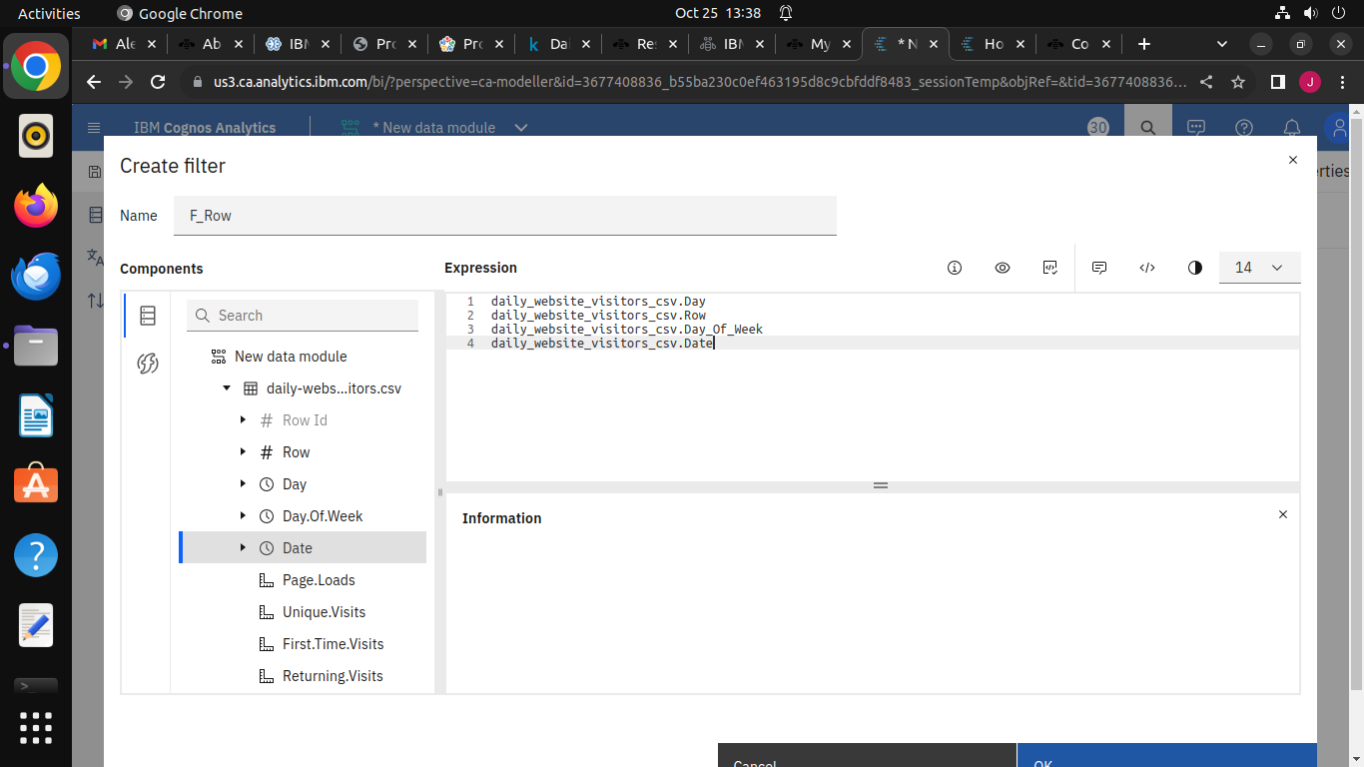

Slide 12


