Slide 1
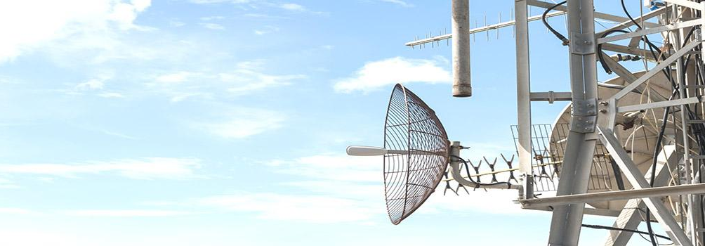
Churn Reduction in Telecom Industry
Theasus
Group

Slide 2
Contents
About
Objective
Exploration
Analysis
Conclusion
Implementation

Slide 3




About
Theasus is a collective effort of
Nagalaxmi (Naga)
Deshan
Fervis
Ashish

Slide 4


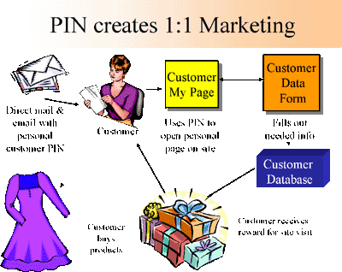



Objective
Develop a strategy to reduce churn for telecom industry
Contact
Response
Acquire
Retain
Prospect
Churn

Slide 5
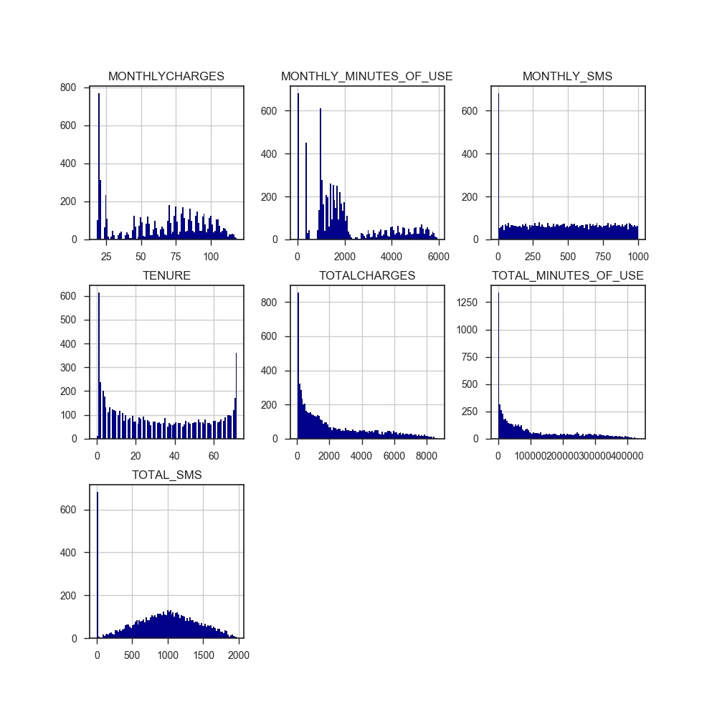
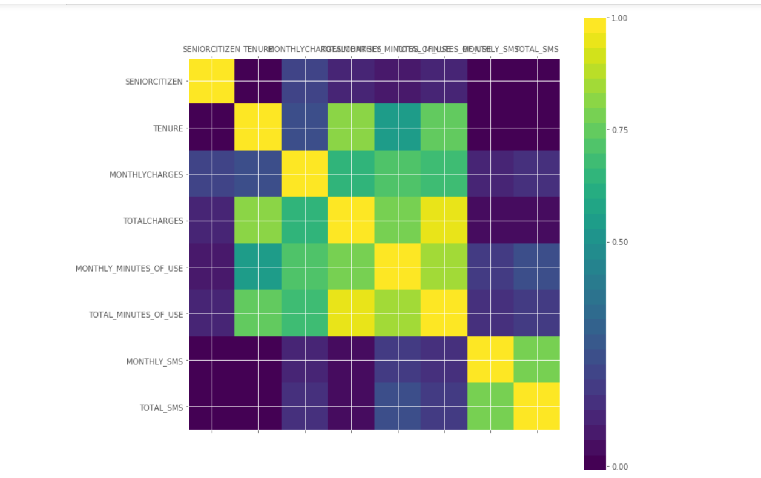
EDA Exploratory Data Analysis
Training data set
About 7K+ observations
Total 46 features
38 categorical & 8 continuous
Correlation Metrics

Slide 6
EDA Attributes & Label
SeniorCitizen
MultipleLines
Partner
InternetService
Dependents
TechSupport
OnlineSecurity
Tenure
StreamingTV
OnlineBackup
CHURN (0/1)
PhoneService
StreamingMovies
DeviceProtection
PaymentMethod
Contract
MonthlyCharges
MonthlyMOU
PaperlessBilling
MonthlySMS
TotalSMS
TotalCharges
TotalMOU

Slide 7
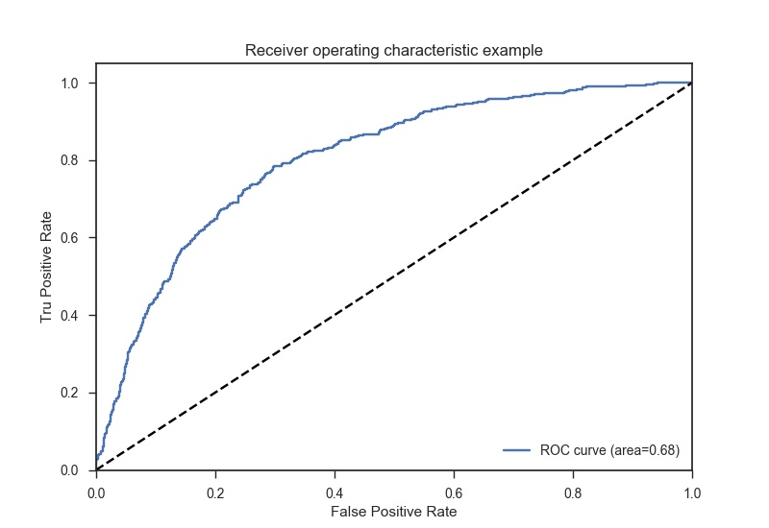
Analysis
SCORE
Model | Parameter | Train | Test | Test Accuracy | AUC | TPR | FPR | Predictions Vs Actuals
Logistic Regression | Class-weight=balanced | 0.73 | 0.729 | 0.729 | 0.746 | 0.78 | 0.29 | [1, 1, 1, 1, 0, 0, 1, 1, 1, 1] [1, 0, 0, 1, 0, 0, 1, 0, 1, 1]
Decision Tree | Class-weight=balanced | 1 | 0.728 | 0.728 | 0.652 | 0.499 | 0.194 | [0, 0, 0, 0, 1, 0, 0, 1, 0, 0] [0, 0, 1, 0, 1, 0, 0, 0, 0, 1]
Random Forest | Class-weight=balanced | 1 | 0.8 | 0.8 | 0.697 | 0.486 | 0.092 | [0, 0, 0, 0, 1, 0, 0, 1, 0, 1] [0, 0, 1, 0, 1, 0, 0, 0, 0, 1]
Neural Network | Hidden Layer=3 | 0.827 | 0.795 | 0.795 | 0.713 | 0.546 | 0.12 | [0, 0, 0, 0, 1, 0, 0, 0, 0, 1] [0, 0, 1, 0, 1, 0, 0, 0, 0, 1]
KNN- K Nearest Neighbor | K=15 | 0.79 | 0.755 | 0.755 | 0.598 | 0.266 | 0.069 | [0, 1, 0, 0, 0, 0, 0, 0, 0, 1] [1, 0, 0, 1, 0, 0, 1, 0, 1, 1]
SVM – Support Vector Machine | Kernel=Linear | 0.773 | 0.778 | 0.778 | 0.65 | 0.394 | 0.091 | [0, 0, 0, 0, 1, 0, 0, 0, 0, 0] [0, 0, 1, 0, 1, 0, 0, 0, 0, 1]
ROC Curve
AUC – Area Under Curve
TPR – True Positive Rate
FPR – False Positive Rate

Slide 8
Let’s Go!
Implementation

Slide 9
Conclusion
To reduce customer churn, a propensity model must be applied to drive strategic efforts from key business areas such as Marketing, Product development, and Customer Service
Based on this study, Logistic Regression proves to be the effective approach to predict the likelihood of churn, with 72% accuracy rate
OBSERVATION | RECOMMENDATION
89% of churned customers – 23% of total base were on month-to-month contract. | Migrate customers to long term contracts from a month-to-month
69% of churned customers – 18% of total base were FiOS customers | Enhance internet service
15% of churned customers were setup for Electronic Payment | Investigate electronic payment method
91% of churned customers – 24% of total base were phone service subscribers 50% of these churned phone subscribes had charges of $80+/month | Aggressively improve mobile service plans
70% of churned customers – 20% of total base were on paperless billing | Re-evaluate paperless billing method

