Slide 1


E-STORE the RKV E-commerce site
Submitted By B.Poojitha R170621
G.sneha R170614
•
•
•
•

Slide 2
PROBLEM STATEMENT
▶ The main vision of the project is automation of the store. Instead of Physically Approaching the store. Standing in the Queue for Billing ,This Site will help users to Book items in Bulk and Also make the Billing Easy through Online.

Slide 3
ABSTRACT
▶ In the existing Manual store , The customer has to manually visit the store, purchase items, stand in the queue for billing and complete billing manually, which is a time consuming process and increase the crowd in the store. So to avoid these problems this E-Store is introduced. E-Store will help users to book the groceries ,Food ,Cakes for Birthdays etc.in Advance so that the Crowd and Rush Problem will be reduced. Instead of Physically Approaching the store and Standing in The Queue for Billing, This Site will help users to Book items in Bulk and Also make the Billing Easy through Online. This Web-Application is Much User-friendly and Secure.

Slide 4
Existing System
As of Today, Students in our College has to Visit the Store and Buy Items Manually and the Billing Process is also Manual. This is a Time Consuming and Traditional Process. It will be Hard for the Store Management to Control the Crowd. It is also Hard For the Students to Buy item during Rush-days and Stand in the Queue for Billing. It is also difficult for the students to book cakes for Birthdays .Students also face-difficulties in Canteen.

Slide 5
Proposed System
We Propose System:
Will allow users to Book the Groceries through Online from our Store
Will allow users to Book Cakes through Online in Advance.
Will reduce difficulties in the Canteen.
Billing through Online Which will reduce the Time of Billing.
User-friendly.
Easy to Use With Better UI

Slide 6
ADMIN MODULE
▶ ADMIN
▶ Admin Login Page
Admin part in so important part of the system and he take cares all the part the shopping system. the system developed an admin user created and using admin user email id and password he can login to the system figure given below.
▶ Admin Home Page
Admin will get different menu in his panel after login with valid user id and password. The menu admin will get are Category, under category will get submenu Add Category, Manage Category and Archive

Slide 7
▶ Category.
Add Manufacturer, Manage Manufacturer. He will get Add product, Manage Product and Archive Product submenu under product menu. The customer request for product will show on Manager Order menu.
▶ Add CategoryHe will also get Manufacturer menu, under Manufacturer menu will get submenu
From admin panel admin add category that will show in home page if admin select the publication status as published, and will not show if he select publication status as unpublished. Figure of Add Category given below

Slide 8
▶ Manage Category
Manage category is an important part of admin panel, for set status that the category will show or not in home page admin can select this. He can view, edit and delete the category from Manage Category menu.
▶ View Category
In view category submenu customer can show the details of the category. Figure of View Category given below.
▶ Edit Category
If mistake done when added category, by editing the page admin can correct the
information that updated when it created. Figure of edit category given below

Slide 9
▶ Delete Category
Unused category or the product category the company decided to stop sell permanently can delete, before deleting it, a notification will come to reconfirm that admin sure he wants to delete it. Figure of Delete category given below.
▶ Add Product
From admin panel admin Add Product that will show in home page if admin select the publication status as published, and will not show if he select publication status as unpublished. Figure of Add Product given below

Slide 10
▶ Manage Product
Manage Product is an important part of admin panel, for setting status that the Product will show or not in home page, admin can select this. He can view, edit and delete the product from Manage Product submenu.
▶ View Product
In View option customer can show the details of the product Figure of view product given below.
▶ Edit Product
If mistake done when added product, by editing the page admin can correct the information that updated when it created. Figure of Edit Product given below

Slide 11
▶ Delete Product
Unused Product or the product the company decided to stop sell permanently can delete, before deleting it, a notification will come to reconfirm that admin sure he wants to delete it.
▶ Manage Order
The product which were ordered by the customer can manage from this menu. When a product delivered to the customer, and customer paid for this, then need to change product order status to delivered and paid, that can be done from this menu. Figure of Manage Order given below
▶ View Order
In view category submenu customer can show the details of the category. Figure of View Order given below.
▶ Edit Order Status
The product that delivered the customer have to change the product deliver status asdelivered and as a result the product will not display at admin.

Slide 12
CUSTOMER MODULE
▶ CUSTOMER INTERFACE
▶ CUSTOMER LOGIN AND REGISTRATION PAGE:
Customer have to login before adding product in cart. In this page existing customer
canlogin to buy product and new user can create an account for buying the product.

Slide 13
CART MODULE
▶ CART:
▶ Add To Cart Page
To buy a product the customer have to add product to cart. Also customer can view the product details, as well as large view by putting the cursor over the product image.
▶ CART PRODUCT BEFORE CHECK OUT
The customer can view the product, update number of product, delete product from cartand send request to check out and given figure below.
▶ FINAL CHECKOUT AND ADD SHIPPING INFORMATION
From the customer panel before adding shipping information he can see the productdetails, also
have to add Shipping information.

Slide 14
▶ E-COMMERCE PROCESS
▶ Select Payment Method
There are several method of payment to pay to product cost, customer select any of them. After selecting the payment method customer have to confirm the order.

Slide 15
▶ Technologies Used
▶ FRONTEND : Reactjs,Bootsrap .
▶ BACKEND : Nodejs,Mongodb.
▶ ENVIRONMENT : Visual Studio Code.

Slide 16
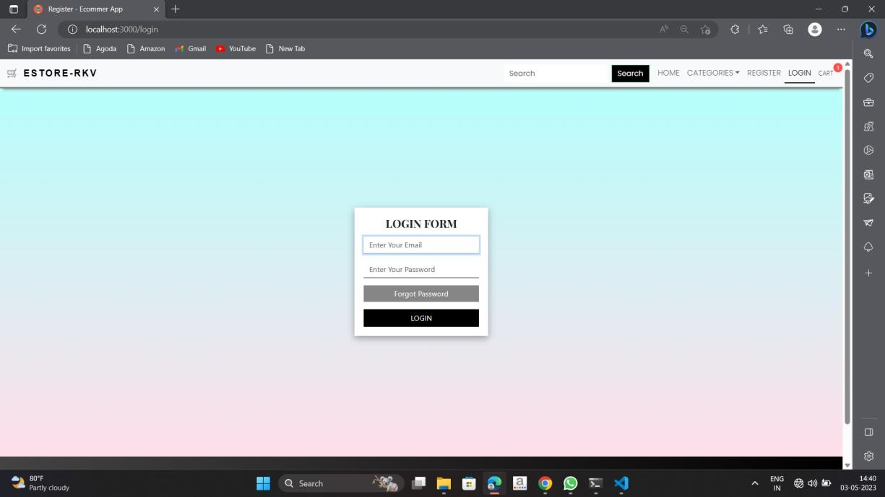
Project Sample Outputs
▶ Sample Outputs:

Slide 17
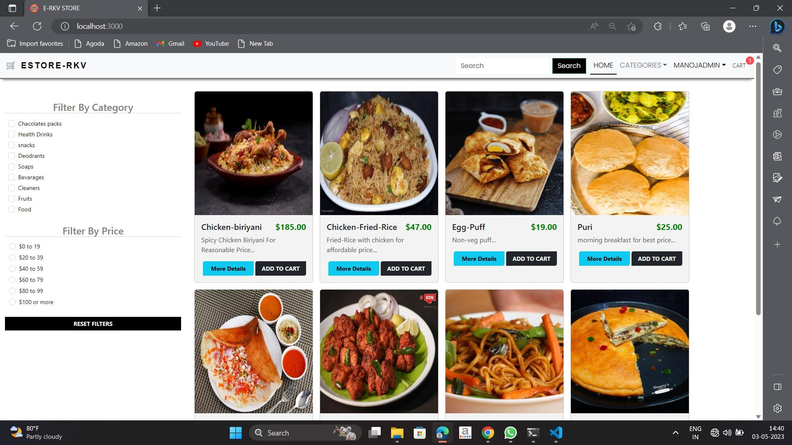

Slide 18
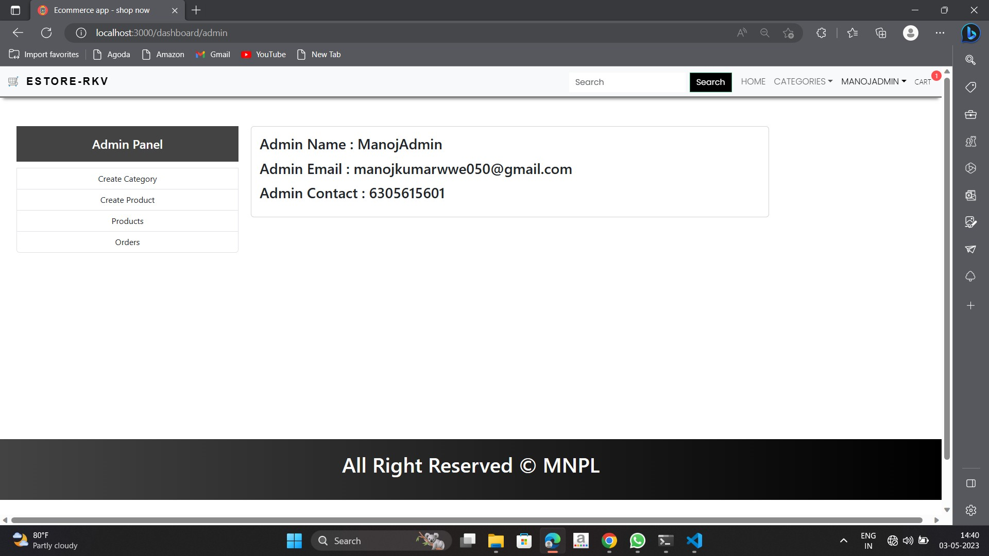

Slide 19
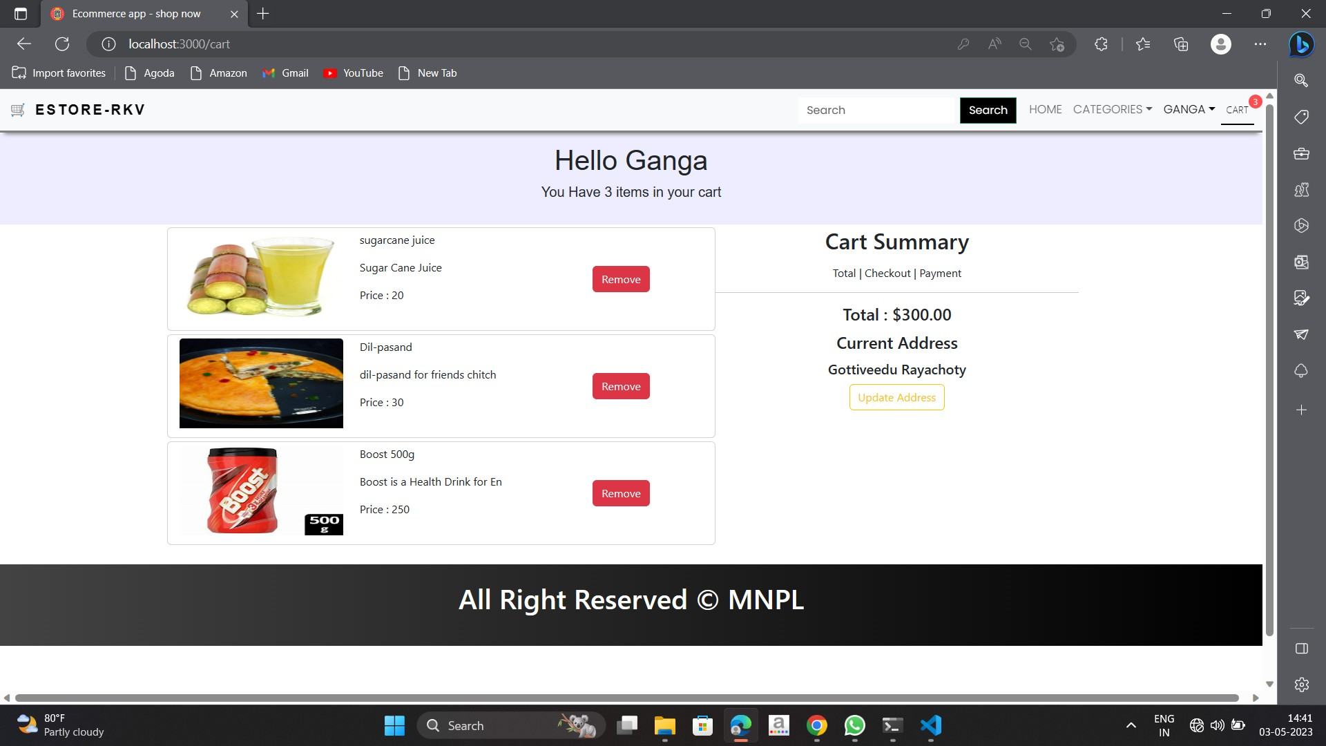

Slide 20
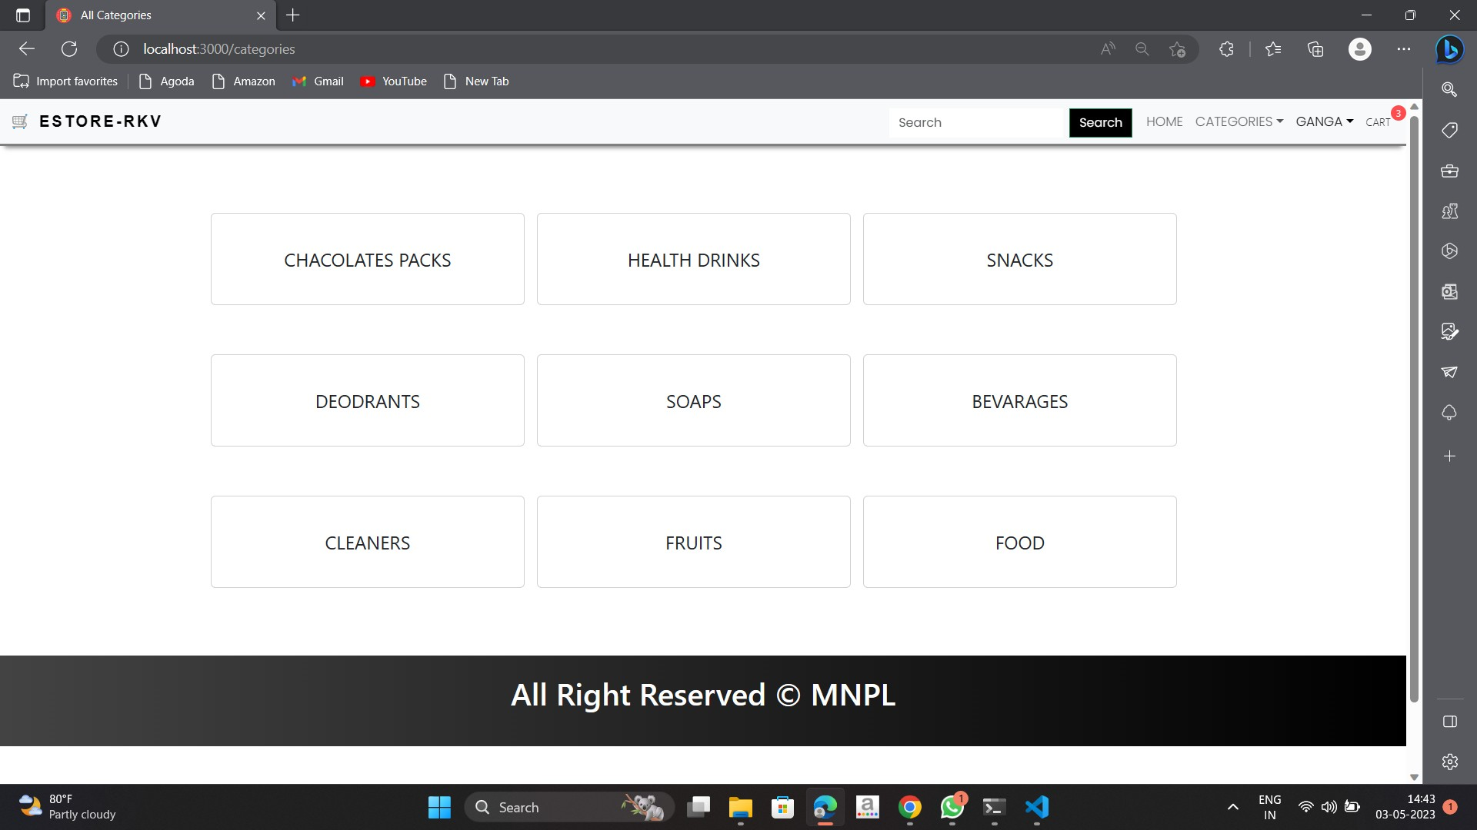

Slide 21
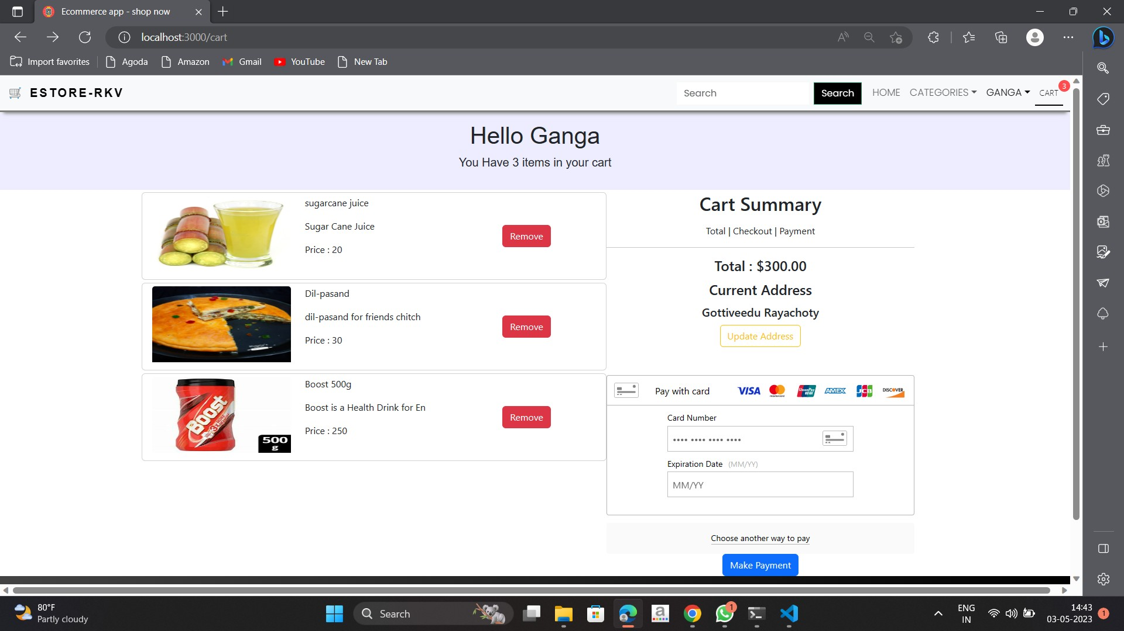

Slide 22
Conclusion
This web Application provides Costumers to Purchase items through online without standing in the Queue for billing and improve Crowd management in the Store. It saves time and also makes the sellers life also easy and helps them to increase their sales. The E-store RKV e-commerce site need to be tested thoroughly tested before implementation to find any security gaps.

Slide 23
THANK YOU

