Slide 1

Task -9

Slide 2
Task-10
Row Labels | Average of views
YouTube Spotlight | 125432237
TaylorSwiftVEVO | 28896049
Disney•Pixar | 23667171.33

Slide 3
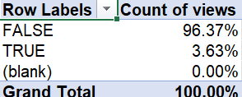
Task-11

Slide 4
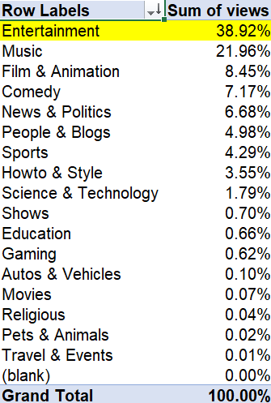
Task-12

Slide 5
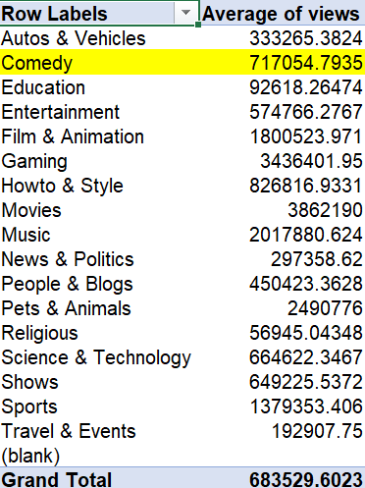
Task-13

Slide 6

Task-14

Slide 7
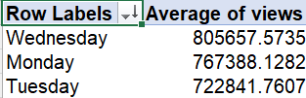
Task-15

Slide 8
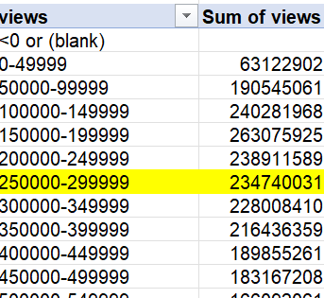
Task 16

