Slide 1
Implementing a Shallow Neural Network using Logistic Regression N150390(G.Naga Laxmi)
Neural Network
Shallow Neural Network
Logistic Regression

Slide 2
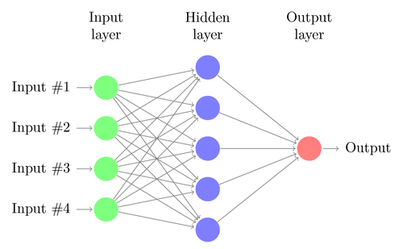
Neural Network
A Neural Network is a series of algorithms that endeavors to recognize underlying relationships in a set of data through a process that mimics the way the human brain operates. In this sense, neural networks refer to systems of neurons, either organic or artificial in nature.

Slide 3
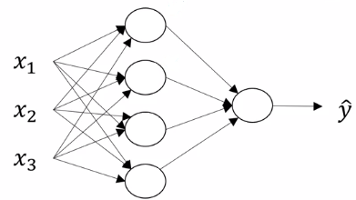
Shallow Neural Network
Shallow neural networks consist of only 1 or 2 hidden layers. Understanding a shallow neural network gives us an insight into what exactly is going on inside a deep neural network

Slide 4
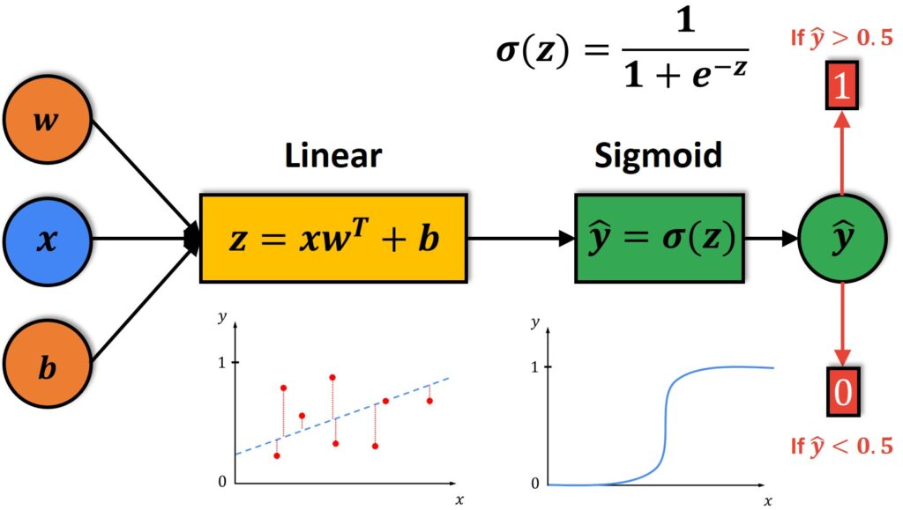
Logistic Regression
The logistic model is used to model the probability of a certain class or event existing such as pass/fail, win/lose, alive/dead or healthy/sick. This can be extended to model several classes of events such as determining whether an image contains a cat,dog,lion etc.

Slide 5
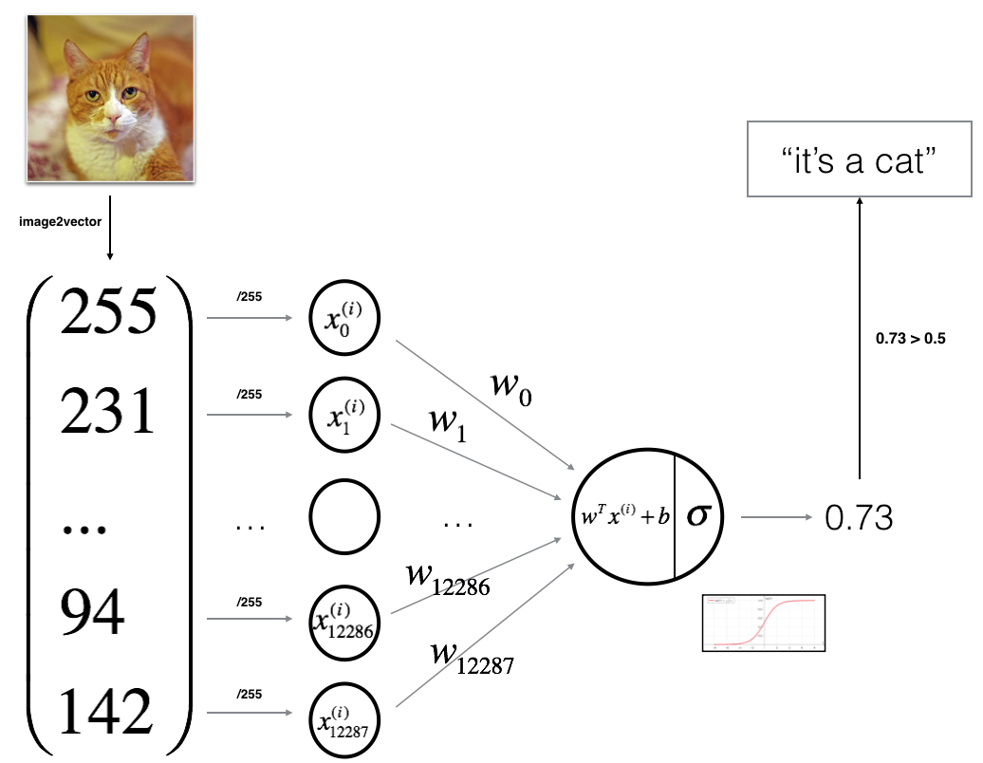
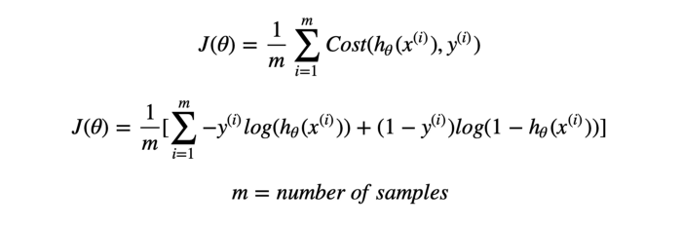
Network Implementation step by step
Mathematical expression of the algorithm:

Slide 6
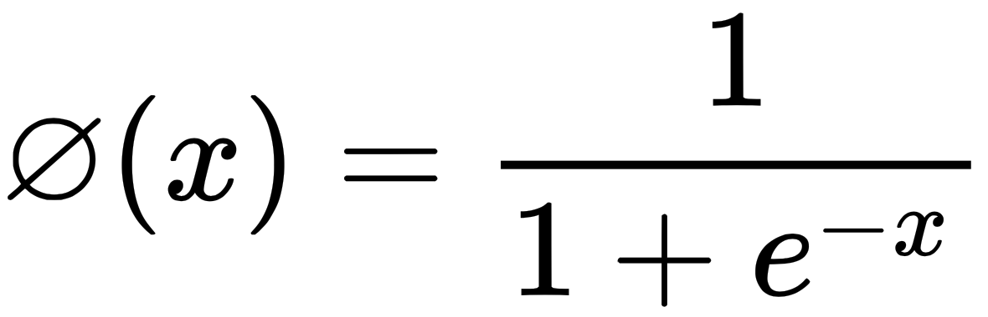
sigmoid function:

Slide 7
Initializing parameters:W,b
Forward and Backward propagation:
To learning the parameters
Farward Propagation:X,A,J(cost Function)
Backword propagation:dw,db

Slide 8
Optimization
You have initialized your parameters.
Update the parameters using gradient descent.
Gradient Descent:The Gradient descent algorithm multiplies the gradient by a number (Learning rate or Step size) to determine the next point.
W=W-ɑ(dW)
b=b-α(db)

Slide 9
Prediction
Calculate y^
Convert the entries of a into :
0 (if activation <= 0.thershold)
1 (if activation > thershold)

Slide 10
Algorithm:
Initialize (w,b)
Optimize the loss iteratively to learn parameters (w,b):
computing the cost and its gradient
updating the parameters using gradient descent
Use the learned (w,b) to predict the labels for a given set of examples

Slide 11
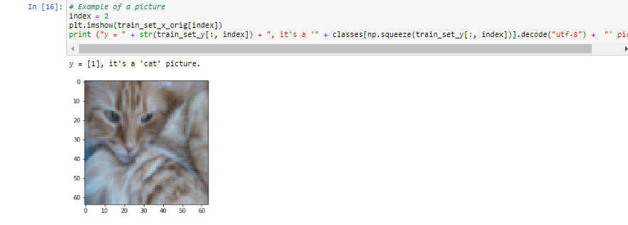
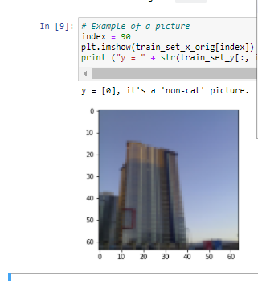
Results:

Slide 12
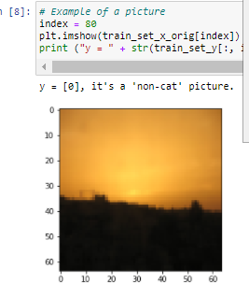
Cost after iteration 1800: 0.146542
Cost after iteration 1900: 0.140872
train accuracy: 99.04306220095694 %
test accuracy: 70.0 %

Slide 13
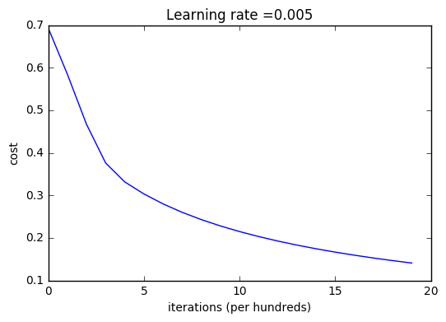
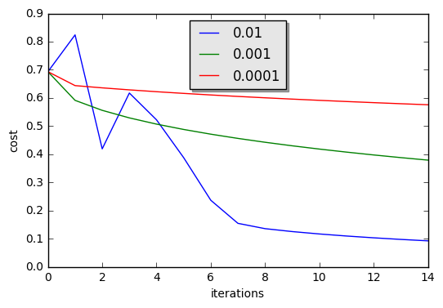
with different learning rates

Slide 14
Future work:
.Using this shallow neural network implement DNN,CNN
.Using CNN detecting the object from the live vedio

Slide 15


