Slide 1
Contest 1 Title Here
Opportunity
Users
Mention Primary Users and Secondary Users
Benefits Proposition
Problem Assumptions
User Needs Analysis
Stakeholders for the Solution
Submitted by
Team Name
Team Number
Team Members

Slide 2



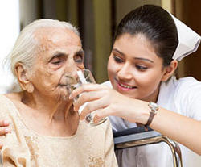
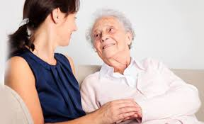
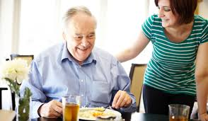

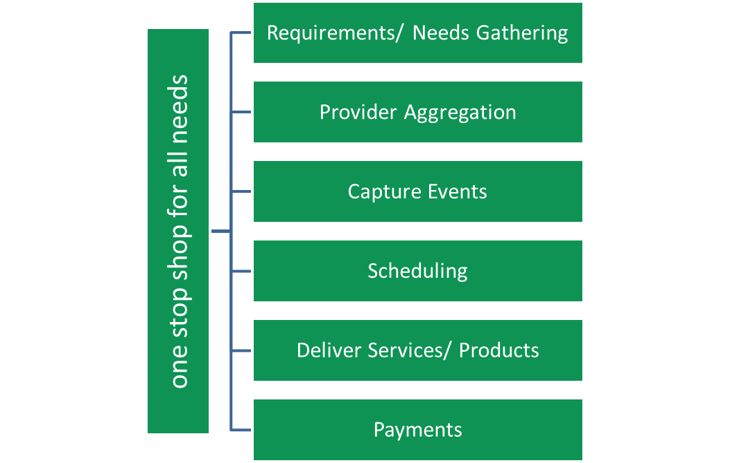
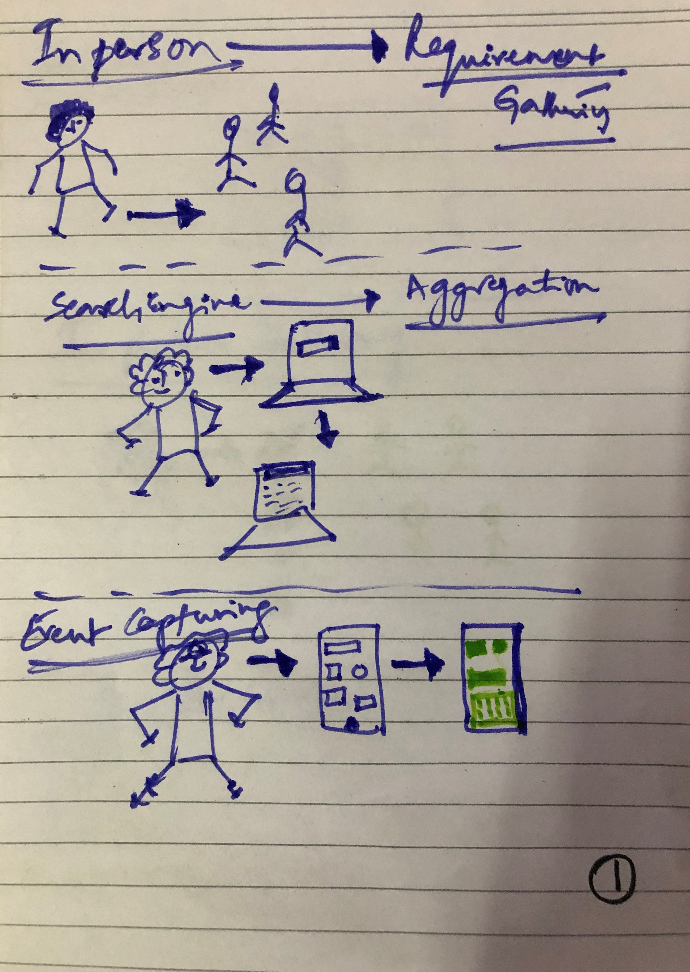
Example: Improving the Quality of Life of Senior Citizens
Opportunity
Users
There is growing opportunity for products and services specifically for senior citizens.
Providing these products or services would improve their ‘Quality of Life’ and prolong their ability to remain independent.
This a market estimated to be over US$ 500 billion.
Presently our team would be addressing this for the market in India, which is almost untapped.
Primary Market: Senior Citizens living independently (away from children)
Focusing on tier 1, 2 n 3 cities in India.
Secondary Market: Senior Citizens who need help on a day to day basis
Senior citizens who may want help on a need basis (intermittent requirements)
Other geographies… villages in India, Asia and then other countries. (scaling)
Benefits Proposition
Problem Assumptions
Addresses an untapped market
Provides an opportunity to increase revenues of several stakeholders
Improves the ‘Quality of Life’ of not just senior citizens but also their families.
Characteristics of senior citizens (Customers)
Living independently without their children or active care takers.
Have some knowledge of technology and can use it (at least rudimentary)
Willing to explore options (products or services)
elderly people with little or no mobility limitations in independent living
elderly people with mobility limitations for instance in: climbing stairs, leave and enter the house and move outdoors
User Needs Analysis
Stakeholders for the Solution
Original Opportunity – To look for effective ways to improve the ‘quality of life’ of senior citizens.
Rewriting the opportunity as – To create products or services that improve the ‘quality of life’ of senior citizens Basic ‘Quality of Life’ needs are characterized as:
Health Care needs
Nutrition needs
Mobility (Transportation/ Travel) needs
Help with household chores
Personal Care needs
Social needs (including inclusion)
Financial needs
Psychological needs
Technological needs
Need for Purpose
Senior citizens
Family of senior citizens
Service providers …
Health care providers
Financial institutions
Professional services and so on…
Society & Community
Government
Submitted by
Team Name
Team Number
Team Members

