Slide 1
Contest 2 Title Here
Opportunity/ Problem Statement
Users/ Stakeholders
Mention Primary Users and Secondary Users
List of Stakeholders
Solution Concept (with systems diagram)
Solution Assumptions
Resources Required (Software & Hardware)
Outcomes & Impact on Society
Submitted by
Team Name
Team Number
Team Members

Slide 2





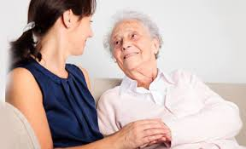
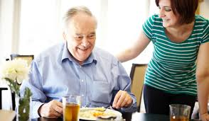
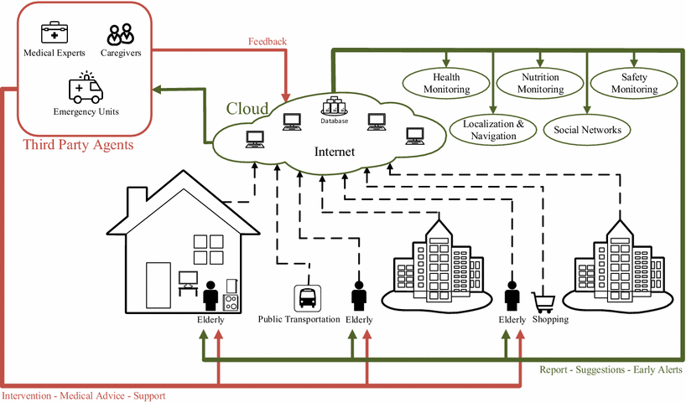
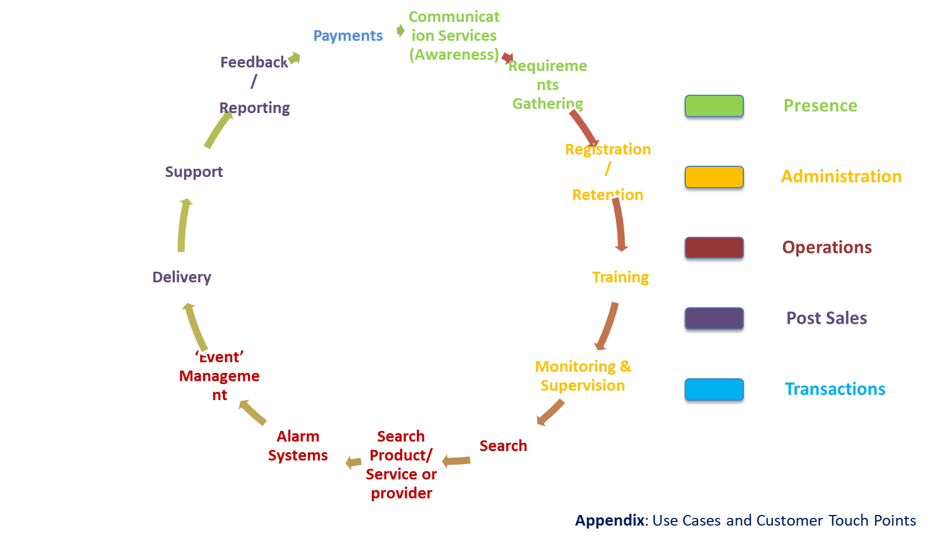
Improving Quality of Life of Senior Citizens
Opportunity/ Problem Statement
Users/ Stakeholders
There is growing opportunity for products and services specifically for senior citizens.
Providing these products or services would improve their ‘Quality of Life’ and prolong their ability to remain independent.
This a market estimated to be over US$ 500 billion.
Presently our team would be addressing this for the market in India, which is almost untapped.
Primary Market: Senior Citizens living independently (away from children)
Focusing on tier 1, 2 n 3 cities in India.
Secondary Market: Senior Citizens who need help on a day to day basis
Senior citizens who may want help on a need basis (intermittent requirements)
Other geographies… villages in India, Asia and then other countries. (scaling)
Stakeholders:
Senior citizens
Family of senior citizens
Service providers …
Health care providers
Financial institutions
Professional services and so on…
Society & Community
Government
Solution Concept (with systems diagram)
Solution Assumptions
Seniors like to socialize with others.
Seniors are tech averse, don’t want to have to learn new technologies.
Needs to be low price
Characteristics of senior citizens (Assumptions) who would be using this solution
Living independently without their children or active care takers.
Have some knowledge of technology and can use it (at least rudimentary)
Willing to explore options (products or services)
elderly people with little or no mobility limitations in independent living
elderly people with mobility limitations for instance in: climbing stairs, leave and enter the house and move outdoors;
Resources Required (Software & Hardware)
Outcomes & Impact on Society
Presence, Admin & Ops
Channel features:
Landing/Ambassador pages; Promotions/Discounts; Contests; SEO; Campaigns; Blogs/Forums; Social media marketing; Video testimonials; Chatbots; references
Consistent presence across channels:
All portals
All media content
Mobile content
Personalization:
Behavioural
Past usage/purchase
Location and Time
Preference based
Persona based
Retargeting
Warming up
Presence & Know
Know your Customer:
Identify - know you
Preferences - remember you
Life stages - understand you
Educate your Customer:
Training videos
Gamification
Senior Citizens:
Address needs that are currently not being served
Easy and better access to care (???)
Reduces stress
Improve comfort
Improves the ‘quality of life’
Providing them with a purpose
Providing them with means of earning/ some additional revenues...
Family of the senior citizens
Saves time, effort and money
Reduces stress
Improves their life
Service Providers
Increased revenue
Cross-sell and upsell
Intangible benefits
(sense of doing good)
Community
Sense of taking care of their own
Increased productivity
Social inclusion
Collaborative consumption
Post Sales & Transact
Online Purchase:
Create Catalog
Manage Catalog
Registration
Payment processor/Wallet integration
Self Service:
Modify/Cancel
Confirmation
Reserve
Submitted by
Team Name
Team Number
Team Members

