Slide 1
REVOLUTIONIZING RETAIL: THE IMPACT OF AI-POWERED VIRTUAL PERSONAL SHOPPING ASSISTANTS

Slide 2
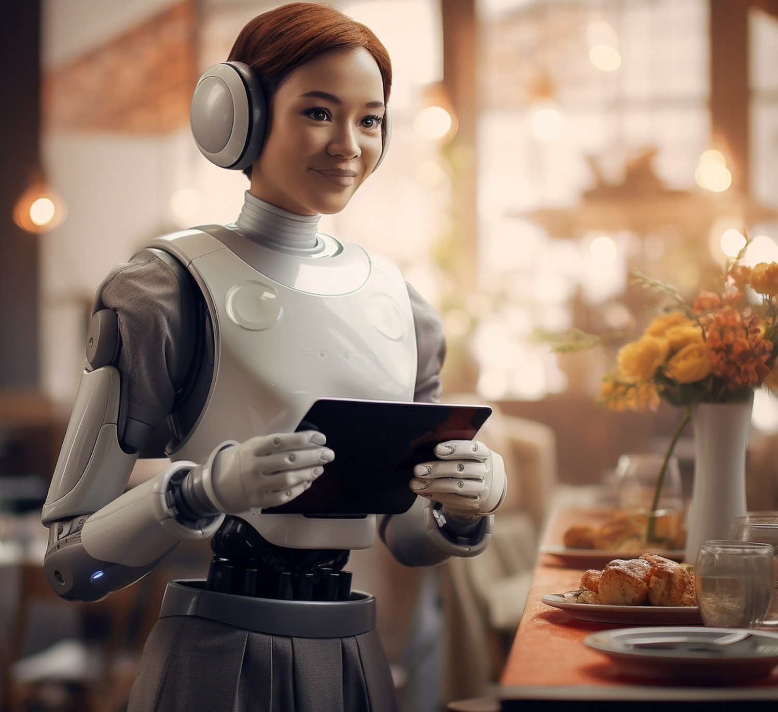
INTRODUCTION
In the fast-growing Internet business,
there is an increasing need for personalized
and frictionless shopping
experiences. Introducing
the AI-driven
personal virtual shopping assistant, a revolutionary device that meets with speciﬁc tastes and preferences of each client. This state-of-the-art assistant changes how clients shop by use of advanced artiﬁcial intelligence tools that
give recommendations based on
with
individual attributes and interact customers using simple chatbots.

Slide 3

ENHANCING CUSTOMER EXPERIENCE
The AI-powered assistant also plays a crucial role in customer engagement and retention. By managing loyalty
programs, o ering discounts, and gathering
exclusive valuable
feedbacfi, it helps build a strong connection between the brand and its customers. Personalized marfieting campaigns and special o ers fieep
customers long-term growth.
coming bacfi, fostering
loyalty and driving sales

Slide 4

DATA-DRIVEN PERSONALIZATION
With its powerful analytics capabilities, the assistant provides businesses with deep insights into customer behavior and market trends. These data-driven insights enable better decision-making, from inventory management to sales strategies, helping businesses stay competitive and responsive to market demands. Detailed sales reports and behaviour analytics reﬁne recommendation algorithms, continuously improving the shopping experience.

Slide 5
SEAMLESS INTEGRATION
The AI-Powered Virtual Personal Shopping Assistant is designed for seamless integration across various platforms, ensuring a consistent and engaging shopping experience whether customers are on a website, mobile app, or social media. It supports third-party integrations with payment gateways, logistics partners, and CRM systems, making it a versatile addition to any retail ecosystem. API access allows for further customization, enabling businesses to tailor the assistant to their speciﬁc needs.

Slide 6


CHALLENGES AND OPPORTUNITIES
While AI-powered virtual personal shopping assistants present opportunities for enhanced customer engagement, retailers must address challenges such as data privacy, ethical AI usage, and customer trust. Embracing these challenges leads to long-term success.

Slide 7
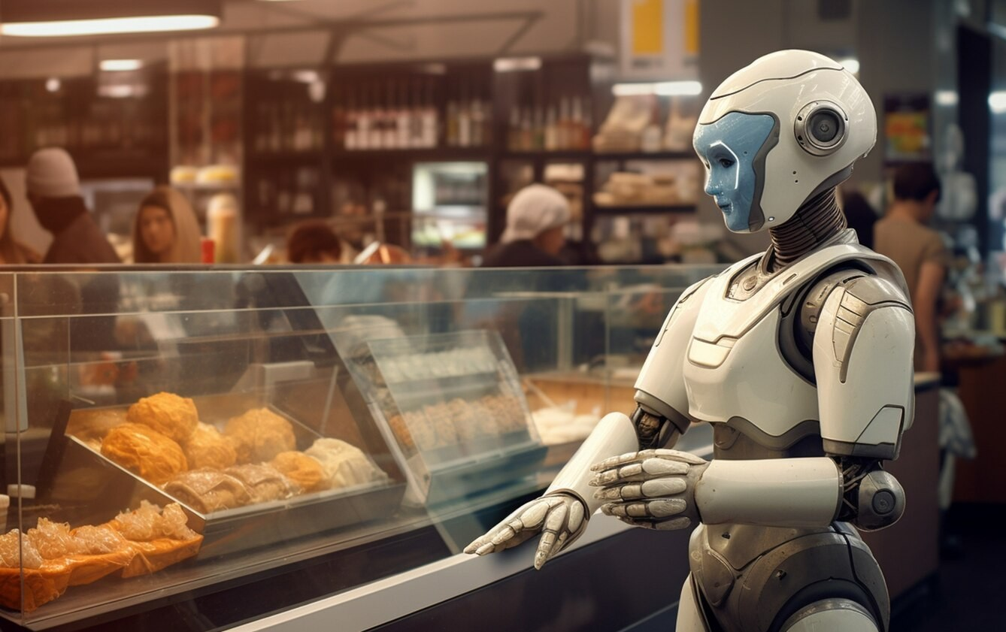
FUTURE TRENDS
The future of retail will continue to be shaped by advancements in AI and virtual personal shopping assistants. Anticipate trends such as expanded virtual try-on experiences, predictive purchasing recommendations, and enhanced omnichannel integration.

Slide 8
CONCLUSION
The AI-Powered Virtual Personal Shopping Assistant represents a transformative leap forward in retail technology, redeﬁning the way customers shop and interact with brands. By harnessing the capabilities of natural language processing, machine learning, and advanced analytics, this assistant delivers a personalized, intuitive, and seamless shopping experience.

Slide 9
Thanks!

