Slide 1



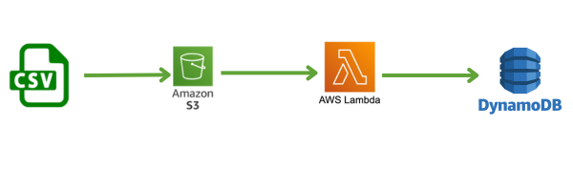
Serverless Document & Data Processing Using AWS Lambda
A Scalable & Automated Approach to Real-Time Data Extraction
Team Members
Nagamedha Sakhamuri
Harika Gavini
Krithika Reddy
Sri Venkata Naga Sai
Harika Kakarala
Notes:
"Hello everyone, we’re a team of five and our project is titled Serverless Document & Data Processing Using AWS Lambda.
At a high level, this project automates the extraction of metadata from structured files like CSV, using a fully serverless AWS pipeline.
Our team includes:
Nagamedha Sakhamuri
Harika Gavini
Krithika Reddy
Sri Venkata Naga Sai
Harika Kakarala
We’ll walk you through the implementation, challenges we faced, and the results we achieved in the upcoming slides."

Slide 2
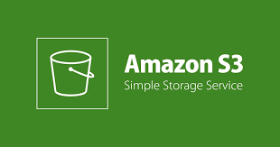


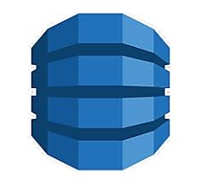

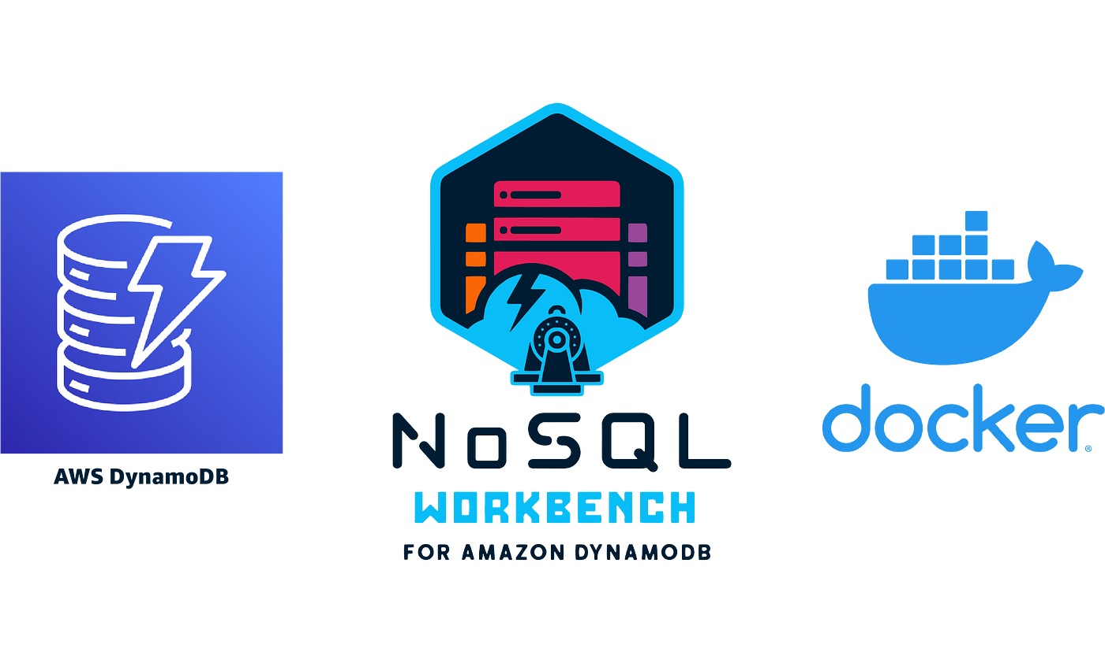


Tech Stack
This project is completely built on AWS Serverless ecosystem using Python for automation and scalability.
AWS S3 | Storage for user file uploads (CSV, JSON)
AWS SQS | Queue for reliable event handling
AWS Lambda (Dockerized) | To process and extract metadata from files
AWS DynamoDB | NoSQL Database for storing extracted metadata
CloudWatch | Monitoring, Error Tracking
DynamoDB Workbench | For easy data visualization
Python | Programming Language
PyCharm Community Edition | Development Environment
GitHub | Version Control & Collaboration
Notes:
"Here’s the complete tech stack used for this project. We’ve built this pipeline entirely on AWS's serverless ecosystem — which means there’s no need for manual provisioning or scaling.
We used:
S3 for file uploads — acting as the entry point for structured files like CSV or JSON.
SQS as a queue to ensure reliable event triggering — it decouples S3 from the actual processing logic.
AWS Lambda, which we containerized using Docker, to extract metadata from each uploaded file. Using Docker gave us more control over the runtime and dependencies.
DynamoDB, a NoSQL database, was used to store the extracted metadata efficiently and at scale.
CloudWatch helped us monitor logs, track executions, and debug issues.
DynamoDB Workbench allowed us to easily view and validate the records without building a frontend.
All the core processing logic was written in Python, developed using PyCharm Community Edition, and the code was version-controlled using GitHub.” we already mentioned in our proposal , why we chose these resources, so we are going skip that part today.

Slide 3
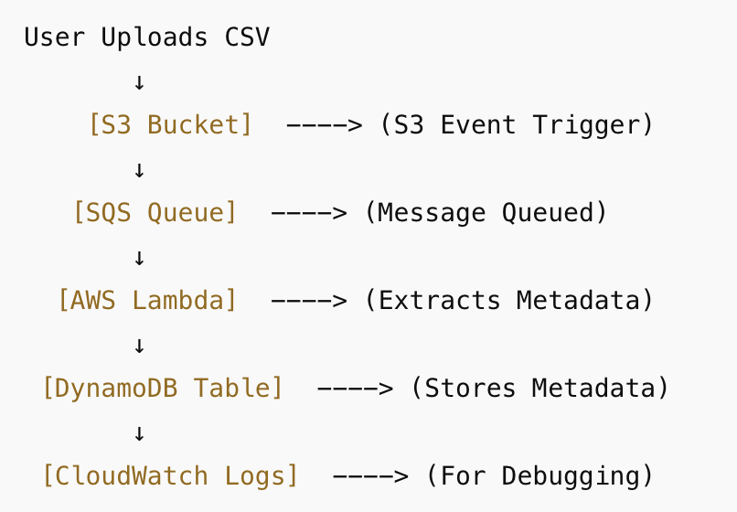
WHY THESE RESOURCES?
AWS S3 – Secure, scalable file storage. (Alternatives like Azure Blob Storage & Google Cloud Storage are costlier and less integrated with Lambda.)
Amazon SQS – Event-driven queuing to ensure processing reliability. (Better than using direct Lambda triggers, which may fail under heavy loads.)
AWS Lambda – Auto-scaling, cost-efficient, and serverless computing. (Better than EC2 or traditional batch processing systems.)
DynamoDB – NoSQL, low-latency storage for metadata. (SQL databases are slower & not optimized for unstructured metadata.)
CloudWatch – Real-time monitoring and logging for debugging & analytics. (Ensures smooth execution without manual intervention.)
Notes:
"Now let’s talk about why we specifically chose these AWS services.
Our primary goal was to make the solution serverless, scalable, and cost-effective — and each component was selected with that in mind.
S3 is a natural choice for file uploads. It integrates seamlessly with other AWS services and is highly durable.
SQS adds a layer of reliability. Instead of triggering Lambda directly from S3, which can drop events under load, we used SQS to buffer and manage event flow.
Lambda, especially Dockerized, gave us the flexibility to package all dependencies and handle memory or runtime limitations effectively.
DynamoDB is a great fit for storing structured metadata without needing a predefined schema — and it supports fast reads and writes at scale.
CloudWatch was essential for logging and monitoring the entire pipeline without additional setup.
And DynamoDB Workbench made it simple to view and validate metadata records, which helped during development and testing.
On the right, you can see a high-level architecture of how these components connect — but we’ll walk you through that in detail in the next slide."

Slide 4
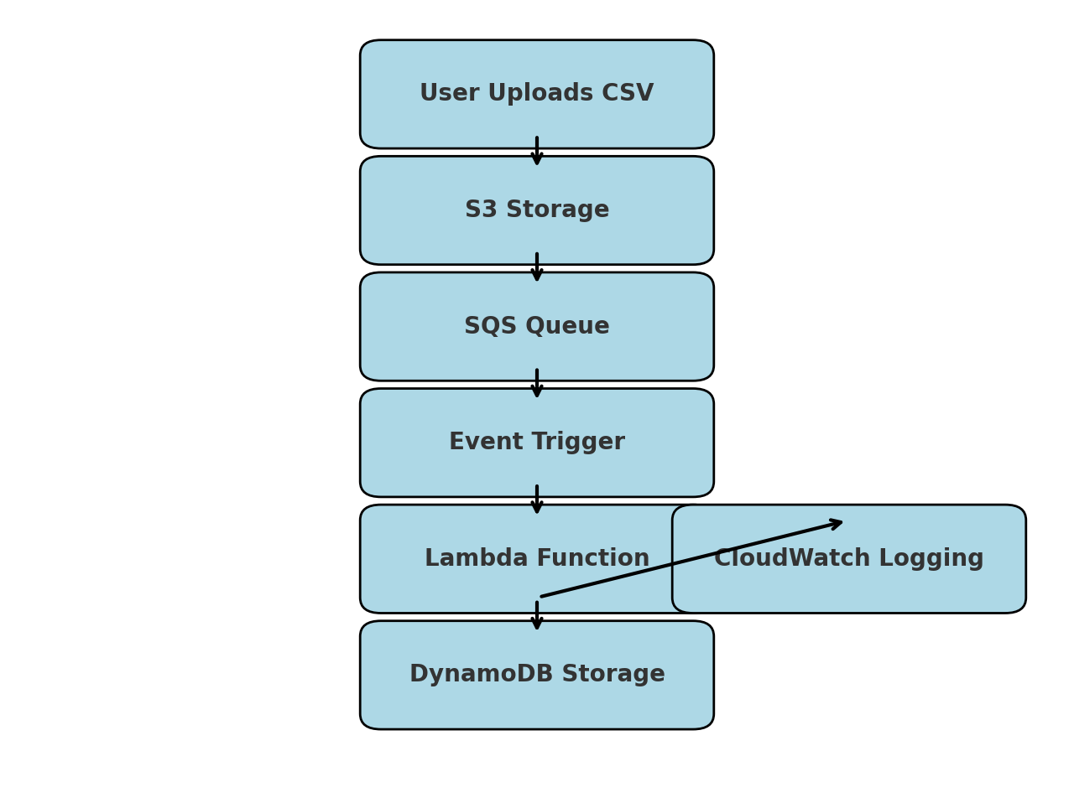
Design & Implementation
We designed an event-driven, serverless architecture that automatically processes files without any manual intervention.
User uploads CSV to S3
S3 triggers an event → Sends message to SQS
SQS triggers Dockerized Lambda Function
Lambda:
Reads file from S3
Extracts useful metadata like:
Filename
File Size
Region
Stores this metadata in DynamoDB
DynamoDB Workbench is used to view and analyze this data.
Live DEMO Link: https://youtu.be/OkruHlKifrg?feature=shared
Notes:
"Now let's go through the architecture in detail and explain how the system actually works end-to-end.
The process starts when the user uploads a structured file — typically a CSV — into an S3 bucket. This upload triggers an event.
Instead of directly invoking a Lambda, we configured the S3 bucket to send the event to an SQS queue. This adds a buffer between file uploads and processing, ensuring reliability — even if multiple files are uploaded quickly or simultaneously.
Next, the SQS message triggers our Lambda function. We've packaged the Lambda as a Docker container, which gives us complete control over dependencies, runtime, and resource limits. This was especially helpful when dealing with larger files or more complex Python libraries.
Inside the Lambda:
We download the file from S3 using the event information.
The file is parsed line by line, and we extract key metadata such as:
Filename
File size
Region
This structured metadata is then inserted into a DynamoDB table for persistent storage.
We chose DynamoDB for its flexibility and performance — especially for NoSQL use cases like ours, where schema flexibility and speed are important.
After Lambda execution, everything is logged in CloudWatch, where we can monitor success/failure, execution time, and debug any issues.
Finally, we used DynamoDB Workbench to view and validate the results. It gave us a simple interface to confirm that the data was being extracted and stored correctly — without needing to build a separate frontend.
The beauty of this pipeline is that the whole process — from file upload to data being queryable in DynamoDB — happens in just a few seconds, without any manual steps."

Slide 5
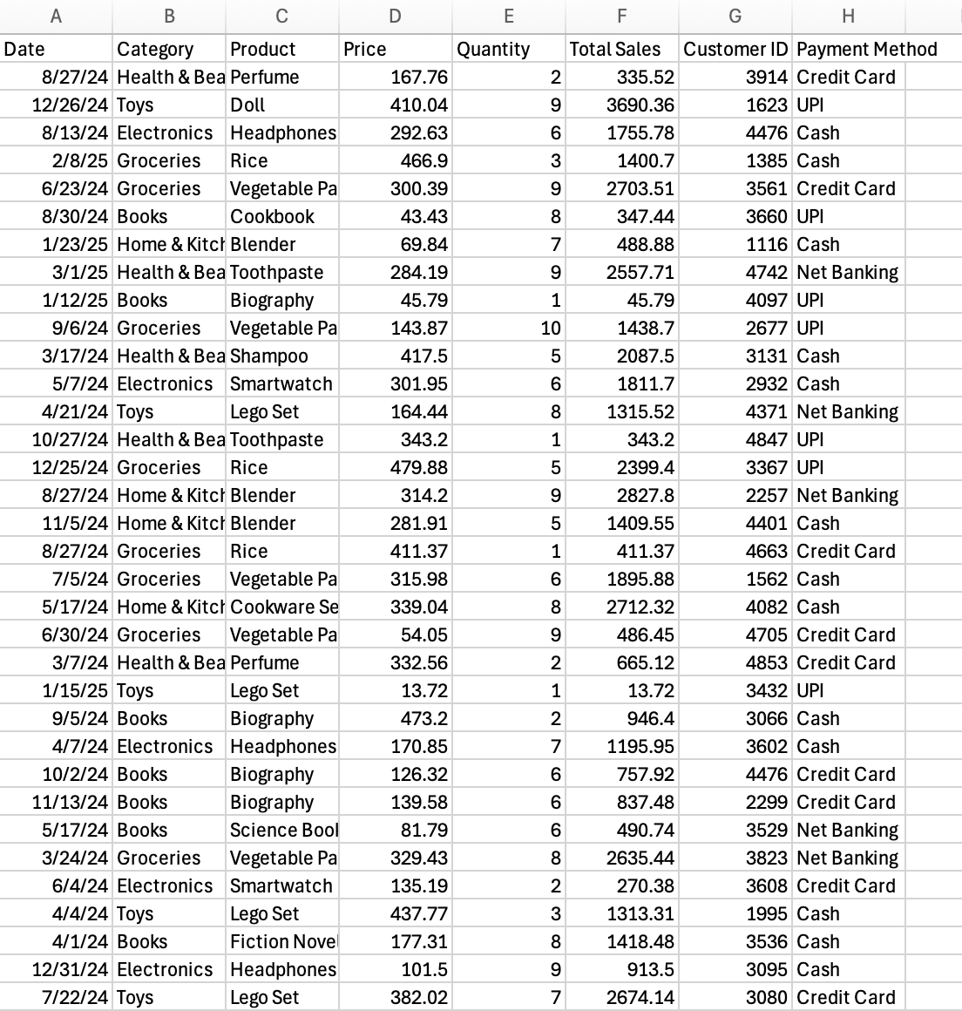
I/P
Notes:
I/p is a csv file with details like product, quantity, payment method

Slide 6
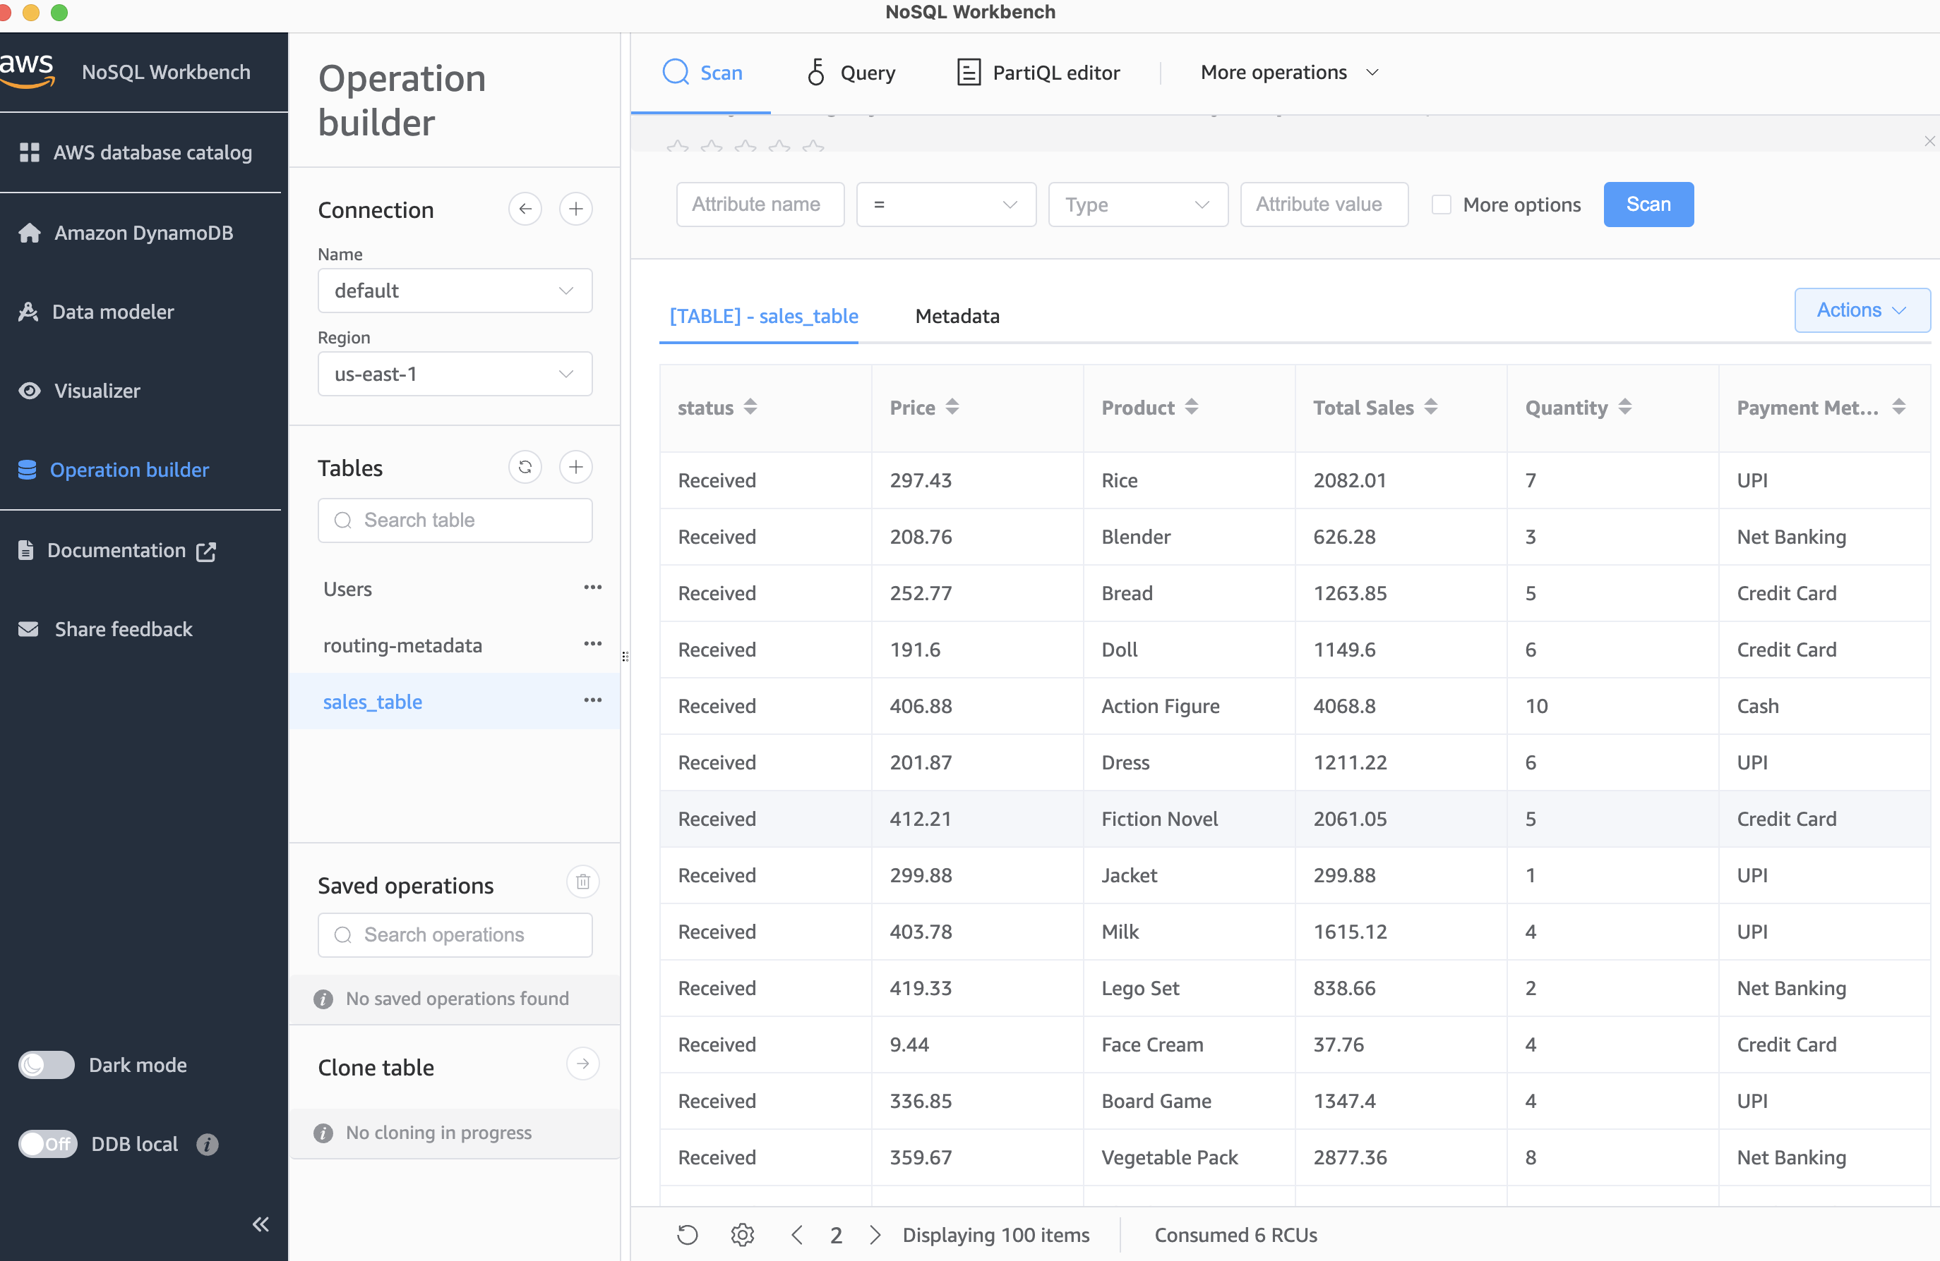
O/P
Notes:
”here’s visual proof that our system is fully working and end-to-end functional. This is our o/p.
This is the DynamoDB Workbench view connected to our AWS environment. You can clearly see records stored in the sales_table — each one automatically processed from the uploaded CSV file.
Metadata like:
Product name
Quantity
Total sales amount
Price
Payment method
And status
...have all been extracted and stored in a structured, queryable format — completely without manual effort.
This confirms that our entire pipeline — from file upload in S3 to Lambda processing, to metadata extraction and finally, storage in DynamoDB — is functioning exactly as intended."

Slide 7
Challenges
Problem Faced | Solution Implemented
IAM Permission Errors | Proper AWS Role & Policy setup
Lambda File Size Limits | Used Dockerized Lambda with optimized code
S3 & SQS Event Configuration | Managed triggers & event subscriptions correctly
Testing Locally | Used Docker image & CloudWatch for debugging
Notes:
"While designing and deploying the solution, we encountered a few technical challenges that helped us strengthen the implementation.
IAM Permission Errors: Initially, our Lambda couldn’t access S3 or DynamoDB. We resolved this by properly setting up IAM roles with the necessary policies.
Lambda File Size Limits: Some files were larger than expected. We used a Dockerized Lambda setup which allowed more flexibility in memory and runtime.
S3 & SQS Event Configuration: Getting the S3 bucket to publish messages to SQS and then mapping SQS to Lambda took several iterations and careful event rule configurations.
Testing Locally: Since Lambda is a cloud-native service, local testing wasn’t straightforward. We solved this by running the same Docker image locally and used CloudWatch logs extensively to debug in real-time."

Slide 8
RESULTS
What We Achieved:
Fully automate document processing [Upload → Auto Triggered → Auto Processed → Auto Stored]
Real-time metadata extraction for any structured CSV files
View-ready structured output in DynamoDB Workbench
No manual data entry or file handling
Fast Processing Time → Hardly few seconds per file
Can handle multiple files in parallel (Auto Scaling)
Highlights of Implementation:
Fully automated → No human effort
Event-driven → Real-time processing
Serverless → No infrastructure management
Scalable → Any number of files
Cost Effective → Pay only for what you use
Notes:
"Here are the outcomes we achieved by the end of the project:
We successfully automated document processing — from file upload to metadata extraction and storage — without any manual steps.
Metadata is extracted in real-time, and the results are immediately viewable in DynamoDB Workbench.
There’s no manual file handling or data entry involved.
The processing time is just a few seconds per file, even when processing them in parallel.
Thanks to the serverless architecture, the pipeline scales automatically and is cost-effective — we only pay when the Lambda runs.
The key strengths of our solution are:
It's fully automated and event-driven.
There’s no need to manage infrastructure.
It scales seamlessly as file load increases.
And it's a low-maintenance, production-ready architecture."

Slide 9
RESULTS
The biggest achievement is a fully working automated pipeline that processes documents in real-time with zero manual effort.
🌍 Business Impact Created:
Reduces manual effort by 90%
Saves up to 80% costs compared to traditional methods
Processes large datasets in seconds instead of hours
🎯 Real-World Use cases
Finance → Auto process Bank Statements / Reports
Retail / Sales → Process Inventory & Sales Data
Healthcare → Process Patient Data / Reports
HR & Recruitment → Resume Parsing & Metadata Extraction
Any business dealing with large document handling
Notes:
"From a business perspective, the value of this system is significant:
It reduces manual effort by over 90%, especially in cases where teams manually parse and upload data.
It cuts operational cost by up to 80%, as there’s no need for manual labor or dedicated servers.
And it’s capable of processing large datasets in seconds, compared to hours with manual processes.
In terms of real-world applications, this can be used in:
Finance, to automate the processing of statements and reports.
Retail or Sales, to ingest and analyze transaction or inventory data.
Healthcare, to structure and store medical reports.
HR & Recruitment, to automate resume parsing and extract metadata.
And really any business dealing with repetitive document uploads and metadata extraction."

Slide 10



PROJECT TIMELINE
Week | Task | Status
Week 1 | Setup AWS Infrastructure | Completed
Week 2 | Develop Lambda for Data Extraction | Completed
Week 3 | Integration & Testing | Completed
Week 4 | Optimization & Logging | Completed
Week 5 | Deployment & Scaling | Completed
Week 6 | Final Presentation & Documentation | In-Progress
Each team member contributed based on their expertise for efficient execution.
GitHub Repo: https://github.com/Nagamedha/CC_Project
Notes:
"This slide summarizes the weekly progress and how we managed the overall development timeline.
We divided responsibilities among the five team members based on our individual areas of expertise — AWS setup, backend logic, debugging, and documentation.
In Week 1, we focused on setting up the AWS infrastructure — including S3, Lambda, SQS, and DynamoDB.
Week 2 was dedicated to developing the core Lambda function for data extraction.
During Week 3, we worked on integrating all services and thoroughly tested the pipeline.
Week 4 was about optimizing the logic and implementing structured logging using CloudWatch.
Week 5 covered the deployment phase and ensured the solution scaled smoothly.
Now, in Week 6, we’re finalizing the presentation and documentation — which is still in progress. That’s the only part we haven’t fully wrapped up yet, but it’s actively being worked on and will be completed by next week.
The project is fully developed, tested, optimized, and deployed — and we’re happy to share that our GitHub repo is public. Anyone interested can download and build on top of it for future enhancements or similar use cases."

Slide 11
FUTURE SCOPE
🚀 What’s Next?
🔹 Expand support for more file types (PDFs, XML, Excel) 🔹 Implement AI-powered data validation for accuracy 🔹 Add a web-based frontend for easy file uploads 🔹 Scale the system for enterprise-level usage
🔹 Auto Notification to users after processing
This project eliminates inefficiencies, reduces costs, and enables real-time automation!
Notes:
"While we’ve successfully implemented the core pipeline, there’s definitely scope for future expansion.
First, we can support more file types like PDFs, Excel, and XML, not just CSV and JSON.
We can also integrate AI-powered data validation to ensure the quality and consistency of extracted metadata.
Another logical step is to build a web-based frontend where users can upload files directly — removing the need to interact with AWS manually.
The system can be scaled for enterprise-level workloads — with higher throughput and better error handling.
And finally, we can enable notifications, so users get real-time alerts once their file is processed.
Due to limited time, we focused on getting the core AWS pipeline production-ready. We didn’t perform deep testing across different machines or instance types — but we selected optimal AWS configurations that gave us excellent results within our constraints."

Slide 12
CONCLUSION
Automated, scalable, and real-time document processing.
Eliminates manual effort, reducing costs by up to 80%.
Supports diverse industries:
e-commerce, finance, healthcare.
This is the future of cloud-based data processing!
Notes:
"To wrap up — this project delivers a fully automated, scalable, and real-time document processing pipeline using AWS.
It significantly reduces manual effort and can cut operational costs by up to 80%, especially in industries that rely heavily on structured documents.
The architecture we’ve built supports use cases across e-commerce, finance, healthcare, HR, and more — wherever structured files like CSVs or JSONs are in use.
With further extensions like AI, multi-format support, and a frontend interface — this can truly scale into a full-fledged enterprise product.
We believe this represents the future of cloud-based data processing — fast, flexible, and fully automated."

Slide 13

for your Attention!
Open to any Questions/Feedback you may have!
Notes:
"Thank you for your time and attention! "We are now open to any questions regarding our methodology, timeline, or implementation plan."

