Slide 1



Serverless Document & Data Processing Using AWS Lambda
A Scalable & Automated Approach to Real-Time Data Extraction
Team Members
Nagamedha Sakhamuri
Harika Gavini
Krithika Reddy
Sri Venkata Naga Sai
Harika Kakarala
Notes:
"Good [morning everyone. (Introduce), and today we are presenting our proposal for Serverless Document & Data Processing Using AWS Lambda."
"This project is designed to eliminate manual document processing inefficiencies by automating real-time data extraction through cloud technologies."
"Our team consists of five members, each with specialized expertise in cloud infrastructure, backend development, testing, DevOps, and deployment. Over the next six weeks, we will work collaboratively to design and implement this solution using AWS services."
"We aim to build a cost-effective, scalable, and fully automated data processing pipeline that will revolutionize document handling for businesses."

Slide 2
🚨 THE PROBLEM & WHY IT MATTERS
Current Challenges:
Massive data growth in businesses, but manual processing is inefficient.
Existing solutions (manual data entry, batch processing, on-prem servers) fail due to:
High costs 💰
Lack of real-time processing ⏳
Scalability issues 📈
Real-World Impact:
Finance – Extracting transaction details from bank statements
E-commerce – Managing large inventory updates
Healthcare – Processing patient reports & insurance claims
Our Unique Approach:
Automated, serverless file processing using AWS
Real-time extraction with zero manual intervention
Cost-efficient, scalable, and future-ready
Notes:
"Businesses today handle massive amounts of structured data in the form of CSVs, financial statements, and inventory logs. Manual data processing is inefficient, time-consuming, and error-prone."
"Traditional methods such as manual entry, batch processing, and on-premise storage solutions have significant limitations: ✅ Require constant human intervention, leading to errors. ✅ Lack scalability, making it difficult to handle large datasets. ✅ Are expensive due to infrastructure costs and maintenance."
"For example, financial institutions that process thousands of bank transactions daily face serious delays due to outdated batch-processing methods. Similarly, an e-commerce company handling real-time inventory updates struggles with traditional systems that can't keep up."
"Our proposal aims to solve these issues by developing a fully serverless document processing system that is scalable, automated, and cost-effective."

Slide 3
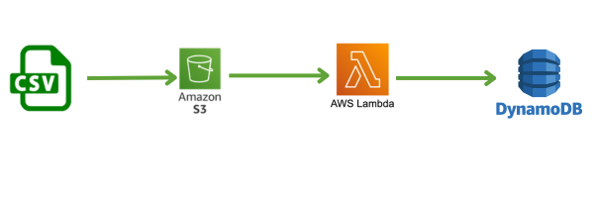
GOAL & EXPECTED RESULTS
🎯 What We Aim to Achieve:
Fully automate document processing using AWS Lambda
Process structured files (CSV, JSON) in real-time
Ensure scalability & eliminate manual workload
Store extracted metadata for fast access in DynamoDB
🌍 Business Impact:
Reduces manual effort by 90%
Saves up to 80% costs compared to traditional methods
Processes large datasets in seconds instead of hours
Notes:
"Our goal is to design and implement a real-time, serverless document processing system using AWS."
"The key objectives of this project are: ✅ Automate document uploads and processing with AWS Lambda. ✅ Extract metadata from structured files and store it for fast retrieval. ✅ Eliminate the need for manual intervention, improving efficiency. ✅ Ensure a scalable and cost-effective system that can process large datasets dynamically."
_"Upon successful implementation, we expect:
A 90% reduction in manual effort for handling documents.
Up to 80% cost savings compared to traditional processing methods.
Real-time processing capabilities, ensuring businesses can make data-driven decisions faster."_
"By following this structured approach, we aim to deliver a solution that will streamline document workflows and make processing faster and more efficient."

Slide 4
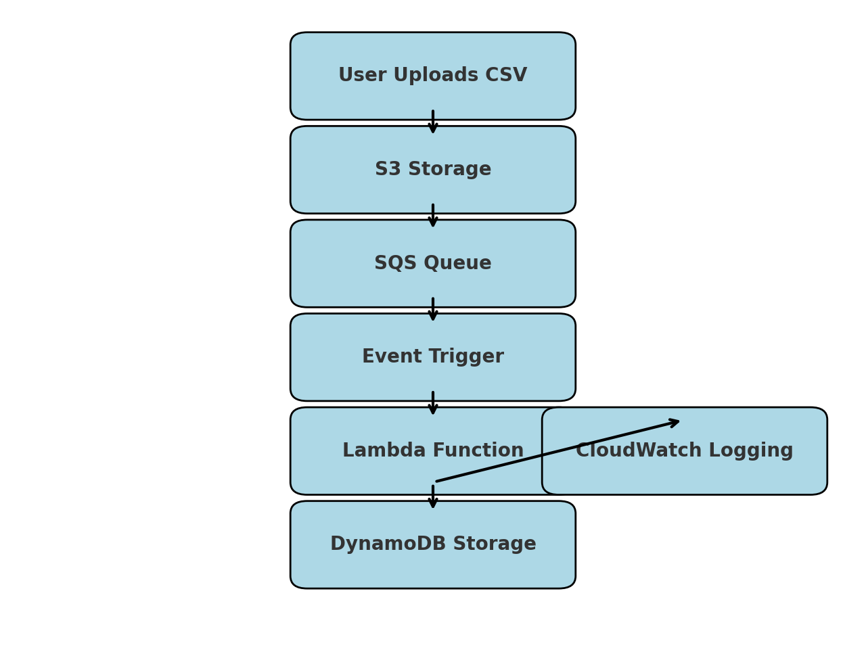
🔍 METHODOLOGY
User uploads a CSV file → Stored in AWS S3.
S3 triggers an SQS message → Notifies processing service.
SQS triggers an event → Ensures reliability & decoupling of processes.
AWS Lambda executes → Extracts file size, type, and metadata.
Lambda stores extracted metadata in DynamoDB for instant retrieval.
CloudWatch logs & monitors the entire process for debugging & performance tracking.
Notes:
"To successfully develop this project, we will implement the following step-by-step methodology:"
"📂 Step 1: Users upload CSV files to an AWS S3 bucket. 📩 Step 2: S3 triggers an event that sends a message to Amazon SQS. ⚡ Step 3: The SQS message ensures event-driven execution and triggers AWS Lambda. 📊 Step 4: AWS Lambda extracts metadata such as file size, type, and structure. 📄 Step 5: The extracted metadata is stored in DynamoDB for quick retrieval and analysis. 🔍 Step 6: AWS CloudWatch is used for monitoring, logging, and debugging."

Slide 5
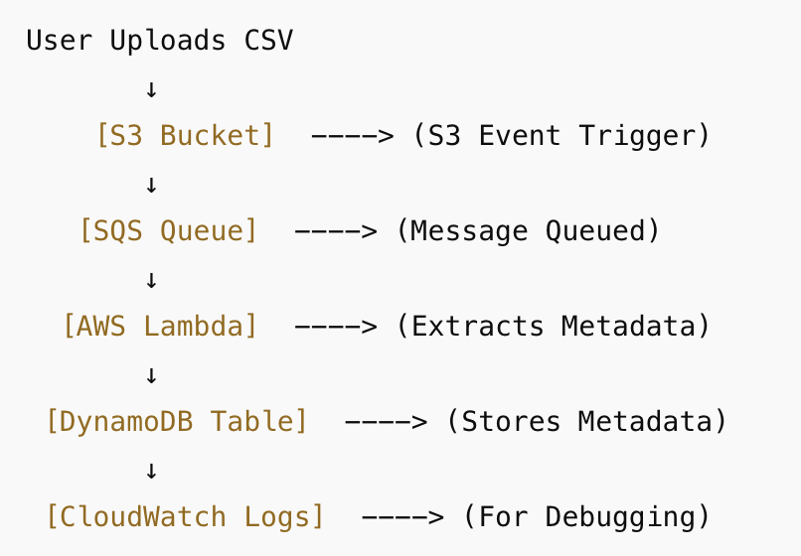
WHY THESE RESOURCES?
AWS S3 – Secure, scalable file storage. (Alternatives like Azure Blob Storage & Google Cloud Storage are costlier and less integrated with Lambda.)
Amazon SQS – Event-driven queuing to ensure processing reliability. (Better than using direct Lambda triggers, which may fail under heavy loads.)
AWS Lambda – Auto-scaling, cost-efficient, and serverless computing. (Better than EC2 or traditional batch processing systems.)
DynamoDB – NoSQL, low-latency storage for metadata. (SQL databases are slower & not optimized for unstructured metadata.)
CloudWatch – Real-time monitoring and logging for debugging & analytics. (Ensures smooth execution without manual intervention.)
Notes:
"We carefully selected AWS services based on their scalability, efficiency, and cost-effectiveness."
✅ AWS S3 – Secure, scalable storage for document uploads. (Other services like Google Cloud Storage are costlier and less integrated with Lambda.) ✅ Amazon SQS – Ensures reliable event-driven processing. (Direct Lambda triggers are less fault-tolerant.) ✅ AWS Lambda – Fully serverless and cost-effective. (Using EC2 instances would increase costs and require manual scaling.) ✅ DynamoDB – Fast NoSQL storage for metadata. (Relational databases are slower and less optimized for metadata storage.) ✅ CloudWatch – Real-time logging and debugging.
"By leveraging these AWS services, we will develop a highly scalable and efficient document processing pipeline."

Slide 6



PROJECT TIMELINE
Week | Task
Week 1 | Setup AWS Infrastructure
Week 2 | Develop Lambda for Data Extraction
Week 3 | Integration & Testing
Week 4 | Optimization & Logging
Week 5 | Deployment & Scaling
Week 6 | Final Presentation & Documentation
Each team member contributes based on their expertise for efficient execution.
Notes:
This project will be completed over six weeks, with responsibilities divided among five team members based on their expertise."
"Each team member will contribute to a specific phase of development, ensuring efficient execution."
"By following this structured timeline, we will ensure that the project is fully developed, tested, optimized, and deployed before the final presentation."

Slide 7

for your Attention!
Open to any Questions/Feedback you may have!
Notes:
"Thank you for your time and attention! "We are now open to any questions regarding our methodology, timeline, or implementation plan."

Slide 8
FUTURE SCOPE
🚀 What’s Next?
🔹 Expand support for more file types (PDFs, XML, Excel) 🔹 Implement AI-powered data validation for accuracy 🔹 Add a web-based frontend for easy file uploads 🔹 Scale the system for enterprise-level usage
This project eliminates inefficiencies, reduces costs, and enables real-time automation!
Notes:
"While this proposal focuses on structured files like CSVs, we plan to expand our system to support additional document types such as PDFs, XML, and Excel."
"We also aim to implement: ✅ AI-powered data validation to detect and correct errors in real-time. ✅ A web-based frontend for easier file uploads and monitoring. ✅ Enterprise-level scaling to handle millions of files per day."
"With these enhancements, this system has the potential to be a powerful cloud-based document automation suite used across multiple industries."

Slide 9
CONCLUSION
Automated, scalable, and real-time document processing.
Eliminates manual effort, reducing costs by up to 80%.
Supports diverse industries:
e-commerce, finance, healthcare.
This is the future of cloud-based data processing!
Notes:
✅ Conclusion: "Our proposal outlines a highly efficient, scalable, and cost-effective solution for document processing. We are confident that by implementing this plan, we can deliver a system that reduces costs, improves efficiency, and enables real-time automation."
🚀 "Thank you once again!

