Slide 1

Why AI Understanding Our Emotions Online Is a Game-Changer?
Notes:
Hello Evryone, good Afternoon, Before i start Am i audible and is my screen visible to all of you ? Ok i would like to start with a quetsion you are seeing on screen?
In today’s world, emotions are everywhere — people express how they feel through tweets, comments, and reviews.
And companies that can actually understand those emotions? They gain a serious edge.
Take AI systems like ChatGPT or Grok — they analyze the tone and sentiment in user inputs to generate responses that feel natural and emotionally aware. That’s a big reason why these tools are so engaging — they don’t just respond; they connect.
In industries like fashion or food delivery, brands track feedback to see if customers are excited, frustrated, or losing interest — and they use that insight to adjust offerings and strategy in real time.
So whether it’s retaining users, improving services, or making AI more human — Understanding emotion gives businesses and platforms a real advantage.
And that’s exactly why sentiment analysis is such a game-changer today.

Slide 2
Smart Sentiment Analytics: Decoding Social Media Emotions with Computational Intelligence
Team Members
Nagamedha Sakhamuri
Nikitha Bonthala
Professor
Yanqing Zhang
Notes:
So now that we’ve seen how powerful sentiment analysis is across industries — from enhancing customer experience to making AI more human — we were curious to build something of our own in this space.
That’s how this project began.
We are a team of two— i',m Medha and my teammate is Nikitha —
Together, we are here today to present our project titled: Smart Sentiment Analytics: Decoding Social Media Emotions with Computational Intelligence.
In this project, we explore how machine learning and AI can understand real-world emotions expressed in tweets and YouTube comments — and classify them into positive, negative, or neutral sentiment.

Slide 3

THE PROBLEM
The internet is flooded with public opinions — tweets, YouTube comments, product reviews.
These texts contain valuable emotional signals but are often noisy, sarcastic, or informal.
Traditional sentiment analysis tools struggle to understand real-world, user-generated content.
Businesses miss out on critical insights hidden in unstructured feedback.
Notes:
So what’s the problem we’re trying to address?
You might already have a sense of it by now — but this slide highlights the specific challenges we’re focusing on.
We live in a world overflowing with public opinions — from tweets and YouTube comments to product reviews. But these aren't formal paragraphs — they’re messy, informal, sarcastic, and often loaded with slang, emojis, and typos.
Yet, even in all that noise lies valuable emotional signals. The problem is — traditional sentiment tools struggle to make sense of it.
They often misread sarcasm as positive tone, or completely miss, subtle frustration hidden in polite wording. So the real challenge becomes — how do we teach machines to understand emotion like a human, even when the input is raw and chaotic?
If we can’t solve that, businesses miss out on insights, feedback gets ignored, and AI systems stay emotionally unaware.
That’s the core problem we set out to tackle in this project.

Slide 4
PROJECT OBJECTIVE & HYPOTHESIS
What We Set Out to Achieve
OBJECTIVE:
HYPOTHESIS:
TARGET OUTCOME:
Build a sentiment analysis engine tailored for real-world social media content.
Traditional models underperform on informal user-generated data; transformer-based models like BERT, combined with feature enhancement (emojis, sarcasm), can significantly boost accuracy.
Improve classification performance from traditional baseline (~72–74% accuracy) to a more reliable, context-aware system using BERT.
Notes:
Now that we’ve understood the problem — let’s move to what exactly we set out to achieve through this project.
Our objective was clear: we wanted to build a sentiment analysis engine that works on messy, real-world social media content — not just academic examples.
We had a hypothesis that traditional models, although interpretable, struggle with informal and noisy data. But transformer-based models like BERT, which capture deeper context, could handle this better — especially if we enhanced them with features like emoji interpretation and sarcasm detection.
So our goal was to push past the usual 72–74% accuracy benchmark, and build something more context-aware and reliable using BERT.
This lays the foundation for the next few slides where we’ll show you how we approached, implemented, and evaluated this idea.

Slide 5
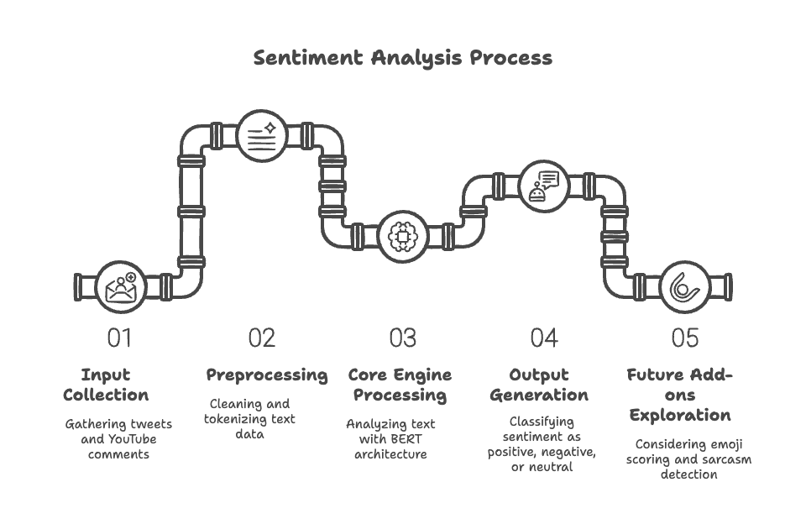
ARCHITECTURE
Notes:
This pipeline visually summarizes the full lifecycle of how our sentiment engine works.
🔹 Step 1 – Input Collection: We began by gathering real-world user comments from Twitter and YouTube via Kaggle datasets. This gave us raw, diverse, and emotionally rich content.
🔹 Step 2 – Preprocessing: Since this data often includes emojis, hashtags, slang, and noise, we cleaned it up and tokenized it, ensuring it’s ready for model ingestion. This step was especially important to standardize informal language.
🔹 Step 3 – Core Engine Processing: This is the brain of our pipeline. We used BERT-based models here to deeply analyze each sentence’s context. This layer helps the model understand subtle cues — like sarcasm or emphasis — that older models usually miss.
🔹 Step 4 – Output Generation: The output is a sentiment label — positive, negative, or neutral — for each input text. This result is backed by model confidence, and later used for evaluation.
🔹 Step 5 – Future Add-ons: We also explored extensions like emoji scoring and sarcasm detection. They’re not yet full modules but show strong promise in boosting the model’s emotional understanding.
This architecture is modular, interpretable, and designed for expansion — making it a strong base for future emotionally aware AI systems.

Slide 6
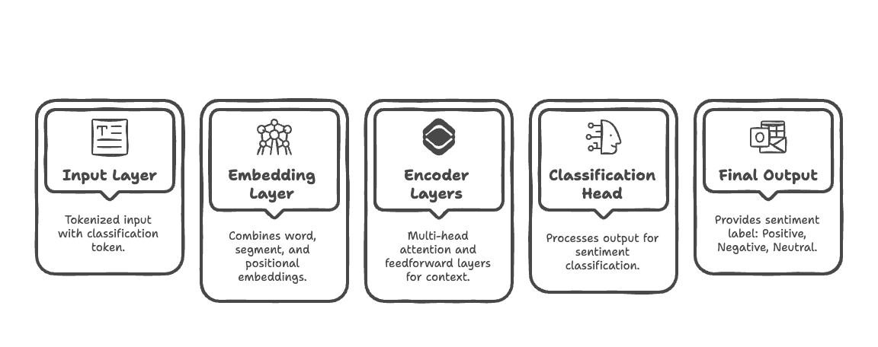
BERT ARCHITECTURE
How We Designed Our Sentiment Engine
Notes:
Now that we've seen the overall pipeline, let’s zoom into the heart of our engine — the DistilBERT architecture.
We begin with the Input Layer, where user comments are first tokenized and a special classification token is added — this helps the model focus on sentiment-level understanding from the start.
Next comes the Embedding Layer, which merges three things — word embeddings, positional embeddings, and segment embeddings — so the model can understand not just meaning, but also structure and context.
Then we move into the core — the Encoder Layers. These are built with multi-head attention and feedforward layers. This is where BERT really shines — it can weigh multiple parts of a sentence simultaneously, making it effective even for sarcasm, long comments, or emoji-heavy inputs.
The processed representation is passed into the Classification Head, which condenses all that context into just one label — is the sentiment positive, negative, or neutral?
Finally, we get the Final Output — the sentiment prediction.
This modular yet powerful design is why transformer models outperform traditional approaches, especially on real-world, noisy data like social media.

Slide 7
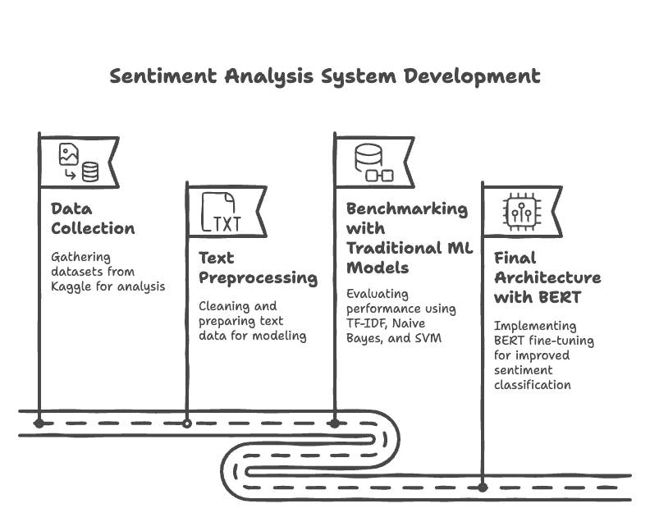
Methodology
Notes:
Here’s a step-by-step breakdown of how we developed our sentiment analysis system.
We began with Data Collection, sourcing real-world social content — specifically Twitter and YouTube comments — from Kaggle. These datasets gave us informal, noisy, and highly expressive text, perfect for training models that deal with real human sentiment.
Next was Text Preprocessing. This involved cleaning and normalizing the data — removing special characters, converting to lowercase, handling stopwords, and dealing with emojis and URLs. This step ensured consistency and reduced noise before feeding the text into any model.
We then moved into Benchmarking with Traditional ML Models. We started with TF-IDF and Logistic Regression, then tested Naive Bayes and SVM. These gave us baseline accuracy and helped us understand where classical models fall short — especially with sarcasm, emojis, or sentence context.
Finally, we transitioned to the Final Architecture with BERT, where we fine-tuned DistilBERT on our datasets. This allowed us to capture deep context, better understand informal expressions, and significantly boost accuracy.
Each phase was designed to build on the previous one — making our system robust, scalable, and truly emotion-aware.

Slide 8
Common Steps Before Modeling
Preparing Our Sentiment Data: From Raw Text to Clean Input
Datasets Used:
Sentiment140 (1.6M tweets labeled via emoticons)
1.6 million labeled tweets (positive, negative, neutral)
Noisy, real-world Twitter data — perfect for testing robustness
Labels derived using emoticons in the original dataset
US YouTube Comments (real user-generated feedback)
Large collection of real user comments
Diverse tone, slang, and emoji-rich text — challenging for sentiment models
Notes:
Before we could model anything, the first step was preparing quality input — and that started with our datasets.
We used two major datasets:
The first was Sentiment140, which contains 1.6 million tweets labeled based on emoticons. This dataset gave us large-scale, noisy, real-world Twitter data — ideal for testing the robustness of our models. The labeling was automated using positive and negative emojis in the original tweets, which helped in efficiently creating a massive labeled dataset.
The second dataset was the US YouTube Comments dataset. This brought in a different flavor — longer comments, diverse tone, and more slang and emoji usage. It was particularly useful for testing the model’s ability to handle informal feedback and sarcasm.
Together, these datasets exposed our models to a wide range of sentiment expression styles — short tweets, longer narratives, slang, and even sarcasm. This diversity was essential for building a system that could generalize well across platforms.
These real-world, user-generated datasets gave us a strong foundation to build and compare our models meaningfully.

Slide 9
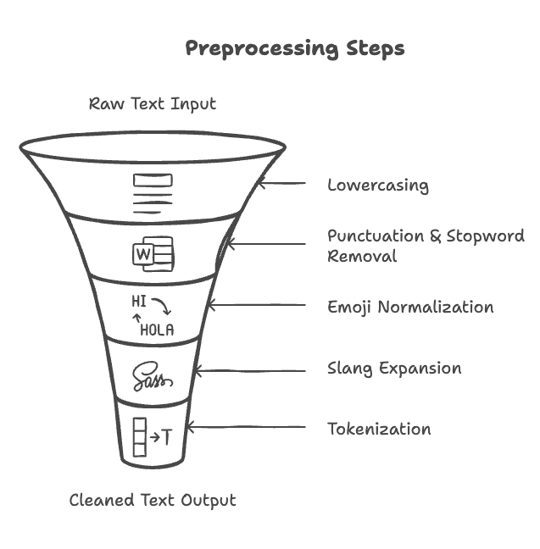
Common Steps Before Modeling
Preparing Our Sentiment Data: From Raw Text to Clean Input
Why Preprocessing Matters:
Removes noise from raw social media text
Standardizes diverse user writing styles
Improves downstream model performance
Notes:
Once we had the datasets, the next crucial step was preprocessing — and this made a huge difference in how well our models performed.
Social media text is raw and messy — it's filled with emojis, abbreviations, slang, and inconsistent punctuation. If we fed that directly into a model, we’d get poor, unstable results.
So we built a step-by-step cleaning pipeline:
First, lowercasing to standardize all text.
Then, we removed punctuation and stopwords — reducing noise without losing sentiment.
Emoji normalization was key — converting symbols like "🔥" into words like “fire” so models could actually understand them.
We also used slang expansion — turning “gonna” into “going to”, and so on — because models trained on formal text don’t always get informal lingo.
Finally, we applied tokenization to break the text into digestible pieces.
This pipeline helped standardize writing styles, reduced ambiguity, and significantly improved the performance of both traditional and deep learning models.
In short, preprocessing was the bridge between chaotic user text and structured machine understanding.

Slide 10
Traditional Model Evaluation & Insights
From Preprocessing to Benchmarking: Our Traditional Model Journey
Why Traditional First?
To establish a clear baseline for comparison
Faster experimentation with interpretable results
Models Applied After Preprocessing:
Logistic Regression, Naive Bayes, SVM
Used on preprocessed data with TF-IDF features (unigrams + bigrams)
Model:
TF-IDF + Logistic Regression
Simple, interpretable baseline to quickly measure text polarity
CNN Text Classifier
Explores deep learning with limited resource needs, good for pattern detection
Best Performer:
SVM with TF-IDF achieved ~72% accuracy with balanced F1-score
Key Observations from Results:
Worked well on clean, strongly opinionated text
Weak on sarcasm, emojis, ambiguous or neutral statements
Confusion matrix showed overlap between neutral vs positive/negative classes
Dataset Size & Why?
TF-IDF + LR
1,000 rows
Ideal for fast benchmarking and avoiding overfitting on a simple model
CNN
5,000 rows
Enough to train word embeddings and detect patterns without needing much compute
Notes:
Before jumping into advanced models, we started with traditional approaches — like TF-IDF with Logistic Regression and a basic CNN text classifier.
The reason? We needed a baseline — something fast, interpretable, and simple to benchmark against. These models helped us understand how well raw social media text could be classified without needing heavy compute.
We began with 1,000 rows for TF-IDF + LR — perfect for fast experimentation. For CNN, we scaled to 5,000 rows, enough to capture word patterns using embeddings, but still lightweight.
We tested several models — Logistic Regression, Naive Bayes, SVM — all using preprocessed data with TF-IDF features.
Our best performer here was SVM with TF-IDF, which reached about 72% accuracy and a balanced F1-score.
But there were limitations:
These models worked well only when the text was clean and clear-cut.
They struggled with sarcasm, emojis, and ambiguous tones.
And the confusion matrix revealed overlap between neutral and opinionated statements.
These insights made one thing clear: traditional models couldn’t fully capture emotional nuance, which pushed us to explore transformer-based methods next.

Slide 11
Transition to BERT
Moving Beyond Limitations: Why We Chose BERT
Why BERT?
Traditional models lack contextual understanding
BERT handles bidirectional language flow
Better at capturing sarcasm, emotion, and subtext
BERT Model Pipeline:
Input → Tokenized with WordPiece + [CLS] token
Passed through 12 Transformer Encoder Layers
Contextual embedding from [CLS] used for classification
Final output: Sentiment label (Positive, Negative, Neutral)
Model | Dataset Size | Why That Size?
DistilBERT (Initial) | 10,000 rows | Controlled test to prevent Colab memory issues during fine-tuning
DistilBERT (Final) | 50,000 rows + Augmentation | Once performance was stable, scaled up with more data to leverage BERT's full potential
Notes:
After seeing the limitations of traditional models, we transitioned to transformer-based methods, specifically DistilBERT.
Why BERT? Traditional models treat text as bags of words — they ignore word order and context. But human emotion lives in context — in sarcasm, in subtext, in phrases like “Oh, great…” which could mean anything without tone.
BERT helps bridge this gap. It processes text bidirectionally, capturing meaning based on both left and right context. That makes it far better at understanding emotion, slang, and sarcasm — especially in user-generated content.
Our BERT pipeline looks like this: We tokenize inputs using WordPiece, feed them through 12 transformer layers, and extract contextual meaning from the [CLS] token, which is then used for sentiment classification.
We started with 10,000 rows to ensure we didn’t run into memory issues on Colab and to validate performance early. Once stable, we scaled to 50,000+ rows with augmentation to fully utilize BERT’s potential.
This step was crucial — it unlocked a significant jump in accuracy and emotional understanding, which we’ll showcase in the results.

Slide 12
Evaluation Metrics
✅ Accuracy:
✅ Precision:
✅ Recall:
✅ F1-Score:
✅ Confusion Matrix:
Overall correctness of predictions
% of predicted positives that were correct
% of actual positives that were correctly identified
Balanced metric (precision + recall)
Visual view of model strengths & weaknesses
Key Insight: By starting simple and scaling intelligently, we balanced performance with resource constraints. DistilBERT emerged as the best fit for real-world sentiment analysis due to its deep contextual understanding.
Notes:
To evaluate our models fairly, we relied on five key metrics.
Accuracy gives us the overall correctness — how often the model got the sentiment right.
Precision tells us, of the positive predictions made, how many were actually correct — useful when false positives are costly.
Recall focuses on how well the model catches actual positives — great for understanding coverage.
F1-Score balances both precision and recall, especially helpful in real-world cases where class imbalance exists.
And finally, the Confusion Matrix offers a visual breakdown of performance — showing where the model confuses neutral with positive or negative.
These metrics gave us a holistic view of model performance — not just raw accuracy, but also how well each model understood emotional nuance.
As our key insight notes: by starting simple and scaling smartly, we found that DistilBERT consistently outperformed others in context-rich scenarios, making it the best fit for our problem.

Slide 13
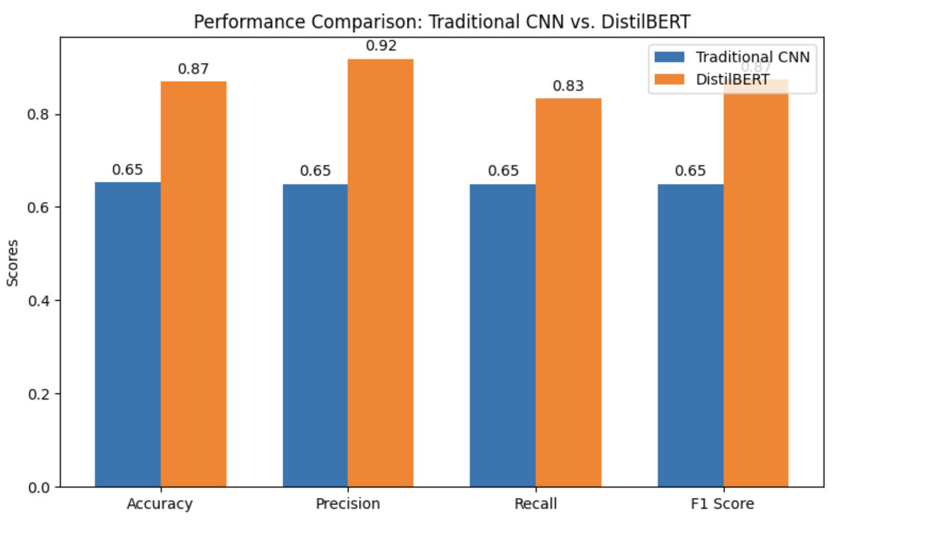
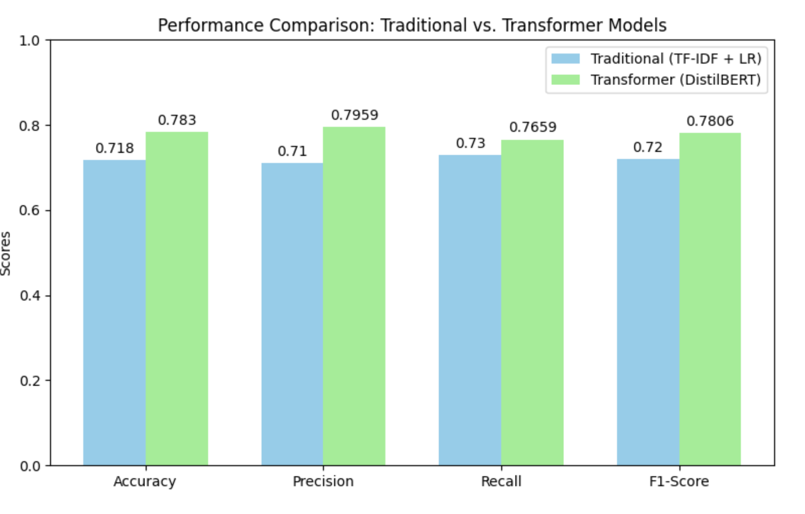
RESULTS
Model | Accuracy | F1-Score | Notes
TF-IDF + LR | 71.8% | 0.72 | Interpretable but missed nuance (emojis, sarcasm)
CNN | 65.4% | 0.65 | Better at short-term patterns, limited context understanding
DistilBERT (10k) | 83.2% | 0.83 | Good improvement with transformers
DistilBERT (50k) | 87% | 0.87 | Best on all metrics, especially with slang/emotion-rich content
Notes:
Here’s a consolidated view of the models we experimented with — along with the accuracy, F1-score, and qualitative notes.
TF-IDF + Logistic Regression gave us a solid baseline — around 71.8% accuracy, but it struggled with informal language, emojis, and sarcasm. It was interpretable, but lacked depth.
CNN showed slight improvements in picking up short-term text patterns, but didn’t handle longer context well — ending with 65.4% accuracy, which was a drop.
Then came DistilBERT with 10k rows, giving us an immediate performance boost — reaching 83.2% accuracy and an F1 of 0.83. Even at smaller scale, transformers clearly outperformed traditional models.
Finally, we scaled it to 50,000 rows with augmentation, and this version of DistilBERT achieved 87% accuracy and 0.87 F1-score — the best among all.
The bar charts below help visualize how each model stacks up across metrics like precision, recall, and F1-score. DistilBERT consistently leads in every category.
Also, from our confusion matrix, we observed:
CNN and TF-IDF had trouble distinguishing neutral from negative or positive.
DistilBERT had minimal false positives and handled ambiguous sentiments far better — especially with emoji-rich or sarcastic comments.
This consistent improvement across metrics is what led us to finalize DistilBERT as the backbone of our sentiment engine.

Slide 14
KEY OBSERVATIONS
Traditional Model (TF-IDF + LR)
Quick & lightweight, perfect for benchmarking
Struggled with slang, emojis, abbreviations, and contextual cues
Reached ~72% F1-Score, but plateaued early despite tuning
CNN-Based Classifier
Captured local patterns and n-gram features better than TF-IDF
Still lacked the ability to model long-range dependencies or sarcasm
Required careful training and still underperformed at ~65% F1-Score
DistilBERT (Transformer)
Excelled at context understanding, handling emojis, hashtags, sarcasm
Demonstrated consistent gains with dataset scaling:
10k samples → 83% accuracy
50k samples + data augmentation → 87% accuracy, F1: 0.87
Outperformed all others on precision, recall, and robustness on real-world text
🏆 Final Model Choice: DistilBERT
✅ Best performance on all core metrics
✅ Handled complex, noisy, social language (hashtags, emojis, sarcasm)
✅ Generalized well even on YouTube comments not seen in training
✅ Final validation accuracy: 87%, F1-Score: 0.87
Notes:
Let’s quickly reflect on the key takeaways from all the models we tried.
TF-IDF + Logistic Regression was fast and simple — great for benchmarking. But it struggled with real-world nuances like slang, abbreviations, and sarcasm. It hit around 72% F1-score and plateaued, even after tuning.
Our CNN-based classifier was slightly better in capturing local patterns using n-gram embeddings. However, it couldn’t capture long-range dependencies or emotional subtext — sarcasm still tripped it up. Even with careful training, it capped around 65% F1-score.
Then came DistilBERT, and that changed everything. Its deep contextual understanding allowed it to handle emojis, hashtags, sarcasm, and informal tone very effectively.
With 10k samples, we already saw 83% accuracy.
When scaled to 50k rows with augmentation, accuracy jumped to 87% with 0.87 F1-score.
We also found that DistilBERT generalized very well — even on YouTube data it hadn’t seen during training.
So, based on all core metrics — accuracy, precision, recall, and robustness — our final model choice was clear: 🏆 DistilBERT.

Slide 15
Current Project Status & What’s Next
Where We Stand — And What Comes Next
✅ Completed:
Dataset collection (Sentiment140 & YouTube comments)
🔜 Upcoming:
Emoji sentiment scoring (token-level handling)
Traditional ML models (TF-IDF + Logistic Regression)
CNN-based deep learning model
DistilBERT fine-tuning (1k → 10k → 50k)
Data augmentation pipeline (RandomWordAug)
Evaluation: accuracy, precision, recall, F1-score
Confusion matrix & visual comparisons completed
Sarcasm detection using RoBERTa or BERT+head(optional if time permits)
Final evaluation and documentation
Notes:
So far, we’ve made strong progress across all major phases of the project.
✅ On the completed side, we’ve:
Collected and preprocessed real-world data from Sentiment140 and YouTube comments.
Built and benchmarked traditional ML models, including Logistic Regression with TF-IDF.
Implemented a CNN-based deep learning model.
Successfully fine-tuned DistilBERT, scaling from 1k → 10k → 50k rows for maximum performance.
Built a data augmentation pipeline using RandomWordAug to enrich diversity.
And we completed full evaluation using accuracy, precision, recall, F1-score, plus confusion matrices and comparative visuals.
➡️ What’s upcoming:
We’ve already prototyped emoji sentiment scoring — next, we’ll refine it for token-level integration.
We’ve explored sarcasm detection, possibly using RoBERTa or a custom BERT+head configuration — this remains optional depending on time.
And finally, we’ll wrap up with evaluation, model packaging, and documentation.
We’ve laid a solid foundation — and now we’re preparing for the final polish and future enhancements.

Slide 16
Future Scope & Scalability
What This Project Can Evolve Into
Expand to multilingual sentiment analysis (e.g., Hindi, Telugu, Tamil)
Apply to product reviews, support chats, political/social opinion mining
Plug-in capability for real-time comment moderation or brand monitoring
Train on domain-specific datasets (healthcare, finance, entertainment)
Explore advanced transformer variants (e.g., RoBERTa) for multilingual and domain-specific scaling
Notes:
Looking ahead, our sentiment engine has strong potential to scale.
🔁 First, we aim to expand into multilingual analysis — supporting languages like Hindi, Telugu, and Tamil to make the system more inclusive.
💬 It can also be applied to product reviews, support chats, and opinion mining in various industries.
⚙️ A plug-in module for real-time moderation is another exciting direction — for example, detecting offensive or emotional comments live.
🧠 On the tech side, we plan to explore advanced models like RoBERTa for better multilingual and domain-specific tuning.
📊 And finally, we’ll scale to industry-specific datasets — like healthcare, finance, and entertainment — to make sentiment models context-aware.
This roadmap moves our project closer to real-world, intelligent AI deployment.

Slide 17
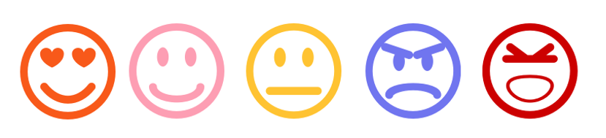
CONCLUSION
Wrapping Up: Key Takeaways
Sentiment analysis is critical in decoding user emotions online
We explored both traditional and deep learning models
BERT emerged as a strong choice for real-world sentiment understanding
Current results show significant improvement over baseline models
Foundation ready for advanced enhancements and scale-up
Notes:
To wrap up, our project confirms that sentiment analysis is essential for decoding emotions from online content.
We started simple, tested traditional models, and gradually moved toward deep learning and transformers.
Among all, DistilBERT stood out — handling informal, noisy text far better than earlier models.
Our results show a clear jump in accuracy and robustness, setting a solid baseline for real-world applications.
We now have a strong foundation to build on — whether it's multilingual support, sarcasm detection, or domain-specific use cases.
This is just the beginning — and the emotional intelligence of AI is only going to grow from here.

Slide 18
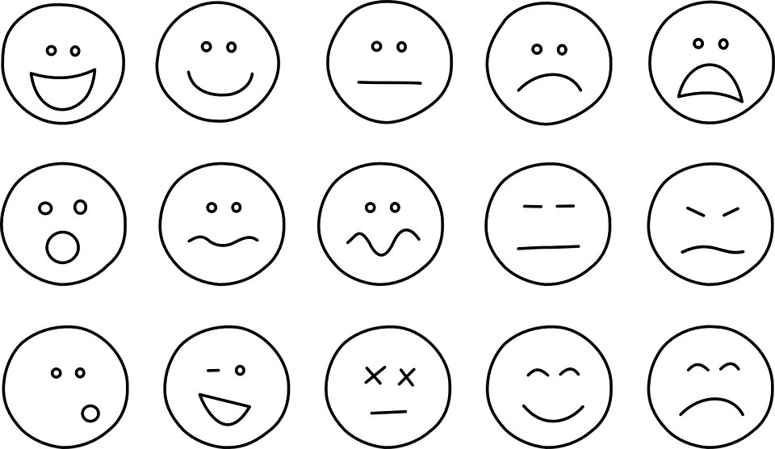
References & Resources
Kaggle Datasets:
Sentiment140: https://www.kaggle.com/datasets/kazanova/sentiment140
US YouTube Comments: https://www.kaggle.com/datasets/aashita/yt-comments-sentiment-dataset
BERT Paper:
Devlin et al., “BERT: Pre-training of Deep Bidirectional Transformers for Language Understanding” (2018)
Tools:
NLTK, scikit-learn, Transformers (HuggingFace)
Code Link: CNN + DistilBERT - https://drive.google.com/drive/folders/1B2nnUR6kjZahp6Wl1As9ikK9Au-EjibA?usp=sharing Traditional + BERT - https://drive.google.com/drive/folders/1oY9fI2SetXvNIWBURFLRQk66A_tUB-TY?usp=sharing
Notes:
To support our project, we relied on two Kaggle datasets — Sentiment140 for tweets, and a YouTube Comments dataset for diverse, user-generated content.
We grounded our model architecture on the original BERT paper by Devlin et al., which introduced deep bidirectional transformers for language understanding.
For tooling, we used NLTK for text preprocessing, Scikit-learn for traditional ML models, and HuggingFace Transformers for implementing and fine-tuning BERT models.
Finally, we’ve included links to our code repositories — one for CNN and DistilBERT, and another for traditional + transformer models — in case you’d like to explore the implementation further.

Slide 19


Thank you for your Attention!
We are open to any Questions/feedback you may have!
Mail: nsakhamuri1@student.gsu.edu
Notes:
That brings us to the end of our presentation. Thank you so much for your time and attention!
this project gave us a deeper understanding of how AI can connect with human emotions through text.
We’re happy to take any questions, suggestions, or feedback you may have. And if you’d like to follow up later, feel free to reach out at the email shown on screen.
Thanks again!

