Slide 1



AI-DRIVEN TEXT AND IMAGE-BASED CLASSIFICATION OF DIGITAL CONTENT IN E-COMMERCE
Project Proposal Presentation
Course: CSC 8980 Topics in CS
Instructor: Dr. Mario Kubek
Team Members:
Nagamedha Sakhamuri
Nookaraju Guttula
Laxmi Prasanna Ravikanti
Notes:
"Good Morning everyone, I am medha and this is my team , Raju and Laxmi. We are here to present our project today but before that let me ask you a question, we all use e-commerce platforms right? Have you ever experienced a situation where you search for a product and some irrelevant product appears in the list? Our project exactly addresses this issue. we are excited to present our project on AI-driven classification for e-commerce platforms. Our goal is to tackle the problem of inaccurate product categorization using machine learning techniques for text and image-based classification."
"Our system integrates NLP for text processing and computer vision for image classification, providing a robust approach to automated product categorization."
"Over the next few minutes, we will walk through the problem, our methodology, use cases, and how this solution impacts e-commerce platforms."

Slide 2
INTRODUCTION
E-commerce platforms rely on structured product categorization to enhance product discovery.
Text-based and image-based product classification is crucial for accurate recommendations.
Manual classification is tedious, inconsistent, and unsustainable for large-scale catalogs.
Our project develops an AI-based pipeline that classifies products based on text descriptions and images.
We integrate Natural Language Processing (NLP) and Computer Vision (CV) to automate product classification.
Notes:
"The rapid growth of e-commerce has made it increasingly difficult to manage product classification manually. Sellers need their products to be placed in the right category to ensure discoverability, while buyers rely on accurate categorization for effective search results."
"Manually tagging thousands of products is inefficient, leading to inconsistencies in product searchability and incorrect placements."
"We propose an AI-based system that automates this process using text-based and image-based classification models."
"This approach reduces human errors, improves efficiency, and enhances the shopping experience for consumers."

Slide 3
PROBLEM STATEMENT
Volume Overload: Rapid addition of products makes manual categorization infeasible.
Searchability Issues: Misclassification leads to irrelevant or missed product search results.
Classification Errors: Relying only on textual descriptions may lead to misclassification when similar words are used across different categories.
Scalability Challenges: Manual categorization cannot handle diverse products across large e-commerce platforms.
Need for AI-Driven Automation: Leveraging text and image data provides a more accurate classification system.
Notes:
"E-commerce platforms struggle with categorization due to large product volumes, misclassification, and inefficiency in manual processes. Here are the key problems we are addressing:"
"Volume Overload: Rapidly growing product catalogs make manual classification infeasible. Platforms like Flipkart and Amazon list thousands of new products daily, making manual classification unscalable."
"Searchability Issues: Misclassified products lead to inaccurate search results. If a mobile phone is wrongly categorized as an accessory, customers searching in the 'Smartphones' section won’t find it, leading to lost sales opportunities."
"Classification Errors: Product descriptions alone may be misleading. For instance, words like ‘Apple’ could refer to a fruit or a brand. Similarly, ‘Bass Speaker’ could be mistaken for a musical instrument instead of a sound system. Our model integrates image data to reduce such ambiguities."
"Scalability Challenges: Manual processes slow down as product variety increases. Traditional classification methods struggle to adapt to new trends in fashion, electronics, and consumer goods."
"To solve these challenges, we introduce an AI-driven classification system that combines textual and image-based learning for better accuracy and efficiency."

Slide 4
PROJECT OBJECTIVE
Develop an AI-driven system that classifies products using text descriptions and images.
Leverage machine learning models for text and image analysis to identify correct product categories.
Improve classification accuracy and consistency across large-scale datasets.
Enable real-time, automated classification integrated into e-commerce search and inventory systems.
Notes:
"The main goal of our project is to automate product classification with AI-powered models."
"By using NLP and image recognition, we can create a robust system that reduces manual intervention while improving accuracy."
"This approach enhances product discoverability and supports better recommendations for buyers."

Slide 5
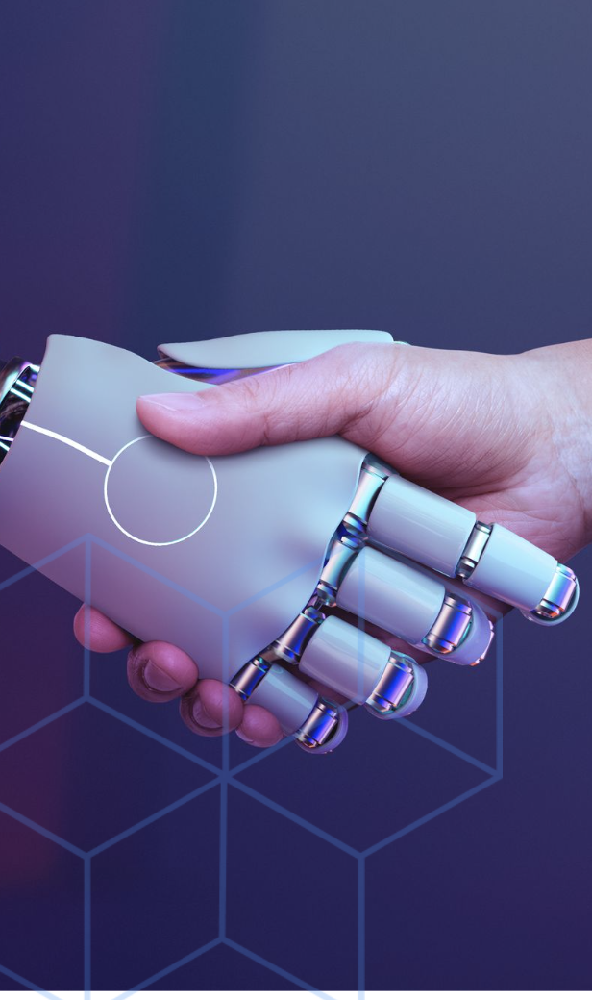
HYPOTHESIS
Combining text and image data enhances classification accuracy significantly.
Deep learning models for images and NLP for text outperform manual classification methods.
Automation will reduce operational inefficiencies, minimize human error, and improve scalability.
Notes:
"Our hypothesis is that leveraging both text and image data will provide a much more accurate and scalable classification model compared to traditional methods."
"Deep learning techniques like BERT for text and CNNs for images allow for better contextual understanding and feature extraction."
"We believe this will significantly reduce misclassification errors and improve operational efficiency."

Slide 6
PROPOSED METHODOLOGY
Dataset Used:
Flipkart Products Dataset from Kaggle (1050 entries Link). Real-world, structured, and includes both text and image data. Ideal for experimentation.
Text Processing & Feature Extraction:
Remove HTML tags, punctuation, and stopwords.
Apply tokenization, lemmatization, and vectorization.
Use TF-IDF, Word2Vec, and BERT embeddings for representation.
Image Processing & Feature Extraction:
Convert images into feature vectors using Convolutional Neural Networks (CNNs).
Extract visual patterns and textures that complement textual metadata.
Model Selection & Classification:
Text Classification Models: Naïve Bayes, SVM, LSTM, and BERT.
Image Classification Models: CNN-based architectures (ResNet, EfficientNet).
Multimodal Learning: Combine text and image features for improved classification accuracy.
Notes:
"For this project, we used the Flipkart Products dataset from Kaggle, which contains 1050 product entries including titles, descriptions, image URLs, and category labels. We chose this dataset because it’s real-world, lightweight, and structured — making it perfect for rapid experimentation within the course timeline. It offers both textual and visual fields, aligning directly with our objective of building a text + image classification model."
"We’re also following a top-down methodology — starting from the problem we’re trying to solve, identifying relevant use cases, and only then selecting machine learning methods that are best suited to those use cases. We’re not just experimenting with techniques; every model and method we picked supports a clearly defined goal."
"First, we preprocess text and image data separately. On the text side, we clean and normalize the data by removing HTML tags, stopwords, and unnecessary punctuation. Then we apply tokenization and lemmatization before converting the text into numerical form using TF-IDF, Word2Vec, and BERT embeddings."
"We selected these techniques because each offers unique benefits: TF-IDF captures frequency-based importance of words, Word2Vec helps with semantic similarity, and BERT understands context deeply by analyzing relationships between words.
"For image processing, we use Convolutional Neural Networks — Unlike traditional methods, CNNs can automatically detect patterns and learn important product features without manual feature engineering." specifically ResNet and EfficientNet — to extract visual patterns such as shape, color, and texture.
"For classification, we use a range of models — Naïve Bayes and SVM for basic text classification, LSTM and BERT for deeper text understanding, and CNNs(ResNet and EfficientNet) for image classification.
Finally, we integrate all extracted features in a multimodal learning setup, where text and image representations are combined before final classification to enhance prediction accuracy."

Slide 7
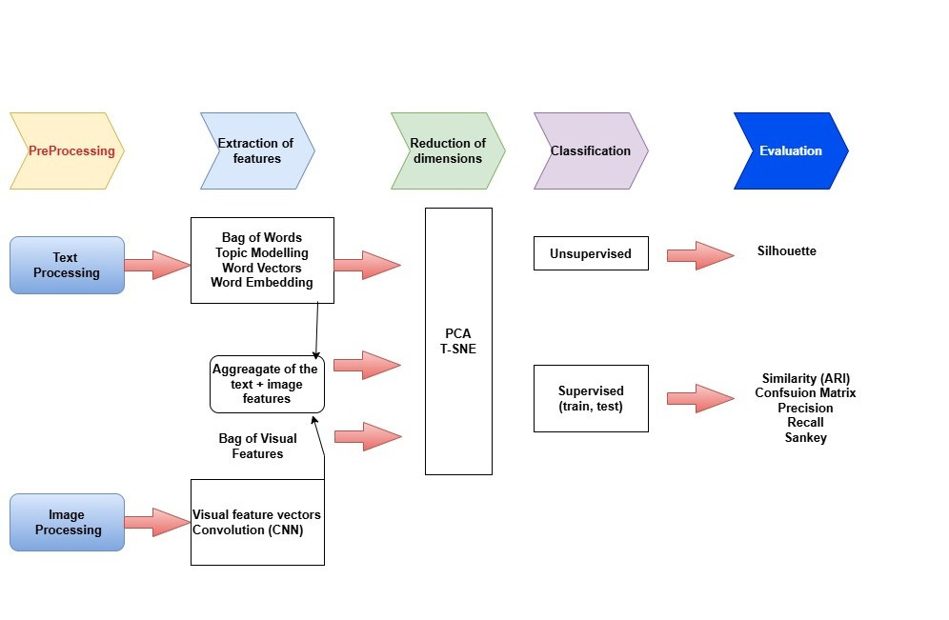
END-TO-END WORKFLOW
Step 1: Load Flipkart product dataset (including text descriptions and images).
Step 2: Apply NLP techniques for text preprocessing.
Step 3: Extract visual features from images using CNNs.
Step 4: Convert text into embeddings (TF-IDF, Word2Vec, BERT).
Step 5: Train separate text and image classification models.
Step 6: Implement multimodal learning to combine text and image data.
Step 7: Deploy final model to classify unseen products.
Notes:
Our approach aligns with the diagram here. First, we clean and process text and image data. Then we extract features, reduce dimensions where needed, and classify the products using supervised models. In the end, we evaluate with metrics like precision and confusion matrix "This is the overall pipeline of our AI classification system."
"Step 1: We collect product data, including both text descriptions and images from e-commerce sources."
"Step 2: Text preprocessing is performed to remove noise and convert text into numerical vectors using embeddings."
"Step 3: Images are processed using CNN-based models to extract relevant features."
"Step 4: Text and image-based models classify products separately, and then results are merged using a multimodal approach."
"Step 5: The final classification is made using ensemble techniques, ensuring robustness and high accuracy."

Slide 8
PROJECT PLAN & TEAM ROLES
Phase | Task | Duration
Phase 1 | Dataset understanding, preprocessing for text & images | Mar 15 - Mar 25
Phase 2 | Feature extraction & model design (text and image) | Mar 26 - Apr 5
Phase 3 | Training & fine-tuning of text & image classifiers | Apr 6 - Apr 15
Phase 4 | Multimodal learning integration & evaluation | Apr 16 - Apr 20
Phase 5 | Documentation, results consolidation & submission | Apr 21 - Apr 25
Nagamedha Sakhamuri: Handled text preprocessing and feature engineering.
Nookaraju Guttula: Developed and optimized text classification models (BERT, LSTMs).
Laxmi Prasanna Ravikanti: Designed and trained image classification models (CNNs, ResNet).
All Team Members: Integrated multimodal learning, testing, and final system evaluation.
Notes:
"We have structured our project into five phases to ensure smooth execution."
"Phase 1: Understanding dataset and preprocessing text & images."
"Phase 2: Implementing feature extraction and training initial models for text and image classification."
"Phase 3: Training and fine-tuning advanced models like BERT and CNNs."
"Phase 4: Integrating multimodal learning and evaluating results."
"Phase 5: Finalizing documentation and preparing submission."
"Our team has divided responsibilities based on expertise areas."
"Nagamedha focused on text preprocessing and feature extraction."
"Nookaraju worked on building and optimizing NLP models like BERT and SVM."
"Lakshmi Prasanna handled image classification using CNNs and model deployment."
"All members collaborated on integration and testing of the final multimodal system."

Slide 9
CONCLUSION
Our system integrates text and image-based AI classification to improve e-commerce product categorization.
Combining NLP & Computer Vision results in higher accuracy, efficiency, and scalability.
Future scope includes adaptive learning, multilingual support, and multimodal deep learning enhancements.
We will consider expanding to multi-faceted classification (e.g., by usage, material, brand) as a future enhancement if time permits.
Notes:
"Our AI system significantly improves product classification by integrating text and image data."
"Our system integrates NLP and computer vision to address classification challenges in e-commerce, significantly improving automation, precision, and user experience.
"Future improvements include adaptive learning, multilingual support, and enhanced real-time processing."
"Our system integrates NLP and computer vision to address classification challenges in e-commerce, significantly improving automation, precision, and user experience."
As part of future work, we will be exploring Professor Kubek’s suggestion to support multi-faceted classification. That means assigning multiple attributes to a product — for example, predicting not just the category, but also material type (e.g., cotton), usage (e.g., indoor), or brand tier."
Currently, our system performs single-label classification based on text and image features. But to support multiple facets, we could explore approaches such as:"
Multi-output classifiers (predicting multiple attributes at once)
Separate classifiers per facet (like one for usage, one for material)
Multi-task neural networks (shared layers for multiple outputs)
Weak supervision or rule-based tagging for facet bootstrapping
"If time permits, we’ll experiment with these methods during implementation to lay the groundwork for a flexible, dashboard-style classification system."

Slide 10

for your Attention!
Open to any Questions/Feedback you may have!
Notes:
"Thank you for your attention! We are happy to answer any questions and receive feedback.

