Slide 1
Personal Finance Chatbot
Intelligent Guidance for Saving, Taxes, and Investments

Slide 2
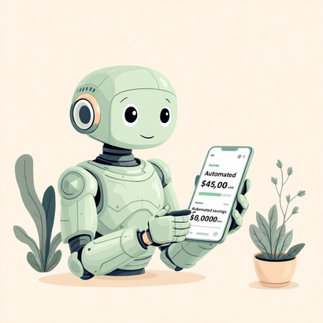
Introduction to Personal Finance Chatbots
- AI-powered assistants for managing money
- Growing importance in modern financial planning

Slide 3

Core Features
- Smart savings guidance
- Tax planning tips
- Investment recommendations

Slide 4
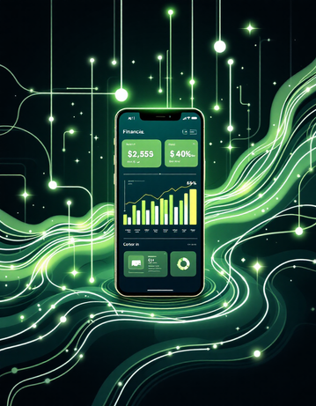
Benefits for Users
- 24/7 accessibility
- Personalized financial advice
- Better financial literacy

Slide 5
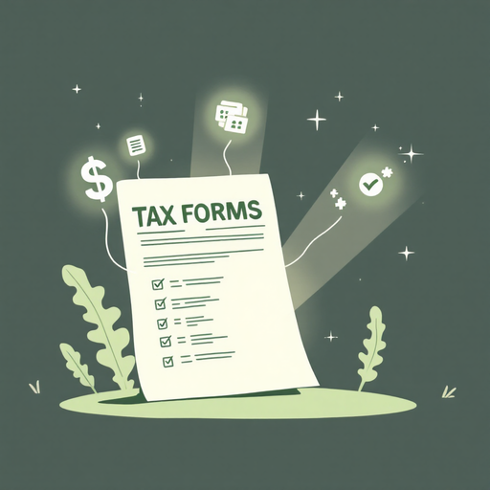
Technology Behind It
- Artificial Intelligence & NLP
- Secure data handling
- Continuous learning & improvement

Slide 6
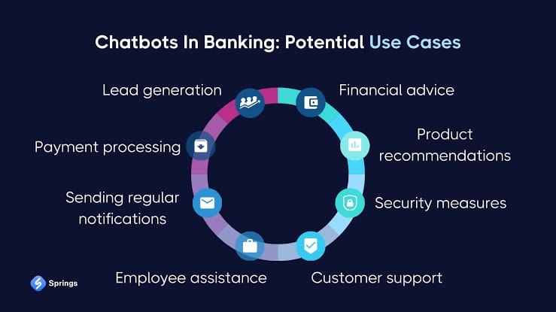
Use Cases & Examples
- Students managing budgets
- Families optimizing taxes
- Beginners starting investments

Slide 7
Conclusion & Future Outlook
- Smarter, more personalized finance in the future
- Integration with banks & apps
- Making financial planning accessible to all

