Slide 1

RESUME BUILDER WEBSITE
Group Members:
Ch. K. N. Karthik
B. Naga Muni Reddy
K. Srinivas
T. Manikanta
B. Kishore

Slide 2
Abstract
A resume also spelled resume or resume also called curriculum vitae or CV, is a document that contains a summary or listing of relevant job experience and education. The resume or CV is typically the first item that a potential employer encounters regarding the job seeker and is typically used to screen applicants, often followed by an interview, when seeking employment.

Slide 3
Introduction
Resume is the first thing which creates an impression whether it might be good or bad among you by the employers. That’s why resume is very important. However, resume looks great when it is in a structured manner. Resume is said to be good or bad which is based on what information you decided to include. Its not that much easy to build a well-structured or well-designed resume. In this project, we will reduce your work regarding the making of an effective resume for you. Resume builder simplifies your work by allowing you to create your own resume by just entering the information all about you which is required. This will be done by providing some user-friendly software. Resume builder can display some resume templates for you, so that you can choose one template which you like according to your interests. Then you can enter the respective data into the data fields provided within the template itself.

Slide 4
System Requirements
SOFTWARE REQUIRMENTS:
Editor: visual studio code
composer software for converting into pdf
Database : Xampp server
Any browser compatible with the editor
HARDWARE REQUIREMENTS:
Operating System : Windows 7
Harddisk : 256GB
Processor: Intel core i5
Ram: 8GB

Slide 5
Existing System
A resume building web project can be developed as an extension of an existing system/application that already has user data, such as an online job portal or social media platform, by integrating a resume builder feature that enables users to create and edit their professional resumes using the existing data on their profile. The feature could be designed to allow users to select a template, input their personal and professional information, add relevant experience, and highlight their skills and achievements, with the option to save and download their resume as a PDF or share it with potential employers.

Slide 6
Disadvantages of Existing System
The present system for resume building just provides information based on user own format. Though user can prepare resume only in given format.
Disadvantages:
• Inability of modification of data
• Provides fixed format of resume
• Lack of immediate retrieval
• Inability of sharing the resume data
• Lack of expert guidance at every step of building resume

Slide 7
Proposed System
The proposed system for a resume building website includes an easy-to-use user interface with options for selecting templates and design elements, as well as a database for storing user information such as personal details and work experience. The website should also have features for editing and formatting resumes, and options for exporting and sharing the resumes. Overall, the system aims to streamline the resume building process and provide users with a professional and effective tool for job searching, career development, and recruitment.

Slide 8
Advantages Of Proposed System
In proposed system, we make an user friendly website in which anyone is can build their own resume with ease without consulting any expert explicitly. It leads to some advantages mentioned as follows…..
Advantages:
• Easy to update and edit resume
• Free resume hosting
• Various types of templates
• Expert guidance at every step of resume building
• Search for a particular candidate by skills

Slide 9
What are the main components of a resume builder?
A resume builder website typically consists of several main components that work together to help users create and customize their resumes.
These components can vary slightly depending on the specific website, but here are some common elements you'll find in a resume builder:
User Interface.
Registration and Login.
Resume Templates.
Content input.
Formatting and styling tools.
Saving and downloading

Slide 10
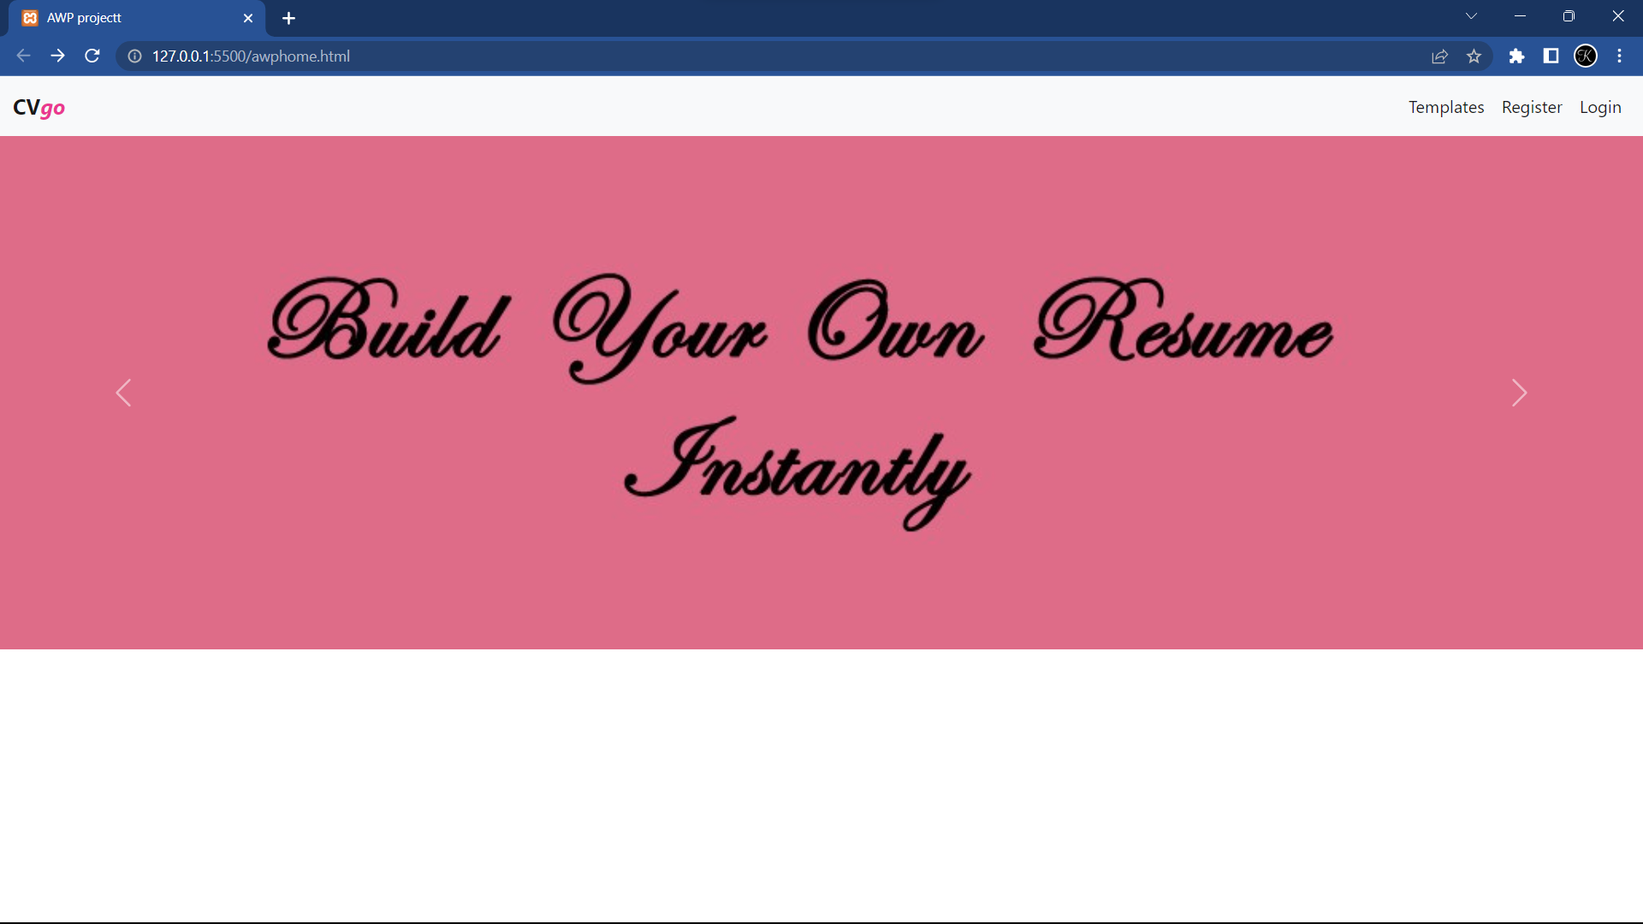
Output
Output

Slide 11
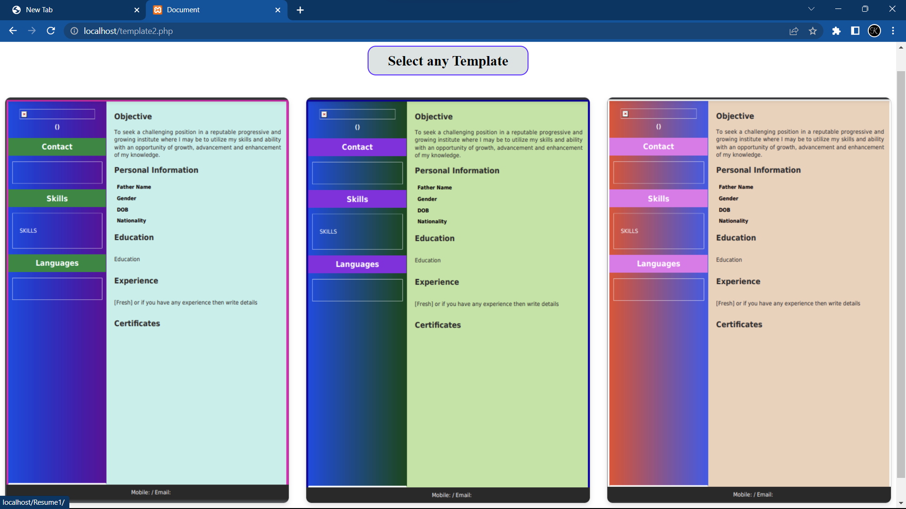

Slide 12
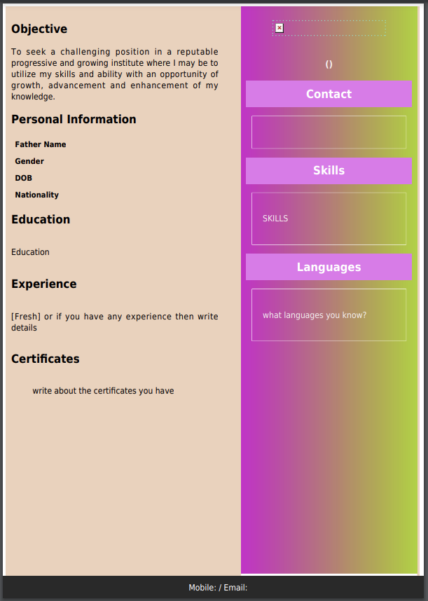

Slide 13
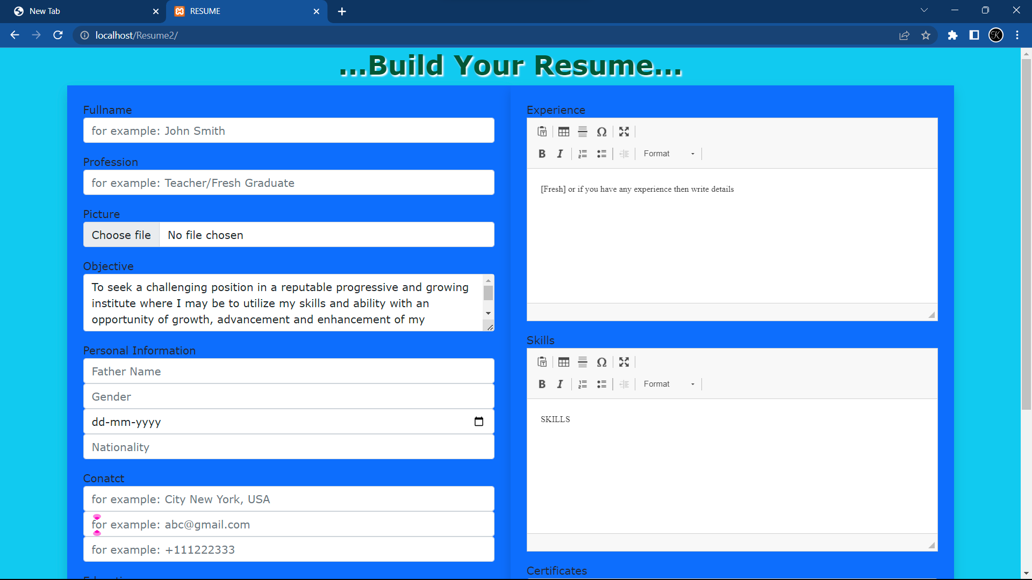

Slide 14
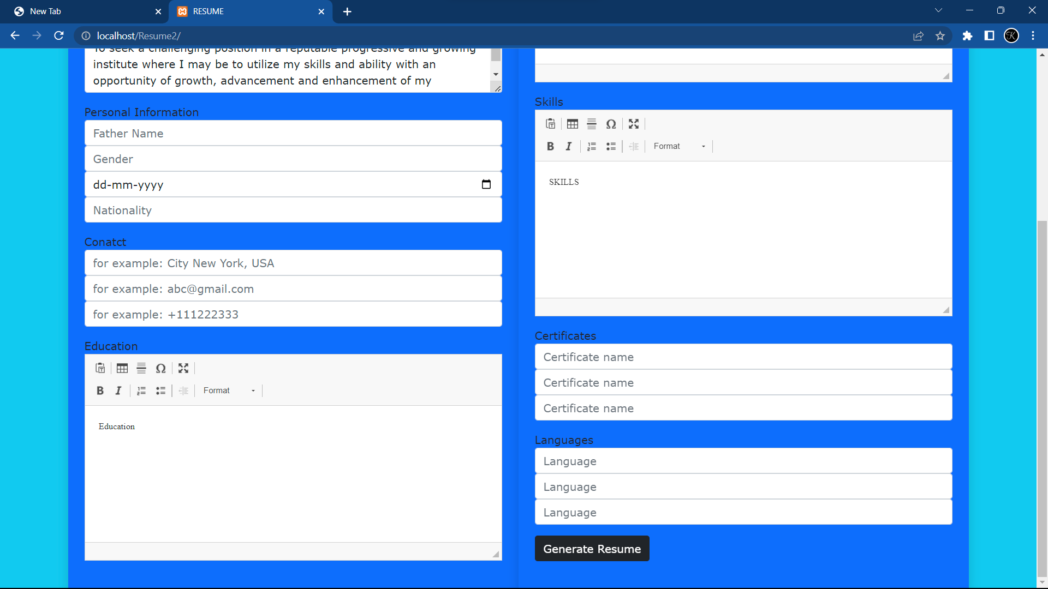

Slide 15
Conclusion
In conclusion, the resume building web project is an essential tool for job seekers to create a professional-looking and well-structured resume that can effectively showcase their skills and experience to potential employers. The project should include user-friendly interface, customizable templates, and features such as spell-check and grammar correction to ensure the accuracy and quality of the final product. Overall, a successful resume building web project can greatly benefit job seekers in their career search by helping them stand out in a competitive job market.

Slide 16


