Slide 1
Fake Social Media Profile detection and reporting
PIP2001 Capstone Project
Review-3
Batch Number: CBC-04
Roll number | Student name
20211CBC00019 | Majjari Ravi Shankar Prasad
20211CBC0060 | Chigulla Nagapavan
20211CBC0017 | S Nagesh
20211CBC0034 | P Akshay Kumar
Under the Supervision of,
Ms.Arshiya Lubna
Assistant Professor
School of Computer Science and Engineering
Presidency University
Name of the Program: B.TECH
Name of the HoD: DR.S.PRAVINTH RAJA
Name of the Program Project Coordinator: Ms. Swapna
Name of the School Project Coordinators: Dr. Sampath A K / Dr. Abdul Khadar A / Mr. Md Ziaur Rahman

Slide 2
Content
Abstract
Literature Survey
Objectives
Problem statement
Proposed method
Existing Methods – Drawbacks
Architecture Diagram
output
conclusion
References

Slide 3
ABSTRACT
The proliferation of fake social media profiles poses a significant threat to user security, trust, and the integrity of online platforms. This project proposes a novel system that leverages machine learning and blockchain technology to combat this growing problem. The system aims to accurately identify fake profiles by analyzing user behavior, content, and relevant metrics.
A secure and transparent reporting mechanism is developed using blockchain to log and track reports of fake profiles. The project aims to enhance user trust by reducing the prevalence of fake profiles and creating amore trustworthy online environment. The system also facilitates secure data sharing between platforms to enable collaboration in combating fake profiles while protecting user privacy.
The expected results include an accurate detection system, an immutable reporting platform, and enhanced trust and security on social media platforms . This project represents a significant step forward in addressing the challenges posed by fake social media profiles and creating a more secure and trustworthy online ecosystem.

Slide 4
Literature Survey
SI NO | Title of the paper and year | Author | Journal | Methodology used | Advantages | Disadvantags
1. | Early detection of cyberbullying on social media networks YEAR:2021 | ManuelF.Lopez-Vizcaino,FranciscoJ.Novoa,VictorCarneiro,FidelCacheda∗ | The International Journal of eScience | supervised learning approach dataset Machine learning models Random Forest(RF),Extra Trees(ET) | Accuracy: 89% | Fixed Thresholds in Early Detection Models
2. | Machine learning‑based social media bot detection Year:2023 | Malak Aljabri1, Rachid Zagrouba3, Afrah Shaahid2, Fatima Alnasser2, Asalah Saleh2, Dorieh M. Alomari4 | Social Network Analysis and Mining. | Systematic Analysis and Taxonomy Development Literature collection | Comprehen-sive Coverage Novel Taxonomy and Structured Analysis | Scope Limitations Variability in Methodolog-ies

Slide 5
Literature Survey
SI NO | Title of the paper and year | Author | Journal | Methodology used | Advantages | Disadvantages
3 | An Autonomous Model for Fake News Detection YEAR : 2021 | Noman Islam 1, Asadullah Shaikh 2®, Asma Qaiser 30, Yousef Asiri 2,O, Sultan Almakdi 2,®,Adel Sulaiman 2,*D, Verdah Moazzam 3 and Syeda Aiman Babar 3 | Apllied Sciences(Appl.Sci.) | Author Credibility Verification Machine Learning-Based Classification | Accuracy- 93.15% Dataset Availability Comparison of Multiple Machine Learning Models | Binary Classification Limitation Potential for False Positives
4 | Identifying Fake News on Social Networks Based on Natural Language Processing | Nicollas R. de Oliveira 1, Pedro S. Pisa 2, Martin Andreoni Lopez 3, Dianne Scherly V. de Medeiros 1, and Diogo M. F. Mattos 1 | Detecting Fake News on Social Networks Using Natural Language Processing: A Machine Learning Approach | Data Collection Data Preprocessin-g Deployment and Real-Time Monitoring | Automation & Scalability Faster Detection Context Awareness | High False Positives & Negatives Data Bias

Slide 6
Objectives
1. Enhance Platform Security
Safety
Trustworthiness
Reducing fake user activities
2. Protect Real Users
Safeguard
Malicious activities
Identity theft
3.Secure Identity Management
Risks of fake profile
Identify and report
Stay updated

Slide 7
Problem statements
Social media platforms have become a breeding ground for fake profiles used for malicious activities such as cyberbullying, misinformation, fraud, and identity theft. Traditional methods of detecting and reporting fake profiles rely heavily on centralized algorithms that can be bypassed by sophisticated attackers. Furthermore, users often lack a transparent and tamper-proof system for reporting and tracking fake profiles.
This project aims to develop a decentralized and cybersecurity-enhanced fake social media profile detection and reporting system using Blockchain technology. The system will leverage AI-based anomaly detection techniques to identify fake profiles and a blockchain-based immutable ledger to securely record user reports and verification results. This approach will ensure transparency, security, and trustworthiness in handling fake profile detection while preventing unauthorized alterations to the data.
By implementing this solution, social media users, platform administrators, and regulatory bodies can collaborate in a secure and verifiable manner to mitigate the risks posed by fake profiles and enhance online safety.

Slide 8
Proposed Methdology
Data Collection and Preprocessing: Collect profile information, activity logs, interaction patterns, and metadata from social media platforms. Identify critical attributes such as profile age, connection network, posting frequency, and linguistic patterns in messages.
AI-Powered Fake Profile Detection: Train supervised learning models (e.g., Decision Trees, Random Forest, SVM) to classify real vs. fake accounts . Implement neural networks (LSTM, CNN) to analyze behavioral anomalies and detect bot-controlled profiles.
Blockchain Integration for Secure Identity Management : Store verified user identities on a public or permissioned blockchain to prevent duplicate or fake profiles . Flagged fake profiles are recorded on a blockchain ledger, ensuring that they cannot be altered or manipulated.
Cybersecurity Measures for Enhanced Protection : Require additional verification methods (OTP, biometric authentication) to prevent fake account creation . Authenticate users without revealing personal data, ensuring privacy.
System Implementation and Deployment : Build a prototype using Ethereum/Hyperledger for blockchain integration and TensorFlow/Scikit-learn for AI-based detection.

Slide 9
Existing methods - Drawbacks
Rule-Based Detection Systems: Uses predefined rules such as unusual activity patterns, incomplete profiles, or repetitive content to flag fake accounts.
Manual Reporting: Platforms set fixed rules (e.g., no profile picture, too many friend requests) to flag suspicious accounts.
Graph-Based Social Network Analysis: Examines connections between users to detect bot-like behaviors and anomalies in social networks.
User Reporting Systems: Social media platforms allow users to report fake accounts, which are then reviewed manually or through automated systems.
CAPTCHA & Bot Detection Techniques: CAPTCHA tests and bot-detection techniques (such as mouse movement tracking) differentiate between human users and automated fake accounts.

Slide 10
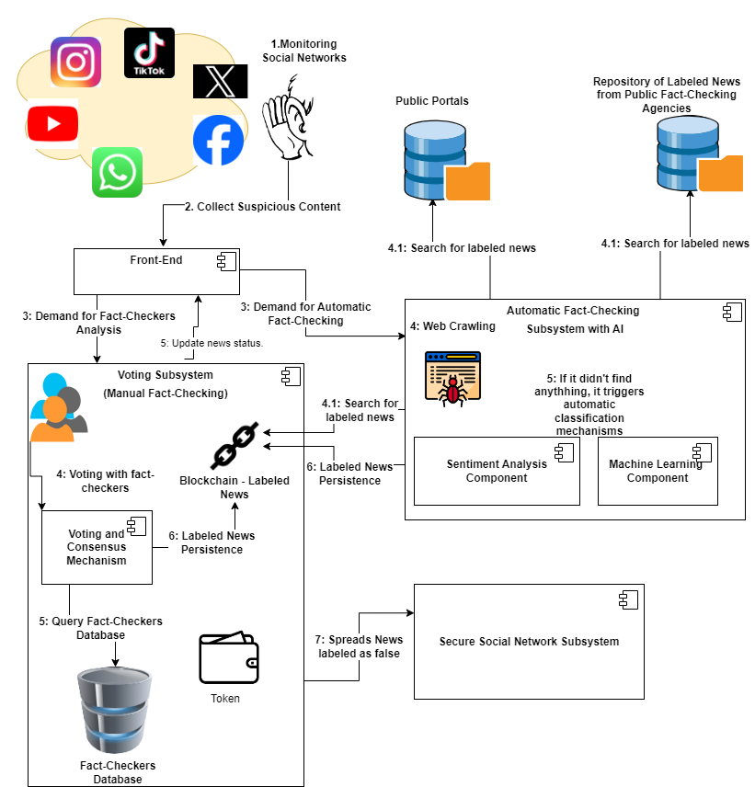
Architecture Diagram
Figure: 1 Model Diagram

Slide 11
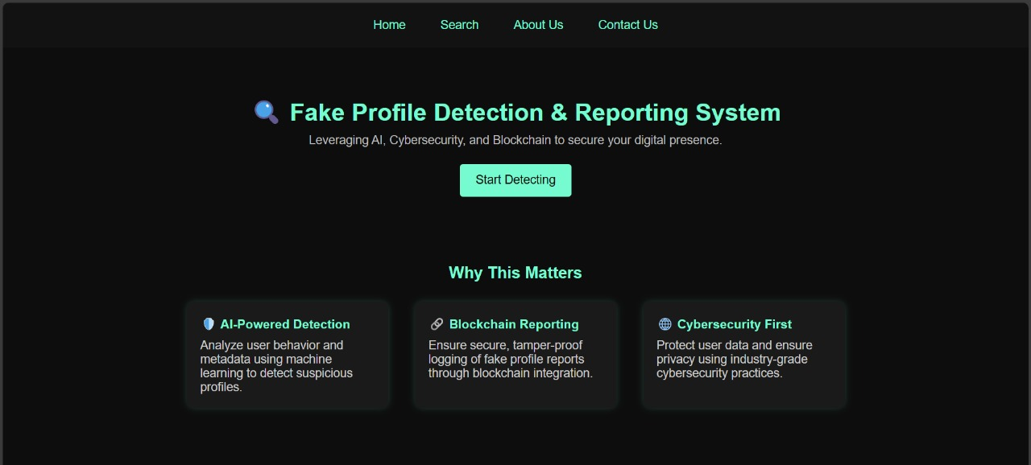
Output

Slide 12
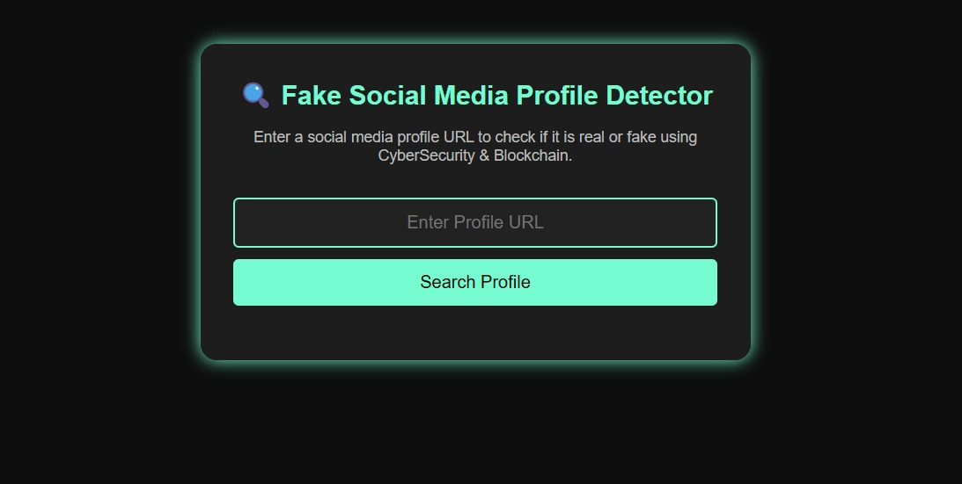

Slide 13
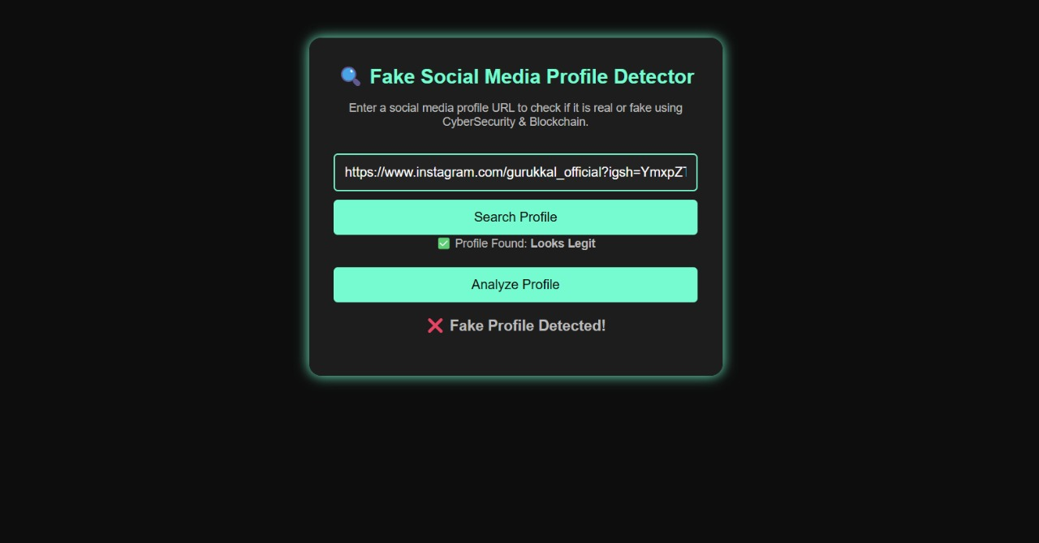

Slide 14
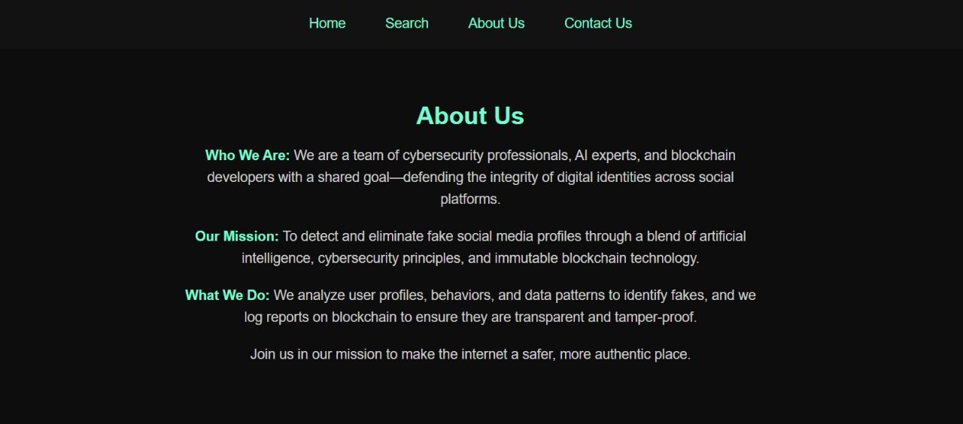

Slide 15


Slide 16
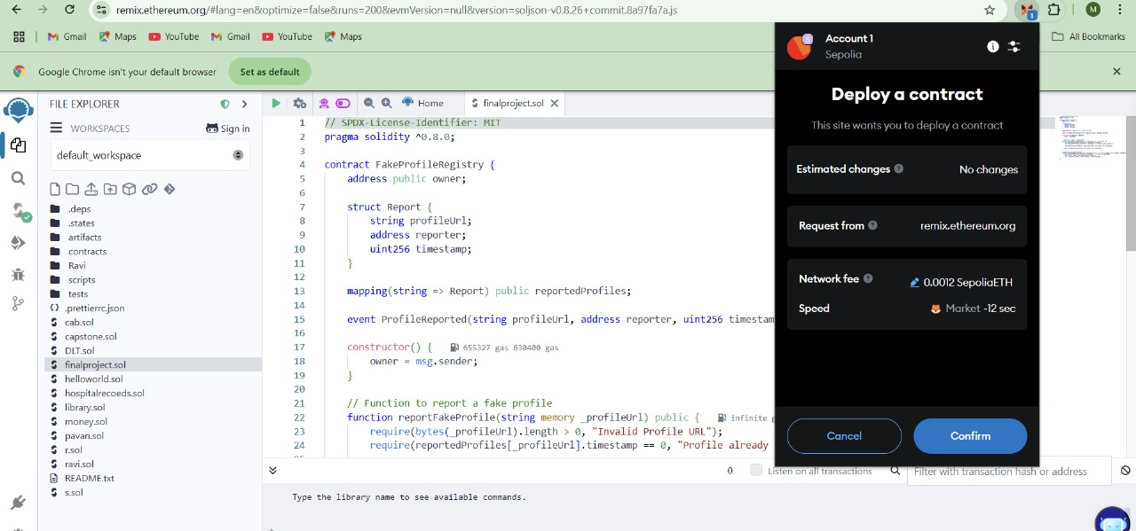

Slide 17
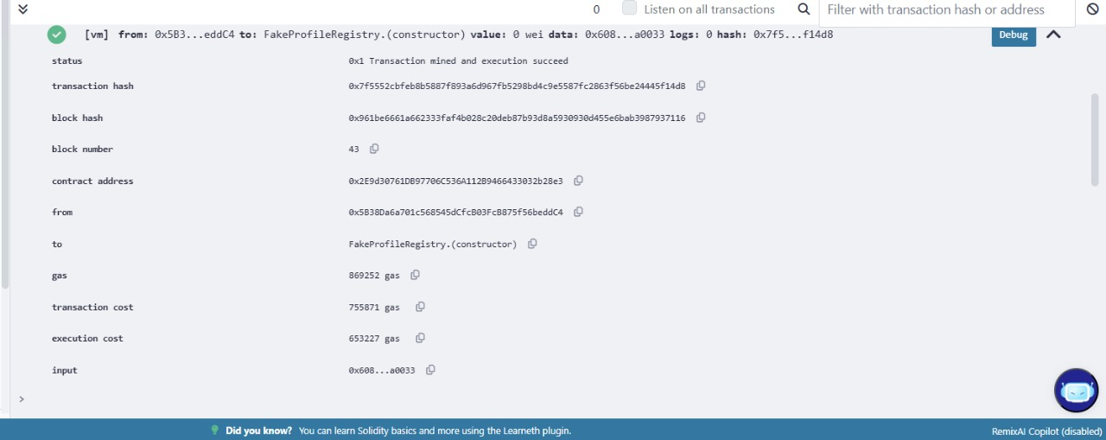

Slide 18
conclusion
The increasing prevalence of fake social media profiles poses significant risks, including identity theft, misinformation, and cyber fraud. Traditional detection methods, which rely on centralized control, often fail to provide transparency and security in identifying and mitigating such threats.
This project proposes a blockchain-based decentralized solution integrated with cybersecurity techniques to detect and report fake profiles effectively. By leveraging AI-driven anomaly detection and an immutable blockchain ledger, the system ensures enhanced transparency, security, and user trust. The decentralized nature of blockchain prevents data manipulation, while smart contracts automate the reporting and verification process, making social media safer and more reliable.

Slide 19
References:
Nguyen, T., Hui, P., Harper, F. M., Terveen, L., & Konstan, J. A. (2018). Identifying user attributes for fake profile detection in online social networks. Social Network Analysis and Mining, 8(1), 1-13. [DOI:10.1007/s13278-018-0516-6]
Nakamoto, S. (2008). Bitcoin: A Peer-to-Peer Electronic Cash System. Retrieved from [https://bitcoin.org/bitcoin.pdf]
Zolanvari, M., Aledhari, M., & Alazab, M. (2019). BotDFA: Fake Social Media Profile Detection Using Machine Learning Algorithms. IEEE Access, 7, 70889-70901. [DOI:10.1109/ACCESS.2019.2917459]

Slide 20


