Slide 1
Fake Social Media Profile detection and reporting
PIP2001 Capstone Project
Review-0
Batch Number: CBC-04
Roll Number | Student Name
20211CBC0019 | M.RAVI SHANKAR PRASAD
20211CBC0060 | CHIGULLA NAGAPAVAN
20211CBC0017 | NAGESH S
20211CBC0034 | P.AKSHAY KUMAR
Under the Supervision of,
Ms. ARSHIYA LUBNA
Assistant Professor
School of Computer Science and Engineering
Presidency University
Name of the Program: COMPUTER SCIENCE AND ENGINEERING
Name of the HoD: Dr. PRAVINTH RAJA
Name of the Program Project Coordinator: SUMA GOWDA
Name of the School Project Coordinators: Dr. Sampath A K / Dr. Abdul Khadar A / Mr. Md Ziaur Rahman

Slide 2
Content
Problem Statement
Github Link
Analysis of Problem Statement
Timeline of the Project
References

Slide 3
Problem Statement Number:
Organization: Government of Gujarat
Category (Hardware / Software / Both) : Software
Problem Description: The social life of everyone has become associated with the online social net works. These sites have made a drastic change in the way we pursue our social life. Making friends and keeping in contact with them and their updates has become easier. But with their rapid growth, many problems like fake profiles, online impersonation have also grown. Fake profiles often spam legitimate users, posting inappropriate or illegal content. Several signs can help you spot a social media fake who might be trying to scam your business. Identifying fake social media profiles and taking corrective measures. Expected Output: An Application software that detects the fake social media profile Users: Crime branch and other investigative agencies
Difficulty Level: Complicated

Slide 4
GITHUB LINK
https://github.com/Nagapavan907

Slide 5
Analysis of Problem Statement:
Increased availability of fake profiles on social networks has been very detrimental to current cybersecurity, having led to incidents of misinformation and financial fraud with identity theft besides cyber harassment. Traditional detection uses centralized algorithms relying on manual reports, which might be ineffective at times, fallible to some manipulation, or slow in reactions. Besides that, lack of transparency in managing reports and even identifying fake accounts creates trust amongst users.
Challenges to Address:
Decentralization & Transparency: Traditional social media platforms handle fake account reports in a centralized manner, leading to concerns over bias, inefficiency, and data manipulation.
2. Identity Verification & Authentication:
Ensuring that social media users are legitimate without compromising their privacy.

Slide 6
Analysis of Problem Statement:
3. Tamper-proof Evidence & Reporting:
Fake profile reports often lack transparency and can be manipulated or ignored by platform administrators.
4. Real-time Detection & Response:
AI-powered fake profile detection must be secure, efficient, and resistant to adversarial attacks.
5. Cybersecurity & Data Privacy:
Protecting user identities and personal data from exposure while preventing deepfake-based identity fraud.

Slide 7
Analysis of Problem Statement:
Proposed Solution:
A Blockchain-powered Fake Profile Detection & Reporting System combined with Cybersecurity measures such as AI-based identity verification, cryptographic hashing, and decentralized consensus mechanisms can enhance social media security. The solution would:
Use blockchain's immutability to store verified reports of fake profiles.
Employ smart contracts to automate and reward legitimate reporting.
Utilize AI-driven cybersecurity techniques to detect suspicious activity in real-time.
Implement Zero-Knowledge Proofs (ZKP) or Decentralized Identifiers (DIDs) for privacy-preserving identity verification.

Slide 8
Analysis of Problem Statement:
The proliferation of fake social media profiles has led to issues like misinformation, identity theft, cyber fraud, and online harassment. Traditional detection methods rely on centralized platforms that can be manipulated, lack transparency, and often fail to provide timely responses to fraudulent activities. To combat this, integrating Blockchain and Cybersecurity technologies can offer a decentralized, secure, and transparent solution for detecting and reporting fake social media profiles.
1.Challenges in Fake Profile Detection and Reporting:
Scalability Issues: Social media platforms host billions of users, making manual or even algorithmic detection challenging.
Lack of Transparency: Current reporting mechanisms are often opaque, and decisions about fake accounts are made without user involvement.

Slide 9
Analysis of Problem Statement:
Data Manipulation & Trust Issues:
Centralized databases can be compromised, leading to biased or false reports.
Automated Bots & Deepfakes:
AI-generated profiles and deepfake-based identities make detection harder.
Inefficient Reporting Systems:
Users report fake accounts, but action often takes time, leading to continued harm.

Slide 10
Analysis of Problem Statement:
2.Role of Blockchain in Fake Profile Detection:
Blockchain technology offers a decentralized, immutable, and transparent approach to combating fake profiles by:
Identity Verification & Digital Signatures:
Users can have verified blockchain-based identities using Decentralized Identity (DID) systems.
Immutable Data Storage:
Fake profile reports stored on blockchain ensure that data is not altered or manipulated.
Smart Contracts for Automated Actions:
Smart contracts can automate fake account flagging and reputation management without centralized control.

Slide 11
Analysis of Problem Statement:
3.Cybersecurity Measures for Fake Profile Detection
AI-Powered Behavioral Analysis:
AI can analyze suspicious activities (e.g., mass following, fake engagement) to detect anomalies.
Facial Recognition & Biometric Authentication:
Secure verification can reduce bot-generated and impersonated accounts.
Machine Learning-Based Fake Profile Detection:
ML models can detect linguistic patterns, profile inconsistencies, and bot behavior.
End-to-End Encryption & Zero-Knowledge Proofs (ZKP): Ensures privacy while allowing identity verification.

Slide 12
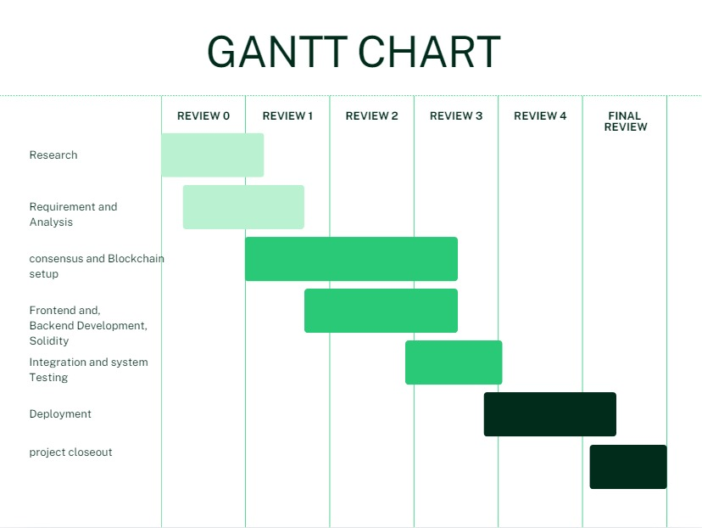
Timeline of the Project:

Slide 13
References (IEEE Paper format)
Sharma, K., & Kumar, S. (2019). "Fake News Detection in Social Media using Blockchain." 2019 3rd International Conference on Trends in Electronics and Informatics (ICOEI), Tirunelveli, India, pp. 230-234. doi: 10.1109/ICOEI.2019.8862603
Malini, M., Manoranjani, K., Pandeeswari, P., & Ragavi, K. (2024). "Detect Fake Social Media Profiles Using BERT and Blockchain." International Research Journal of Modernization in Engineering Technology and Science, vol. 6, no. 3, pp. 51271-51278. Available: https://www.irjmets.com/uploadedfiles/paper/issue_3_march_2024/51271/final/fin_irjmets1711540543.pdf
Altshuler, Y., Fire, M., Shmueli, E., Elovici, Y., & Bruckstein, A. (2013). "The Social Amplifier—Reaction of Human Communities to Emergencies." Journal of Statistical Physics, vol. 152, no. 3, pp. 399-418. doi: 10.1007/s10955-013-0724-x
Fire, M., Kagan, D., Elyashar, A., & Elovici, Y. (2014). "Friend or Foe? Fake Profile Identification in Online Social Networks." Social Network Analysis and Mining, vol. 4, no. 1, pp. 1-23. doi: 10.1007/s13278-014-0194-5
Fire, M., Goldschmidt, R., & Elovici, Y. (2014). "Online Social Networks: Threats and Solutions." IEEE Communications Surveys & Tutorials, vol. 16, no. 4, pp. 2019-2036. doi: 10.1109/COMST.2014.2321628

Slide 14


