Slide 1
PSCS222-BLOCKCHAIN FOR THE GOVERNMENT TO BE ABLE TO TRACK THE ORIGIN AND DESTINATION OF PRODUCT
PIP2001 Capstone Project
Review-1
Batch Number: CBC-04
Roll Number | Student Name
20211CBC0019 | M.RAVI SHANKAR PRASAD
20211CBC0060 | CHIGULLA NAGAPAVAN
20211CBC0017 | NAGESH S
20211CBC0034 | P.AKSHAY KUMAR
Under the Supervision of,
Ms. ARSHIYA LUBNA
Professor / Associate Professor / Assistant Professor
School of Computer Science and Engineering
Presidency University
Name of the Program: COMPUTER SCIENCE AND ENGINEERING
Name of the HoD: DR. PRAVINTHA RAJA
Name of the Program Project Coordinator: SUMA GOWDA
Name of the School Project Coordinators: Dr. Sampath A K / Dr. Abdul Khadar A / Mr. Md Ziaur Rahman

Slide 2
Introduction
Contemporary supply chains have opened up a word of connected commerce far beyond what previous generations imaginet possible . But with this this comes unprecedented complexity as multiple parties must 1 cooperate to move goods around the globe They face new challenges of maintaining visibility into origin, authenticity, and asset handing as they cross organizational boundaries . Retallers and manufacturers place a peat deal of trust in their upstream suppliers, distributors, and transportation providers.

Slide 3
Literature Review
Blockchain technology offers a secure, transparent, and decentralized system for tracking the origin and destination of products, which can be highly beneficial for government applications. It enables tamper-proof records, ensuring authenticity and compliance in supply chains. Various sectors, such as food and pharmaceuticals, have already adopted blockchain to improve traceability and prevent fraud

Slide 4
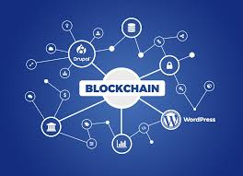
Existing method Drawback
Existing methods for tracking the origin and destination of products, often relying on centralized databases and manual record-keeping, suffer from issues such as data tampering, lack of transparency, and inefficiencies. These systems are vulnerable to corruption, fraud, and errors, making it difficult to ensure the authenticity and traceability of products.

Slide 5
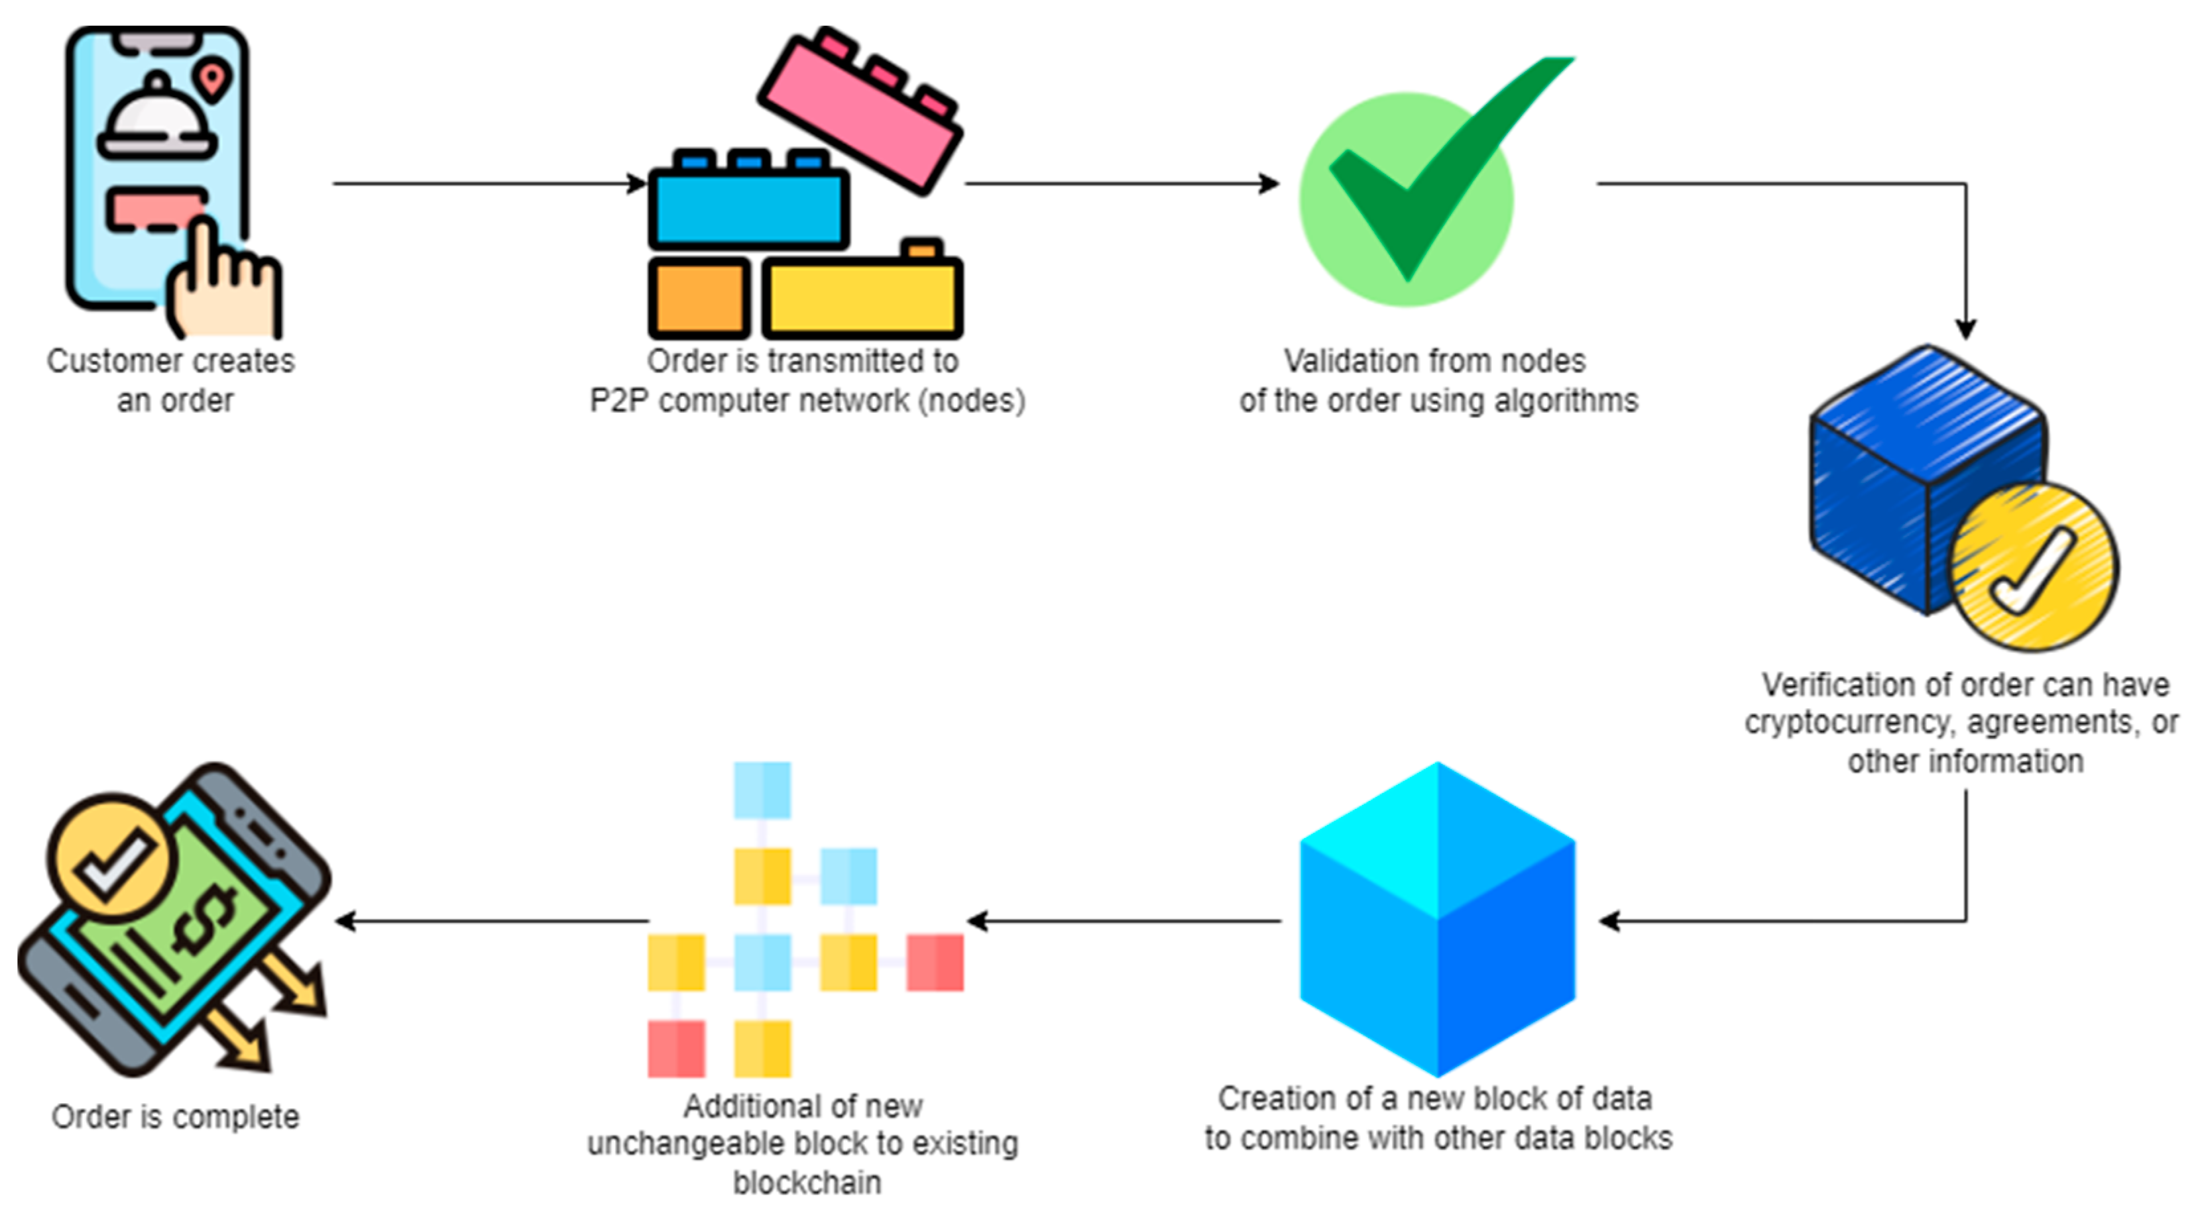
Proposed Method
The proposed method leverages blockchain technology to create a decentralized, transparent, and tamper-proof system for tracking the origin and destination of products. By using smart contracts and distributed ledger technology, the system ensures real-time updates and secure record-keeping across all stakeholders in the supply chain

Slide 6
Objectives
The objectives of the project are to develop a blockchain-based system that enables the government to accurately track the origin and destination of products in real time.
It aims to enhance supply chain transparency by providing an immutable and secure record of product movements, ensuring compliance with regulations
Additionally, it seeks to streamline communication between stakeholders, improve data accuracy, and facilitate faster, more informed decision-making in government oversight.

Slide 7
Methodology/Modules
Blockchain Network Setup
Smart Contracts
Product Registration Module
Tracking Module
Verification and Auditing Module

Slide 8
Architecture
Blockchain Layer
Smart Contract Layer
Data Input Layer
API Gateway
User Interface

Slide 9
software components
Blockchain Platform
Smart Contract Engine
Data Collection Module
API Layer
User Interface

Slide 10
Expected Outcomes
Enhanced Transparency
Improved Security
Real-time Tracking
Regulatory Compliance
Cost and Time Efficiency

Slide 11
Timeline of the Project (Gantt Chart)
Phase 1: Planning & Requirements (Weeks 1-3):
Focuses on requirement gathering, planning, and selecting the right blockchain platform.
Phase 2: Development & Testing (Weeks 3-5):
Focuses on the actual development of the blockchain solution, including smart contract creation, backend and frontend development, and rigorous testing.
Phase 3: Deployment & Maintenance (Weeks 5-9):
Focuses on production deployment, user training, and long-term maintenance of the system

Slide 12
Conclusion
In conclusion, the implementation of a blockchain-based system for tracking the origin and destination of products offers a transformative solution for government oversight and supply chain transparency.
By leveraging decentralization, immutability, and real-time data tracking, the system enhances security, reduces fraud, and ensures compliance with regulations. It also streamlines communication between stakeholders, improving efficiency and decision-making

Slide 13
Github Link
The Github link provided should have public access permission.
Github Link
https://github.com/Nagapavan907

Slide 14
References (IEEE Paper format)
Add APA Citation for all references.
Camargo, L. M., Marques, C., & Souza, J. M. (2019). Blockchain technology for government supply chain transparency: A case study. IEEE Access, 7, 102411-102423. https://doi.org/10.1109/ACCESS.2019.2934433.
Santos, A., Oliveira, B., & Marques, L. (2020). Smart contracts in government: An application in public procurement. In Proceedings of the IEEE International Conference on Blockchain and Cryptocurrency (ICBC) (pp. 12-18). https://doi.org/10.1109/ICBC.2020.8751039.
Use the below link for various APA styles :
Saberi, S., Kouhizadeh, M., Sarkis, J., & Shen, L. (2019). Blockchain technology and its relationships to sustainable supply chain management. International Journal of Production Research, 57(7), 2117-2135. https://doi.org/10.1080/00207543.2018.1533261.
UK Government Office for Science. (2016). Distributed Ledger Technology: Beyond Blockchain. Retrieved from https://www.gov.uk/government/publications/distributed-ledger-technology-beyond-blockchain.

Slide 15


