Slide 1
IPAT FRAMEWORK

Slide 2
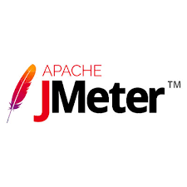
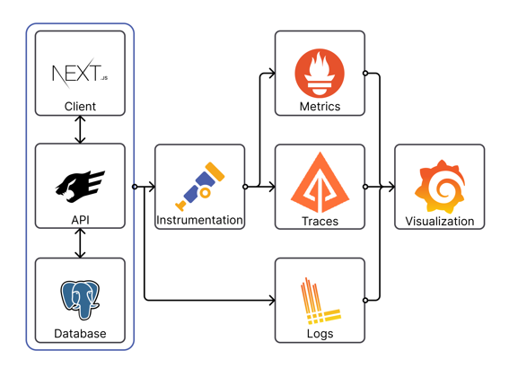
ARCHITECTURE

Slide 3
IPAT FRAMEWORK COMPONENTS - OPENTELEMETRY
Open Telemetry (also referred as OTel) is an open-source observability framework made up of a collection of tools, APIs, and SDKs.
It is used to instrument, generate, collect, and export telemetry data (metrics, logs and traces) to analyse the software’s performance and behaviour.
Open-source, Robust and Portable
Open Telemetry resolves one big problems.(creating a standard to report and transmit measurements)
The telemetric analysis helps the developer learn about which features of their software are the best.

Slide 4
PREREQUISITES:
Visual studio code
sample application source code file/jar file
Opentelemetry Java agent -jar file
prtometheus.exe
zipkin.exe
promtail.exe
loki.exe
Grafana 9.2.6.exe

Slide 5
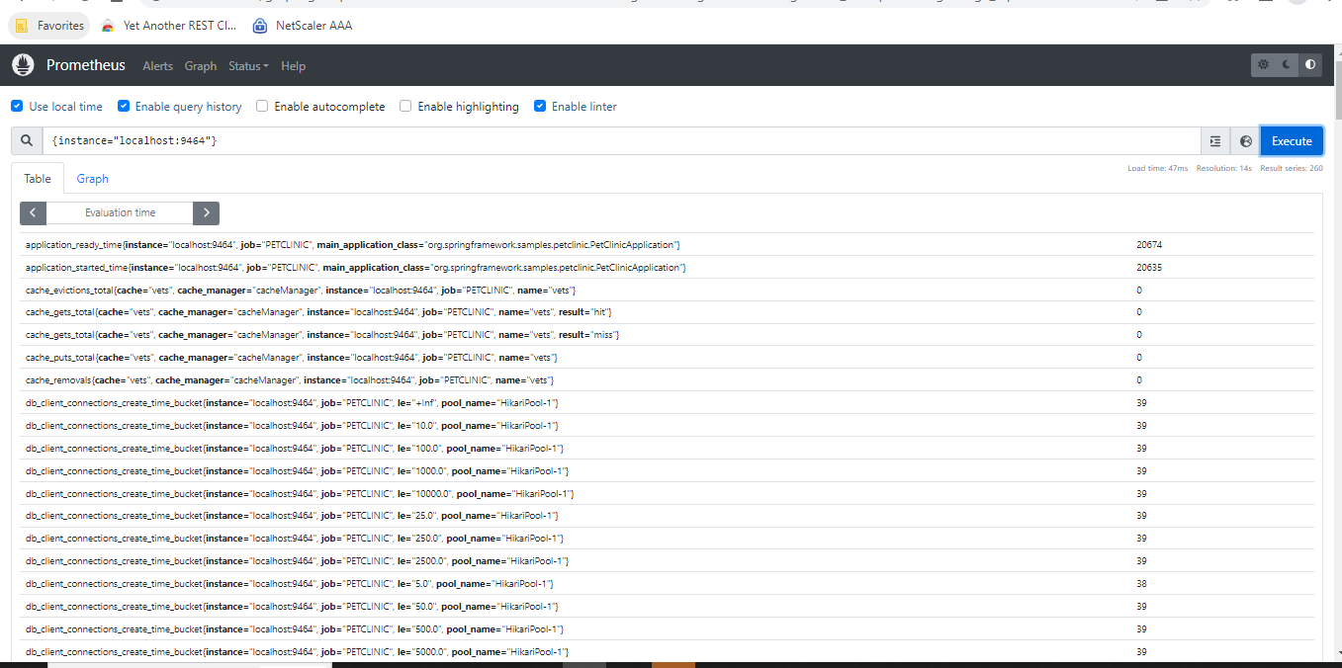
IPAT FRAMEWORK COMPONENTS - PROMETHEUS
Prometheus is an open-source technology designed to provide monitoring and alerting functionality.
It can collect and store metrics as time-series data, recording information with a timestamp.
It can also collect and record labels, which are optional key-value pairs.
Prometheus is a versatile monitoring tool, which you can use to monitor a variety of infrastructure and application metrics. Here are a few common use cases.(ser
Prometheus can display collected data in tabular or graph form, shown in its web-based user interface. You can also use APIs to integrate with third-party visualization solutions like Grafana.

Slide 6
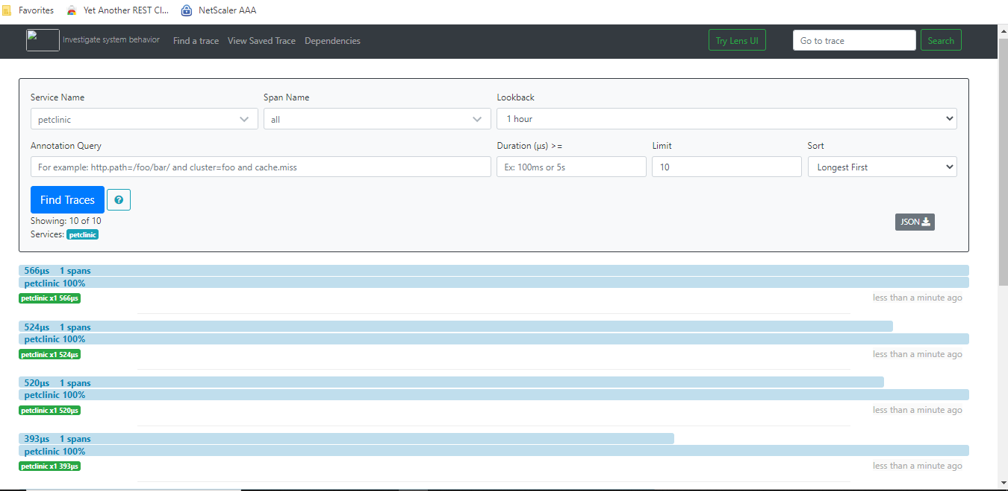
IPAT FRAMEWORK COMPONENTS -ZIPKIN
Zipkin is a distributed tracing system. It helps gather timing data needed to troubleshoot latency problems in service architectures. Features include both the collection and lookup of this data.
If you have a trace ID in a log file, you can jump directly to it. Otherwise, you can query based on attributes such as service, operation name, tags and duration. Some interesting data will be summarized for you, such as the percentage of time spent in a service, and whether operations failed.
The Zipkin UI also presents a Dependency diagram showing how many traced requests went through each application. This can be helpful for identifying aggregate behavior including error paths or calls to deprecated services.

Slide 7
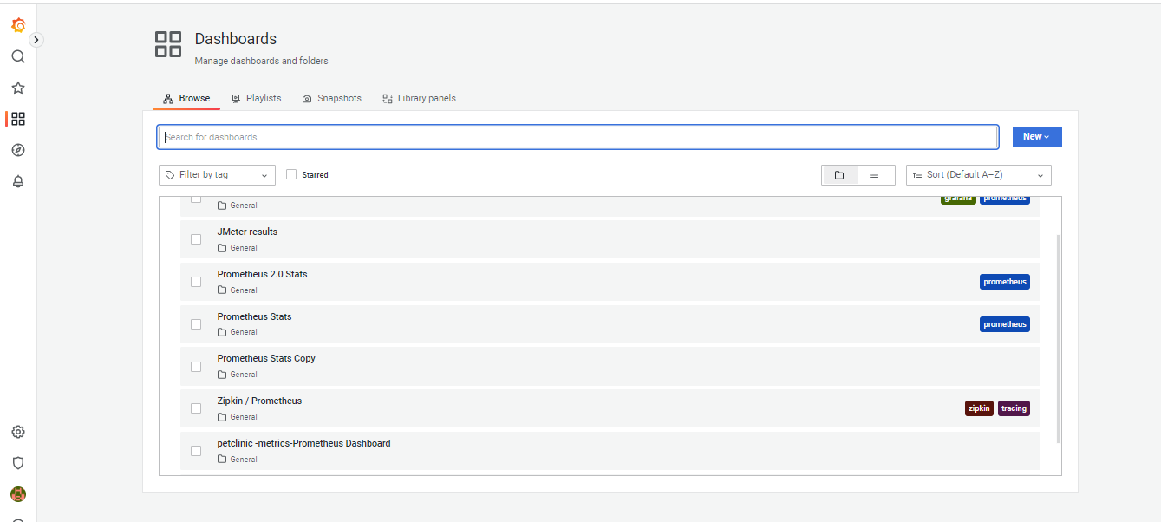
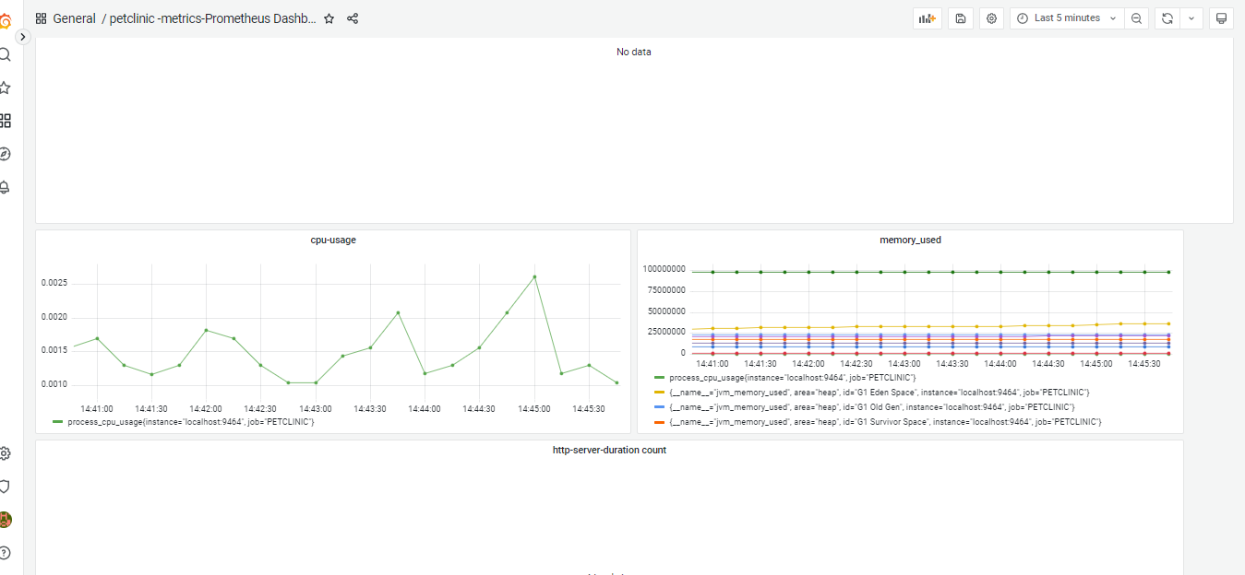
IPAT FRAMEWORK COMPONENTS -GRAFANA
Grafana is an open-source interactive data-visualization platform, developed by Grafana labs which allows users to see their data via charts and graphs that are unified into one dashboard (or multiple dashboards!) for easier interpretation and understanding.

Slide 8
METRICS
It is a measurement about a service, captured at runtime. Logically, the moment of capturing one of these measurements is known as a metric event which consists not only of the measurement itself, but the time that it was captured and associated metadata.
Open Telemetry defines three metric instruments:
Counter: A value that is summed over time.
Measure: A value that is aggregated over time.
Observer: Captures a current set of values at point in time.

Slide 9
LOGS
A log is a timestamped text record, either structured (recommended) or unstructured, with metadata.
While logs are an independent data source, they may also be attached to spans. In Open Telemetry, any data that is not part of a distributed trace or a metric is a log.
For example, events are a specific type of log.
Logs are often used to determine the root cause of an issue and typically contain information about who changed what as well as the result of the change.

Slide 10
How to collect Traces, Metrics And Logs?
Manual/Automation Instrumentation
Exporting Traces to zipkin server.
Exporting Metrics to Prometheus server.
All the Traces and Metrics visualization in Grafana.
Logs are visible on console.

Slide 11
DEMO…….

Slide 12
Thank You

