Slide 1
Authors - NAGAPRASAD V R, Department of computer science - MANOJ P, department of electronics and communication
IMPLEMENTATION OF DIGITAL PASSPORT
USING BLOCK-CHAIN TECHNOLOGY

Slide 2
WHY IS DIGITALIZATION OF PASSPORTS REQUIRED
As technology is growing over the years it has become easy to tamper documents ,change valuable information in the document.
Passport is a very important document used for unique identification , Air travel and it is also used for security clearances.
We might have seen how fake passports can be generated or existing passports can be tampered to change information in them
Blockchain technology can be used to authenticate and validate the integrity of passports by storing them on chain for eternity.

Slide 3
Purpose of using block-chain in this project
Blockchian contains data for eternity , This property can be used to store passport data of each user for a long time.
Blockchain being decentralized, Censorship of Data cannot be done and data is available in the chain even if one of the node in the chain is not working
Blockchain being tamper-proof, we can leverage this property to ensure the passport's integrity is not compromised.
Travel history can be converted to a transaction and this data can be used for threat analysis and inspect people with suspicious activity.

Slide 4
Solana Blockchain applications
Solana Blockchain uses Rust language to interact with the chain . And it is a very low level language having efficient memory and concurrency control.
The gas fee is very less in Solana when compared to other Blockchains like Ethereum.
Transactions are very quick with minimum defects and very low failure rate.
Solana uses proof of stake and proof of history making it more faster and secure
Rust has a unique implementation of Ownership and access control on programs residing on Blockchian as well

Slide 5
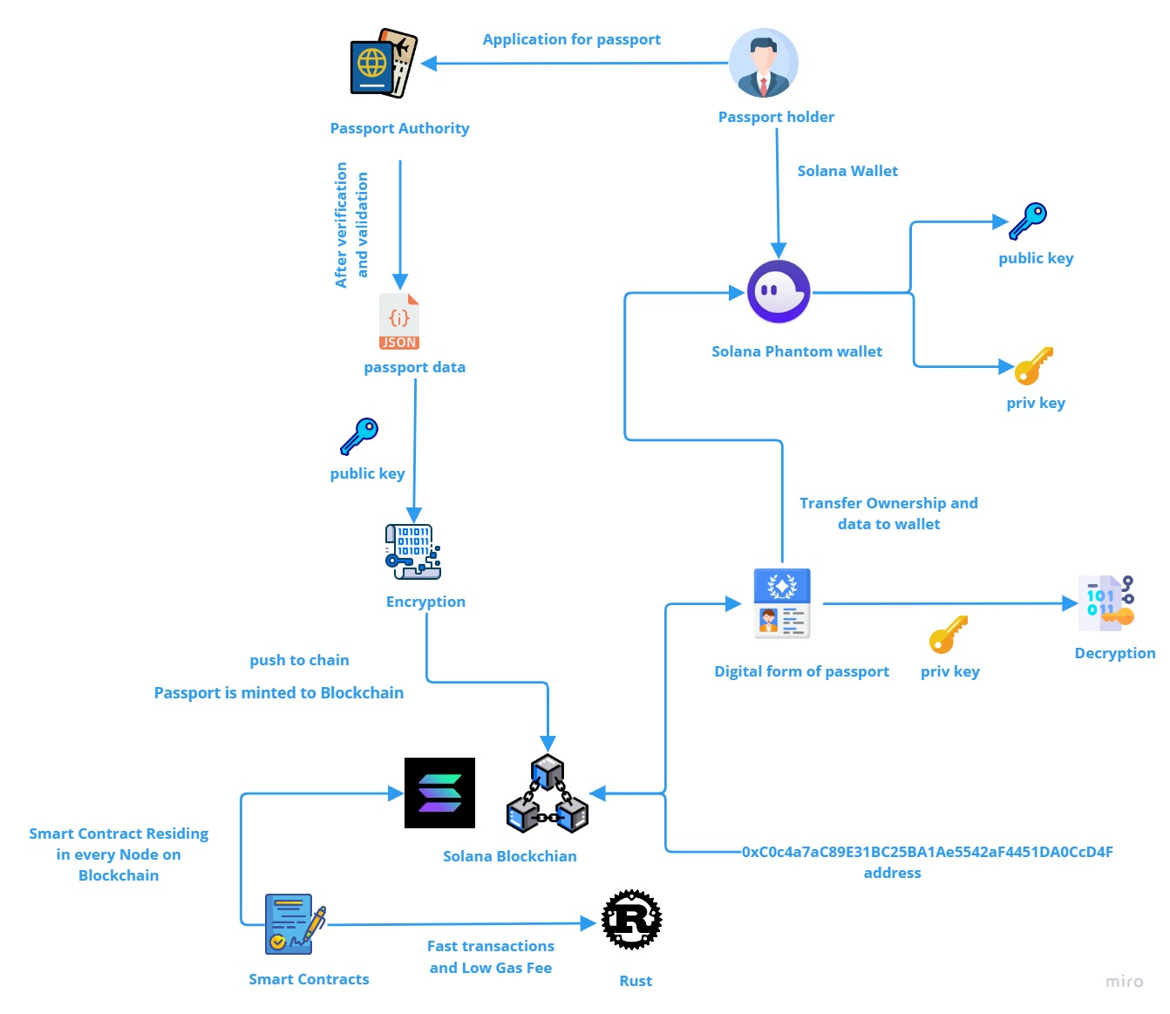

Slide 6
How it works
We can think of the implementation as creating an Non Fungible Token (NFT) .where the NFT holds each users data. The Passport authority will have access to Solana chain so that they can mint data on the chain. Basically we can imagine the users data like a Json or a dictionary type data.
This data will be encrypted using the passport holder's public key. So the data is now secured and confidential. We have to build a smart contract initially to interact with the chain so that we can store data , retrieve data and modify data.
This smart contract is written in Rust language and it offers many functionalities for interaction with chain. The passport authority pushes these data to the chain and digitally signs this transaction meaning that the passport was minted by government and then its ownership is transferred to that particular passport holder. At this stage there is an NFT present on the user's wallet which is the encrypted data of his passport.
The user can use his private keys to decrypt the NFT to view it as clear text.

Slide 7
THANK YOU

