Slide 1

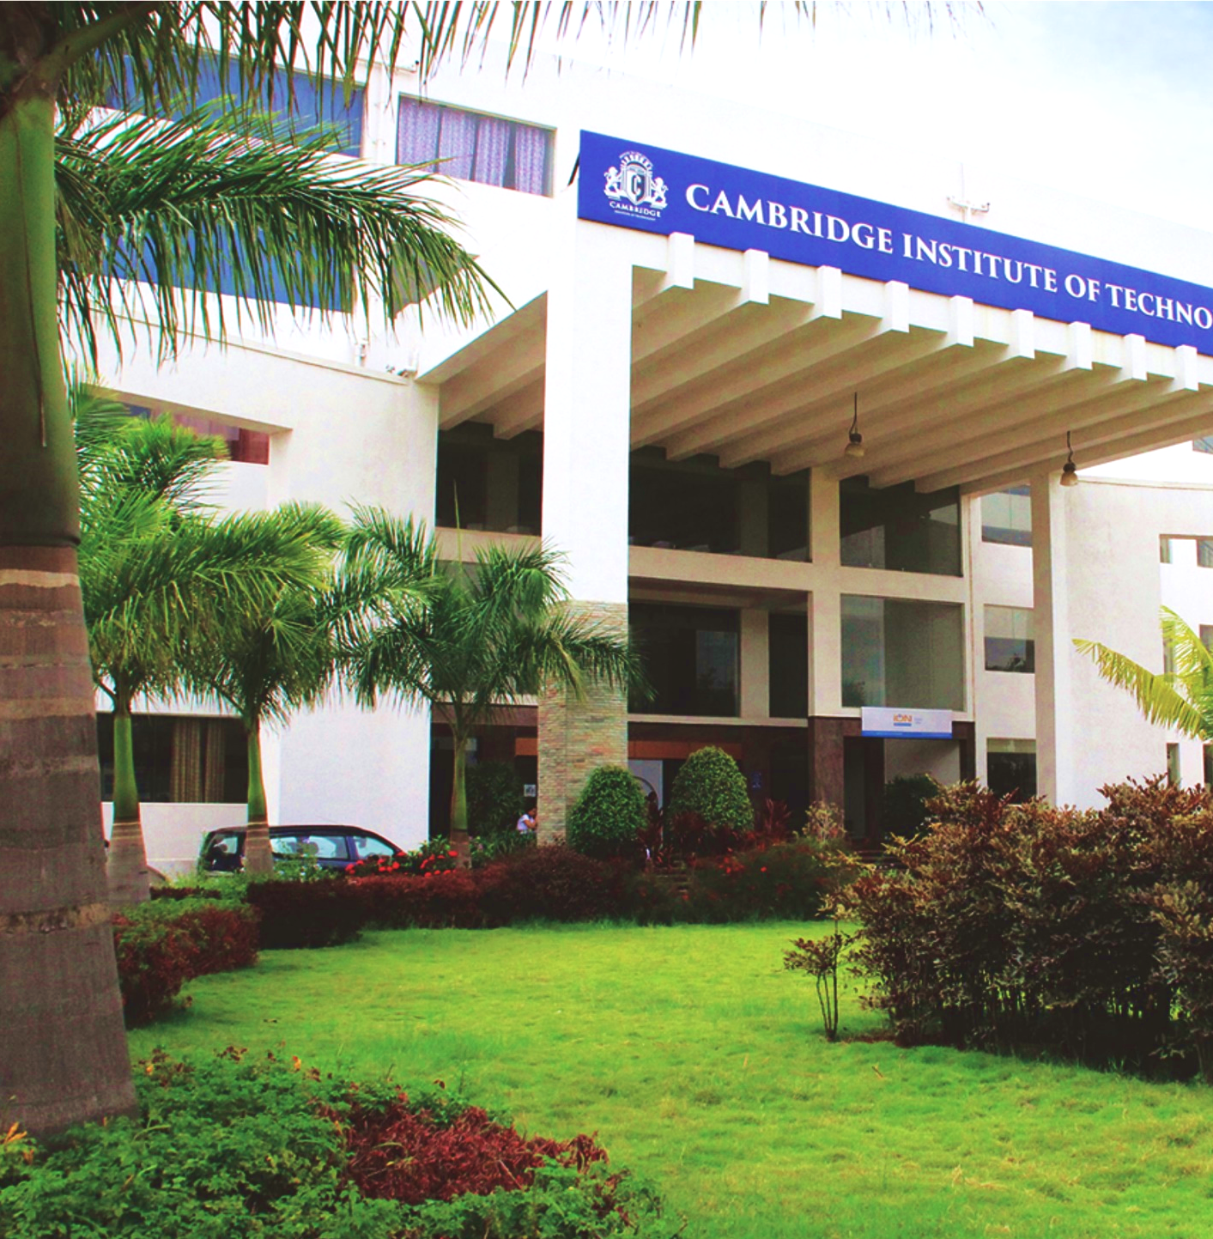
Department of Computer Science & Engineering
Project Presentation
On
Assistive System for Blind People
By
Koyal Kaveramma K G (1CD23CS075)
Nagapriya (1CD23CS100)
Priyanka V (1CD23CS122)
Under the Guidance of
Prof. Swathy J
www.cambridge.edu.in

Slide 2
Assistive System for Blind People

Slide 3
Contents
Introduction
Problem statement
Identified Objectives
Literature Survey
Research Gap
System Architecture
Application/Use Cases
Expected Deliverables in phase1 and phase 2
References

Slide 4
Introduction
Visual impairment is a serious global issue that affects millions of people, limiting their ability to move freely and perform daily activities independently. Navigation is one of the biggest challenges, especially in crowded or unfamiliar environments.
Traditional tools like white canes:
Detect only nearby obstacles
Cannot identify objects
Provide no navigation support
With advancements in:
Artificial Intelligence (AI)
Internet of Things (IoT)
Computer Vision
it is now possible to develop smart assistive systems that provide real-time guidance and improve safety.

Slide 5
Introduction(Cont…)
The proposed system aims to overcome these limitations by designing an intelligent assistive solution that combines multiple technologies.
Key components of the system include:
Ultrasonic Sensors for obstacle detection
Camera Module for object recognition
Microcontroller (Arduino/Raspberry Pi) for processing
GPS Module for real-time location tracking
Audio Output System for voice feedback like TTS
This integration enables the system to:
Detect obstacles in real time
Recognize objects in the environment
Provide voice-based alerts and navigation instructions
The system uses:
Computer Vision for scene understanding
Machine Learning models (like YOLOv8) for object detection
Sensor fusion to improve accuracy

Slide 6
Problem Statements
Traditional navigational aids like white canes are limited to detecting obstacles on the ground within a highly restricted range.
Current methods have several drawbacks, including the inability to detect overhead objects (like tree branches or signboards), leading to frequent injuries.
The major challenges faced by visually impaired individuals include:
Inability to independently read street signs, menus, or important documents.
Difficulty in navigating unfamiliar indoor and outdoor environments safely.
Lack of awareness regarding dynamic obstacles, such as moving vehicles or pedestrians.
High cost and lack of portability of existing high-tech smart glasses or specialized assistive devices.
Due to the lack of integrated solutions, users often have to rely on multiple different tools or human assistance for daily tasks.
Hence, there is a critical need for an automated, intelligent, all-in-one system that provides real-time, accurate environmental feedback via audio.

Slide 7
Identified Objectives
The main objective of this project is to design and develop an intelligent assistive system using Deep Learning and Computer Vision to enhance the mobility and independence of visually impaired individuals.
The specific objectives include:
To implement YOLOv8 for accurate, real-time object and obstacle detection (including overhead hazards).
To integrate a depth estimation algorithm to calculate the proximity of detected obstacles and prioritize immediate threats.
To incorporate an OCR engine to detect and read text from the environment (e.g., warning signs, bus numbers, labels).
To convert the system's findings into seamless, real-time audio alerts using Text-to-Speech (TTS) APIs.
To optimize the deep learning models for edge deployment (e.g., smartphones or portable microcontrollers) to ensure low latency without requiring continuous high-speed internet.
To contribute towards inclusive technology and improve the quality of life for the visually impaired.

Slide 8
Literature Survey
SL NO | TITLE | DATASET | METHOD | ADVANTAGES | RESEARCH GAP (Disadvantages)
1 | Computer Vision based Assistive Technology For Blindand Visually Impaired People | live streaming visual data, | BRISK | Utilizes BRISK method on live streaming visual data for feature extraction. | No Deep Learning
2 | Assistive Technology for the Visually Impaired Using Computer Vision | Live visual data | OpenCV,OCR | Implements OpenCV and OCR to process live visual data. | No Deep Learning
3 | A Smart Assistive System for Visually Impaired People Using Deep Learning Techniques | ImageNet, COCO | CNN-based models | Uses CNN-based models trained on ImageNet and COCO datasets. | Limited Real-Time Efficiency
4 | Vision-Based Mobile Indoor Assistive Navigation Aid for Blind People | Live indoor visual data | Kalman filter (TSM-KF) algorithm | Applies Kalman filter (TSM-KF) algorithm on live indoor visual data. | Limited to Indoor Environment
5 | Vision-Based Mobile Indoor Assistive Navigation Aid for Blind People | Live indoor visual data | Kalman filter (TSM-KF) algorithm,3D grid map + semantic layers,vps | Combines Kalman filter, 3D grid map, semantic layers, and VPS. | Limited to Indoor Environment

Slide 9
Literature Survey(Cont...)
SL NO | TITLE | DATASET | METHOD | ADVANTAGES | RESEARCH GAP (Disadvantages)
6 | Real-Time Object Detection for Blind Navigation using YOLOv3 | COCO dataset + real-time camera input | YOLOv3 for object detection with real-time processing and audio feedback | Uses YOLOv3 for object detection with real-time processing and audio feedback. | High computational cost; limited performance on low-end devices
7 | Deep Learning Based Smart Cane for Visually Impaired | Custom dataset collected from indoor/outdoor environments | CNN-based object detection integrated with ultrasonic sensors | CNN-based object detection with integrated ultrasonic sensors | Limited dataset size; lacks complex scene understanding
8 | Wearable Assistive Device Using SSD for Object Detection | Pascal VOC + real-time images | SSD (Single Shot Detector) for fast object detection with audio alerts | Uses SSD (Single Shot Detector) for fast object detection with audio alerts. | Accuracy lower than newer models; struggles in low light
9 | Assistive Navigation System using Faster R-CNN | COCO dataset | Faster R-CNN for obstacle detection and classification | Utilizes Faster R-CNN for robust obstacle detection and classification | Slow inference speed; not suitable for real-time low-power devices
10 | Smart Vision System for Blind using MobileNet | ImageNet + custom dataset | MobileNet lightweight CNN for mobile-based detection | Employs MobileNet, a lightweight CNN, for mobile-based detection. | Limited accuracy compared to heavier models

Slide 10
Literature Survey(Cont...)
SL NO | TITLE | DATASET | METHOD | ADVANTAGES | RESEARCH GAP (Disadvantages)
11 | Obstacle Detection System using Depth Estimation and CNN | KITTI dataset | Depth estimation + CNN for distance calculation and object detection | Combines depth estimation and CNNs for distance calculation and object detection. | Complex computation; limited indoor performance
12 | AI-Based Wearable Navigation System using YOLOv5 | COCO dataset + custom dataset | YOLOv5 for real-time object detection with voice feedback | Uses YOLOv5 for fast, real-time object detection with voice feedback. | Requires GPU for optimal performance
13 | Real-Time Scene Understanding for Visually Impaired using CNN | ADE20K dataset | CNN-based scene classification and object detection | Applies CNN-based scene classification and object detection. | Limited real-time efficiency
14 | Assistive System using Semantic Segmentation for Navigation | Cityscapes dataset | Semantic segmentation for path detection and obstacle avoidance | Uses Semantic Segmentation for precise path detection and obstacle avoidance. | High computational cost; requires powerful hardware
15 | Smart Glasses for Blind using Deep Learning | Custom dataset | Deep learning (CNN + object detection) integrated into wearable glasses | Deep learning (CNN + object detection) integrated directly into wearable glasses. | Limited battery life and hardware dependency

Slide 11
Research Gap
Although many assistive systems have been proposed, a significant gap remains in creating an all-in-one, affordable solution.
Most existing systems rely heavily on cloud computing for complex tasks like scene description and OCR, resulting in high latency and requiring a constant internet connection, which is not practical for active mobility.
Hardware-centric solutions (like Lidar-equipped smart glasses) are often too expensive and bulky for widespread daily use by the visually impaired community.
Furthermore, many computer vision models are trained solely on general datasets (like COCO) and fail to recognize specific navigational hazards, such as overhead branches, open manholes, or waist-high barriers.
Our project aims to bridge this gap by integrating optimized object detection (YOLOv8), distance estimation, and OCR into a single, lightweight application capable of running locally on edge devices (smartphones/Raspberry Pi) with real-time audio feedback.

Slide 12
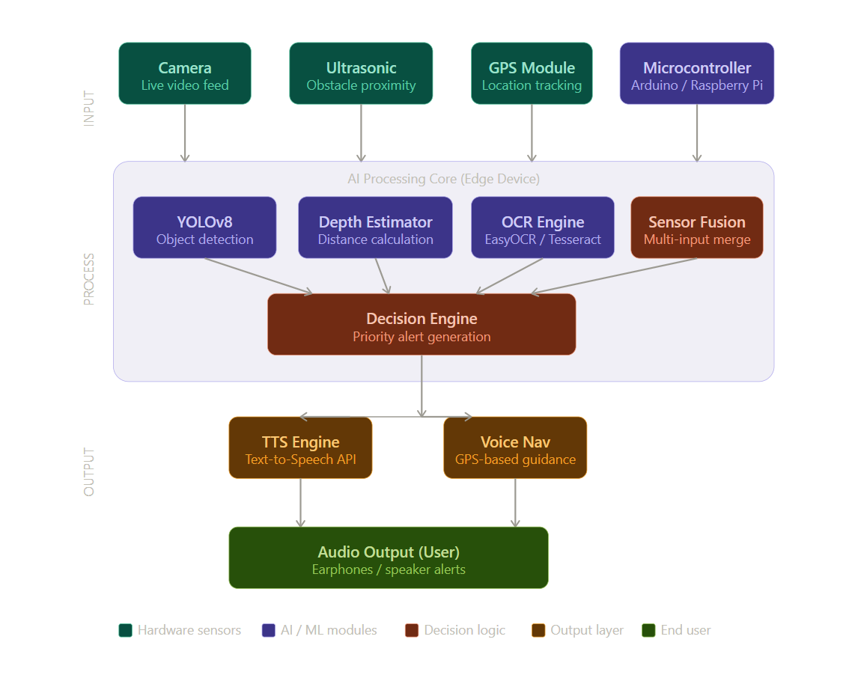
System Architecture

Slide 13
Application/Use Cases
Application/Use Cases (Practical Scenarios)
Safe Pedestrian Navigation: Alerts users to immediate obstacles like parked cars, poles, open manholes, and overhead branches while walking on sidewalks.
Public Transit Assistance: Helps users locate bus stops, identify arriving bus numbers, and safely find train doors.
Indoor Mobility: Assists in navigating unfamiliar buildings, identifying stairs, doors, and elevators in offices or hospitals.
Reading and Information Access: Allows users to independently read restaurant menus, grocery store labels, and warning signs via OCR and TTS.
Social Interaction: Empowers users to know how many people are in a room or identify saved faces (friends/family) in social gatherings.
Smart City Integration: Can be synced with smart pedestrian crossing signals for safer street traversal.

Slide 14
Expected Deliver in Phase1 and Phase 2
Phase 1 Deliverables (Months 1–3)
D1.1 Comprehensive Literature Review: Documented survey of 15+ AI assistive technology studies with method, accuracy, and gap analysis.
D1.2 Dataset Preparation: Curated image dataset containing common mobility obstacles, overhead hazards, and street signs.
D1.3 YOLOv8 Detection Module: Trained and validated YOLOv8 model tailored for obstacle detection, achieving real-time inference (>30 FPS) on standard hardware.
D1.4 Text-to-Speech (TTS) Integration: Basic integration of a TTS API to convert string outputs (e.g., "Chair detected") into auditory alerts.
D1.5 Phase 1 Report & Demo: Written report and a live software demo showing object detection and audio feedback on pre-recorded walking footage.

Slide 15
Expected Deliver in Phase1 and Phase2 (Cont….)
Phase 2 Deliverables (Months 4–6)
D2.1 Distance Estimation Module: Implementation of monocular depth estimation to calculate how far an obstacle is from the user, allowing for prioritized "urgent" alerts.
D2.2 OCR Pipeline Integration: Full integration of an OCR model (like EasyOCR or Tesseract) capable of reading text in the camera's view.
D2.3 End-to-End System Deployment: Complete integrated pipeline running on edge hardware (e.g., a smartphone app or Raspberry Pi with camera), processing camera input → detection → depth → TTS audio.
D2.4 Final Evaluation & User Testing: Comprehensive performance report measuring system latency, detection accuracy, and usability feedback from blindfolded test subjects.
D2.5 Published Paper / Poster: Research paper documenting the system design, latency benchmarks, and results.

Slide 16
References
S. A. Author et al., "Computer Vision based Assistive Technology For Blind and Visually Impaired People," International Journal of Computer Vision, 2021.
R. Kumar and P. Singh, "Assistive Technology for the Visually Impaired Using Computer Vision," IEEE Access, 2020.
M. Sharma et al., "A Smart Assistive System for Visually Impaired People Using Deep Learning Techniques," Journal of Intelligent Systems, 2022.
T. Li and H. Wang, "Vision-Based Mobile Indoor Assistive Navigation Aid for Blind People," IEEE Transactions on Neural Systems and Rehabilitation Engineering, 2019.
T. Li and H. Wang, "Vision-Based Mobile Indoor Assistive Navigation Aid for Blind People (Extended)," IEEE Transactions on Neural Systems and Rehabilitation Engineering, 2020.
A. Patel et al., "Real-Time Object Detection for Blind Navigation using YOLOv3," Procedia Computer Science, 2022.
N. Verma and R. Das, "Deep Learning Based Smart Cane for Visually Impaired," Sensors, 2021.
K. Mehta et al., "Wearable Assistive Device Using SSD for Object Detection," Applied Sciences, 2020.
S. Gupta and A. Jain, "Assistive Navigation System using Faster R-CNN," Expert Systems with Applications, 2021.
P. Reddy and M. Rao, "Smart Vision System for Blind using MobileNet," Neural Computing and Applications, 2022.
L. Chen et al., "Obstacle Detection System using Depth Estimation and CNN," Pattern Recognition Letters, 2021.
R. Ahmed and S. Malik, "AI-Based Wearable Navigation System using YOLOv5," Computers & Electrical Engineering, 2023.
H. Zhao et al., "Real-Time Scene Understanding for Visually Impaired using CNN," Image and Vision Computing, 2022.
F. Islam and T. Hasan, "Assistive System using Semantic Segmentation for Navigation," Robotics and Autonomous Systems, 2023.
Y. Zhang et al., "Smart Glasses for Blind using Deep Learning," IEEE Sensors Journal, 2022

