Slide 1

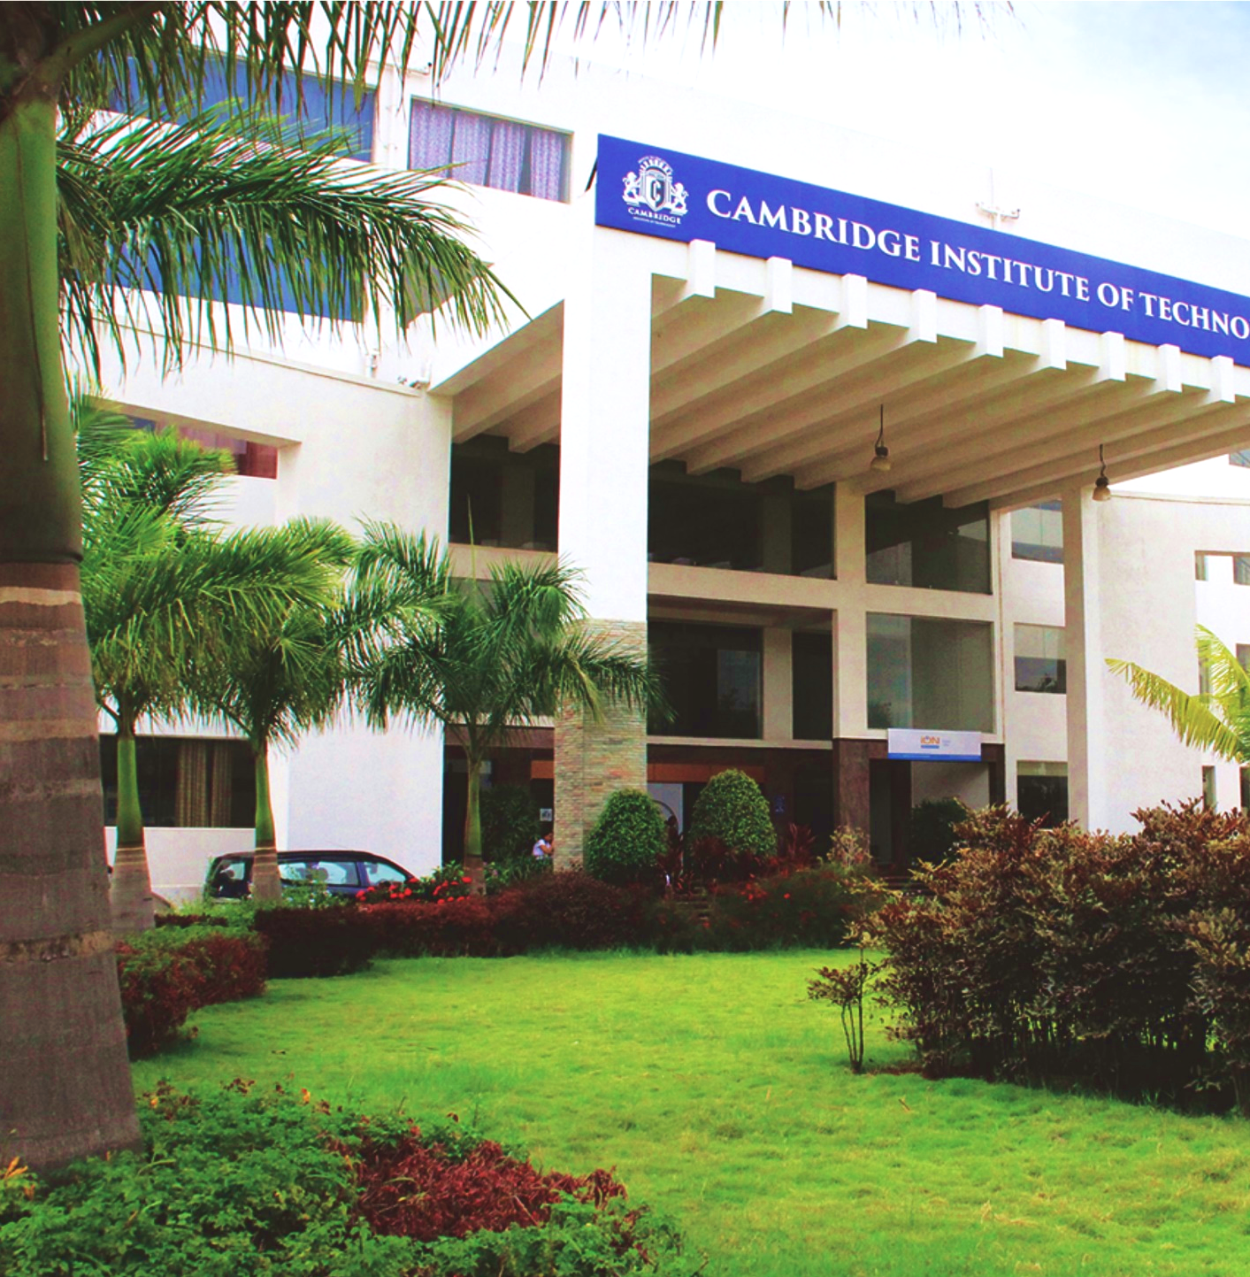
Project Presentation
On
Assistive System for Blind People
By
Koyal Kaveramma K G (1CD23CS075)
Nagapriya (1CD23CS100)
Priyanka V (1CD23CS122)
Under the Guidance of
Prof. Swathy J
Department of Computer Science & Engineering
www.cambridge.edu.in

Slide 2
Contents
Introduction
Objectives
Literature Survey
Proposed Method
Architecture
Hardware/Software Requirements
Algorithms/Methdology
Implementation Modules Identified
Works completed
Works to be completed.
References

Slide 3
Introduction
Visual Impairment and Navigation Challenges
Visual impairment is a serious global issue that affects millions of people, limiting their ability to move freely and perform daily activities independently. Navigation is one of the biggest challenges, especially in crowded, unfamiliar, or dynamic environments.
Traditional tools such as white canes:
Detect only nearby obstacles
Cannot identify surrounding objects
Provide no navigation support
Offer limited environmental awareness
Need for Improvement
Safer mobility solutions
Greater independence for users
Real-time environmental understanding

Slide 4
Introduction(Cont…)
Smart Assistive Navigation System
Recent technological advancements have enabled the development of intelligent assistive systems that enhance mobility and safety.
Key enabling technologies:
Artificial Intelligence (AI)
Internet of Things (IoT)
Computer Vision
Machine Learning
The proposed system aims to overcome the limitations of traditional tools by combining these technologies into a single smart assistive solution.
Objectives:
Improve user safety
Assist with navigation
Provide real-time information about surroundings

Slide 5
Introduction(Cont…)
Main Components
Ultrasonic Sensors for obstacle detection
Camera Module for object recognition
Microcontroller (Arduino/Raspberry Pi) for processing
GPS Module for real-time location tracking
Audio Output System for voice feedback (TTS)
System Capabilities
Detect obstacles in real time
Recognize objects in the environment
Provide voice-based alerts and navigation instructions
Assist users in making safer movement decisions

Slide 6
Introduction(Cont…)
Technologies Used
Computer Vision for scene understanding
Machine Learning models (e.g., YOLOv8) for object detection
Sensor Fusion to improve accuracy and reliability

Slide 7
Objectives
Main Objective
The main objective of this project is to design and develop an intelligent assistive system using Deep Learning and Computer Vision to enhance the mobility, safety, and independence of visually impaired individuals.
Key Goals
Provide real-time environmental awareness
Improve obstacle and object detection accuracy
Enable safer navigation in indoor and outdoor environments
Deliver voice-based assistance for easier interaction
Expected Impact
Increased user independence
Improved accessibility through smart technology
Enhanced quality of life for visually impaired users

Slide 8
Objectives (Cont…)
Specific Objectives
Implement YOLOv8 for accurate real-time object and obstacle detection, including overhead hazards.
Integrate a depth estimation algorithm to measure obstacle distance and prioritize immediate threats.
Incorporate an OCR engine to detect and read environmental text such as warning signs, bus numbers, and labels.
Convert system findings into real-time audio feedback using Text-to-Speech (TTS) technology.
Optimize deep learning models for edge deployment on smartphones and portable devices with low latency.
Reduce dependence on continuous high-speed internet connectivity.
Contribute to inclusive technology and improve accessibility for visually impaired individuals.

Slide 9
Literature Review
SL NO | TITLE | AUTHOR | YEAR | DATASET | METHOD | ADVANTAGES | RESEARCH GAP (Disadvantages)
1 | Computer Vision based Assistive Technology For Blindand Visually Impaired People | S. A. Author et al | 2021 | live streaming visual data, | BRISK | Utilizes BRISK method on live streaming visual data for feature extraction. | No Deep Learning
2 | Assistive Technology for the Visually Impaired Using Computer Vision | R. Kumar and P. Singh | 2020 | Live visual data | OpenCV,OCR | Implements OpenCV and OCR to process live visual data. | No Deep Learning
3 | A Smart Assistive System for Visually Impaired People Using Deep Learning Techniques | M. Sharma et al | 2022 | ImageNet, COCO | CNN-based models | Uses CNN-based models trained on ImageNet and COCO datasets. | Limited Real-Time Efficiency
4 | Vision-Based Mobile Indoor Assistive Navigation Aid for Blind People | T. Li and H. Wang | 2019 | Live indoor visual data | Kalman filter (TSM-KF) algorithm | Applies Kalman filter (TSM-KF) algorithm on live indoor visual data. | Limited to Indoor Environment
5 | Vision-Based Mobile Indoor Assistive Navigation Aid for Blind People | T. Li and H. Wang | 2020 | Live indoor visual data | Kalman filter (TSM-KF) algorithm,3D grid map + semantic layers,vps | Combines Kalman filter, 3D grid map, semantic layers, and VPS. | Limited to Indoor Environment

Slide 10
Literature Review(Cont...)
SL NO | TITLE | AUTHOR | YEAR | DATASET | METHOD | ADVANTAGES | RESEARCH GAP (Disadvantages)
6 | Real-Time Object Detection for Blind Navigation using YOLOv3 | A. Patel et al | 2022 | COCO dataset + real-time camera input | YOLOv3 for object detection with real-time processing and audio feedback | Uses YOLOv3 for object detection with real-time processing and audio feedback. | High computational cost; limited performance on low-end devices
7 | Deep Learning Based Smart Cane for Visually Impaired | N. Verma and R. Das | 2021 | Custom dataset collected from indoor/outdoor environments | CNN-based object detection integrated with ultrasonic sensors | CNN-based object detection with integrated ultrasonic sensors | Limited dataset size; lacks complex scene understanding
8 | Wearable Assistive Device Using SSD for Object Detection | K. Mehta et al | 2020 | Pascal VOC + real-time images | SSD (Single Shot Detector) for fast object detection with audio alerts | Uses SSD (Single Shot Detector) for fast object detection with audio alerts. | Accuracy lower than newer models; struggles in low light
9 | Assistive Navigation System using Faster R-CNN | S. Gupta and A. Jain | 2021 | COCO dataset | Faster R-CNN for obstacle detection and classification | Utilizes Faster R-CNN for robust obstacle detection and classification | Slow inference speed; not suitable for real-time low-power devices
10 | Smart Vision System for Blind using MobileNet | P. Reddy and M. Rao | 2022 | ImageNet + custom dataset | MobileNet lightweight CNN for mobile-based detection | Employs MobileNet, a lightweight CNN, for mobile-based detection. | Limited accuracy compared to heavier models

Slide 11
Literature Review(Cont...)
SL NO | TITLE | AUTHOR | YEAR | DATASET | METHOD | ADVANTAGES | RESEARCH GAP (Disadvantages)
11 | Obstacle Detection System using Depth Estimation and CNN | L. Chen et al | 2021 | KITTI dataset | Depth estimation + CNN for distance calculation and object detection | Combines depth estimation and CNNs for distance calculation and object detection. | Complex computation; limited indoor performance
12 | AI-Based Wearable Navigation System using YOLOv5 | R. Ahmed and S. Malik | 2023 | COCO dataset + custom dataset | YOLOv5 for real-time object detection with voice feedback | Uses YOLOv5 for fast, real-time object detection with voice feedback. | Requires GPU for optimal performance
13 | Real-Time Scene Understanding for Visually Impaired using CNN | H. Zhao et al | 2022 | ADE20K dataset | CNN-based scene classification and object detection | Applies CNN-based scene classification and object detection. | Limited real-time efficiency
14 | Assistive System using Semantic Segmentation for Navigation | F. Islam and T. Hasan | 2023 | Cityscapes dataset | Semantic segmentation for path detection and obstacle avoidance | Uses Semantic Segmentation for precise path detection and obstacle avoidance. | High computational cost; requires powerful hardware
15 | Smart Glasses for Blind using Deep Learning | Y. Zhang et al | 2022 | Custom dataset | Deep learning (CNN + object detection) integrated into wearable glasses | Deep learning (CNN + object detection) integrated directly into wearable glasses. | Limited battery life and hardware dependency

Slide 12
Datasets
 | MODULE 1 | MODULE 2 | MODULE 3 | MODULE 4
Datasets | COCO 2017 VizWiz 2024 | TextOCR | NYU Depth V2 KITTI Depth | Custom Dataset VizWiz-VQA
Purpose | Detect people Vehicles Furniture Urban mobility hazards Overhead obstacles | Signboard reading Warning labels Bus numbers Environmental text recognition | Obstacle distance estimation Hazard prioritization | Real-world testing Urban navigation scenarios Performance evaluation

Slide 13
Proposed method
AI-Based Assistive Navigation System for Visually Impaired People
The proposed system combines Computer Vision, Deep Learning, OCR, and Depth Estimation to provide real-time navigation assistance for visually impaired users.
The system performs:
Real-time object and obstacle detection using YOLOv8
Scene text recognition using OCR
Distance estimation using MiDaS depth estimation
Audio feedback using Text-to-Speech (TTS)
Hazard prioritization based on obstacle proximity
Safe navigation guidance in indoor and outdoor environments

Slide 14
Proposed method (Cont…)
Working Principle
Capture live video using a camera.
Detect objects and obstacles using YOLOv8.
Estimate obstacle distance using MiDaS.
Extract useful text from surroundings using OCR.
Prioritize critical hazards based on distance.
Convert information into speech using TTS.
Deliver real-time audio alerts to the user.
Expected Output
Obstacle warnings
Object identification
Text reading assistance
Navigation guidance

Slide 15
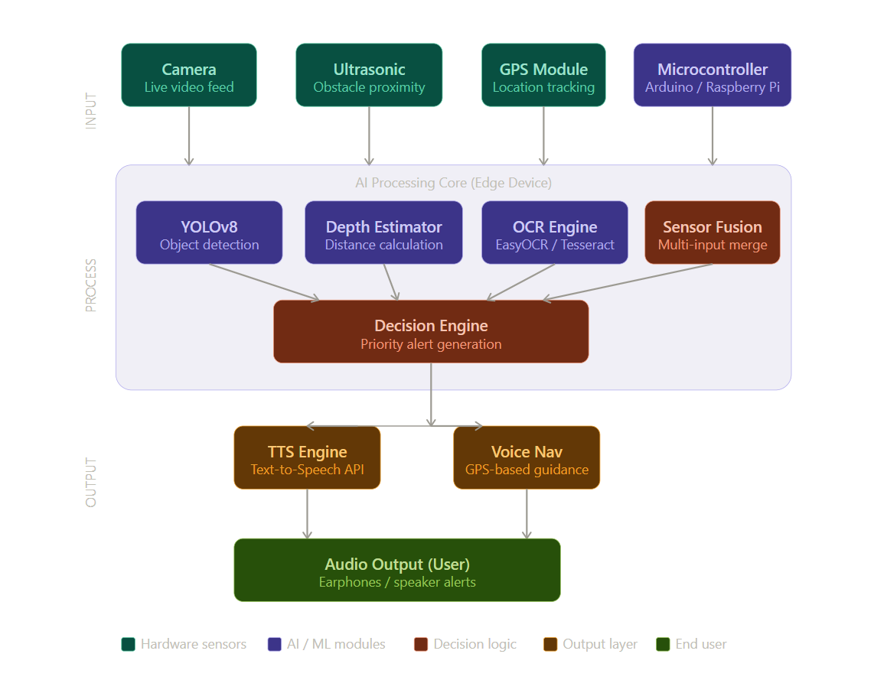
Architecture

Slide 16
Architecture(Cont…)
Camera Module
Captures live video feed of the surroundings.
Provides visual data for object detection and scene analysis.
Ultrasonic Sensor
Detects nearby obstacles.
Measures distance between the user and obstacles.
GPS Module
Tracks the user's current location.
Supports navigation and route guidance.
Microcontroller (Arduino/Raspberry Pi)
Interfaces with sensors and AI modules.
Controls data collection and communication.

Slide 17
Architecture(Cont…)
YOLOv8 Object Detection
Identifies objects such as pedestrians, vehicles, poles, and obstacles.
Enables real-time environmental awareness.
Depth Estimator
Calculates the distance of detected objects.
Helps determine obstacle proximity and collision risk.
OCR Engine (EasyOCR/Tesseract)
Extracts text from signs, boards, and labels.
Converts visual text into readable information.
Sensor Fusion Module
Combines data from camera, ultrasonic sensor, and GPS.
Improves accuracy and reduces sensor uncertainty.
.

Slide 18
Architecture(Cont…)
Decision Engine
Processes outputs from all AI modules.
Prioritizes alerts based on obstacle severity and distance.
Generates appropriate navigation instructions.
Text-to-Speech (TTS) Engine
Converts alerts and notifications into speech.
Provides hands-free interaction.
Voice Navigation Module
Generates GPS-based navigation guidance.
Directs users through voice commands.
Audio Output
Delivers alerts and navigation instructions through earphones or speakers.
Enables safe and independent navigation for users.

Slide 19
Hardware/Software requirements
Software Requirements
Operating System: Linux (Ubuntu 20.04+), Raspberry Pi OS, or Android.
Programming Language: Python 3.8+.
IDE: VS Code, Jupyter Notebook, Google Colab (for training).
Deep Learning Framework: PyTorch, Ultralytics YOLOv8.
OCR Library: EasyOCR / Tesseract OCR.
Computer Vision: OpenCV 4.5+.
TTS Library: pyttsx3, gTTS, or Coqui TTS.
Depth Estimation: MiDaS (Monocular Depth Estimation).
Deployment: Flask (API), or direct embedded Python on Raspberry Pi.
Package Manager: pip / conda.

Slide 20
Hardware/Software requirements(Cont…)
Hardware Requirements
Camera Module: Raspberry Pi Camera v2 or USB webcam / smartphone camera.
Processor: Raspberry Pi 4B (ARM Cortex-A72) or Intel i5+ for PC deployment.
RAM: Minimum 4 GB (8 GB recommended for smooth inference).
GPU: Optional — NVIDIA GPU with CUDA for accelerated training.
Storage: 32 GB microSD card or 20 GB SSD.
Audio Output: 3.5mm earphones or Bluetooth headset.
Battery: Portable power bank (10,000 mAh) for mobile deployment

Slide 21
Algorithms
YOLOv8 Object Detection
Performs real-time object detection.
Detects multiple objects simultaneously.
Optimized for edge deployment.
MiDaS Depth Estimation
Generates depth maps from single RGB images.
Estimates distance to nearby obstacles.
OCR (EasyOCR)
Detects and recognizes scene text.
Supports multilingual text recognition.
Text-to-Speech (TTS)
Converts detected information into speech.

Slide 22
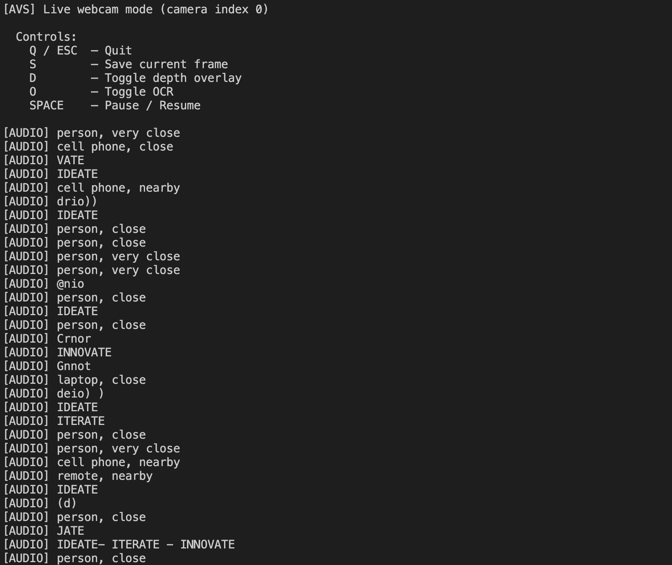
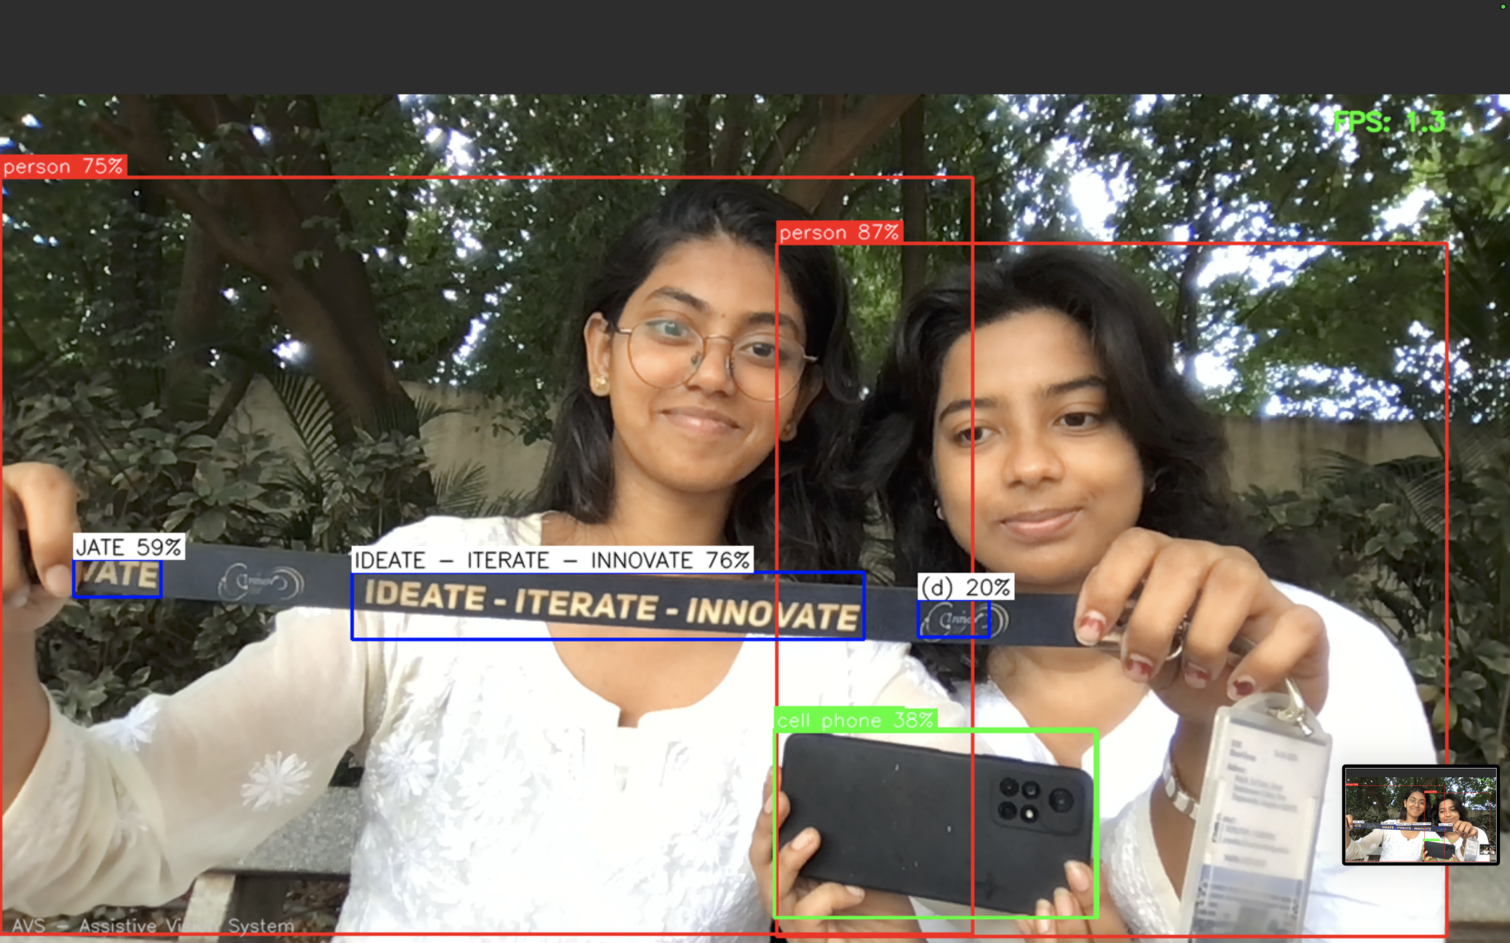
Implementation

Slide 23

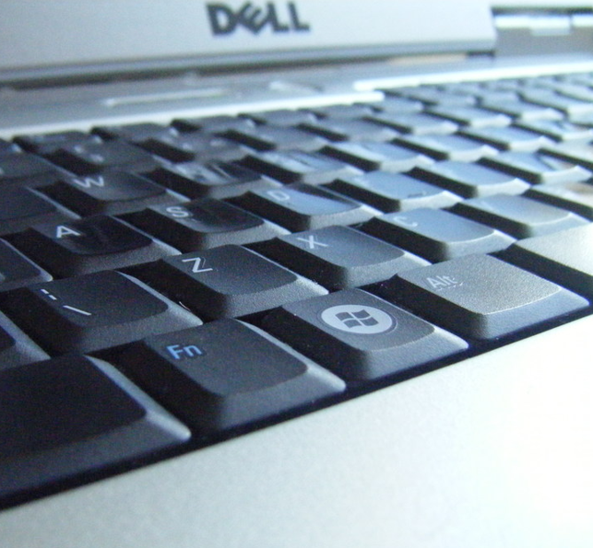
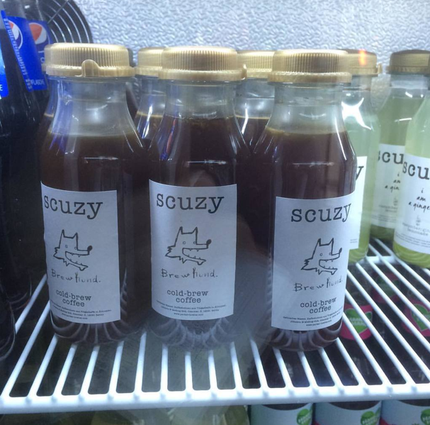
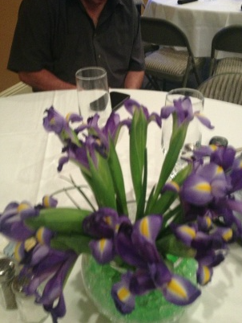
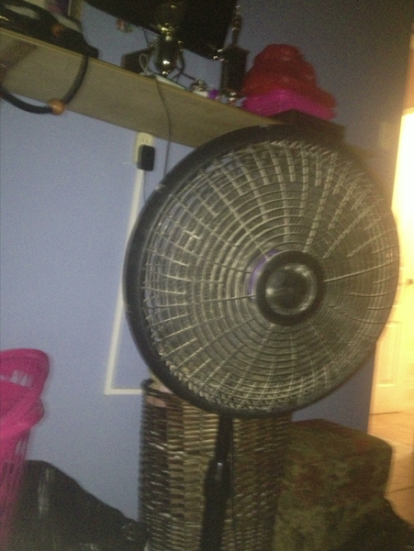
Works Completed
Literature Survey
Problem statement finalization
Data preprocessing and annotation
Model Training YOLOv8 for object detection
MiDaS depth estimation integration
TTS output pipeline

Slide 24
Works to be completed
Hardware implementation
Improving the inference
Enabling night-vision
Module integration and testing
Edge deployment (Raspberry Pi/Android)
Final evaluation and optimization

Slide 25
References
[1] S. A. Author et al., "Computer Vision based Assistive Technology For Blind and Visually Impaired People," International Journal of Computer Vision, 2021.
[2] R. Kumar and P. Singh, "Assistive Technology for the Visually Impaired Using Computer Vision," IEEE Access, 2020.
[3] M. Sharma et al., "A Smart Assistive System for Visually Impaired People Using Deep Learning Techniques," Journal of Intelligent Systems, 2022.
[4]T. Li and H. Wang, "Vision-Based Mobile Indoor Assistive Navigation Aid for Blind People," IEEE Transactions on Neural Systems and Rehabilitation Engineering, 2019.
[5] T. Li and H. Wang, "Vision-Based Mobile Indoor Assistive Navigation Aid for Blind People (Extended)," IEEE Transactions on Neural Systems and Rehabilitation Engineering, 2020.
[6] A. Patel et al., "Real-Time Object Detection for Blind Navigation using YOLOv3," Procedia Computer Science, 2022.
[7] N. Verma and R. Das, "Deep Learning Based Smart Cane for Visually Impaired," Sensors, 2021.
[8] K. Mehta et al., "Wearable Assistive Device Using SSD for Object Detection," Applied Sciences, 2020.
[9] S. Gupta and A. Jain, "Assistive Navigation System using Faster R-CNN," Expert Systems with Applications, 2021.
[10] P. Reddy and M. Rao, "Smart Vision System for Blind using MobileNet," Neural Computing and Applications, 2022.
[11] L. Chen et al., "Obstacle Detection System using Depth Estimation and CNN," Pattern Recognition Letters, 2021.
[12] R. Ahmed and S. Malik, "AI-Based Wearable Navigation System using YOLOv5," Computers & Electrical Engineering, 2023.
[13] H. Zhao et al., "Real-Time Scene Understanding for Visually Impaired using CNN," Image and Vision Computing, 2022.
[14] F. Islam and T. Hasan, "Assistive System using Semantic Segmentation for Navigation," Robotics and Autonomous Systems, 2023.
[15] Y. Zhang et al., "Smart Glasses for Blind using Deep Learning," IEEE Sensors Journal, 2022

Slide 26
Thank you

