Slide 1
CMOS Logic Gate Design
Ref: Designing Combinational Logic Gates in CMOS -CHAPTER 6, Jan Rabey

Slide 2
Static CMOS Circuit
At every point in time (except during the switching transients) each gate output is
connected to either
V
or
V
ss
via a low-resistive path
DD
The outputs of the gates assume at all times the value of the Boolean function,
implemented by the circuit (ignoring the transient effects during switching periods)
This is in contrast to the
circuit class, which relies on temporary
dynamic
storage of signal values on the capacitance of high impedance circuit nodes

Slide 3
Static Complementary CMOS
V_{DD}
In1
PMOS only
In2
…
PUN
InN
F(In1,In2,…InN)
In1
In2
…
PDN
NMOS only
InN
PUN and PDN are dual logic networks
Notes:
One and only one of the networks (PUN or PDN) is conducting in steady state

Slide 4
NMOS Transistors in Series/Parallel Connection
Transistors can be thought as a switch controlled by its gate signal
NMOS switch closes when switch control input is high

Slide 5
PMOS Transistors in Series/Parallel Connection

Slide 6
Threshold Drops
V_{DD}
V_{DD}
PUN
S
D
V_{DD}
D
0 → V_{DD}
S
0 → V_{DD} - V_{Tn}
V_{GS}
C_{L}
C_{L}
PDN
V_{DD} → 0
V_{DD} → |V_{Tp}|
V_{GS}
D
C_{L}
S
C_{L}
V_{DD}
S
D
Notes:
Why PMOS in PUN and NMOS in PDN … threshold drop
NMOS transistors produce strong zeros; PMOS transistors generate strong ones

Slide 7
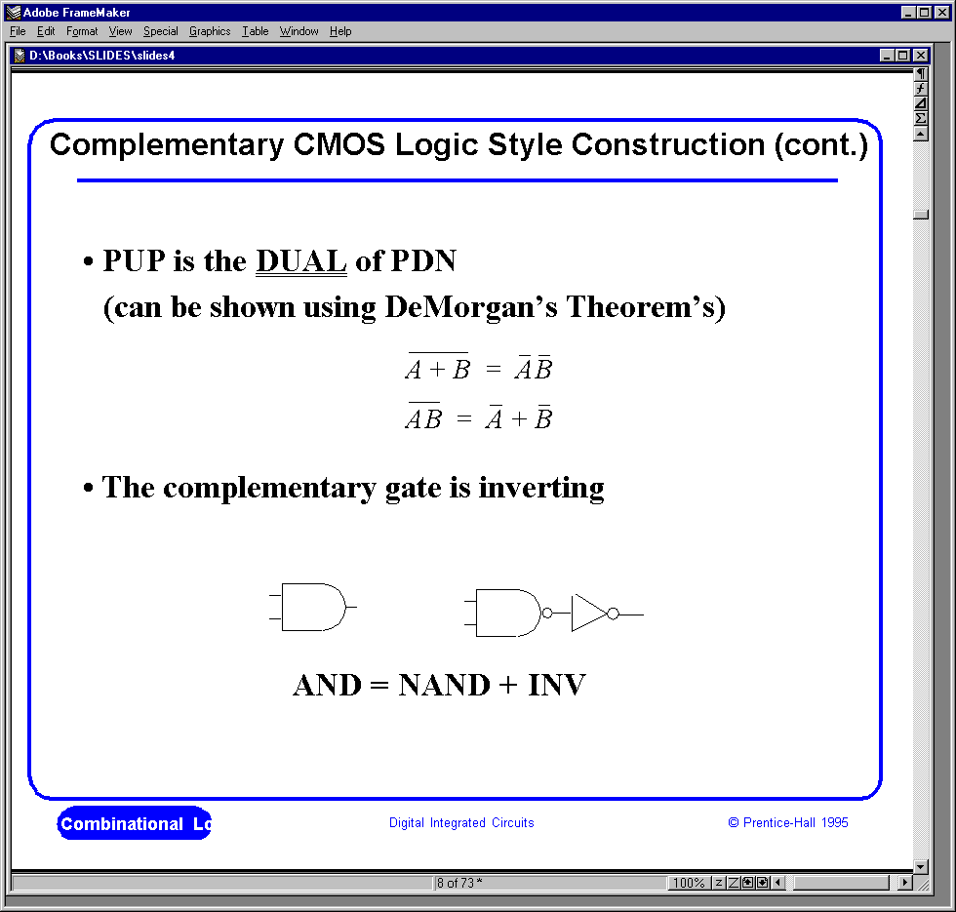
Complementary CMOS Logic Style

Slide 8
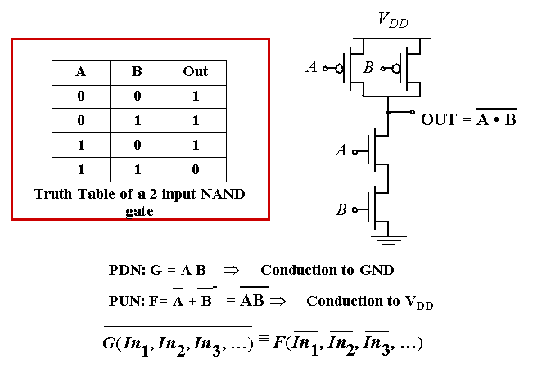
Example Gate: NAND

Slide 9
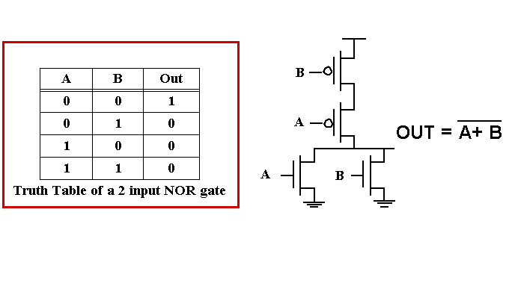
Example Gate: NOR

Slide 10
Complex CMOS Gate
B
A
C
D
OUT = D + A • (B + C)
A
D
B
C
Notes:
Shown synthesis of pull up from pull down structure

Slide 11
Constructing a Complex Gate

Slide 12
Cell Design
Standard Cells
General purpose logic
Can be synthesized
Same height, varying width
Datapath Cells
For regular, structured designs (arithmetic)
Includes some wiring in the cell
Fixed height and width

Slide 13
Standard Cell Layout Methodology – 1980s
Routing
channel
V_{DD}
signals
GND
Notes:
Contacts and wells not shown.
What does this implement??

Slide 14
Standard Cells
With same diffusion
V
DD
With silicided diffusion
V
DD
Out
In
Out
In
GND
GND

Slide 15
Standard Cells
V
2-input NAND gate
DD
A
B
Out
GND

Slide 16
Stick Diagrams
Contains no dimensions
Represents relative positions of transistors
V
DD
V
DD
Inverter
NAND2
Out
Out
In
A
B
GND
GND

Slide 17
Stick Diagrams
Logic Graph
X
A
PUN
j
C
B
C
X
i
V_{DD}
X = C • (A + B)
C
i
B
j
A
A
B
PDN
A
GND
B
C
Notes:
Systematic approach to derive order of input signal wires so gate can be laid out to minimize area
Note PUN and PDN are duals (parallel <-> series)
Vertices are nodes (signals) of circuit, VDD, X, GND and edges are transitions

Slide 18
Two Versions of C • (A + B)
A
C
B
A
B
C
V_{DD}
V_{DD}
X
X
GND
GND
Notes:
Line of diffusion layout – abutting source-drain connections
Note crossover eliminated by A B C ordering

Slide 19
Multi-Fingered Transistors
One finger
Two fingers (folded)
Less diffusion capacitance

Slide 20
CMOS Properties
Full rail-to-rail swing; high noise margins
Logic levels not dependent upon the relative device sizes; ratioless
Always a path to Vdd or Gnd in steady state; low output impedance
Extremely high input resistance; nearly zero steady-state input current
No direct path steady state between power and ground; no static power dissipation
Propagation delay function of load capacitance and resistance of transistors

Slide 21
Switched Delay Model
Capacitance on the internal node – due to the source drain of the two MOSFETs in series
A
R_{eq}
A
R_{p}
R_{p}
R_{p}
B
A
B
R_{p}
R_{p}
A
R_{p}
A
C_{int}
R_{n}
C_{L}
A
B
R_{n}
C_{L}
A
R_{n}
R_{n}
C_{L}
R_{n}
C_{int}
A
B
A
NOR2
NAND2
INV
Notes:
Note capacitance on the internal node – due to the source drain of the two fets in series

Slide 22
Input Pattern Effects on Delay
Delay is dependent on the pattern of inputs
Both inputs go low
Delay is 0.69 r_{p}/2 C_{L}
One input goes low
Delay is 0.69 r_{p} C_{L}
Both inputs go high
Delay is 0.69 2R_{n} C_{L}
R_{p}
R_{p}
A
B
R_{n}
C_{L}
B
R_{n}
C_{int}
A

Slide 23
Delay Dependence on Input Patterns
Input Data Pattern | Delay (psec)
A=B=0→1 | 67
A=1, B=0→1 | 64
A= 0→1, B=1 | 61
A=B=1→0 | 45
A=1, B=1→0 | 80
A= 1→0, B=1 | 81
A=B=1→0
A=1 →0, B=1
Voltage [V]
A=1, B=1→0
time [ps]
NMOS = 0.5μm/0.25 μm
PMOS = 0.75μm/0.25 μm
C_{L} = 100 fF
Notes:
Gate sizing should result in approximately equal worst case rise and fall times.
Reason for difference in the last two delays is due to internal node capacitance of the pulldown stack. When A transitions, the pullup only has to charge CL; when A=1 and B transitions pullup have to charge up both CL and Cint.
For high to low transitions (first three cases) delay depends on state of internal node. Worst case happens when internal node is charged up to VDD – VTn.
Conclusions: Estimates of delay can be fairly complex – have to consider internal node capacitances and the data patterns.

Slide 24
Transistor Sizing
R_{p}
R_{p}
R_{p}
2
A
B
2
4
4
B
R_{n}
R_{p}
C_{int}
C_{L}
2
2
A
B
R_{n}
R_{n}
R_{n}
C_{L}
C_{int}
1
A
A
B
1
Notes:
Assumes Rp = Rn

Slide 25
Transistor Sizing
Reference Inverter
CMOS NOR gate implementation

Slide 26
Transistor Sizing
It is possible to extend this same design technique to create multiple input NOR gates

Slide 27
Transistor Sizing a Complex CMOS Gate
B
8
A
4
C
8
D
4
OUT = D + A • (B + C)
A
2
D
1
B
2
C
2
Notes:
For class lecture.
Red sizing assuming Rp = Rn
Follow short path first; note PMOS for C and B 4 rather than 3 – average in pull-up chain of three – (4+4+2)/3 = 3
Also note structure of pull-up and pull-down to minimize diffusion cap at output (e.g., single PMOS drain connected to output)
Green for symmetric response and for performance (where Rn = 3 Rp)
Sizing rules of thumb
PMOS = 3 * NMOS
1 in series = 1
2 in series = 2
3 in series = 3
etc.

Slide 28
Fan-In Considerations
A
B
C
D
A
C_{L}
B
C₃
C
t_{pHL} = 0.69 R_{eqn}(C₁+2C₂+3C₃+4C_{L})
Propagation delay deteriorates rapidly as a function of fan-in
C₂
D
C₁
Notes:
While output capacitance makes full swing transition (from VDD to 0), internal nodes only transition from VDD-VTn to GND
C1, C2, C3 on the order of 0.85 fF for W/L of 0.5/0.25 NMOS and 0.375/0.25 PMOS
CL of 3.2 fF with no output load (all diffusion capacitance – intrinsic capacitance of the gate itself).
To give a 80.3 psec tpHL (simulated as 86 psec)

Slide 29
t_{p} as a Function of Fan-In
Gates with a fan-in greater than 4 should be avoided.
quadratic
tpLH increases linearly due to the linearly increasing value of the diffusion capacitance
t_{pHL}
t_{p}
t_{p} (psec)
tpHL increase quadratically due to the simultaneous increase in pull-down resistance and internal capacitance
t_{pLH}
t_{pLH}
linear
fan-in
Notes:
Fixed fan-out (NMOS 0.5 micrcon, PMOS 1.5 micron)
tpLH increases linearly due to the linearly increasing value of the diffusion capacitance
tpHL increase quadratically due to the simultaneous increase in pull-down resistance and internal capacitance

Slide 30
t_{p} as a Function of Fan-Out
t_{p}NOR2
t_{p}NAND2
t_{p}INV
t_{p} (psec)
eff. fan-out

Slide 31
Fast Complex Gates: Design Technique 1
1.Transistor sizing
2. Progressive sizing
In_{N}
MN
C_{L}
M1 > M2 > M3 > … > MN
FET closest to the output is the smallest
In₃
M3
C₃
In₂
M2
C₂
In₁
M1
C₁
M1 have to carry the discharge current from M2, M3, … MN and C_{L} so make it the largest
MN only has to discharge the current from MN (no internal capacitances)
Notes:
M1 have to carry the discharge current from M2, M3, … MN and CL so make it the largest
MN only has to discharge the current from MN (no internal capacitances)

Slide 32
Fast Complex Gates: Design Technique 2
Place latest arriving signal (critical path) closest to the output
Transistor ordering
critical path
critical path
charged
0→1
charged
In₃
1
C_{L}
In₁
M3
C_{L}
M3
1
In₂
1
In₂
M2
C₂
charged
M2
C₂
discharged
In₃
1
discharged
In₁
M1
C₁
charged
M1
C₁
0→1
Delay determined by time to discharge C_{L}, C₁ and C₂
Delay determined by time to discharge C_{L}
Notes:
For lecture.
Critical input is latest arriving signal
Place latest arriving signal (critical path) closest to the output

Slide 33
Fast Complex Gates: Design Technique 3
Alternative logic structures
F = ABCDEFGH
Notes:
Reduced fan-in -> deeper logic depth
Reduction in fan-in offsets, by far, the extra delay incurred by the NOR gate (second configuration).
Only simulation will tell which of the last two configurations is faster, lower power

Slide 34
Fast Complex Gates: Design Technique 4
Isolating fan-in from fan-out using buffer insertion
C_{L}
C_{L}
Notes:
Reduce CL on large fan-in gates, especially for large CL, and size the inverters progressively to handle the CL more effectively

Slide 35
Ratioed Logic

Slide 36
Ratioed Logic

Slide 37
Active Loads

Slide 38
Dynamic Logic

Slide 39
Dynamic CMOS
In static circuits at every point in time (except when switching) the output is connected to either GND or V_{DD} via a low resistance path.
fan-in of n requires 2n (n N-type + n P-type) devices
Dynamic circuits rely on the temporary storage of signal values on the capacitance of high impedance nodes
requires on n + 2 (n+1 N-type + 1 P-type) transistors

Slide 40
Dynamic Gate
off
Clk
M_{p}
Clk
M_{p}
on
1
Out
Out
In₁
C_{L}
((AB)+C)
A
In₂
PDN
C
In₃
B
Clk
M_{e}
off
Clk
M_{e}
on
Two phase operation
Precharge (Clk = 0)
Evaluate (Clk = 1)
Notes:
For lecture
Evaluate transistor, Me, eliminates static power consumption

Slide 41
Conditions on Output
Once the output of a dynamic gate is discharged, it cannot be charged again until the next precharge operation
Inputs to the gate can make at most one transition during evaluation
Output can be in the high impedance state during and after evaluation (PDN off), state is stored on C_{L}
Notes:
This behavior is fundamentally different than the static counterpart that always has a low resistance path between the output and one of the power rails.

Slide 42
Properties of Dynamic Gates
Logic function is implemented by the PDN only
number of transistors is N + 2 (versus 2N for static complementary CMOS)
Faster switching speeds
Due to the reduced number of transistors in the circuit and the single transistor load per fan-in, the load capacitance for the circuit is substantially lower than for static CMOS
No I_{sc}, so all the current provided by PDN goes into discharging C_{L}
Overall power dissipation usually higher than static CMOS
no static current path ever exists between V_{DD} and GND (including P_{sc})
no glitching
Notes:
CL being lower also contributes to power savings

Slide 43
Properties of Dynamic Gates
PDN starts to work as soon as the input signals exceed V_{Tn}, so V_{IH} and V_{IL} equal to V_{Tn}
low noise margin (NM_{L})
Needs a precharge/evaluate clock

