Slide 1
DESIGN[RTL] AND PHYSICAL DESIGN OF ASYNCHRONOUS FIFO
PROJECT PRESENTATION
by
Nagaraj M S 221038034
Sireesh O J 221038035
VL-09
Master of Engineering ME [VLSI Design]
Under the guidance of
Dr. Madhushankara M
Associate Professor
Manipal School of Information Sciences
MAHE, Manipal

Slide 2
Presentation Outline
Introduction
Objectives
Block diagram
Simulation Waveform
Physical design
Conclusion
References

Slide 3
1. Introduction
FIFO
First In First Out
Used as a temporary storage element , where there is a mismatch in data rate coming in and going out.
ASYNCHRONOUS FIFO
FIFO where the data values are written to the FIFO at a different rate and data values are read from the same FIFO at a different rate, both at the same time.
Where read and write clocks are not Synchronized.to each other.

Slide 4
2. Objectives
RTL Design of Asynchronous FIFO.
Generating the netlist by doing the synthesis.
LEC[Logical Equivalence Check].
Physical design.

Slide 5
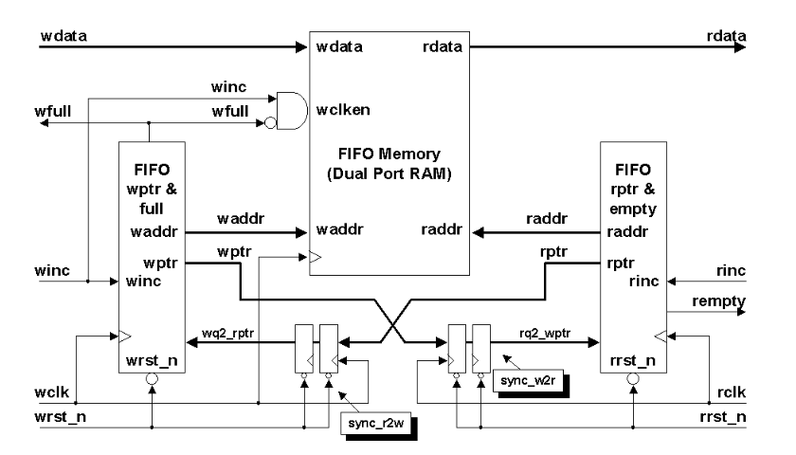
Block diagram
3. Block diagram

Slide 6
Specifications:
Read Clock Frequency | 1/20ns = 50MHz
Write clock Frequency | 1/10ns = 100MHz
Burst length | 128 data
FIFO Depth Required | 64

Slide 7
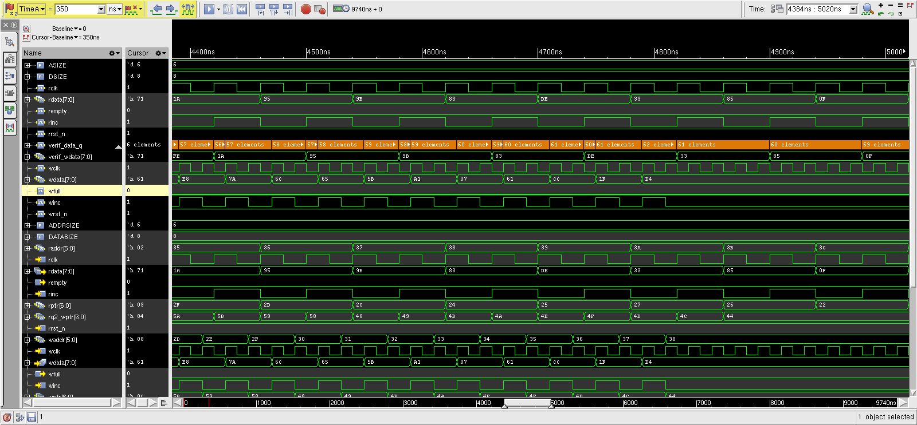
4. Simulation Waveform

Slide 8
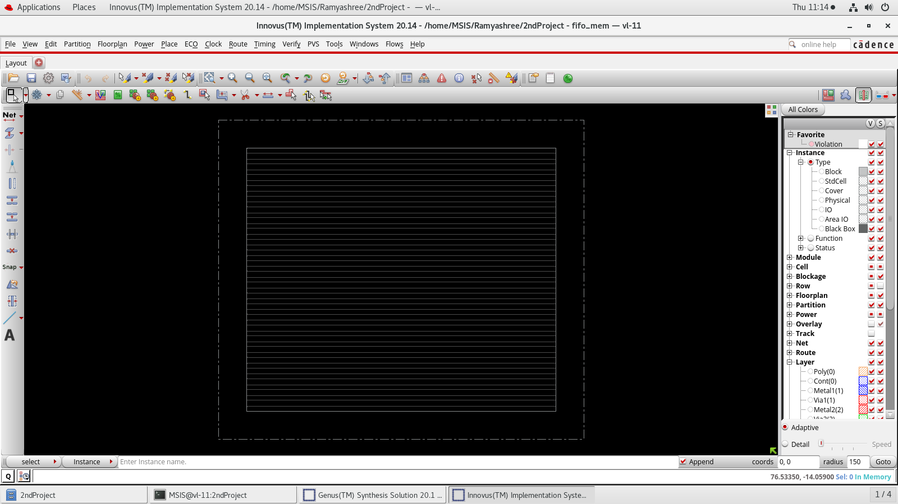
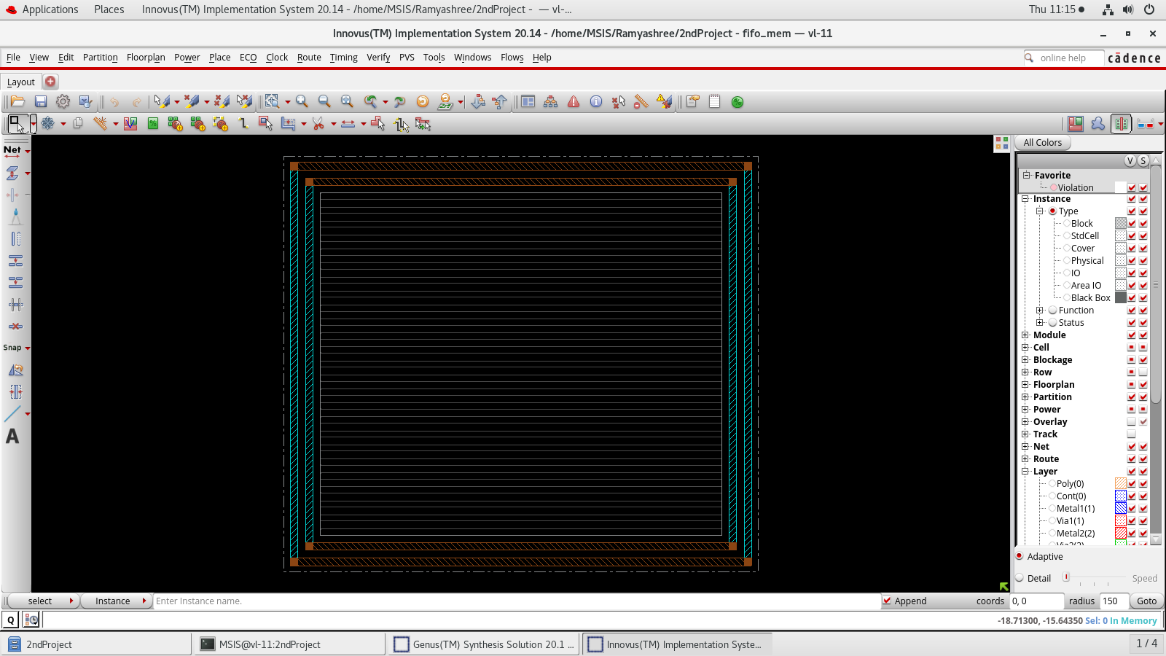
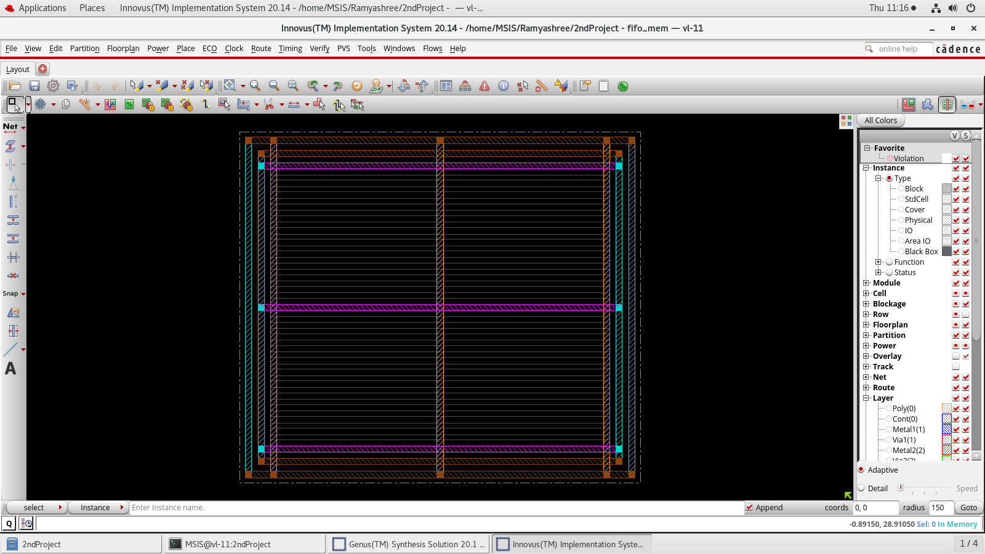
5. Physical Design
Creating Power and
Ground rings
Creating Power and Ground stripes
Floor planning

Slide 9
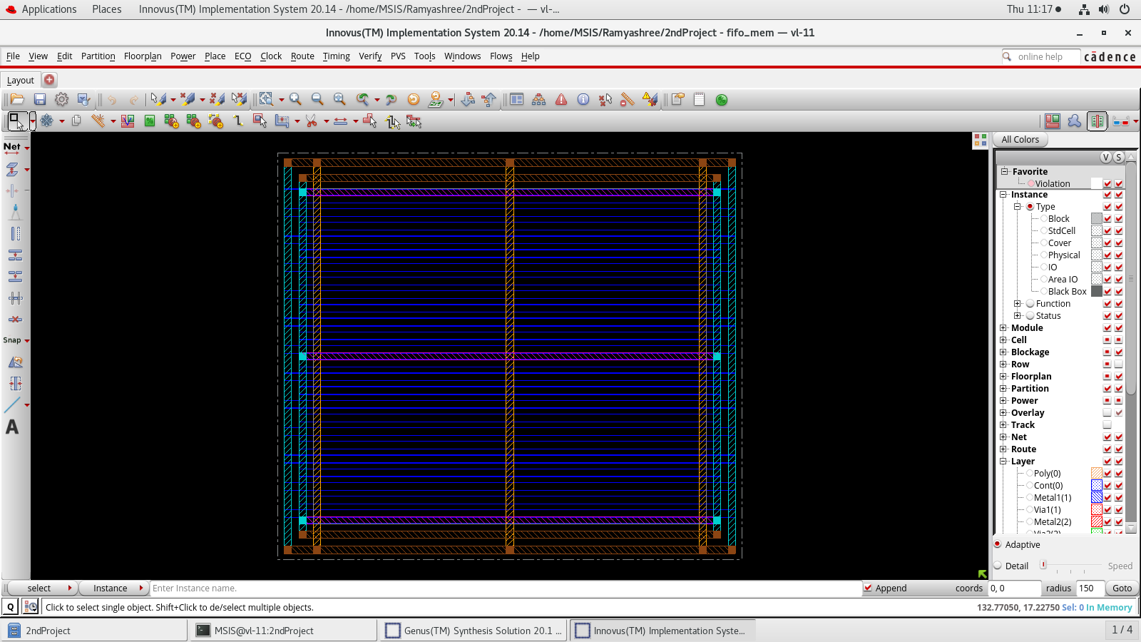
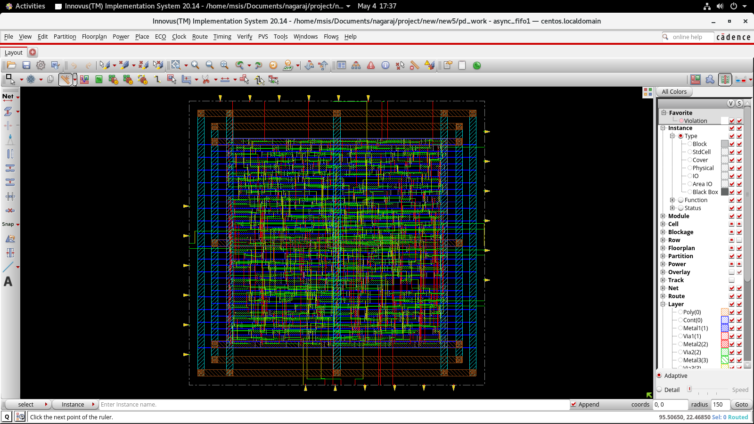
Route
Standard cell placement

Slide 10
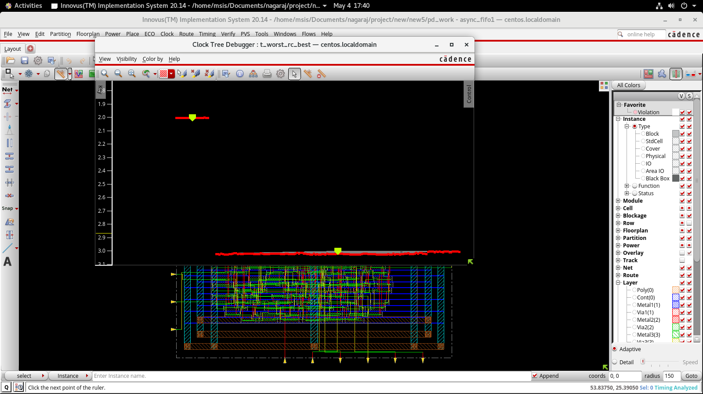
Clock Tree Debugger

Slide 11
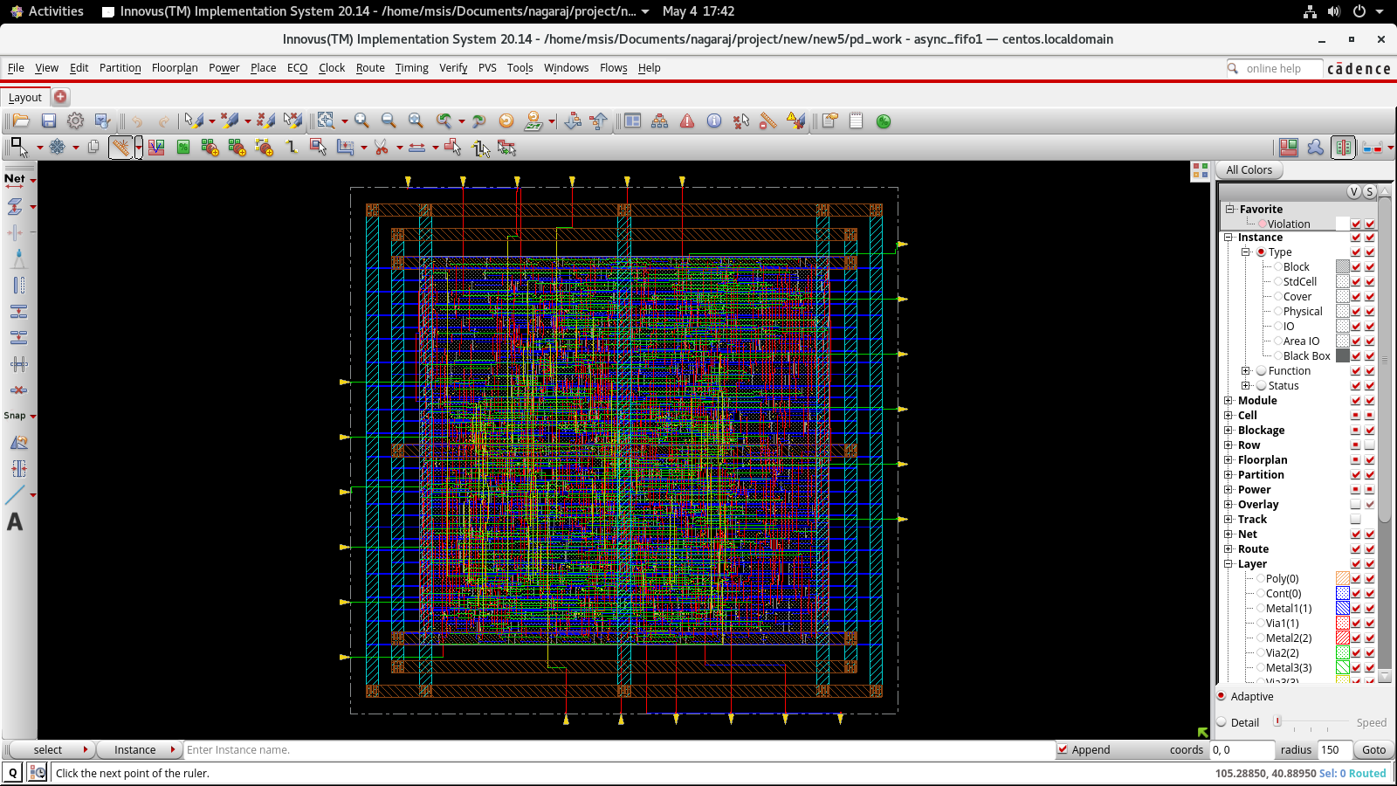
Routing

Slide 12
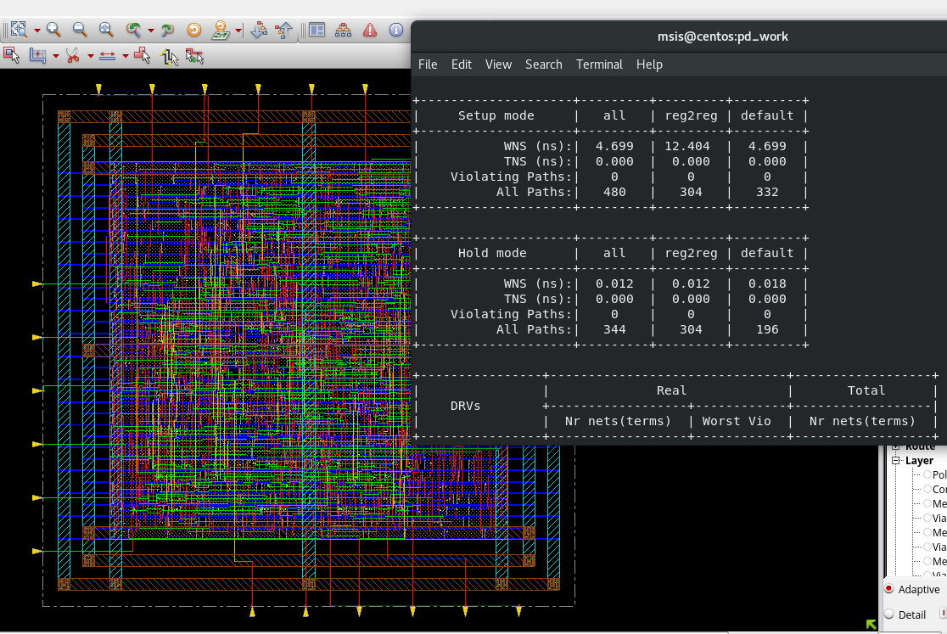
Final design After Optimization

Slide 13
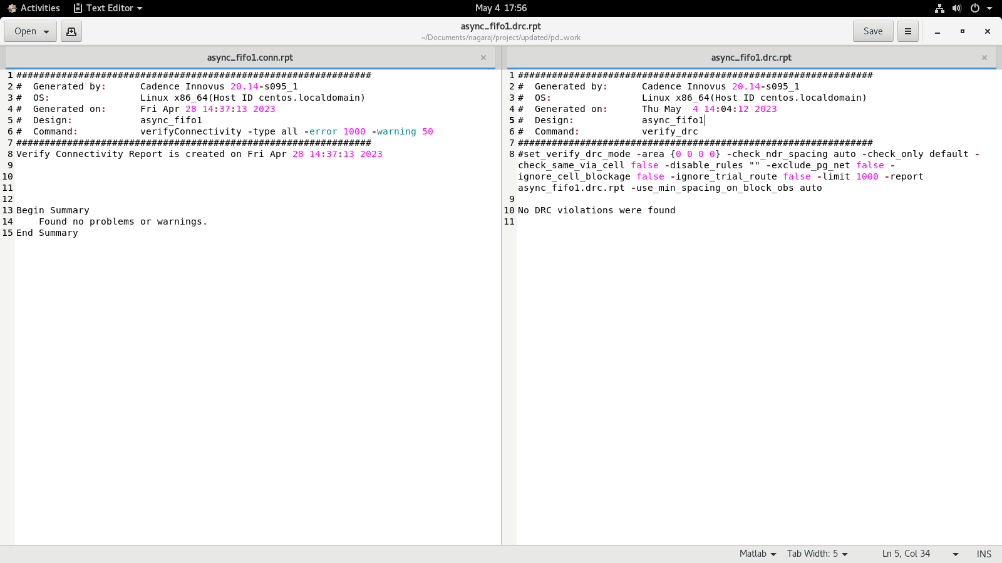
DRC and Connectivity report

Slide 14
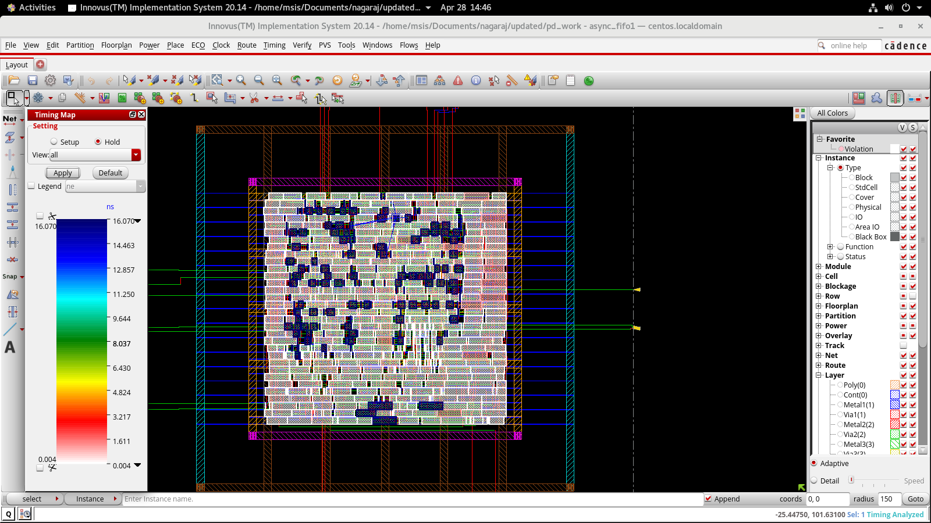
Timing Map for Hold

Slide 15
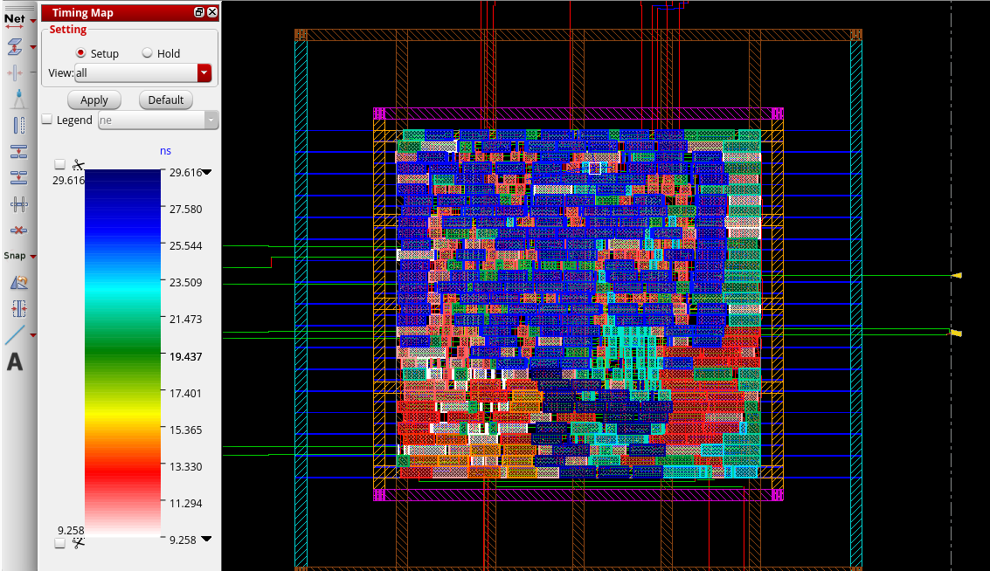
Timing Map for Setup

Slide 16
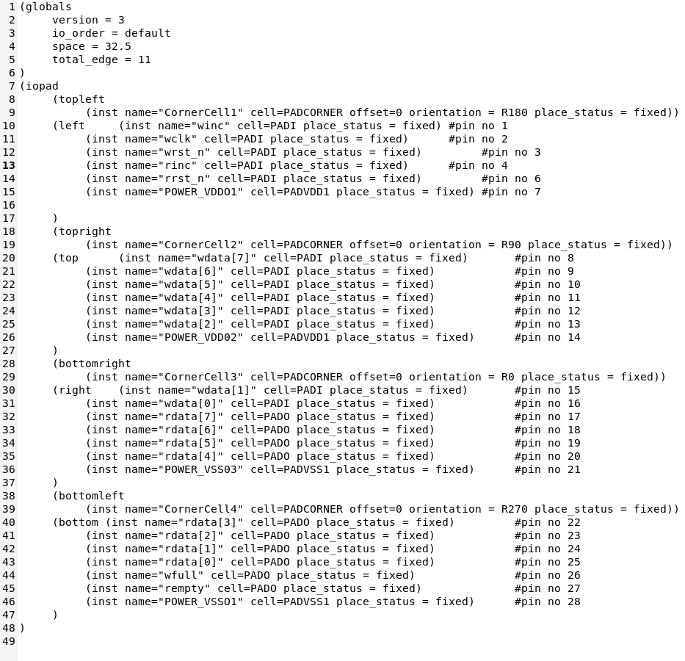
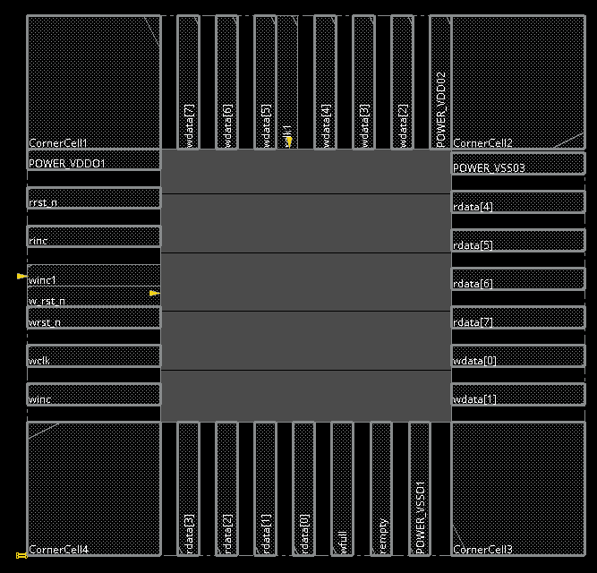
IO file for IO pad placement

Slide 17
6. Conclusion
The design and verification of Asynchronous FIFO is carried out successfully.
Logic equivalence check is done .
Physical design for the Asynchronous FIFO is done.

Slide 18
References
Simulation and Synthesis Techniques for Asynchronous FIFO Design . Clifford E. Cummings, Sunburst Design, Inc. cliffc@sunburst-design.com
Constraining designs for synthesis and timing analysis by Sridhar Gangadharan and Sanjay Churiwala.
Physical design Essentials by khosrow Golshan.

Slide 19
Queries
&
Suggestions

Slide 20
THANK YOU…

