Slide 1
3D Printing Introduction
Toyota Production Systems Lab
Grade 6-8

Slide 2
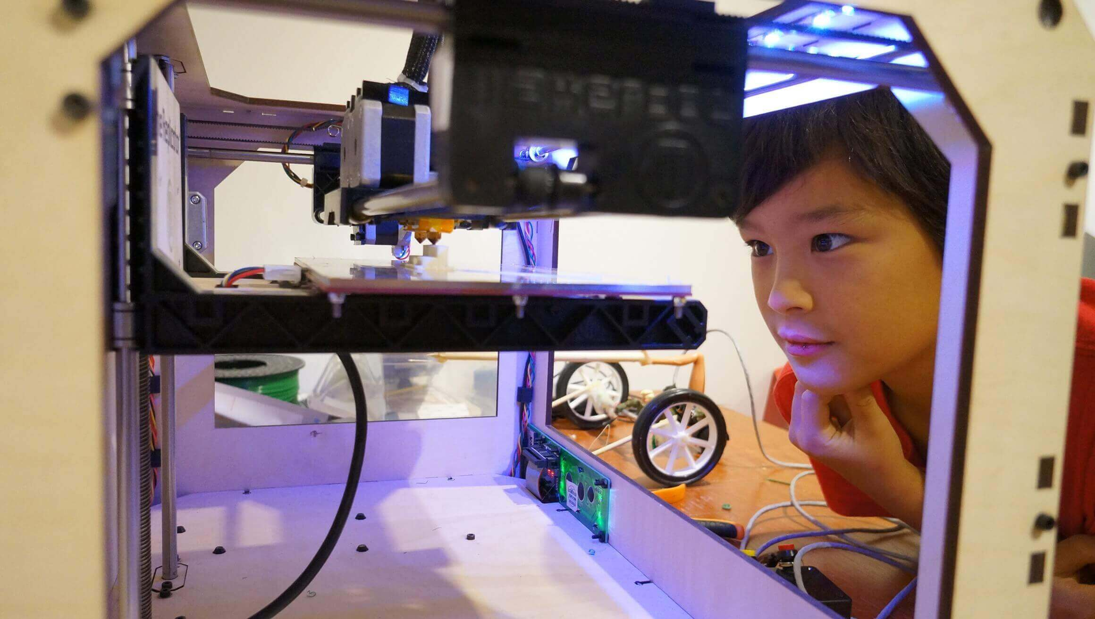
3D Printing
3D Printing is about utilizing a printer that builds a part or an object from the ground up, one layer at a time.
It adds one layer on top of another, making it an additive process!
Think layers of a cake!

Slide 3
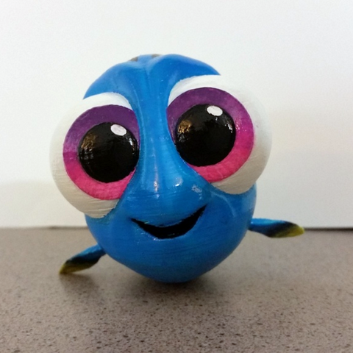
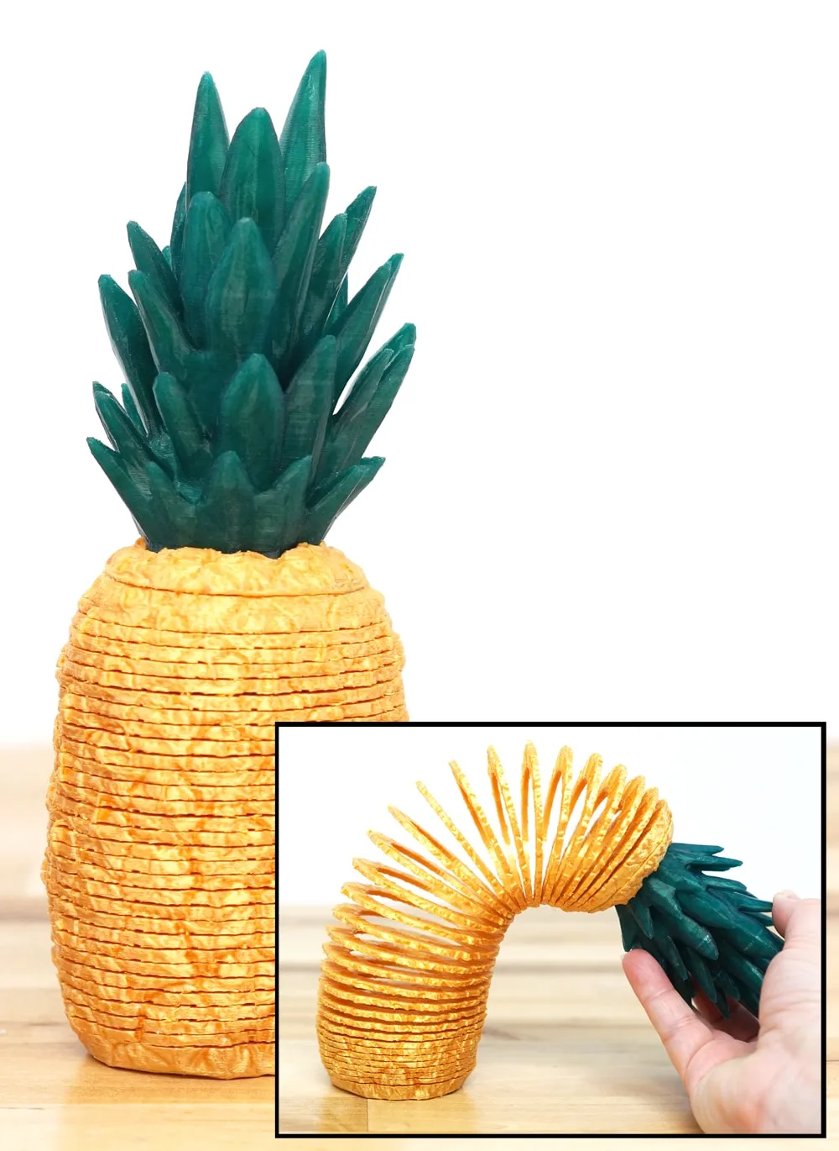
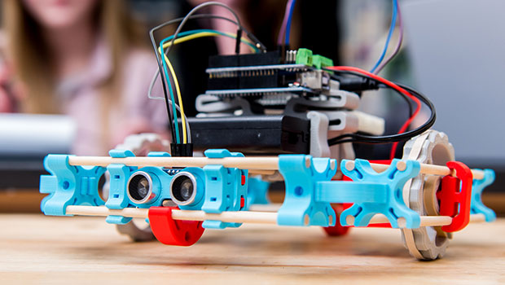
3D Printing Continued…
Using computer software, it can print ideas in 3 Dimensions!
Can make very detailed designs… it brings ideas to life!
Here are some fun examples of the many things you can build!
Your own Finding Dory figurine
Robot
Pineapple Slinky

Slide 4
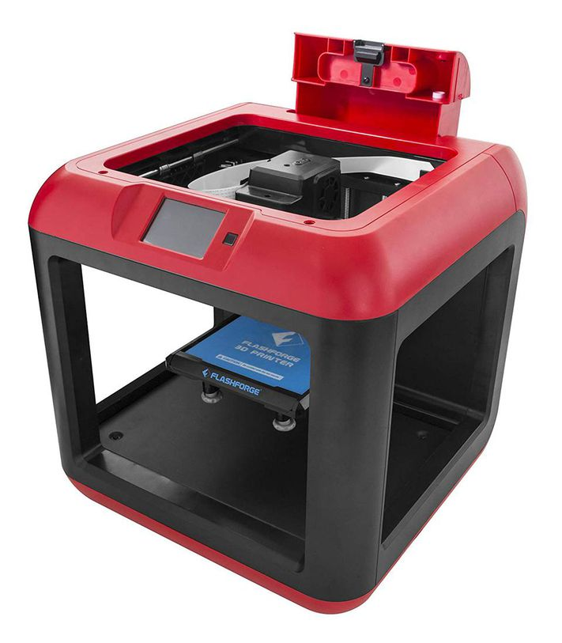
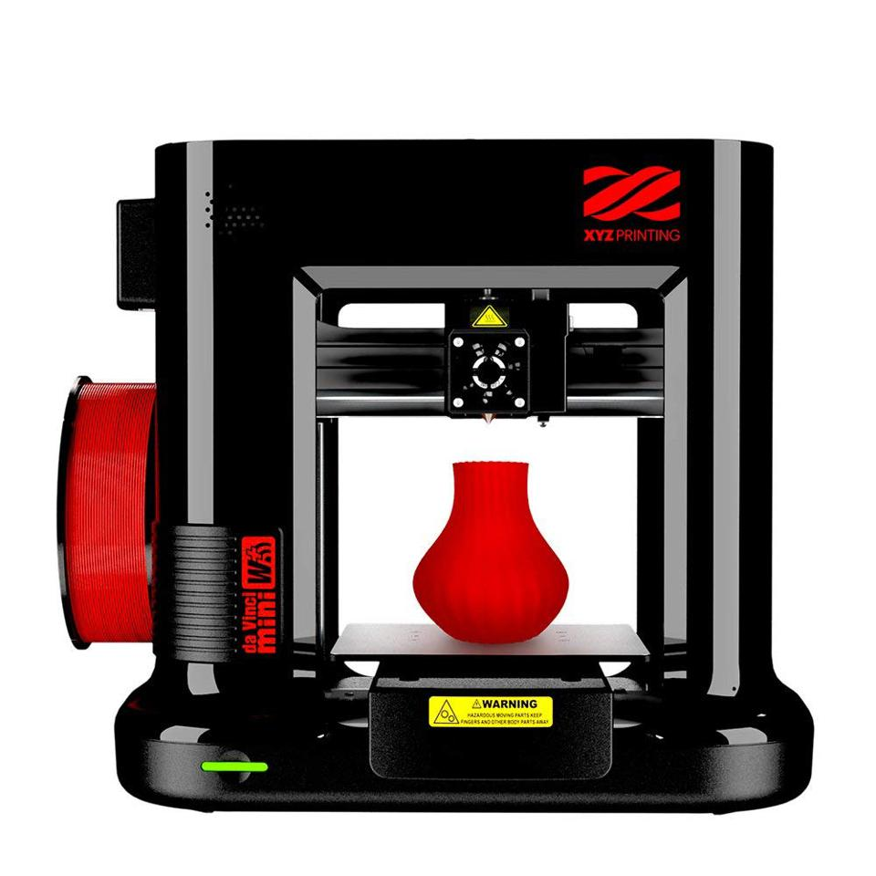
3D Printer
To understand 3D Printing and how it works, first we need to learn about the 3D Printer!
3D Printers come in all different shapes and sizes.
Each 3D Printer has the same parts that make it work properly.
The next slides will teach us the important parts of a 3D printer!

Slide 5
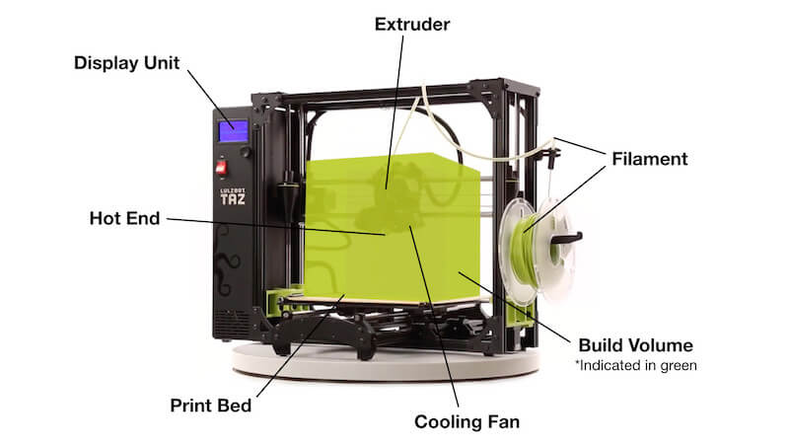
Parts of a 3D Printer!
Display Unit - shows the functions such as time to print and fill rate.
Extruder – heats up the material so it is soft and sticky and pushes it out a nozzle to create the part.
Filament – is the material that is used to create the part. Usually, the part is made from different kinds of plastic, either PLA, Carbon Fiber or Nylon

Slide 6
Parts of a 3D Printer!
Hot End - Tip of the extruder where hot material comes out.
Print Bed – base in which the part is built upon.
Build Volume– the three-dimensional space in which the part can be created.
Cooling Fan – Fan near the extruder that cools the material as it comes out of the hot end.

Slide 7
Video – How 3D Printers Work!
Video: How 3D Printers Work with Kamri Noel
This video from National Geographic Kids is a great introduction to 3D Printing and how 3D printers’ work.
Watch the video to understand the process!
Link to Video: How 3D Printers Work with Kamri Noel

Slide 8
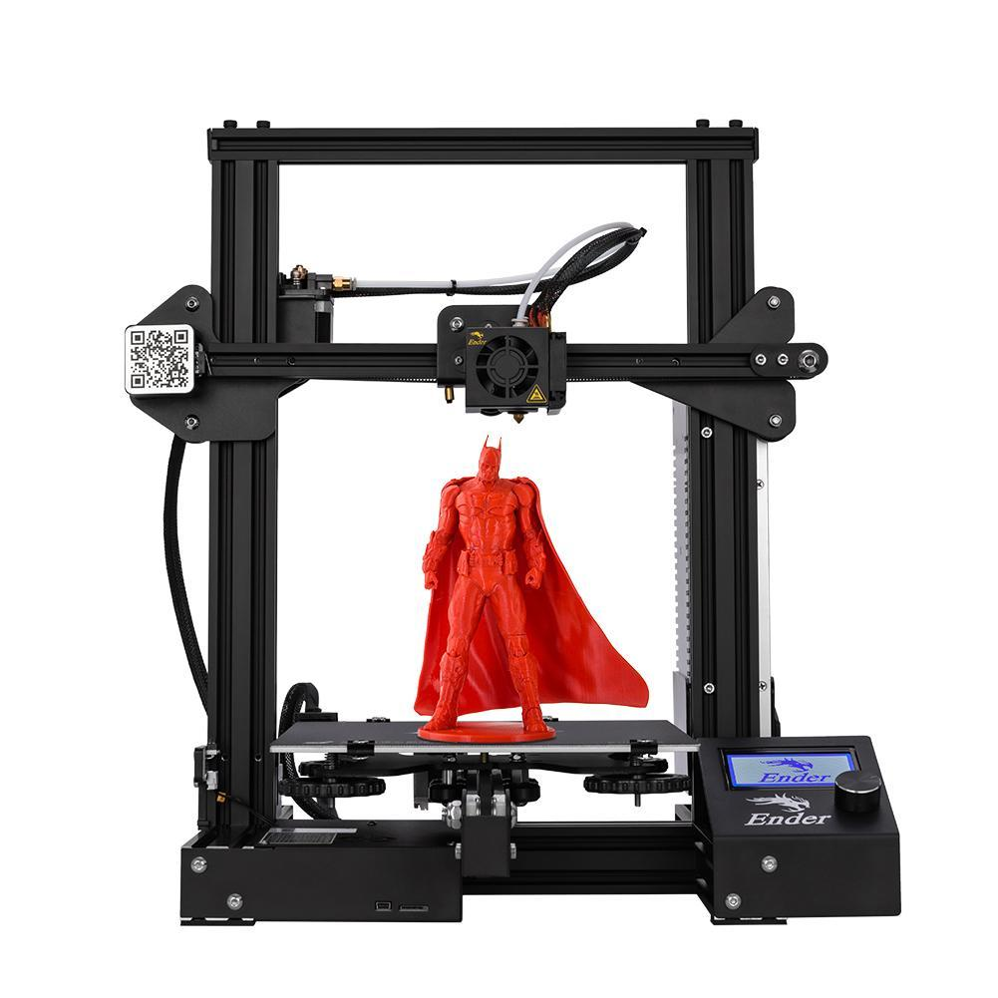
Activity
Labelling the Parts of a 3D Printer
Let us use what we learned to fill in the different parts of a 3D Printer, so we are familiar with how the printer works!
Label the parts of the 3D printer given the parts in the word bank.

Slide 9

What We Learned
You can take your designs and make anything with a 3D printer! Now that we know how a 3D printer works and the parts of the printer, we can see the applications and different types of printers there are!

