Slide 1
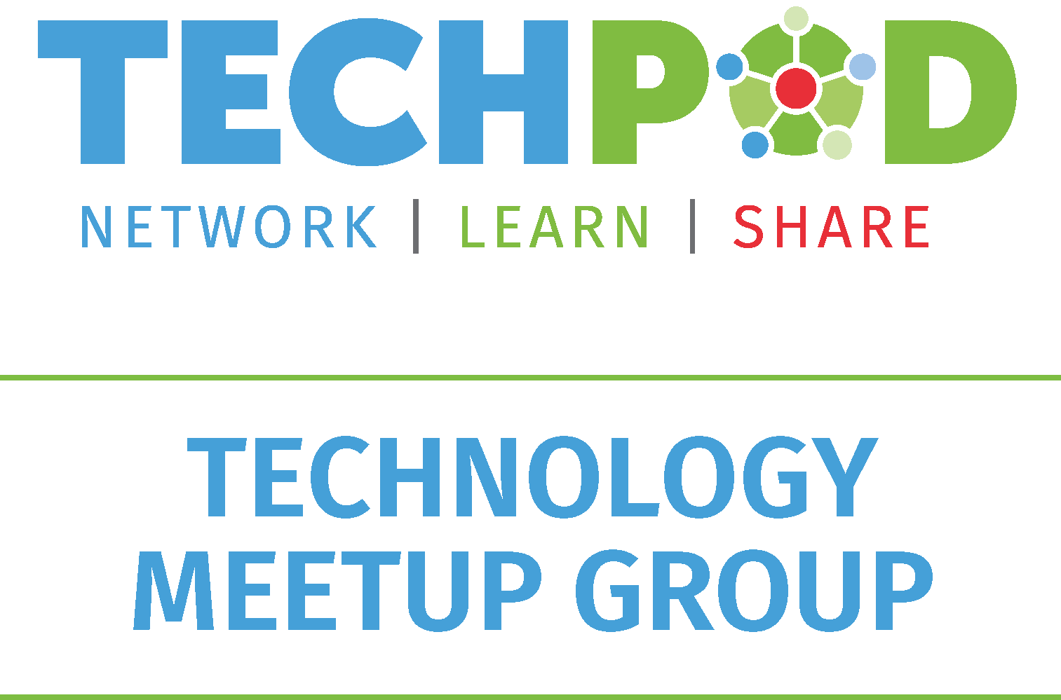
Apache Arrow : Columnar In-Memory Analytics

Slide 2
Who am I?
Nagaraj Sundaramahalingam
Product Software Engineer II @ Wolters Kluwer India
Experience in Data Warehousing, Data Analytics, Data Science
Active cyclist

Slide 3
Apache Arrow

Slide 4
Apache Arrow
Cross-language development platform for in-memory data.
Computational libraries and zero-copy streaming messaging and inter-process communication.
Standardized language-independent columnar memory format for flat and hierarchical data.
Languages currently supported - C, C++, C#, Go, Java, JavaScript, MATLAB, Python, R, Ruby.
Reference: https://arrow.apache.org/

Slide 5
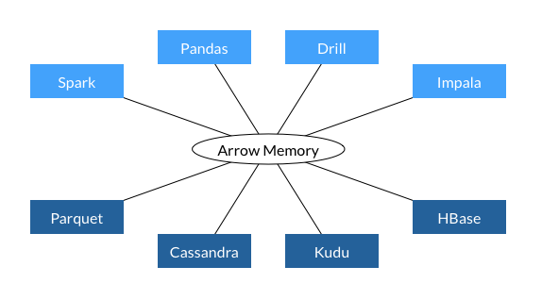
Apache Arrow
Feature Engineering
XGBOOST
GPU
Neural Networks
TensorFlow
Reference: https://arrow.apache.org/

Slide 6
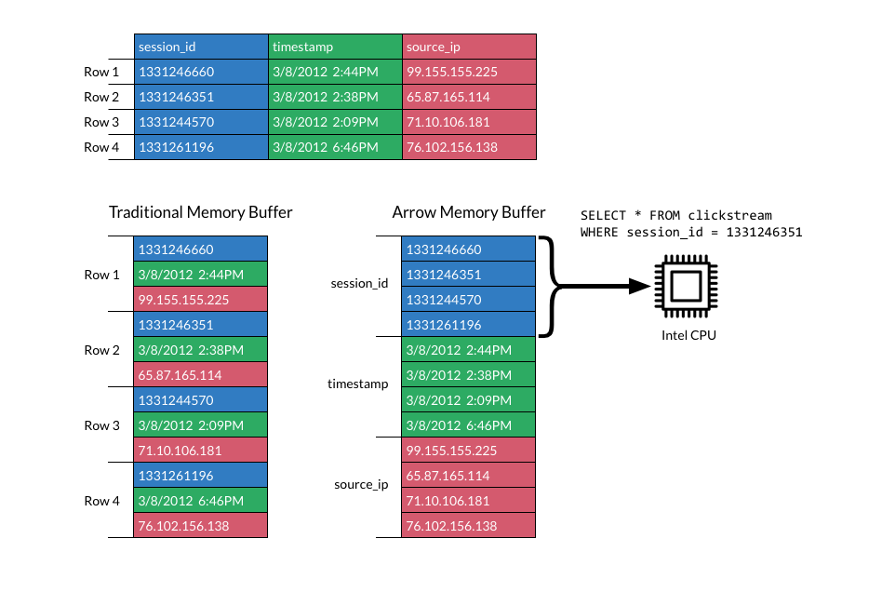
Apache Arrow
Feature Engineering
XGBOOST
GPU
Neural Networks
TensorFlow
Reference: https://arrow.apache.org/

Slide 7
Zero-Copy
Zero-copy operations reduce the number of time-consuming mode switches between user space and kernel space.
Ex.: Reading a file and then sending it over a network the traditional way requires two data copies and two context switches per read/write cycle. Sending the same file via zero copy reduces the context switches to two and eliminates all CPU data copies
Reference: https://en.wikipedia.org/wiki/Zero-copy

Slide 8
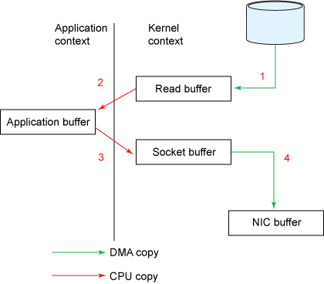
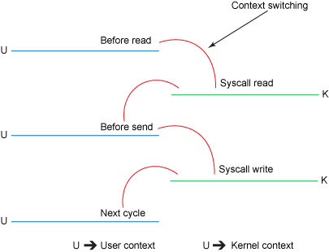
Traditional-Copy
Feature Engineering
XGBOOST
GPU
Neural Networks
TensorFlow
Reference: https://developer.ibm.com/technologies/java/articles/j-zerocopy/

Slide 9
Traditional-Copy
Reads file contents from the disk and stores them into a kernel address space buffer.
Context switch from kernel to user mode. Now the data is stored in the user address space buffer.
Context switch from user mode to kernel mode. Data is put into a different buffer, that is associated with the destination socket.
DMA engine passes the data from the kernel buffer to the protocol engine.
Reference: https://developer.ibm.com/technologies/java/articles/j-zerocopy/

Slide 10
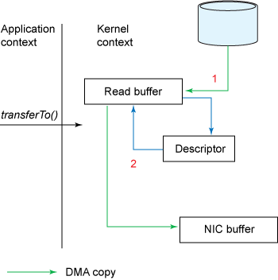
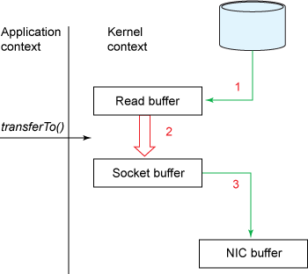
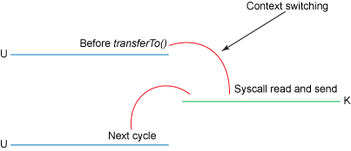
Zero-Copy
Feature Engineering
XGBOOST
GPU
Neural Networks
TensorFlow
Reference: https://developer.ibm.com/technologies/java/articles/j-zerocopy/

Slide 11
Zero-Copy
File contents copied into a kernel buffer by the DMA engine.
No data is copied into the socket buffer. Instead, only descriptors with information about the location and length of the data are appended to the socket buffer. The DMA engine passes data directly from the kernel buffer to the protocol engine, thus eliminating the remaining final CPU copy.
Reference: https://developer.ibm.com/technologies/java/articles/j-zerocopy/

Slide 12
Apache Arrow
Arrow improves performance for data consumers and data engineers.
Less time spent gathering and processing data.
More time spent analyzing it and coming to useful conclusions.

Slide 13
More on Apache Arrow

Slide 14
Apache Arrow
Few projects of Apache Arrow
Turbodbc: Python module to access relational databases via (ODBC) returns Arrow Tables and Record-Batches.
Petastorm: Single machine or distributed training and evaluation of deep learning models directly from datasets in Apache Parquet format. Supports Tensorflow, Pytorch, and PySpark.
Apache Parquet: A columnar storage format available to any project in the Hadoop ecosystem.
And much more…
Reference: https://arrow.apache.org/powered_by/

Slide 15
Demo (CSV, MS-SQL Server)

Slide 16
Even more exciting…

Slide 17
Arrow Flight, Vaex
Plasma In Memory Object Store:
https://arrow.apache.org/blog/2017/08/08/plasma-in-memory-object-store/
Arrow Flight:
https://arrow.apache.org/blog/2019/10/13/introducing-arrow-flight/
https://www.dremio.com/is-time-to-replace-odbc-jdbc/
https://github.com/apache/arrow/tree/apache-arrow-0.15.0/python/examples/flight
Vaex:
https://towardsdatascience.com/ml-impossible-train-a-1-billion-sample-model-in-20-minutes-with-vaex-and-scikit-learn-on-your-9e2968e6f385
https://vaex.readthedocs.io/en/latest/

Slide 18
Any Questions ….
Notebook links:
https://github.com/nagaraj-datascientist/turbodbc_basics
https://github.com/nagaraj-datascientist/apache_arrow_basics

