Slide 1
Android
Prepared by : Nagarajan VS

Slide 2
Agenda
Introduction
History
Advantages
Architecture
Categories of Android Applications
Linux Kernel
Libraries
Runtime
Application Framework
Core of Android Application(Resources)
Activity and its Life Cycle
Intent
SQL Lite Database

Slide 3
Introduction
Android is an open source and Linux-based operating system for mobile devices such as smartphones and tablet computers.
Android was developed by the Open Handset Alliance, led by Google, and other companies.
Android programming is based on Java programming language so if you have basic understanding on Java programming then it will be a fun to learn Android application development.

Slide 4
History
The first beta version of the Android Software Development Kit (SDK) was released by Google in 2007 where as the first commercial version, Android 1.0, was released in September 2008.
On June 27, 2012, at the Google I/O conference, Google announced the next Android version, 4.1 Jelly Bean. Jelly Bean is an incremental update, with the primary aim of improving the user interface, both in terms of functionality and performance.
The source code for Android is available under free and open source software licenses. Google publishes most of the code under the Apache License version 2.0 and the rest, Linux kernel changes, under the GNU General Public License version 2.
Current Latest Version of Android is Android 7.0 (Nougat)

Slide 5
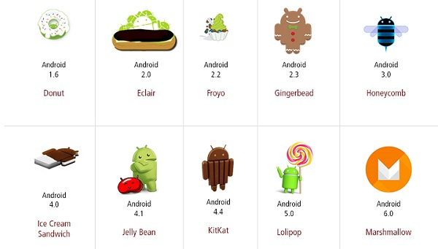

Slide 6
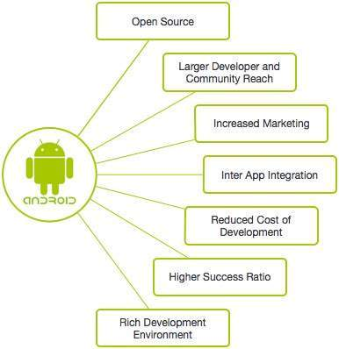
Advantages
Android applications are usually developed in the Java language using the Android Software Development Kit.
Once developed, Android applications can be packaged easily and sold out either through a store such as Google Play, SlideME, Opera Mobile Store, Mobango, F-droid and the Amazon Appstore.
Android powers hundreds of millions of mobile devices in more than 190 countries around the world. It's the largest installed base of any mobile platform and growing fast. Every day more than 1 million new Android devices are activated worldwide.

Slide 7
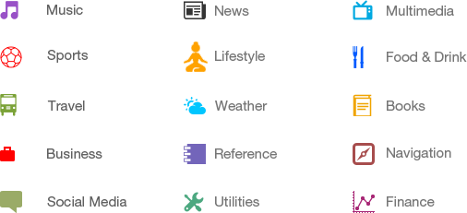
Categories of Android Applications

Slide 8
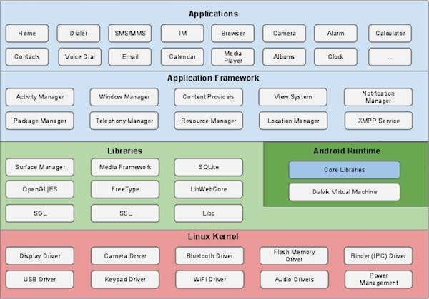
Architecture

Slide 9
Linux kernel
At the bottom of the layers is Linux - Linux 3.6 with approximately 115 patches. This provides a level of abstraction between the device hardware and it contains all the essential hardware drivers like camera, keypad, display etc. Also, the kernel handles all the things that Linux is really good at such as networking and a vast array of device drivers, which take the pain out of interfacing to peripheral hardware.

Slide 10
Libraries
On top of Linux kernel there is a set of libraries including open-source Web browser engine WebKit, well known library libc, SQLite database which is a useful repository for storage and sharing of application data, libraries to play and record audio and video, SSL libraries responsible for Internet security etc.
Android Libraries - This category encompasses those Java-based libraries that are specific to Android development. Examples of libraries in this category include the application framework libraries in addition to those that facilitate user interface building, graphics drawing and database access. A summary of some key core Android libraries available to the Android developer is as follows −

Slide 11
Android Libraries
android.app − Provides access to the application model and is the cornerstone of all Android applications.
android.content − Facilitates content access, publishing and messaging between applications and application components.
android.database − Used to access data published by content providers and includes SQLite database management classes.
android.opengl − A Java interface to the OpenGL ES 3D graphics rendering API.
android.os − Provides applications with access to standard operating system services including messages, system services and inter-process communication.
android.text − Used to render and manipulate text on a device display.
android.view − The fundamental building blocks of application user interfaces.
android.widget − A rich collection of pre-built user interface components such as buttons, labels, list views, layout managers, radio buttons etc.
android.webkit − A set of classes intended to allow web-browsing capabilities to be built into applications.
Having covered the Java-based core libraries in the Android runtime, it is now time to turn our attention to the C/C++ based libraries contained in this layer of the Android software stack.

Slide 12
Android Runtime
This is the third section of the architecture and available on the second layer from the bottom. This section provides a key component called Dalvik Virtual Machine which is a kind of Java Virtual Machine specially designed and optimized for Android.
The Dalvik VM makes use of Linux core features like memory management and multi-threading, which is intrinsic in the Java language. The Dalvik VM enables every Android application to run in its own process, with its own instance of the Dalvik virtual machine.
The Android runtime also provides a set of core libraries which enable Android application developers to write Android applications using standard Java programming language.

Slide 13
Application Framework
The Application Framework layer provides many higher-level services to applications in the form of Java classes. Application developers are allowed to make use of these services in their applications.
The Android framework includes the following key services −
Activity Manager − Controls all aspects of the application lifecycle and activity stack.
Content Providers − Allows applications to publish and share data with other applications.
Resource Manager − Provides access to non-code embedded resources such as strings, color settings and user interface layouts.
Notifications Manager − Allows applications to display alerts and notifications to the user.
View System − An extensible set of views used to create application user interfaces.

Slide 14
Developing Android Application
Download Android Studio IDE from the below path,
https://developer.android.com/studio/index.html
Once downloaded follow the wizard to setup the IDE (Internet Connection is must)
Install Java jdk Latest version(Necessary)

Slide 15
Core of the Application(Resources)
Resources : res/
anim/ - XML files that define property animations. They are saved in res/anim/ folder and accessed from the R.anim class.
color/ - XML files that define a state list of colors. They are saved in res/color/ and accessed from the R.color class.
drawable/ - Image files like .png, .jpg, .gif or XML files that are compiled into bitmaps, state lists, shapes, animation drawable. They are saved in res/drawable/ and accessed from the R.drawable class.
layout/ - XML files that define a user interface layout. They are saved in res/layout/ and accessed from the R.layout class.
menu/ - XML files that define application menus, such as an Options Menu, Context Menu, or Sub Menu. They are saved in res/menu/ and accessed from the R.menu class.
raw/ - Arbitrary files to save in their raw form. You need to call Resources.openRawResource() with the resource ID, which is R.raw.filename to open such raw files.
values/
XML files that contain simple values, such as strings, integers, and colors. For example, here are some filename conventions for resources you can create in this directory −
arrays.xml for resource arrays, and accessed from the R.array class.

Slide 16
integers.xml for resource integers, and accessed from the R.integer class.
bools.xml for resource boolean, and accessed from the R.bool class.
colors.xml for color values, and accessed from the R.color class.
dimens.xml for dimension values, and accessed from the R.dimen class.
strings.xml for string values, and accessed from the R.string class.
styles.xml for styles, and accessed from the R.style class.
xml/ - Arbitrary XML files that can be read at runtime by calling Resources.getXML(). You can save various configuration files here which will be used at run time.

Slide 17
Accessing Resources in Code
When your Android application is compiled, a R class gets generated, which contains resource IDs for all the resources available in your res/ directory. You can use R class to access that resource using sub-directory and resource name or directly resource ID.
Example
To access res/drawable/myimage.png and set an ImageView you will use following code −
ImageView imageView = (ImageView) findViewById(R.id.myimageview);
imageView.setImageResource(R.drawable.myimage);
<?xml version="1.0" encoding="utf-8"?>
<resources>
<string name="hello">Hello, World!</string>
</resources>
Now you can set the text on a TextView object with ID msg using a resource ID as follows −
TextView msgTextView = (TextView) findViewById(R.id.msg);
msgTextView.setText(R.string.hello);

Slide 18
Layout
Consider a layout res/layout/activity_main.xml with the following definition −
<?xml version="1.0" encoding="utf-8"?>
<LinearLayout xmlns:android="http://schemas.android.com/apk/res/android"
android:layout_width="fill_parent"
android:layout_height="fill_parent"
android:orientation="vertical" >
<TextView android:id="@+id/text"
android:layout_width="wrap_content"
android:layout_height="wrap_content"
android:text="Hello, I am a TextView" />
<Button android:id="@+id/button"
android:layout_width="wrap_content"
android:layout_height="wrap_content"
android:text="Hello, I am a Button" />
</LinearLayout>
This application code will load this layout for an Activity, in the onCreate() method as follows −
public void onCreate(Bundle savedInstanceState) {
super.onCreate(savedInstanceState);
setContentView(R.layout.main_activity);
}

Slide 19
Activity
An activity represents a single screen with a user interface just like window or frame of Java.Android activity is the subclass of ContextThemeWrapper class.
If you have worked with C, C++ or Java programming language then you must have seen that your program starts from main() function. Very similar way, Android system initiates its program with in an Activity starting with a call on onCreate() callback method. There is a sequence of callback methods that start up an activity and a sequence of callback methods that tear down an activity as shown in the below Activity life cycle diagram

Slide 20
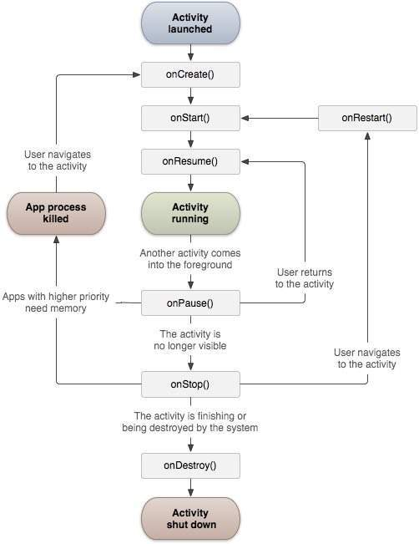
Activity Life Cycle

Slide 21
Intent
The intent itself, an Intent object, is a passive data structure holding an abstract description of an operation to be performed.
An Android Intent is an abstract description of an operation to be performed. It can be used with startActivity to launch an Activity, broadcastIntent to send it to any interested BroadcastReceiver components, and startService(Intent) or bindService(Intent, ServiceConnection, int) to communicate with a background Service.

Slide 22
SQL Lite Database
SQLite is a opensource SQL database that stores data to a text file on a device. Android comes in with built in SQLite database implementation.
SQLite supports all the relational database features. In order to access this database, you don't need to establish any kind of connections for it like JDBC,ODBC e.t.c
Database - Package
The main package is android.database.sqlite that contains the classes to manage your own databases
Database - Creation
In order to create a database you just need to call this method openOrCreateDatabase with your database name and mode as a parameter. It returns an instance of SQLite database which you have to receive in your own object.Its syntax is given below
SQLiteDatabase mydatabase = openOrCreateDatabase("your database name",MODE_PRIVATE,null);
Apart from this , there are other functions available in the database package , that does this job. They are listed below
openDatabase(String path, SQLiteDatabase.CursorFactory factory, int flags, DatabaseErrorHandler errorHandler)
The common flags mode could be OPEN_READWRITE OPEN_READONLY
openDatabase(String path, SQLiteDatabase.CursorFactory factory, int flags)
openOrCreateDatabase(String path, SQLiteDatabase.CursorFactory factory)
openOrCreateDatabase(File file, SQLiteDatabase.CursorFactory factory)

Slide 23
Database Insertion
we can create table or insert data into table using execSQL method defined in SQLiteDatabase class. Its syntax is given below
mydatabase.execSQL("CREATE TABLE IF NOT EXISTS Test(Username VARCHAR,Password VARCHAR);");
mydatabase.execSQL("INSERT INTO TestTable VALUES('admin','admin');");

Slide 24
Database - Fetching
We can retrieve anything from database using an object of the Cursor class. We will call a method of this class called rawQuery and it will return a resultset with the cursor pointing to the table. We can move the cursor forward and retrieve the data.
Cursor resultSet = mydatbase.rawQuery("Select * from TestTable",null);
resultSet.moveToFirst();
String username = resultSet.getString(1);
String password = resultSet.getString(2);

Slide 25
Database - Helper class
For managing all the operations related to the database , an helper class has been given and is called SQLiteOpenHelper. It automatically manages the creation and update of the database. Its syntax is given below
public class DBHelper extends SQLiteOpenHelper {
public DBHelper(){
super(context,DATABASE_NAME,null,1);
}
public void onCreate(SQLiteDatabase db) {}
public void onUpgrade(SQLiteDatabase database, int oldVersion, int newVersion) {}
}

Slide 26
Any Questions ?
Thankyou,
Nagarajan.V.S

