Slide 1

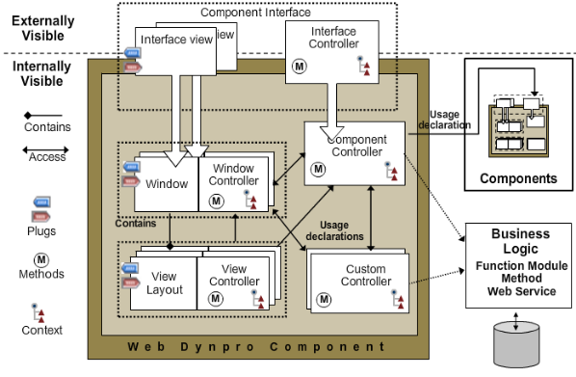
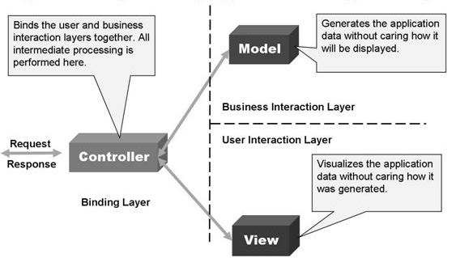
Object Oriented Programming
&
SAP Webdynpro ABAP

Slide 2
Different types of Applications developed using ABAP
&
Programming methodologies used
Procedure Oriented Approach
Includes
Forms
RFCs
Function Groups
Webdynpro ABAP
User Exits & Customer Exits
Reports
BAdis
Object Oriented Approach
Conversions
Module Pool
Class
Object
Interface

Slide 3
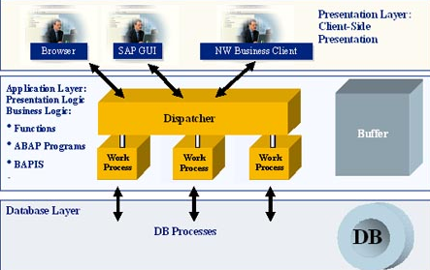
ABAP Objects
SAP Webdynpro
Overview
Basics
Cross Component Programming
Dynamic Programming
Webdynpro for ABAP is the UI technology to develop web application on ABAP environment using MVC paradigm. So we will be able to access applications from different platforms such as Browsers, mobile and hand held devices without using SAP GUI .
MVC paradigm offers following
Clear separation of business logic and display logic
Uniform meta model for all types of user interfaces
Execution on a number of client platforms
Extensive platform independence of interfaces
Simply say, we can develop web enabled SAP applications to run from Web Browser

Slide 4
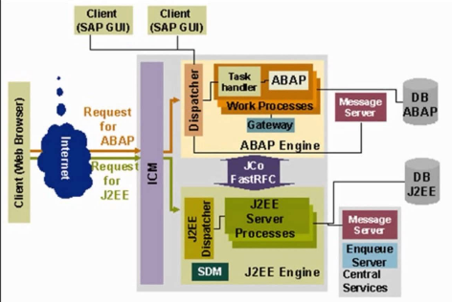
ABAP Objects
SAP Webdynpro
Overview
Basics
Cross Component Programming
Dynamic Programming
ICM: Internet Communication Manager will act as interface between SAP & Internet. We are also having Webdynpro for Java. Now focus only on Webdynpro for ABAP (WD4A)

Slide 5
ABAP Objects
SAP Webdynpro
Overview
Basics
Cross Component Programming
Dynamic Programming
Development Environment:
Webdynpro is framework based programming where we will focus on UI design and business logic . Rest of activities such as communicating with Browser etc will be taken care by the Framework environment
1. Graphical tools provided
To design Layout of User Interface UI
To pass to and from UI elements such as Input fields, check box, tables etc.
To write the business logic
2. Clear separation between Business logic and display logic
3. By default every Webdynpro application is structured according to the Model View controller programming model
Model: An interface to access the backend data
View : It represent the data on to the UI
Controller: simply connects the View and Model

Slide 6
ABAP Objects
SAP Webdynpro
Overview
Basics
Cross Component Programming
Dynamic Programming
Things to know before starting Webdynpro Apps
Transactions Used:
SE80 – Object Browser
SE24 – Class
SICF – Internet Services activation
Parts
Webdynpro Component
Window
View
Controllers (Component, Custom, Window & View Controller)
Layout
Context
Attributes
Webdynpro Application

Slide 7
ABAP Objects
SAP Webdynpro
Overview
Basics
Cross Component Programming
Dynamic Programming
Component:
It is a central, reusable unit of the application project
View:
it is a smallest unit of Webdynpro application visible for the user. All the required UI elements(Input fields, Check box, Tables etc) are arranged in view. It is similar to Screen design in Module pool programming
Context:
Context is used to pass data to and from UI elements. Data will be arranged in hierarchical structure called context Nodes and Attributes
Controller:
It is the actual location where we will write business logic. As it Webdynpro app uses OOPs concepts, need to implement logic in Methods. Controller contains some predefined method definitions called Hook Method and we can write our own methods

Slide 8
Example#1: First Example
In this chapter we will familiar with
How to create Webdynpro component
What is Webdynpro Component
What is Window
What is View
What is Interface View
What is Web Application
How to test the Web Application

Slide 9
Example#1: First Example
SAP Webdynpro
Webdynpro Component
Window
View
Layout
UI element Properties
Web Application

Slide 10
Example#2: UI Element & Context
With this chapter you will familiar with
What is Context
Context Node
Context Element
How to bind Context to UI element
How to Set & Get Data to & From Context
What are the interfaces and Methods used to do the above
Table Control UI Element
What are Hook Methods and What is the Role of Hook Methods

Slide 11
Example#2: UI Element & Context
SAP Webdynpro
Context
Binding Context to UI Element
Set & Get Data to Context
Hook Methods

Slide 12
Example#3: Navigation through Plugs & View Container UI Element
With this example you will familiar with
How to navigate from one View to Another View
Inbound & Outbound Plugs
Embedding Views on to the Window
Establish Navigation Links among Views
How to share data among multiple Views
Context Mapping
Component Controller Attributes
Outbound Plugs
Calling Fire method to initiate the Navigation
Displaying multiple view on same view using View Container UI Element

Slide 13
Example#3: Navigation through Plugs & View Container UI Element
SAP Webdynpro
Navigation
Inbound & Outbound Plugs
Embedding Views
Creating Navigation Links
Sharing Data among views
Calling Fire Method
View Container UI Element

Slide 14
Example#4: Component Usage
ALV Table, Select-Options & F4 Help
With this example you will familiar with
What is Component Usage
How to use other Components in our component
What is the Interface view
How can we access the resources of Used component
How to transfer data to Used component
ALV Table – Component SALV_WD_TABLE
Select Options WDR_SELECT_OPTIONS
F4 Help WDR_OVS

Slide 15
Example#4: Component Usage
ALV Table, Select-Options & F4 Help
SAP Webdynpro
Component Usage
Interface View
Resource of Used Component
ALV Table
Select Options
F4 Help

Slide 16
Example#5: Assistance Class
With this example you will familiar with
What is Purpose of Assistance Class
How to create Assistance Class
How to use Assistance Class

Slide 17
Example#5: Assistance Class
SAP Webdynpro
Assistance Class
How to use Assistance Class

Slide 18
Example#6: Message Handling, POP UP Dialogs, Layouts & OTR
With this example you will familiar with
How to handle Messages in Webdynpro
POP Window
Handling Events for Pop UP Windows
Online Text Repository
Different Types of Layouts
Flow Layout
Row Layout
Grid Layout
Matrix Layout

Slide 19
Example#6: Message Handling, POP UP Dialogs, Layouts & OTR
SAP Webdynpro
Message Handling
Pop Up Dialogs
Layouts

Slide 20
Example#7: Custom Component Reusability
With this example you will familiar with
How to use Other custom component in our Component
How to exchange data between the components
How to Call methods of used component
How to handle events of used Component

Slide 21
Example#7: Custom Component Reusability
SAP Webdynpro
Define Component
Reuse Component

Slide 22
Example#8: Dynamic Programming
With this example you will familiar with
Change Properties of UI elements Dynamically
Dynamic Context
Dynamic Component Reusability

Slide 23
Example#8: Dynamic Programming
SAP Webdynpro
Change Properties Dynamically
Dynamic Context
Dynamic Component Reusability

Slide 24
Example#9: Complex Controls: Tree & Tab Strip
With this example you will familiar with
Handling Tree UI Element
Handling Tab Strip UI Element

Slide 25
Example#9: Complex Controls: Tree & Tab Strip
SAP Webdynpro
Tree
Tab Strip

Slide 26
Example#10: Component Configuration
With this example you will familiar with
Component Configuration

