Slide 1
Objekt orientierte Programmierung
объектно-ориентированного программирования
面向对象编程
ऑब्जेक्ट ओरिएंटेड प्रोग्रामिंग
object georiënteerd programmeren
Object Oriented Programming
programación orientada a objetos
programmation orientée objet
ఆబ్జెక్ట్ ఓరియంటెడ్ ప్రోగ్రామింగ్
programação orientada a objeto
பொருள் சார்ந்த நிரலாக்க

Slide 2
ABAP Objects
SAP Object
Overview
Comparison
Example
Features of ABAP Objects
Class
Object
Methods
Static vs Instance
Events
Inheritance
Interfaces
There are different types of Applications developed with help of ABAP
Reports: Summarized or Statistical information
Module pool Programming: Data entry programs
Layout sets: Printing or sending the business documents
Conversion: Automation process
Enhancement & Modification: Changing or enhancing the standard
Connectivity: Connecting with applications in distributed environment or with Partner systems
Currently applications can be developed using procedure oriented approach where we are using some techniques called
Subroutines
Function Module
Includes
Macros
Above techniques provide features Reusability and Readability when developing complex programs.
Just have a small Look into it!!!!!

Slide 3
ABAP Objects
SAP Object
Overview
Comparison
Example
Features of ABAP Objects
Class
Object
Methods
Static vs Instance
Events
Inheritance
Interfaces
In the Modularization techniques, Most of the time functionality can be reused with help of Function Modules. You might have developed function modules.
What would be the result of Below Report ZRABCD????
Application Program: ZRABCD
.
.
.
Call Function ‘SET_VALUE’
Exporting i_ebeln = ‘101’
.
.
Call Function ‘SET_VALUE’
Exporting i_ebeln = ‘102’
Function Group: ZXYZ
Global Variable
g_ebelnTYPE ebeln.
Function Module
Function SET_VALUE.
Importing i_ebeln
Code:
g_ebeln = i_ebeln.
Endfunction
Only Purchase Order ‘102’ is available in the global variable G_EBELN.
Then what if program is still requires ‘101’??

Slide 4
ABAP Objects
SAP Object
Overview
Comparison
Example
Features of ABAP Objects
Class
Object
Methods
Static vs Instance
Events
Inheritance
Interfaces
You might be thinking about Internal table to fix the issue. Right??? Simply declare internal table in the function group and keep on add the Purchase Orders to it. This is not a problem at all. We can write some piece of additional code to overcome this situation.
So we will extend the example. Let us assume that there are some other data as well. For example
Purchase Header
Purchase Item
Purchase Schedule lines
We will take example data for the above and represent in different formats
one way is All the data combined together
Second way is logically group the data

Slide 5
ABAP Objects
SAP Object
Overview
Comparison
Example
Features of ABAP Objects
Class
Object
Methods
Static vs Instance
Events
Inheritance
Interfaces
Pur. Order | Pur. Doc. Type | Vendor
101 | Normal | ABC
102 | Normal | ABC
103 | Normal | ABC
Purchase Order Header Internal table
Pur. Order | Pur. Item | Material | Pur. Quantity | UoM | Net Price | Currency
101 | 1 | Bolt | 200 | PC | 10 | INR
101 | 2 | Light | 10 | PC | 100 | INR
101 | 3 | Wheel | 4 | PC | 500 | INR
102 | 1 | Tyre | 8 | PC | 150 | INR
102 | 2 | Wheel | 4 | PC | 500 | INR
103 | 1 | Light | 20 | PC | 100 | INR
103 | 2 | Wheel | 8 | PC | 500 | INR
103 | 3 | Tyre | 8 | PC | 150 | INR
Purchase Order Item Internal Table
Pur. Order | Pur. Item | Sch. Line | Del. Date | Quantity
101 | 1 | 1 | 10.01.2016 | 100
101 | 1 | 2 | 20.01.2016 | 100
101 | 2 | 1 | 10.01.2016 | 5
101 | 2 | 2 | 20.01.2016 | 5
101 | 3 | 1 | 10.01.2016 | 2
101 | 3 | 2 | 10.01.2016 | 2
102 | 1 | 1 | 05.01.2016 | 8
102 | 2 | 1 | 05.01.2016 | 4
103 | 1 | 1 | 01.01.2016 | 5
103 | 1 | 2 | 05.01.2016 | 5
103 | 1 | 3 | 10.01.2016 | 10
103 | 2 | 1 | 10.01.2016 | 8
103 | 3 | 1 | 10.01.2016 | 8
Purchase Schedule Lines Internal table
It seems the example is straight forward. Simply some set of internal tables.

Slide 6
ABAP Objects
SAP Object
Overview
Comparison
Example
Features of ABAP Objects
Class
Object
Methods
Static vs Instance
Events
Inheritance
Interfaces
We will try to represent same data in different format
Purchase Order Header
Pur. Order | 101
Pur. Doc. Type | Normal
Vendor | ABC
Pur. Order | Pur. Item | Material | Pur. Quantity | UoM | Net Price | Currency
101 | 1 | Bolt | 200 | PC | 10 | INR
101 | 2 | Light | 10 | PC | 100 | INR
101 | 3 | Wheel | 4 | PC | 500 | INR
Purchase Order Item
Pur. Order | Pur. Item | Sch. Line | Del. Date | Quantity
101 | 1 | 1 | 10.01.2016 | 100
101 | 1 | 2 | 20.01.2016 | 100
101 | 2 | 1 | 10.01.2016 | 5
101 | 2 | 2 | 20.01.2016 | 5
101 | 3 | 1 | 10.01.2016 | 2
101 | 3 | 2 | 10.01.2016 | 2
Purchase Order Schedule
Here also some set of internal tables and work area.
But Can you find something different ????????????????????????????????
Not Yet…..

Slide 7
ABAP Objects
SAP Object
Overview
Comparison
Example
Features of ABAP Objects
Class
Object
Methods
Static vs Instance
Events
Inheritance
Interfaces
Purchase Order#2
Pur. Order | 102
Pur. Doc. Type | Normal
Vendor | ABC
Pur. Order | Pur. Item | Material | Pur. Quantity | UoM | Net Price | Currency
102 | 1 | Tyre | 8 | PC | 150 | INR
102 | 2 | Wheel | 4 | PC | 500 | INR
Pur. Order | Pur. Item | Sch. Line | Del. Date | Quantity
102 | 1 | 1 | 05.01.2016 | 8
102 | 2 | 1 | 05.01.2016 | 4
Purchase Order#3
Pur. Order | 103
Pur. Doc. Type | Normal
Vendor | ABC
Pur. Order | Pur. Item | Material | Pur. Quantity | UoM | Net Price | Currency
103 | 1 | Light | 20 | PC | 100 | INR
103 | 2 | Wheel | 8 | PC | 500 | INR
103 | 3 | Tyre | 8 | PC | 150 | INR
Pur. Order | Pur. Item | Sch. Line | Del. Date | Quantity
103 | 1 | 1 | 01.01.2016 | 5
103 | 1 | 2 | 05.01.2016 | 5
103 | 1 | 3 | 10.01.2016 | 10
103 | 2 | 1 | 10.01.2016 | 8
103 | 3 | 1 | 10.01.2016 | 8

Slide 8
ABAP Objects
SAP Object
Overview
Comparison
Example
Features of ABAP Objects
Class
Object
Methods
Static vs Instance
Events
Inheritance
Interfaces
Now????
Any difference ????
In first approach, we have combined all the data based on technical prospective. But in the second approach still using technical prospective, But we have combined data based on some real time entity representation
First way is procedure oriented. Second way is Object Oriented. So in the Object oriented approach we will represent data the in more realistic. So we will mostly bind the data that is tightly related.
Till now we have seen is Data part. Now look into the features of the Object Oriented Programming in terms of Readability, Reusability & Extendibility
Features of Object Oriented Programming
Encapsulation
Abstraction
Inheritance
Polymorphism

Slide 9
ABAP Objects
Encapsulation:
Bind Data and functionality together
Abstraction:
Provide access to required data and functionality to the outside world
Inheritance:
Reduce the repetitive code by reusing existing coding using inheritance
Polymorphism:
When reusing the functionality using inheritance, without disturbing the existing logic in the method we can provide our custom implementation
SAP Object
Overview
Comparison
Example
Features of ABAP Objects
Class
Object
Methods
Static vs Instance
Events
Inheritance
Interfaces
3 Things in OOPs
Interface:
Template of Public components with out implementation. Used in framework based programming
Class: Data definitions and associated functionalities under visibility sections
Object: Using class functionalities from outside of the class

Slide 10
ABAP Objects
SAP Object
Overview
Comparison
Example
Features of ABAP Objects
Class
Object
Methods
Static vs Instance
Events
Inheritance
Interfaces
Relation Between
4 Concepts & 3 Main Components
Interface
Template of Functionalities *
Polymorphism
Class
Data and Functionalities
Under Visibility Section
Encapsulation
Abstraction
Inheritance & Abstraction
Object
Using functionalities
Sub Class
Data and Functionalities
Under Visibility Section and components of Super Class
Encapsulation

Slide 11
ABAP Objects
The main Component of Object Oriented Programming is
CLASS
Entire class will be divided into sections called visibility sections and each section contains components
Components of Class
Characteristics as Attributes
Functionalities as Methods
Notify status via Events
Apart from above we have following
Data Types
In SAP ABAP, Class is having two parts
Definition
Implementation
In the definition Part contains Class components and which are placed in appropriate Visibility section. Visibility sections controls, how can we will access those component s
Visibility sections
Private Section: Components accessed Within the Class
Public Section: Components accessed Within the Class, Inside the Subclass & Outside the
Protected Section: Components accessed Within the Class & Inside the Subclass
SAP Object
Overview
Comparison
Example
Features of ABAP Objects
Class
Object
Methods
Static vs Instance
Events
Inheritance
Interfaces

Slide 12
ABAP Objects
SAP Object
Overview
Comparison
Example
Features of ABAP Objects
Class
Object
Methods
Static vs Instance
Events
Inheritance
Interfaces
Class can be of two types based on its creation
Local Class
Global Class
Local class will be created with in the any ABAP Program in SE38. we can access this class components in side the same program
Global class will be declared in SE24 and Can access components in the across the SAP system
Syntax:
Definition Section
CLASS <Class_Name> DEFINITION.
PUBLIC SECTION.
“Data types, Attributes, Methods & Events
PROTECTED SECTION.
“Data types, Attributes, Methods & Events
PRIVATE SECTION.
“Data types, Attributes, Methods & Events
ENDCLASS.
Implementation Section
CLASS <Class_Name> IMPLEMENTATION.
“Methods Implementation done here
ENDCLASS.

Slide 13
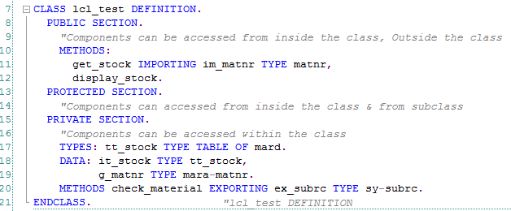
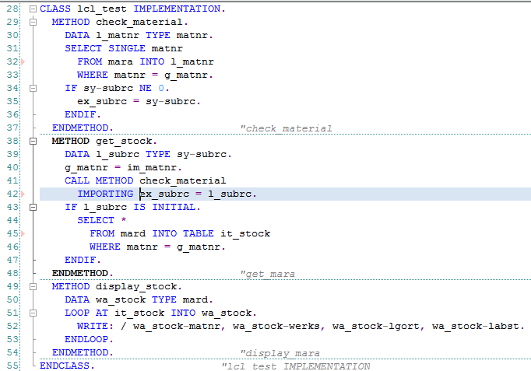
ABAP Objects
SAP Object
Overview
Comparison
Example
Features of ABAP Objects
Class
Object
Methods
Static vs Instance
Events
Inheritance
Interfaces
Class Example
Class Definition
Class Implementation

Slide 14
ABAP Objects
SAP Object
Overview
Comparison
Example
Features of ABAP Objects
Class
Object
Methods
Static vs Instance
Events
Inheritance
Interfaces
Object is the instance of the Class. In order make use of Class components we need to create Object for the Class. This is applicable for Instance specific components of the Class. Whereas class components can be accessed directly using Class Name
Following are the steps to access class components
1. Declare Object for the Class
Syntax:
DATA <OBJECT_NAME> TYPE REF TO <CLASS_NAME>
2. Create Object
Syntax:
CREATE OBJECT <object_name>
3. Access Components of Class using Object
Syntax:
Attributes
<object_name>-><attribute_name>
Method
CALL METHOD <object_name>-><method_name>

Slide 15
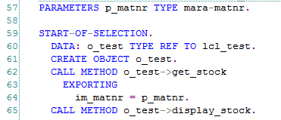
ABAP Objects
SAP Object
Overview
Comparison
Example
Features of ABAP Objects
Class
Object
Methods
Static vs Instance
Events
Inheritance
Interfaces
Example

Slide 16
ABAP Objects
SAP Object
Overview
Comparison
Example
Features of ABAP Objects
Class
Object
Methods
Static vs Instance
Events
Inheritance
Interfaces
There are two types of Components in CLASS
Static Components
Instance Components
For Instance Components, memory is allocated for each time whenever object is created for the class
For the Static components only one time memory is allocated during the program execution
We can declare components with following key words
Component | Static | Instance Specific | Remarks
Data Type | CLASS-TYPES | TYPES | Declare local data types
Attribute | CLASS-DATA | DATA | Variables
Method | CLASS-METHODS | METHODS | Functionalities
Event | CLASS-EVENT | EVENT | Broadcasting the status of the class

Slide 17
ABAP Objects
SAP Object
Overview
Comparison
Example
Features of ABAP Objects
Class
Object
Methods
Static vs Instance
Events
Inheritance
Interfaces
Method is the functionality of the class.
Types of Methods
Constructor Methods: Special methods, will be called whenever instance is created or first time class is accessed
Normal Methods: it will be called by using instance or Class
Event Handler Methods: Special method, it will be called whenever event is raised
Method having
Importing Parameter
Exporting Parameter
Method can be having visibility
Public
Private
Protected
Methods can be declared as
Static – accessed via Class
Instance – accessed via Instance

Slide 18
ABAP Objects
SAP Object
Overview
Comparison
Example
Features of ABAP Objects
Class
Object
Methods
Static vs Instance
Events
Inheritance
Interfaces
Normal Method:
Method defines the functionality of the Class. Methods can have Import and Export Parameters. We can also pass internal tables. We have to specify type for each parameter
Declaring Method
METHODS meth
IMPORTING [VALUE(]i₁ i₂ ... [)] TYPE type [OPTIONAL]... EXPORTING [VALUE(]e₁ e₂ ... [)] TYPE type ... CHANGING [VALUE(]c₁ c₂ ... [)] TYPE type [OPTIONAL]... RETURNING VALUE(r) EXCEPTIONSexc₁ exc₂ ... .
Implementing Method
Method <method_Name>.
“Processing Logic
EndMethod.
Calling Method
CALL METHOD meth
EXPORTING i₁ = f₁ i₂ =f₂ ...
IMPORTING e₁ = g₁ e₂=g₂ ... CHANGING c₁ = f₁ c₂ =f₂ ... RECEIVING r = h EXCEPTIONS e₁ = rc₁ e₂ =rc₂ ...

Slide 19
ABAP Objects
SAP Object
Overview
Comparison
Example
Features of ABAP Objects
Class
Object
Methods
Static vs Instance
Events
Inheritance
Interfaces
Example

Slide 20
ABAP Objects
SAP Object
Overview
Comparison
Example
Features of ABAP Objects
Class
Object
Methods
Static vs Instance
Events
Inheritance
Interfaces
Constructor Method
Constructor method called automatically whenever object is created. We can also define the constructor method. There are two types of constructor methods
Instance Constructor: CONSTRUCTOR
Parameters: We can pass import Parameters
It will be called whenever CREATE OBJECT statement got executed
Static Constructor: CLASS_CONSTRUCTOR
Parameters: no Importing and Exporting Parameters
It will be called whenever first time Class is accessed

Slide 21
ABAP Objects
SAP Object
Overview
Comparison
Example
Features of ABAP Objects
Class
Object
Methods
Static vs Instance
Events
Inheritance
Interfaces
Example: Constructor Method

Slide 22
ABAP Objects
SAP Object
Overview
Comparison
Example
Features of ABAP Objects
Class
Object
Methods
Static vs Instance
Events
Inheritance
Interfaces
Instance vs Static
We can declare components either as Instance components or Static components.
Generally class can have many instances and each instance having its own memory which will not be shared with other instance.
So whatever the component which are declared as instance components are exists for each object separately.
Components which are declared as static exists only once throughout the class
Object#1
Instance Components
Class
Instance Components
Static Components
Whenever object created for the class, memory allocated only for Instance components.
Memory only allocated only one time for static components
Object#2
Instance Components
Static Components

Slide 23
ABAP Objects
SAP Object
Overview
Comparison
Example
Features of ABAP Objects
Class
Object
Methods
Static vs Instance
Events
Inheritance
Interfaces
Keywords to declare static components and Instance components
Component | Static | Instance Specific | Remarks
Data Type | CLASS-TYPES | TYPES | Declare local data types
Attribute | CLASS-DATA | DATA | Variables
Method | CLASS-METHODS | METHODS | Functionalities
Event | CLASS-EVENT | EVENT | Broadcasting the status of the class
Note:
Instance components can be accessed via Object
2. Static components can be accessed via Class as well as Object

Slide 24
ABAP Objects
SAP Object
Overview
Comparison
Example
Features of ABAP Objects
Class
Object
Methods
Static vs Instance
Events
Inheritance
Interfaces
Example

Slide 25
ABAP Objects
SAP Object
Overview
Comparison
Example
Features of ABAP Objects
Class
Object
Methods
Static vs Instance
Events
Inheritance
Interfaces
Events:
Events are class components which are used to send some status to outside. Generally events inform the current state of the object using interface parameters
it is a two step process
a. Events Raising
Create a event
Raise an event
b. Event Handling
Create event handling method
Register event handling method
Events can be raised (Declared & Raised ) and Handled (Event Handling Method & Register the event handler method) in the same class or in different classes

Slide 26
ABAP Objects
SAP Object
Overview
Comparison
Example
Features of ABAP Objects
Class
Object
Methods
Static vs Instance
Events
Inheritance
Interfaces
Declaring & Triggering
Declaring
Static Event
CLASS-EVENTS evt EXPORTING... VALUE(e1 e2 ...) TYPE type [OPTIONAL]..
Instance Event
EVENTS evt EXPORTING... VALUE(e1 e2 ...) TYPE type [OPTIONAL]..
When you declare an event, you can use the EXPORTINGaddition to specify parameters that are passed to the event handler. The parameters are always passed by value.
Instance events always contain the implicit parameterSENDER, which has the type of a reference to the type or the interface in which the event is declared.
Triggering Events
Instance event triggered by Instance Method and Static event triggered by any method
RAISE EVENT evt EXPORTING e₁ = f₁ e₂ = f₂ ...
The self-reference me is automatically passed to the implicit parameter sender

Slide 27
ABAP Objects
SAP Object
Overview
Comparison
Example
Features of ABAP Objects
Class
Object
Methods
Static vs Instance
Events
Inheritance
Interfaces
Handling Events
Events are handled using special methods. It contains two steps
1. Define event handler method for the event
2. Register event handler method for the event
Declaring event handler method
We can declare event handle r method same as normal method
Syntax
METHODS meth FOR EVENT evt OF cif IMPORTING e₁ e₂ ...
Evt – Event Name
Cif – Class or Interface Name
Registering Event handler method
We need to register event handler method to react to the event using following statement
Syntax
SET HANDLER h₁ h₂ ... [FOR]...[{ref|FOR ALL INSTANCES}]
Timing of Event Handling
After the RAISE EVENT statement, all registered handler methods are executed before the next statement is processed

Slide 28
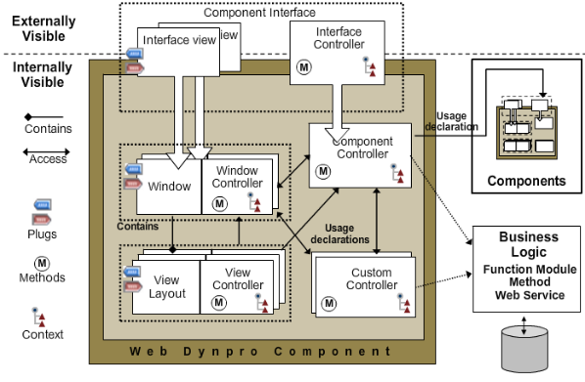
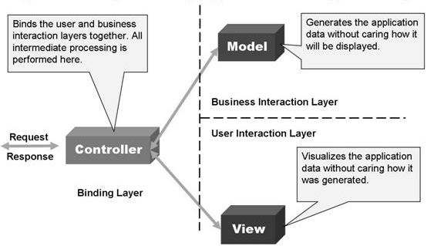
SAP Webdynpro ABAP

Slide 29
Webdynpro ABAP
Different types of Applications developed using ABAP
&
Programming methodologies used
Procedure Oriented Approach
RFCs
Includes
Forms
Function Groups
User Exits & Customer Exits
Webdynpro Applications
Reports
BAdis
Object Oriented Approach
Module Pool
Class
Object
Conversions
Interface

Slide 30
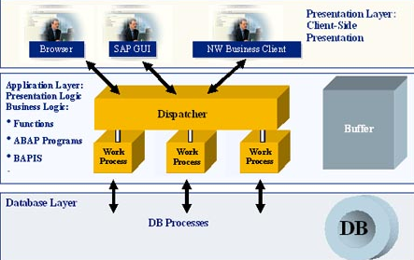
Webdynpro ABAP
SAP Applications can be accessed via GUI or Browser

Slide 31
Webdynpro ABAP
Webdynpro for ABAP is the UI technology to develop web applications on ABAP environment using MVC paradigm.
So we will be able to access applications from different platforms such as Browsers, mobile and hand held devices without using SAP GUI .
Web Application development adheres MVC Pattern and Developed using Object Oriented methodology
MVC paradigm offers following
Clear separation of business logic and display logic
Uniform meta model for all types of user interfaces
Execution on a number of client platforms
Extensive platform independence of interfaces

Slide 32
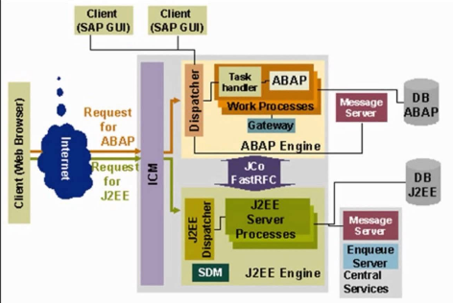
Webdynpro ABAP
ICM: Internet Communication Manager will act as interface between SAP & Internet. We are also having Webdynpro for Java. Now focus only on Webdynpro for ABAP (WD4A)

Slide 33
Webdynpro ABAP
Development Environment:
Webdynpro is framework based programming where we will focus on UI design and business logic . Rest of activities such as communicating with Browser etc will be taken care by the Framework environment
1. Graphical tools provided
To design Layout of User Interface UI
To pass to and from UI elements such as Input fields, check box, tables etc.
To write the business logic
2. Clear separation between Business logic and display logic
3. By default every Webdynpro application is structured according to the Model View controller programming model
Model: An interface to access the backend data
View : It represent the data on to the UI
Controller: simply connects the View and Model

Slide 34
Webdynpro ABAP
Transactions Used:
SE80 – Object Browser
SE24 – Class
SICF – Internet Services activation

Slide 35
Example#1: First Example
In this chapter we will familiar with
How to create Webdynpro component
What is Webdynpro Component
What is Window
What is View
What is Interface View
What is Web Application
How to test the Web Application

Slide 36

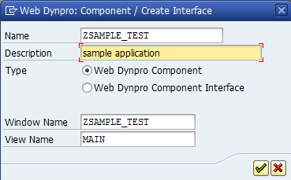
Example#1: First Example
SAP Webdynpro
Webdynpro Component
Window
View
Layout
UI element Properties
Web Application
Step1: Transaction SE80 and Select Web Dynpro Comp/Intf.
and Give name for Component. Here ZSAMPLE_TEST
Step#2: In the Pop up enter
Description
View name
Window name
Note: System will propose default names. We can use same

Slide 37
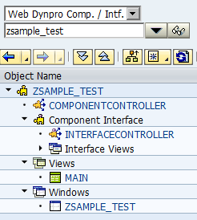
Example#1: First Example
SAP Webdynpro
Webdynpro Component
Window
View
Layout
UI element Properties
Web Application
In the Left Navigation Pane we can see all the generated Components
Component Name
Component Controller
Component Interface
Views
Windows

Slide 38
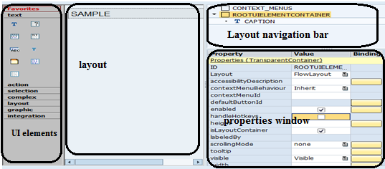
Example#1: First Example
SAP Webdynpro
Webdynpro Component
Window
View
Layout
UI element Properties
Web Application
View layout editor:
it allows us to place UI elements and set their properties.

Slide 39
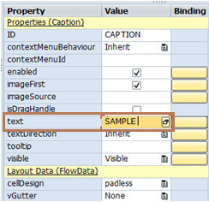
Example#1: First Example
SAP Webdynpro
Webdynpro Component
Window
View
Layout
UI element Properties
Web Application
Step3: Adding UI elements to the view.
Drag and Drop Caption UI Element onto the Layout and specify the text to be displayed

Slide 40


Example#1: First Example
SAP Webdynpro
Webdynpro Component
Window
View
Layout
UI element Properties
Web Application
Step4: Embed the View onto the Window
Note: this step is optional if in your component contains only one View.
By Default, View will be embedded onto the window.
If you create several views then this step is necessary
And this Window should be set as Interface view
By Default one inbound Plug will be set as Interface Plug
Note: We will see complete details about Plugs in coming sessions

Slide 41
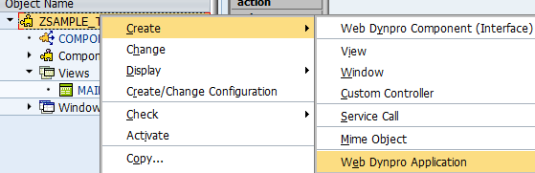
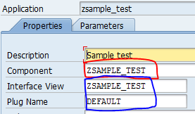
Example#1: First Example
SAP Webdynpro
Webdynpro Component
Window
View
Layout
UI element Properties
Web Application
Step5: Create Webdynpro Application.
This step is similar to create Transaction for Module pool Program
Right click on component and chose create and select Webdynpro application. Pop up will be displayed. Enter some description and press enter.
Note: here we haven’t created any interface view and plug. But system will create both by default. We can create our own based on requirement.
Save and activate the Component.

Slide 42

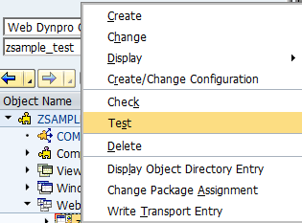
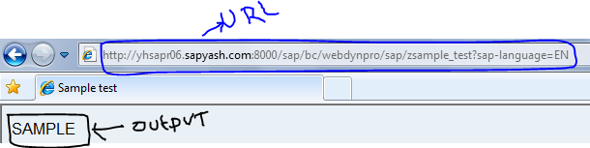
Example#1: First Example
SAP Webdynpro
Webdynpro Component
Window
View
Layout
UI element Properties
Web Application
Step6: Test the Application
Select ZSAMPLE_TEST and right click and chose Test

Slide 43
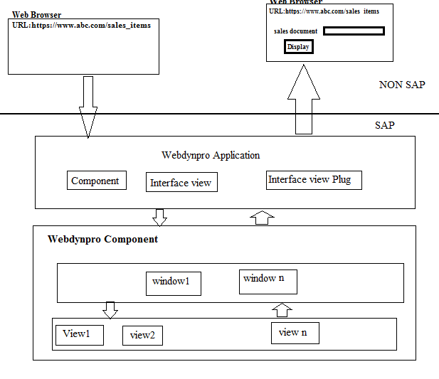
Example#1: First Example
SAP Webdynpro
Webdynpro Component
Window
View
Layout
UI element Properties
Web Application
Request & Response Cycle

Slide 44
Example#1: First Example Summary
We have discussed about
How to create Webdynpro component
What is Webdynpro Component
What is Window
What is View
What is Interface View
What is Web Application
How to test the Web Application

Slide 45
Example#2: UI Element & Context
With this chapter you will familiar with
What is Context
Context Node
Context Element
How to bind Context to UI element
How to Set & Get Data to & From Context
What are the interfaces and Methods used to do the above
Table Control UI Element
What are Hook Methods and What is the Role of Hook Methods

Slide 46
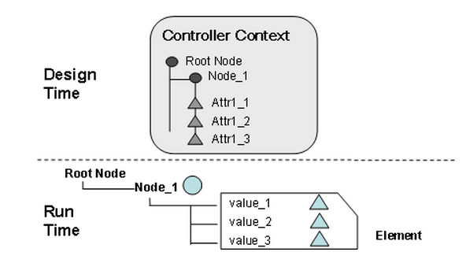
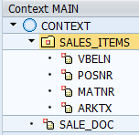
Example#2: UI Element & Context
SAP Webdynpro
Context
Binding Context to UI Element
Set & Get Data to Context
Hook Methods
Context:
Context is the Hierarchical representation of date in Webdynpro. It is basically used for following purpose
Pass data to and From UI Element called Binding
Share data among multiple Views called Mapping
Steps to work with Context
Declare or Define the Context
Bind UI element to the Context
Set & Get data to & From Context via program logic

Slide 47
Example#2: UI Element & Context
SAP Webdynpro
Context
Binding Context to UI Element
Set & Get Data to Context
Hook Methods
Lets start building Application
Input:
Sales Order
Output:
Sales Order Header
Sales Order Item
Schedule Lines
UI Elements Used for this Requirement
Input: Sales Order – Input Field
Button: Display - Button
Output: Sales Header – Form
Sales Item - Table Control
Schedule Lines - Table Control

Slide 48
Example#2: UI Element & Context
SAP Webdynpro
Context
Binding Context to UI Element
Set & Get Data to Context
Hook Methods
Step#1: Create component, Window and View
Step#2: Create Context
There are two Components in Context
Context Node
Context Element
Context Element is the actual place where data is available. Every Context Element should be under Context Node
Context Node contains one or more Context Elements
CONTEXT is root context Node
SALES_ITEMS is the context Node which contains context elements VBELN, POSNR etc.
SALES_DOC is the Context element under CONTEXT Node

Slide 49
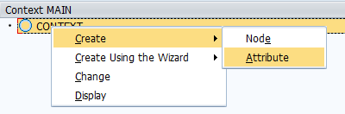
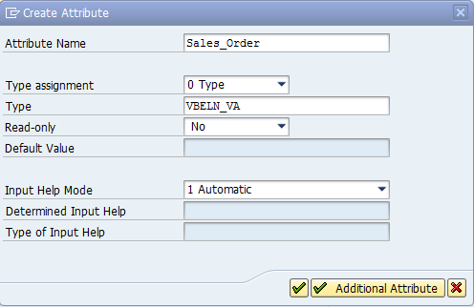

Example#2: UI Element & Context
SAP Webdynpro
Context
Binding Context to UI Element
Set & Get Data to Context
Hook Methods
Creating Context Node & Attributes
Right Click on CONTEXT node
→ Create → Node or Attribute
Context Attribute: Properties to be Specified
Result
Name of Element
Data Type
Context Element SALES_ORDER will be added under the Context Node CONTEXT

Slide 50
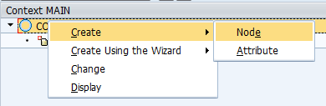
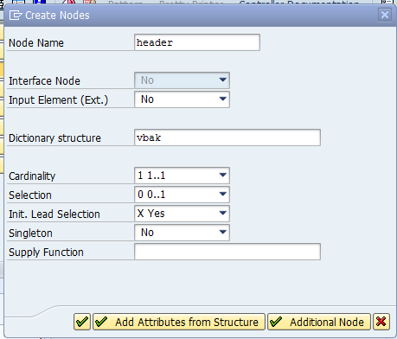
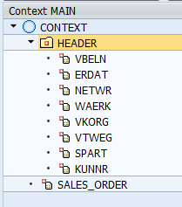
Example#2: UI Element & Context
SAP Webdynpro
Context
Binding Context to UI Element
Set & Get Data to Context
Hook Methods
Context Node
Name
Specify Following
Name
Dictionary Structure
Cardinality: Select 1..1
Fields to be included
Select necessary fields to be added to the Node by clicking the
Button
Datatype
Cardinality
Fields Selection

Slide 51
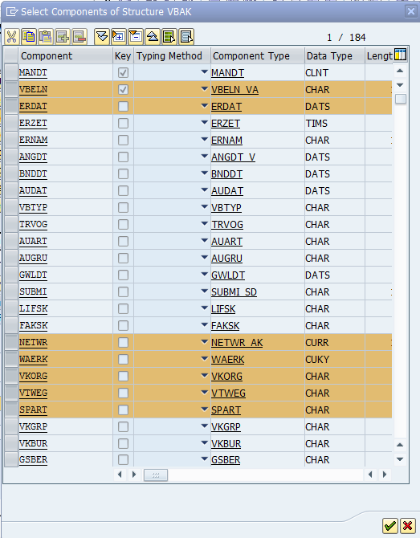
Example#2: UI Element & Context
SAP Webdynpro
Context
Binding Context to UI Element
Set & Get Data to Context
Hook Methods
Context Node: Fields Selection

Slide 52
Example#2: UI Element & Context
SAP Webdynpro
Context
Binding Context to UI Element
Set & Get Data to Context
Hook Methods
Cardinality: It specifies number of instances to be created during runtime
1…1 Only one element is instantiated.
0…1 At runtime, no more than one element is instantiated, but it is also possible that no element is instantiated.
1…n n elements can be instantiated, but at least one element must be instantiated.
0…n The number of instantiated elements of the context node can vary.
Note: In general
if you want to hold single record then select 1..1 Cardinality
If you want to hold multiple records then select 0..N cardinality
In very rare cases rest of other cardinalities will work

Slide 53
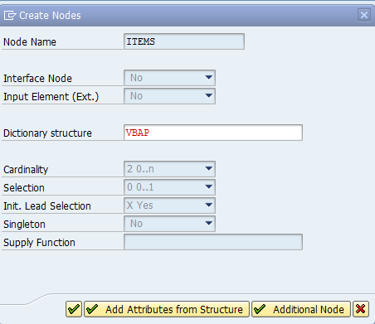
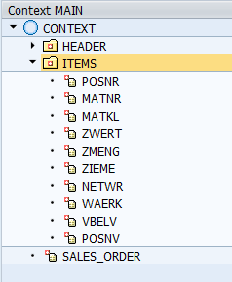
Example#2: UI Element & Context
SAP Webdynpro
Context
Binding Context to UI Element
Set & Get Data to Context
Hook Methods
Context Node: Item
Name
Structure
Result
Cardinality
Field Selection

Slide 54
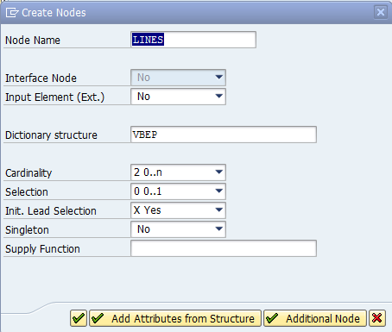
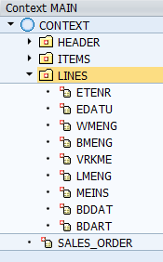
Example#2: UI Element & Context
SAP Webdynpro
Context
Binding Context to UI Element
Set & Get Data to Context
Hook Methods
Context Node: Schedule Lines
Result
Done with Context… Any Doubts????

Slide 55
Example#2: UI Element & Context
SAP Webdynpro
Context
Binding Context to UI Element
Set & Get Data to Context
Hook Methods
UI Layout Design
We can add UI Elements on to the layout in 3 Ways
Drag and Drop: Individual elements can be dragged and dropped
Right Click on ROOTELEMENTCONTAINER: Similar to the above
Creating Container Form: This option is generally good for Designing the Input Screen
I would like to take the opportunity to introduce the Group and Panel UI elements as well apart from Input Field, Button & Table UI Elements

Slide 56
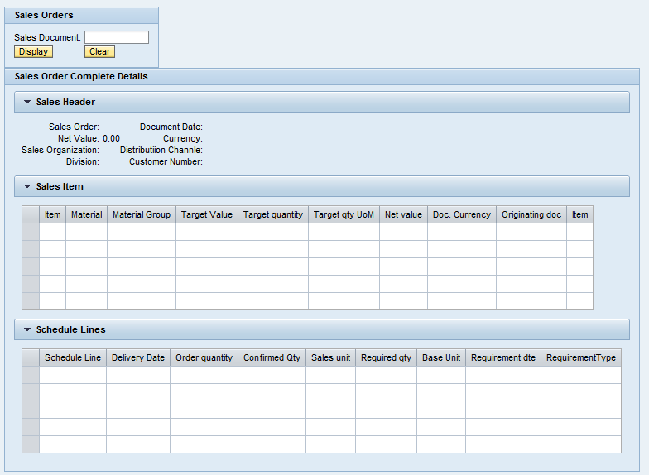
Example#2: UI Element & Context
SAP Webdynpro
Context
Binding Context to UI Element
Set & Get Data to Context
Hook Methods
Design the Layout
Group
Input Field
Buttons
Panel
Table

Slide 57
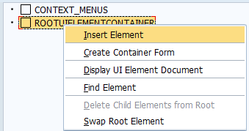
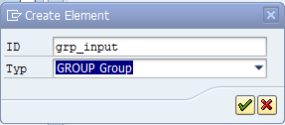

Example#2: UI Element & Context
SAP Webdynpro
Context
Binding Context to UI Element
Set & Get Data to Context
Hook Methods
Design the Layout. Some elements required Binding with Context Some elements not required Binding
First add 2 Group UI Elements as below
Right Click on ROOTELEMENTCONTAINER
Select Insert Element Option
Enter Some Unique ID ‘GRP_INPUT’
Specify the Type of UI Element : GROUP
Result: Group UI element will be added on the Layout
Similarly, Add one more Group GRP_DETAILS and add 3 Panels under the Group GRP_DETAILS
Note: For Group and PNL_HEADER, Select Layout Grid layout and Choose Number of Column as 2

Slide 58
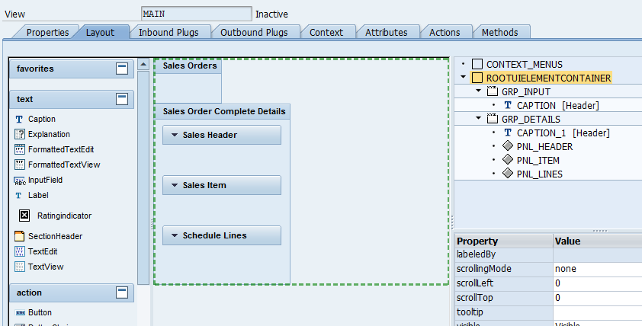
Example#2: UI Element & Context
SAP Webdynpro
Context
Binding Context to UI Element
Set & Get Data to Context
Hook Methods
After Adding the Group and Panel UI elements, Result as follows
We will introduce one more option called Layout. Each aggregate UI element having layout selection which actually controls the arrangement of underlying UI elements. Let see in further section

Slide 59
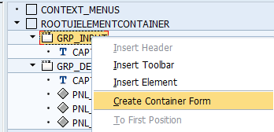
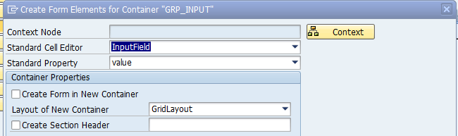
Example#2: UI Element & Context
SAP Webdynpro
Context
Binding Context to UI Element
Set & Get Data to Context
Hook Methods
Add Input Field and Buttons
Note: when adding the Input field, it contains 2 steps
Add UI element
Bind it to the Context
If we choose Drag and Drop then both steps performed manually
If we choose Create Container Form Option then both steps performed at a time
Create Container Form:
Right Click on GRP_INPUT and choose Create Container Form Option. Then Following Pop up will appear. Then Click on Context Button

Slide 60
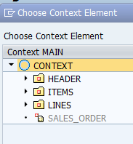
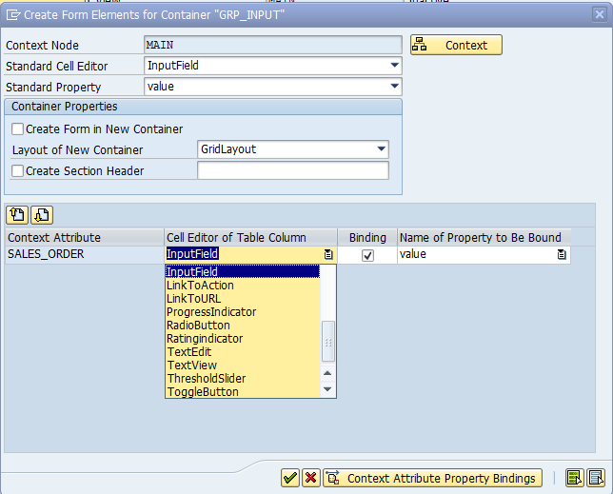
Example#2: UI Element & Context
SAP Webdynpro
Context
Binding Context to UI Element
Set & Get Data to Context
Hook Methods
Right Click on GRP_INPUT and choose Create Container Form Option. Then Following Pop up will appear. Then Click on Context Button
Select the Node. So that all the underlying Context elements will be used for Input UI elements
In the CONTEXT node, only one Context Element SALES_ORDER exists
We can choose Type of UI element
In our case we selected as Input Field
In this approach, Both UI element placing and Binding happened same time

Slide 61

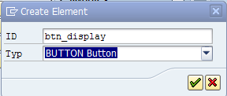
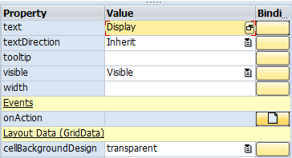
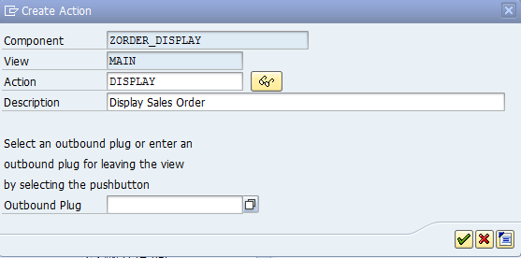

Example#2: UI Element & Context
SAP Webdynpro
Context
Binding Context to UI Element
Set & Get Data to Context
Hook Methods
Field will be added in the Layout as below
Add Button. Button having two major properties
Text : Text will be displayed on the Button
Action: Event Handling
To add event, Click on Create Button
Enter the Action Name. With this action name, Event handler method will be created where actually we will implement logic

Slide 62
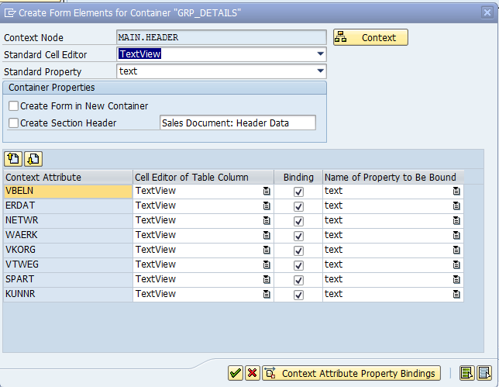
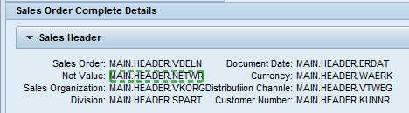
Example#2: UI Element & Context
SAP Webdynpro
Context
Binding Context to UI Element
Set & Get Data to Context
Hook Methods
Create Header UI elements
Right Click on PNL_HEADER panel and select Create Container Form Option then Select the Context Node HEADER and Choose UI Element Type TEXTVIEW

Slide 63
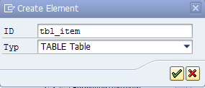
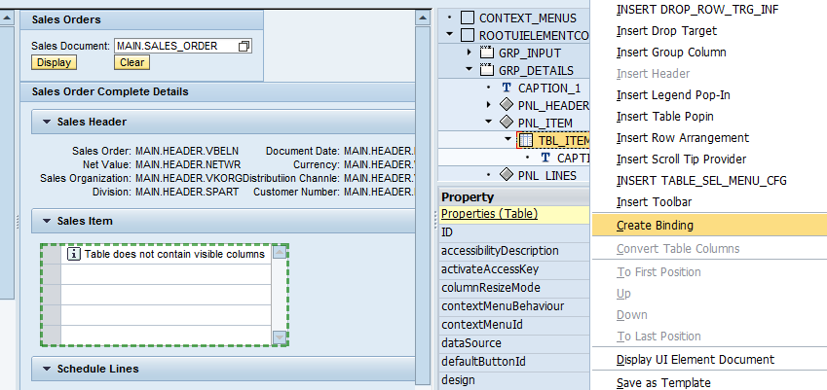
Example#2: UI Element & Context
SAP Webdynpro
Context
Binding Context to UI Element
Set & Get Data to Context
Hook Methods
Add Table Control and Bind to the Context Node

Slide 64
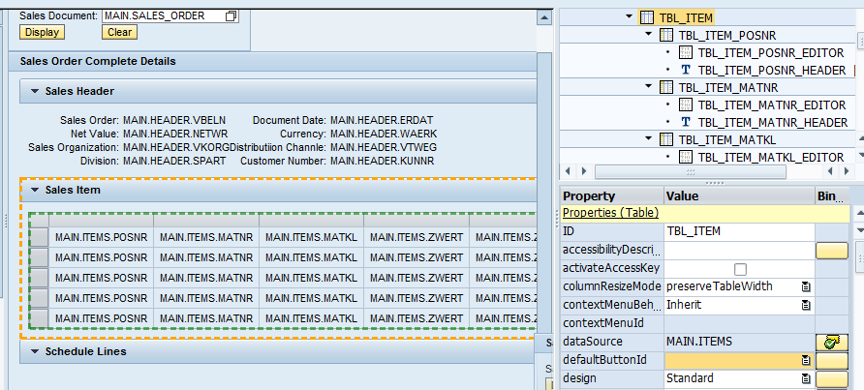
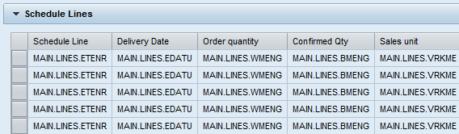
Example#2: UI Element & Context
SAP Webdynpro
Context
Binding Context to UI Element
Set & Get Data to Context
Hook Methods
Field will be added in the Layout as below
Do the same for Schedule Lines as well.

Slide 65
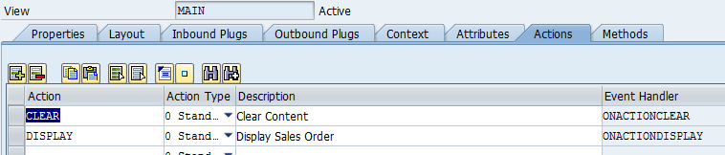
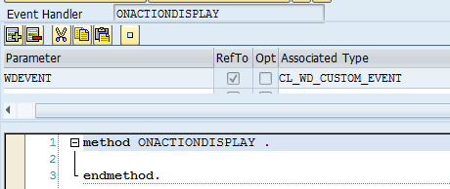
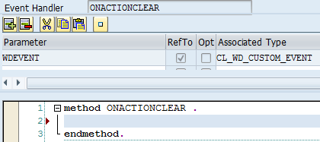
Example#2: UI Element & Context
SAP Webdynpro
Context
Binding Context to UI Element
Set & Get Data to Context
Hook Methods
Now coding Part
As we have added two buttons, and created two actions. For each action, there is one event handler methods

Slide 66
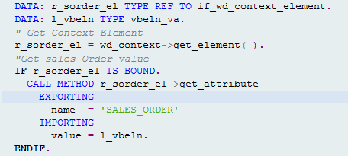
Example#2: UI Element & Context
SAP Webdynpro
Context
Binding Context to UI Element
Set & Get Data to Context
Hook Methods
Get data from context Attribute
Get data from Context Attribute
Whenever we are running the application, Webdynpro framework will create instances for each and every underlying parts (Windows, Views & Context).
Context Element implements interface: IF_WD_CONTEXT_ELEMENT
Step#1: Get the reference of Parent Node: using following method
<r_element> = <Parent_Node>→GET_ELEMENT().
<r_elemment> is Type ref to IF_WD_CONTEXT_ELEMENT
Step#2: Get Value of the Attribute
CALL METHOD <r_element>→GET_ATTRIBUTE EXPORTING name = <Attribute_Name> IMPORTING value = <Variable>.

Slide 67


Example#2: UI Element & Context
SAP Webdynpro
Context
Binding Context to UI Element
Set & Get Data to Context
Hook Methods
Set data to Context Node (1..1 Cardinality)
Context Node implements interface: IF_WD_CONTEXT_NODE
Step#1: Get the Context node reference
Call Method <Parent_Node>→GET_CHILD_NODE EXPORTING name = <Node_Name> RECEIVING child_node = <Node_Reference>.
<Node_Reference> is Type ref to IF_WD_CONTEXT_NODE
Step#2: Set Value of the Node
CALL METHOD <Node_Reference>->SET_STATIC_ATTRIBUTES EXPORTING Static_attributes = <Work_Area>

Slide 68


Example#2: UI Element & Context
SAP Webdynpro
Context
Binding Context to UI Element
Set & Get Data to Context
Hook Methods
Set data to Context Node (0..N Cardinality)
Context Node implements interface: IF_WD_CONTEXT_NODE
Step#1: Get the Context node reference
Call Method <Parent_Node>→GET_CHILD_NODE EXPORTING name = <Node_Name> RECEIVING child_node = <Node_Reference>.
<Node_Reference> is Type ref to IF_WD_CONTEXT_NODE
Step#2: Set Value of the Node
CALL METHOD <Node>->BIND_TABLE
EXPORTING new_items = <Internal_Table>

Slide 69
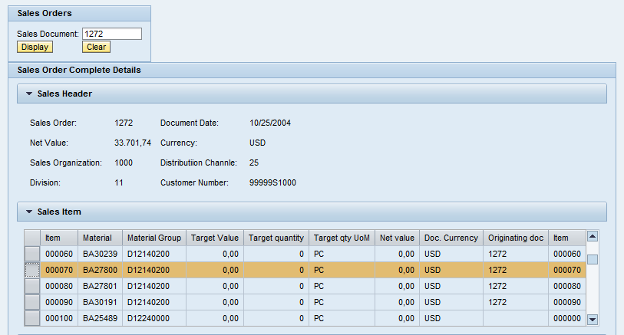
Example#2: UI Element & Context
SAP Webdynpro
Context
Binding Context to UI Element
Set & Get Data to Context
Hook Methods
Set data to Context Node (0..N Cardinality)

Slide 70

Example#2: UI Element & Context
SAP Webdynpro
Context
Binding Context to UI Element
Set & Get Data to Context
Hook Methods
Table Event Handling
Upon selecting the Sales Item, Schedule line should be displayed
Handle event in Table Control

Slide 71
Example#3: Navigation through Plugs & View Container UI Element
With this example you will familiar with
How to navigate from one View to Another View
Inbound & Outbound Plugs
Embedding Views on to the Window
Establish Navigation Links among Views
How to share data among multiple Views
Context Mapping
Component Controller Attributes
Outbound Plugs
Calling Fire method to initiate the Navigation
Displaying multiple view on same view using View Container UI Element

Slide 72
Example#3: Navigation through Plugs & View Container UI Element
SAP Webdynpro
Navigation
Inbound & Outbound Plugs
Embedding Views
Creating Navigation Links
Sharing Data among views
Calling Fire Method
View Container UI Element

Slide 73
Example#3.1: Some UI Elements
With this example you will familiar with
Drop Down Box
List Box
Radio Button Group
Check Box Group
Group
Panel

Slide 74
Example#3.1: Some UI Elements
SAP Webdynpro
Drop Down
List Box
Radio Button Group
Check Box Group
Group
Panel

Slide 75
Example#4: Component Usage
ALV Table, Select-Options & F4 Help
With this example you will familiar with
What is Component Usage
How to use other Components in our component
What is the Interface view
How can we access the resources of Used component
How to transfer data to Used component
ALV Table – Component SALV_WD_TABLE
Select Options WDR_SELECT_OPTIONS
F4 Help WDR_OVS

Slide 76
Example#4: Component Usage
ALV Table, Select-Options & F4 Help
SAP Webdynpro
Component Usage
Interface View
Resource of Used Component
ALV Table
Select Options
F4 Help

Slide 77
Example#5: Assistance Class
With this example you will familiar with
What is Purpose of Assistance Class
How to create Assistance Class
How to use Assistance Class

Slide 78
Example#5: Assistance Class
SAP Webdynpro
Assistance Class
How to use Assistance Class

Slide 79
Example#6: Message Handling, POP UP Dialogs, Layouts & OTR
With this example you will familiar with
How to handle Messages in Webdynpro
POP Window
Handling Events for Pop UP Windows
Online Text Repository
Different Types of Layouts
Flow Layout
Row Layout
Grid Layout
Matrix Layout

Slide 80
Example#6: Message Handling, POP UP Dialogs, Layouts & OTR
SAP Webdynpro
Message Handling
Pop Up Dialogs
Layouts

Slide 81
Example#7: Custom Component Reusability
With this example you will familiar with
How to use Other custom component in our Component
How to exchange data between the components
How to Call methods of used component
How to handle events of used Component

Slide 82
Example#7: Custom Component Reusability
SAP Webdynpro
Define Component
Reuse Component

Slide 83
Example#8: Dynamic Programming
With this example you will familiar with
Change Properties of UI elements Dynamically
Dynamic Context
Dynamic Component Reusability

Slide 84
Example#8: Dynamic Programming
SAP Webdynpro
Change Properties Dynamically
Dynamic Context
Dynamic Component Reusability

Slide 85
Example#9: Complex Controls: Tree & Tab Strip
With this example you will familiar with
Handling Tree UI Element
Handling Tab Strip UI Element

Slide 86
Example#9: Complex Controls: Tree & Tab Strip
SAP Webdynpro
Tree
Tab Strip

Slide 87
Example#10: Component Configuration
With this example you will familiar with
Component Configuration

Slide 88
Before Enter the Course… Just have a small look into
ABAP/4
With the ABAP Programming Language we are developing different types of Applications
Like Reports, Dialog Programs, Conversions, Customer exits, Badis etc..
Here two things to consider
1. Which methodology we are using
2. How we are accessing the above applications
Methodology:
Either Procedure Oriented or Object Oriented techniques we are using or mix of both as ABAP is Event Driven Programming Language and supports Both of the Above approaches

Slide 89

Before Enter the Course… Just have a small look into
ABAP/4
What about accessing the applications??
How we are accessing the Applications???
Mostly End User interacting with Reports & Transaction Programs. Rest of the Applications (Enhancements, Conversions) will be called in the backend of other applications
And User accessing the SAP Applications via SAP GUI

