Slide 1
Radio-frequency identification (RFID)
Radio-frequency identification (RFID) uses electromagnetic fields to automatically identify and track.

Slide 2
RFID is used in many applications like attendance system
It is also helpful to keep track of goods and in automated toll collection system on highway.
RFID is used in many companies to provide access to their authorized employees.
Radio Frequency Identification (RFID) refers to a two components: tags and readers.

Slide 3
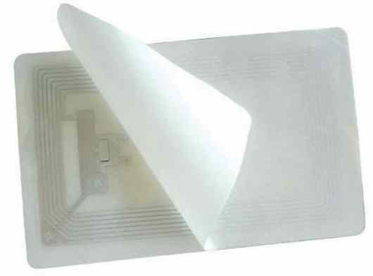
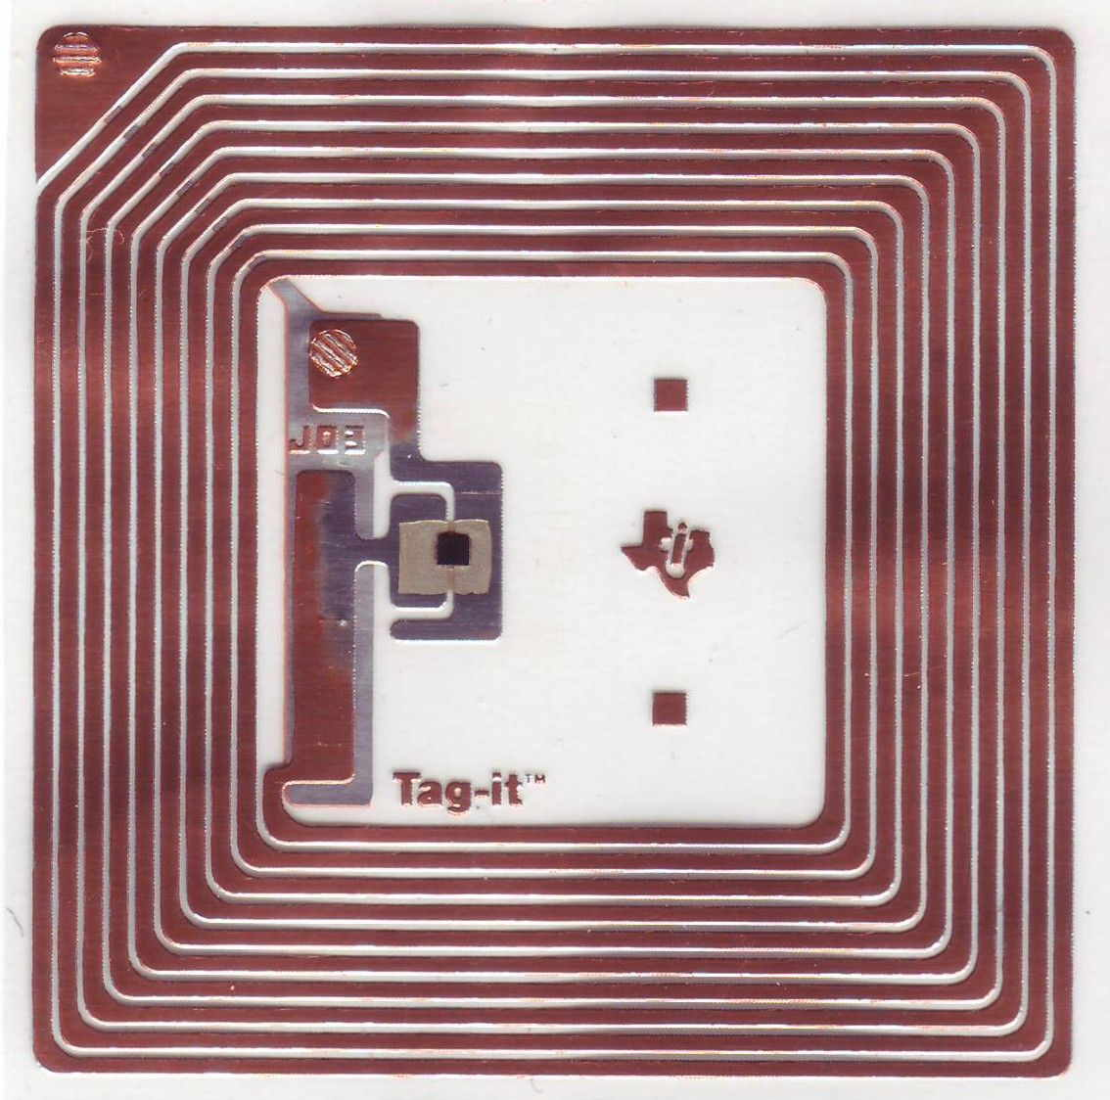
RFID Tag:
RFID tag includes microchip with radio antenna.
which carries 12 Byte unique Identification number.
RFID Tag
RFID Tag Inside

Slide 4
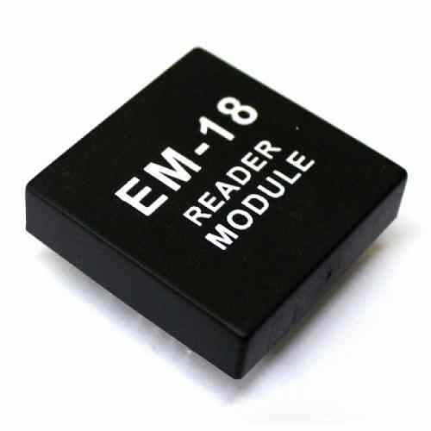
RFID Reader:
EM18 is a RFID reader
It is used to read unique ID from RFID tags.
frequency 125 kHz
Whenever RFID tags comes in range, RFID reader reads its unique ID and transmits it serially to the microcontroller or PC.
EM18 RFID Reader Module

Slide 5
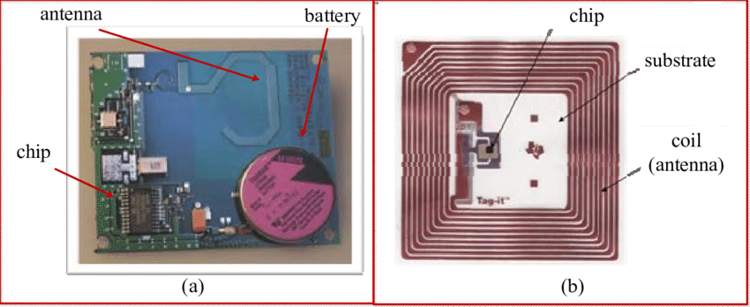
Basically, RFID systems categorised as active and passive based on how they are powered and their range.
Passive RFID tags are powered by the reader and do not have a battery
operate in Low frequency (~125 KHz) as well as High frequency (~13 MHz) band
have limited read range of up to ~1m.
Active RFID tags are powered by batteries.
They operate at 455 MHz, 2.45 GHz, or 5.8 GHz
read range of 60 feet to 300 feet (20 meters to 100 meters).
Active RFID Passive RFID

Slide 6
There are various RFID readers available according to their frequency are shown as follows
Frequency | Range | Different modules | Applications
120-150 kHz | 5-20 cm | EM-18, ILA-12, etc. | Factory data collection, identifying animals etc.
13.56 MHz | 10 cm – 1m | MFRC522, SM130 | Smart cards

Slide 7
Interfacing Arduino uno and RFID-EM-18

Slide 8
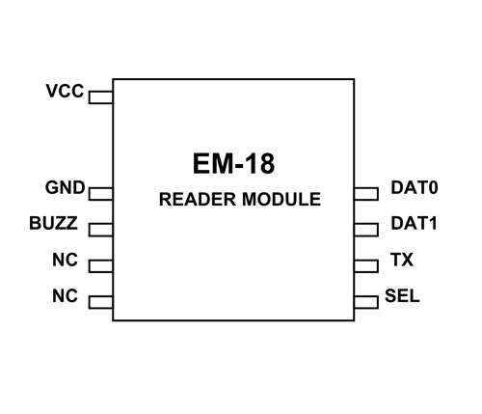
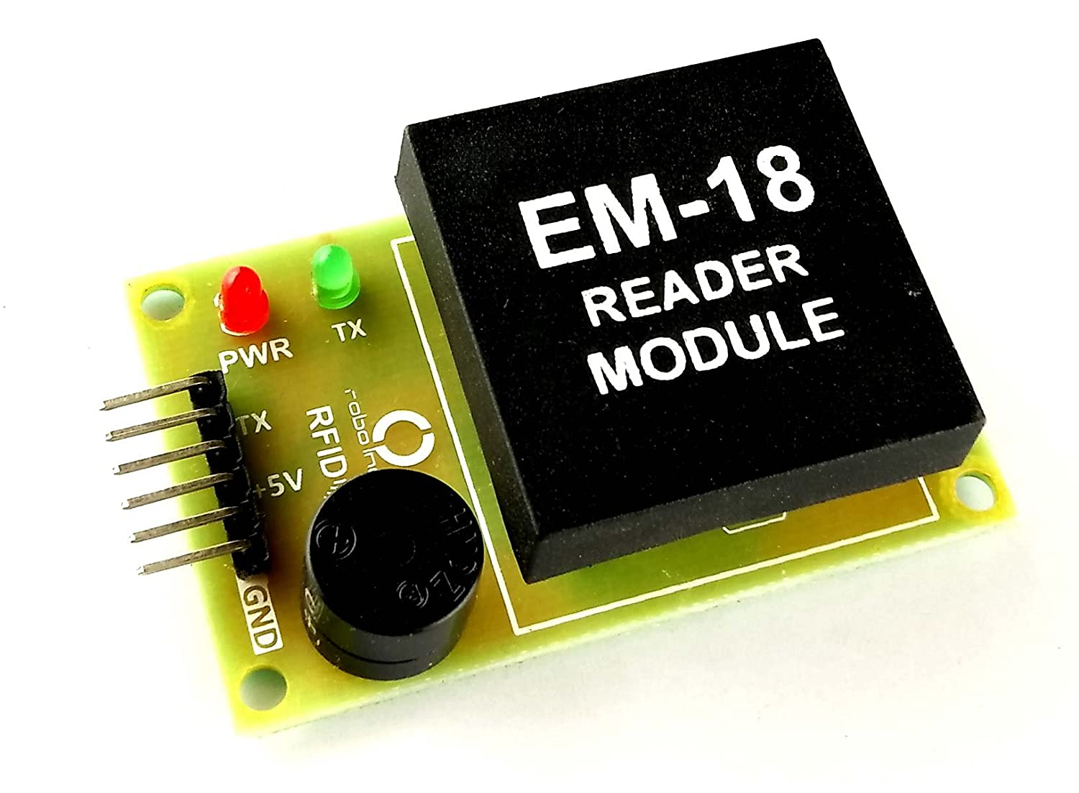
EM-18 is a nine pin device. Among nine pins, 2 pins are not connected, so we basically have to consider seven terminals.
Should be connected to BUZZER
No Connection
No Connection
Select pin

Slide 9
EM-18 Features and Specifications
Operating voltage of EM-18: +4.5V to +5.5V
Current consumption:50mA
Can operate on LOW power
Operating temperature: 0ºC to +80ºC
Operating frequency:125KHz
Communication parameter:9600bps
Reading distance: 10cm, depending on TAG
Integrated Antenna

Slide 10
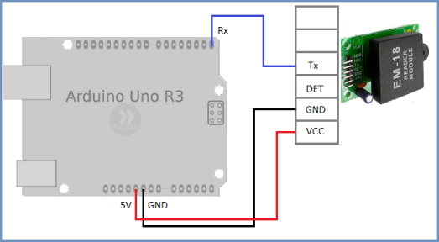

Slide 11
Programming

