Slide 1


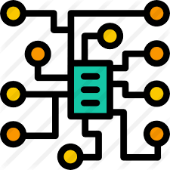
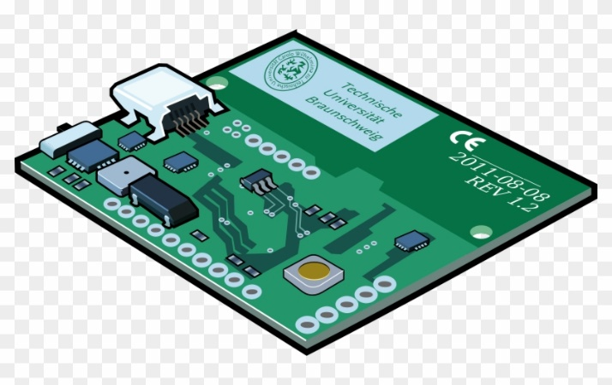
Andhra Pradesh State Skill Development Corporation
Printed Circuit Board (PCB)
Presented by,
B Nagaraju,
Technical Skill Trainer-APSSDC
Phone no: +91-8463961431
Mail id: Nagaraju.b@apssdc.in

Slide 2
Introduction to PCB Design Manufacturing

Slide 3
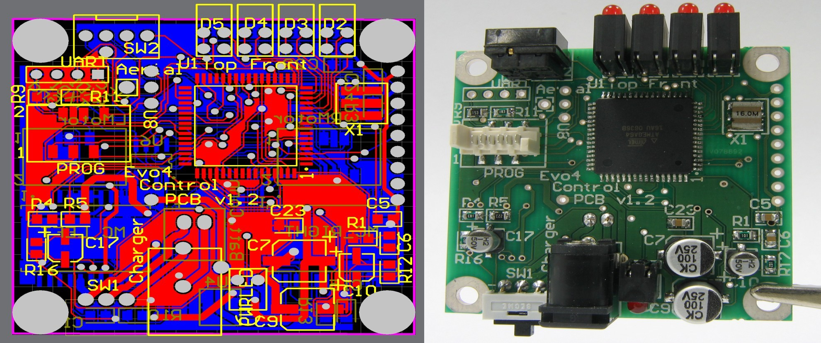
PCB Design Presentation

Slide 4
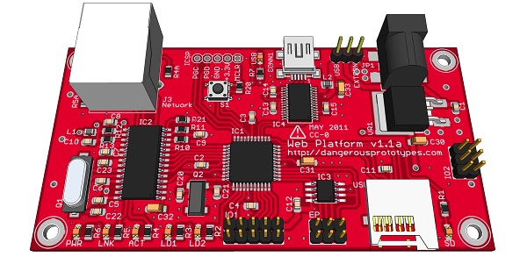
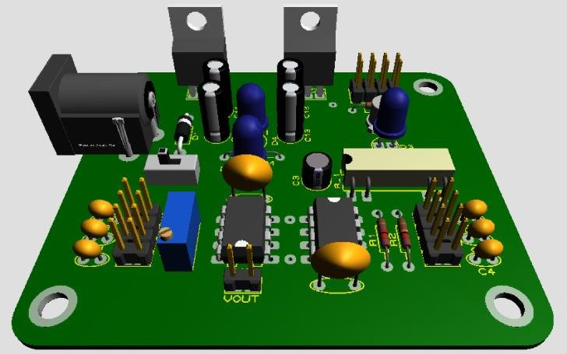
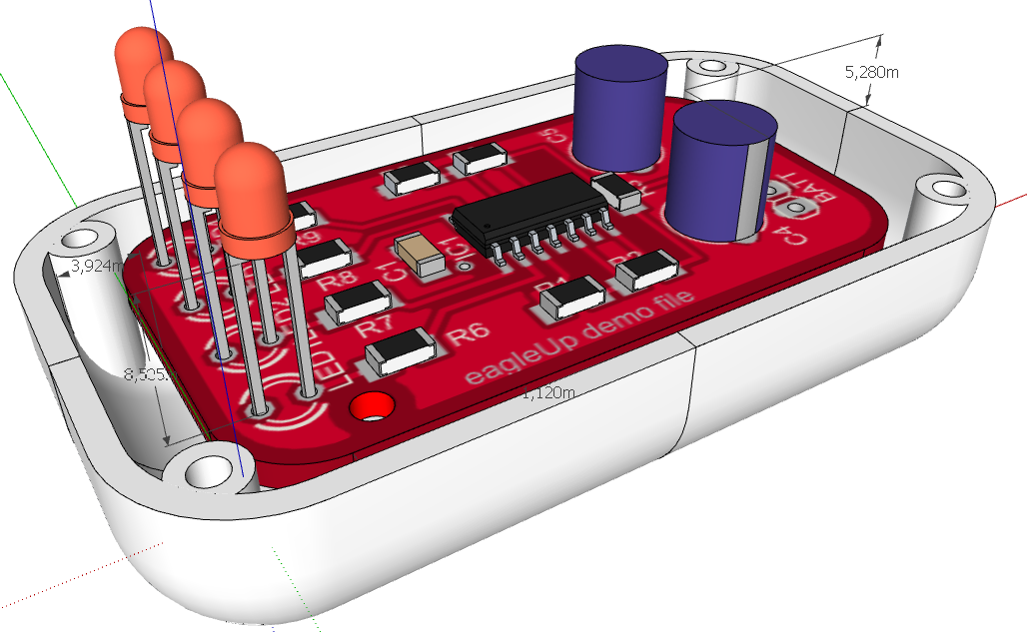

Slide 5
What is PCB
•
•
•
Printed Circuit Board
Electronic Board that connects circuit components
PCB populated with electronic components is a printed circuit assembly (PCA)
PCBs are rugged, inexpensive, and can be highly reliable
Mass manufacturing Professional
•
•
•

Slide 6
Materials of PCB
•
Conducting layers are typically made of thin copper foil.
The board is typically coated with a solder mask that is
green in color. Other colors that are normally available are blue and red.
Unwanted copper is removed from the substrate after etching leaving only the desired copper traces or pathways

Slide 7
Parts of a PCB
Components
Pads
Traces
Vias
Top Metal Layer
Bottom Metal Layer

Slide 8
Components
•
Components are the actual devices used in the circuit.
This includes input/output connections.
I/O ports, including power supply connections, are also important in the PCB design.
•
•

Slide 9
Pads
•
•
•
•
Location that components connect to.
You will solder components to the pads on the PCB. Pads will connect to traces.
Pads have an inner diameter and outer diameter.

Slide 10
Traces
Traces connect pads together.
Traces are essentially the wiring of the PCB.
High current traces should be wide.
Signal traces usually narrower than power or ground traces

Slide 11
Vias
Pad with a plated hole connecting traces from one layer of board to other layers.
Attempt to minimize via use in your PCBs. Some component leads can be used as vias.

Slide 12
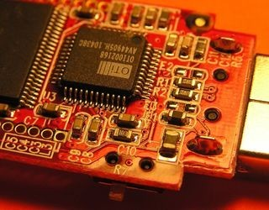
Top Metal Layer
•
Most of the components reside on the top layer
Fewer traces on the top layer
Components are soldered to the pads on the top layer of PCB
Higher circuit densities
•
•
•

Slide 13
Bottom Metal Layer
Few components on this layer.
Many traces on this layer.
Most soldering done on this layer.

Slide 14
Jumpers
•
Often, many signal wires need to exist in too small of a space and must overlap.
Running traces on different PCB layers is an option. Multilayer PCBs are often expensive.
Solution: use jumpers
•
•
•

Slide 15
Solder Mask
Protect copper traces on outer layers from corrosion
Areas that shouldn't be soldered may be covered with polymer resist solder mask coating
Designed to keep solder only in certain areas
Prevents solder form binding between conductors and thereby creating short circuits

Slide 16
Silkscreen
Printing on the solder mask to designate component locations
Readable information about component part numbers and placement.
Helpful in assembling, testing and servicing the circuit board.

Slide 17
Multilayer PCBs
•
•
More then a top and bottom layer.
Typically there will be a power plane, ground plane, top layer, and bottom layer.
Sometimes signal layers are added as needed.
Sometimes RF planes made of more expensive materials are added.
•
•

Slide 18
Physical Design Issues
•
•
•
•
Component Size Heat Dissipation Input and Output Mounting Points

Slide 19
Component Size
•
•
Make sure components will actually fit.
This especially applies for circuits that require high component densities.
Some components come in multiple sizes. SMT vs Through Hole
Sometimes you can get tall and narrow caps or short and wide capacitors.
•
•

Slide 20
Heat Dissipation-Heat Sinks
•
•
•
Heat sink dissipates heat off the component Doesn’t remove the heat just moves it
Some components may get hot. Make sure you get a large enough heat sink.
Data sheets specify the size of the heat sink
A short circuit may result when two devices share the same heat sink
•
•

Slide 21
Mounting Points
•
The PCB needs to be mechanically secured to something.
Could be the chassis-consist of metal frame on which the circuit boards and other electronic components are mounted.
Could be another PCB/socket on PCB. Could be attachments to a heatsink.
•
•
•

Slide 22
Pre-work
Thoroughly simulate your circuit-make sure the circuit worked in simulations
Thoroughly test the prototype-make sure the circuit worked on the bread board
Have all the data sheets handy for every components
Play around with the placement of the components

Slide 23
Simulations
•
Important to simulate the circuits before building them
Allow margin for component tolerances Avoid using precise components. e.g a PWM
controller that requires exact 10 V DC to work and
will fail if there is 10.01V
High performance circuits or SMT devices require PCBs and should be simulated extensively first.
•
•
•

Slide 24
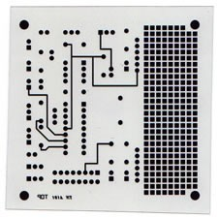
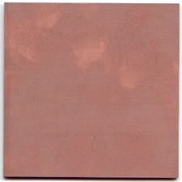
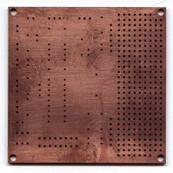
Steps in PCB design
1. Film Generation
2. Shear Raw Material
3. Drill Holes
Industry standard 0.059" thick, copper clad, two sides

Slide 25
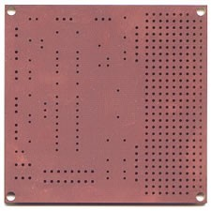
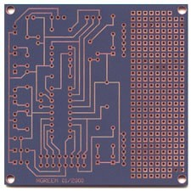
Steps in PCB design
4. Electrolus copper
5. Apply Image
Apply Photosensitive Material to develop selected areas from panel
Apply copper in hole barrels

Slide 26
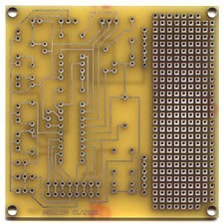
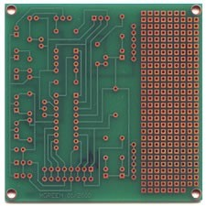
Steps in PCB Design
6. Strip and Etch
7. Solder Mask
Remove dryfilm, then etch exposed copper
Tin protects the copper circuitry from being etched
Apply solder mask area to entire board with the exception of solder pads

Slide 27
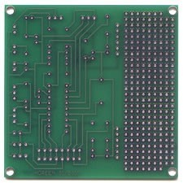
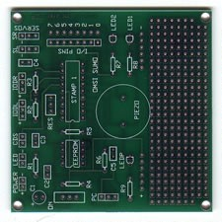
Steps in PCB Design
8. Solder Coat
9. Silkscreen
Apply white letter marking using screen printing process
Apply solder to pads

Slide 28
THANK YOU !!!

