Slide 1

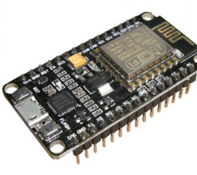
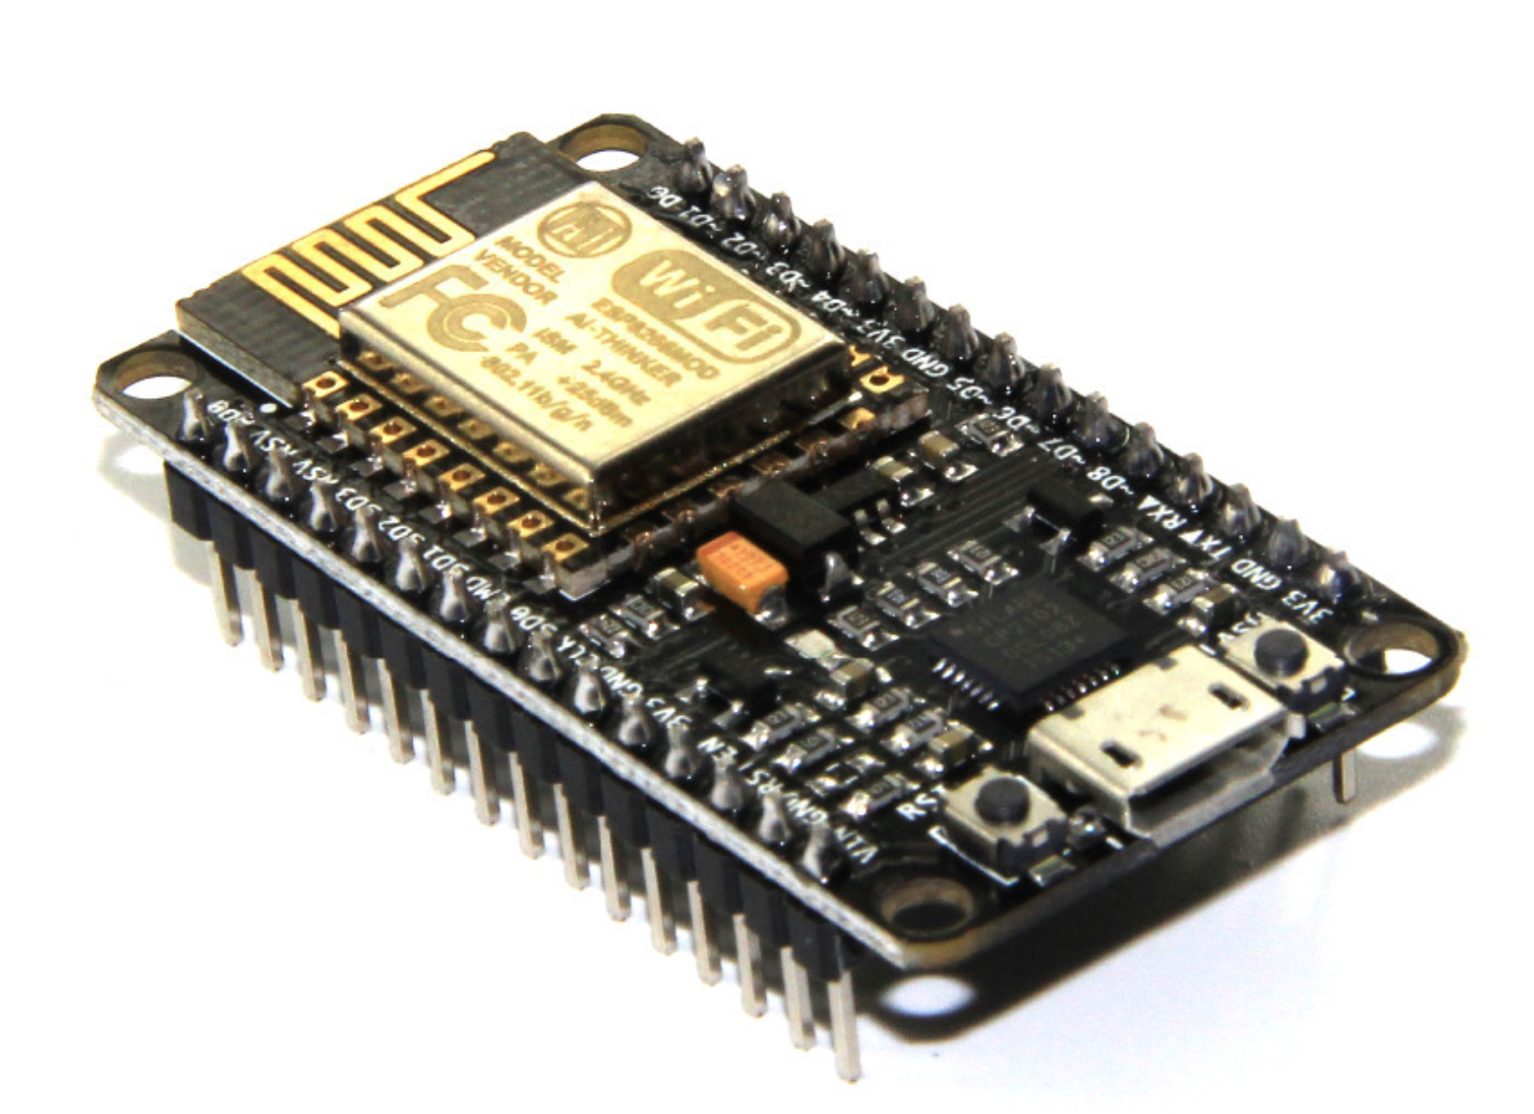
Andhra Pradesh State Skill Development
Corporation
nodeMCU
(ESP8266)
By,
Nagaraju B - APSSDC.
Technical Skill Trainer,
Mobile no: +91-8463961431
email: nagaraju.b@apssdc.in

Slide 2
What is NodeMCU?
NodeMCU (Node MicroController Unit) is an open-source software and hardware development environment.it as a System-on-a-Chip (SoC) called the ESP8266.
here:
node - firmware (software)
MCU - (MicroController Unit) (hardware)
Designed and manufactured by Espressif Systems and hardware which is based on the ESP-12 module.
The firmware uses the Lua scripting language.

Slide 3
The general features of this board:
Easy to use
Programmability with Arduino IDE or IUA languages
Having an internal antenna
Containing 13 GPIO pins, 10 PWM channels, I2C, SPI, ADC, UART.
Low cost.
Integrated support for WIFI network.
Reduced size of the board.
Low energy consumption.

Slide 4
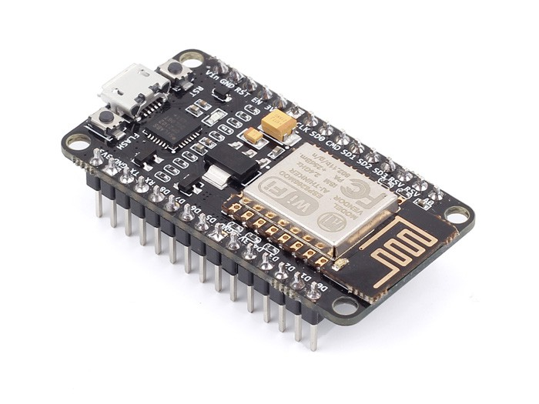
NodeMCU Board:

Slide 5
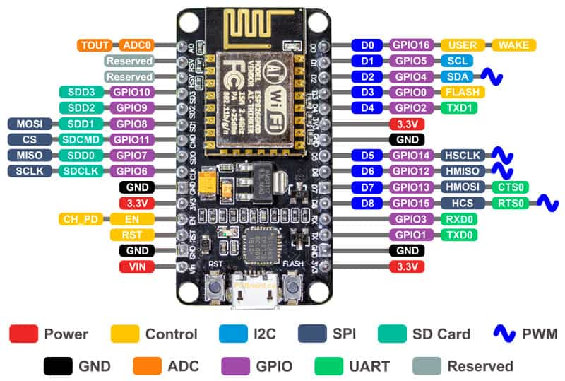
NodeMCU Pinout and Functions:

Slide 6
Power Pins There are four power pins. VIN pin and three 3.3V pins.
  VIN can be used to directly supply the NodeMCU/ESP8266 and its peripherals. – you can also supply 5V regulated to the VIN pin
  3.3V pins are the output of the onboard voltage regulator and can be used to supply power to external components.
GND are the ground pins of NodeMCU/ESP8266
I2C Pins are used to connect I2C sensors and peripherals. Both I2C Master and I2C Slave are supported.

Slide 7
GPIO Pins NodeMCU/ESP8266 has 17 GPIO pins which can be assigned to functions such as I2C, I2S, UART, PWM, IR Remote Control, LED Light and Button programmatically.
ADC Channel The NodeMCU is embedded with a 10-bit ADC.
UART Pins NodeMCU/ESP8266 has 2 UART interfaces (UART0 and UART1) which provide asynchronous communication (RS232 and RS485).
SPI Pins NodeMCU/ESP8266 features two SPIs (SPI and HSPI) in slave and master modes.
SDIO Pins NodeMCU/ESP8266 features Secure Digital Input/Output Interface (SDIO) which is used to directly interface SD cards.

Slide 8
PWM Pins The board has 4 channels of Pulse Width Modulation (PWM). The PWM output can be implemented programmatically and used for driving digital motors and LEDs.
Control Pins are used to control the NodeMCU/ESP8266. These pins include Chip Enable pin (EN), Reset pin (RST) and WAKE pin.
  EN: The ESP8266 chip is enabled when EN pin is pulled HIGH. When pulled LOW the chip works at minimum power.
  RST: RST pin is used to reset the ESP8266 chip.
  WAKE: Wake pin is used to wake the chip from deep-sleep.
Tiny Sine WaveControl Pins are used to control the NodeMCU/ESP8266. These pins include Chip Enable pin (EN), Reset pin (RST) and WAKE pin.

Slide 9
How to program NodeMCU

Slide 10
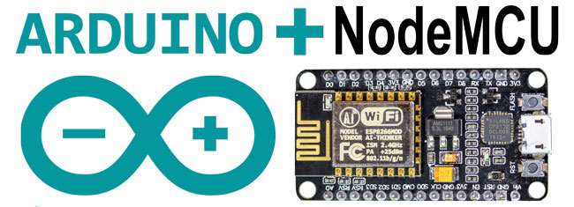

NodeMCU Compatibility With Arduino IDE

Slide 11

Download and Install the Arduino IDE
The Arduino IDE (Integrated Development Environment) is available for no cost. You can visit the Arduino site (www.arduino.cc), which is an excellent resource for all-things Arudino.
From there, you will want to download the latest Arduino IDE (https://www.arduino.cc/en/Main/Software)
After downloading the IDE, proceed to install using the default setup options.

Slide 12
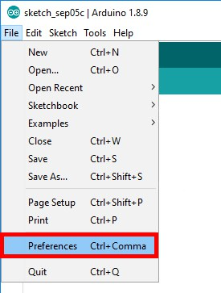
Add NodeMCU Library to the IDE
Select the File…Preferences
This will open up a new window, where we set the IDE to point to the configuration file.
In the field “Additional Boards Manager URLs:” enter
http://arduino.esp8266.com/stable/package_esp8266com_index.json
Select the OK button at the bottom of the window

Slide 13
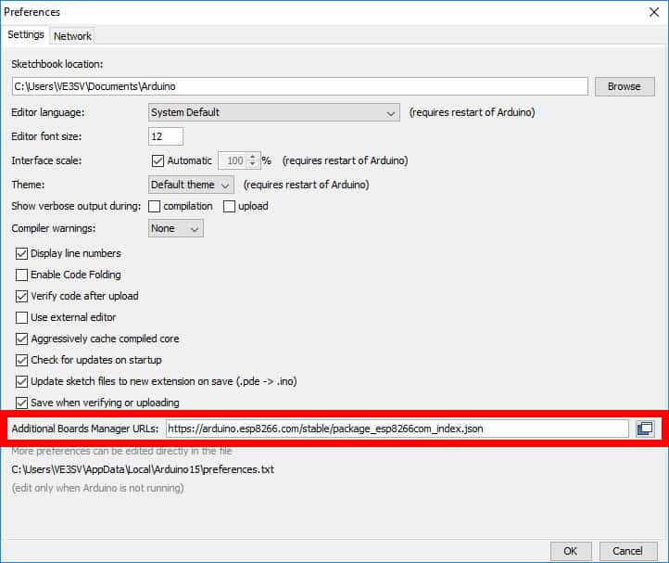

Slide 14
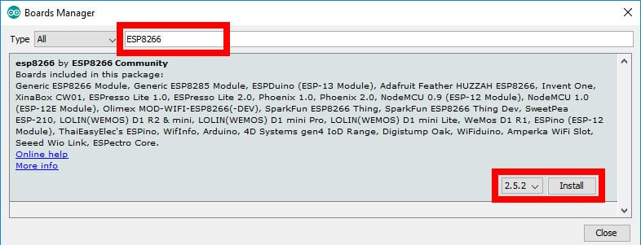
Selecting the NodeMCU Board Driver
Navigate to the Boards Manager from the Tools…Board…Boards Manager menu option
A new options windows will appear.
From the Boards Manager window, enter esp8266 in the search bar.
This will display the new ESP8266 driver as supplied by the ESP8266 Community. At the bottom of the options box, select the version to be setup
Now select Install to complete the installation of the driver which will take a few seconds to download and install.
Select Close to complete the installation.

Slide 15
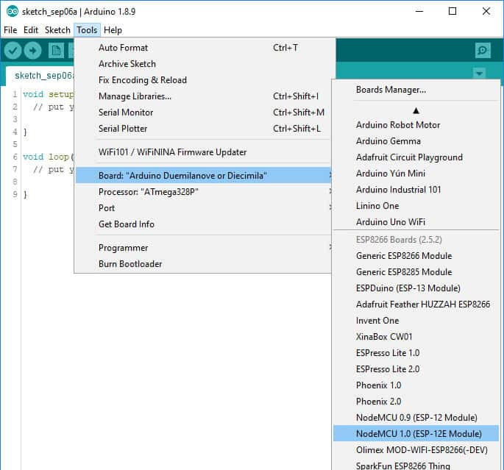
Selecting Board Version
Now from the Tools…Board menu, the dropdown list will contain many different hardware board.
Scroll down and select the NodeMCU 1.0 (ESP-12E Module).

Slide 16
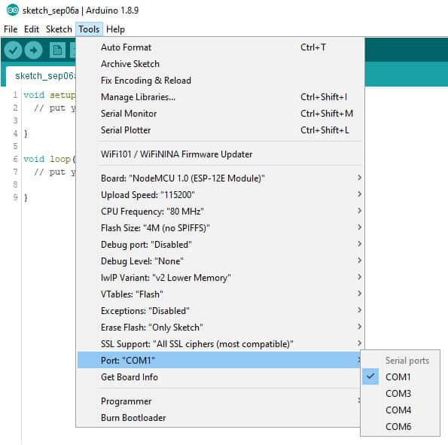
Defining The Communications Port
The communications port must be defined to allow the Arduino IDE to communicate with the NodeMCU. Connect your PC by a USB cable to the NodeMCU.
After connection, the PC will provide power to the NodeMCU.
To determine which communications port has been selected on your system, select the Tools…Port menu option.
The options list will present the available COM ports. For our example, our NodeMCU added COM6 and will be selected by clicking on COM6.

Slide 17
Arduino IDE NodeMCU Configuration Complete

Slide 18
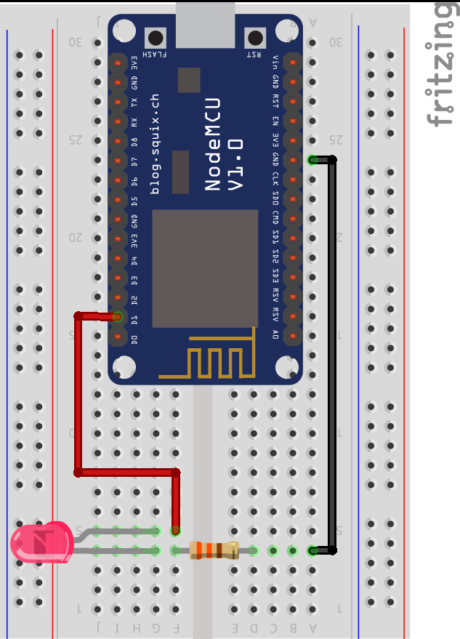
Code To Test NodeMCU Functionality
int LED=D0;
void setup()
{
pinMode(LED, OUTPUT);
}
void loop()
{
digitalWrite(LED, HIGH) delay(1000);
digitalWrite(LED, LOW);
delay(1000);
}

Slide 19
Establishing a Wi-Fi connection
#include "ESP8266WiFi.h"
const char* ssid = "ssid"; //Enter SSID
const char* password = "password"; //Enter Password
void setup(void)
{
Serial.begin(115200);
WiFi.begin(ssid, password);
while (WiFi.status() != WL_CONNECTED)
{
delay(500);
Serial.print("*");
}
Serial.println("");
Serial.println("WiFi connection Successful");
Serial.print("The IP Address of ESP8266 Module is: ");
Serial.print(WiFi.localIP());// Print the IP address
}
void loop()
{
// EMPTY
}

Slide 20


Slide 21


