Slide 1
Routing & Services
In Angular
Name: Nagaraju J N
Email: nagaraju.jn@gmail.com
Phone: 8971540150

Slide 2
Routing
Angular applications are mostly Single Page Applications (SPA). The server always serves a single HTML page, and navigation between the application pages/sections is managed on the client side in JavaScript.
This approach allows smoother transitions between pages, and reduces the number of server calls needed to navigate between pages, improving the UX.
The routing of an SPA is therefore managed on the client side, and the Angular team provides a library for this purpose: @angular/router. This router allows you to associate routes (URLs) with Angular components.
To generate routing module with the CLI we use below command:
ng generate module app-routing --flat --module=app

Slide 3
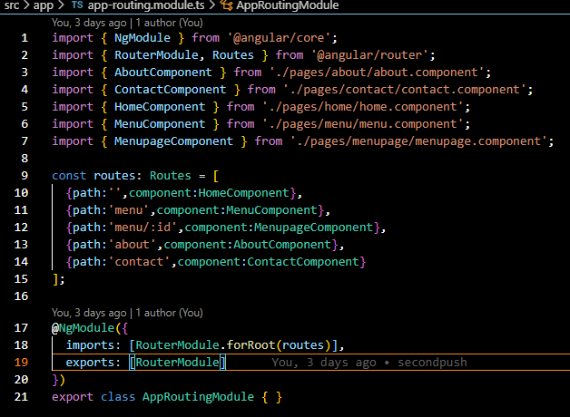
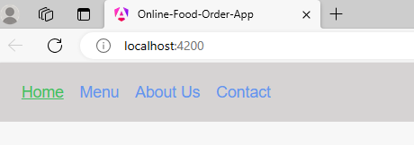
Router-outlet
The purpose of the RouterOutlet is The NavbarComponent should remain displayed at all times which means that components should be inserted under it. Let's add the router-outlet in the AppComponent.
app.component.html
<app-navbar></app-navbar>
<router-outlet></router-outlet>
Out put of the Navbar:

Slide 4
Services
Services are where the Angular team advocates placing the business logic and data management of the application. Having a clear separation between the presentation layer and the other processings of the application increases reusability and modularity.
I have created one services for my app with help to CLI:
ng genarate service services/order-details
The following content is automatically generated in the order-details.service.ts file:
import { Injectable } from '@angular/core'
@Injectable({
providedIn: 'root'
})
export class OrderDetailsService
{
}

Slide 5
Dependency injection (DI):
provides components with access to services and other resources. Angular provides the ability for you to inject a service into a component to give that component access to the service.
Add the @Injectable() decorator to a service class so that Angular can inject it into a component as a dependency; the optional argument tells Angular where to register this class by default.
@Injectable({providedIn: 'root'})
export class OrderDetailsService
{
}

Slide 6
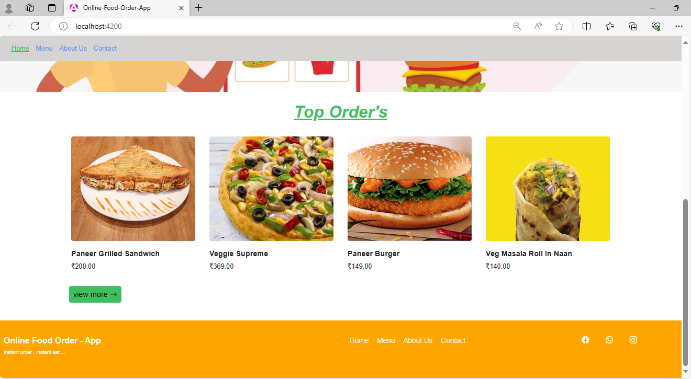
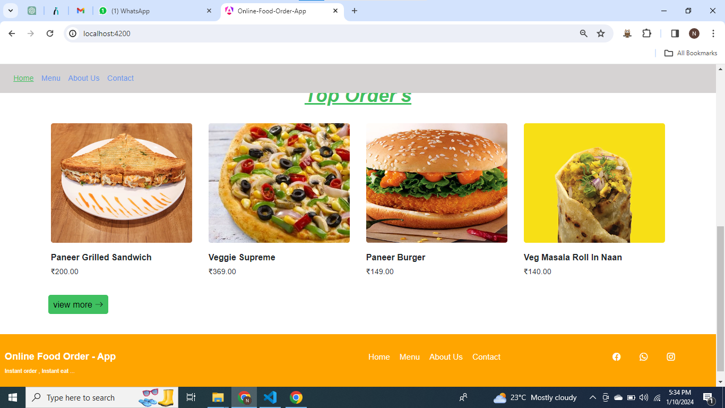

Slide 7
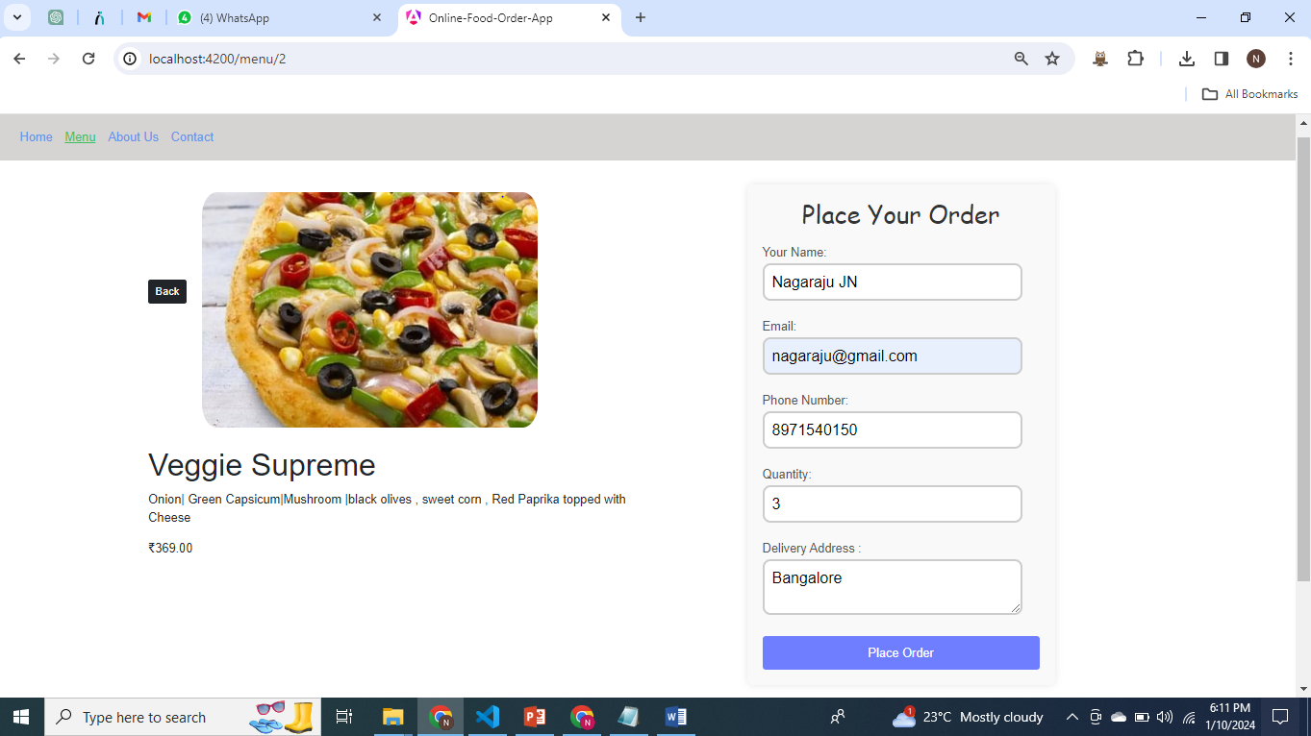

Slide 8
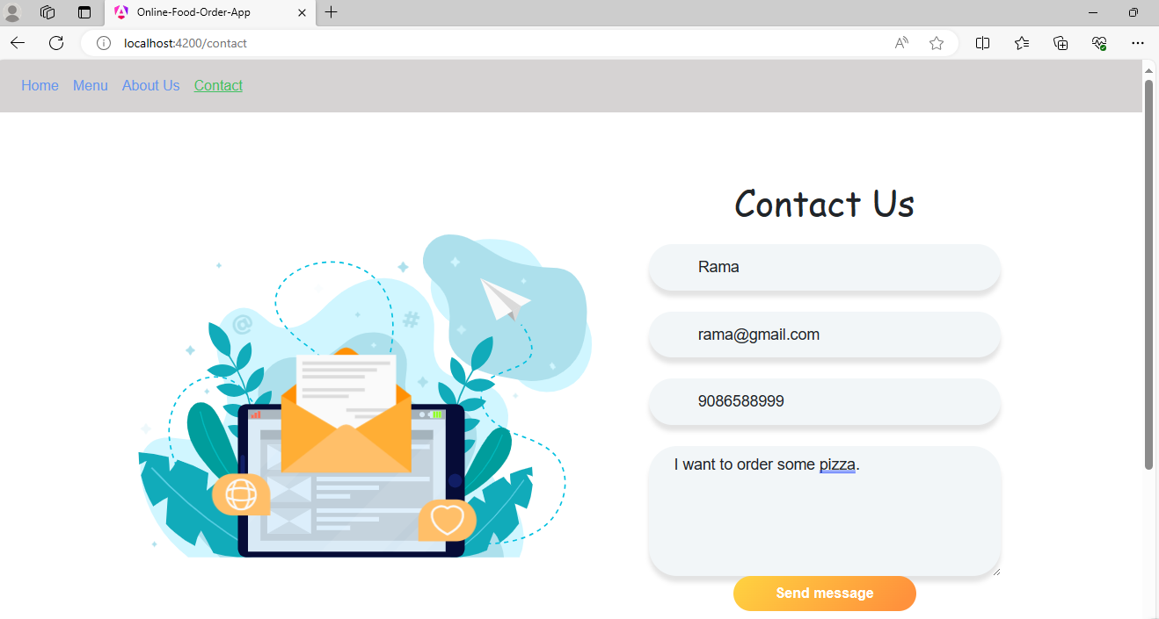

Slide 9
Thank You

