Slide 1
Polycystic Ovary Syndrome Detection using MobileNet and Image Processing Techniques

Slide 2



Dept of Computer science and engineering
PROJECT REVIEW : 02-07-2024
GUIDE:
Dr.V.Balaji, HOD, Dept of CSE
The TEAM(1):
Y20CS3245
Y20CS3234
Y20CS3235
L21CS3273
L21CS3276

Slide 3



Agenda
Introduction
Scope of the project
Proposed model
Tools and Technologies
Dataset Description
Data preprocessing
Methodology
Model Testing and Analysis
Result and discussions
Model Deployment and Output

Slide 4

What is PCOS
An overview of PCOS and its symptoms

Slide 5

Introduction
ABSTRACT: Polycystic Ovary Syndrome(PCOS) is a disease that occurs in women during their child-bearing years. The reproductive organs of women called ovaries that produce progesterone and estrogen-hormones that regulate the menstrual cycle, are affected. Ovaries also produce little amounts of androgen also called as male hormones. The basic features of PCOS are: Cysts in ovaries, High levels of hormone: androgen. ,Irregular Periods, Excessive body hair growth ,Acne, Obesity, and at times INFERTILITY.
Since the condition is a syndrome, it has a collection of symptoms that suggest its presence. These symptoms play a vital role in detection of this condition. Along with these symptoms, causes which may lead to the risks of the syndrome can also be considered. It is necessary to detect PCOS as early as possible since it holds the risk of infertility, diabetes, endometrial cancer and cardiovascular disease at later stage of the condition.
8.2% to 22.5% of women in India, suffer from PCOS . This endocrinopathy can significantly impact the patient’s lifestyle, wherein the patient may face depression, anxiety, eating disorders, and sleep apnea. Further, metabolic syndromes can put them at risk of cardiovascular disorders, endometrial cancer, and diabetes mellitus .

Slide 6
Symptom’s
It's important to remember that the severity and combination of symptoms can vary widely among individuals. Not everyone with PCOS will experience all of these symptoms, and some may only have one or two. Additionally, symptoms may change over time. If you suspect you have PCOS or are experiencing symptoms, it's advisable to consult with a healthcare professional for a proper diagnosis and guidance on managing and treating the condition.
Irregular Menstrual Cycles.
Ovulatory Dysfunction.
Androgen Excess Symptoms.
Polycystic Ovaries.
Insulin Resistance.

Slide 7
SCOPE OF THE PROJECT
The proposed project aims to revolutionize the diagnostic process for Polycystic Ovary Syndrome (PCOS) by developing a novel deep learning-based system that leverages a Convolutional Neural Network (CNN) specifically designed for classifying polycystic ovarian ultrasound images. This innovative approach offers numerous significant advantages, addressing the current diagnostic challenges and enhancing the overall quality of care for women with PCOS.
Enhanced Diagnostic Accuracy
Increased efficiency and speed
Improved Accessibilty
Resource Optimisation
Consistency and Standardisation
Potential for broader applications
Advancing Medical Research
Interdisciplinary collaboration

Slide 8
PROPOSED MODEL- MOBILENET
Introduction to Mobile Net: Mobile Net is a lightweight convolutional neural network architecture designed for efficient mobile and embedded vision applications. It is known for its low computational complexity and small memory footprint, making it suitable for deployment on devices with limited resources
Advantages of Mobile Net:
Efficiency: Mobile Net is optimized for speed and efficiency, making it well-suited for real-time applications such as medical image analysis.
Compact Architecture: The architecture of Mobile Net consists of depth-wise separable convolutions, reducing the number of parameters and computational cost while maintaining performance.
Scalability: Mobile Net can be scaled to different sizes (e.g., MobileNetV1, MobileNetV2) to balance between speed, accuracy, and resource constraints.

Slide 9
Applications in PCOS Diagnosis:
Feature Extraction: Mobile Net can be used to extract relevant features from ultrasound images that are indicative of PCOS-related characteristics such as ovarian morphology, follicle count, and textural patterns.
Real-time Analysis: Due to its efficiency, Mobile Net enables real-time analysis of ultrasound scans, providing immediate feedback to clinicians during diagnostic procedures.
Integration with Mobile and Web Platforms: Mobile Net's lightweight architecture facilitates deployment on mobile devices and web platforms, expanding access to advanced diagnostic tools beyond traditional clinical settings..

Slide 10
Tools and Technologies
Numpy, Pandas
Matplotlib, Seaborn
Tensorflow, Keras
Scikit Learn
Python Image Library (PIL)
Convolution Neural Networks- MobileNet
Streamlit

Slide 11
DATASET DESCRIPTION
A Datasets included ultrasound pictures of healthy ovaries as well as cystic ovaries .The ultrasound photos that showed infected cysts on the ovary were given the label ‘infected’ while the ultrasound images that showed a healthy ovary were given the label ‘not infected’. The data is further used as Train data, test data and validation data.
This dataset serves as a comprehensive repository containing various physical and clinical parameters crucial in determining PCOS and infertility-related issues. It includes ultrasound images categorized into two classes: 'infected' denoting the presence of PCOS, and 'notinfected' indicating the absence of PCOS.
A noteworthy aspect of this dataset is its extensive coverage, encompassing data collected from ten different hospitals across Kerala, India. This diversity in data sources enhances the dataset's robustness and represents a broader spectrum of patients, ensuring a more comprehensive and varied dataset for training and testing.
The inclusion of physical and clinical parameters alongside ultrasound images contributes to a holistic understanding of PCOS-related conditions. Such a multidimensional dataset can aid in building more accurate and reliable models for the automated detection of PCOS and associated fertility issues.

Slide 12
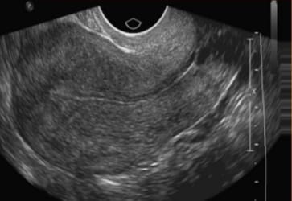
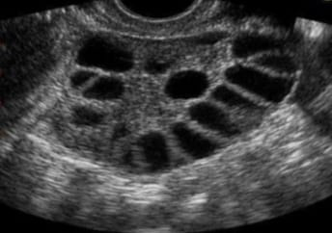
Sample image
Not Infected
Infected

Slide 13
DATA PREPROCESSING
To prepare the images for analysis, several preprocessing steps were undertaken. The objective of preprocessing is to enhance the quality of the images, ensure consistency across the dataset, and facilitate effective training of the neural network. The preprocessing pipeline included the following steps:
1.Conversion to Grayscale: Ultrasound images are typically captured in grayscale. To standardize the dataset, all images were converted to grayscale, ensuring that the CNN model focuses on the essential features without being influenced by color variation.
2. Resizing: The images were resized to a standard dimension of 128x128 pixels. This resizing step ensures uniformity in image size, which is crucial for feeding the data into the neural network. Resizing helps in reducing computational complexity and memory usage while retaining important structural details necessary for classification.
3. Normalization: Pixel values were normalized to the range [0, 1] by dividing each pixel value by 255.0. Normalization helps in accelerating the training process and improving the convergence of the neural network by ensuring that the input data is scaled appropriately

Slide 14
4. Flattening and Conversion to Arrays: After resizing and normalization, each image was flattened into a one-dimensional array. This flattening process converts the two-dimensional spatial information of the image into a single vector of pixel values. The resulting arrays represent the processed images in a format that is suitable for further manipulation and analysis within the CNN framework.
5. Saving Preprocessed Data into CSV Files
Upon completing the preprocessing steps, the preprocessed image data along with corresponding labels (infected or not infected) were saved into CSV (Comma-Separated Values) files. This step serves multiple purposes like data persistence, ease of loading.

Slide 15
DATA SPLITTING
The dataset splitting process typically involves randomly assigning a portion of the dataset to the training set and withholding the remainder for testing. In our implementation, we utilized the train_test_split function from the sklearn.model_selection module. This function allows for customizable partitioning based on parameters such as test size and random state, ensuring consistency in results across different runs.
For instance, with a test size of 20% (test_size=0.2) and a random state set to ensure reproducibility (random_state=42), the dataset was divided such that 80% of the data was allocated to the training set and 20% to the testing set. This division strikes a balance between providing sufficient data for training the model and retaining an adequate sample size for robust evaluation.

Slide 16

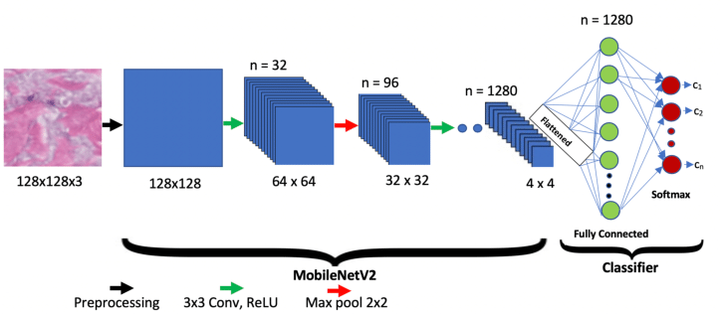
METHODOLGY
In this project, we utilized MobileNet, a lightweight and efficient neural network architecture designed for mobile and embedded vision applications. MobileNet is particularly advantageous for tasks requiring a balance between model performance and computational efficiency.
MobileNet employs depthwise separable convolutions, which significantly reduce the number of parameters and computational load compared to traditional convolutional networks. The architecture consists of the following key components:

Slide 17
MOBILENET
1. Input Layer: Accepts images of 128x128 pixels.
2.Depthwise Separable Convolutions:
Depthwise Convolution: Applies a single convolutional filter per input channel.
Pointwise Convolution: Uses 1x1 convolutions to combine the outputs of the depthwise convolution.
3.Convolutional Layers:
Initial Convolutional Layer: Uses a standard convolution with a stride of 2, followed by batch normalization and ReLU activation.
Depthwise Separable Convolution Blocks: Each block consists of a depthwise convolution followed by a pointwise convolution. These blocks are repeated multiple times throughout the network.
4.Global Average Pooling Layer: Reduces each feature map to a single value by taking the average of all its elements.
5.Fully Connected Layer: A final fully connected layer (often with a softmax activation for classification tasks) to produce the output probabilities for each class.
6. Output Layer: Produces the final classification output.

Slide 18
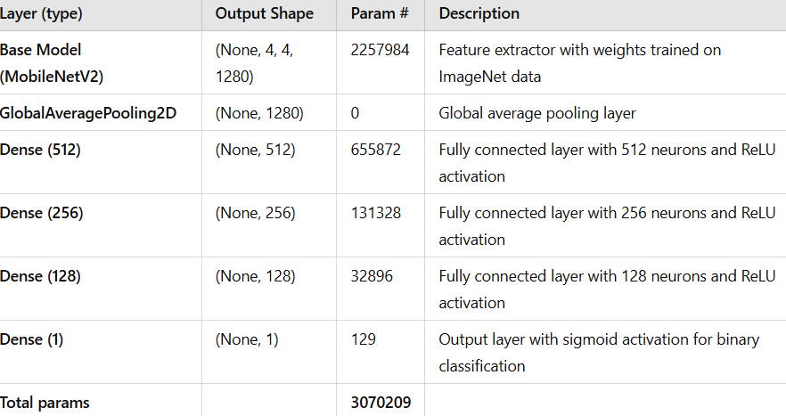
Architecture

Slide 19
Model Compilation
To prepare our MobileNet model for training, we compiled it using the following configurations:
1. Loss Function:
Binary Crossentropy: We used binary_crossentropy as the loss function, which is suitable for binary classification tasks. It measures the difference between the predicted probabilities and the actual class labels, helping the model to minimize the error during training.
2. Optimizer:
Adam Optimizer: The model was optimized using the Adam optimizer (Adam()). Adam combines the advantages of two other extensions of stochastic gradient descent: Adaptive Gradient Algorithm (AdaGrad) and Root Mean Square Propagation (RMSProp). It computes adaptive learning rates for each parameter and efficiently handles sparse gradients on noisy problems.
3. Metrics:
Accuracy: We monitored accuracy as the primary metric to evaluate the performance of the model during training and testing. Accuracy measures the proportion of correctly predicted instances out of the total instances, providing a clear indicator of the model's performance.

Slide 20
Cross Validation and Model Training
K-Fold cross-validation is a technique used to evaluate the performance and generalizability of a machine learning model. It involves dividing the dataset into K equally sized folds. The model is trained K times, each time using K-1 folds as the training set and the remaining fold as the validation set. This ensures that every data point is used for both training and validation exactly once. By averaging the performance across all folds, we obtain a more reliable estimate of the model's effectiveness. We generate confusion matrices for every fold

Slide 21
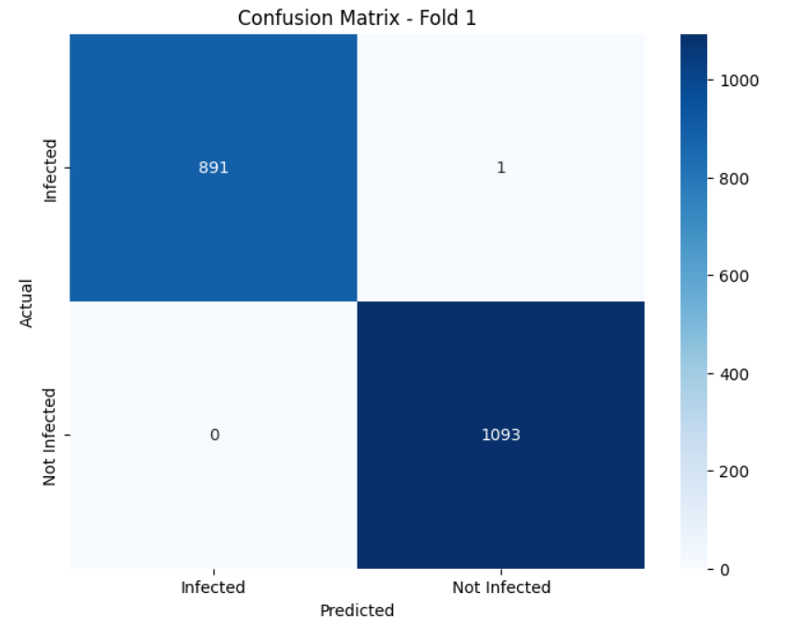
Confusion matrix for fold 1

Slide 22

Model Testing and Analysis:
Once we have validated the model's performance using K-Fold cross-validation and ensured its consistency across different folds, the next step involves retraining the CNN model on the entire training dataset. This step aggregates all available training data to maximize the model's exposure to diverse examples of PCOS-infected and not infected ultrasound images

Slide 23
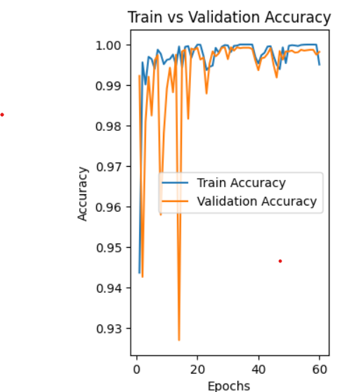
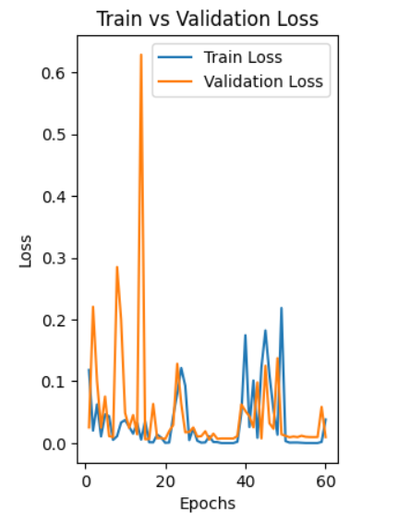
Loss, Accuracy of Training and Validation

Slide 24
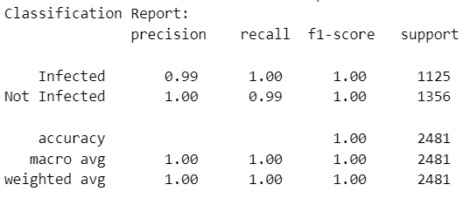
RESULTS AND DISCUSSIONS
Classification Report

Slide 25
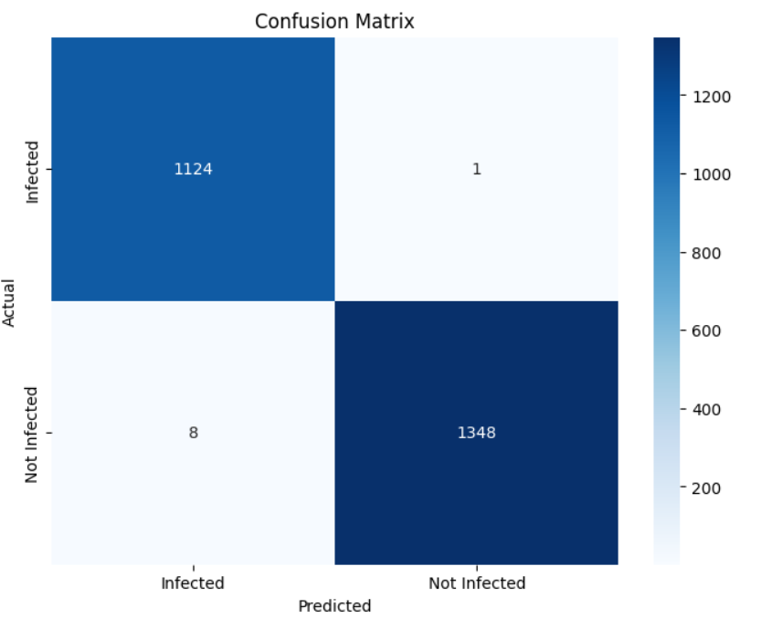
Confusion Matrix

Slide 26
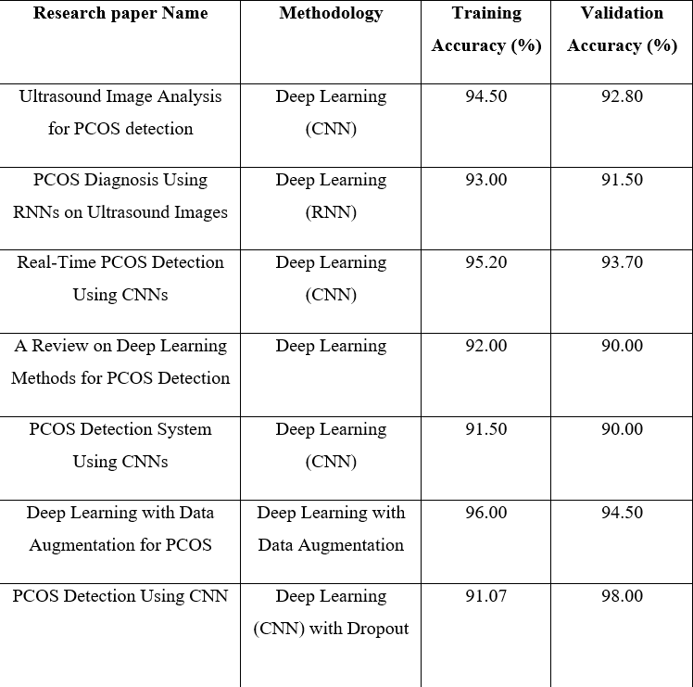
Comparative Analysis

Slide 27
Model Deployment Using Streamlit
Introduction to Streamlit:
Introduction to Streamlit: Streamlit is a popular open-source framework that allows you to create web applications for machine learning and data science projects quickly and easily.
Purpose of Model Deployment: The primary goal of deploying a machine learning model with Streamlit is to make your trained model accessible to end-users through an intuitive web interface.
User Interaction: Streamlit enables seamless interaction between users and machine learning models. Users can input data, interact swith visualizations, and receive model predictions in real-time.
Deployment Workflow: Outline the typical steps involved in deploying a model with Streamlit, including preparing the model for deployment, writing the Streamlit app script, and deploying the app to a cloud platform or a local server.
Example Applications: Mention some practical applications where Streamlit can be used, such as sentiment analysis, image classification, financial predictions, etc., showcasing its versatility.

Slide 28
OUTPUT
The output of the deployment includes:
• Result Type: The model predicts whether the gait is normal or ataxic.
• Probabilities: The probabilities associated with each class (non-infected, infected) are displayed as percentages.
• Data Visualization: Additional visualizations, such as feature plots, can be included to provide more insights into the predictions

Slide 29


Thank You

