Slide 1
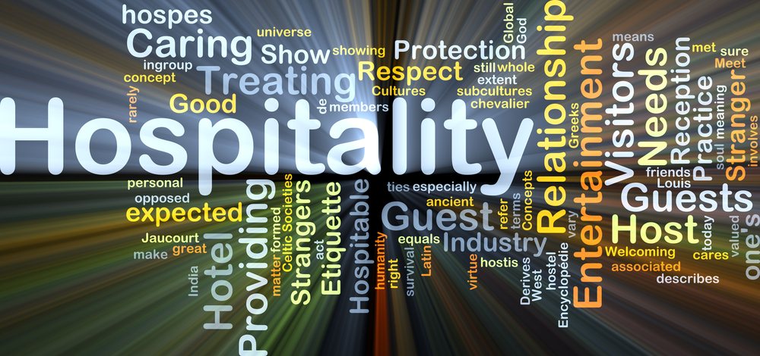
ATHIDHI
Athidhi Devo Bhava (Sanskrit)
(Guest is equivalent to God)
Notes:
ATHIDHI – This is what we named our product.
In Sanskrit language, ATHIDHI means guest. There is a saying “Athidhi Devi Bhava”, which means “Guest is equivalent to God”

Slide 2
Challenges faced by Hotels
Challenges faced by Guests
Competition in the hospitality sector.
Millennial expectations
Recognizing and Keeping Valued customers.
Technology Impact
Customer Experiences
Social media rating
Unnoticed guest issues
Money & quality
Reservation issues
Housekeeping
Past Feedback/complaints not addressed.
Notes:
Millennial - a person reaching young adulthood in the early 21st century.
Technology Impact - Most of the travelers depend on technology in every step.
Customer Experiences – Increasing customer expectations in every trip/reservation.
Social media ratings - Bad reviews impacting the ratings
Guest challenges
Money & Quality – what they get and what they pay.
Reservation issues – Not honoured and checkin issues
Housekeeping – Hotel room maintenance
Customer dissatisfaction is unknown in their feedback forms as angry customers may just walk away.
They cannot think of all inconveniences faced while checking out and may not fill the feedback with enough information
Time constraint -No time to fill the form sent.
They may be positive while filling the form, but end up writing bad reviews in social media.
Based on the statistics, only 5% of the customers respond to the feedback requests.

Slide 3
Feedback less than 5% of customers provide feedback even after multiple follow-ups
😀 😐 ☹️
👍 👎
Around 85% of guests book their trips online.
Around 60% of guests resolve their stay issues online.
Sad part is very few of them provide feedback.
Notes:
Feedback is the source for information related to customer experiences, which can be used as the basis for improvement in subsequent interactions.

Slide 4
Proposed Solution
Integrity
Respect
Trustworthiness
Accountability
Feedback/comments by the Hospitality staff on behalf of the guest
CHECK OUT
New Guest
Create Profile & Reservation
CHECK IN
Interface for Hospitality Staff to feed inputs
Housekeeping
Check in
Checkout
Boarding
Misc
Send apology/appreciation emails based on the inputs
Store the reservation details with feedback filled in comments section for future references
Repeat Guest
Create Reservation
Check Past profiles & Reservations to get customer preferences based on Profile ID
Send Notifications to the hotel teams based on the earlier feedback to take necessary actions and make the stay pleasant.
Send notification’s to the guest based on his experience like Weather & Traffic updates
Opera APIs
Hapi APIs
Notes:
Our proposed solution is focused on the Ethical issues faced in the Hospitality industry:-
Integrity - desire to do the right things
Trustworthiness - win customer’s trust to have them come back
Respect for others – value customer feedback and address
Accountability – Take ownership & accountability for every action
Leverage customer profile
Data from Hapi should be leveraged to know the past experiences and to build customized, personalized features for the guest like room preferences, better room maintenance, customized menus, Airport pickups & Cab services (if needed), weather forecasts (can be sent to the customer)
APIs leveraged
Opera
Profile Service
Reservation Service
Hapi
Profile Service
Guest Service
Reservation Service

Slide 5
How to engage staff to do this?
Reward Employees for the feedbacks which impact the customer satisfaction and ratings.
Make it a mandate for the staff to provide the feedback (either good or bad) and the same can be tracked based on the staff ID.
Run a job to trigger alerts/notifications to fill in feedback as part of their daily tasks.
Leverage Hapi data to build dashboards and make it transparent to the staff on regular basis.
Appraisal based on the feedbacks submitted.

Slide 6
What Hotels get?
What Guests get?
Enhanced hotel’s view on the guest
Avoid bad reviews in social media.
Turn poor customer experiences to better ones.
Better visibility in hospitality with minimal effort by the team.
High Business Impact with minimal or no additional cost
Preferences stored/shared across Hospitality systems
Notifications sent prior to their arrival
Better reception during check-in
Customized or personalized stay experience
Better customer satisfaction
Notes:
Millennial - a person reaching young adulthood in the early 21st century.
Technology Impact - Most of the travelers depend on technology in every step.
Customer Experiences – Increasing customer expectations in every trip/reservation.
Social media ratings - Bad reviews impacting the ratings
Guest challenges
Money & Quality – what they get and what they pay.
Reservation issues – Not honoured and checkin issues
Housekeeping – Hotel room maintenance
Customer dissatisfaction is unknown in their feedback forms as angry customers may just walk away.
They cannot think of all inconveniences faced while checking out and may not fill the feedback with enough information
Time constraint -No time to fill the form sent.
They may be positive while filling the form, but end up writing bad reviews in social media.
Based on the statistics, only 5% of the customers respond to the feedback requests.

Slide 7
Questions & Answers

Slide 8
Thank you Team Chargers Akhilesh Nagaranjani Sasi varna Sudhir

