Slide 1

IoT-Based Air Quality Monitoring System
Real-Time Pollution Analysis and Health Alert Notifications
A smart environmental monitoring solution designed to protect public health in urban, industrial, and residential areas through continuous IoT-enabled air quality sensing and intelligent alerts.
NAKKA JASWANTH YADAV
323129520094

Slide 2

Problem Statement
The Core Challenge
Limited Coverage
Air pollution creates significant health risks and environmental challenges for communities worldwide. Yet the systems meant to protect us are falling short.
Citizens and environmental authorities urgently need intelligent systems capable of continuously monitoring air quality and issuing real-time health alerts when pollution levels exceed safe limits.
Traditional monitoring relies on sparse, fixed monitoring stations that cannot capture localized pollution events.
No Continuous Data
Existing approaches fail to provide continuous, real-time environmental data across affected areas.
Delayed Alerts
Without real-time systems, health alerts are not generated promptly when pollution exceeds safe thresholds.

Slide 3




Proposed Solution
An IoT-Based Air Quality Monitoring System that continuously measures, analyzes, and reports environmental pollution conditions in real time.
IoT Sensors
Centralized Platform
Continuously measure air pollution levels across deployment areas
Real-time analysis of collected environmental data via cloud connectivity
Secure Interface
Health Alerts
User-friendly monitoring interface for environmental conditions
Timely identification of unsafe conditions and automatic alert generation

Slide 4

Sensors and Parameters Monitored
The system continuously measures the following environmental parameters to provide a comprehensive picture of current air quality and pollution levels:
PM2.5
PM10
CO
CO₂
Fine particulate matter — deepest lung penetration risk
Coarse particulate matter — respiratory irritant
Carbon Monoxide — toxic gas from combustion
Carbon Dioxide — indicator of ventilation quality
Temp
Humidity
Temperature — environmental condition baseline
Relative humidity — affects pollutant behavior

Slide 5



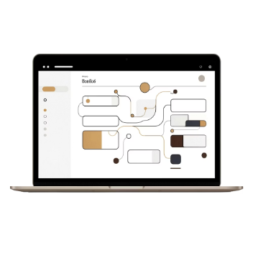
System Components
Each component plays a defined role in delivering continuous, reliable air quality monitoring from the field to the user.
Air Quality Sensors
IoT Communication Modules
Cloud Connectivity & Platform
User Interface & Alerts
PM2.5, PM10, CO, and CO₂ sensors capture pollutant concentrations; temperature and humidity sensors record environmental conditions.
A secure, user-friendly interface displays real-time data. The health alert notification mechanism triggers warnings when safe limits are exceeded.
Transmit collected sensor data wirelessly to the cloud platform, enabling seamless real-time data flow from field devices.
The centralized monitoring platform receives, processes, and analyzes environmental data, computing AQI and identifying pollution trends.

Slide 6

System Working Process
A seamless end-to-end pipeline from environmental sensing to actionable health alerts:
Measure Pollutants
Record Conditions
Collect Data
Transmit Data
Cloud Ingest
This automated pipeline ensures that from the moment a sensor detects a change in air quality, the system responds — processing data, computing the Air Quality Index, and notifying users and authorities before conditions become dangerous.

Slide 7


Real-Time Pollution Analysis
What the System Analyzes
Why It Matters
AQI Monitoring
Real-time analysis empowers both citizens and environmental authorities to understand changing pollution conditions as they happen — not hours or days later.
By continuously monitoring sensor status alongside environmental measurements, the system ensures data integrity and reliable alert generation at all times.
Continuous Air Quality Index computation from live sensor feeds
Pollution Trend Analysis
Identifies rising or falling pollution patterns over time
Historical Records
When pollution levels exceed safe thresholds, health alert notifications are generated immediately — enabling timely preventive action.
Maintains air quality history for long-term environmental assessment
Threshold Detection
Identifies conditions exceeding safe limits and triggers real-time health alert notifications

Slide 8
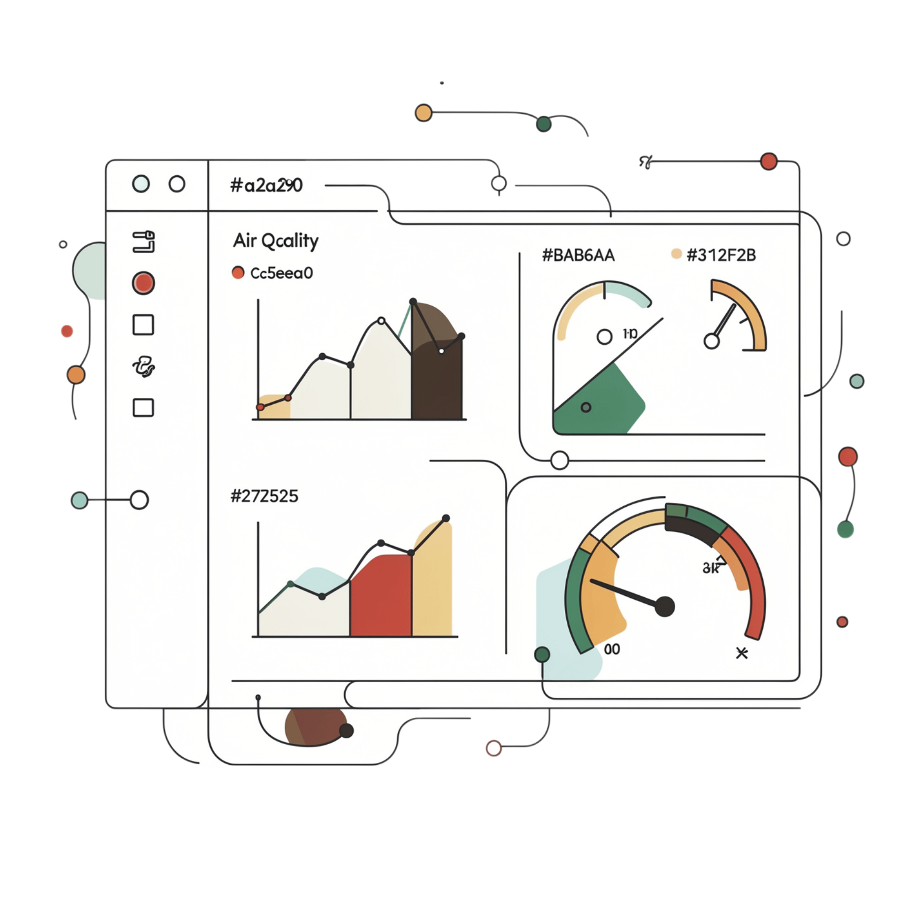
Monitoring Dashboard and Alerts
A Single Platform for Air Quality Intelligence
The centralized interactive dashboard consolidates all monitoring information into one accessible interface, enabling rapid understanding and response.
Current AQI
Pollution Trends & History
Sensor Status
Health Alert Notifications
Live Air Quality Index with color-coded status indicators
Trend charts and historical records for pattern recognition
Real-time health and connectivity status of all deployed sensors
Automated alerts dispatched when pollution exceeds safe limits

Slide 9
Benefits and Applications
Key Benefits
Application Areas
The system is suitable for deployment across a wide range of environments where air quality directly impacts human health and well-being:
Continuous Monitoring
Uninterrupted air quality data collection with real-time pollution analysis and improved environmental awareness
Public Health Protection
Timely health alerts and support for preventive measures when pollution levels become unsafe
Scalable & Secure
Scalable deployment with secure monitoring infrastructure adaptable to diverse environments
Smart Cities
Schools
Hospitals
Industries
Environmental Agencies
Residential Communities

Slide 10

Conclusion
The proposed IoT-Based Air Quality Monitoring System delivers a comprehensive, intelligent solution to one of the most pressing environmental challenges of our time.
Continuous Measurement
Real-Time Intelligence
Uninterrupted monitoring of air pollution, particulate matter, gases, temperature, and humidity across deployment areas
Live AQI monitoring, pollution trend analysis, historical records, and sensor status — all in one centralized platform
Timely Action
Automated health alert notifications empower citizens and authorities to take preventive measures before conditions worsen
By improving environmental awareness, supporting public health protection, enabling pollution analysis, and promoting data-driven decision-making, this system is a meaningful step toward sustainable urban living.

